Slide 1
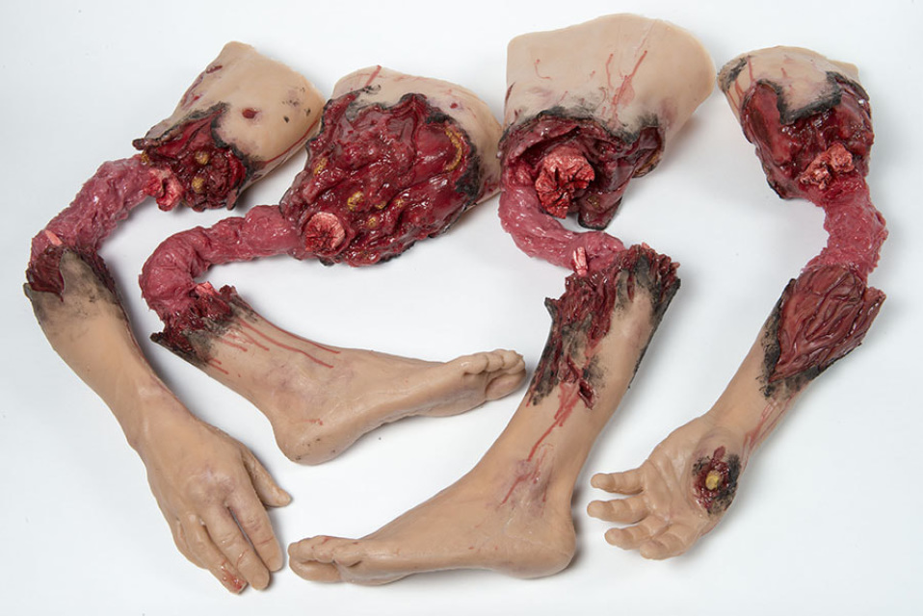
Personal, medical anamnesis and examination in trauma patients
Jakub Lukáč -KÚCH

Slide 2
Specifics of trauma patient examination
Specifics of patient´s anamnesis collection and examination in trauma patients are speed, briefness, thoroughness, decisiveness and ability of improvisation.
Differences are in examination of lightly injured, severely injured or in patient who is unconscious.
Evaluation of patients state
Exclusion or confirmation of life-endangering state
Be vigilant
Think about the worst case scenario

Slide 3
Anamnesis
What is anamnesis
from greek ἀνά, aná, ″open″, a μνήσις, mnesis, „memory“ –freely translated as „recollection“
Anamnesis is collection of several informations about patients health condition.
Division: direct /indirect

Slide 4
Structured anamnesis– your friend ☺
Structured anamnesis - decreases risk of forgetting important information considering your
Structured examination-friend also ☺
-same mechanism
****In general, the procedure of examination method remains the same, what changes are circumstances and form/extent- different approach is required in doctors office, different in ambulance, or in E.R.

Slide 5
Beginning of examination
Starts with patients entrance in doctors office
Opportunity of gaining patients trust
Forget your previous patient
Go through patients documentation
Introduce yourself
Give your patient enough space for self- explanation

Slide 6
Anamnesis:
General sequence:
Current illness
Personal anamnesis (operations, trauma)
Pharmaceutic anamnesis
Alergies
Vaccination
Abuses

Slide 7
Anamnesis:
Current illness:
What happened?
When?
Does he remember exactly what happened?Head trauma?
What are the dynamics of problem?
What was the mechanism of injury ?
What else bothers the patient?
Consumption of any substances such as drugs/alcohol?
Similar trauma in past?
.....
.....

Slide 8
Anamnéza:
Osobní anamnéza:
S čím se pacient léčí? Na co je sledován?
Trpí nějakým infekčním onemocněním?
Jaké úrazy prodělal v minulosti?
Zažil současné trauma již v minulosti?
Po čem má pacient (na břiše, končetinách, hlavě) jizvy?
Podrobil se pacient v minulosti operaci? Čeho?

Slide 9
Anamnesis:
Pharmaceutic anamnesis:
What does the patient take?Regular medication?
Dosage, grammage?
Anticoagulatory drugs?
Who else knows patients medication?
Does the patient have meds with him?Who can bring them?
Last documentation with current meds?

Slide 10
Allergies:
What allergies does the patient have?
What reactions occur after he takes the medicine?
Any allergies to desinfectants, plasters, food?
Ask precisely in elderly!!!

Slide 11
Vaccination:
apply Tetanic anatoxin in patients vaccinated more than 5 years ago –Tetavax (i.m.)
if last vaccination happened more than 10 years ago – re-vaccinate with tetanic imunoglobulin (passive imunization – Tetabulin, Tega )(i.m.
ask for specific reactions to vaccinations in the past
ask for immunodeficient illness
let patient stay in vicinity at least for 15-30 minutes
send patient to his/her general practitioner

Slide 12
Vyšetření úrazového pacienta
Zásady fyzikálního vyšetření (vyšetření smysly):
Aspekce
Palpace
Perkuse
Auskultace
Per rectum
Olfakce

Slide 13
Examination after trauma
Characteristics of injuries change according to age, sex, season, etc...
Common injuries:
cuts, bites, stab wounds
fractures
dislocations
distorsions, distensions, ruptures
POLYTRAUMA
....
.....

Slide 14
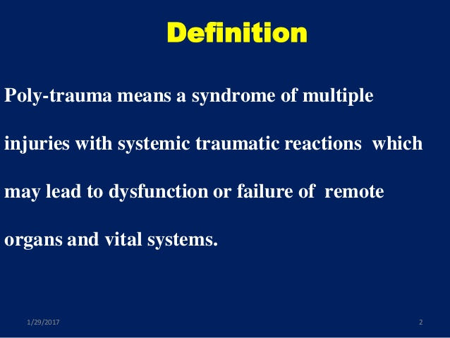
POLYTRAUMA:
at least one organ system injury endangers patients life
Triage positivity – indication for transport to special facility –Trauma Centre

Slide 15
Triage positivity:
Pozitivita: stačí pozitivní 1 položka v alespoň 1 skupině „F“ nebo „A“ nebo „M“, skupina „P“ obsahuje pomocné faktory.
F. Fyziologické ukazatele: 1. GCS < 13 2. TK syst < 90 mmHg 3. DF < 10 nebo > 29/´
A.Anatomická poranění: 1. Pronikající kraniocerebrální 2. Nestabilní hrudní stěna 3. Pronikající hrudní poranění 4. Pronikající břišní poranění 5. Nestabilní pánevní kruh 6. Zlomeniny ³ 2 dlouhých kostí (humerus, femur, tibie)
M. Mechanizmus poranění: 1. Pád z výše > 6 m 2. Přejetí vozidlem 3. Sražení vozidlem rychlostí > 35 km/h 4. Katapultáž z vozidla 5. Zaklínění ve vozidle 6. Smrt spolujezdce
P. Pomocná kritéria: 1. Věk < 6 let 2. Věk > 60 let 3. Komorbidita kardiopulmonální

Slide 16
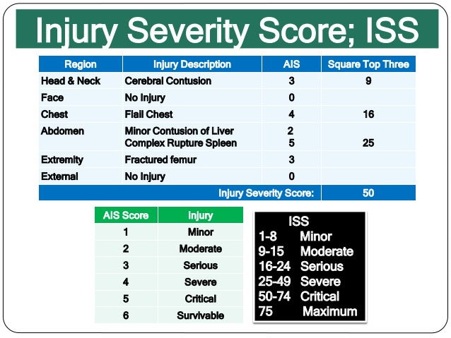
ISS – injury severity score
scoring system – correlation with mortality and morbidity

Slide 17
ATLS-advanced trauma life-support
Primary survey- A,B,C,D,E principle
Secondary survey – head to toe examination
Tertiary survery- definitive examination after patients stabilisation

Slide 18
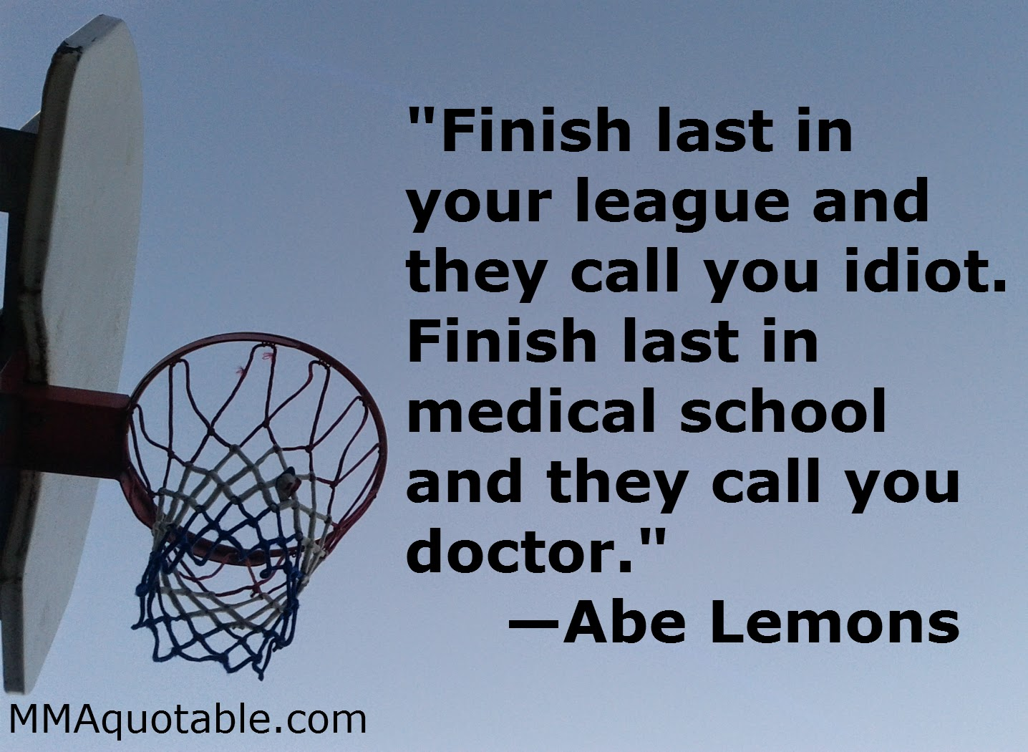
PAUZA

Slide 19
KNEE
Knee examination: position, palpation, range of motion, inspection, manipulation, aspiration
We ask for: time and mechanism, feeling of click, patin, dislocation, sound phenomenon, previous knee injury of same or opposite side, operations, and many more...
We evaluate patients : age, body weight, activity, hobbies...

Slide 20
Mechanism of injury
Meniscus injury: horizontal rotation with vertical load, partially flexed knee
Injury to collateral ligaments: force from side
Injury to cruciate ligaments:
LCA – in weight-loaded knee, rotation of femur in opposite way to tibia (deceleration with change in way)
LCP – fall on flexed knee, hyper-rotation of knee joint

Slide 21
Examination
At least briefly examine opposite (healthy) knee
Aspection: defiguration, antalgic position, colour, hematoma, volume,axial/non-axial position, position of patella (dislocation?) walk, range of motion
Palpation: palpation of pain, temperature, scrooping, „click-phenomenon, movement, effusion
Manipulation: functional tests of knee joint
Aspiration: in joint effusion, diagnostic/therapeutic aspiration

Slide 22
Patella
Palpation- palpable defect, drásoty, scrooping–jack- plane sign,ballotement of patella, milking
In case of patellar fracture suspicion– do not flex the knee !!!
Aspection– we watch patellar position in knee joint

Slide 23
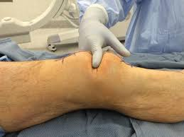
Patellar fracture

Slide 24
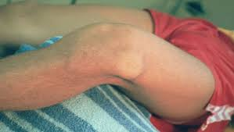
Patellar dislocation

Slide 25
LCA-ligamentum collaterale anterior
Lachmann-most realiable test – knee flex in 20-30° -(opened knee joint), we manually elicit laxity in femur to tibia movement
Pivo-shift test- knee in extension, press against the heel, internal tibial rotation, valgus pressure on knee joint– subluxation of tibia
Anterior drawer test- knee flexed in 90°,doctor sits on patients leg, finger on hamstrings, thumbs around lig. patellae, pull towards yourself - laxity

Slide 26
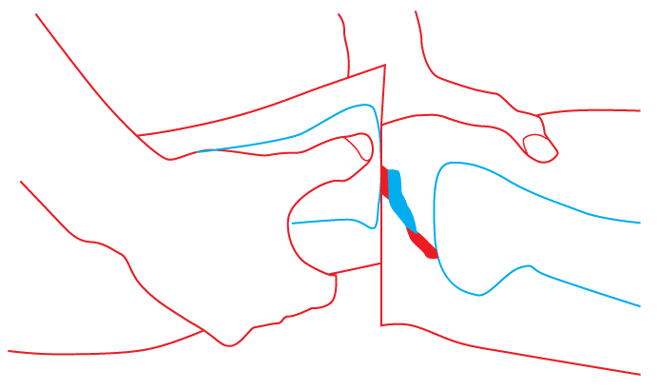

Slide 27
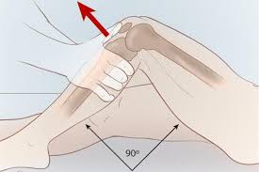

Slide 28
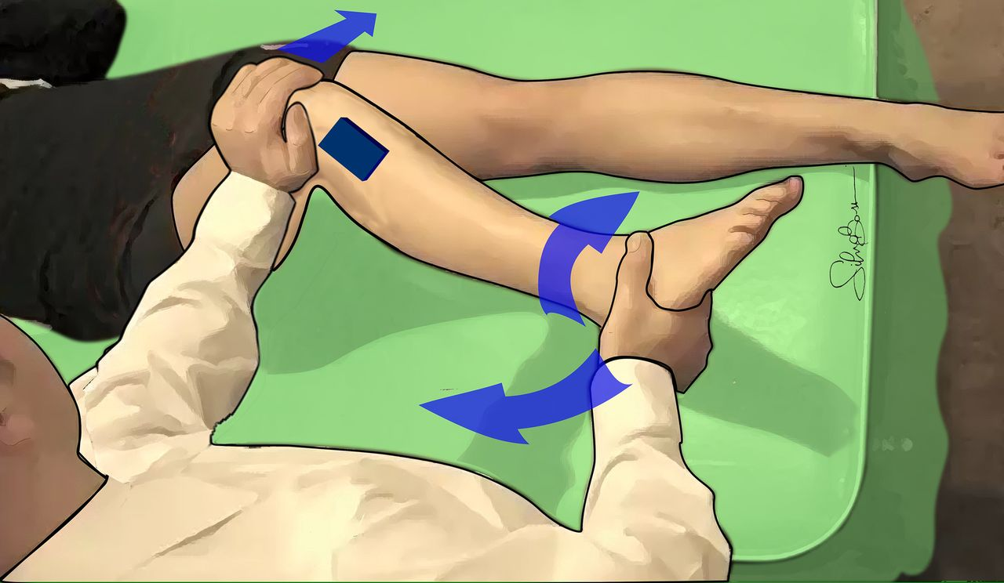

Slide 29
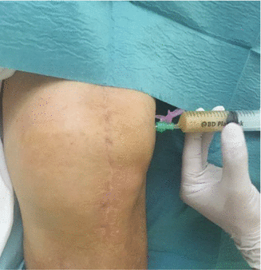
Aspiration:
Diagnostic/therapeutic method– we check for colour, amount, presence of fat drops, taste... ☺

Slide 30
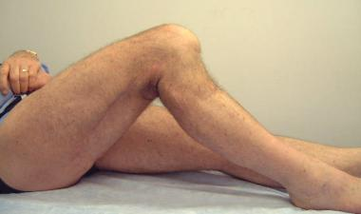
LCP – ligamentum collaterale posterior
Posterior drawer test –
quite rare
Sac test

Slide 31
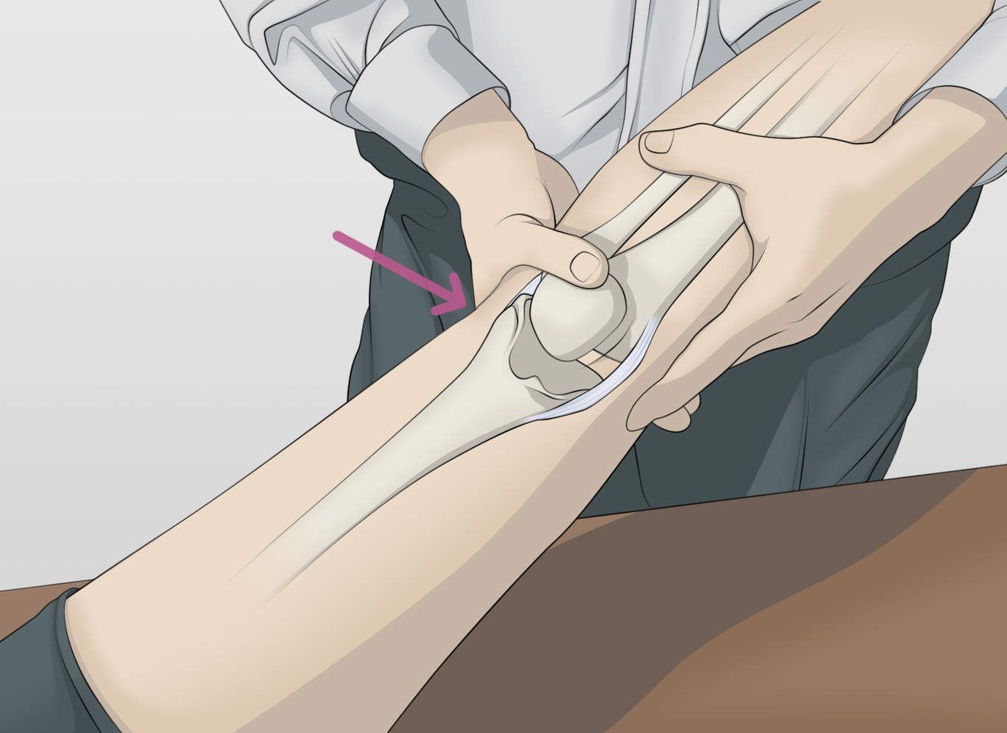
Ligg. collateralia
Varus – valgus test – knee in full extension + force from the side – if laxity is present, there might be injury to both collateral and cruciated ligaments
-during light-semiflexion – probably an isolated injury to collateral ligaments

Slide 32
Meniscus medialis et lateralis
Purpose of these test is to trap both menisci in between the femur and tibia
McMurray test – fingers on knee fissure,knee in hyperflexion, we add intra/extra- rotation, while slowly extending the knee – we watch for pain, „click“ in knee
Steinmann I – knee flexion + intra/extra-rotation
Steinmann II – with increasing flection, pain moves to back
Extension test (sign)- we palpate front part of joint fissure on knee joint, then extend the knee – if pain occurs, the test ist positive
Childress test – tenderness of joint fissure when kneeling
Appley test – patient in prone position – we apply vertical force on foot, and rotate- positivity in case of pain

Slide 33
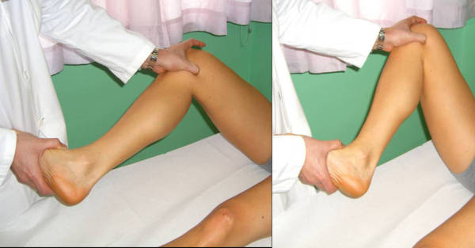

Slide 34
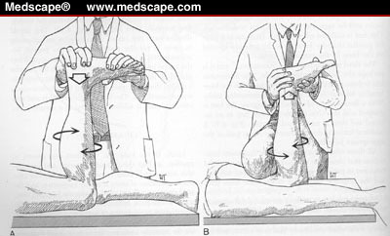

Slide 35
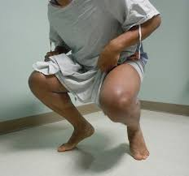

Slide 36
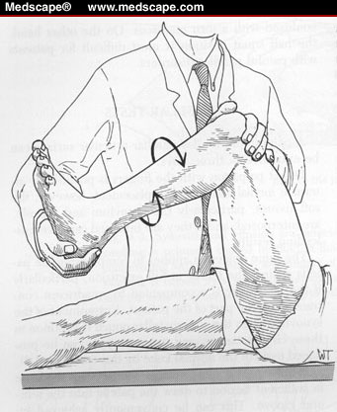

Slide 37
Conclusion–tips and tricks
Increase in volume in matter of hours/days-sign of synovial effusion or blood collection (hemarthros)
if more than one day ( probably synovial effusion)
Hemarthros is an indication for acute ASC!!!
If patient is extremelly painful, and there is no blood in the knee, or mechanical block – examination in second session
X ray of both knee joint – for the sake of comparism
CT of the knee joint – in unclear finding or in suspicion for intraarticular fracture
MRI – in case of unclear finding
Always examine the popliteal fossa – aneurysm, ganglions, Baker´s cyst

Slide 38
Last but not least....
ULTRASOUND OF THE KNEE JOINT? YES OR NO?
..............................................answer?

Slide 39
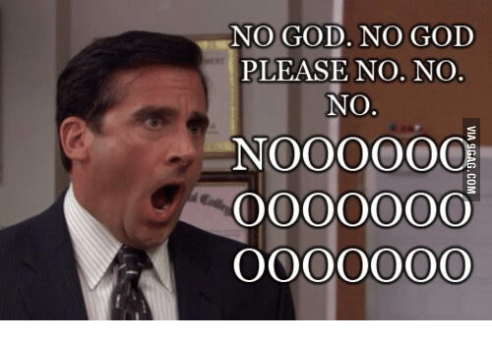

Slide 40

PAUSE ;)

Slide 41
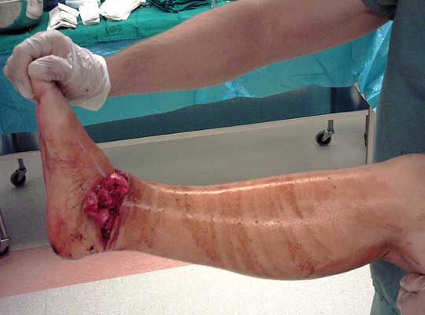
ANKLE
One of the most common injuries
– it affects all groups of people (children, old people, sportsmen, women, men, smokers, atheists, believers)
Character of injury: soft-tissue injury, bone injury, sprains,...

Slide 42
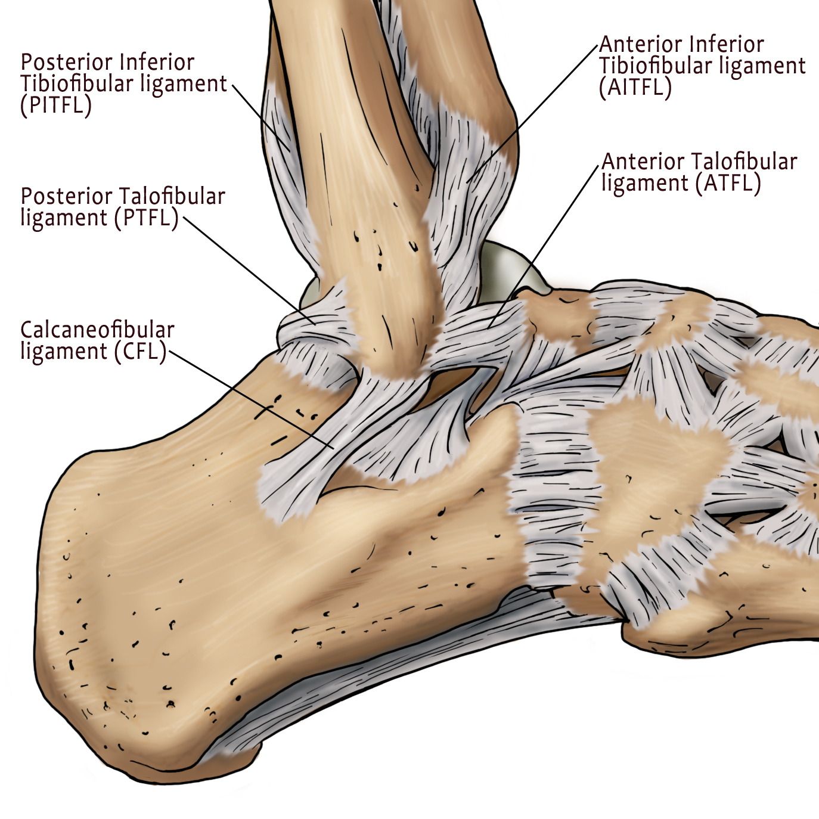

Slide 43
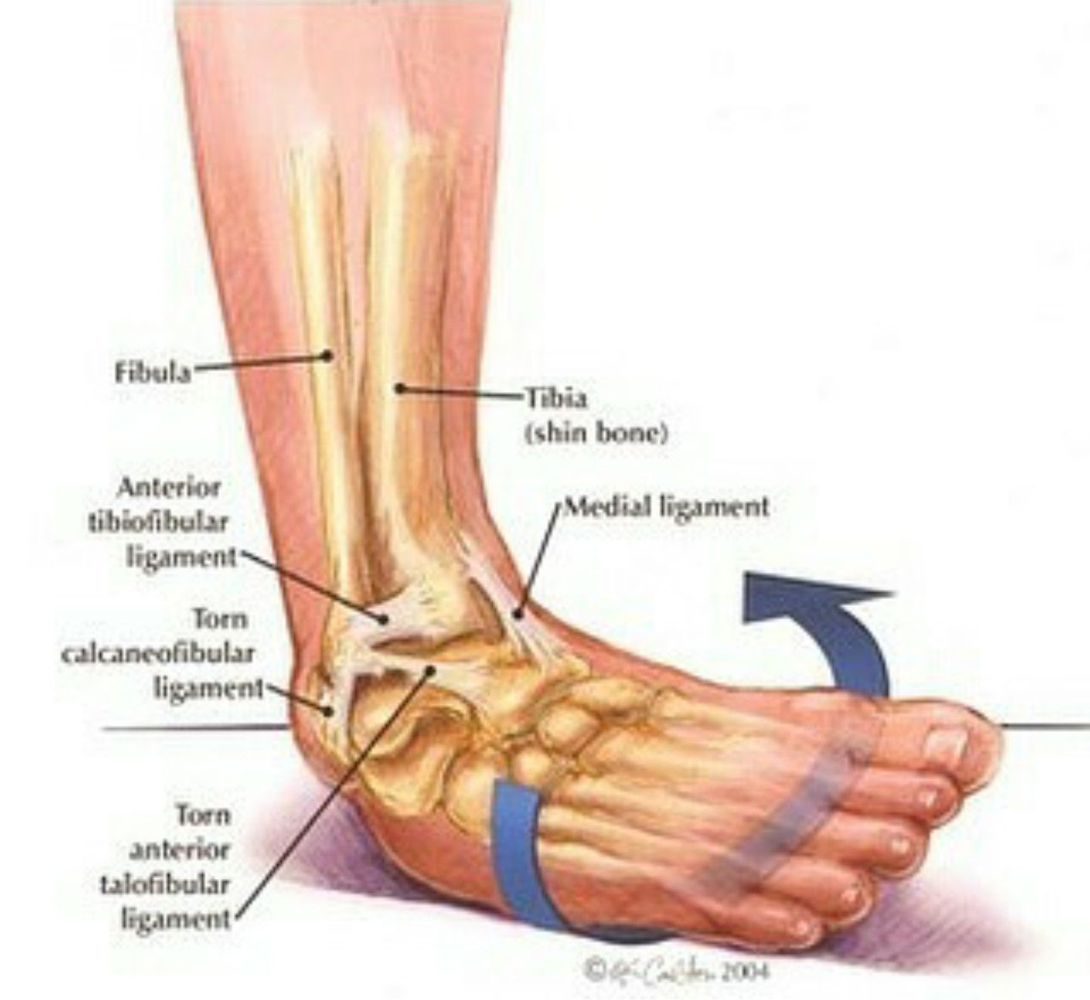
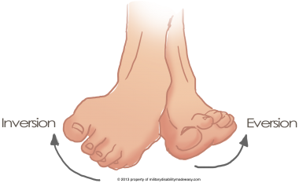
Distorsion of art. talocruralis – ankle joint
It doesnt cause instability, unlike in dislocations
Damage to sof-tissues, ligaments

Slide 44
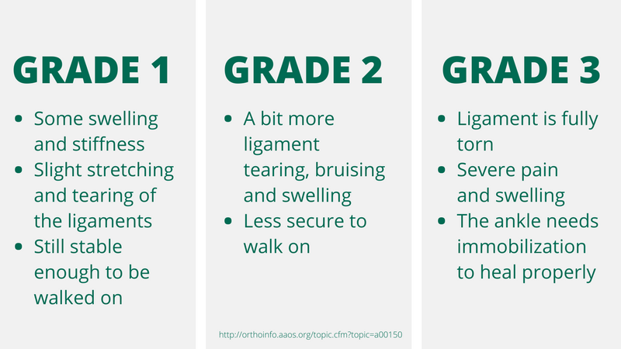
GRADES:

Slide 45
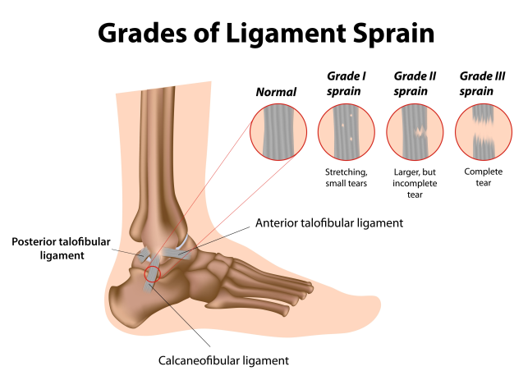

Slide 46
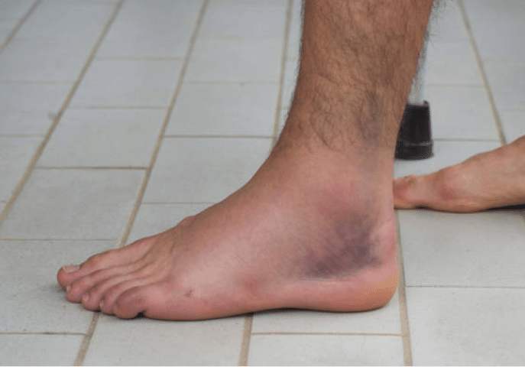
Most often an injury to lateral ligaments of the knee joint

Slide 47
EXAMINATION:
-mechanism of injury, repeatedly same injury?
-inspection
-palpation
-movement
X-ray (supinatio, pronation, AP movement of talar bone)
!!! Always compare with opposited side!!!
outer/inner ankle

Slide 48
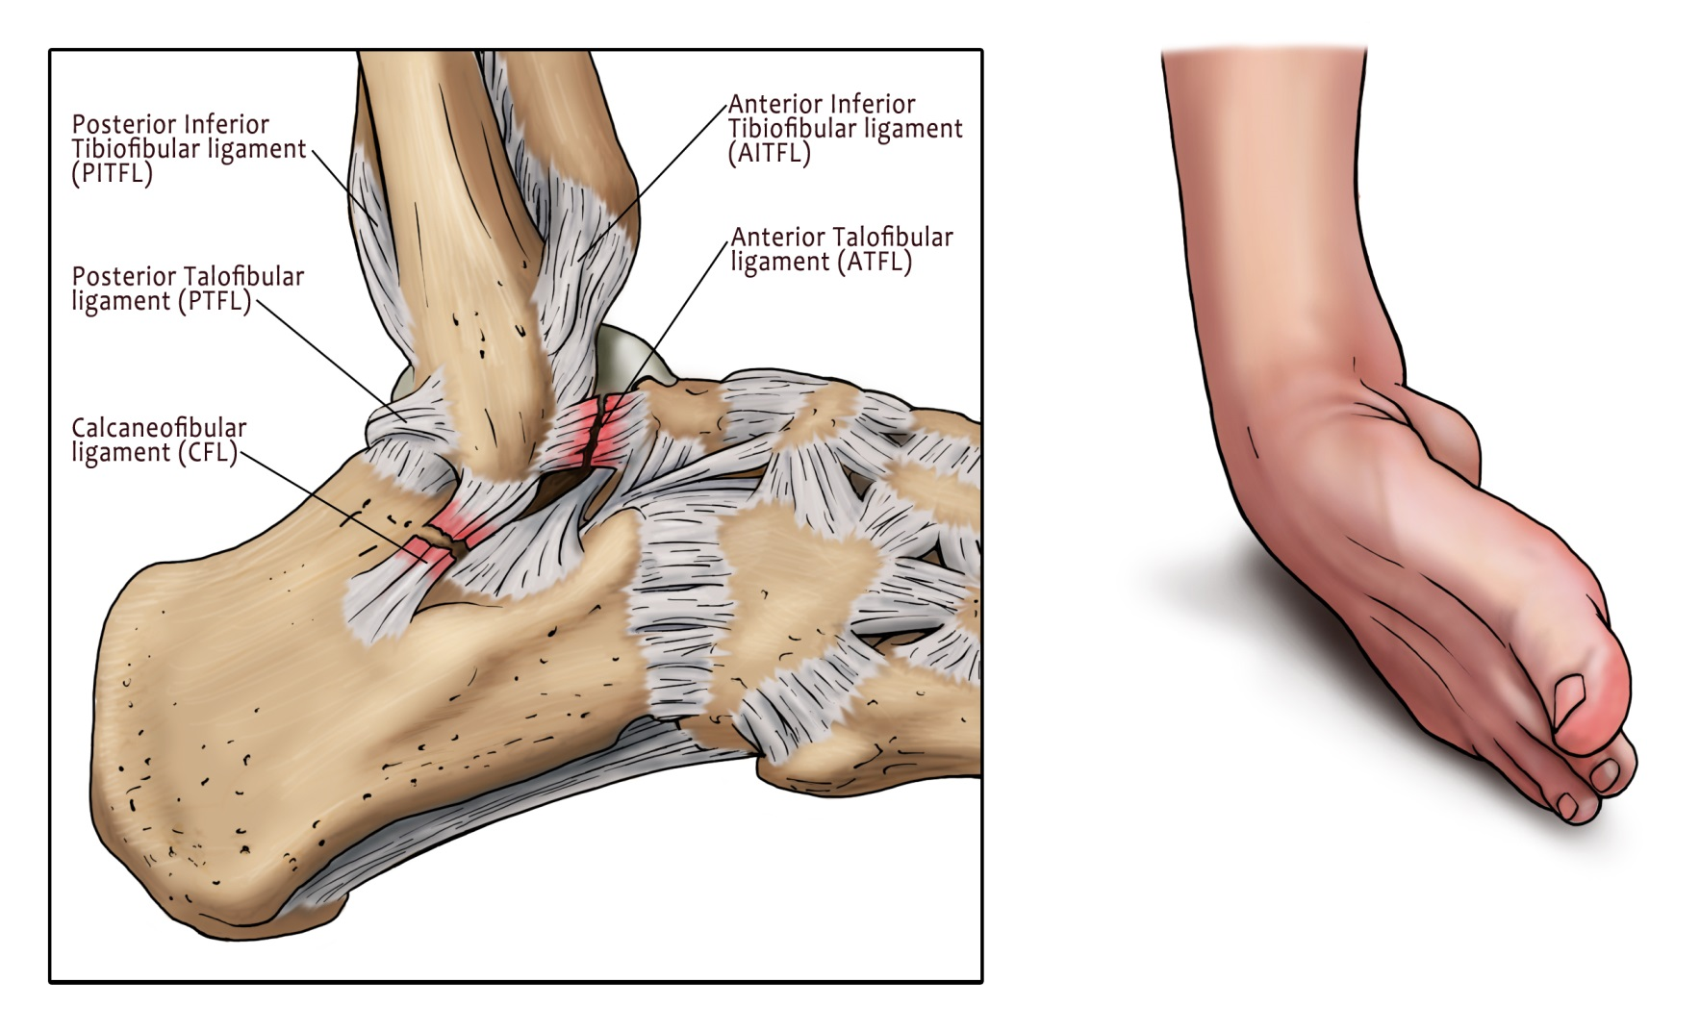
Ligaments of outer ankle: lig. fib-tal. Ant. (FTA, PTFA,CFA
Inner ankle: lig.Deltoideum

Slide 49
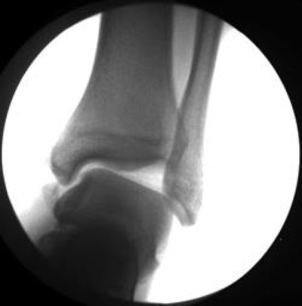
X-ray

Slide 50
´TESTING:
Squeeze test (Hopkins test): squeezing fibula agains tibia in the middle third – pain in distal part of tibio-fibular joint represents possible injury to syndesmosis
Anterior drawer test: testing integrity of the knee joint in AP way (LFTA,PTFA)
Talar tilt test: test integrity of calcaneo-fibular ligament

Slide 51
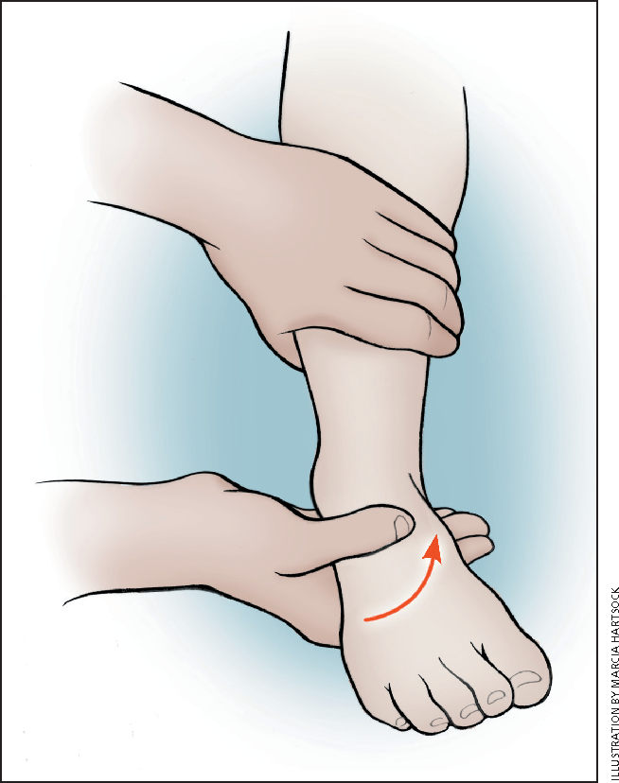
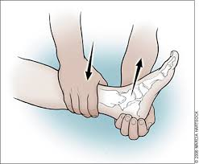

Slide 52
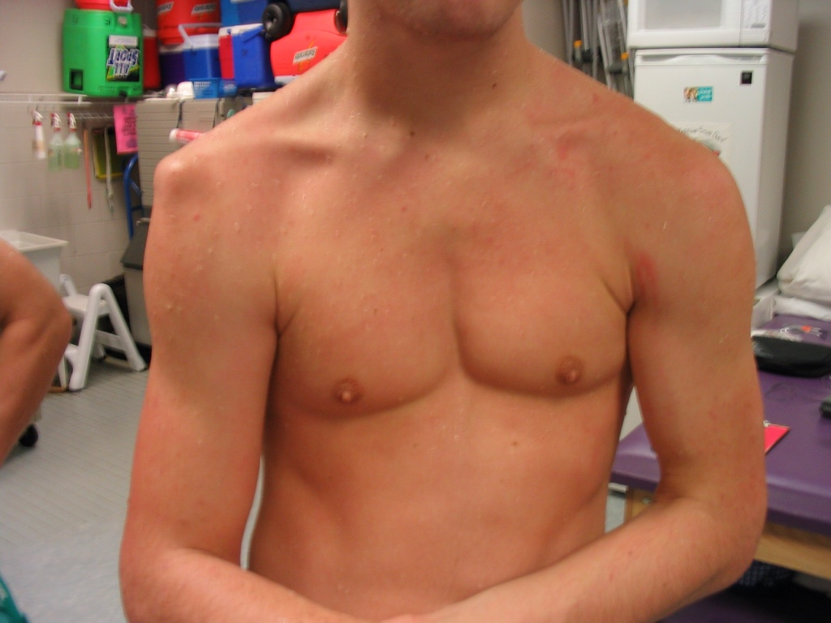
SHOULDER:
Dislocations, fractures, rotatory cuff injuries

Slide 53
Dislocations of shoulder joint
Anatomy: most mobile joint – small articul. surface of glenoid, huge humeral head
Static and dynamic stabilizers:
-static: labrum, capsule, lig. Transversum, lig. coracohumerale
-dynamic: m.deltoideus, rotatory cuff, tendon of m.bicip.brach.
Diagnosis: anamnesis, aspection, palpation, Xray, neurologic examination?

Slide 54
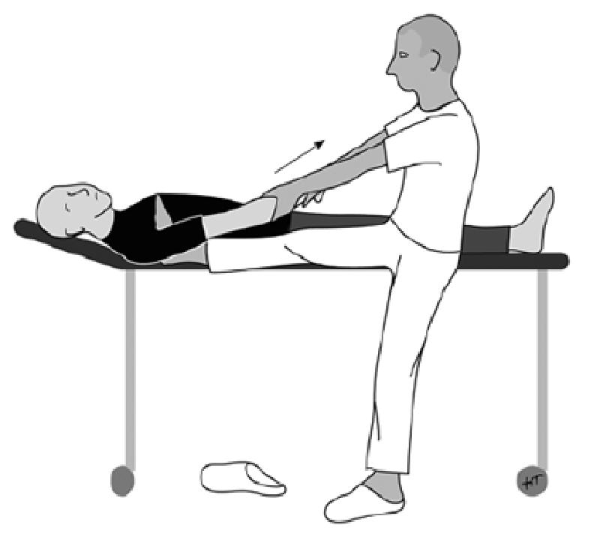
Reduction techniques:
Hippocrates – pull in longitudinal axis– we put our heel in patients armpit/pull with towel, extremity in slight extrarotation
Artl – shoulder over back-rest of chair, extremity pulled in longitudinal axis, slight extrarotation converted to intrarotation, adduction

Slide 55
Tips:
- firstly send patient to X-ray
control perifery, movement, circulation
- control X-ray after reposition
verbal analgetisation
always find out how old the dislocation is
careful and technically right reduction to minimize the risk of iatrogenic injury (Bankart, Hill-Sachs lesion, fractures)

Slide 56
Rotator cuff
Common insertion for four shoulder muscles–
anterior portion- m.subscapularis
cranial portion– m.supraspinatus
posterior portion- m.infraspinatus, m. teres minor
40% of adult population over 60 yrs old has extensive lesions of RC

Slide 57
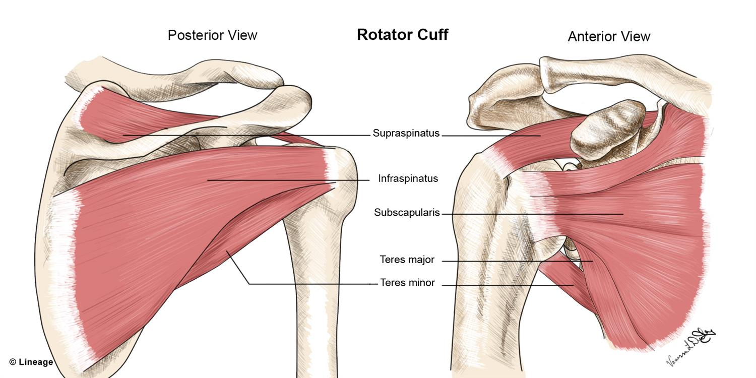

Slide 58
Examination
signs: pain,oedema, weakness, decreases motion,asymetry, defiguration, haematoma, atrophy, pain in SA region
Acute trauma: usually pain is located vento-lateral- lack of actie movement (impossible abduction)
If neurological/vascular deficit or bone trauma is not present, and patient is painful – delayed examination might help
compare to opposite side

Slide 59
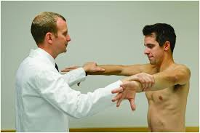
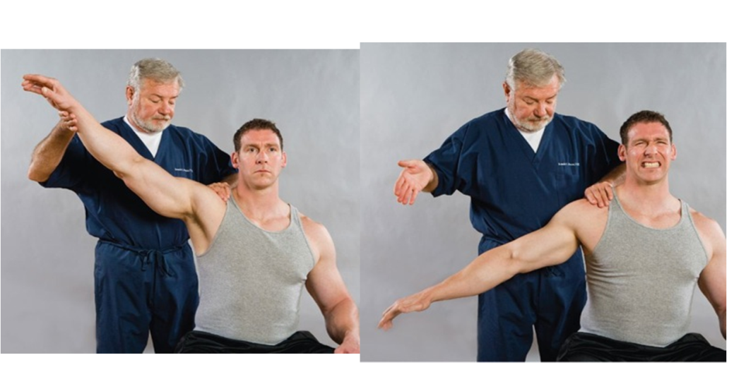
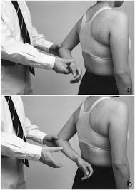
Tests:
M.supraspinatus - empty can test –
-tenderness when elevating against the physician
-drop arm test – elevate above 90°- remove support-inability to control the fall of the arm
M.subscapularis - lift-off test – place extremity behind patients back, back of the hand pressed against the lumbal part of the back, then ask the patient to move hand back to front- deficit in intra-rotation as a sign of subscap. Musle injury

Slide 60
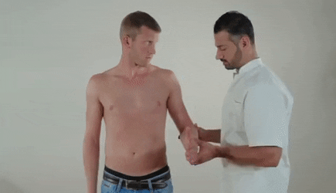
M. infraspinatus/m.teres minor- rameno při tělě, loket flektován v 90°, lékař tlačí proti extrarotaci – emituje bolest při defektu

Slide 61
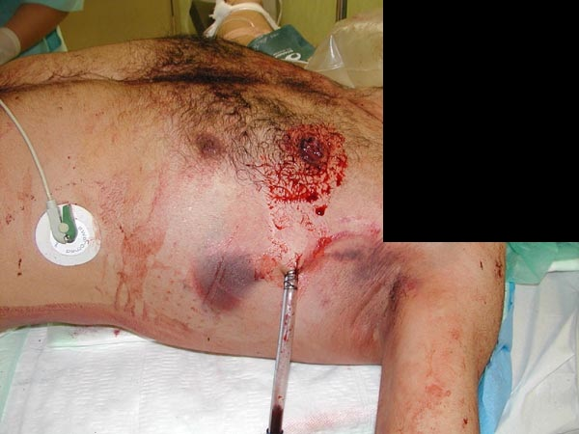
Thoracic injuries:

Slide 62
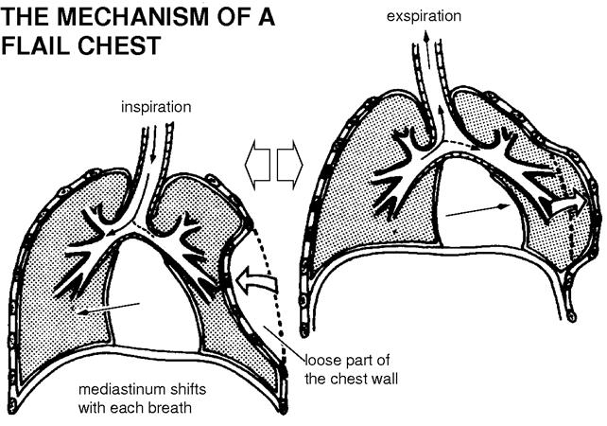

Slide 63
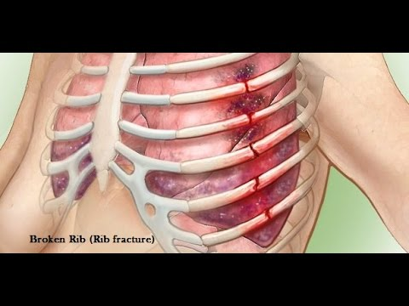
Rib fractures

Slide 64
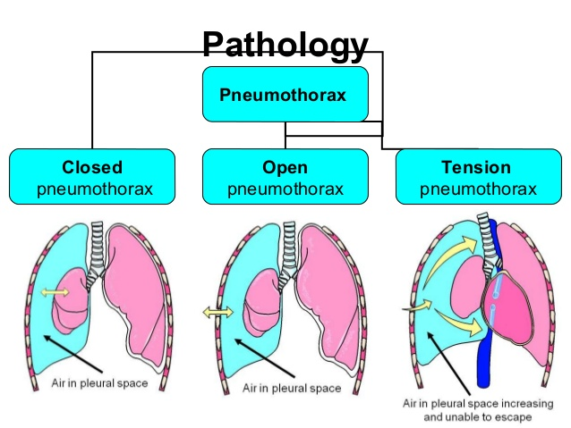
PNO – pneumothorax
according to size,- total, partial (apical,restrosternal, sheath)
present in 50% of all blunt thoracic injuries
opened, closed, tension

Slide 65
Diagnostics
-anamnesis, clinical finding, absence of unilateral breaht sounds, respiratory thoracic excursions decreases, hypersonor tap on thorax
Tension PNO: tracheal deviation, increase of jugular veins volume, cyanosis, respiratory failure/insufficiency, hypotension
X-ray might be a luxury you dont have !!!!

Slide 66
CAVE !!!
Fractures of 3 or more ribs
Hemothorax
Ventilation insufficiency
Pathological breath sounds
Control X-ray – stating the dynamics
Examine the amount of TROPONIN, ECG!!!
Caudal ribs, especially on left side!!!
Block fractures – admit to hospital
Breath exercises
Regime

Slide 67
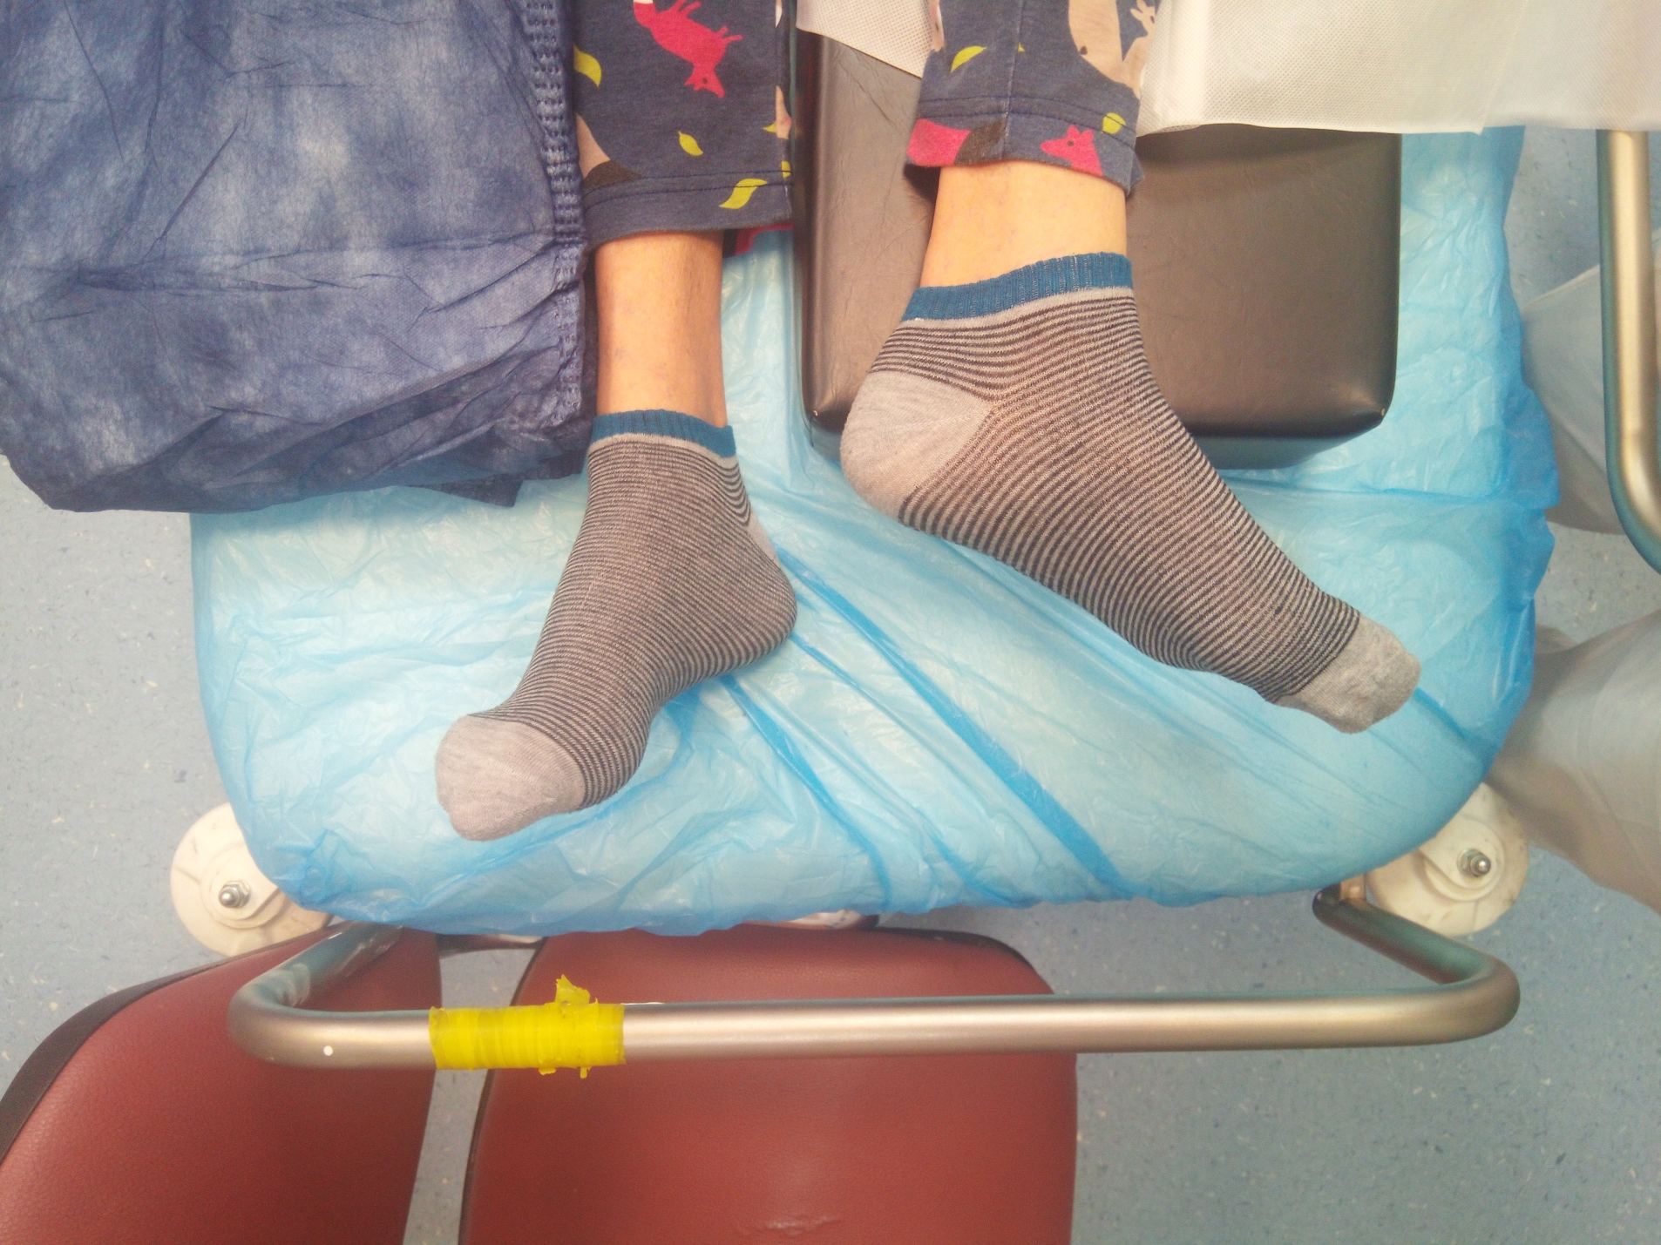
Proximal femur fractures

Slide 68
Proximal femur fractures:
common fractures
substantial social, medical, and economical problem
80% of patients older 70 yrs
young adults – due to high energy trauma incidents
risk factors, prophylaxis
- complications– pneumonia hypostatica, thrombolembolia, infectus urogenitalis, decubitus, necrosis aseptica

Slide 69
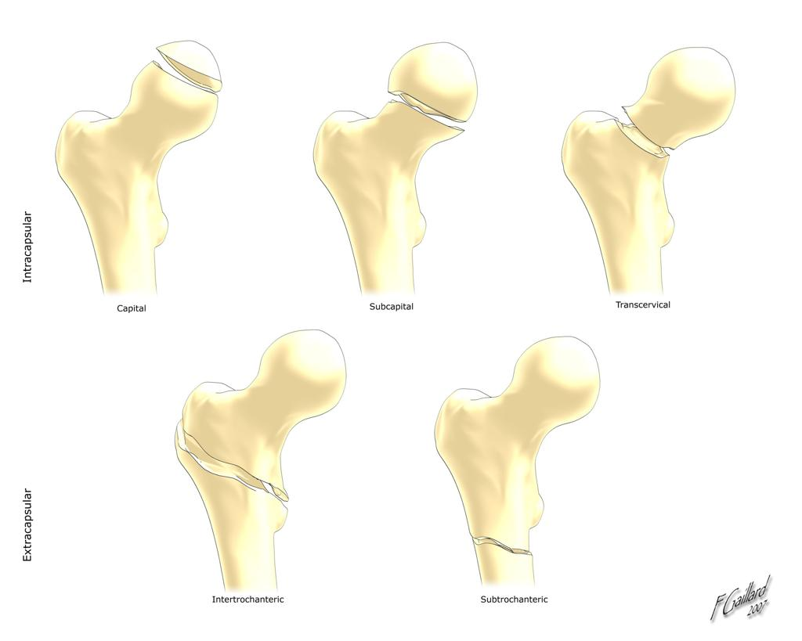
Division:
Proximal femur fractures:
fr. of femoral head
-fr. of femoral neck – intra/extra- capsular

Slide 70
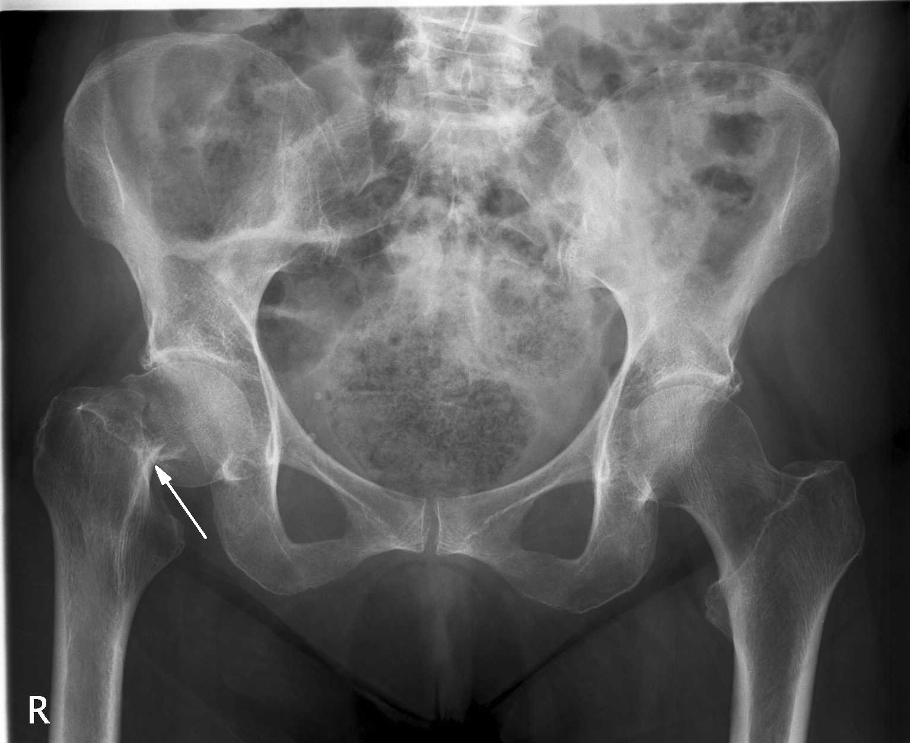
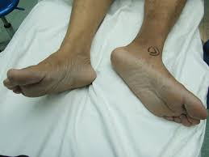
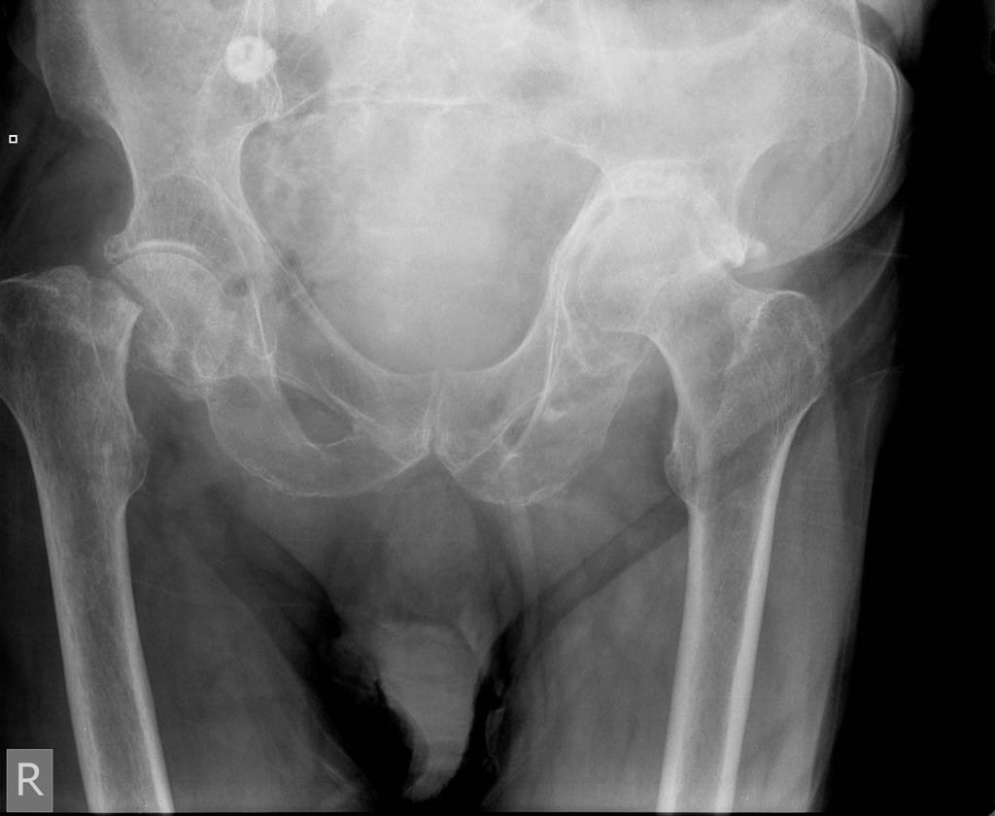
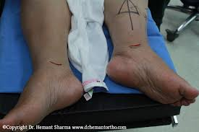

Slide 71
Vyšetření:
Anamnéza, aspekce, palpace
fr. hlavice femuru – antalgické postavení, extrarotace, zkrácení pouze při luxaci
- fr. krčku femuru- zkrácená, extrarotace končetiny
Doplnění: Odběry, RTG, při pochybnostech či komplexitě poranění doplnění CT, RTG S+P při příjmu
CAVE: Neopomenout příčinu pádu pacienta/pacientky!!!

Slide 72
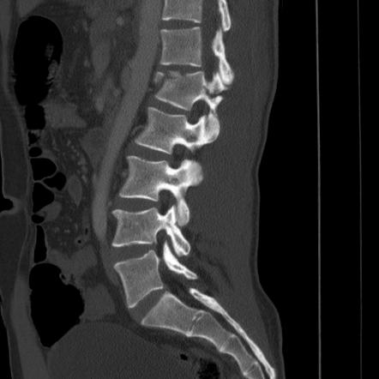
Vertebral column
Examination, diagnostics

Slide 73
Brain concussion
Definition: Shortly lasting unconsciousness, with spontaneous improval, retrograde/antegrade amnesia, without local neurological deficit
signs
diagnostics
examination procedure
In fact, it is considered as light axonal injury

Slide 74
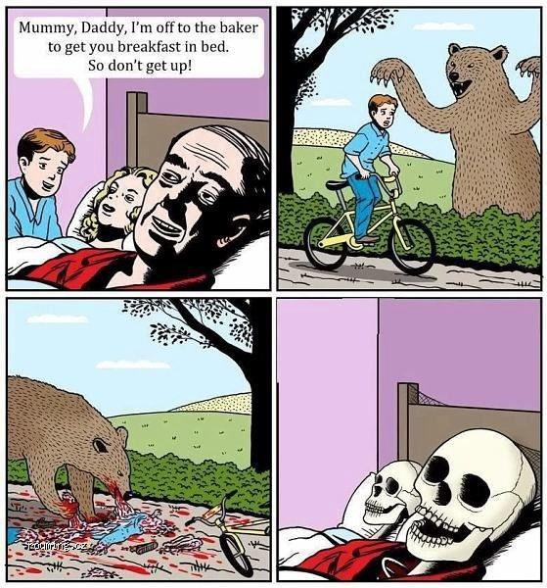
„PRAKTICAL PART“ ☺
Casuistics+patients
examination

