Slide 1
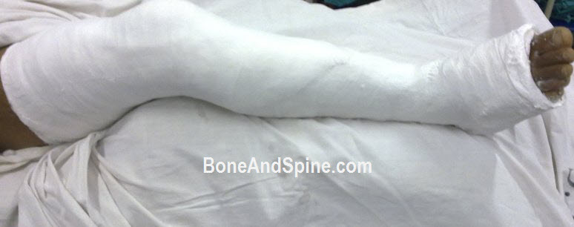
Plaster-of-Paris and
Plaster Technique

Slide 2
Orthopaedic Uses of Cast
1) To support fractured bones, controlling movement of the fragments and resting the damaged tissues
2) To stabilise and rest joints in ligamentous injury
3) To support and immobilise joints and limbs post-operatively until healing has occurred
4) To correct a deformity
5) To ensure rest of infected tissues

Slide 3
Materials available for casting
Plaster-of-Paris
Synthetic Fiberglass Materials:
a) water activated
b) non-water activated
Low-temperature thermoplastics

Slide 4
PLASTER-OF-PARIS
The name POP is derived from an accident to a house built on a deposit of Gypsum, near Paris. The house burnt down. When rain fell on baked mud of the floors it was noted that footprints in mud set rock-hard.
Plaster-of-paris bandages were first used by Matthysen, a Dutch military surgeon in 1952.

Slide 5
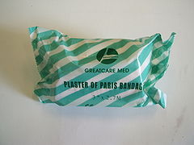
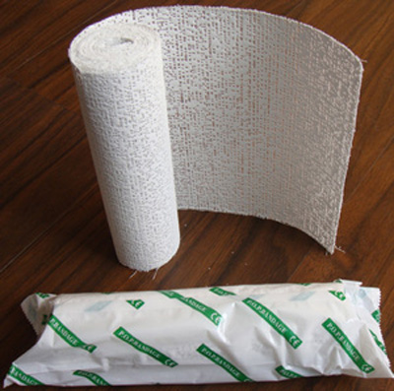
PLASTER-OF-PARIS
The POP bandage consists of a roll of muslin stiffened by dextrose or starch and impregnated with the hemihydrate of calcium sulfate.
When water is added, the calcium sulfate takes up its water of crystallization

Slide 6
PLASTER-OF-PARIS
Setting time: time taken to change from powder form to crystalline form.
Drying time: time taken to change from crystalline form to anhydrous form.
Average setting time: 3-9 minutes
Average drying time: 24-72 hours

Slide 7

PLASTER-OF-PARIS
Factors decreasing setting time:
1) Hot water
2) Salt
3) Resin
Factors increasing setting time:
1) Cold water
2) Sugar

Slide 8
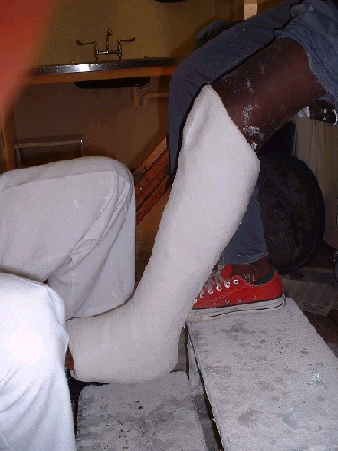
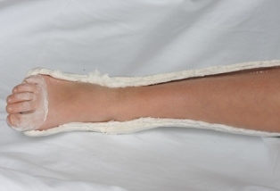
POP … various forms
Slab:
Cast:
only a part of circumference of limb is incorporated.
encircle whole circumference of the limb.

Slide 9
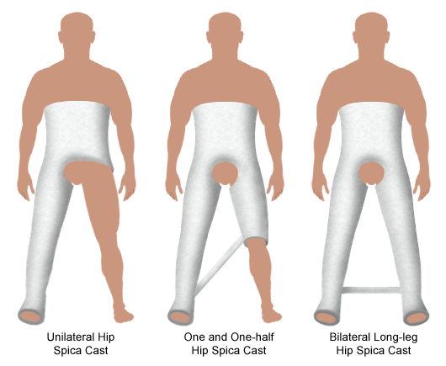
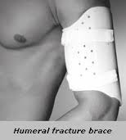
POP … various forms
Spica
Brace

Slide 10

PLASTER-OF-PARIS
Advantages:
Cost-effective
Non-allergic
Easily moulded to different forms
Disadvantages:
Radio-opaque - may occlude # lines
Heavy
Easily breaks when comes in contact with water

Slide 11
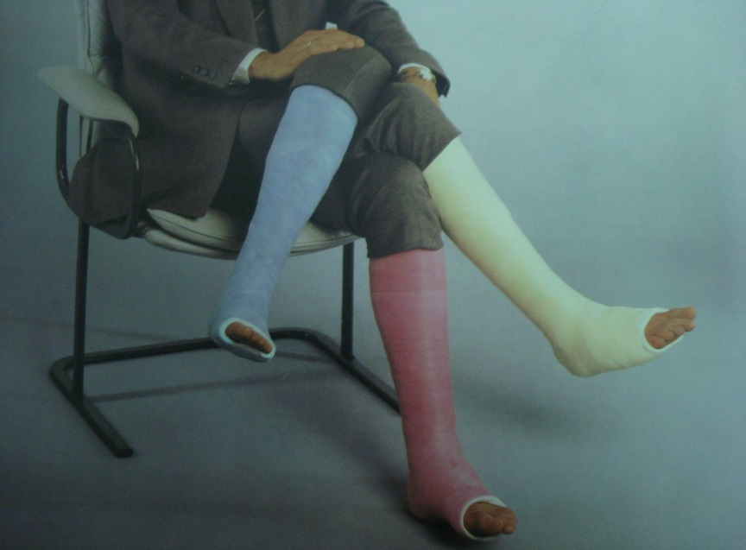
Synthetic Fiberglass Materials
Advantages:
  Lightweight, yet strong
  May be combined with waterproof liners to allow bathing and swimming in the cast.
  Often more radiolucent than plaster
  Lower risk of thermal injury:
      Less material is required
      Very low amount of thermal energy is released during the curing process.

Slide 12
Synthetic Fiberglass Materials
Disadvantages:
  More expensive
  More difficult to mold
  Higher risk of pressure on and constriction of the limb.

Slide 13
Rules of application of POP casts
One joint above and one joint below.
Joints should be immobilized in functional position.
Moulded with palm and not with fingers to avoid indentation.
Not too tight or too loose i.e. adequate padding

Slide 14
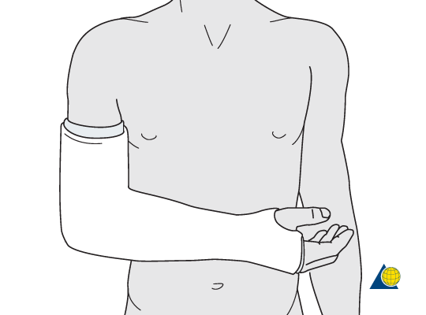
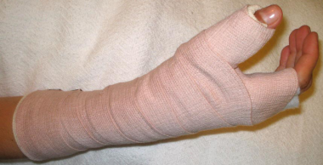
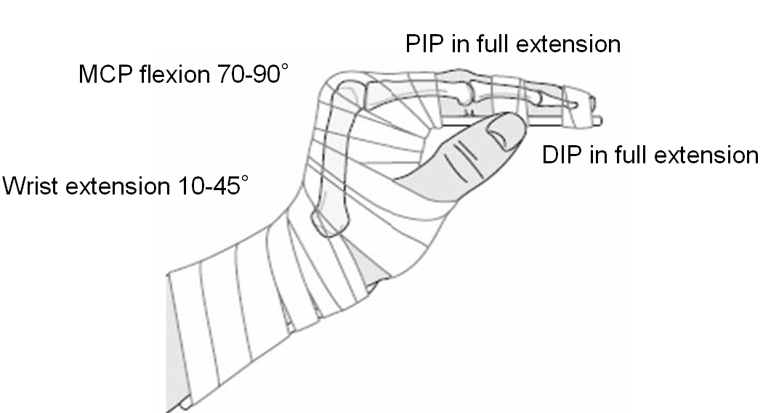
Position of Immobilization
Upper extremity
Elbow: 90° of flexion
Wrist: 30° of extension
Thumb: midway between maximal radial and palmar abduction
Hand: intrinsic plus (MCP joints in at least 70° of flexion and IP joints in extension)

Slide 15
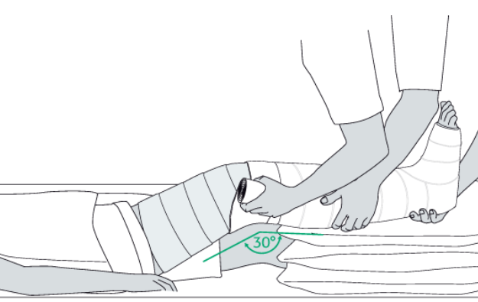
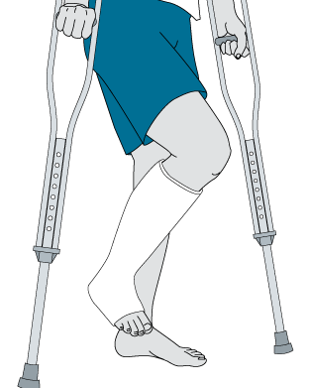
Position of Immobilization
Lower extremity
Hip: 10-30° of abduction
  20-45° of flexion
  15° of external rotation
Knee: 15-30° of flexion
Ankle: Neutral dorsiflexion

Slide 16
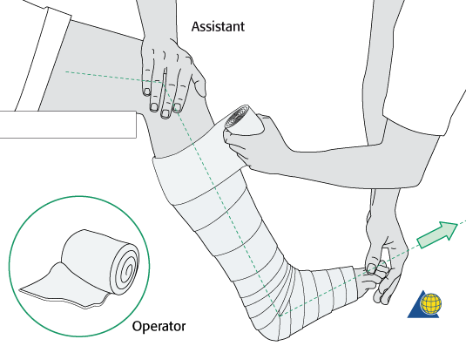
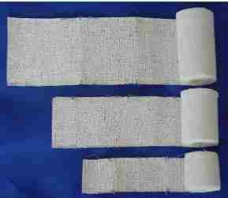
Rules of application of POP casts
  Padding:
  This is placed from distal to proximal with a 50% overlap, a minimum two layers, and extra padding at the fibular head, malleoli, patella, and olecranon.
  Plaster width:
  15 cm width for thigh
  12 cm width for lower leg
    10 cm width for forearm and arm
    8 cm width for wrist
    5 cm width for fingers

Slide 17
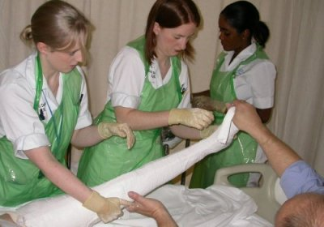
Plaster Technique
Plaster casts can be divided into 2 types:
  Unpadded plaster
  Padded plaster

Slide 18
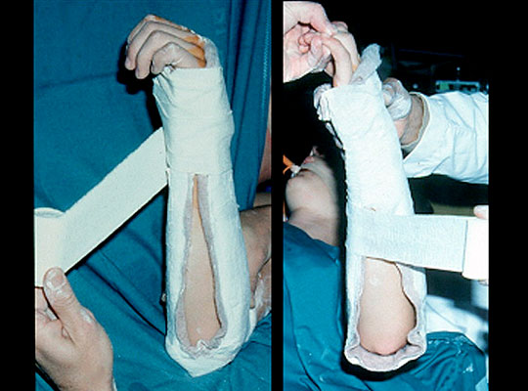
Unpadded Plaster
Made by applying the turns of wet bandage directly to the skin without using any textile. (used by Böhler)
For practical purposes, if stockinet is used the resulting plaster can still be regarded as an unpadded cast.

Slide 19
Padded plaster cast
A layer of cotton-wool is interposed between the skin and plaster, which is firmly compressed against the limb by applying wet plaster bandage under tension.
The elastic pressure of the cotton enhances the fixation of limb by compensating for shrinkage in tissues .

Slide 20
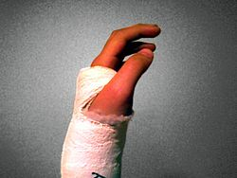
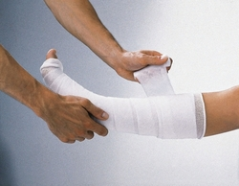
Padded plaster cast

Slide 21
Triple sequence in Plaster Application
Phase 1: examination
Phase 2: plastering
Phase 3: reduction and holding

Slide 22
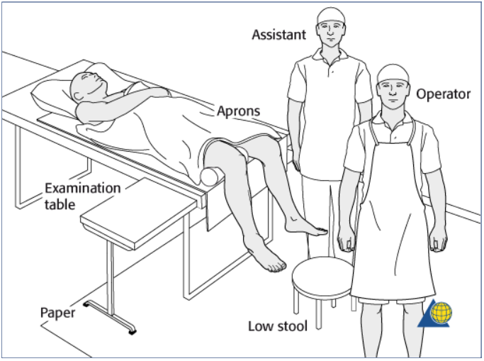
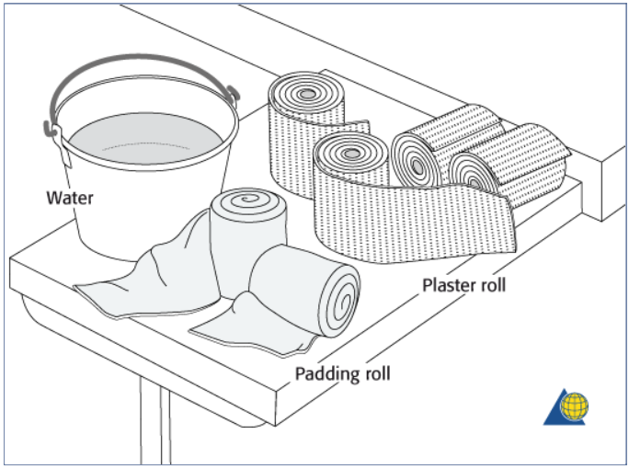
Plastering - principle
Preparation for cast application

Slide 23
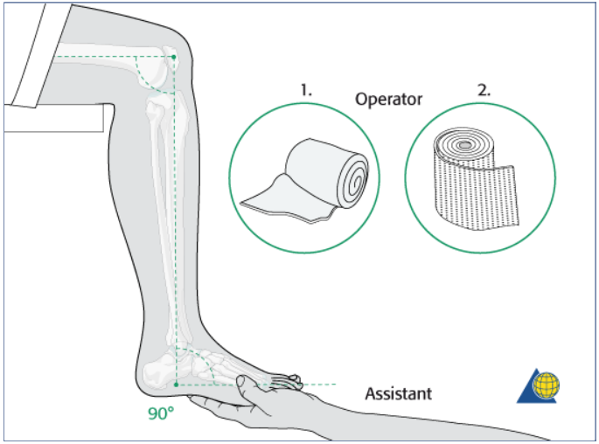
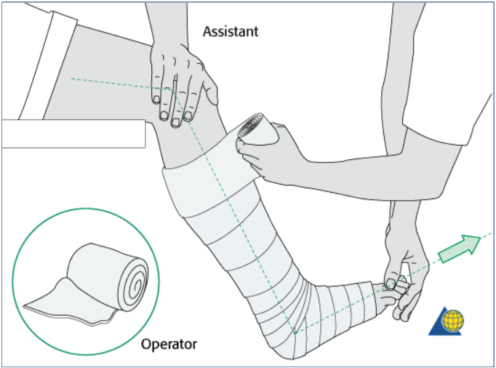
Plastering - principle
Application of the cast

Slide 24
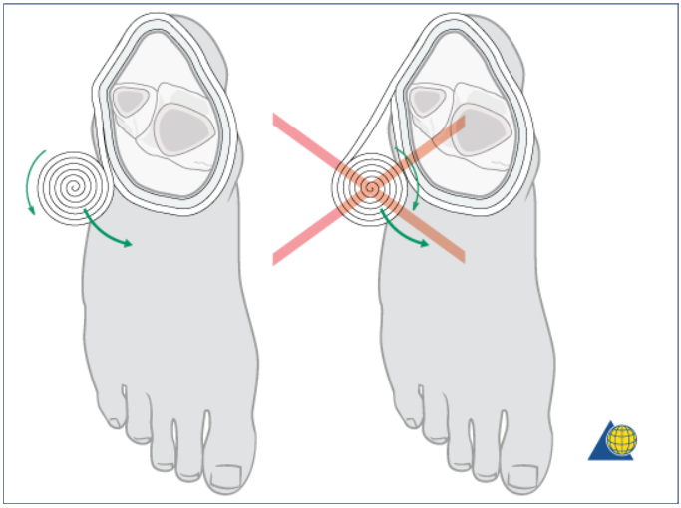
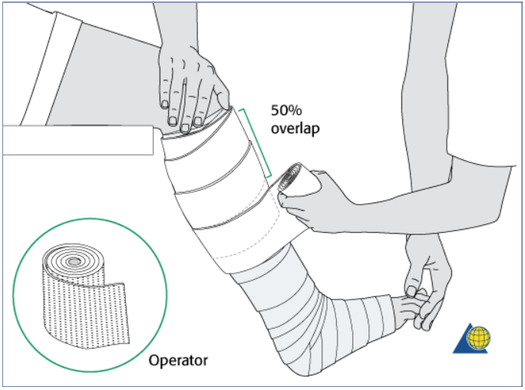
Plastering - principle
Application of the cast

Slide 25
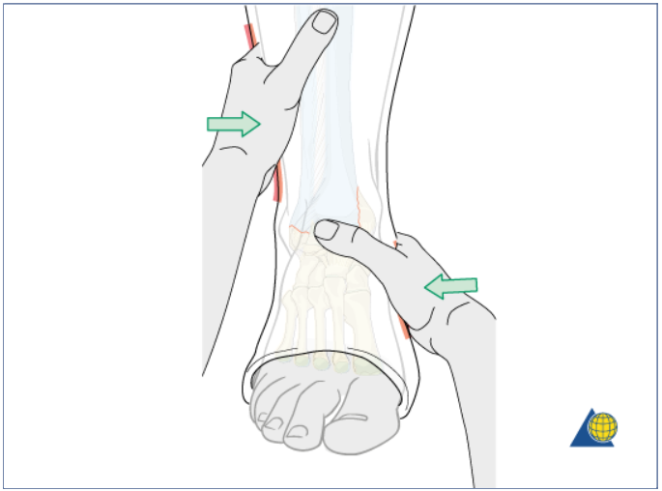
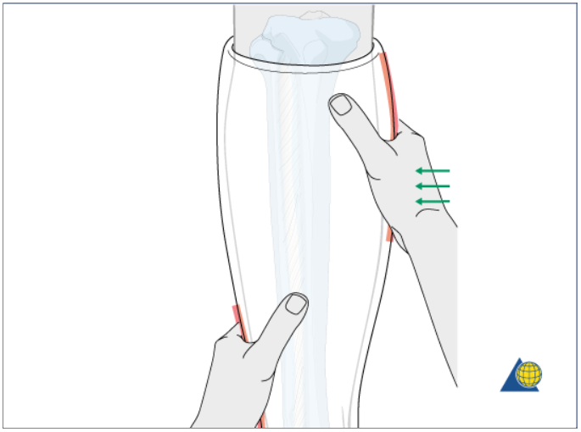
Plastering - principle
Reduction and holding

Slide 26
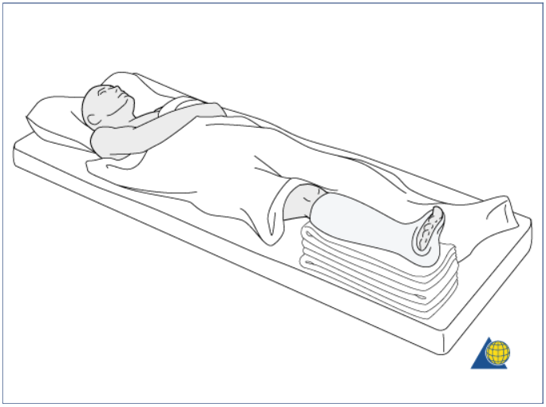
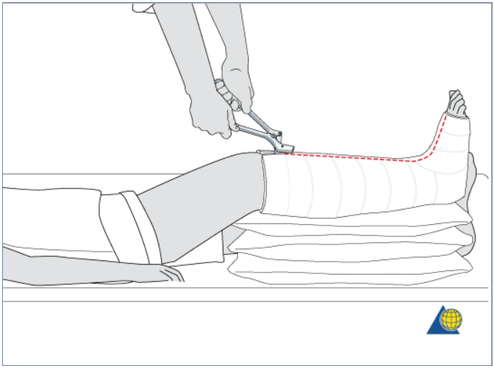
Plastering - principle
Evaporation period

Slide 27
Aftercare
Instructions to be given after applying POP:
1. Come immediately if any of following symptoms develops:
A) Excessive pain,
B) Excessive swelling,
C) Bluish or white discolouration of fingers or toes
2. Keep the plaster cast dry.
3. Mobilize all the joints which are not incorporated in the plaster to their full range of motion once plaster becomes dry.

Slide 28
Aftercare
4. Notice any cracks in the plaster.
5. Physiotherapy of muscles within the plaster and joints outside the plaster is necessary to ensure early rehabilitation.

Slide 29
Complications
Due to tight cast
- pain
- pressure sores
- compartment syndromes
- peripheral nerve injuries

Slide 30
Complications
Due to improper applications
- joint stiffness
- plaster blisters and sores
- breakage
Due to plaster allergy
-allergic dermatitis

Slide 31
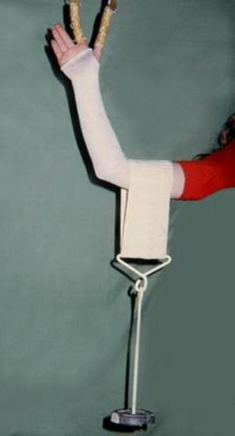
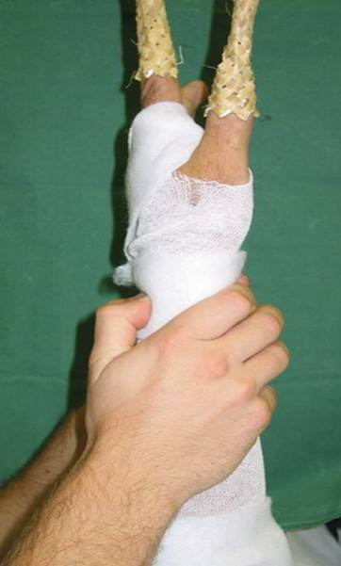
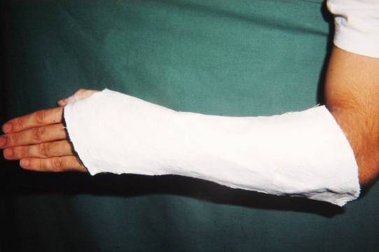
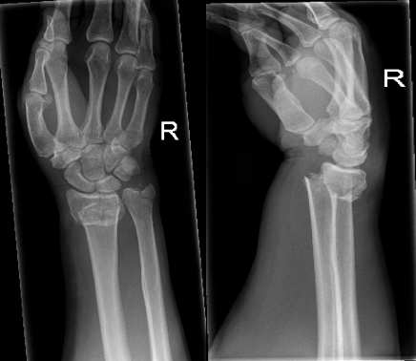
Plan for today ?
POP in patient with distal radius fracture

Slide 32
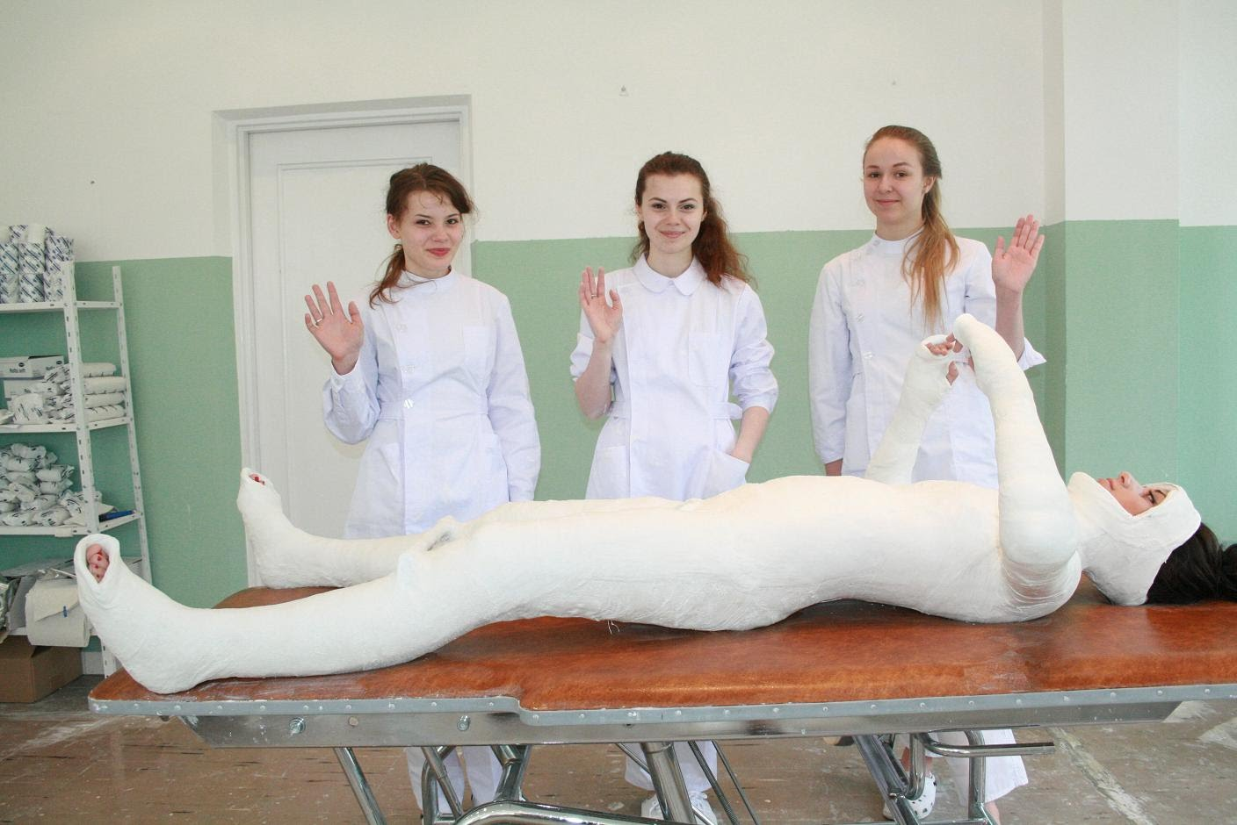
Thank you for your attention

