Slide 1
Plastic Surgery
Daniel Ira MD
Department of Trauma Surgery
University Hospital Brno

Slide 2
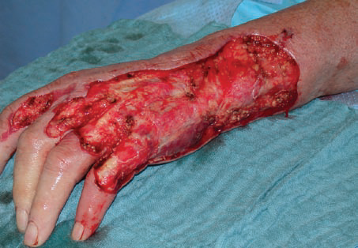
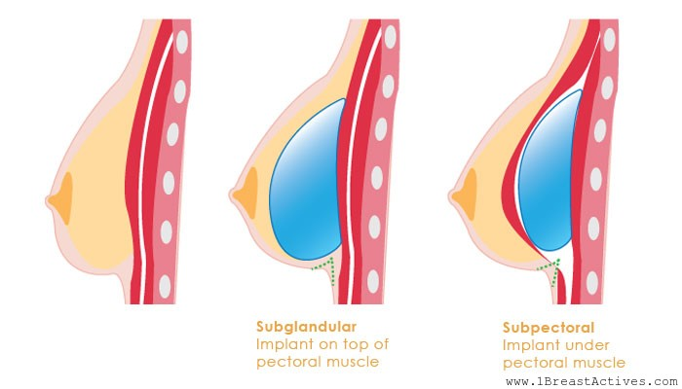
Plastic surgery
is a surgical specialty involving the restoration, reconstruction, or alteration of the human body.
reconstructive surgery - aims to reconstruct a part of the body or improve its functioning
cosmetic surgery - aims at improving the appearance of it.

Slide 3
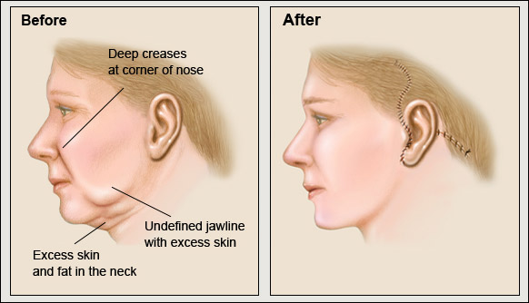
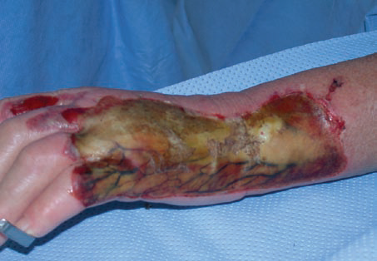
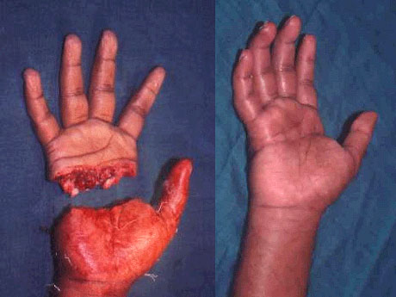
Plastic surgery
Sub-specialties
  Aesthetic surgery
  Burn surgery
  Craniofacial surgery
  Hand surgery
  Microsurgery
  Pediatric plastic surgery

Slide 4
Plastic Surgery
In the term "plastic surgery," the adjective plastic implies sculpting and/or reshaping, which is derived from the Greek πλαστική (τέχνη), plastikē (tekhnē), "the art of modelling"
This meaning in English is seen as early as 1598. The surgical definition of "plastic" first appeared in 1839, preceding the modern "engineering material made from petroleum" sense of plastic (coined by Leo Baekeland in 1909) by 70 years

Slide 5
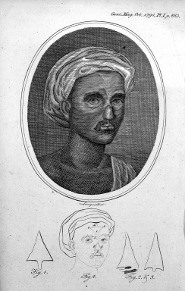
Plastic surgery
History
Treatments for the plastic repair of a broken nose are first mentioned in the Edwin Smith Papyrus (a transcription of an Ancient Egyptian medical text, one of the oldest known surgical treatises, dated to the Old Kingdomm from 3000 to 2500 BC)
Reconstructive surgery techniques were being carried out in
Indiaa by 800 BC ( Sushruta)
The medical works of both Sushruta and Charak, originally in
Sanskritt, were translated into the Arabic languge
during the Abbasid Caliphate in 750 AD. The Arabic translations
made their way into Europe via intermediaries.
Britishh physicians traveled to India to see rhinoplastiess being
performed by native methods

Slide 6
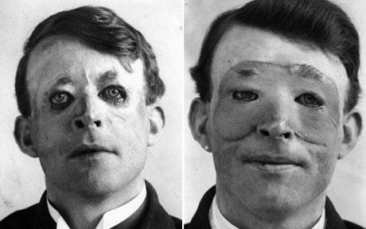
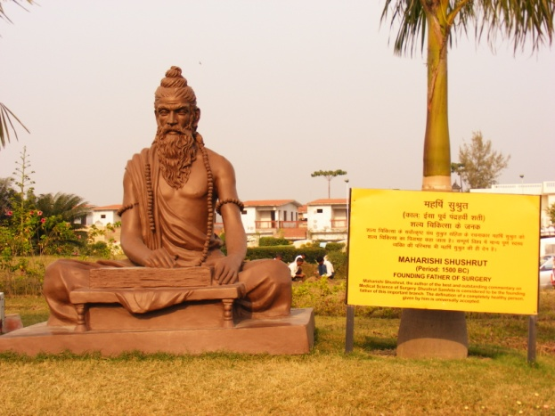
Plastic Surgery
History
Up until the use of anesthesia became established, surgeries involving healthy tissues involved great pain.
In 1793, François Chopart performed operative procedure on a lip using a flap from the neck
In 1896, James Israell, a urological surgeon from Germany, and in 1889 George Monks of the United States each described the successful use of heterogeneous free-bone grafting to reconstruct saddle nose defects
WWI and WWII – huge progress in surgical procedures

Slide 7
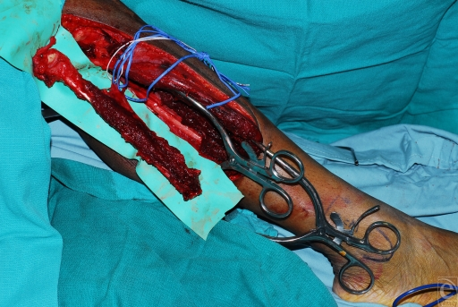
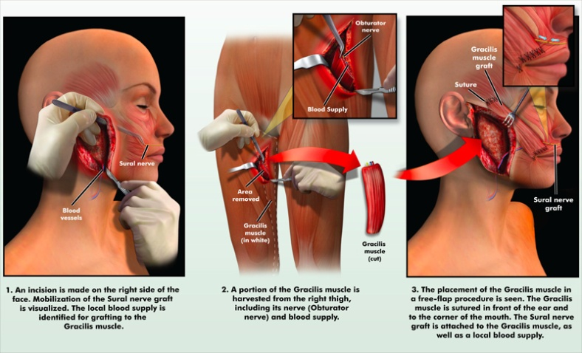
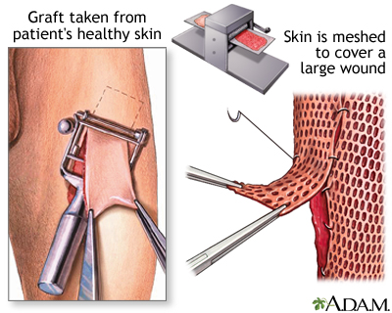
Plastic Surgery
Techniques and procedures
In plastic surgery, the transfer of skin, fat, muscle or bone tissue (grafting) is a very common procedure. Skin, muscle, fat or bone grafts can be derived from the recipient or donors:
Autografts are taken from the recipient. If absent or deficient of natural tissue, alternatives can be cultured sheets of epithelial cellss in vitro

Slide 8
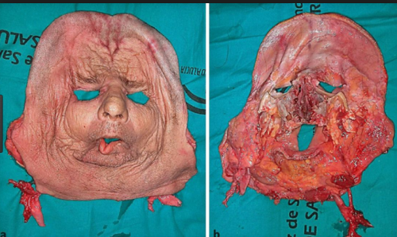
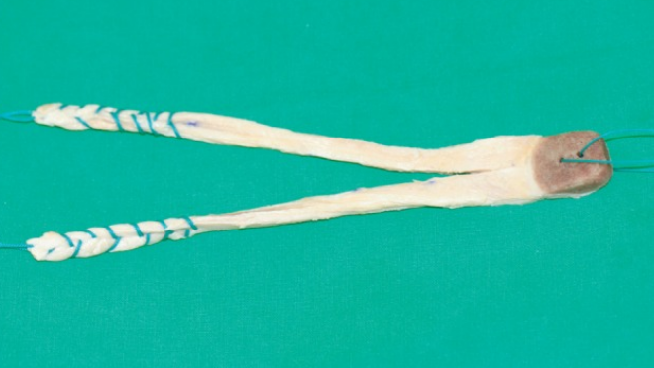
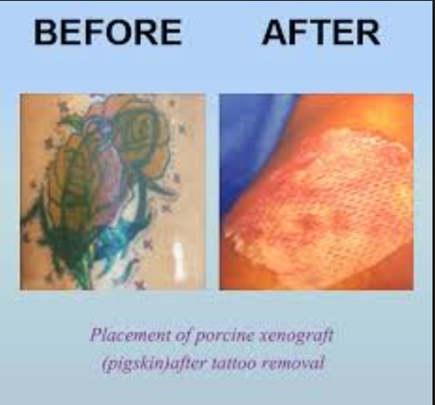
Plastic Surgery
Allografts are taken from a donor of the same species.
Xenografts are taken from a donor of a different species

Slide 9
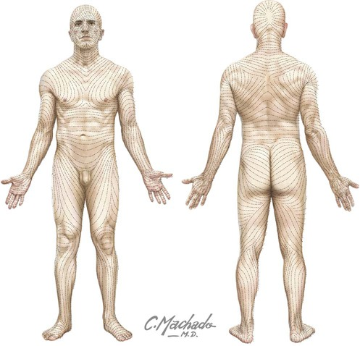
Plastic Surgery
Usually, good results would be expected from plastic surgery that emphasize careful planning of incisions so that they fall within the line of natural skin folds or lines, appropriate choice of wound closure, use of best available suture materials, and early removal of exposed sutures so that the wound is held closed by buried sutures

Slide 10
Plastic Surgery
Aesthetic surgery
Aesthetic surgery is an essential component of plastic surgery and includes facial and body aesthetic surgery. Plastic surgeons use cosmetic surgical principles in all reconstructive surgical procedures as well as isolated operations to improve overall appearance.
Cosmetic surgery is an optional or elective surgery that is performed on normal parts of the body with the only purpose of improving a person’s appearance and/or removing signs of aging
In 2014, nearly 16 million cosmetic procedures were performed in the United States alone.^{[21]} The number of cosmetic procedures performed in the United States has almost doubled since the start of the century

Slide 11
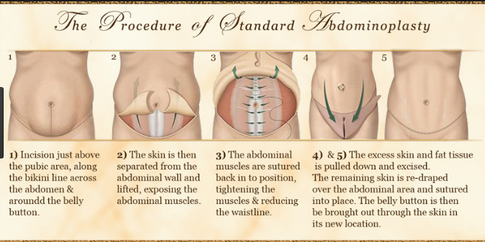
Plastic Surgery
Abdominoplasty ("tummy tuck"): reshaping and firming of the abdomenn

Slide 12
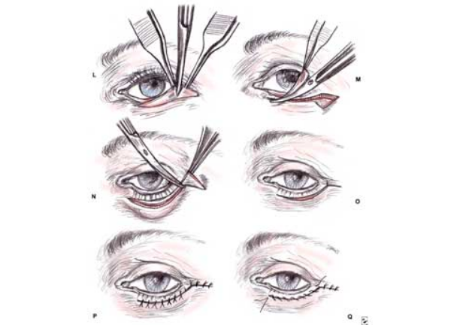
Plastic Surgery
Blepharoplasty ("eyelid surgery"): reshaping of upper/ lower eyelids

Slide 13
Plastic Surgery
Mammoplasty:
Breast augmentations("breast implant" or "boob job"): augmentation of the breasts by means of fat grafting, saline, or silicone gel prosthetics, which was initially performed to women with micromastia
Reduction mammoplasty ("breast reduction"): removal of skin and glandular tissue, which is done to reduce back and shoulder pain in women with gigantomastia and for men with gynecomastia
Mastopexy ("breast lift"): Lifting or reshaping of breasts to make them less saggy, often after weight loss (after a pregnancy, for example). It involves removal of breast skin as opposed to glandular tissue

Slide 14
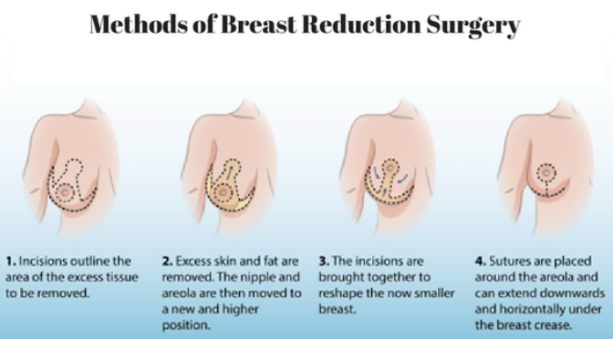
Plastic Surgery

Slide 15
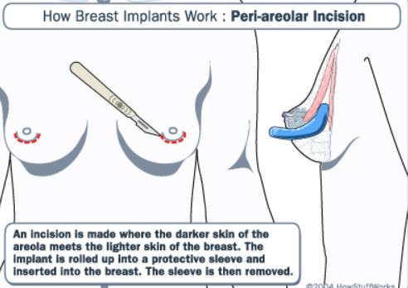
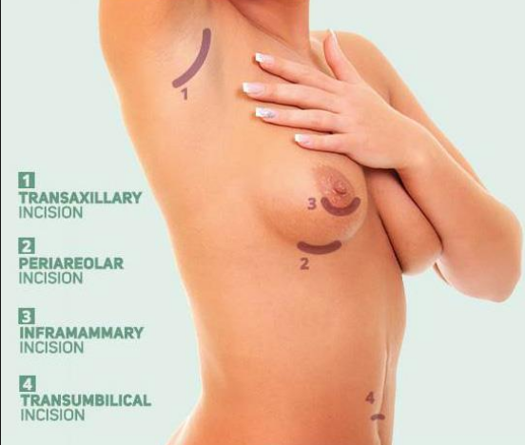
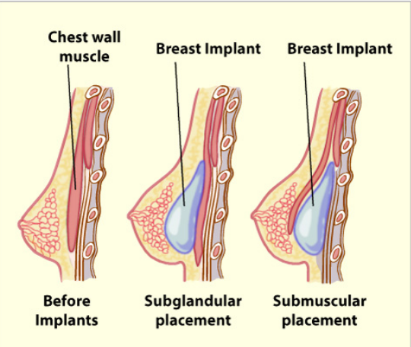
Plastic Surgery

Slide 16
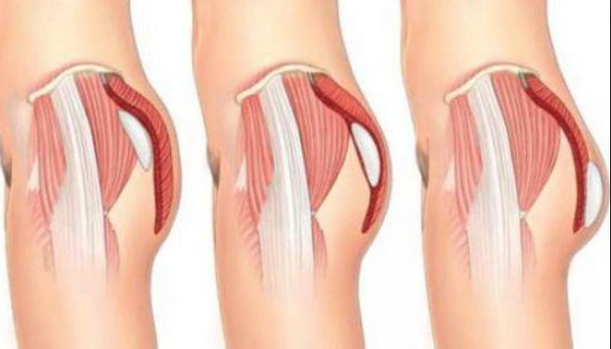
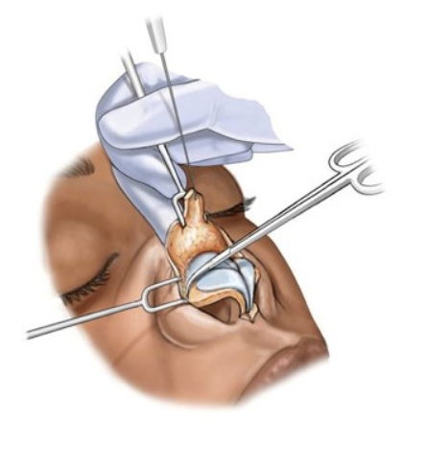
Plastic Surgery
Buttock augmentation ("butt implant"): enhancement of the buttocks using silicone implants or fat grafting ("Brazilian butt lift") and transfer from other areas of the body
  Buttock lift: lifting, and tightening of the buttocks by excision of excess skin
Cryolipolysis: refers to a medical device used to destroy fat cells. Its principle relies on controlled cooling for non-invasive local reduction of fat deposits to reshape body contours.
Cryoneuromodulation: Treatment of superficial and subcutaneous tissue structures using gaseous nitrous oxide, including temporary wrinkle reduction, temporary pain reduction, treatment of dermatologic conditions, and focal cryo-treatment of tissue
Calf Augmentation: done by silicone implants or fat transfer to add bulk to calf muscles
Labiaplasty: surgical reduction and reshaping of the labia
Lip enhancement: surgical improvement of lips' fullness through enlargement
Rhinoplasty ("nose job"): reshaping of the nose

Slide 17
Plastic Surgery
Otoplasty ("ear surgery"/"ear pinning"): reshaping of the ear, most often done by pinning the protruding ear closer to the head.
Rhytidectomy ("face lift"): removal of wrinkles and signs of aging from the face
  Neck lift: tightening of lax tissues in the neck. This procedure is often combined with a facelift for lower face rejuvenation.
  Browplasty ("brow lift" or "forehead lift"): elevates eyebrows, smooths forehead skin
  Midface lift ("cheek lift"): tightening of the cheeks
Genioplasty ("chin implant"): augmentation of the chin with an implant, usually silicone, by sliding genioplasty of the jawbone or by suture of the soft tissue
Cheek augmentation ("cheek implant"): implants to the cheek
Orthognathic Surgery: manipulation of the facial bones through controlled fracturing
Fillers injections: collagen, fat, and other tissue filler injections, such as hyaluronic acid
Brachioplasty ("Arm lift"): reducing excess skin and fat between the underarm and the elbow^{[26]}
Laser Skin Rejuvenation or laser resurfacing: the lessening of depth in pores of the face
Liposuction ("suction lipectomy"): removal of fat deposits by traditional suction technique or ultrasonic energy to aid fat removal
Zygoma reduction plasty: reshaping the face

Slide 18
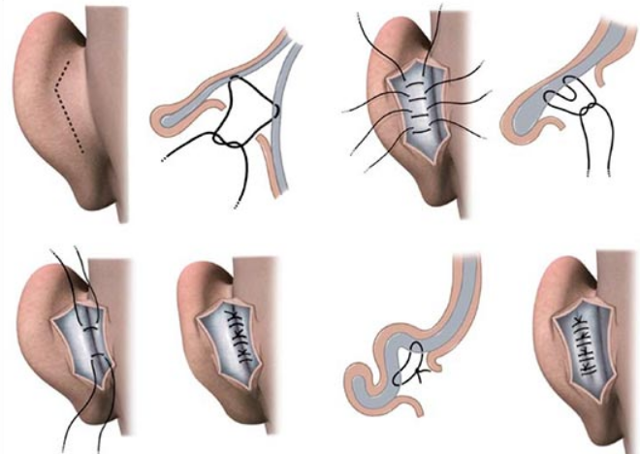
Plastic Surgery
With one of the more common techniques, the surgeon makes a small incision in the back of the ear to expose the ear cartilage. He or she will then sculpt the cartilage and bend it back toward the head. Non-removable stitches may be used to help maintain the new shape. Occasionally, the surgeon will remove a larger piece of cartilage to provide a more natural-looking fold when the surgery is complete.
Another technique involves a similar incision in the back of the ear. Skin is removed and stitches are used to fold the cartilage back on itself to reshape the ear without removing cartilage.

Slide 19
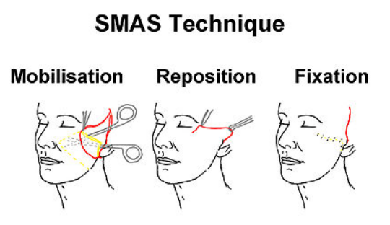
Plastic Surgery
Face lifting

Slide 20
Plastic Surgery
A flap is a unit of tissue that is transferred from one site (donor site) to another (recipient site) while maintaining its own blood supply.
Flaps come in many different shapes and forms. They range from simple advancements of skin to composites of many different types of tissue. These composites need not consist only of soft tissue. They may include skin, muscle, bone, fat, or fascia.

Slide 21
Plastic Surgery
type of blood supply
Random (no named blood vessel)
Axial (named blood vessel)
type of tissue to be transferred
Skin, muscle, bone, fascia, visceral, composite
location of donor site
Tissue may be transferred from an area adjacent to the defect. This is known as a local flap.
Tissue transferred from an noncontiguous anatomic site (ie, from a different part of the body) is referred to as a distant flap.
Distant flaps may be either pedicled (transferred while still attached to their original blood supply) or free.

Slide 22
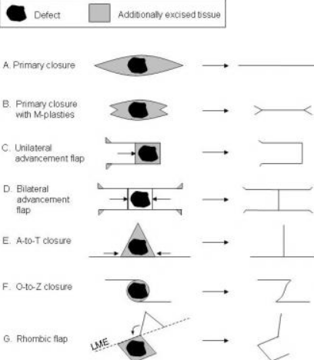
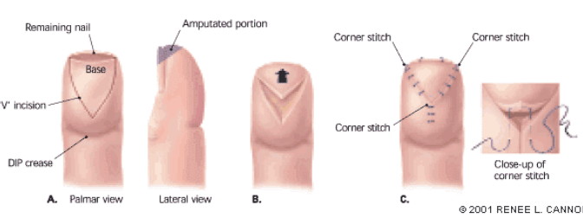
Plastic Surgery
Local flaps
It may be described based on its geometric design, be advanced, or both. Pivotal (geometric) flaps include rotation, transposition, and interpolation. Advancement flaps include single pedicle, bipedicle, and V-Y flaps.

Slide 23
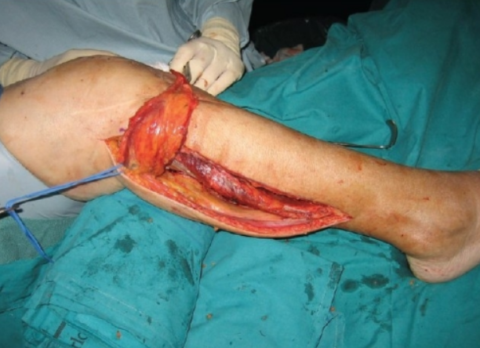
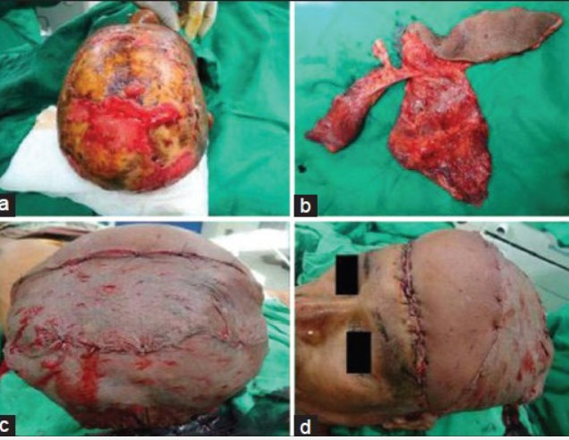
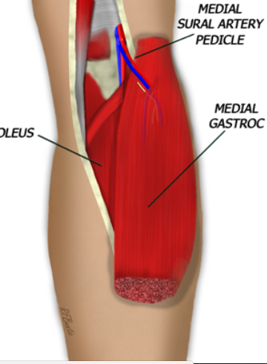
Plastic Surgery
Distant flap

Slide 24
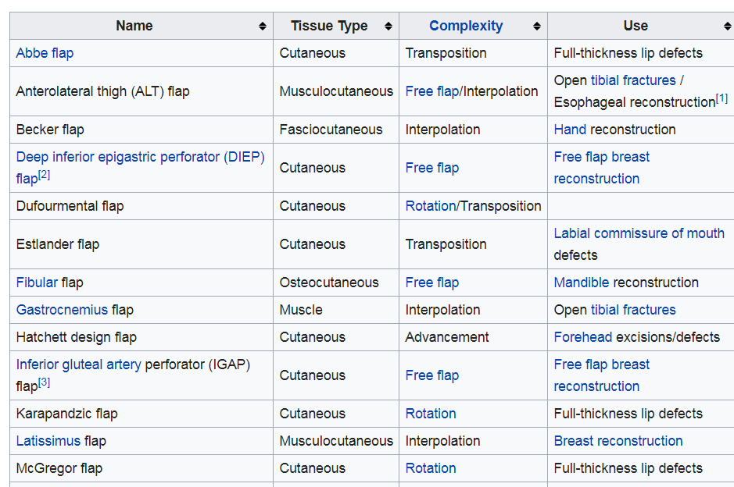
Plastic Surgery

Slide 25
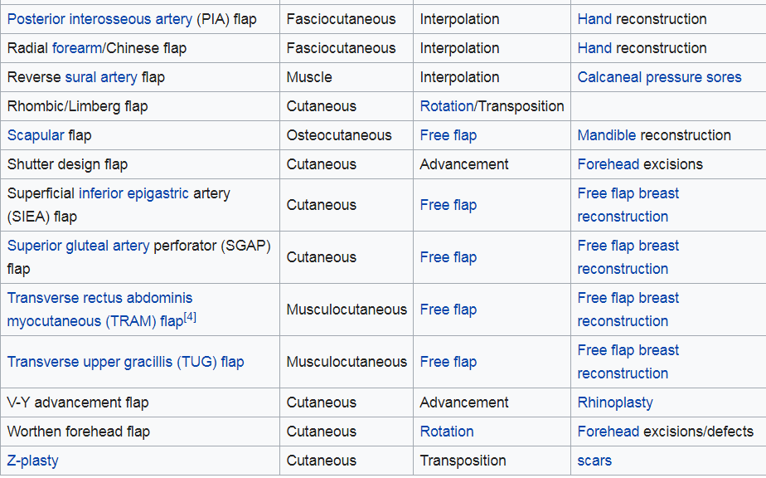
Plastic Surgery

Slide 26
Plastic Surgery
Pediatric plastic surgery
Pediatric plastic surgery is plastic surgery performed on children. Its procedures are most often conducted for reconstructive or cosmetic purposes. In children, this line is often blurred, as many congenital deformities impair physical function as well as aesthetics.
Children make up roughly 3% of all plastic surgery procedures, and the majority of these procedures correct a congenital deformity.

Slide 27
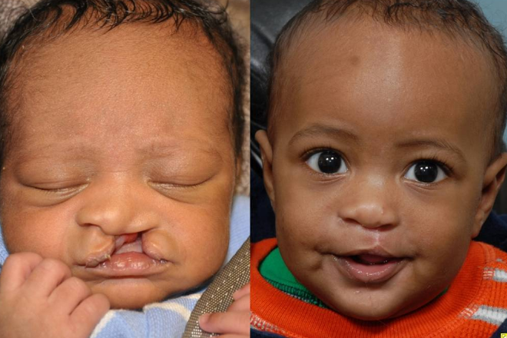
Plastic Surgery
Cleft lip and/or palate - Babies born with the defect will have opening in the vicinity of the upper lip. The size of the opening reaches anywhere from a small notch to near towards the base of the nostril, in which it would either involve one or both sides of the lip.

Slide 28
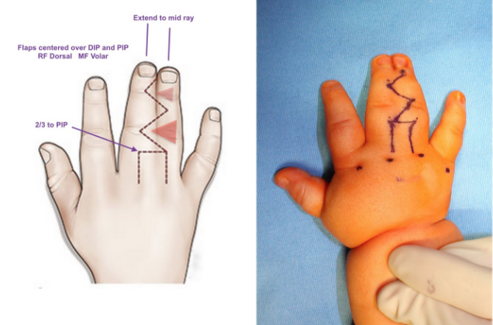
Plastic Surgery
Syndactyly / Polydactyly – The most common of congenital malformations affecting limbs. It is believed that Syndactyly, exhibits in variation, in which digits can be fused either partially or across its entire length, or as simple as only being connected superficially by skin. It affects 1 in every 2,000 – 3,000 live births. Polydactyly is the presence of extra fingers or toes at birth, and is believed to affect somewhere around 2 out of every 1,000 live births.

Slide 29
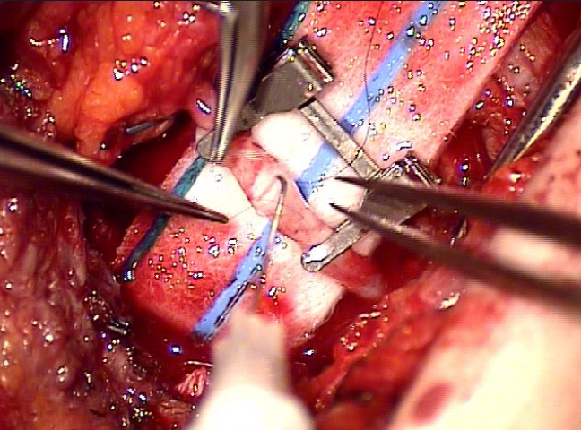
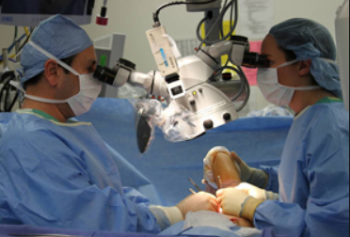
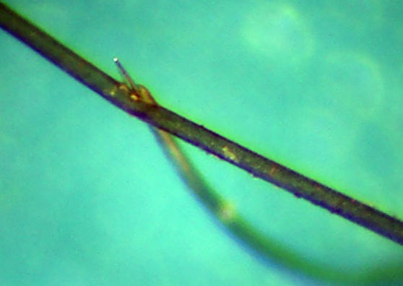
Plastic Surgery
Microsurgery is a general term for surgery requiring an operating microscope. The most obvious developments have been procedures developed to allow anastomosiss of successively smaller blood vessels and nerves (typically 1 mm in diameter) which have allowed transfer of tissue from one part of the body to another and re-attachment of severed parts. Microsurgical techniques are utilized by many specialties today
Microsurgery is generally concerned with the reconstruction of missing tissues by transferring a piece of tissue to the reconstruction site and reconnecting blood vessels.

Slide 30
Plastic Surgery
Free tissue transfer
Free tissue transfer is a surgical reconstructive procedure using microsurgery. A region of "donor" tissue is selected that can be isolated on a feeding artery and vein; this tissue is usually a composite of several tissue types (e.g., skin, muscle, fat, bone). Common donor regions include the rectus abdominis muscle, latissimus dorsi muscle, fibula, radial forearm bone and skin, and lateral arm skin. The composite tissue is transferred (moved as a free flap of tissue) to the region on the patient requiring reconstruction (e.g., mandible after oral cancer resection, breast after cancer resection, traumatic tissue loss, congenital tissue absence). The vessels that supply the free flap are anastomosed with microsurgery to matching vessels (artery and vein) in the reconstructive site.

Slide 31
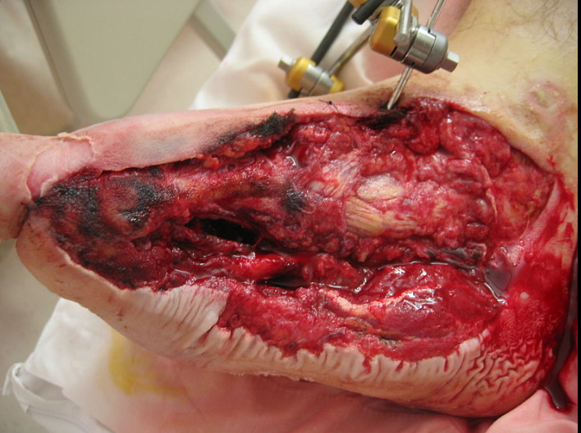
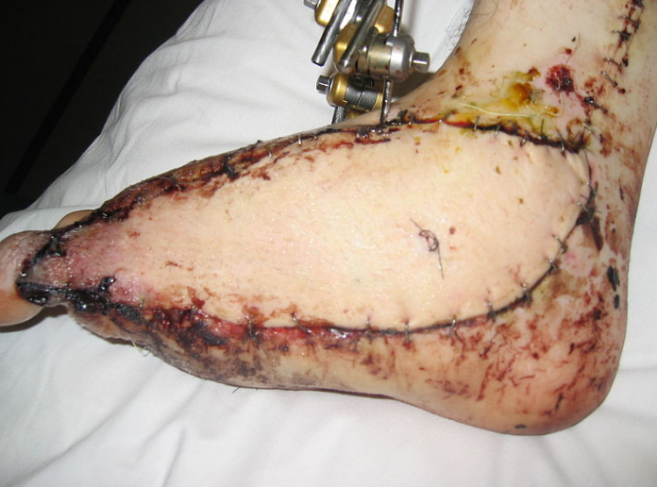
Plastic Surgery

Slide 32
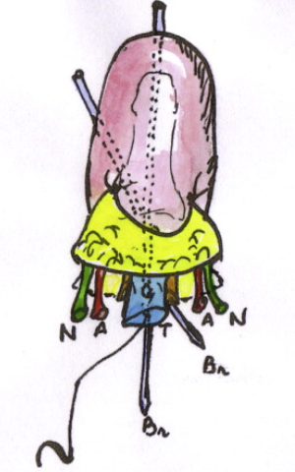
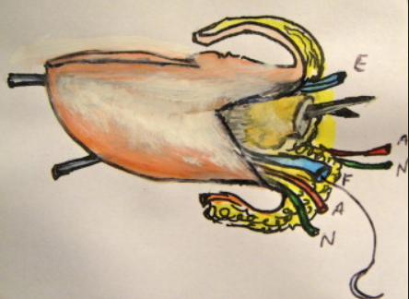
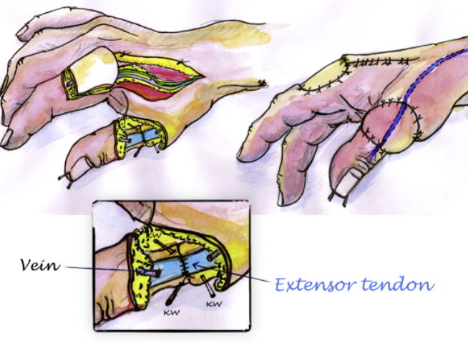
Plastic Surgery
Replantation
Replantation is the reattachment of a completely detached body part. Fingers and thumbs are the most common but the ear, scalp, nose, face, arm and penis have all been replanted. Generally replantation involves restoring blood flow through arteries and veins, restoring the bony skeleton and connecting tendons and nerves as required.

Slide 33
Plastic Surgery
Craniofacial surgery
Craniofacial surgery is divided into pediatric and adult craniofacial surgery. Pediatric craniofacial surgery mostly revolves around the treatment of congenital anomalies of the craniofacial skeleton and soft tissues, such as cleft lip and palate, craniosynostosis, and pediatric fractures. Adult craniofacial surgery deals mostly with fractures and secondary surgeries (such as orbital reconstruction) along with orthognathic surgery. Craniofacial surgery is an important part of all plastic surgery training programs, further training and subspecialisation is obtained via a craniofacial fellowship. Craniofacial surgery is also practiced by Maxillo-Facial surgeons.

Slide 34
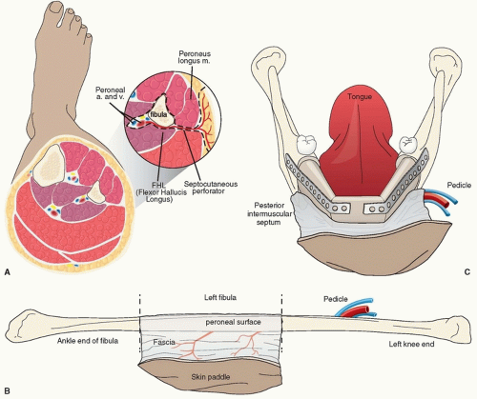
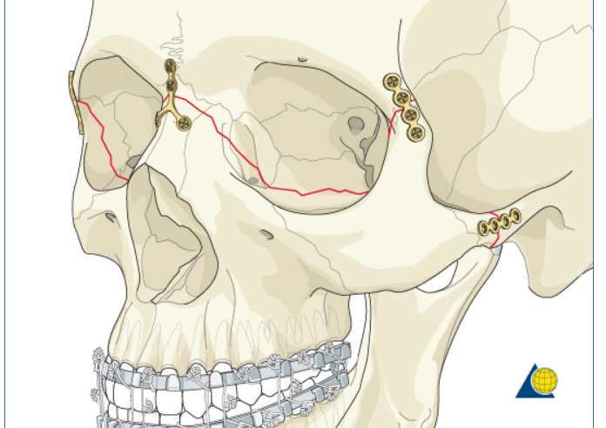
Plastic Surgery

Slide 35
Plastic Surgery
Burn surgery
A burn is a type of injuryy to skin, or other tissues, caused by heat, cold, electricity, chemicals, friction, or radiation. Most burns are due to heat from hot liquids, solids, or fire

Slide 36
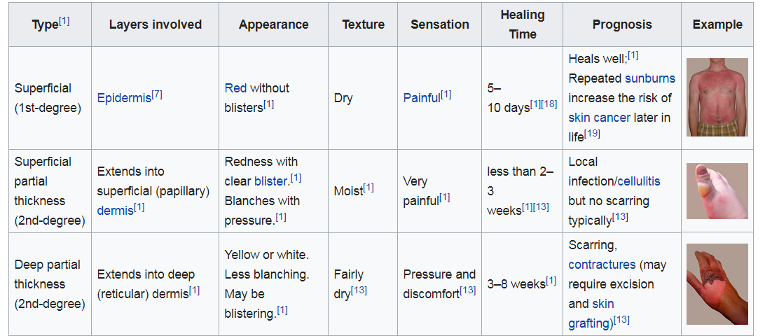
Plastic Surgery

Slide 37
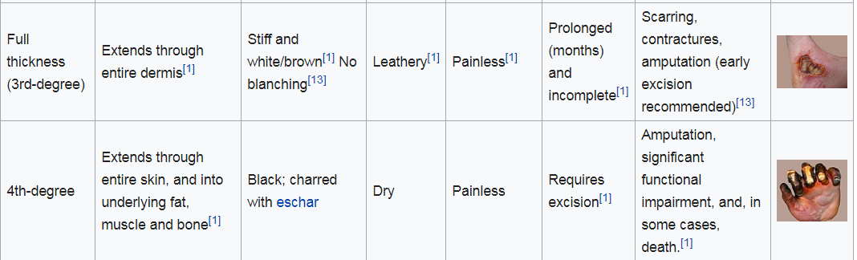
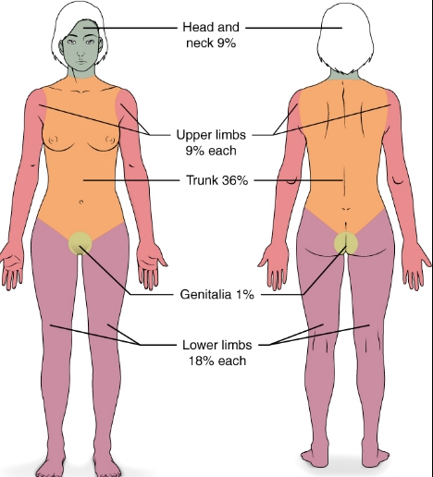
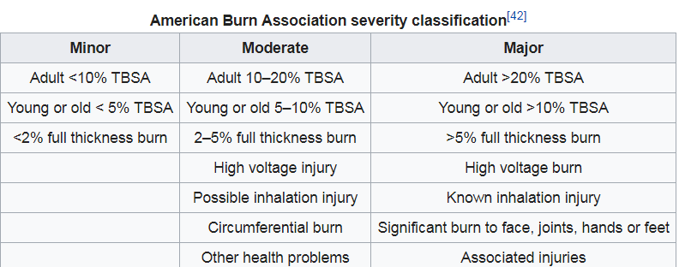
Plastic Surgery

Slide 38
Plastic Surgery
Treatment
Resuscitation begins with the assessment and stabilization of the person's airway, breathing and circulation.
If inhalation injury is suspected, early intubationn may be required.[
This is followed by care of the burn wound itself.
People with extensive burns may be wrapped in clean sheets until they arrive at a hospital.[
As burn wounds are prone to infection, a tetanus booster shot should be given
Intravenous fluid
Wound care (cooling, cleaning,removal of dead tissues, dressing, NPWT)
Medications (pain management, benzodiazepins, antibiotics)
Surgery

Slide 39
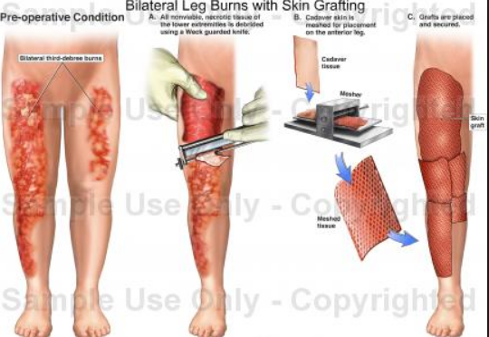
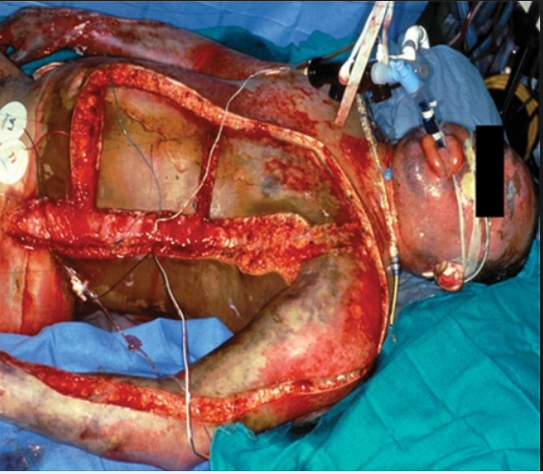

Plastic surgery
Surgery
Escharotomy, fasciotomy, skin grafting

Slide 40
Plastic Surgery
Hand surgery is concerned with acute injuries and chronic diseases of the hand and wrist, correction of congenital malformations of the upper extremities, and peripheral nerve problems (such as brachial plexus injuries or carpal tunnel syndrome). Hand surgery is an important part of training in plastic surgery, as well as microsurgery, which is necessary to replant an amputated extremity. The hand surgery field is also practiced by orthopedic surgeons and general surgeons.

