Slide 1

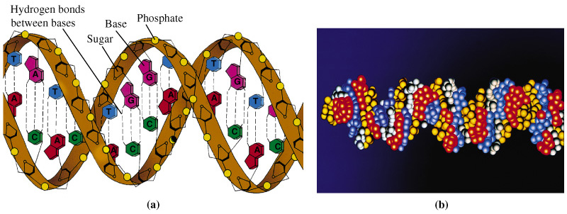
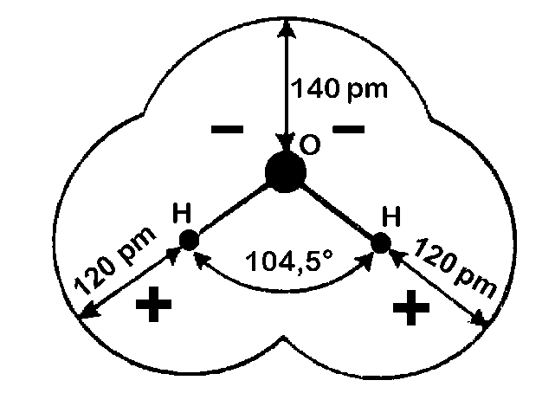
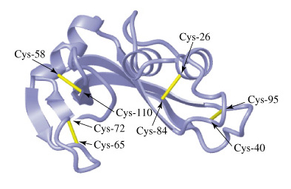
Lectures on Medical Biophysics
Department of Biophysics, Medical Faculty,
Masaryk University in Brno
Structure of living matter

Slide 2
Lecture outline
Water
Properties of colloids
Structure of proteins
Structure of nucleic acids
This lecture deals only with selected components of living matter with distinct biophysical properties. Importance of some other components, e.g. electrolytes will be shown in the lecture on bioelectric phenomena. Check on further information in textbooks of biology and biochemistry.

Slide 3

Water
Molecules of water are strongly polar. Moreover, between the oxygen and hydrogen atoms of neighbouring molecules, hydrogen bonds are formed. They join water molecules in aggregates – clusters.

Slide 4
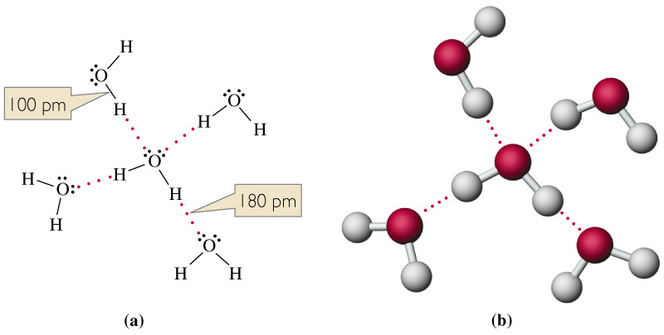
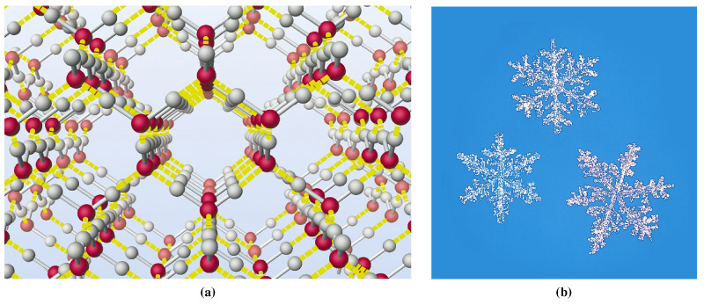
Hydrogen bonds between water molecules
Liquid water
Ice
Pictures: http://cwx.prenhall.com/bookbind/pubbooks/hillchem3/medialib/media_portfolio/11.html

Slide 5
Colloids
Colloids – also known as non-true solutions – the solution consists of solute particles of diameter about 10 – 1000 nm dispersed in the solvent.
We can distinguish two types of colloids according to the type of binding forces:
Micellar colloids (also associative, small particles are bound together by van der Waals bonds)
Molecular colloids (particles are macromolecules which subunits are bound together by covalent bonds)

Slide 6
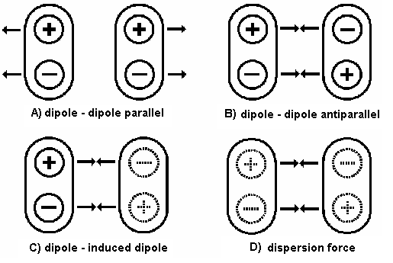
Weak chemical bonds
Hydrogen bonds
Hydrophobic interaction
van der Waals bonds
Also London forces, sometimes not classified as van der Waals bonds

Slide 7
Properties of colloids
Mechanical: rigidity, elasticity, viscosity – caused by covalent and weak chemical bonds
These properties depend on the form of colloid:
sol (liquid) or gel (solid). Gel formation = gelatinisation
Optical:
  Light scatter: Tyndall effect (opalescence). Light can be scattered off the colloid particles. Track of a light beam passing through a colloid is made visible by the light scattered by the colloidal particles.
  Optical activity: Colloidal particles can rotate the plane of polarization of plane-polarised light passing through the colloid
Electrical: see lecture on instrumental methods in molecular biophysics

Slide 8
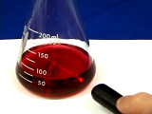
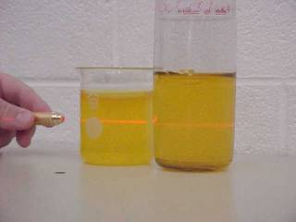
Tyndall effect in micellar and molecular colloids
- In solution of colloidal gold
http://mrsec.wisc.edu/edetc/cineplex/gold/
- In solution of gelatin (a protein)
http://link.springer-ny.com/link/service/journals/00897/papers/0006002/620095mb.htm

Slide 9
Types of Colloids - Biopolymers
According to the affinity of the biopolymer to solvent (water)
  Lyophilic (hydrophilic) - form stable solutions
  Lyophobic (hydrophobic) - form unstable solutions
According to the shape of the biopolymer (the shape is also influenced by the solvent!)
  Linear (fibrillar – DNA, myosin, synthetic polymers…..also scleroproteins, mostly insoluble in pure water)
  Spherical (globular – haemoglobin, glycogen … also spheroproteins, mostly soluble in pure water)

Slide 10
Chemical composition of proteins
According to the products of hydrolysis:
simple (only amino acids in hydrolysate)
conjugated (not only amino acids in hydrolysate)
Nucleoproteins
Haemoproteins
Flavoproteins
Metalloproteins
Lipoproteins
…..
(see Biochemistry)

Slide 11
Structure of proteins
Structural units of proteins are amino acids (AA), connected by peptide bond:
-RCH-NH-CO-RCH-,
which can hydrolyse:
-RCH-NH-CO-RCH- + H₂O ←⎯→ -RCH-NH₂ + -RCH-COOH
The carboxylic and amino groups can dissociate or protonise. E.g. the glutamic and asparagic acids have one free carboxylic group:
-COOH ←⎯→ -COO⁻ + H⁺
AA lysine and arginine have one free amino group, which can protonise:
-NH₂ + H⁺ ←⎯→ -NH₃⁺
In proteins, 20 different AA can be found which can be divided into AA with polar and non-polar side chain.
AA with aromatic ring or heterocycle (phenylalanine, tyrosine, tryptophan) strongly absorb UV light around 280 nm.
AA cysteine contains sulphhydryl (thiol) group (-SH), which is oxidised by dehydrogenation and connected with dehydrogenated group of another cysteine residue by covalent disulphidic bridge (bond -S-S-).

Slide 12
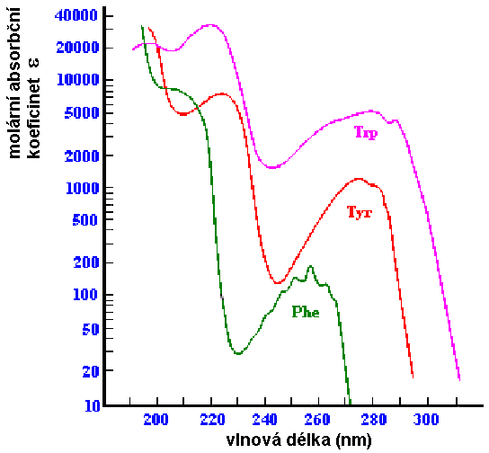
Structure of proteins
Molar absorption coefficient ε
Disulphidic bridges stabilise the protein structure (bovine ribonuclease A)
http://cwx.prenhall.com/horton/medialib/media_portfolio/text_images/FG04_28a-b.JPG
Wavelength (nm)
Absorption spectrum of free phenylalanine, tyrosine and tryptophan in UV range
According:http://www.fst.rdg.ac.uk/courses/fs460/lecture6/lecture6.htm

Slide 13
Structure of proteins
Primary (sequence of covalently bound AA residues)
Secondary (mutual spatial arrangement of neighbouring links of the polypeptide chain – given mainly by hydrogen bonds)
α-helix
β-structure (pleated sheet)
other
Tertiary (spatial arrangement of the polypeptide chain as a whole – given by hydrophobic and hydrogen bonds, stabilised by -S-S- bridges)
Quaternary (a way of non-covalent association of individual polypeptide chains (subunits) in whole of higher order)
  Homogeneous – all subunits are identical
  Heterogeneous – subunits of two or more kinds

Slide 14
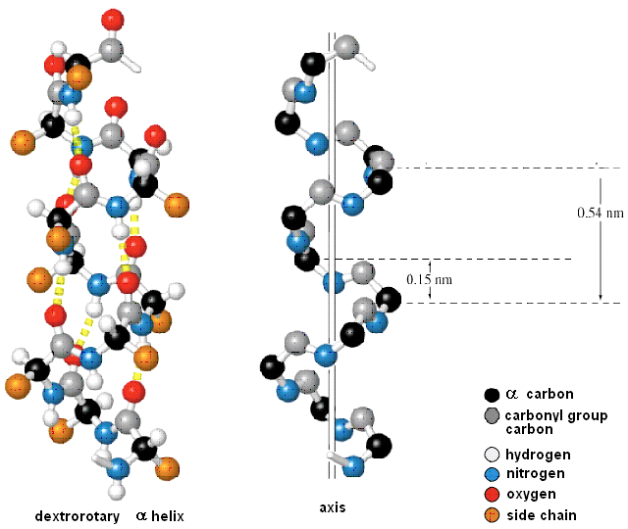
Rise per residue
Podle: http://cwx.prenhall.com/horton/medialib/media_portfolio/text_images/FG04_10.JPG

Slide 15
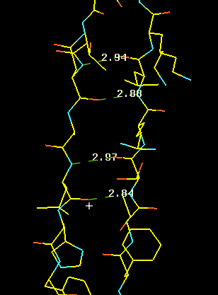
β-structure (pleated sheet – antiparallel model) http://www-structure.llnl.gov/Xray/tutorial/protein_structure.htm

Slide 16
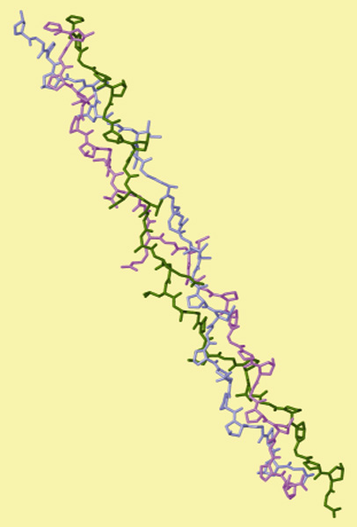
Triple helix of collagen http://cwx.prenhall.com/horton/medialib/media_portfolio/text_images/FG04_34.JPG

Slide 17
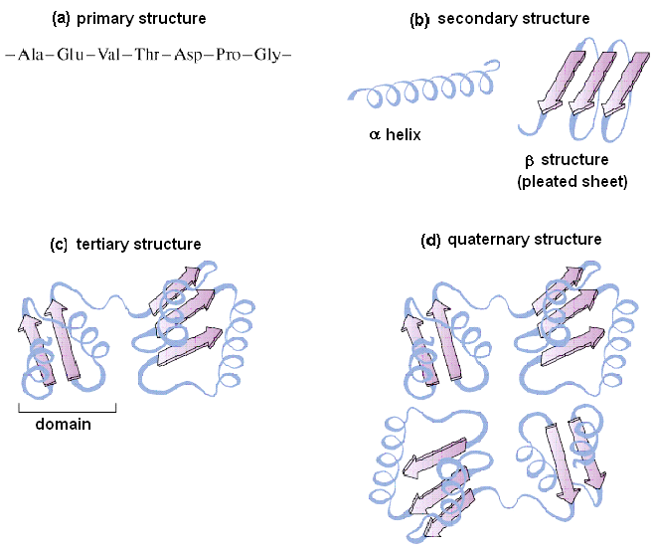
Podle: http://cwx.prenhall.com/horton/medialib/media_portfolio/text_images/FG04_01.JPG

Slide 18
Structure of nucleic acids (NA)
Mononucleotide (the structural subunit of NA) is formed by:
Pyrimidine (C, U, T) or purine (A, G) nitrogen base
Sugar (ribose or deoxyribose)
Phosphoric acid residue
DNA: up to hundreds thousands of subunits. M.w. 10⁷ – 10¹². Two chains (strands) form antiparallel double helix.
RNA:
m-RNA (mediator, messenger)
t-RNA (transfer)
r-RNA (ribosomal)
(viral RNA, microRNA …… ?)

Slide 19
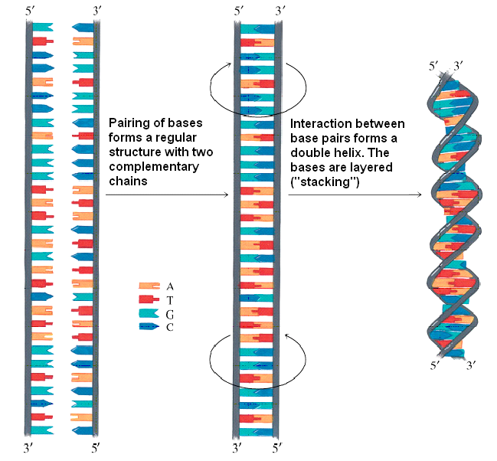
http://cwx.prenhall.com/horton/medialib/media_portfolio/text_images/FG19_13_90035.JPG

Slide 20
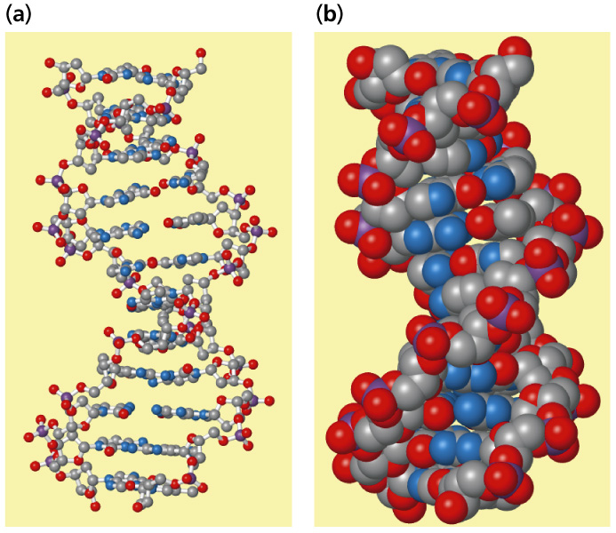
B-DNA http://cwx.prenhall.com/horton/medialib/media_portfolio/text_images/FG19_15aC.JPG

Slide 21
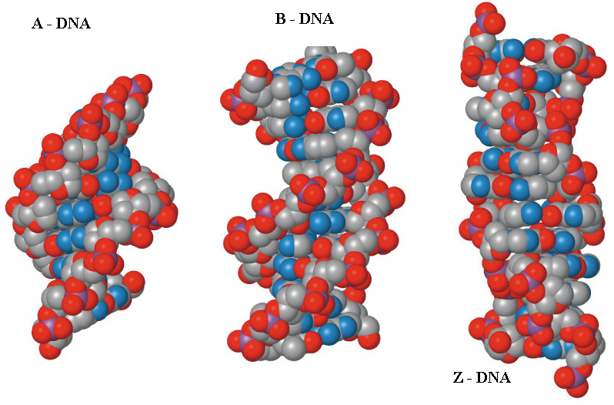
A-DNA – dehydrated, B-DNA – commonly present under physiological conditions, Z-DNA – in sequences rich on CG pairs

Slide 22
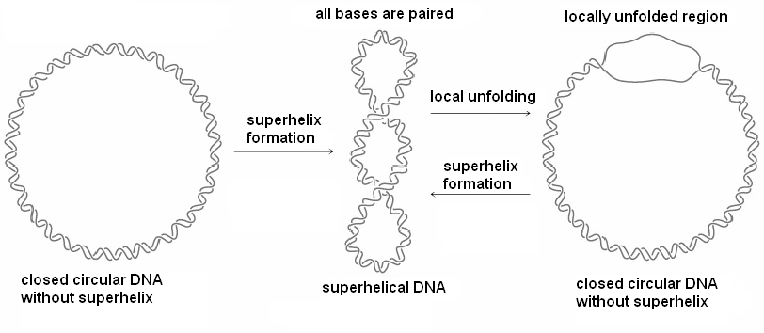
Superhelical structure of circular DNA
Podle http://cwx.prenhall.com/horton/medialib/media_portfolio/text_images/FG19_191C.JPG

Slide 23
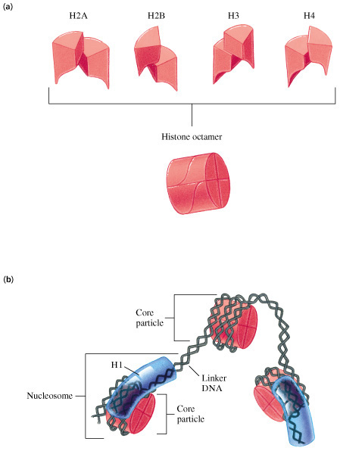
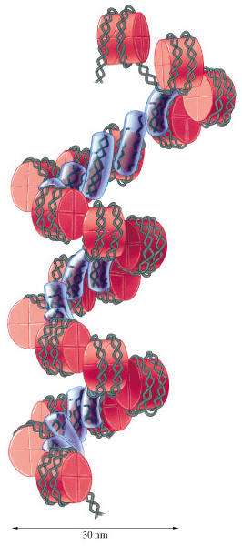
Structure of chromatin http://cwx.prenhall.com/horton/medialib/media_portfolio/text_images/FG19_23_00742.JPG, http://cwx.prenhall.com/horton/medialib/media_portfolio/text_images/FG19_25_00744.JPG

Slide 24
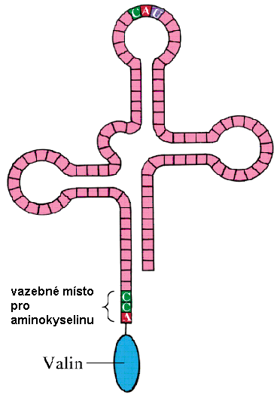
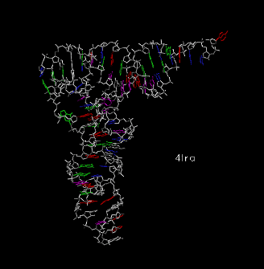
Transfer RNA for valine – schematic
t-RNA from yeasts ↓
http://cwx.prenhall.com/bookbind/pubbooks/hillchem3/medialib/media_portfolio/text_images/CH23/FG23_14.JPG, http://www.imb-jena.de/cgi-bin/ImgLib.pl?CODE=4tra
„Clover leaf structure“
Amino acid binding site
Valine

Slide 25
Ribosomal RNA
Next picture was published in: Science 11 February 2011: Vol. 331 no. 6018 pp. 730-736 in the article: Crystal Structure of the Eukaryotic 40S Ribosomal Subunit in Complex with Initiation Factor 1 (Julius Rabl, Marc Leibundgut, Sandro F. Ataide, Andrea Haag, Nenad Ban)
Description:
Architecture of the 40S. (A) Front and back views of the tertiary structure of the 40S showing the 18S rRNA as spheres and colored according to each domain (5′ domain, red; central domain, green; 3′ major domain, yellow; 3′ minor domain, blue; ESs, magenta), and the proteins as gray cartoons (abbreviations: H, head; Be, beak; N, neck; P, platform; Sh, shoulder; Bo, body; RF, right foot; LF, left foot). (B) Secondary structure diagram of the Tetrahymena thermophila (a protist)18S RNA …showing the rRNA domains and the locations of the ESs. (C) Ribosomal proteins of the 40S are shown as cartoons in individual colors; rRNA is shown as gray surface. The 40S is shown as in (A). (D) View of the quaternary interactions between ES6 and ES3 at the back of the 40S. The RNA is displayed as a cartoon with the proteins omitted for clarity. ES6 helices are colored in a gradient from light to dark magenta and labeled from A to E... ES3 is highlighted in pink, and the rest of the 18S rRNA is colored in gray. (E) The position of helix h16 in bacterial 30S [left…] and in 40S.

Slide 26
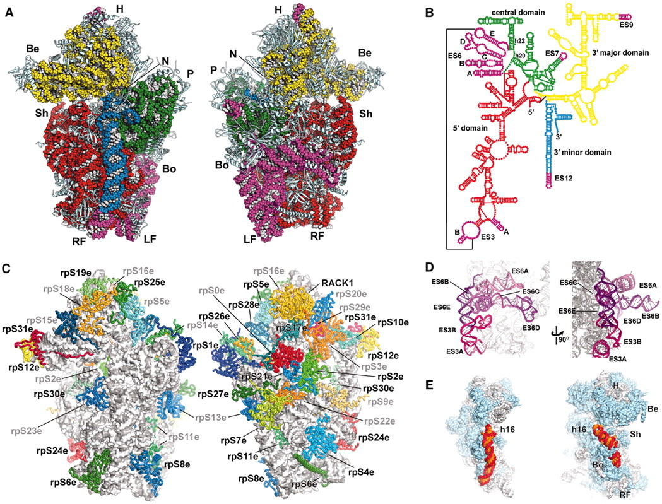

Slide 27
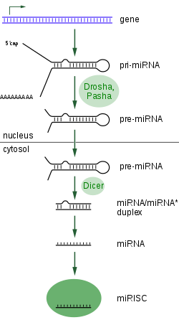
MicroRNA (source: Wikipedia)
MicroRNA or miRNA are single strand non-coding RNAs with a typical length of 21-23 nucleotides which take a part in regulation of gene expression. miRNAs are produced by transcription from DNA genes but they are not translated into proteins.
After modification by nucleases called „Drosha“ and „Pasha“ the pre-miRNA enters the cytoplasm where can interact with the endonuclease called „Dicer“ forming miRNA. It is bound into the RISC complex (RISC = RNA-induced silencing complex). Just the RISC is able to silence the gene expression, which is known as RNA interference.

Slide 28
Conformation changes and denaturation of biopolymers
Changes in secondary, tertiary and quaternary structure of biopolymers are denoted as conformation changes.
They can be both reversible and irreversible.
‘native’ state of a biopolymer: its functional state. Otherwise the biopolymer has been ‘denatured’.

Slide 29
Denaturation factors
Physical:
  Increased temperature
  Ionising radiation
  Ultrasound
  …..
Chemical:
  Changes of pH
  Changes in electrolyte concentration
  Heavy metals
  Denaturation agents destroying hydrogen bonds – urea
  …..
Combination of above factors: ionising radiation or ultrasound act directly and/or indirectly (chemically via free radicals)

Slide 30
Author:
Vojtěch Mornstein
Content collaboration and language revision:
Carmel J. Caruana, Viktor Brabec
Presentation design:
Lucie Mornsteinová
Last revision and soundtrack added: September 2020

