Slide 1


Magnetic therapy II
Topic 2

Slide 2

Content
Repetitorium
Applicators
Pulsed low-frequency magnetic therapy
Indications and contraindications
Side effects
Safety recommendations
Instructions to patient
Examples of practise
Combination of pulse low-frequency magnetic therapy with another kind of physical therapy

Slide 3

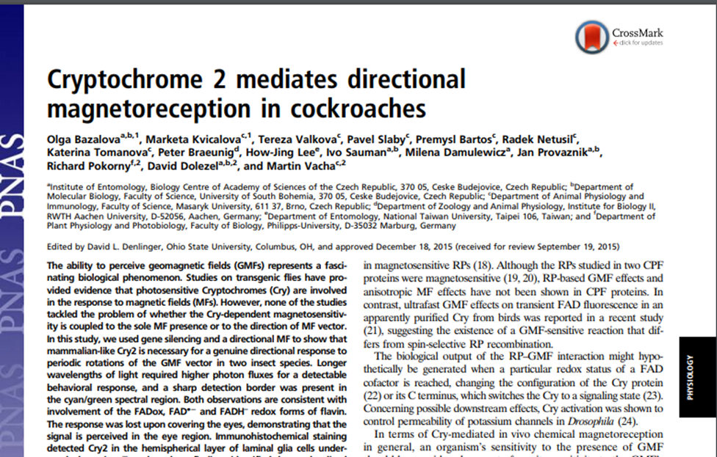
Introduction to the magnetic field
the Earth's magnetic field is known over 6 thousand years
magnetic field is used to orientation by animals – birds, fish, insect
Discoveries of electric energy brings knowledge of magnetic field
(18. century)
Oersted – electric current swings compas shooter
Ampére – experiments with hollow cylinder = solenoid – generate induced current
Faraday – discovered electromagnetic induction
F.A.Mesmer (1774) – favorable effect on joint diseases

Slide 4

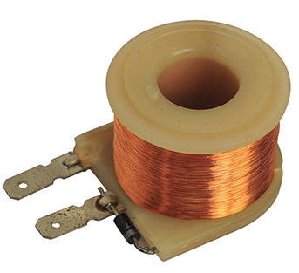
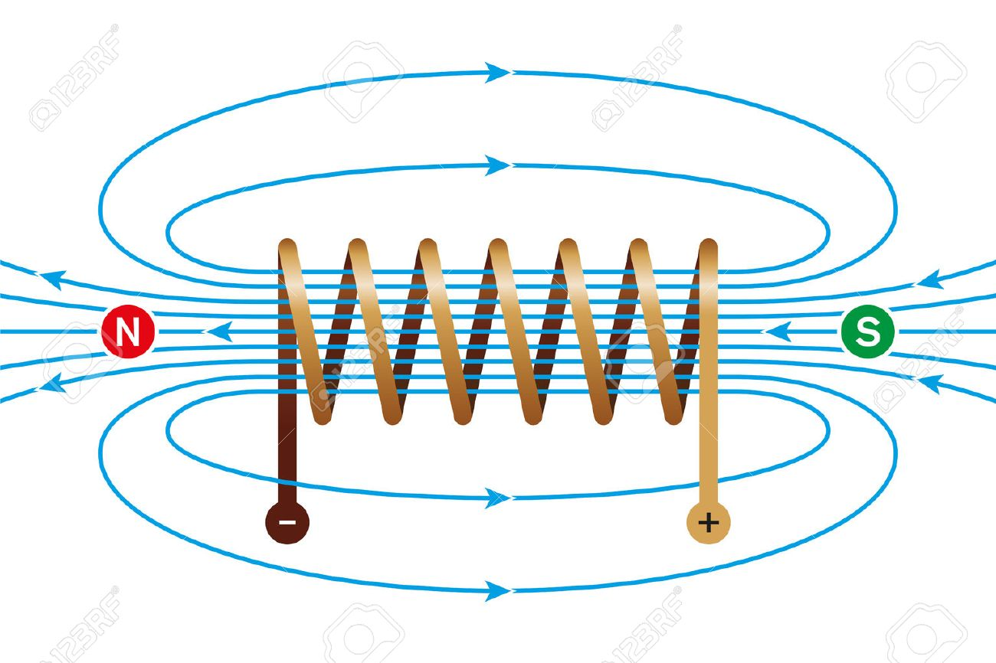
Magnetic field – basics concepts
Theory of electromagnetic field – movement of electrical charge generate induced magnetic field
Magnetic field is generated around each conductor through which the electric current flows
Physical properties depend on this electrical current
This phenomenon is called electromagnetic induction
Induction of magnetic field of the earth – approximately 10⁻⁵ T (Tesla)
https://www.google.com/url?sa=i&url=https%3A%2F%2Fdir.indiamart.com%2Fimpcat%2Felectromagnetic-coil.html&psig=AOvVaw24DdLE5E03b_hgFv3nA7Xx&ust=1602535947143000&source=images&cd=vfe&ved=0CAIQjRxqFwoTCKju5-G1rewCFQAAAAAdAAAAABAN
https://www.google.com/url?sa=i&url=https%3A%2F%2Fwww.123rf.com%2Fphoto_64054956_stock-vector-magnetic-field-of-a-current-carrying-coil-electromagnetic-coil-conductor-made-of-a-copper-wire-spira.html&psig=AOvVaw24DdLE5E03b_hgFv3nA7Xx&ust=1602535947143000&source=images&cd=vfe&ved=0CAIQjRxqFwoTCKju5-G1rewCFQAAAAAdAAAAABAI

Slide 5

Magnetic field – physical characteristics
Intensity and induction of the magnetic field - vector variables
intensity of the magnetic field – H = $\frac{I}{r}$; I – electric current; r - distance from the conductor; unit – A/m
induction of magnetic field – B – is determinated by the force applied by the magnetic field on the conductor ; unit – 1T (tesla) – in practise – mT (militesla)
Frequency – determinated by changing electric current puls magnetic field in applicator; in practice is used frequency modulation!
magnetic gradient - spatial gradient of the magnetic field; the difference of magnetic induction between two locations in magnetic field; unit – mT/cm; gradient over 0,5 mT/cm is highly risky
Diffrent magnetic fields´ characteristics for diffrent applicators

Slide 6
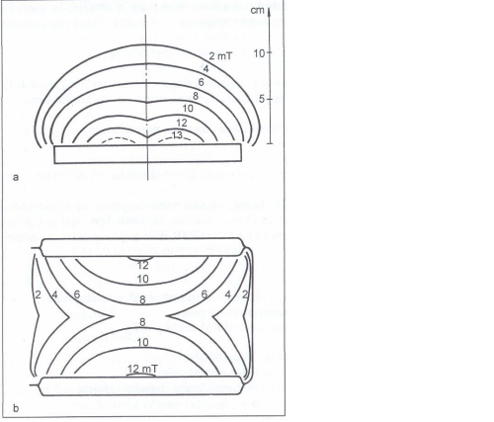
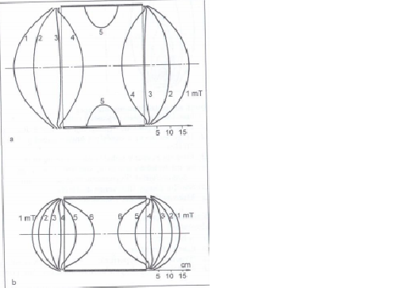
The magnetic gradient is determined by the density of the magnetic induction´s isolines of each applicator

Slide 7
Types of magnetic fields
According current and its changes over time:
  Static field - unchanging intensity and direction of the field over time, this kind of field is generated around permanent magnets and around conducts flown by direct current
  Alternating field (dynamic) – alternating of polarity, values of intensity is changing regularly from 0 to positive maximum and through 0 to negativ maximum and back to 0; this kind of field is generated around conducts flown by alternating current
  Pulse field (dynamic) – jump changes values of intensity; this kind of field is generated around conducts flown by electrical impulses;
  According frequency:
  Low-frequency magnetic field
  High-frequency magnetic field
According distribution of the magnetic field in surroundings
  homogeneous field – has the same size and direction at all points
  inhomogeneous field – has different size and direction in the considered space

Slide 8
General physiological effects
Vasodilatation – area of precapillary sphincter by mechanism of eflux of Ca²⁺
Analgetic effect – increase secretion of endorphin and/or reinforcement binding to specific receptors
Dispersing effect – making the background for following effects by changing rheological properties of tissues and hydration of hyaluronic acid
Myorelaxation (for hypertonic muscles or fibres) and myotonic effect (for hypotonic muscles or fibres) – enhancing perfusion of tissues and changing activity of lactate dehydrogenese
Antiedematous effect – especially in chronic post-traumatic condition; effect by changing ratio of cAMP/cGMP and improving perfusion
Accelerated healing – especially bone trauma by increasing activation of bone specific cells (osteoklast and osteoblast)
Trophotropic effect – effect by vasodilatation of capillary bed; direct effect on cells and theirs organelles (membranes – influencing influx/eflux of ionts, proteins, medicaments), increasing metabolism of tissues in exposed part

Slide 9
Problems of biological effects of the magnetic field
Lack of evidence-based medicine information about effect
Empirical evidence
Magnetic therapy is usually long term, some symptoms of other disease may arise during therapy
The effect can only appear after repeated application
Magnetic field can damage electronic machines like watch, computer, phone, creditcards, flashdisk and other storage media
Combination with other physical therapy modality can be inappropriate or even harmful (dose potentiation)
side effects – during aplication, after aplication;

Slide 10
Applicators
specific magnetic gradient and effect – diffrent applicator
The magnetic gradient is determined by the density of the magnetic induction´s isolines of each applicator
Using multiple applicators at the same time, the effect does not increase
Types of applicators:
  Flat magnetic therapy applicators
  Solenoid-type magnetic therapy applicators
  ring magnetic therapy applicators
  Other types of applicators – depends on the manufacturer

Slide 11
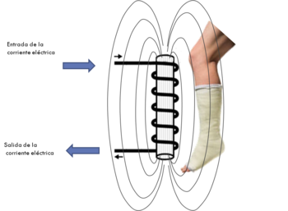
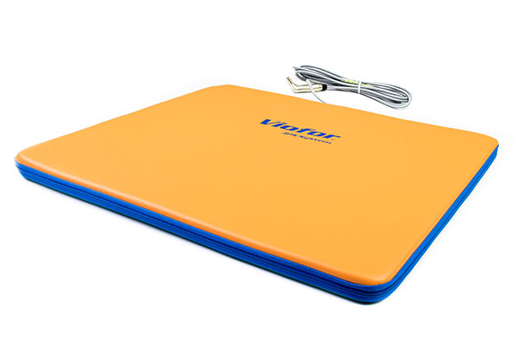
Flat magnetic therapy applicators
various shapes of flat applicators
  square or rectangular
  „double blanket“
  „triple blanket“
to local applications
all-segment applications – spine, upper limps
older types - forbidden to lie on the applicator
newer types - allowed to lie on the applicator
double sides:
  north side (+) – analgetic and inhibition effect
  South side (-) – stimulating and facilitating effect

Slide 12
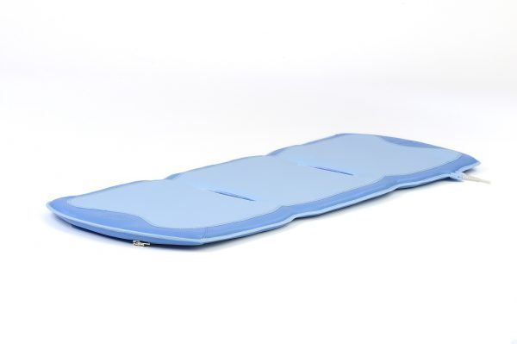
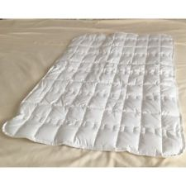
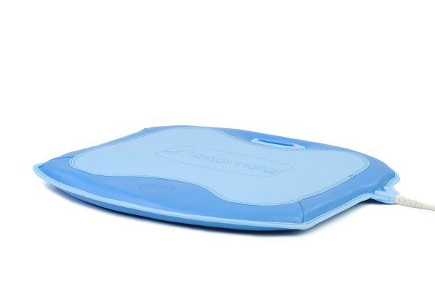
Flat magnetic therapy applicators

Slide 13
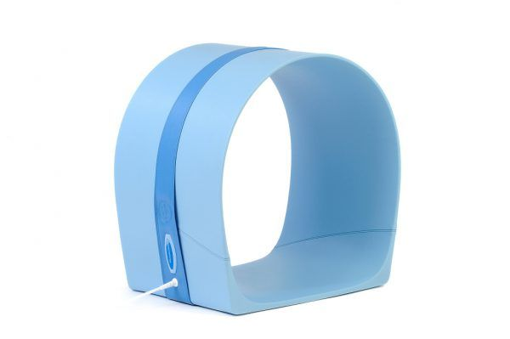
Solenoid-type magnetic therapy applicators
Diameter of 50 to 60 cm – for spine, hip joints, pelvis, sometimes shoulders with C/Th region of the spine
Diameter of 30 cm – thighs, knees
Diameter of 20 cm – knees, lower legs, ankels, feet, elbows, forearms, hands

Slide 14
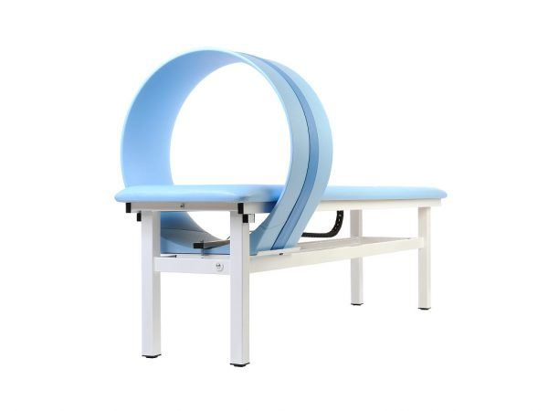
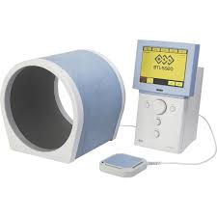
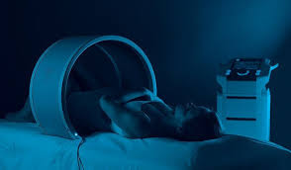
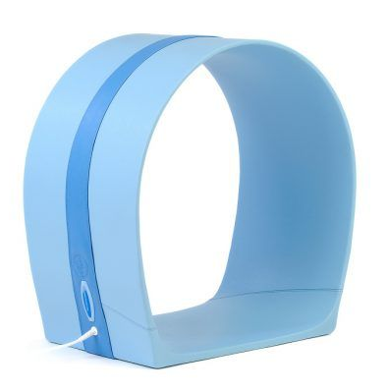
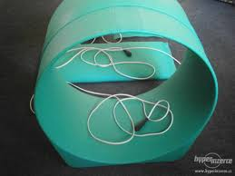
Solenoid-type magnetic therapy applicators

Slide 15
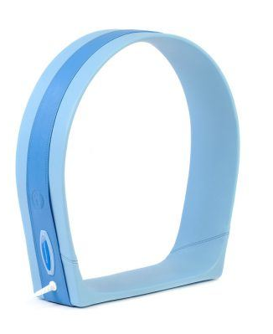
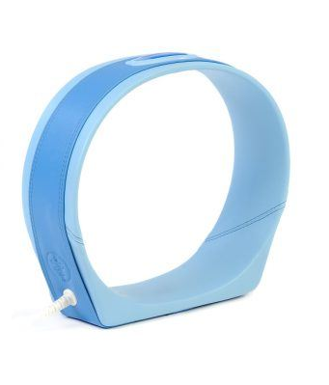
Ring magnetic therapy applicators
Diameter of 40 cm – area of C/Th spine, shoulder, spine segment
Diameter of 30 cm – narrow area on limbs (knee joint gap, lower part of cervical spine)

Slide 16
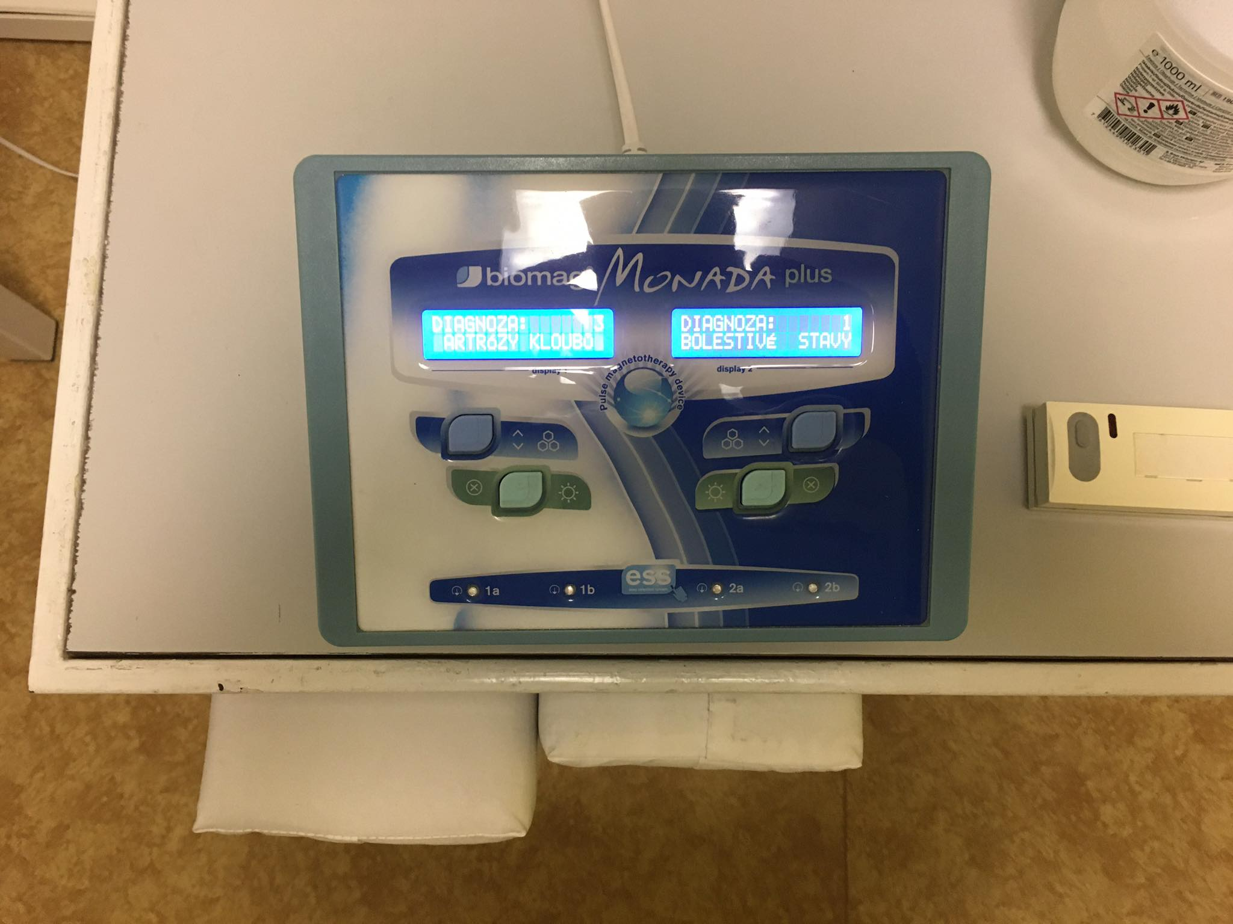
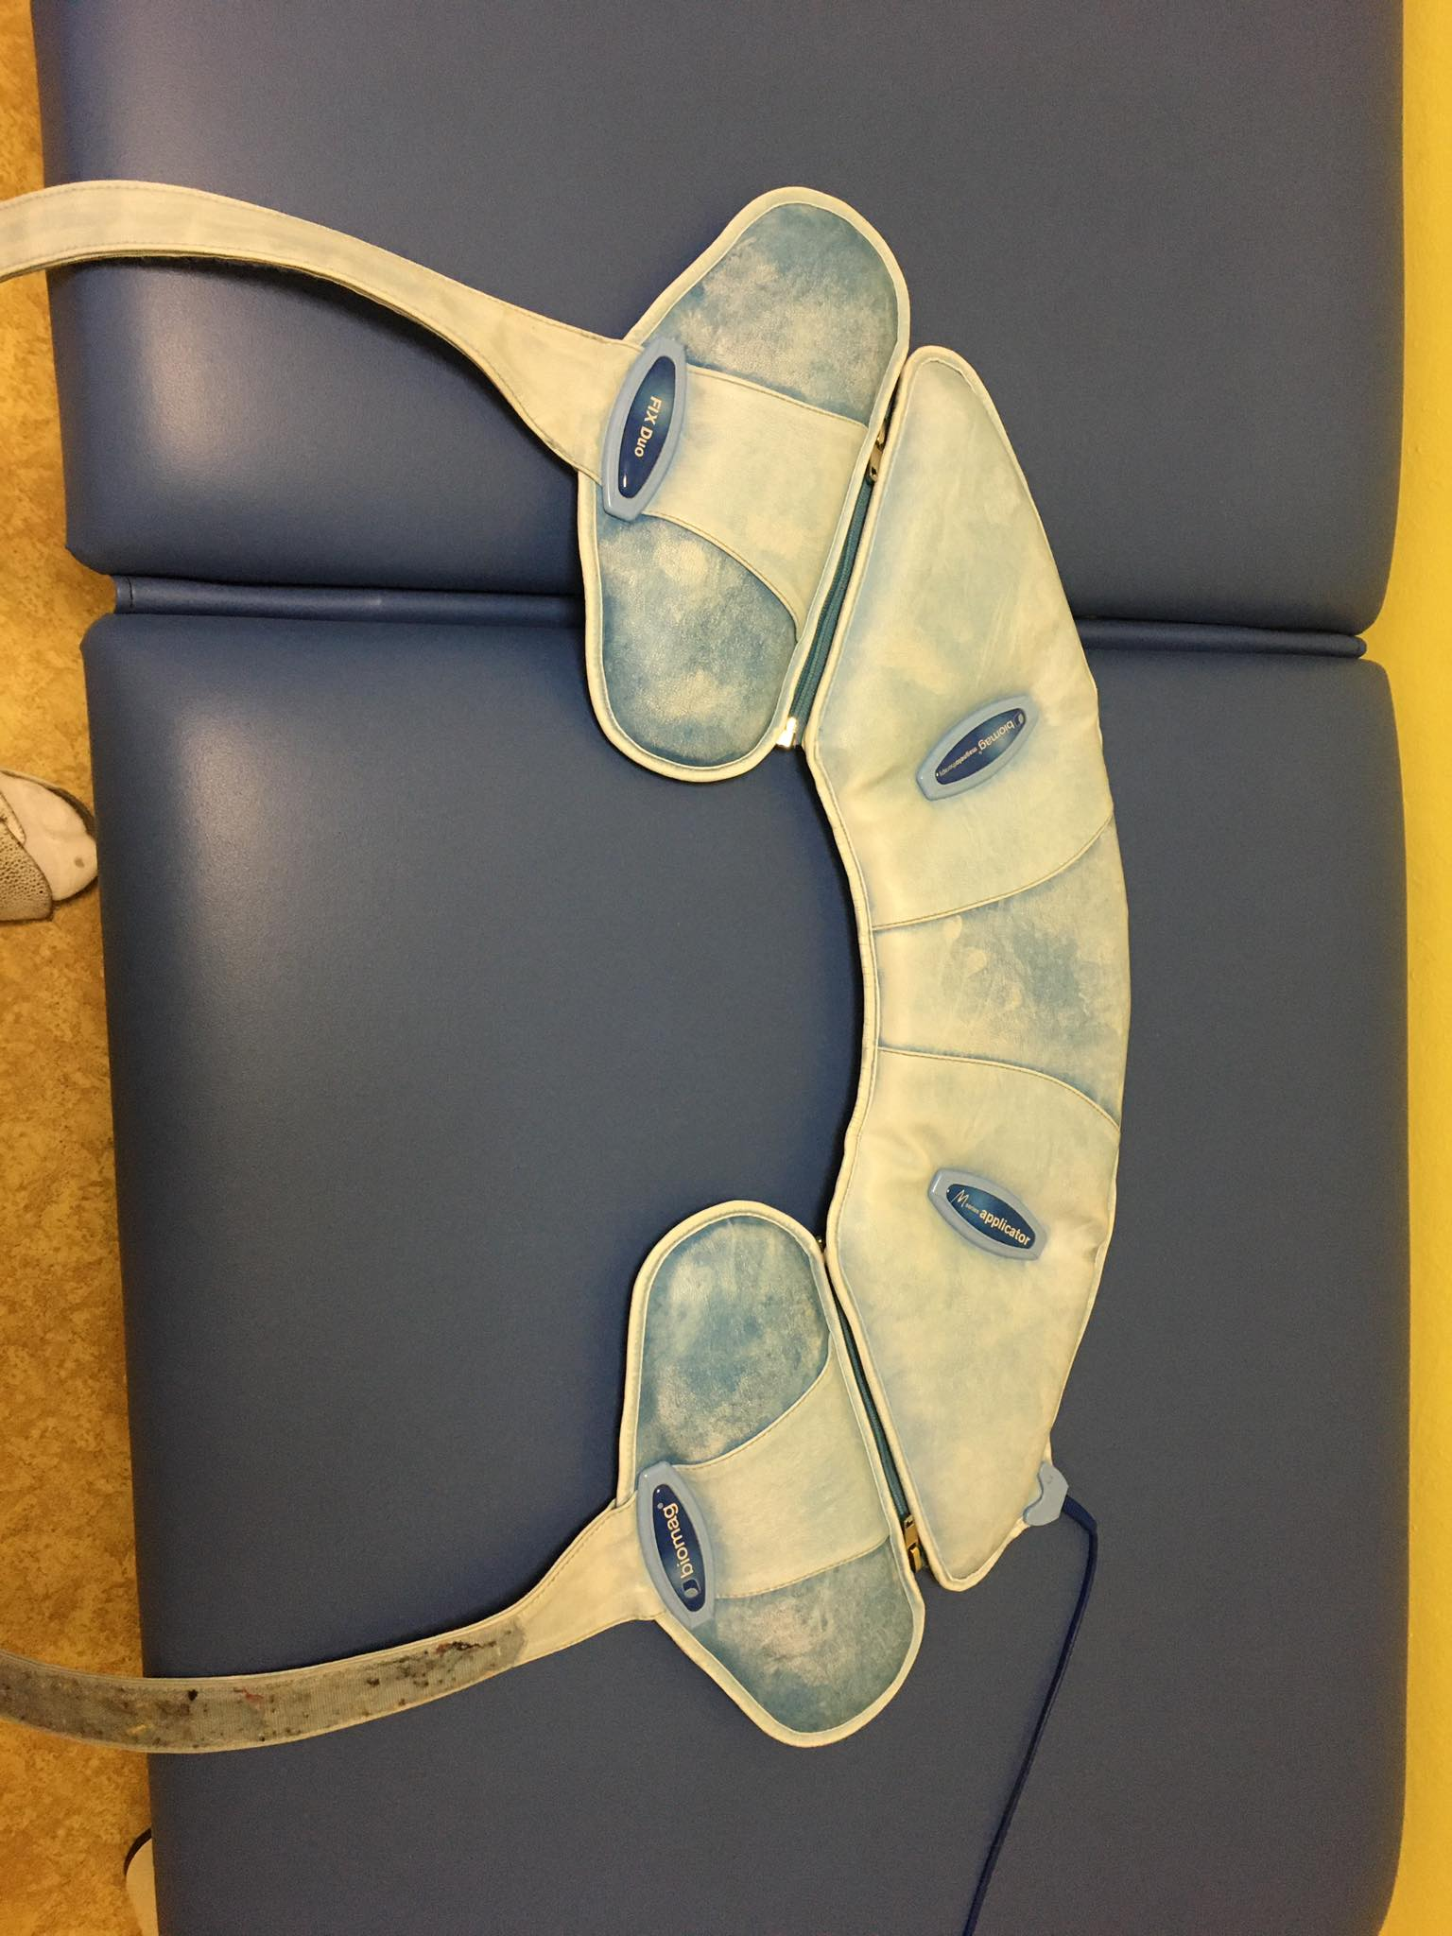
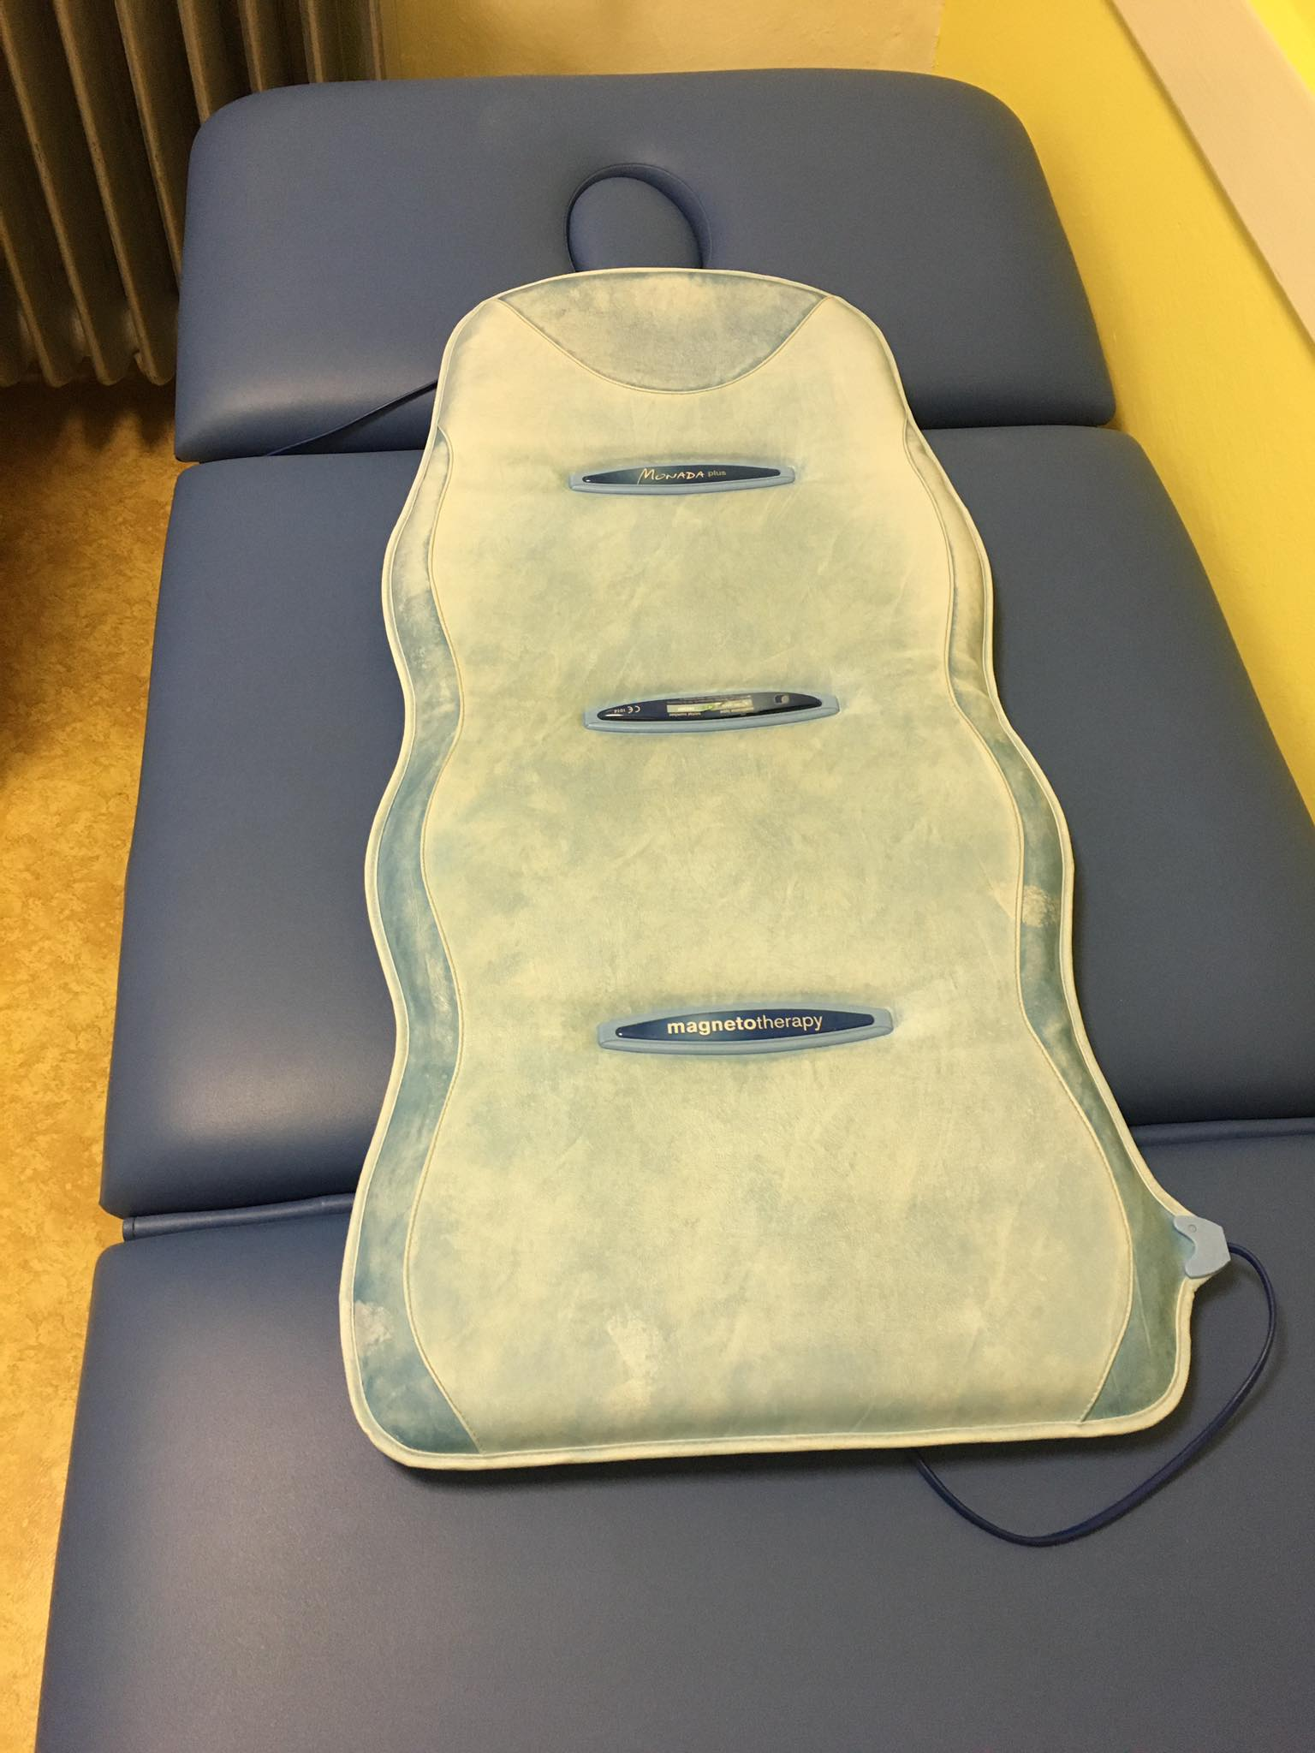
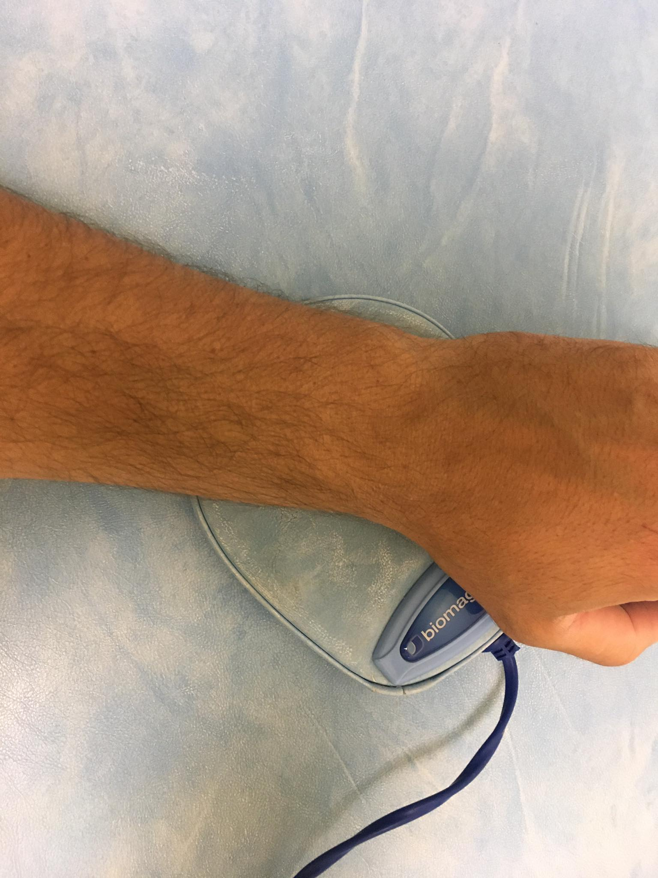
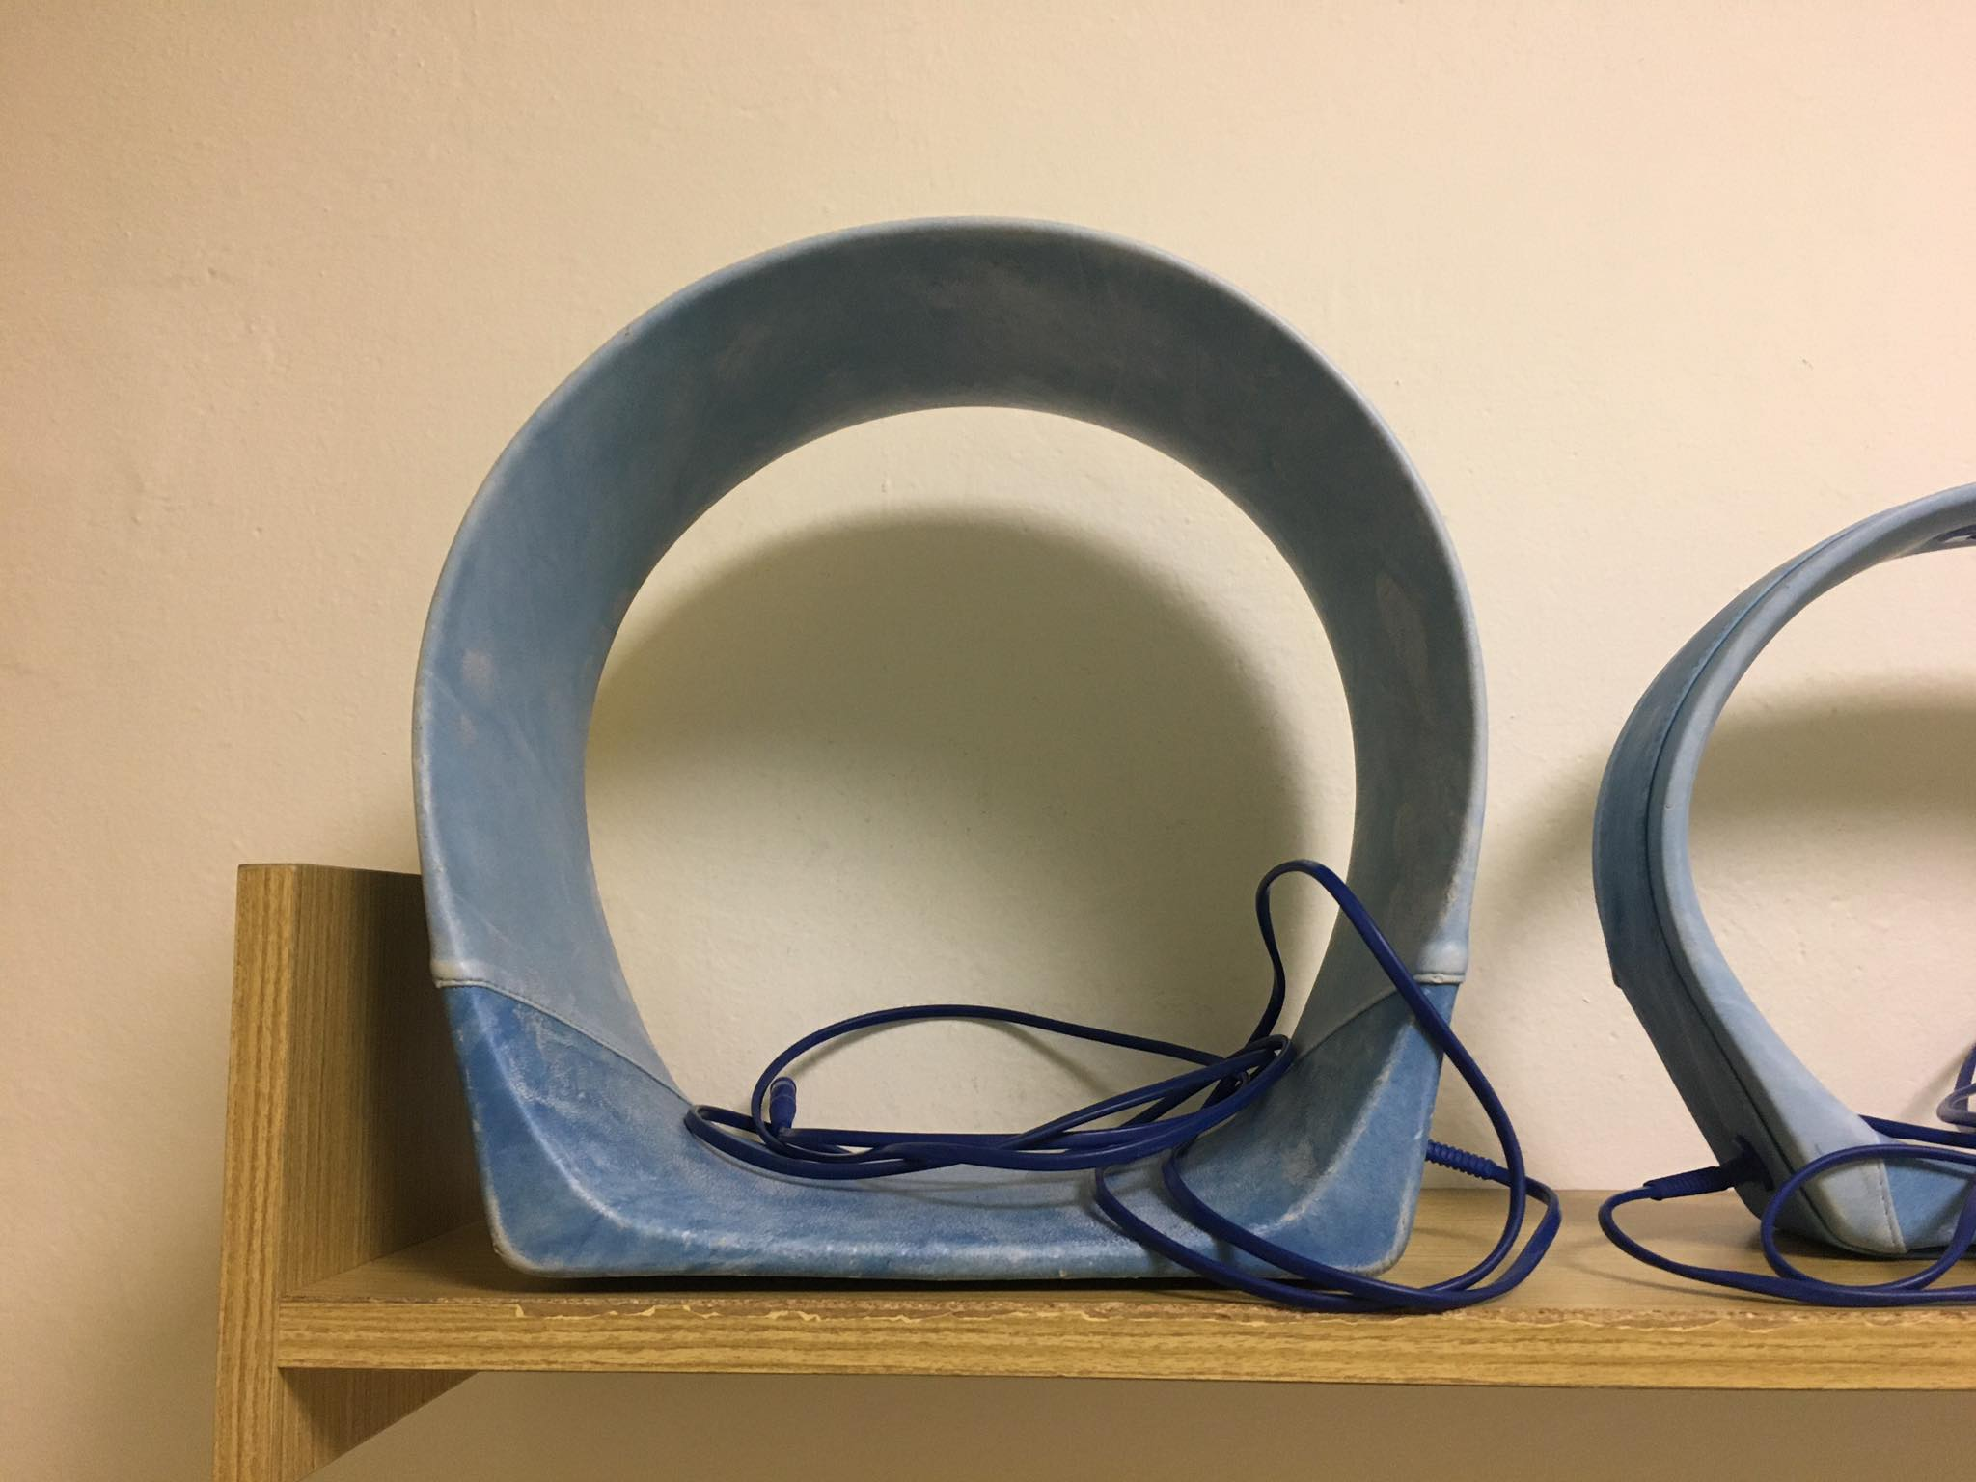
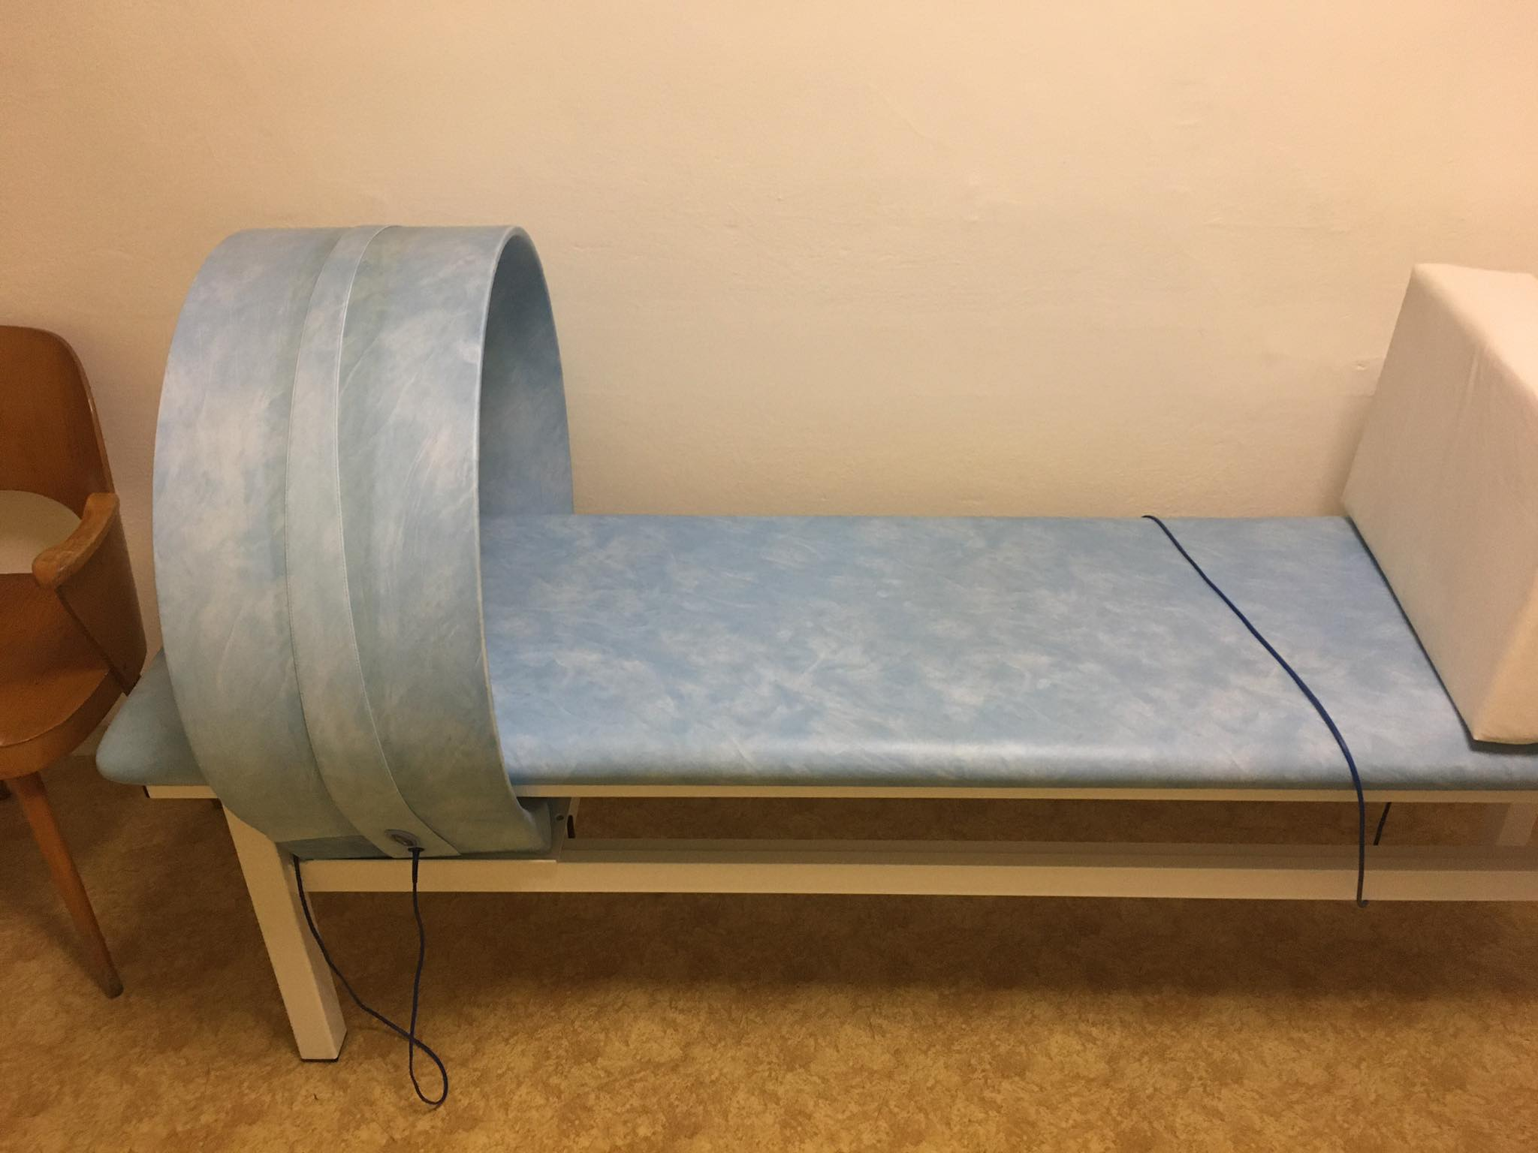
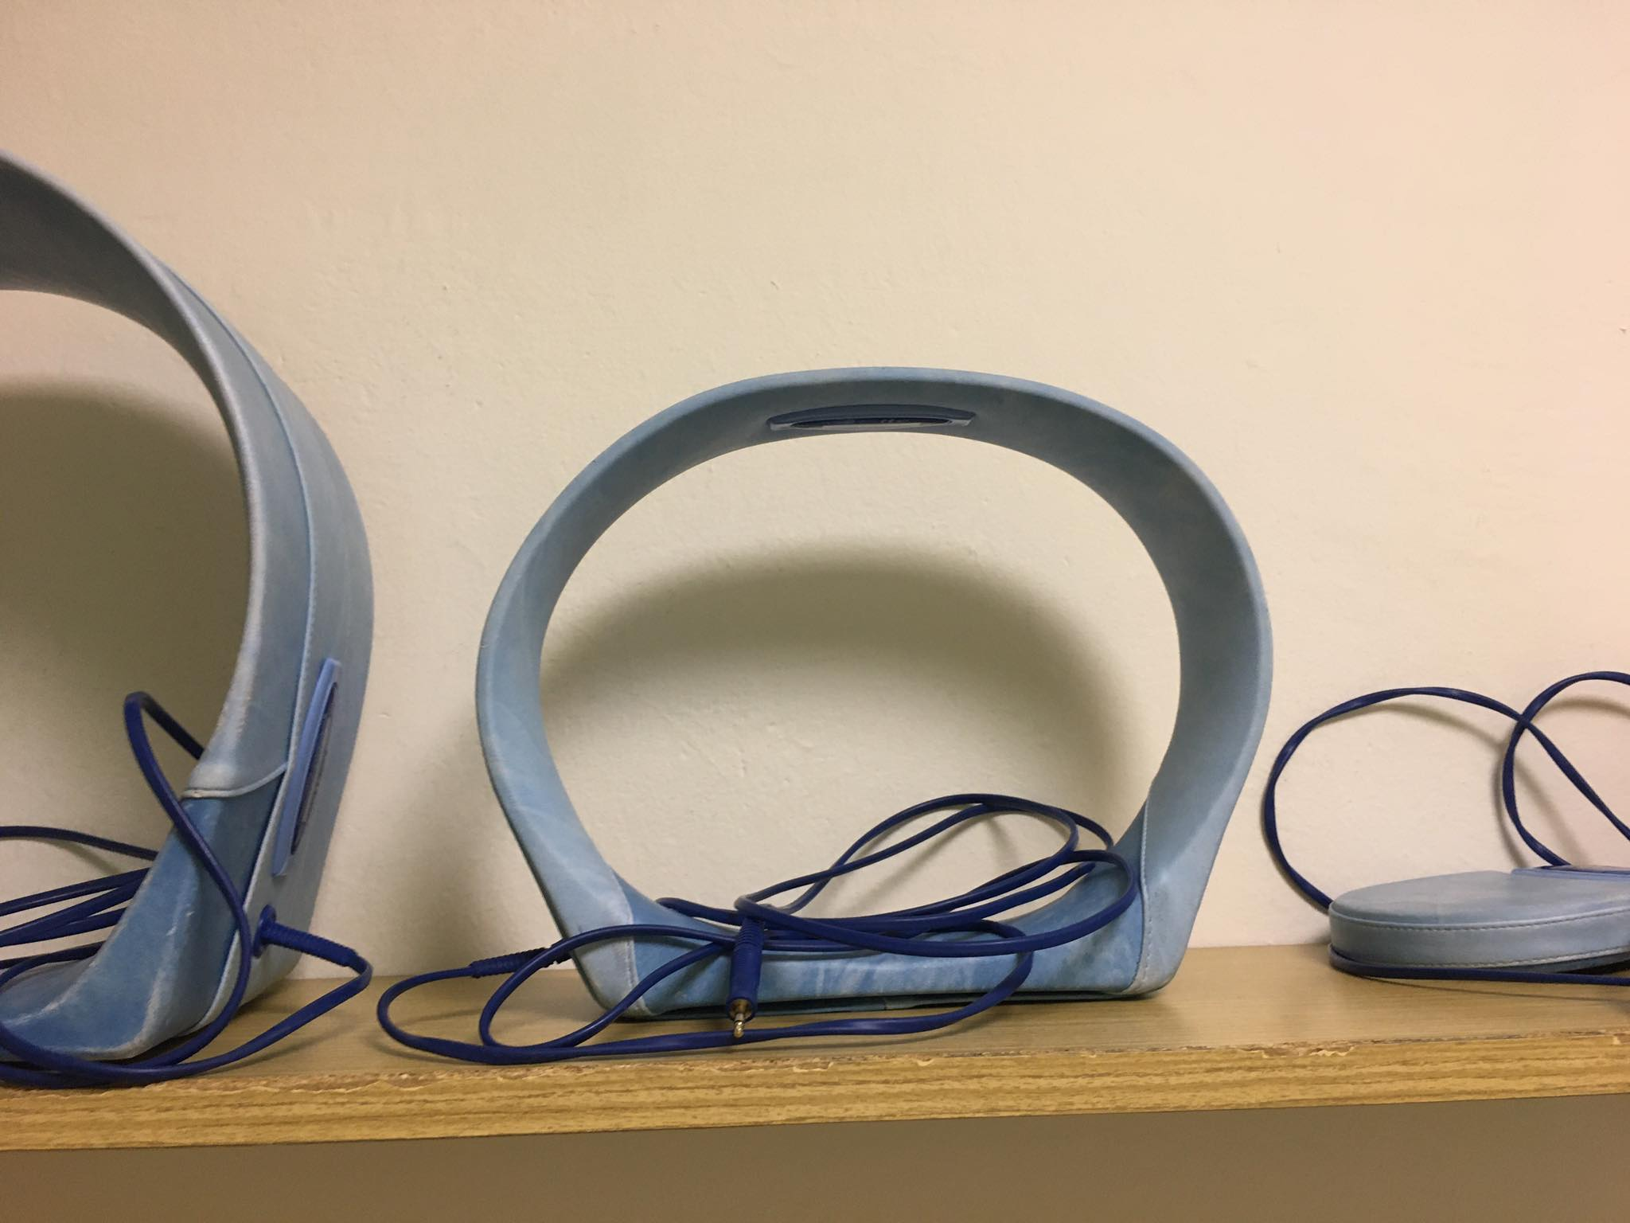
Device and Applicators in Inpatient ward of Department of Sport Medicine and Rehabilitation

Slide 17
Pulsed low-frequency magnetic therapy (PLFMT)
Using time variables, and periodic waveforms
Magnetic fields are driven in the range of 3 - 100 Hz
Using pulse magnetic field:
  magnetic field changes suddenly, changes with a jump
  Only this type of magnetic field is used in physiatry (physical therapy)
  This field is around conductor and coil, where the puls current flows
Homogeneous field
  the magnetic field values are the same direction and size at all points of the space (typically the solenoid)

Slide 18
Pulsed low-frequency magnetic therapy
- Application parameters –
(according Poděbradský, Drápelová)
Intensity: A/m
Magnetic induction: T (Tesla), therapeutic range 1 – 80 mT
Frequency: 3 – 100 Hz
Impulse length: not important
impulse shape: very important, quality devices have almost rectangular course (shorter than 400 nsec)
Time of application: 20 – 40 min, sometimes up to 90 minutes
Number of applications: at least 10 sessions
Repeating: daily

Slide 19
Pulsed low-frequency magnetic therapy
- Frequencies affecting the human body –
(according Drápelová)
anti-inflammatory frequencies < 10 Hz
frequencies affecting the trophic of tissue 25 – 50 Hz
Activation of the blood-circulation around 70 Hz
Analgetic frequencies 50 – 100 Hz

Slide 20
Effects of the pulsed low-frequency magnetic therapy on the body (according Drápelová)
Subcellular level:
electron interactions - transfer of electrons between molecules, which accelerates or slows some chemical reactions
magnetomechanical effect - changes in the orientation of some molecules, especially DNA and RNA, changes in the permeability of membrane systems
magnetoelectric effect - based on the induction of electrical potentials in the living organism - changes in nerve impulses propagation, changes in the intensity of metabolism

Slide 21
Effects of the pulsed low-frequency magnetic therapy on the body (according Drápelová)
Cellular level:
decrease of osmotic resistance of erythrocytes
Calcium channel activation
increase phagocytosis

Slide 22
Effects of the pulsed low-frequency magnetic therapy on the body (according Drápelová)
Tissue level:
increasing oxygen consumption
increasing blood supply through tissues
stimulation of the adrenal gland
activation of the vagus nerve
activation of the immune system
acceleration of healing proces (e.g. fractures)
suppressing of some micro-organisms (not enough valid data!)

Slide 23
And how is it in practice?
Parameters depends on the manufacturer of the device!!!
In practise – we set up only time and intensity (Monada device)
Recommendation: always read the instructions of the device

Slide 24
Benefits
Patients can remain clothed (BUT they have to take off watch, metal objects, credit cards, storage media etc.)
Good tolerance
painless application
not addictive
easy operation of devices

Slide 25
Indications
Indications and prescription of treatment by magnetic field:
previous proper examination
continuously clinical monitored during magnetotherapy

Slide 26
Indications
Treatment in this conditions:
trophic failure
fractures – high doses and long exposure times
degenerative and inflammatory diseases of the musculoskeletal apparatus – frequency above 10 Hz
functional disorders of the musculoskeletal apparatus
recovery and growth of all types of tissues (skin, muscles, ligaments, bones, inner organs, central and peripheral nervous system)
painful conditions known etiology
muscle tone disorders (local and central eutonization)
inflammation - frequency up to 10 Hz
microbial inflammation - frequency 245 Hz
stiffness and adhesion of soft tissue damaged during immobilization

Slide 27
NOTE!
Indications (according Drápelová, MD)
Effects of pulsed low-frequency magnetic therapy:
analgetic
myorelaxation
myotonic
vasodilatory
trophic
immunostimulatory
antioedematous
overall relaxation - endorphin secretion
a slight decrease in blood clotting and fibrin concentration

Slide 28
Contraindications
Contraindications are relevant also for personnel handling the device and to any person who is in the magnetotherapy area!!
1) Absolute
whole period of pregnancy
Pacemaker – cardiac, DBS (deep brain stimulation, cochlear implant)
oncological disease, tumors – especially metastatic tumors
bleeding conditions of any reason
hyperfunction or dysfunction of the endocrine glands
myasthenia gravis
acute tuberculosis - the risk of exacerbation or spread
severe viral, bacterial and mycotic diseases
hypothalamic and pituitary disorders
psychoses

Slide 29
Contraindications
2)Relative
seizure neurological and psychiatric illnesses
magnetotherapy can increase bleeding during menstruation
severe atherosclerosis
severe ischemic conditions (heart, cerebral, lower limb)
be careful in a patient with hypotension or hypertension
NOTE: the negative effect of pulse magnetotherapy on growth zones in children and their reproductive organs has not been demonstrated
NOTE: Application in total hip/knee arthroplasty?
  Magnetotherapy can be used, no negative effects were observed both experimentally and clinically
  But why use magnetotherapy?

Slide 30
Side effects
Relaxation and falling asleep during therapy
Headaches or dizziness during therapy
dizziness or collapses during vertikalization after therapy (hypotonic or hypertonic patients)
Nauzea or diarrhea after therapy
Increasing pain in arthrotic joints or irritated nerve roots during or after therapy
Increasing irritation of CNS
Deterioration of epilepsy

Slide 31
Safety recommendations
health care professionals should be at least a meter away from the applicator
prohibition of entry by pregnant and menstrual women (physical therapist, patients, others)
Take off watch
Put away storage media, mobile phones, credit cards
Slow verticalization after long application of magnetotherapy
These recommendations apply to medical professionals, accompany the patient, the parents of children
the range of the magnetic field depends on the manufacturer of the device!!!!
GENERALY – SAFE ZONE is 1 METER from the applicator

Slide 32
Instructions to patients
Immediately prior to application:
Short anamnesis (case history) - bleeding disorder, oncological disease, pacemaker or other, blood thinners,
Take of watch, put away mobile phone, credit card, flesh disk etc.
Tell how long it take
nothing will feel but it works
Mention side effects
the effect may occur after several applications
put the patient in an appropriate position, position the body segments
the possibility of increasing the effect (even placebo effect) by inserting the magnet into the hands of the patient during therapy

Slide 33
Combination of pulse low-frequency magnetic therapy with another kind of therapy
Inappropiate combinations of magnetotherapy with the following types of treatment:
steroid therapy
treatment with cardiac glycosides, beta-blockers, calcium antagonists
X-ray therapy and others ionizing radiation
high frequency electrotherapy
Combination with ultrasound therapy
Only in indicated cases:
Low-Level Laser (Light) Therapy (LLLT)
acupuncture
balneoprocedures
diadynamic currents
interference currents

Slide 34
Examples of practise
(according Poděbradsky)
Coxarthrosis
  Aim of the therapy – analgetic, disperze and myorelaxation effect
  PLFMT; applicator – solenoid; area – pelvis and hip joints; frequencies – 10 – 25 Hz; magnetic induction – 8 – 15 mT; Time of application – 30 min; Number of applications – 15 sessions; Repeating - daily
Ankylosing spondylitis
  Aim of the therapy – analgetic, disperze effect
  PLFMT; applicator – flat applicator – long blanket on the entire spine; frequencies – 4 – 50 Hz; magnetic induction – 5 – 20 mT; Time of application – 45 min; Number of applications – 20 sessions; Repeating - three times a week
St. post trimaleolar fracture
  Aim of the therapy – bone formation and calcification
  PLFMT; applicator – solenoid; area – ankle; frequency – 25 Hz; magnetic induction – 20 mT; Time of application – 45 - 90 min; Number of applications – 10; sessions; Repeating - three times a week

Slide 35
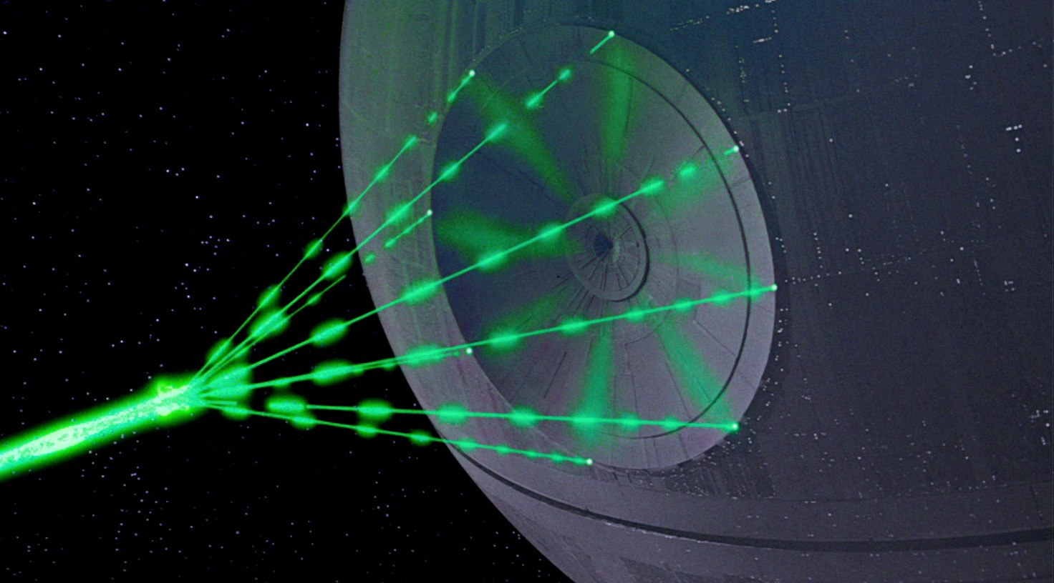
Next time lecture

Slide 36
Thank you for your attention

