Slide 1
Female genital organs

Slide 2
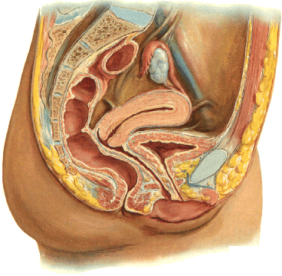
Internal female genital organs
Ovary (ovarium)
Phalopian tube (tuba uterina)
Uterus
Vagina

Slide 3
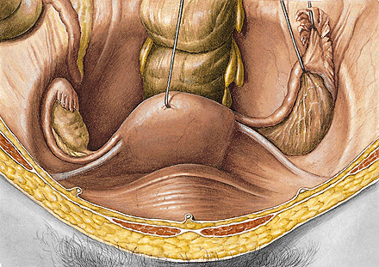
OVARY
Extremitas tubaria
(superior)
Extremitas uterina
(inferior)
Facies medialis
Facies lateralis
Margo mesovaricus
(anterior)
Margo liber
(posterior)

Slide 4
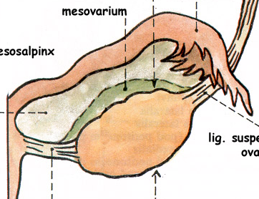

Slide 5
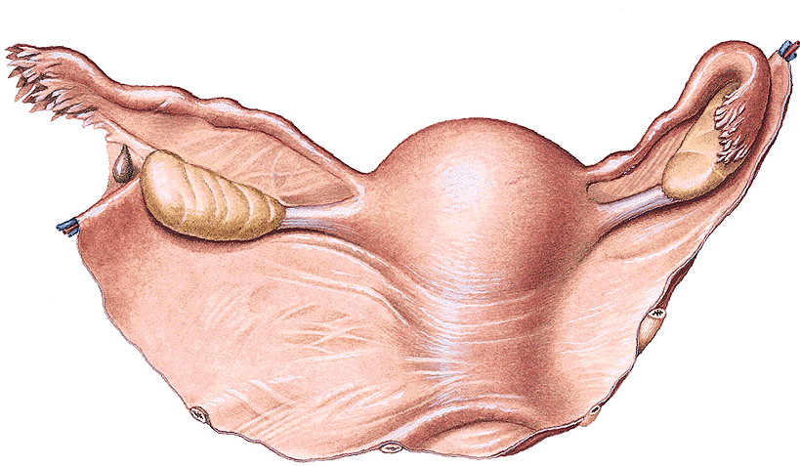
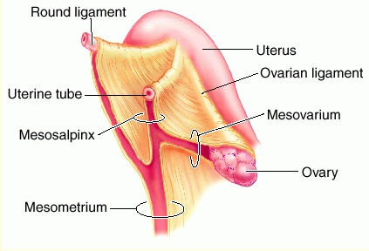
Lig. suspensorium ovarii (vasa ovarica)
Lig. ovarii proprium
Hilus ovarii
Mesovarium
Lig. latum uteri

Slide 6
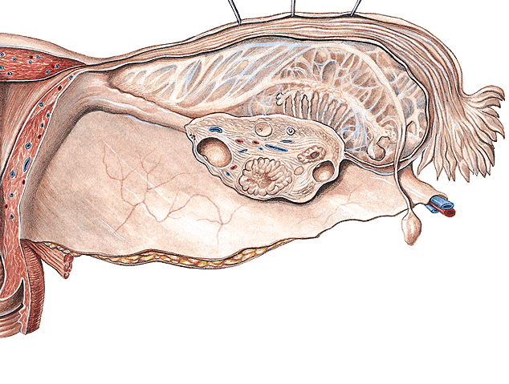
Histology of ovarium
Germinative epithelium
Tunica albuginea
Cortex ovarii
folliculi ovarici
corpora lutea
Medulla ovarii

Slide 7
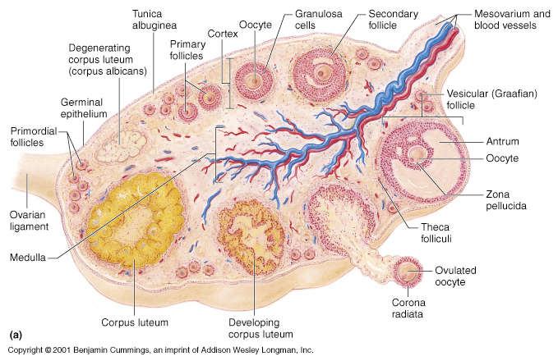

Slide 8
Folliculi ovarici primarii (300 000- 400 000)
Folliculus ovaricus vesiculosus (Graaf´s)
Ovulation
Corpus luteum
menstruationis
graviditatis
Corpus albicans

Slide 9
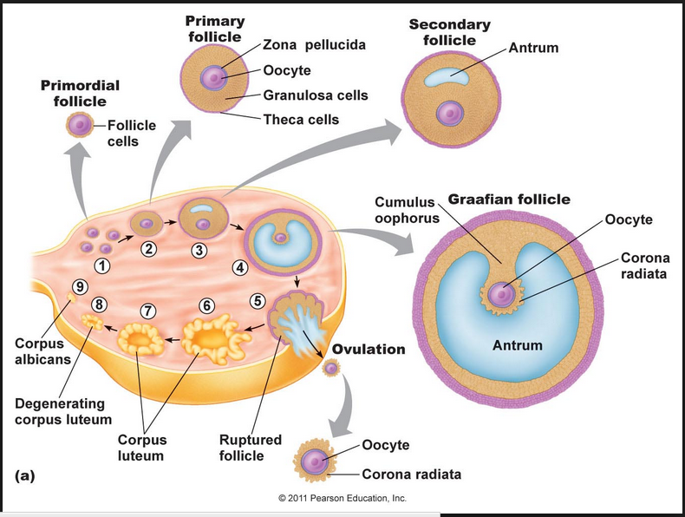
Ovarian cycle

Slide 10
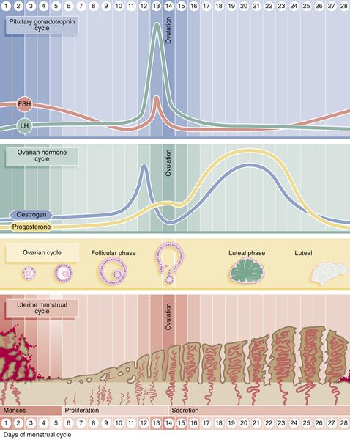
Hypophysis
Ovary -
hormones
Ovulation
cycle
Uterus -
menstr.cycle

Slide 12
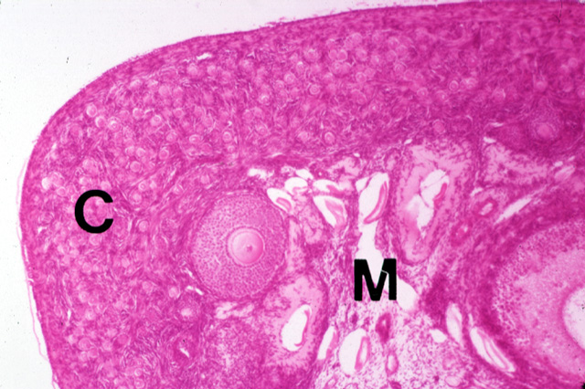
Ovary - cortex with folicule, medulla

Slide 13
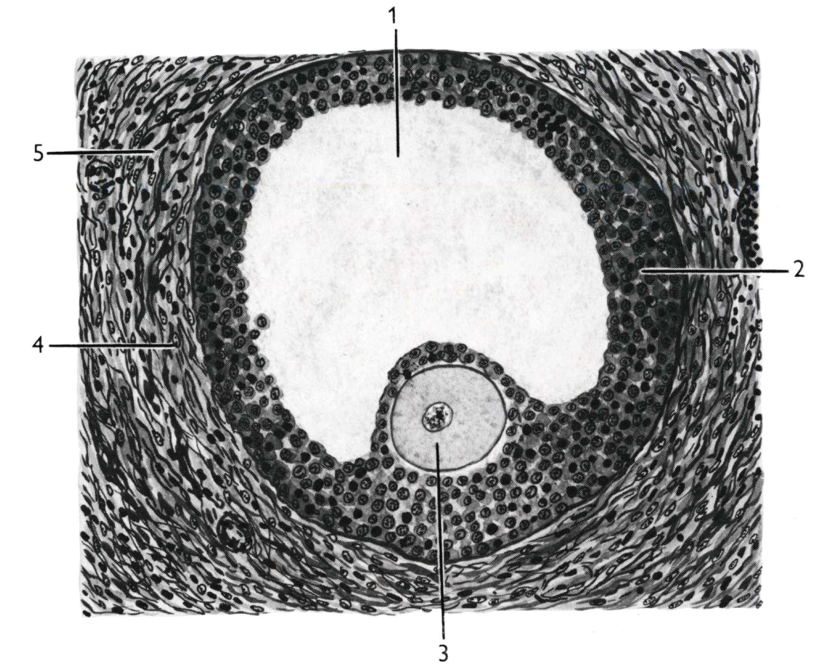
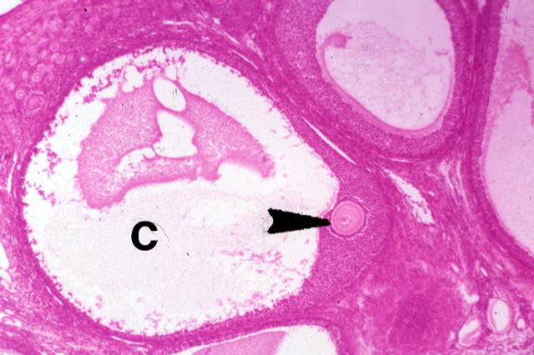
Folliculus ovaricus vesiculosus (Graaf´s)
antrum folliculi (liquor folliculi)
membrana granulosa
oocyt (cumulus oophorus)
theca folliculi interna
theca folliculi externa

Slide 14
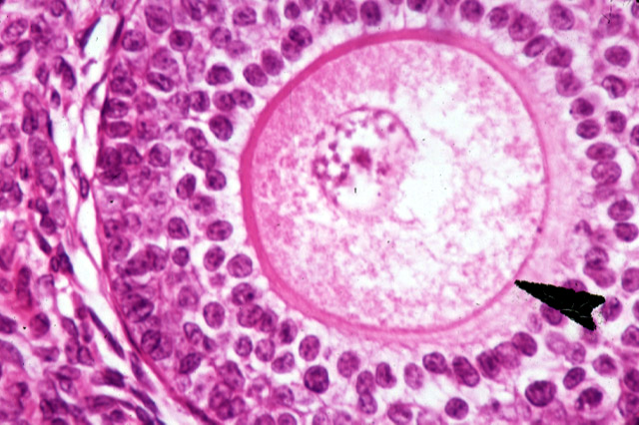
Ovum : zona pellucida, granulosa

Slide 15
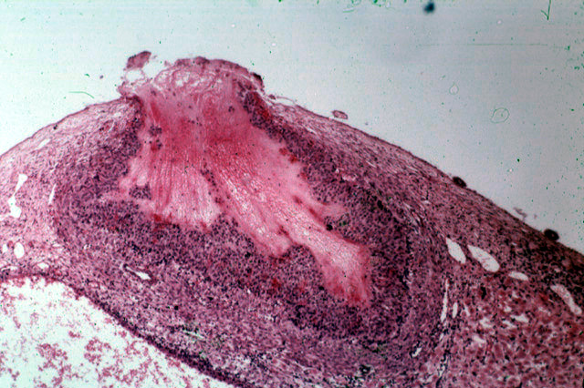
Ovulation

Slide 16
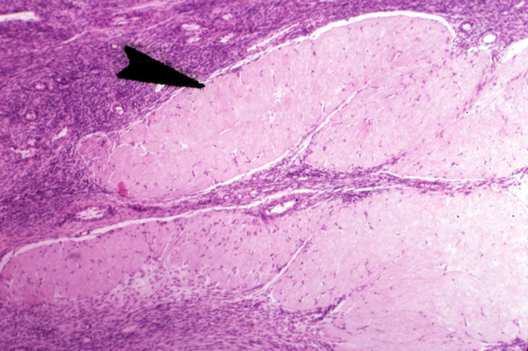
Corpus luteum

Slide 17
LOCALIZATION OF OVARY
Nullipara – fossa ovarica (in front of a. iliaca int.)
Multipara – Claudius fossa (behind a. iliaca int.)

Slide 18
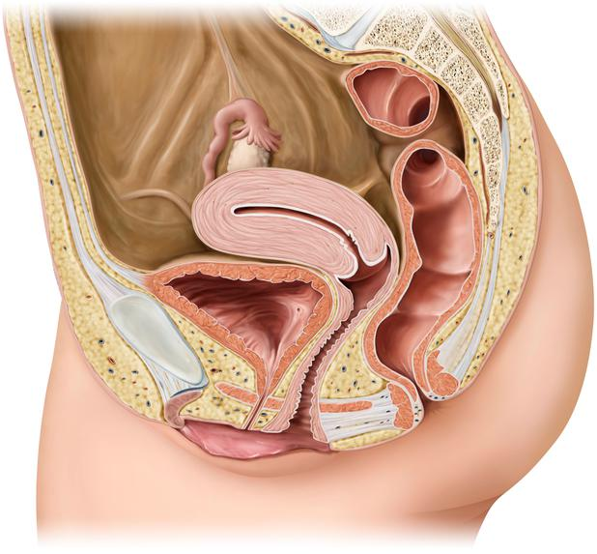

Slide 19
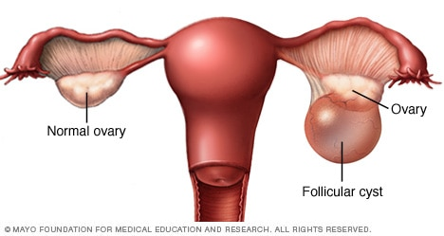
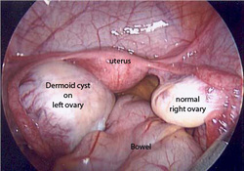

Slide 20
TUBA UTERINA (SALPINX)
Infundibulum tubae uterinae
ostium abdominale tubae
fimbriae (fimbria ovarica)
Ampulla tubae uterinae
Isthmus tubae uterinae
Pars uterina tubae uterinae
ostium uterinum tubae

Slide 21
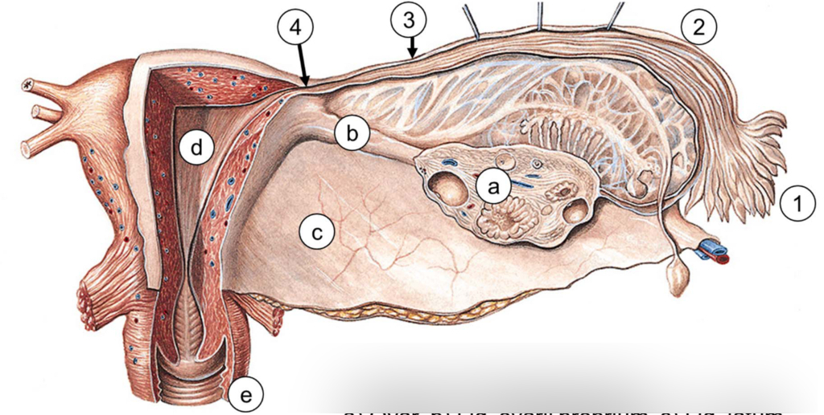

Slide 22
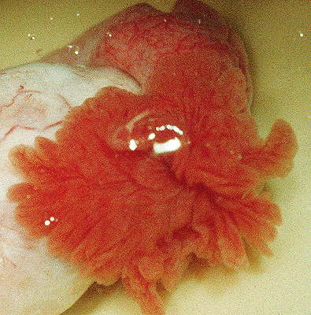
OSTIUM ABDOMINALE TUBAE UTERINAE

Slide 23
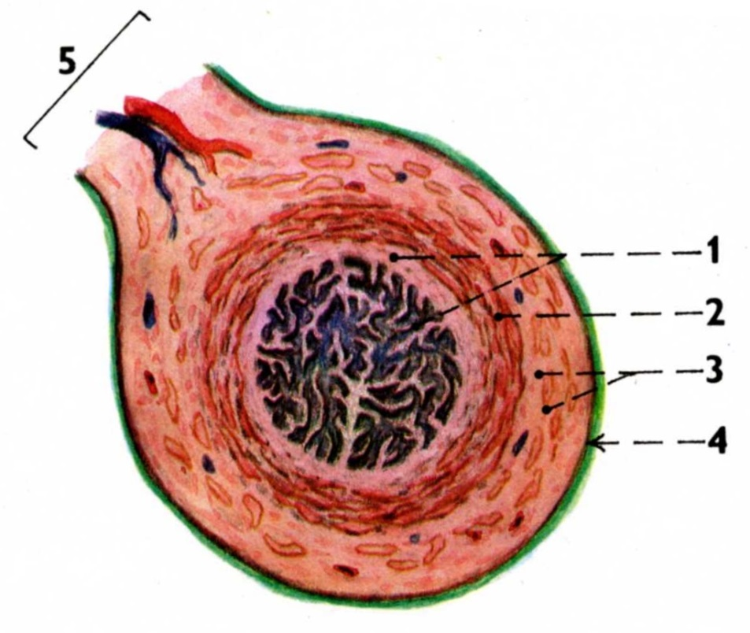
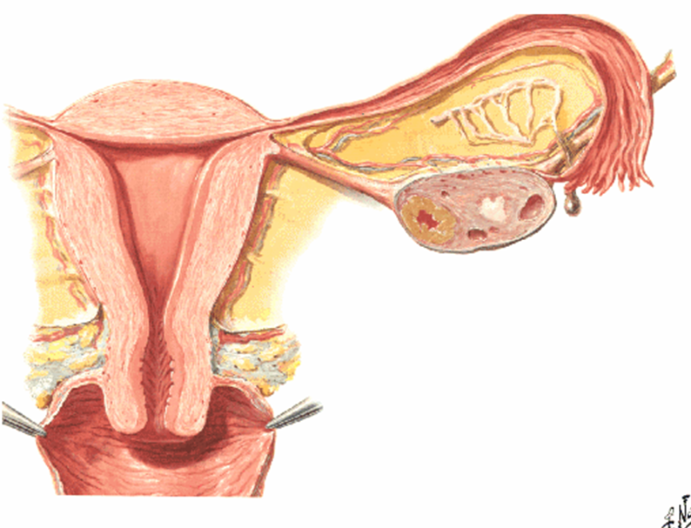
HISTOLOGY OF PHALOPIAN TUBE
1. Mucosal folds
(cylind. epithelium cilliated)
2. Circular muscular layer
3. Longitudinal muscular layer
4. tunica serosa
5. mesosalpinx

Slide 24
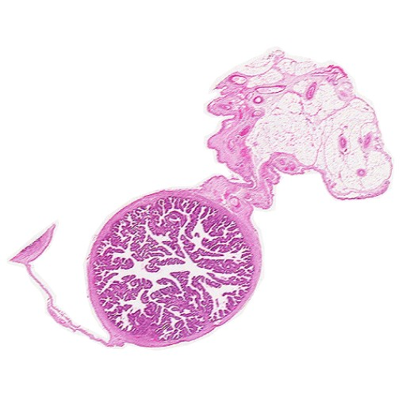

Slide 25
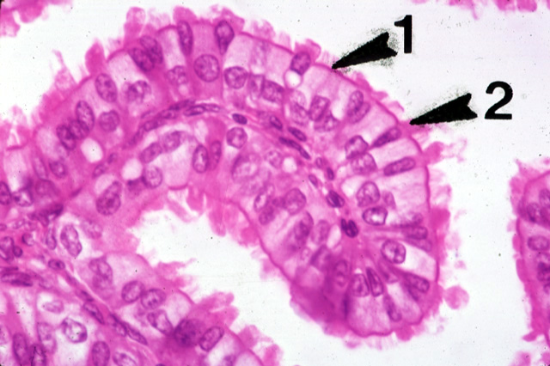
Tuba uterina – mucosal fold = cylindric. epithelium – 1. secretory cells - 2

Slide 26
PHALOPIAN TUBE COURSE
from uterus runs laterally to the pelvic wall
dorsocranially to the upper pole of ovary
fimbriae rotated to facies medialis ovarii

Slide 27
UTERUS (HYSTERA, METRA)
Fundus
Corpus
facies vesicalis
facies intestinalis
Cervix
Isthmus uteri
Margo dx. et sin.
Cornu dx. et sin.
lig. teres uteri
lig. ovarii proprium
fundus
cornu
corpus
cervix
portio vaginalis
cervicis
ostium uteri

Slide 28
Cavum uteri (3 ml)
Canalis isthmi
Ostium internum canalis cervicis
Canalis cervicis (plicae palmatae)
Ostium externum canalis cervicis
(= ostium uteri)
Cervix
portio supravaginalis
portio vaginalis
Fornix vaginae

Slide 30
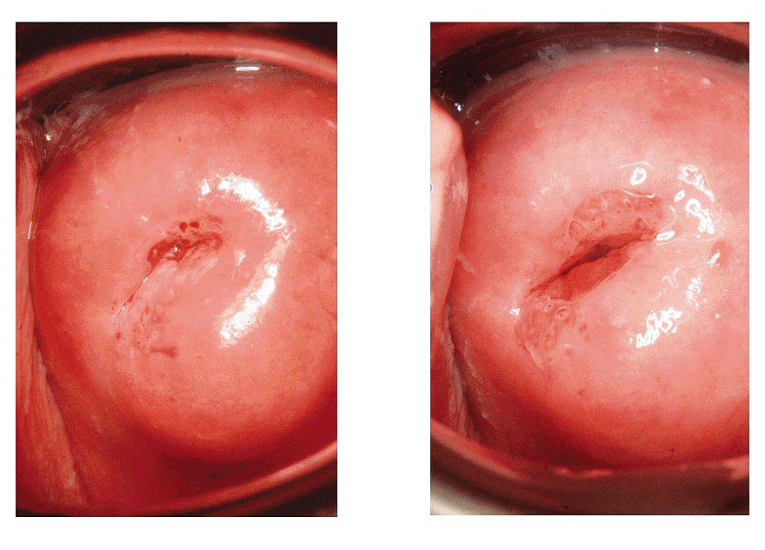
OSTIUM UTERI (OSTIUM EXTERNUM CANALIS CERVICIS)
NULLIPARA
MULTIPARA
Labium anterius et posterius

Slide 31
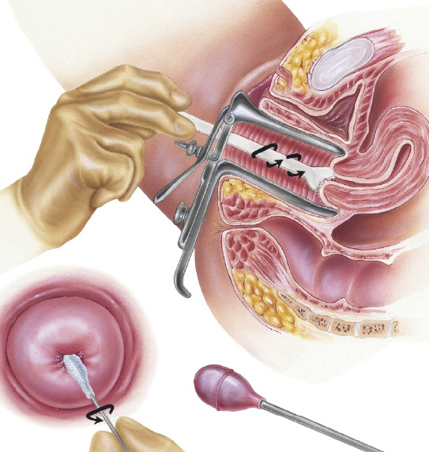
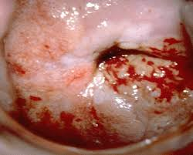

Slide 32
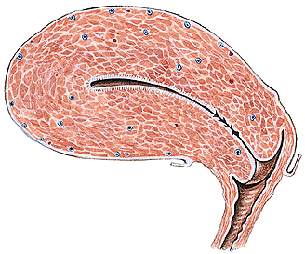
HISTOLOGY OF UTERUS
Endometrium
Myometrium
Perimetrium

Slide 33
ENDOMETRIUM
Simple cylindric epithelium
zona basalis
zona functionalis
glandulae uterinae
glandulae cervicales (mucouse closure)
menstruation cycle
menarche
menopausa (climacterium)
ostium uteri (multilayer stratified epithelium)

Slide 34
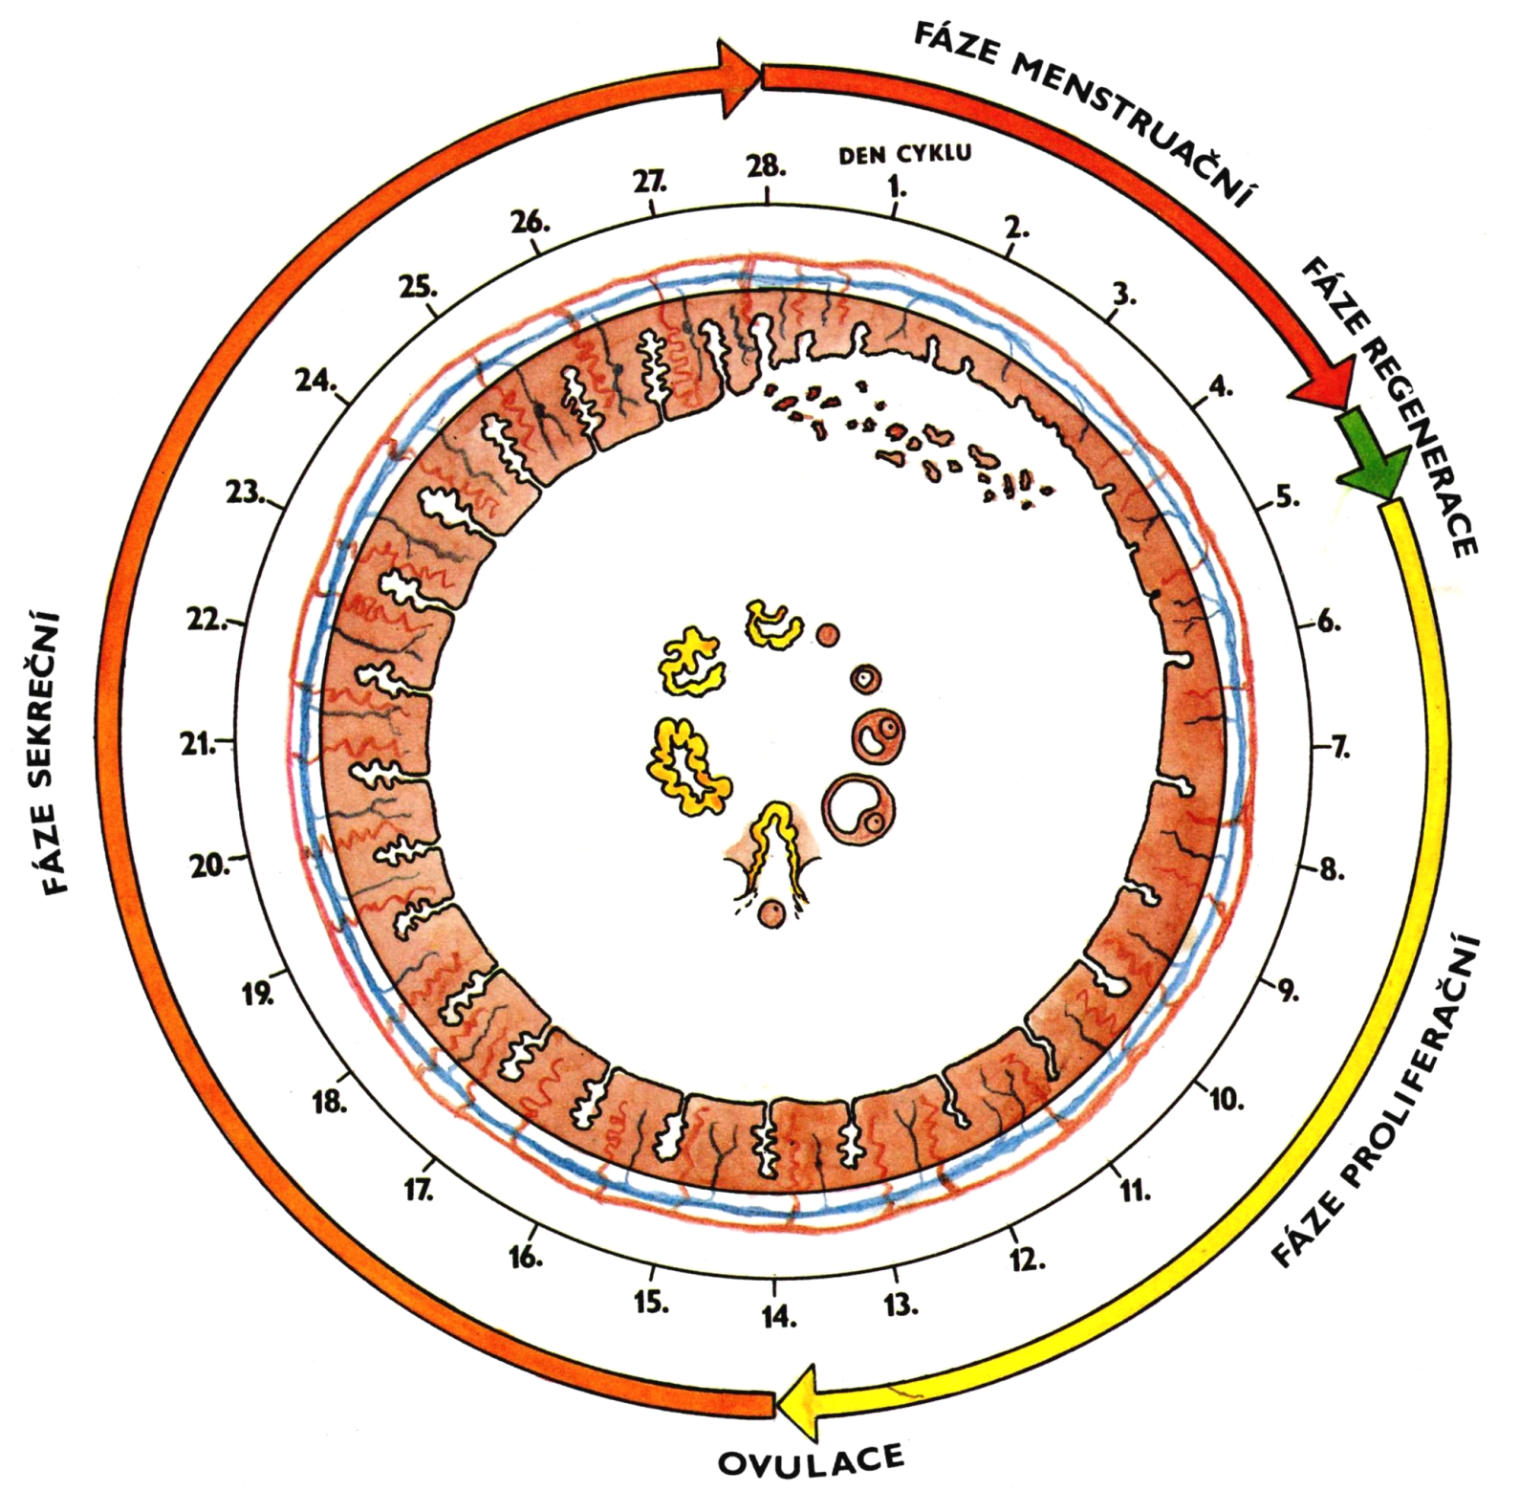
ISCHEMIE
Menstruation cycle
1. Menstruation phase
2. Proliferation phase
3. Secretory phase
4. Ischemia

Slide 35
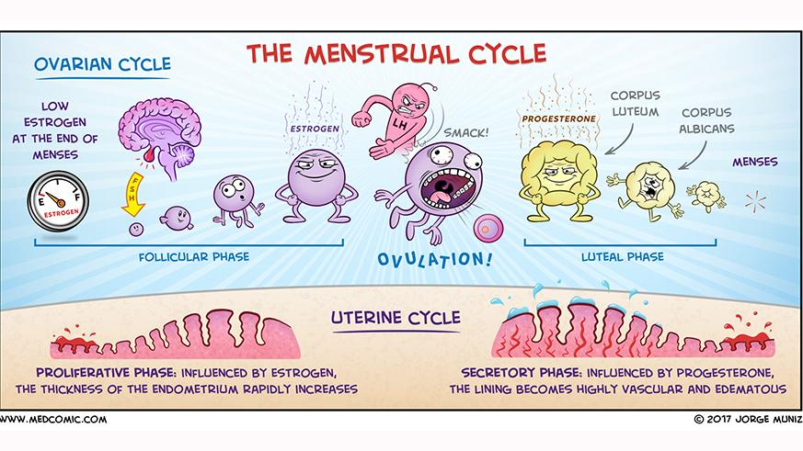

Slide 36
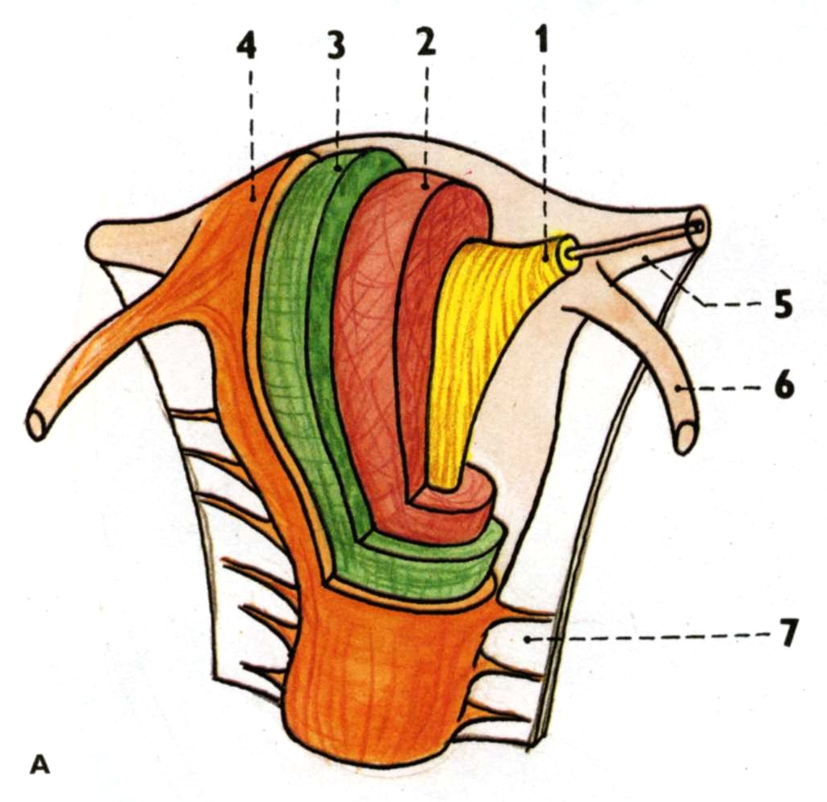
stratum submucosum
stratum vasculosum
stratum supravasculosum
stratum subserosum
MYOMETRIUM

Slide 37
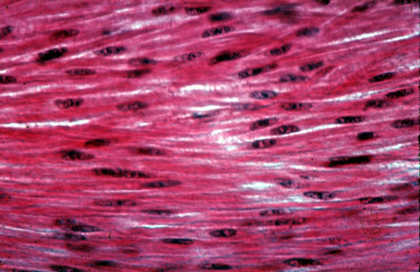
Myometrium, myocytes – smooth muscles

Slide 38
PERIMETRIUM (VISCERAL PERITONEUM)
Lig. latum uteri
Mesosalpinx
Mesovarium
Lig. teres uteri

Slide 39
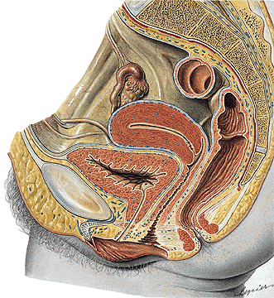
PERIMETRIUM
Excavatio vesicouterina
Excavatio rectouterina
(cavum Douglasi)

Slide 40
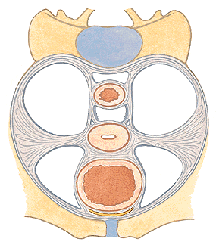
PARAMETRIUM
Lig. pubouterinum
lig. pubovesicale
lig. vesicouterinum
Lig. cardinale uteri
Lig. sacrouterinum
plica sacrouterina
m. rectouterinus
Lig. teres uteri

Slide 41
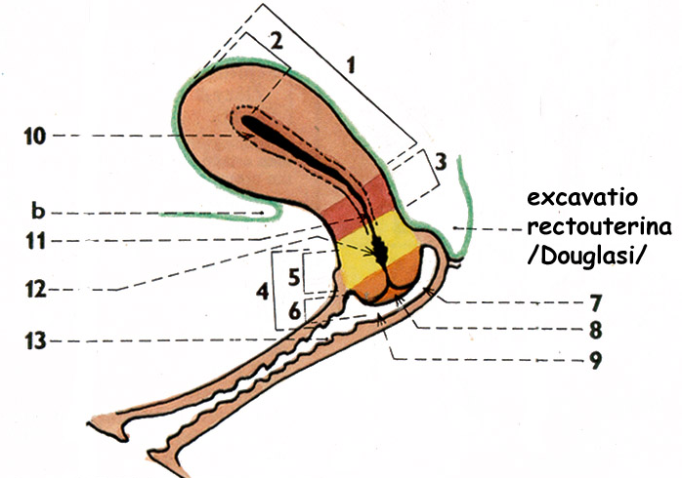

Slide 42
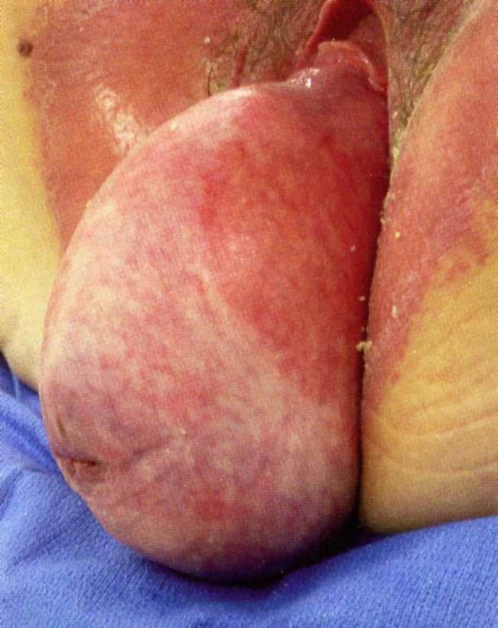
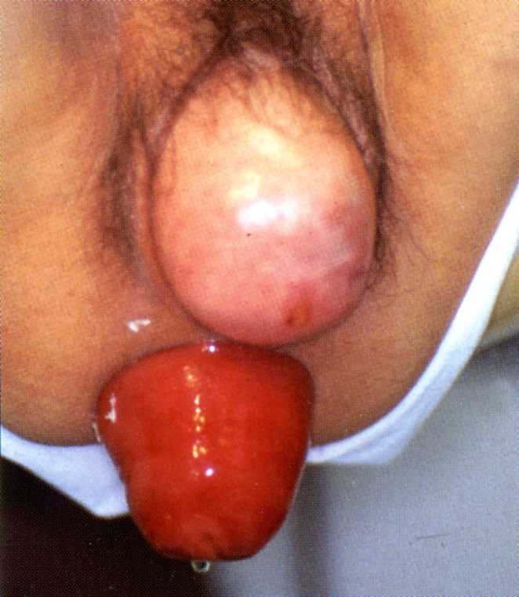
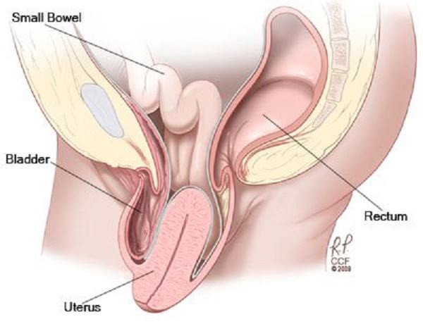
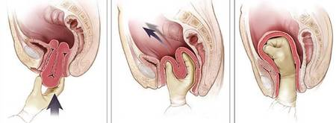
Prolapsus

Slide 43
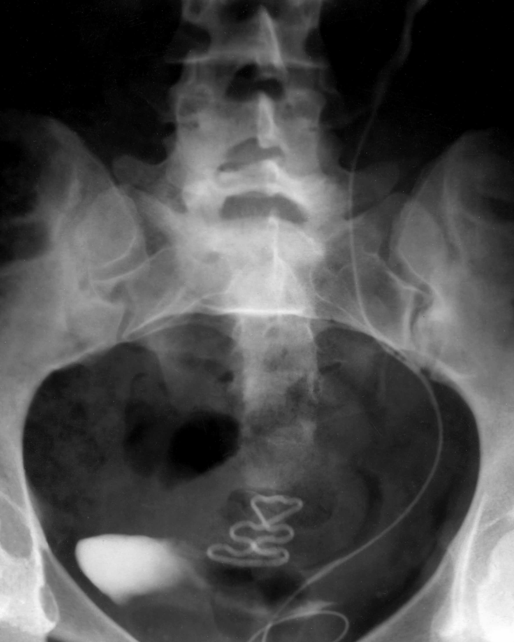
intra
uterine
corpuscule IUC
IUD
Intra
uterine device

Slide 44
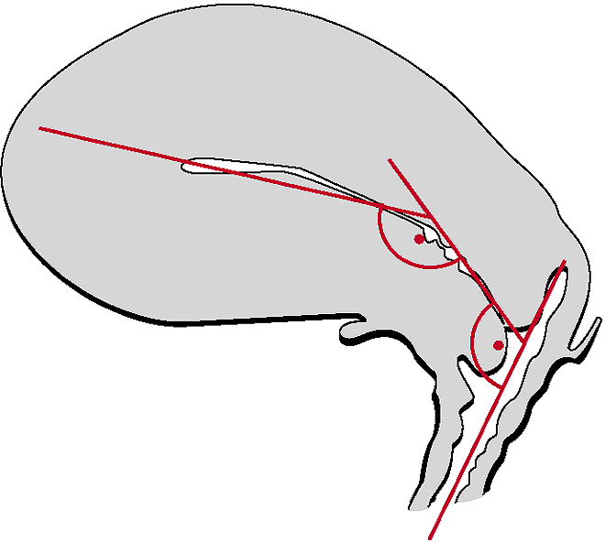
POSITION OF UTERUS
Anteversion (70⁰ – 100⁰)
Anteflexion (100⁰)

Slide 46
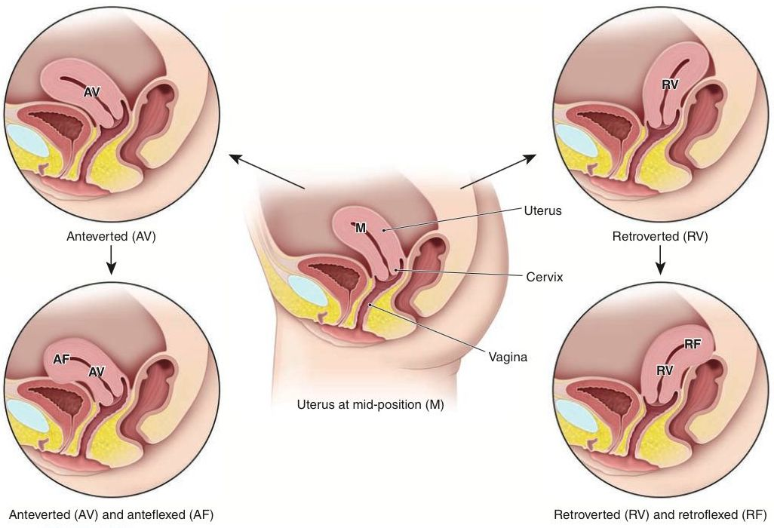

Slide 47
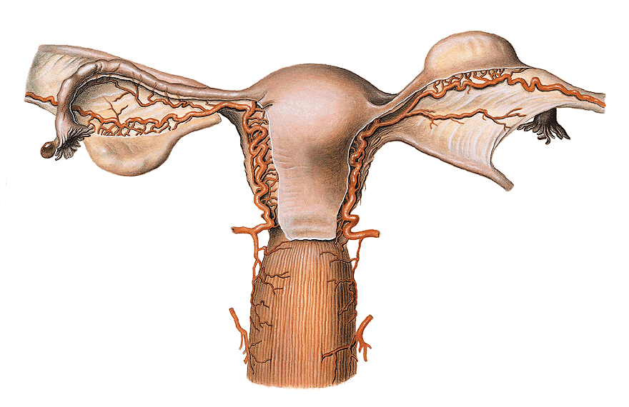
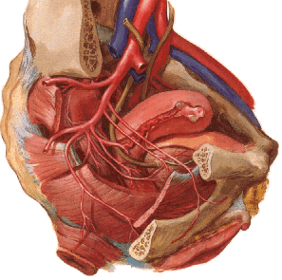
Arteria uterina – anastomosis with a. ovarica (ovarian arcade)
Uterine artery crosses ureter
(2 cm from uterine margine
1,5 cm from fornix vaginae)

Slide 49
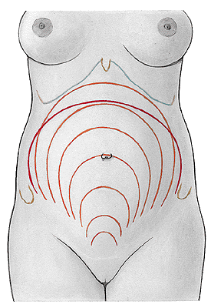
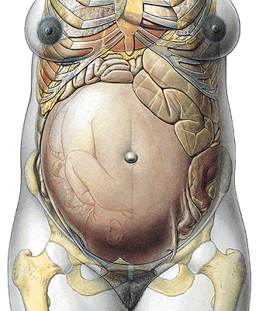
GRAVIDITY
9
8
10
7
6
5
4
3

Slide 50
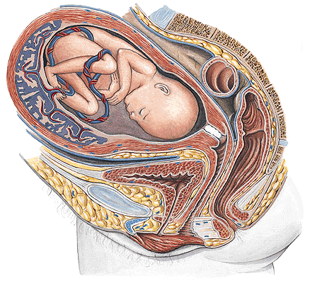
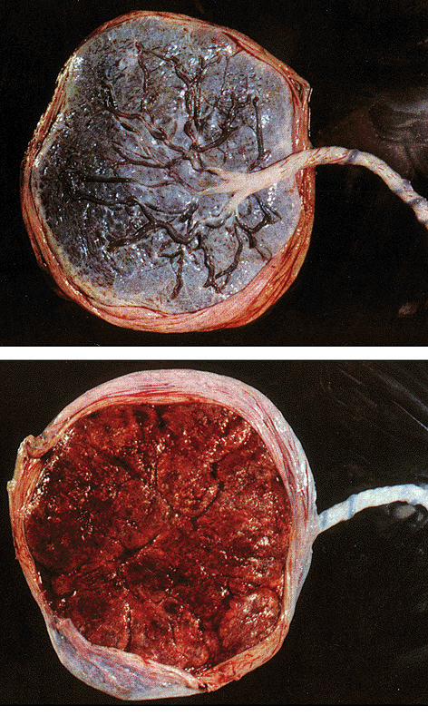
Placenta
Funiculus umbilicalis – 50 cm
(v.umbilicalis, aa. umbilicales)
uterus graviditatis – 1000 g

Slide 51
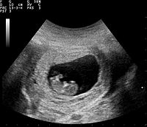

Slide 52
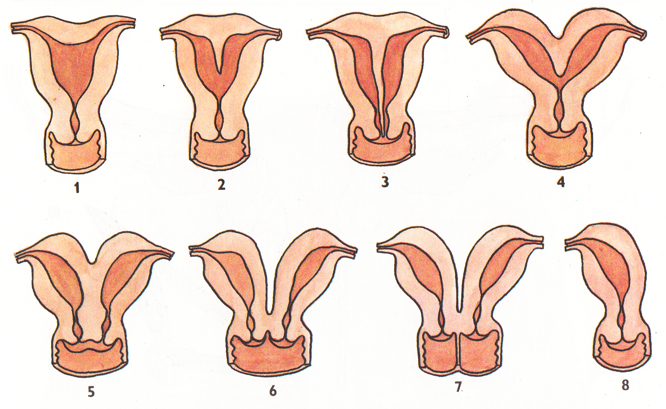
uterus arcuatus
uterus subseptus
uterus septus
uterus bipartitus
uterus duplex
uterus duplex
uterus duplex
cum vagina septa
uterus unicornis

Slide 53
HYSTEROSALPINGOGRAPHY

Slide 54
VAGINA (KOLPOS)
Fornix vaginae
pars anterior et posterior
receptaculum seminis
Paries anterior
crista urethralis
area trigonalis vaginae
Paries posterior
Rugae vaginales
Columna rugarum ant. et post.
Ostium vaginae
(vestibulum vaginae)

Slide 56
Ostium vaginae - hymen
Defloration
Carunculae hymenales
Ostium urethrae ext.
Ostium vaginae

Slide 57
HISTOLOGY OF VAGINA
Mucouse membrane
Multilayer squamous epithelium
No glands !!!
submucouse tissue – venous net
Muscular layer
inner - circular
outer - longitudinal
Adventicia
Serosa – excavatio rectouterina

Slide 58
POSITION OF VAGINA
Ventrocaudal direction
Ventrally:
urinary bladder
urethra - septum urethrovaginale
Dorsally:
excavatio rectouterina
rectum - septum rectovaginale
centrum perineale

Slide 59
promontorium vaginae
m. pubovaginalis
symfýza

Slide 61
Organa genitalia feminina externa
Labia majora pudendi
Labia minora pudendi
Mons pubis
Vestibulum vaginae
Clitoris
Glandulae vestibulares
Bulbus vestibuli

Slide 62
Labia majora pudendi
Sulcus genitofemoralis
Rima pudendi
Commissura labiorum ant.
Mons pubis
Commisura labiorum post.
Pubes
Perineum (raphe perinei)

Slide 63
MONS PUBIS
Pubes
Fatty tissue

Slide 64
Labia minora pudendi
Sulcus interlabialis
Vestibulum vaginae
Smegma
Frenulum labiorum pudendi
Fossa vestibuli vaginae
Praeputium clitoridis
Frenulum clitoridis

Slide 66
CLITORIS
Crura clitoridis
(crista phalica)
Corpus clitoridis
Glans clitoridis
Praeputium clitoridis
Frenulum clitoridis
Corpora cavernosa clitoridis

Slide 69
Tension-free vaginal tape

Slide 71
VESTIBULUM VAGINAE
between labia minora pudendi
Glans clitoridis
(praeputium et frenulum clitoridis)
Ostium urethrae externum
(papilla urethralis, gll. vestib. minores)
Ostium vaginae (hymen)
Fossa navicularis
Frenulum labiorum pudendi
(commisura labiorum pudendi)

Slide 72
BULBI VESTIBULI
Erectile bodies
(corpus spongiosum)
on diaphragma urogenitale
m. bulbospongiosus
(from centrum tendineum
perinei to the dorsum clitoridis)

Slide 73
GLANDULAE VESTIBULARES MAJORES (BARTHOLINI)
On the diaphragma urogenitale
Dorsally from bulbi vestibuli
m. bulbospongiosus
Open to the vestibulum vaginae

Slide 74
Diaphragma pelvis and urogenitale
♀

Slide 75
Deep perineal pouch
m.transversus perinei prof.
m.sphincter urethrae
Superficial perineal pouch
m. bulbospongiosus
m. ischiocavernosus
m. sphincter ani ext.

Slide 77
m. sphincter
urethrovaginalis
m. transversus
perinei profundus
m. ischiocavernosus
m.compressor
urethrae
m. bulbospong.
m. transv. perinei
superfic.
sphincter ani ext.

Slide 79
Thank you for attention!
Have a nice day!

