Slide 1
Peripheral nervous system

Slide 2
Spinal nerves – dorsal roots, plexuses
Cranial nerves – I-XII
Autonomic nervous system

Slide 3
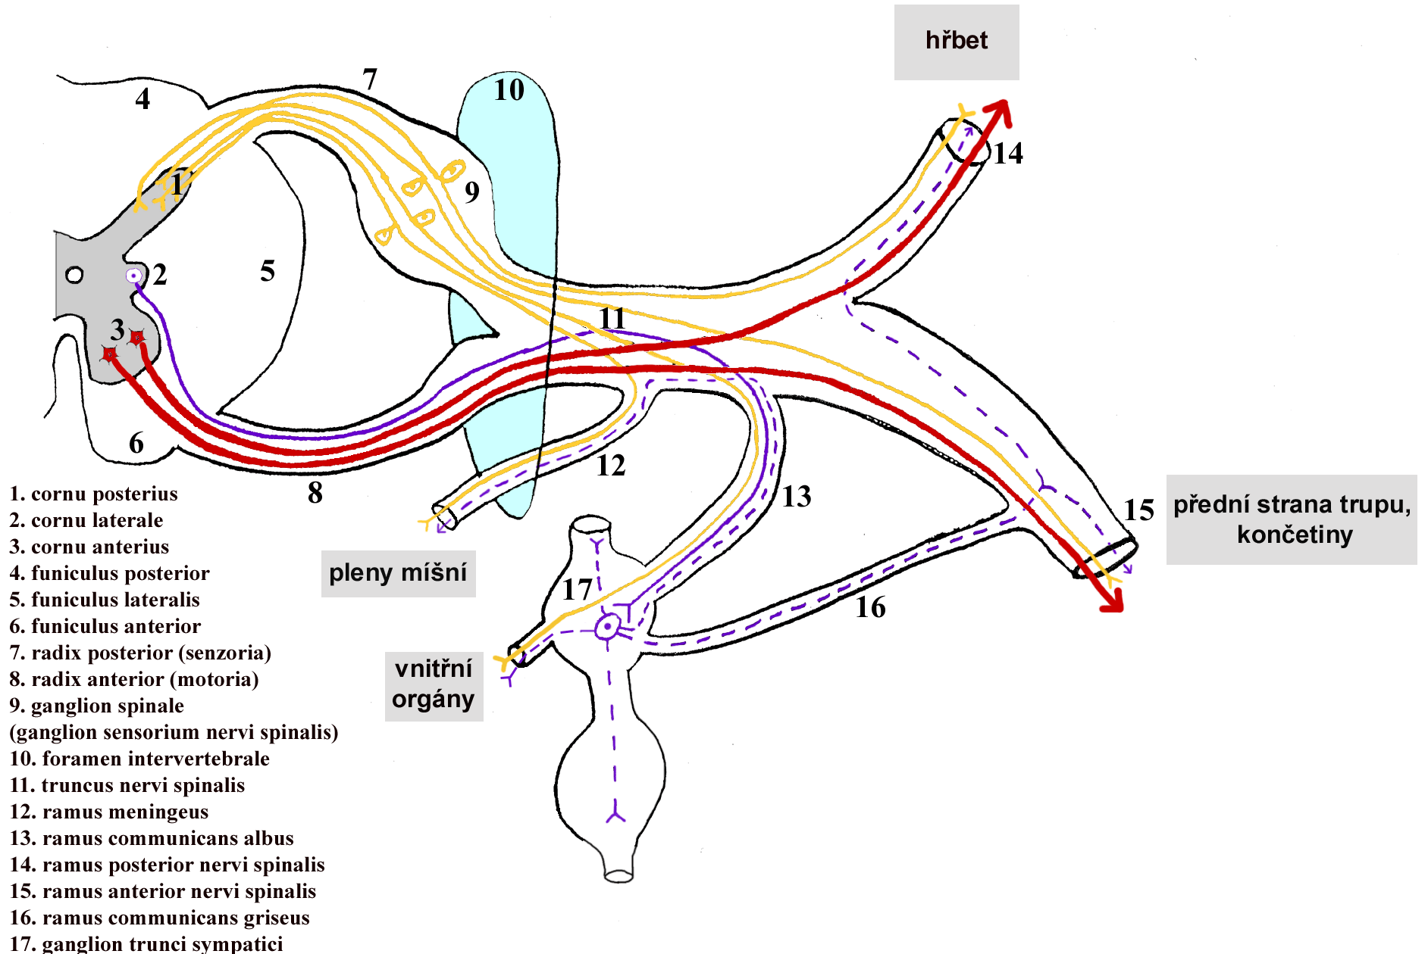
Dorsal branches of spinal nerves
Back
Ventral side of trunk, limbs
Meninges
Organs
Plexuses
Sympaticus

Slide 4
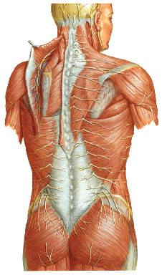
Dorsal branches of spinal nerves
Segmental organization
Medial and lateral branch
Sensoric and motor

Slide 5
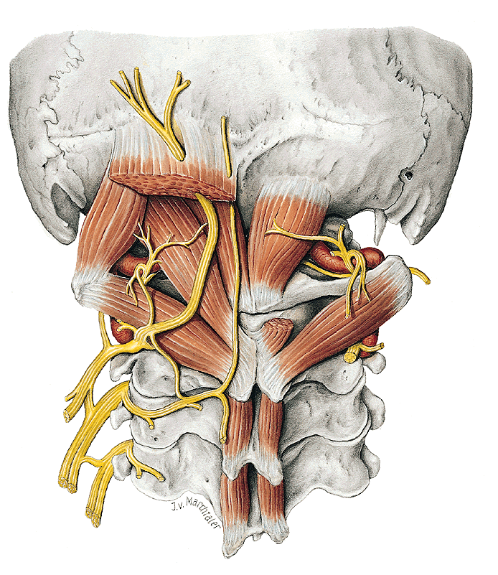
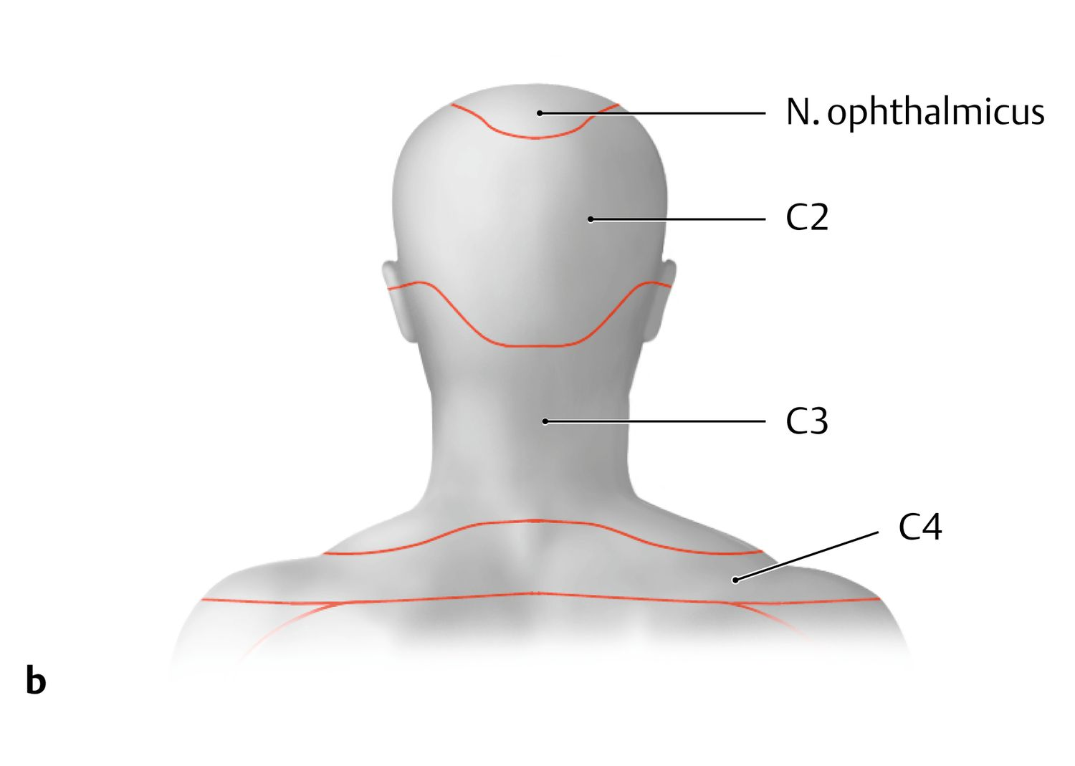
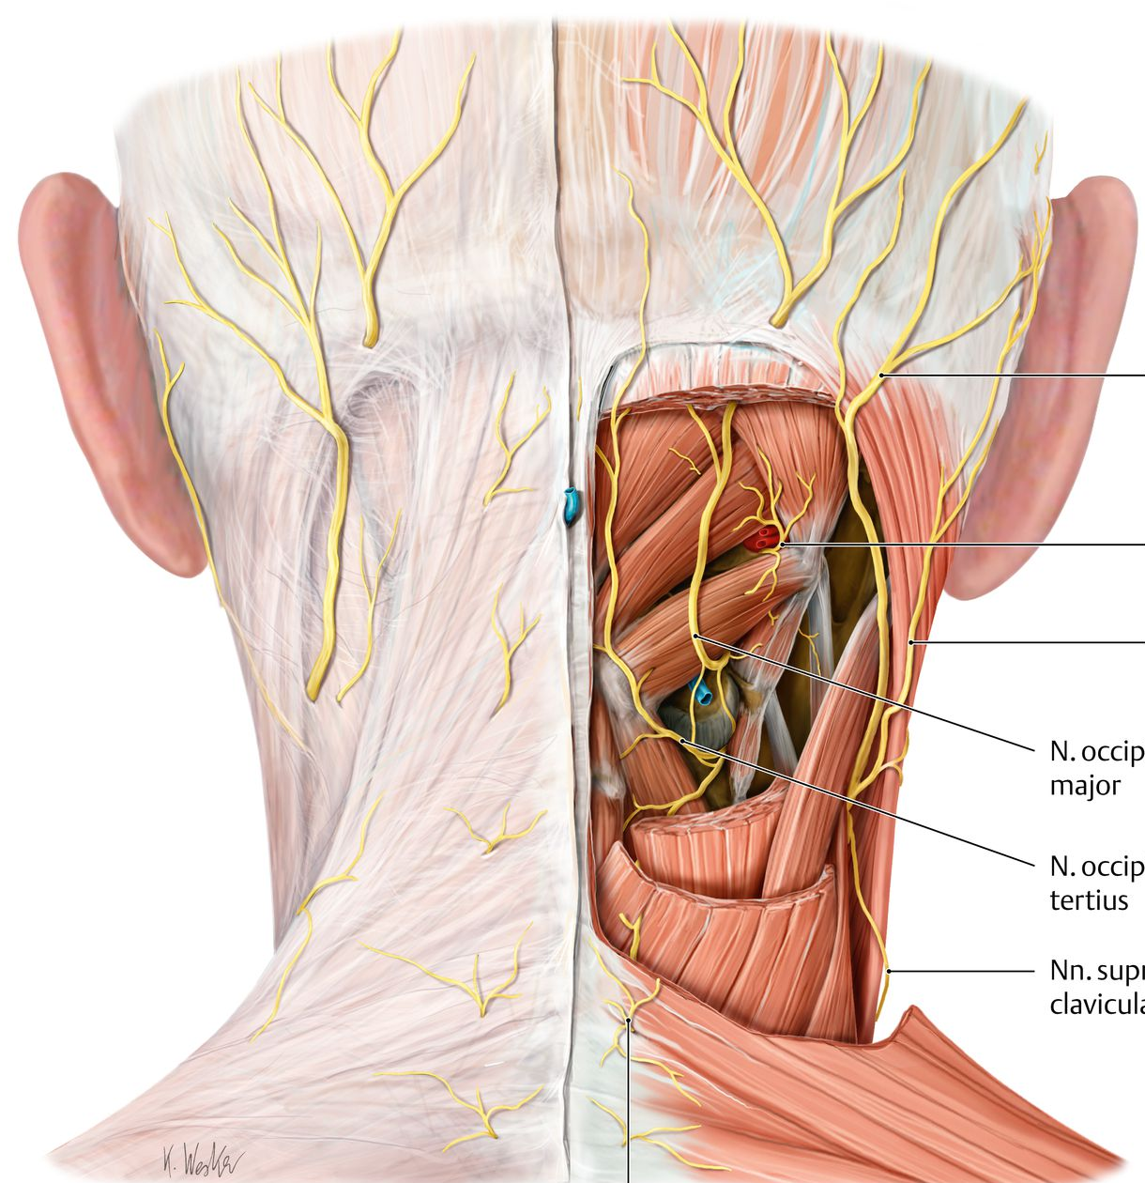
N. suboccipitalis – C1
N. occipitalis major – C2
N. occipitalis tertius – C3
Nn. clunium

Slide 6
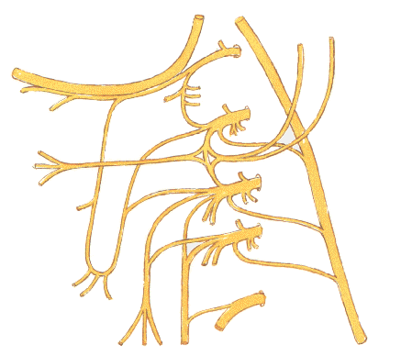
PLEXUS CERVICALIS
C1
Rami ventrales nn. spinalium C1-4
Sensoric branches-– punctum nervosum sensitivum:
- n. occipitalis minor (C2–3)
n. auricularis magnus (C2-C3)
- ramus anterior et posterior
- n. transversus colli (C3)
- nn. supraclaviculares (C3-4)
C2
C3
C4

Slide 7
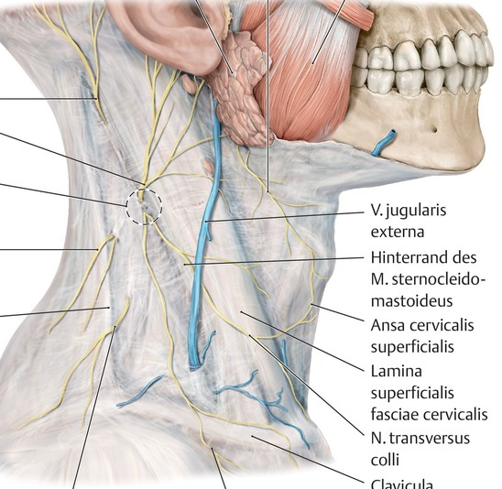
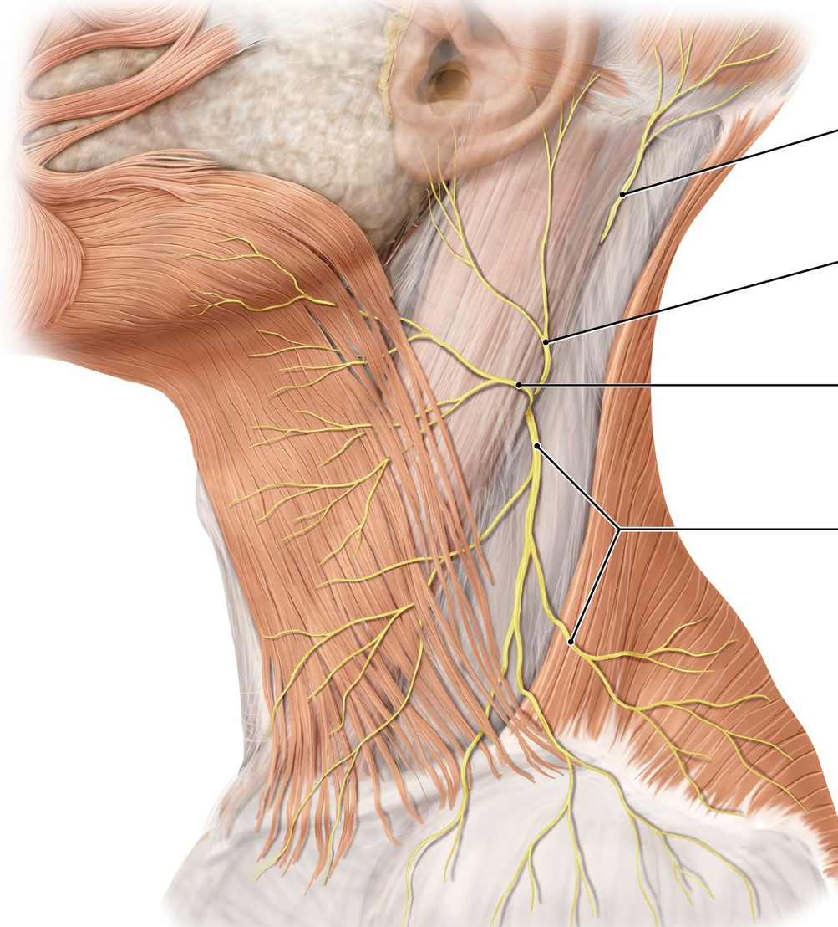

Slide 8
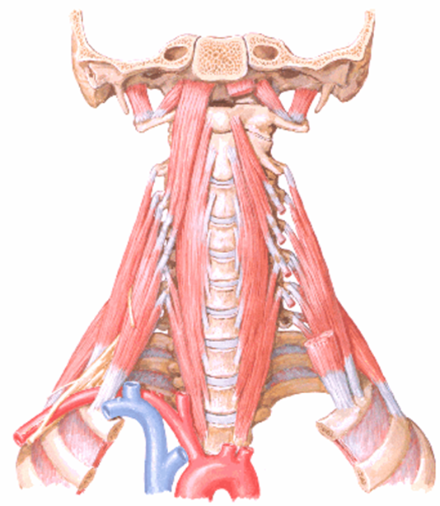
Motor branches:
Rami musculares
mm. praevertebrales
mm. intervertebrales
mm. scaleni
ONLY PARTLY:
m. sternocleidomastoideus
m. trapezius

Slide 9
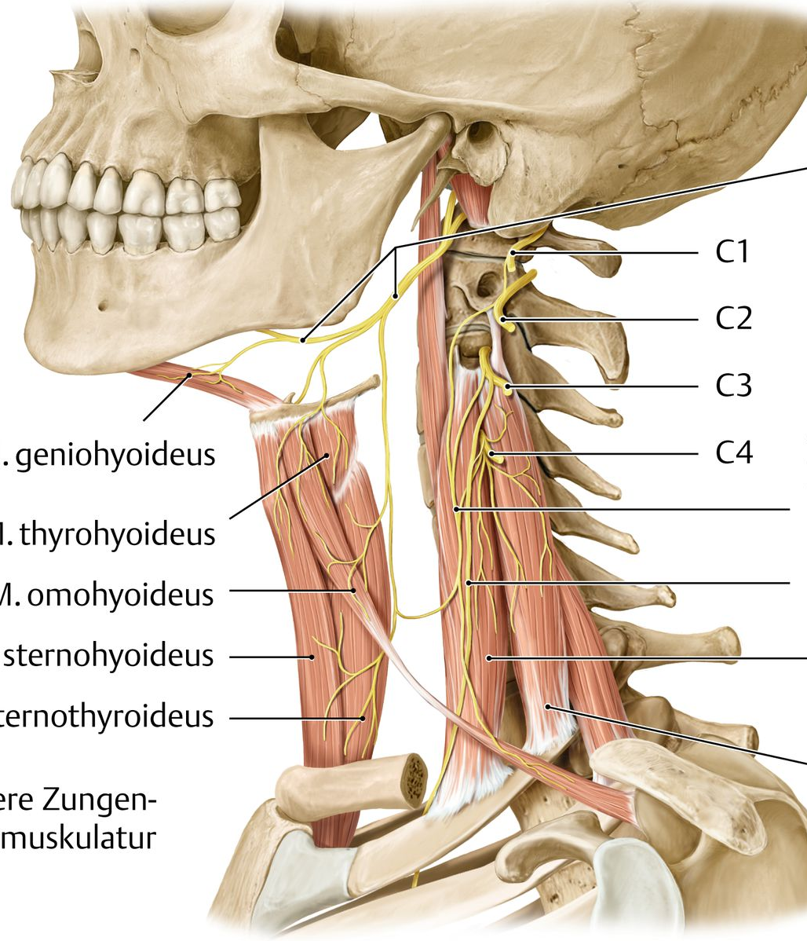
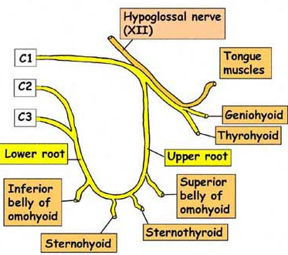
Ansa cervicalis profunda:
Radix superior ansae cervicalis prof.
(accompanies nervus XII.)
Radix inferior ansae cervicalis prof.
Innervation of infrahyoid muscles

Slide 10
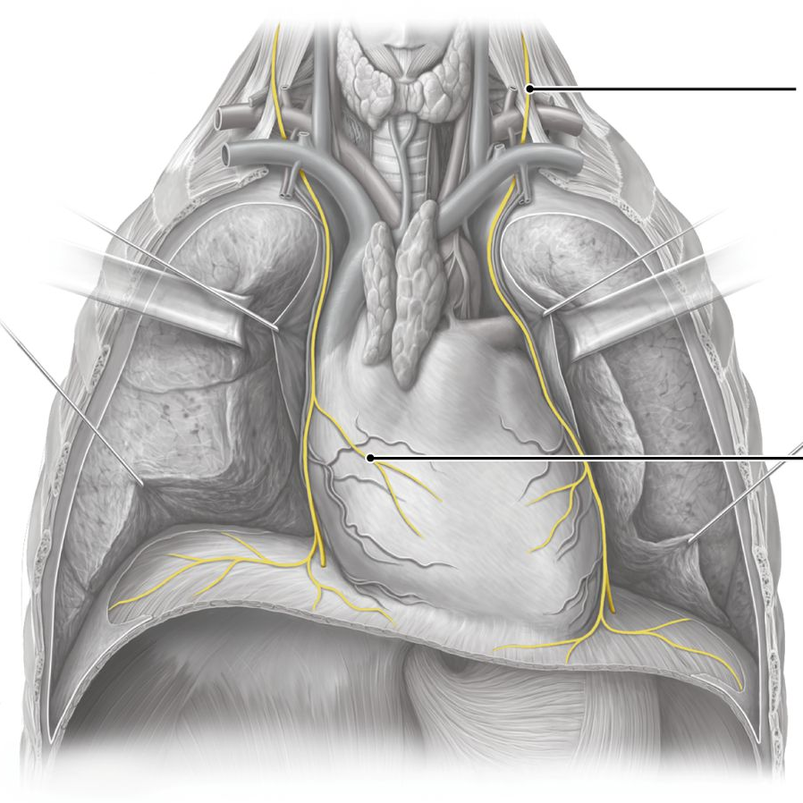
Mixed branches:
  n. phrenicus (C3–5)
  - Motor innervation of the diaphragma, sensoric innervation of the peritoneum to gallbladder and pancreas ; r. pericardiacus - → pericardium and partly pleura

Slide 11
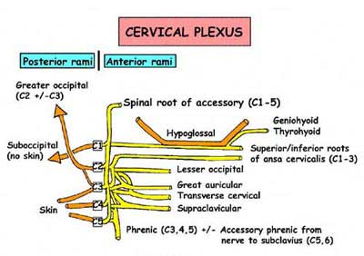

Slide 12
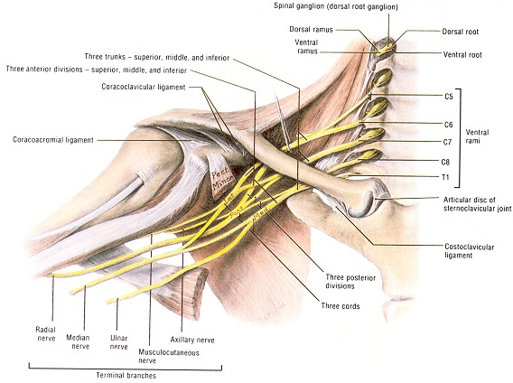
PLEXUS BRACHIALIS
rami ventrales nervorum
spinalium C₅ – Th ₁
innervation of
upper extremity,
heterochtonic
muscles of thorax
and back
Fissura scalenorum
supraclavicular part
infraclavicular part

Slide 13
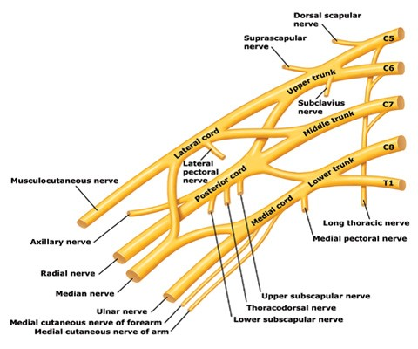
SUPRACLAVICULAR PART
n.dorsalis scapulae
n.suprascapularis
n.thoracicus longus
nn.pectorales
n.subscapularis
n.thoracodorsalis

Slide 14
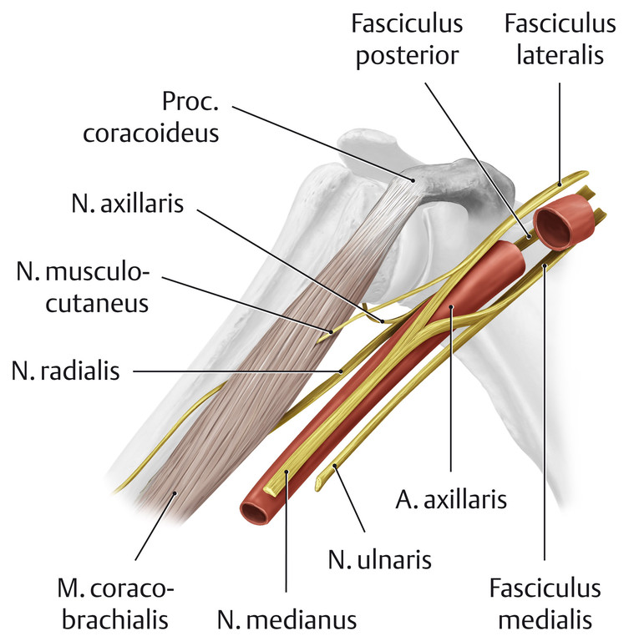
INFRACLAVICULAR PART
Medial cord:
Nervus ulnaris
Nervus cutaneus brachii medialis
Nervus cutaneus antebrachii medialis
Radix medialis nervi mediani
Lateral cord:
Nervus musculocutaneus
Radix lateralis nervi mediani
Posterior cord:
Nervus radialis
Nervus axillaris

Slide 15
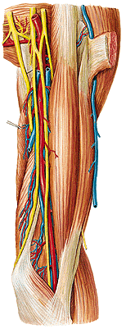
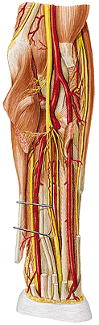
Nervus medianus
Radix medialis et lateralis
Sulcus bicipitalis medialis
Canalis pronatorius
Forearm:
Muscles of anterior group
(exceptions)

Slide 16
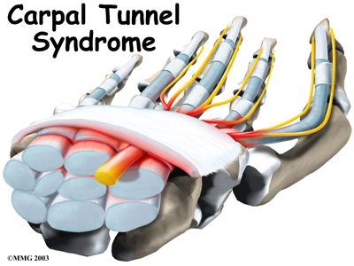
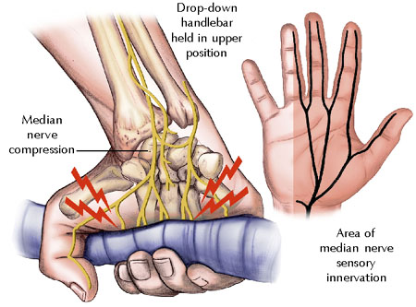
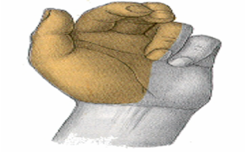
Notes:
Syndrom opičí ruky- vázne opozice palce

Slide 17
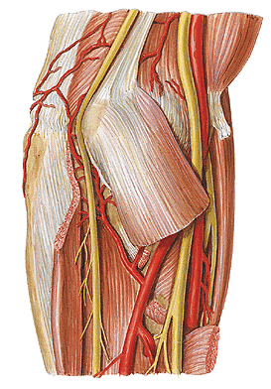
Nervus ulnaris
Medial cord
Sulcus bicipitalis medialis
Sulcus nervi ulnaris
Forearm:
Musculus flexoris carpi ulnaris
Medial part of musculus
flexor digitorum profundus

Slide 18
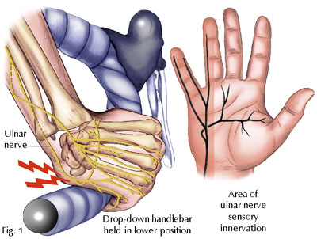
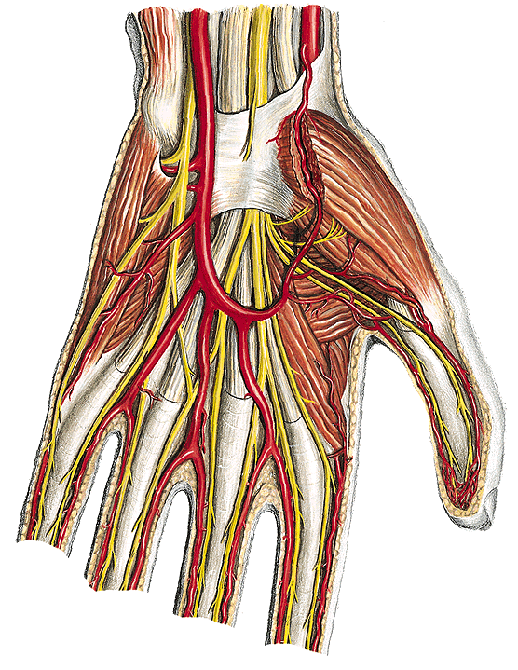
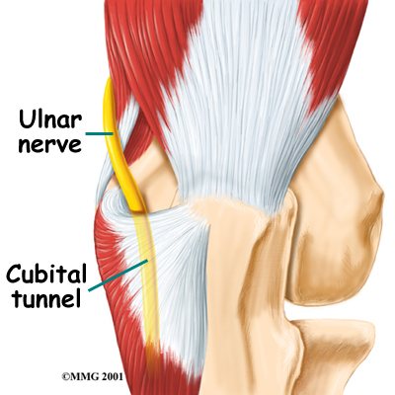
Notes:
Guyonův kanálek

Slide 19
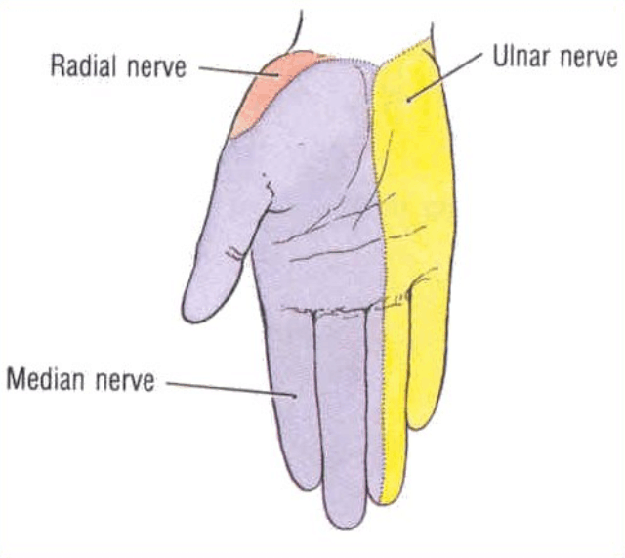
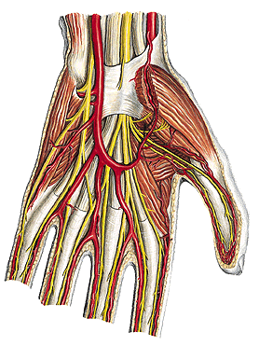
Innervation of the palmar side of hand
Nervus medianus:
Muscles of thenar (exceptions)
Nervus ulnaris:
Muscles of hypothenar
Musculi interossei
Musculi lumbricales 3-4
Musculus adductor pollicis
Caput profundum musculi
flexoris pollicis brevis
Sensoric innervation

Slide 20
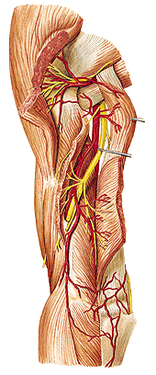
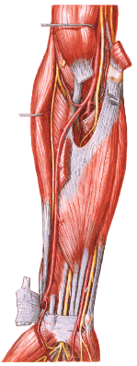
Nervus radialis
Arm:
Muscles of posterior group
Skin (posterior and lateral side)
Forearm:
Superficial and deep branch
Muscles of latral and posterior group
Skin (posterior side)

Slide 21
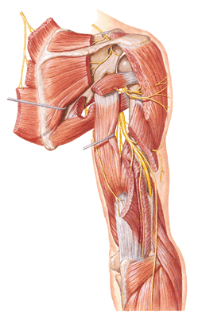
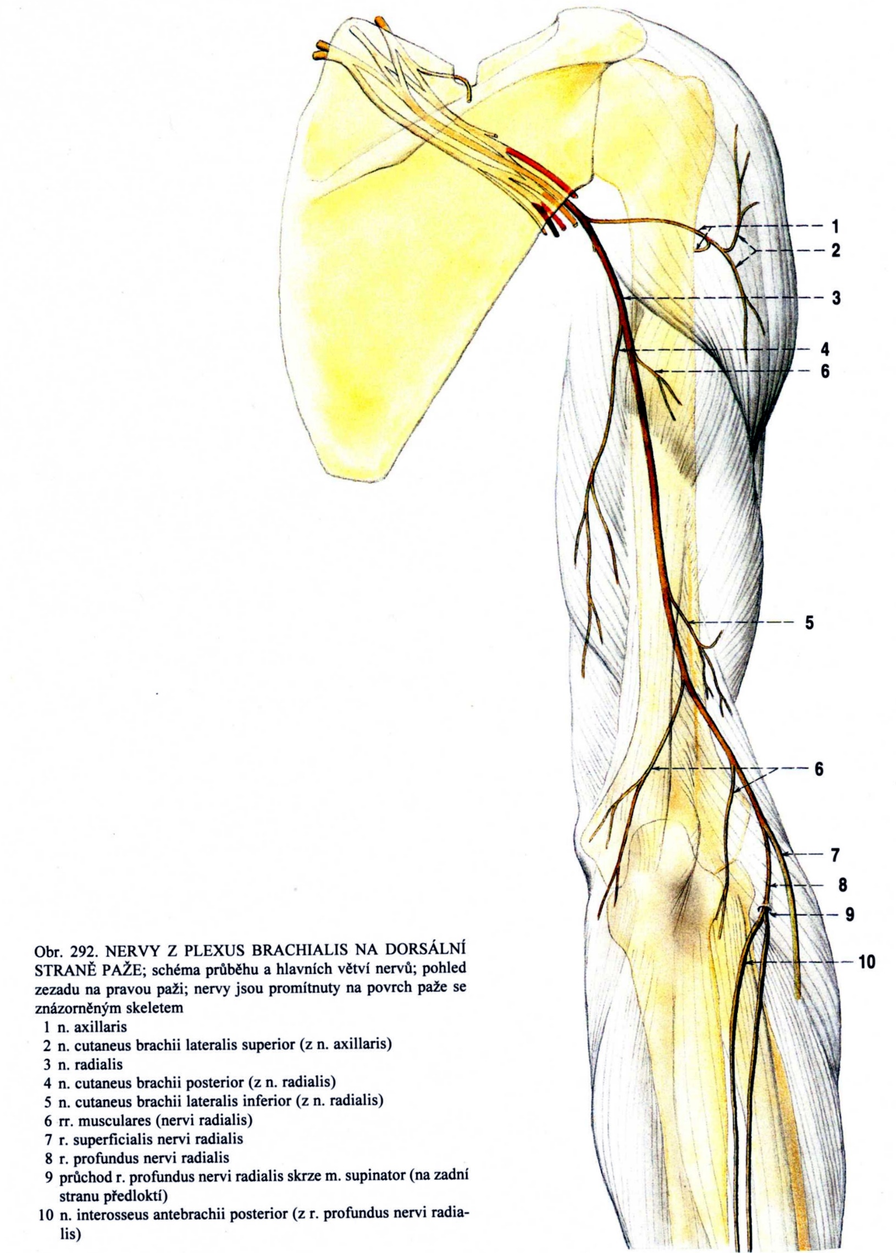
Notes:
Epoletový příznak

Slide 22
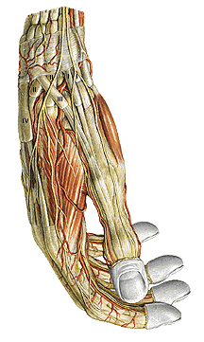
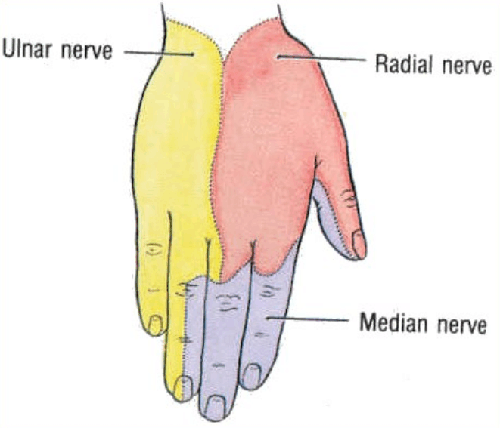
Innervation of the dorsal side of hand

Slide 23
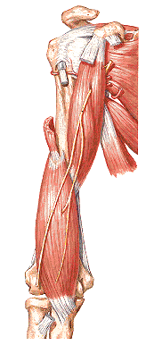
Nervus musculocutaneus
Arm:
Muscles of anterior group – penetrates coracobrachialis
Forearm:
Skin (lateral side) –
Nervus cutaneus antebrachii lateralis

Slide 24
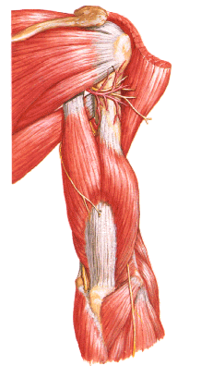
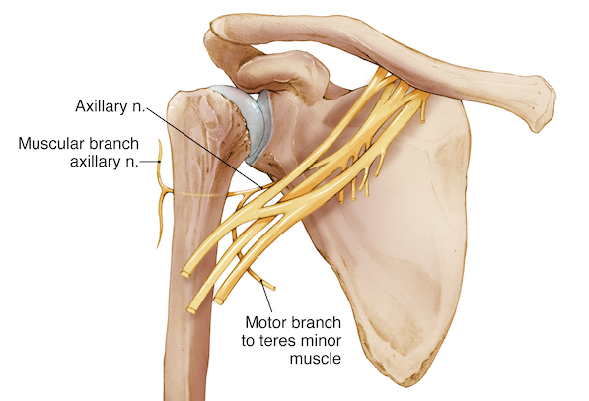
Nervus axillaris
Posterior cord
Penetrates foramen humerotricipitale
Innervates teres minor and deltoideus
Skin of deltoid region

Slide 25
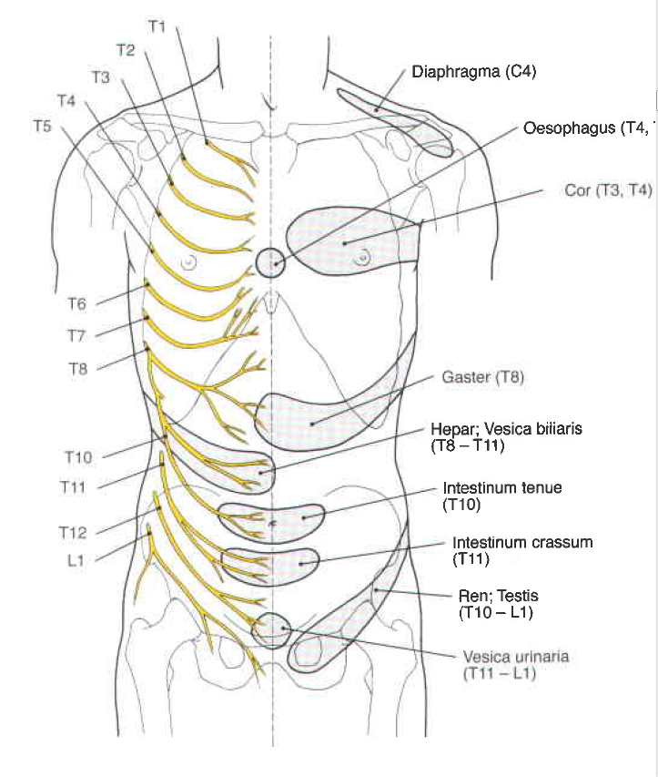
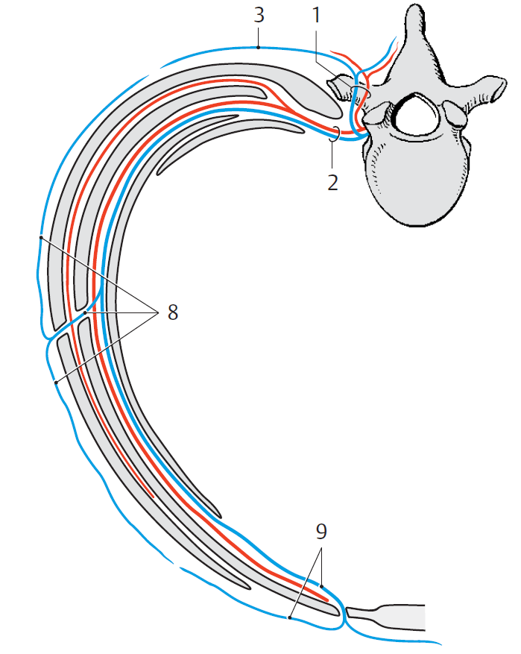
Nn.thoracici Th1-12
Intercostal nerves
Segmental organisation
nn.intercostales
n.subcostalis
rr.musculares
rr.cutanei- laterales
- anteriores

Slide 26
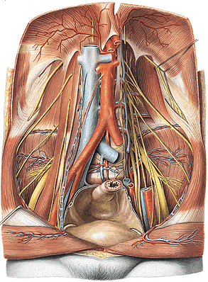
PLEXUS LUMBALIS
rami ventrales nervorum
spinalium L₁ – L ₄
innervation of abdominal wall,
and partially lower extremity
Nervus iliohypogastricus
Nervus ilioinguinalis
Nervus genitofemoralis
Nervus obturatorius
Nervus femoralis

Slide 27
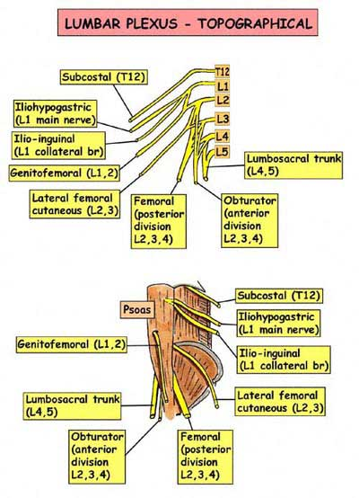
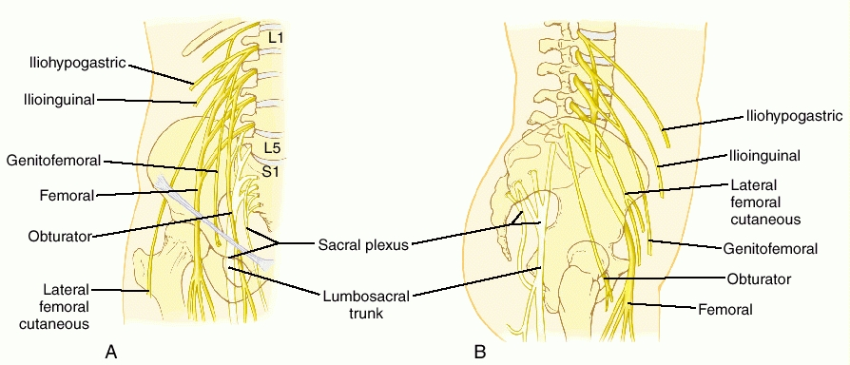

Slide 28
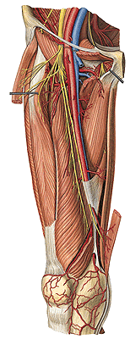
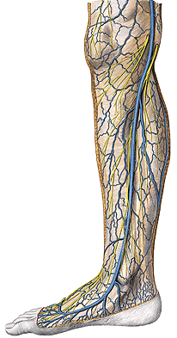
Nervus femoralis
innervation of anterior group
of thigh muscles
Nervus saphenus

Slide 29
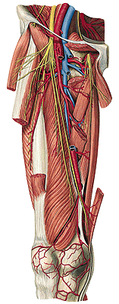
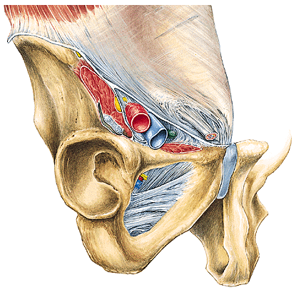
Nervus obturatorius
Canalis obturatorius
Anterior and posterior branch
Innervation of medial thigh muscles and skin

Slide 30
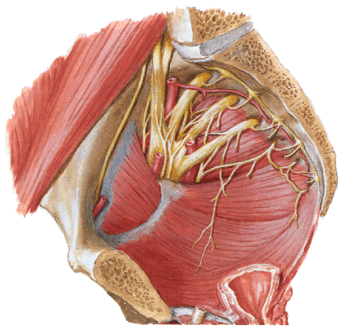
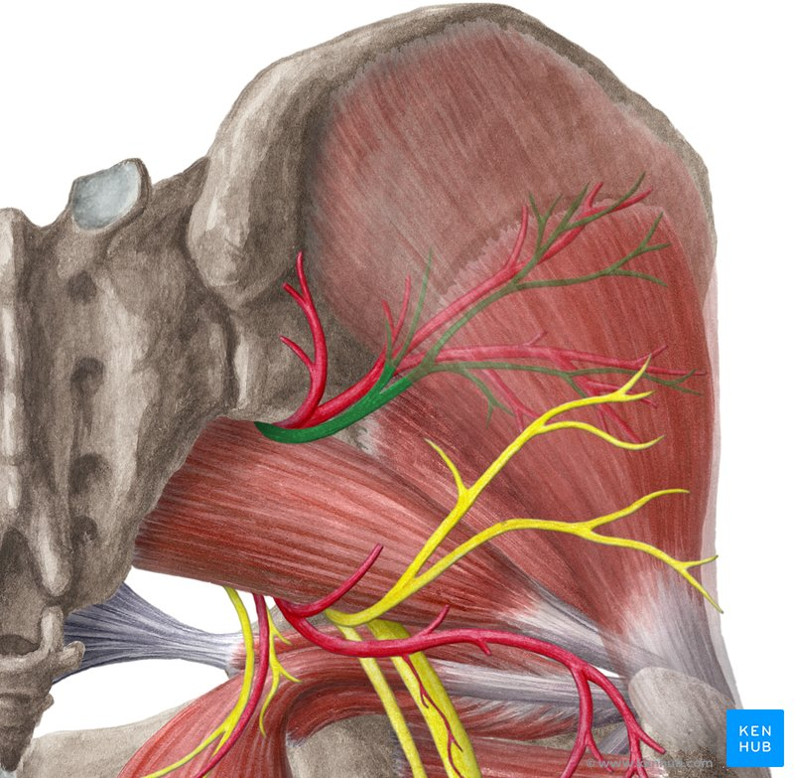
PLEXUS SACRALIS
rami ventrales nervorum
spinalium L₄ – S ₅
Nervus glutaeus superior
Nervus glutaeus inferior
Nervus pudendus
Nervus cutaneus femoris posterior
Nervus ischiadicus

Slide 31
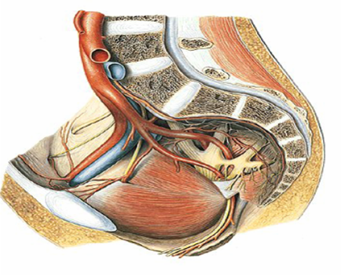

Slide 32
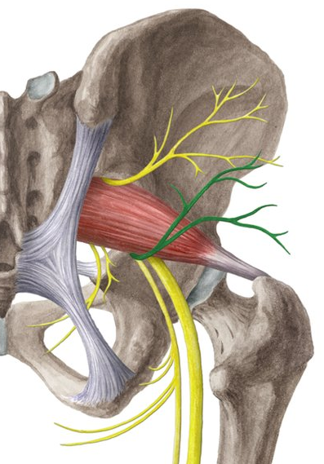
Nervus glutaeus superior et inferior innervates gluteal muscles

Slide 33
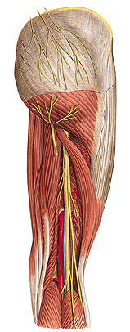


Nervus ischiadicus
innervation of posterior
group of thigh muslces

Slide 34

In distal third of thigh nervus
ischiadicus is splitted and forms:
Nervus fibularis communis
Nervus tibialis

Slide 35


Nervus fibularis communis
On the level of head of fibula is splitted
Nervus fibularis superficialis
innervation of lateral group
of crural muscles
Nervus fibularis profundus
innervation of anterior group
of crural muscles

Slide 36



Nervus fibularis superficialis
Nervus fibularis profundus
Nervus cutaneus dorsalis
medialis et intermedius
Innervation of muscles on the dorsum pedis
Skin of adjacent sides of toe and second finger

Slide 37


Nervus tibialis
innervation of posterior group
of crural muscles

Slide 38


Nervus plantaris medialis et lateralis
Innervation of foot muscles
Skin - line through fourth finger

Slide 39

CRANIAL NERVES

Slide 40



FIBERS OF THE CRANIAL NERVES
motorické jádro
žíhané svaly
1. MOTOR- eferent
HN III, IV, V, VI, VII, IX-XII
efectors= striated muscles of the head and neck
2. PARASYMPATHETIC: HN III, VII, IX, X -– eferent
  N. III - GANGLION CILARE(N.III)
  N. VII - GANGLION PTERYGOPALATINUM ET SUBMANDIBULARE
  N. IX- GANGLION OTICUM
efectors = smooth muscles and glans of the head
3. SENSORIC
  N. V- GANGLION TRIGEMINALE
  N. VII – GANGLION GENICULI
  N. IX + X – GANGLION SUP. ET INF.
axon
pasy ganglion
pasy jádro
pregangl. vl.
postgangl. vl.
hladké svaly
žlázy
SS, S ganglion
SS, S
jádro
receptor
dendrit
axon

Slide 41

NUCLEUSES OF THE CRANIAL NERVES
III – XII
FOSSA RHOMBOIDEA
Are located in the rows:
Sensoric
2 rows laterally
Ncl. n. V
Ncl. n. VII, IX, X
Ncl. n VIII
Motor
2 rows medially
Ncl. nn. III,IV,VI,V, VII, IX-XII
Parasympathetic
Between motor rows
Ncl nn. III, VII, IX+X

Slide 42


OUTPUTS FROM THE BRAIN
I. – telencephalon
II. – diencephalon
III.-XII. – BRAINSTEM
IV. – DORSALLY !!!
III.
IV.
V.
VI.
VII.
VIII.
IX., X., XI.
XII.

Slide 43

OUTPUTS FROM SKULL
IV.
III.
V.
VI.
VII.
VIII.
XII.
IX., X., XI.

Slide 44




I. N. OLFACTORIUS
Function
sensoric
–information from olfactory epithelium to the brain

Slide 45




II. N. OPTICUS
Function
sensoric
– info from optic receptors to the brain

Slide 46




III. N. OCULOMOTORIUS
Extraocular muscles
Musculus ciliaris
Musculus sphincter pupilae

Slide 47


IV. N. TROCHLEARIS
Musculus obliquus superior

Slide 48

V. N.TRIGEMINUS

Slide 49



NERVUS OPHTHALMICUS (N. V₁)
n. frontalis
n. nasociliaris
n. lacrimalis
ganglion ciliare parasympathic
n. supraorbitalis – palpation

Slide 50

NERVUS MAXILLARIS (N. V₂)
foramen rotundum
- somatosensoric – the skin of the middle part of skin, upper dental arch with teeth
n. zygomaticus
n.zygomaticofacialis
n.zygomaticotemporalis
nn. pterygopalatini
n. infraorbitalis
nn. alveolares sup.

Slide 51


NERVUS MANDIBULARIS (N. V₃)
motor
pro svaly
žvýkací
suprahyoidní
m. tensor veli palatini
m. tensor tympani
sensoric
n. alveolaris inferior
n. lingualis- chorda tympani z n. VII
n. auriculotemporalis
parasympathic ganglia submandibulare + oticum
n. mentalis – palpation

Slide 52




Slide 53

VI. N. ABDUCENS
Musculus rectus lateralis

Slide 54


VII. N.FACIALIS
somatosensoric – auricula, meatus acusticus externus
sensoric – taste buds from anterior 2/3 of tongue
somatomotor – mimic muscles, platysma, m. stapedius, m.stylohyoideus, m.digastricus- venter posterior
visceromotor – gl.lacrimalis, sublingualis et submandibularis

Slide 55

NERVUS FACIALIS in the canalis nervi facialis
N. petrosus major
(secretory innervation of small salivary
glands and lacrimal glands)
N. stapedius (m. stapedius)
Chorda tympani
(secretory innervation of submandibular and
Sublingual glands, taste from anterior 2/3 of tongue!!!)

Slide 56


plexus parotideus
Innervation of muscles
of facial expression !!!

Slide 57


VIII. N. VESTIBULOCOCHLEARIS
Sensoric
– hearing + balance

Slide 58

IX. N. GLOSSOPHARYNGEUS
somatosensoric – posterior part of cavum oris, pharynx, middle ear
sensoric – taste from posterior 1/3 of tongue
somatomotor – striated muscles of soft palate and pharynx
visceromotor – gl.parotidea

Slide 59

n.tympanicus – secretory innervation of parotid gland
rr. pharyngei – innervation of pharyngeal muscles and muscles of soft palate
r.stylopharyngeus
rr.linguales – taste from posterior 1/3 of tongue

Slide 60

X. N. VAGUS
somatosensoric - part of auricula and meatus acusticus externus
Viscerosensoric – thoracic and abdominal organs
Somatomotor- striated muscles of pharynx and larynx
Visceromotor- smooth muscles of respirátory and digestive tract and heart

Slide 61

Head:
Pharynx
Taste from the glottis
Meninges
Auricle
Neck:
Muscles and mucous membrane of larynx
Trachea
Esophagus
Heart
Thorax:
Bronchioli
Esophagus
Abdominal cavity:
Stomach
Liver
Kidney
Intestins (left colic flecture)
Genital glands

Slide 62



XI. N. ACCESORIUS
Radices craniales
Radices spinales
Ramus internus-
Added to the n.X.- muscles of larynx
Ramus externus-
m. trapezius + m.
sternocleidomastoideus

Slide 63



XII. N. HYPOGLOSSUS
Motor nerve
Innervation of intra- and extraglossal muscles
Ansa cervicalis profunda

Slide 64


AUTONOMIC NERVOUS SYSTEM (ANS)
FUNCTION:
fylogenetically the oldest part of NS, control smooth muscles,
glands, heart
MORPOLOGICAL DIVISIONS:
- central
- peripheral
FUNCTIONAL DIVISIONS:
Sympathicus (pars sympathica)
Fight or flight - catabolic function (release the energy)
Parasympathicus (pars parasympathica)
Rest or digest - anabolic reactions (store the energy)
Enteric system

Slide 65
cranio- sacral system (parasympathicus)
thoraco-lumbal system (sympathicus)
cranio-sacral system (parasympathicus)
paravertebral
prevertebral
CNS
intramural
effektor

Slide 66

ncl.intermediolateralis
(C8- L3)
VM nucleus CN (III.,
VII.,IX.,X.)
ncl.intermediolateralis
(S2-5)
Psy
thoracolumbal X craniosacral
Ganglia far X close to the target organ
mediator in the target organ noradrenalin X acytylcholin
Sy

Slide 67

Ncl. intermediomedilais
Nervus spinalis
Ncl.intermediolateralis
α motoneurony
VISCEROSENSORIC
VISCEROMOTOR
MOTOR

Slide 68

Sympathicus

Slide 69


SYMPATICUS - system (cervico)-thoraco-lumbar
from C₈ until L₂ – radix ant. sp. nerve
n. spinalis
r.comm. albus
tr. sympaticus
Ncl. intermediolateralis
(from C₈ until L₂)

Slide 70


TRUNCUS SYMPATICUS
ganglia trunci sympatici (paravertebral)
  cervicalia 3 (sup., med., inf.)
  thoracica 10-11
  lumbalia 4-5
  sacralia 4-5
  ganglion impar
rami interganglionares

Slide 71

GANGLION TRUNCI SYMPATICI – eferent fibres
To the organs:
rr. viscerales
(postganglionic fibres)
nn. splanchnici
(praeganglionic fibres,
praevertebral and intramural plexus)
rr.comm. grisei
(to the n. spinalis - skin)
rr. vasculares (net around the
arteries)

Slide 72

Ggl. cervicale sup., med. et stellatum
ggl. cervicale sup.
a. car. com.
r. interganglionaris
ggl. cervicale med.
n. card. cerv. med.
gl. thyroid.
a. subclav.
gl. parathyroid.
ansa subclav.
ggl. cervicothorac.
(stellatum)
plexus vertebr.
n. card. cerv. inf.
Notes:
ve výši 5. krčního obratle

Slide 73


Ganglia thoracica

Slide 74


Ganglia lumbalia et sacralia + ggl.impar

Slide 75

Paraympathicus

Slide 76

PARASYMPATICUS (cranio-sacral system)
Ncl. parasympaticus n. III
(ggl. ciliare)
Ncl. parasympaticus n. VII
(ggl. pterygopalatinum, ggl.submandibulare)
Ncl. parasympaticus n. IX
(ggl. oticum)
Ncl. parasympaticus n. X
(organs of neck, thorax, abdominal – until flexura coli sinistra!!!, genital glands)
Sacral segments of spinal cord (S2-4), ncl. intermediolateralis
(organs of pelvis except of genital glands)

Slide 77



Slide 78



Slide 79


PRAEVERTEBRAL PLEXUSES – THORACIC CAVITY
Plexus cardiacus spf., prof.
Plexus pulmonalis
Plexus aorticus thoracicus
Plexus oesophageus

Slide 80

PRAEVERTEBRAL PLEXUSES – ABDOMINAL CAVITY
Plexus aorticus abdominalis
Plexus coeliacus
(ggl coeliacum dx. sin.)
  plexus gastrici
  plexus lienalis
  plexus hepaticus
  plexus duodenalis
  plexus pancreaticus
Plexus mesentericus superior
Plexus mesentericus inferior
Plexus renalis et suprarenalis
(plexus uretericus)
Plexus testicularis (ovaricus)
Plexus iliaci (plexus femoralis)

Slide 81

PRAEVERTEBRAL PLEXUSES – PELVIS
Plexus hypogastricus superior
(n. praesacralis)
Plexus hypogastricus dx. a sin.
Plexus hypogastricus inf.

Slide 82


Praevertebral ganglia

Slide 83

ENTERIC SYSTEM
Meissnerova
pleteň
Auerbachova
pleteň
stratum circulare
stratum longitudinale
ovlivnění (modulace)
symp. a parasympatikem
l. muscularis mucosae
enterický motorický neuron)
enterický interneuron
enterický viscerosenzorický neuron

Slide 84

CENTRAL PART OF AUTONOMIC NERVOUS SYSTEM
Hypothalamus (subsystem of limbic brain = visceral brain)
HYPOTHALAMUS
Ncll. hypothalamici ant.
control parasympaticus
Ncll. hypothalamici medii
Control the sympaticus

Slide 85
Zadní kořen vede jak somatosenzoriku,
tak i viscerosenzoriku
Při vedení bolesti z útrob tak může dojít k jevu, kdy impulzy z orgánů jsou (na úrovni spinálního ganglia nebo míchy) převedeny na neurony vedoucí vjemy z kůže, což vede k přecitlivělosti daného okrsku kůže na dotek. Tyto okrsky, typické pro jednotlivé vnitřní orgány se nazývají
HEADOVY zóny.

Slide 86

HAEDOVY ZONY
Srdce a oblouk aorty- Th1-Th8- vlevo
Plíce a průdušky- Th3-Th5-Th9- oboustranně
Žaludek- Th5-Th9- vlevo
Dvanáctník, játra, žlučník- Th6-Th9- vpravo
Slezina- Th6-Th7- vlevo
Slinivka břišní- Th8-Th9- vlevo
Slepé střevo,vzestupný tračník- Th10-L1- vpravo
Příčný, sestupný tračník- Th11-Th12- vlevo
Sigmovitý tračník, konečník- L1-L2- vlevo
Ledviny, močový měchýř, močovody- Th10-L3-S3- oboustranně
Pohlavní orgány- Th11-L3-S3- oboustranně

