Slide 1
LOW LEVEL LASER THERAPY
LIGHT AMPLIFICATION BY STIMULATED EMISSION OF RADIATION

Slide 3
WHAT WAVELENGTH HAVE THERAPEUTIC LASERS:

Slide 4
IN PHYSICAL MEDICINE WE PREFERED WAVELENGTH 830 nanometers FOR HEALING JOINTS, DEEP TP, DEEP MUSCLES AND FASCIAS.

Slide 5
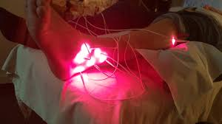
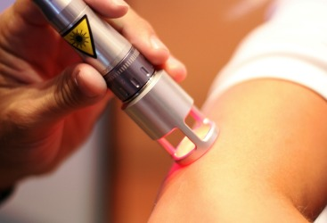
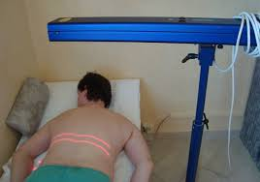

Slide 6
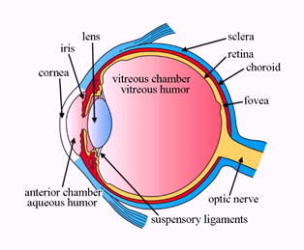

Slide 7
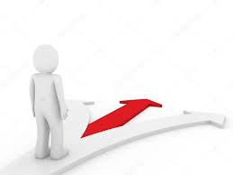
LLLTh is the part of fototherapy
FOTOTHERAPY:
1/ UV- ONLY UVA/HASTEN SKIN AGING, INDUCES PRODUCTION OF VITAMIN D, ACTIVATE MELANOCYTS/
UVB and UVC-CANCER. EFFECT –IONISATION!!
2/ VISIBLE LIGHT: 400- 700nm
3/ INFRARED LIGHT/ CUTANEOUS VASODILATATION, INCREASE METABOLISM, PAIN CONTROL

Slide 8
VISIBLE LIGHT: 400- 700 nanometers

Slide 9
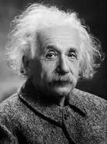
IN 1917 ALBERT EINSTEIN FIRST DESCRIBES ABSORPTION, SPONTANEOUS AND STIMULATED EMISSION OF ELECTROMAGNETIC RADIATION.

Slide 10
THE FIRST NONINVASIVE LASER IN MEDICINE: 1960
/ TOWNES, MAIMANN, GORDON, MESTER, KARRU, OSHIRO/

Slide 12
What is laser
A DEVICE PRODUCES A COHERENT, MONOCHROMATIC AND POLARIZED LIGHT

Slide 13
CONSTRUCTION OF APPARATUS

Slide 14
QUALITY OF THE LASER BEAM

Slide 15
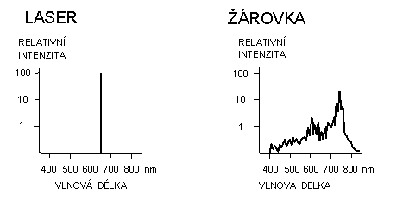
1/ MONOCHROMATICITY
LASER EMITES ONLY ONE WAVELENTH light bulb

Slide 16
2/ POLARIZED BEAM in one lane- easy to pass throught media

Slide 17
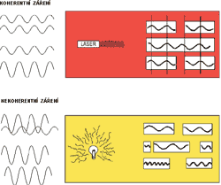
3/COHERENT
ALL IN SAME PHASE

Slide 18
GEOMETRY OF THE LASER BEAM paralier x divergent

Slide 19
PROPERTIES OF THE LIGHT- LASER LIGHT
QUARRY
BOUND
ABSORPTION
PASSAGE

Slide 21
HOW DAS LASER OPERATES ?

Slide 22
INDICATIONS FOR LASER THERAPY
PAIN RELIEF
WOUND HEALING
TP
SCARS
STIMULATE POINTS FOR REFLEX LOKOMOTION IN CHLDREN WITH CEREBRAL PALSY
OTHERS

Slide 25
KONTRAINDICATIONS FOR LASER THERAPY
DIRECT IRRADIATION OF THE EYE
PREGNANCY
MALIGNACY
THYROID GLAND
PHOTOSENSITIVE PATIENTS
IMMUNE SUPPRESSED PATIENTS
ACUTE DISEASE
GONADS
BLEEDIND STATES

Slide 26
OUTPUT: mW: 10-1000 mW/
OUTPUT DENSITY: maximum 1000mW/cm2
ENERGY: JOUL
ENERGY DENSITY: JOUL/cm2- from 2-10J/cm2

Slide 27
LASER GLASSes
EVERY patient , doctor , fysioterapeut, parents must have special glasses, because our eye is 1000x sensitive on laser beam.
Glasses are: absorbing laser beam or reflexive laser beam.

Slide 28
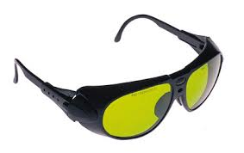
Absorp. Reflex.

Slide 29
IDENTIFICATION OF THE LASER GLASSES
DI
630- 900 nm
D3

Slide 30
NEWS IN LASER THERAPY

Slide 31
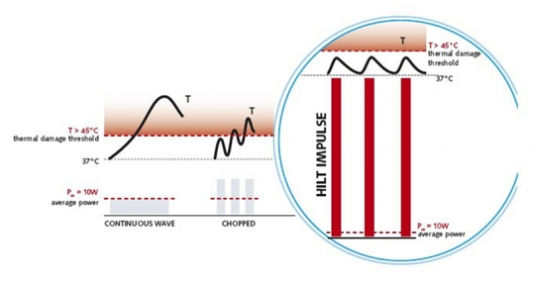
HILTHERAPY

