Slide 1
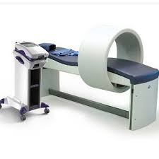
PULSED MAGNETIC THERAPY

Slide 2
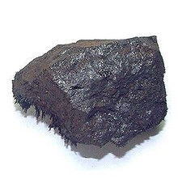
HISTORY
FOR THOUSANDS OF YEARS MAGNETS HAVE BEEN USED BY CHINESE, EGYPTIANS, GREEKS, ROMANS /and others/ TO HEAL.

Slide 4
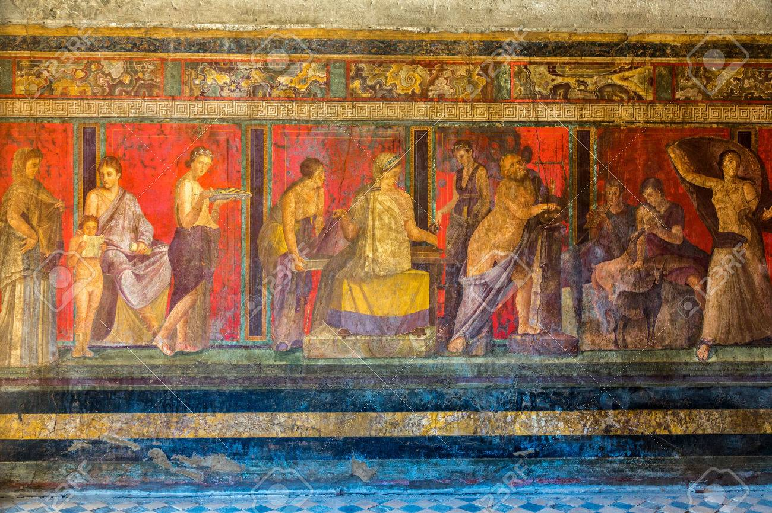
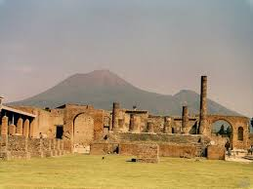
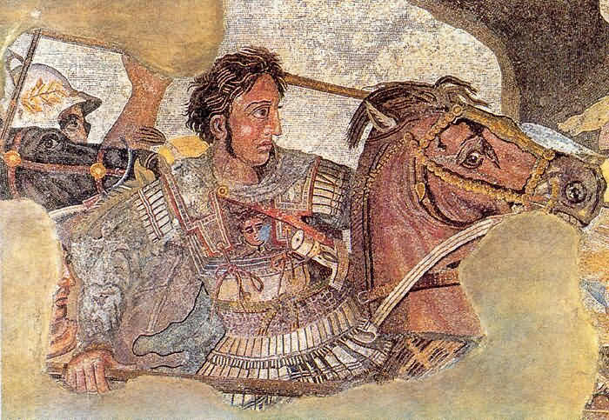
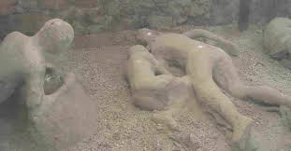

Slide 6
MAGNETIC FIELD- EARTH: 0,04 mT
THERAPEUTIC DOSE: 10-80 mT
NMR: 3 T

Slide 8
ELEKTROMAGNETIC INTERACTION:
Electric field induces magnetic field
Magnetic field induces electric field

Slide 9
This situation is in our body too, so that electronic equipments in our body are KI for magnetotherapy

Slide 12
INDICATIONES:
Arthrosis
CRPSy
Tendinitis and tendovaginitis
Delayed healing
Burns
Fibromyalgia
Delayed bone splicing
Entrapments syndroms
Lumbabo
Spasticity
strains
cerebral pulsy
osteoporosis

Slide 13
KONTRAINDICATIONES:
Metals in human body, which can be heat in magnetic field/ silver Al, …/
Patients with kardiostulator or with defibrilator
Every electronic equipment in the body/pumps, encochlear machine../
Pregnancy
Tumors
Epilepsy/ aplic. on the head/
Serious circularory disorders
acute infection
Mycosis/non healing/
Hyperfunction of the thyroid gland

Slide 14
TREATMENT:
USUALLY LASTING 30 MINUTES
2-7x PER WEEK
10- 20 TIMES

Slide 15
WE CAN USE WITH:
LLLTh
Massage
Manual therapy
balneotherapy

Slide 16
NOTE:
Patient have dress
No cards
No metal on the body

Slide 17
NOTE:
Magnetic field has vagotropic efect
So that slow verticalization after aplication in needed

