Slide 1
Anaesthesia Machine,
Monitoring
L.Dadák
ARK FNUSA & LF MU

Slide 2
Anaesthesia Machine
is able to ventilate the patient by defined mixture of gasses

Slide 3
O2

Slide 4
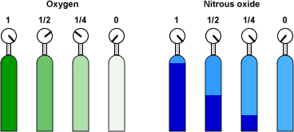
Gas – ISO norm
O2 - white
fractionally distill liquefied air into its various components, (N2 distilling as a vapor,
oxygen O2 is left as a liquid.
Stored as compressed gas.
N20 - blue
pressure 5 MPa
Air white/gray
CO2 - gray
gas
liguid + gas

Slide 5
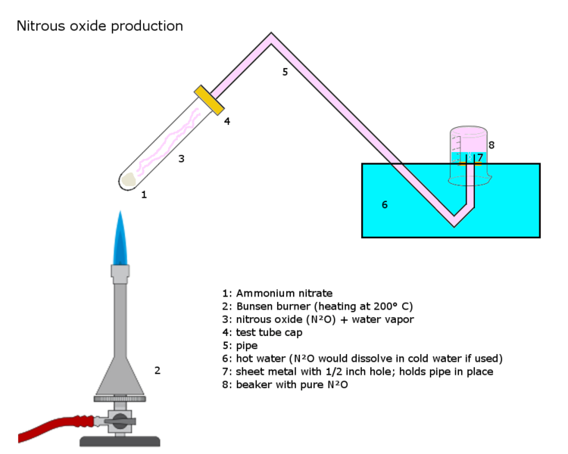
N2O

Slide 6
Anesthesia Machine
is able to ventilate the patient by defined mixture of gasses
Parts:
1.High pressure system
2.Low pressure system
3.Breathing circuit – in/expiratory part
4.Ventilation systems (manual and mechanical)
5.Scavenging system

Slide 7
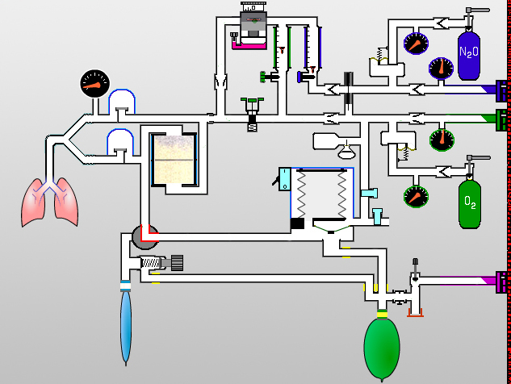
Parts of anesth. machine
1
2
3
4
5

Slide 8
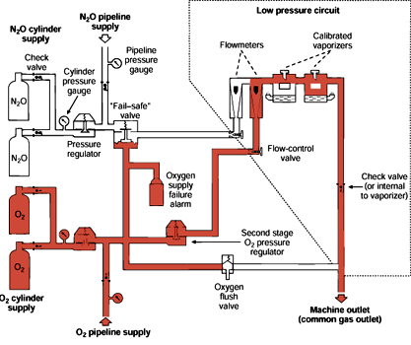

Slide 9
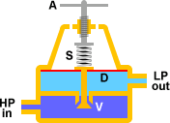
High pressure system
Compressed gas
Cylinder Supply
Pipeline Supply
Oxygen Supply Pressure Failure Safety
pO2 > pN2O
Pressures regulator
manometr

Slide 10
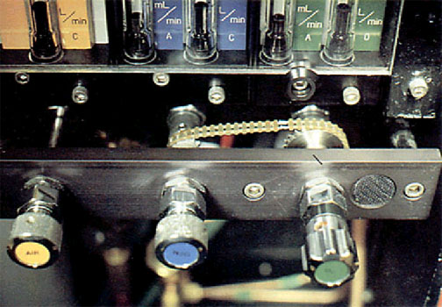
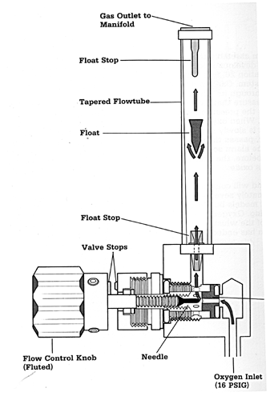
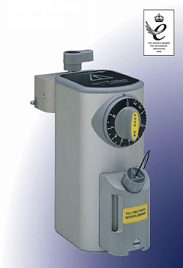
Low pressure system
flowmeter O2, AIR, N2O
Oxygen flush valve
= Bypass,
Vaporizer
APL valve
to deliver appropriate
concentration,
flow

Slide 11

Flow of Anest. gasses
old machines 2..4 l/min
low flow > 1 l/min
minimal flow > 0,5l/min
closed system .. amount of metabolized O2

Slide 12
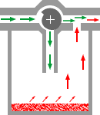
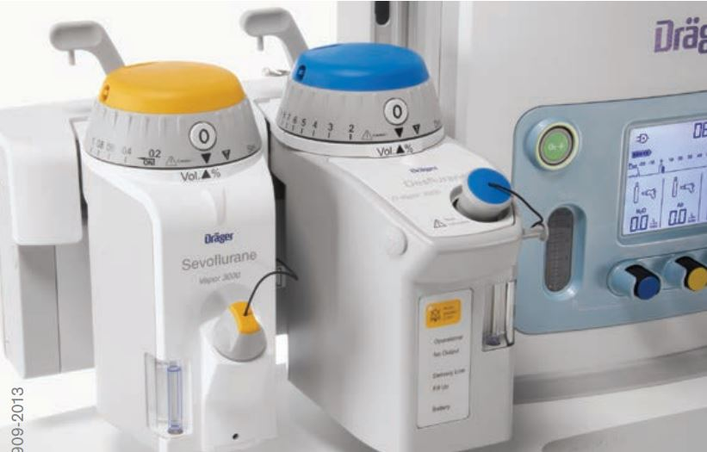
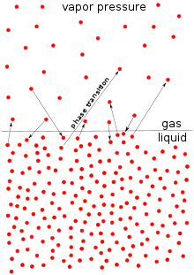
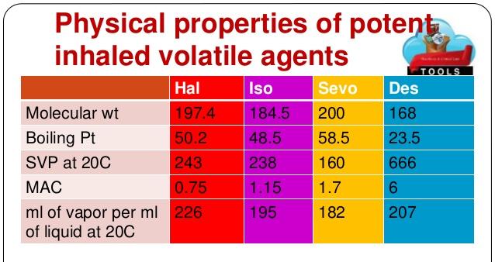
Vaporizer – easy model

Slide 13
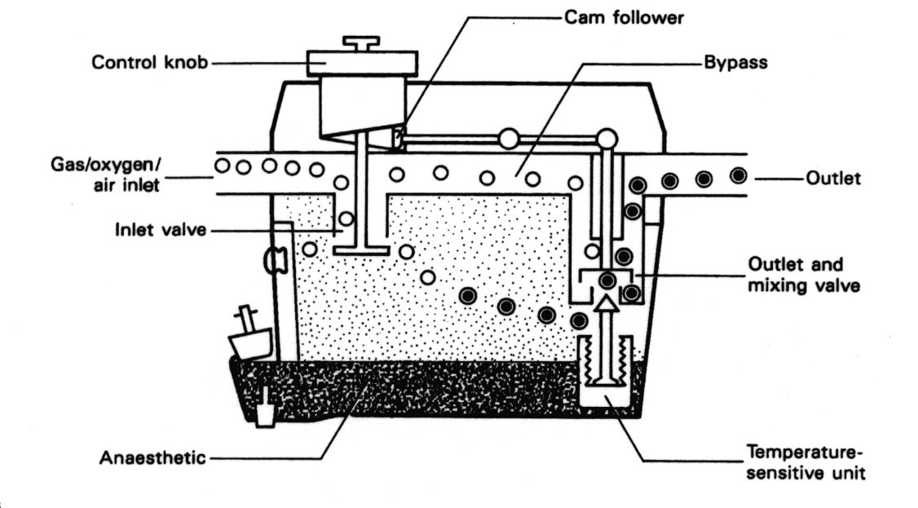
Vaporizers
Energy is needed during evaporation.
Q (termal energy from outside)
T (the gas temperature is lower at the outlet than at the inlet)
Compensation inside
bimetal

Slide 14
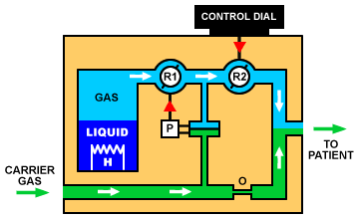

Totaly different one … Desfluran

Slide 15

Breathing Circuit
inspiratory valve
manometr
Y connector
expiratory valve
volumetr
CO2 absorber
tubes
APL valve
to rebreath expired gas without CO2 – low flow

Slide 16
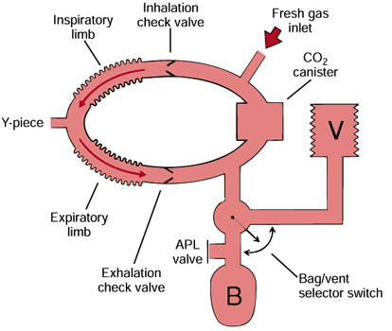

Slide 17
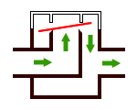
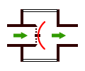
inspiratory + exp. valve
1 dirrection flow

Slide 18
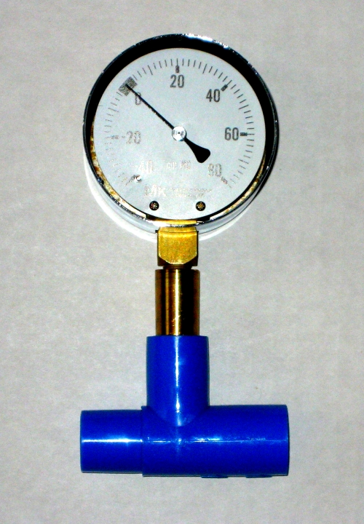
manometr

Slide 19
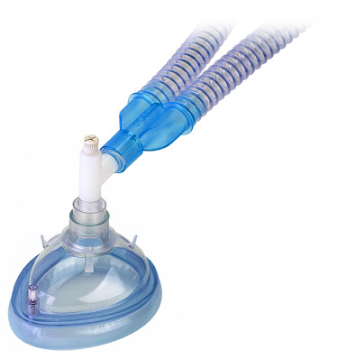
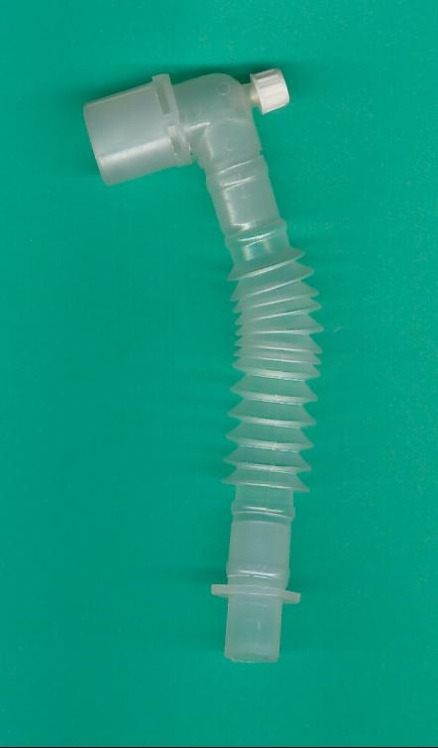
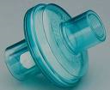
Y connector, filter, tubing

Slide 20
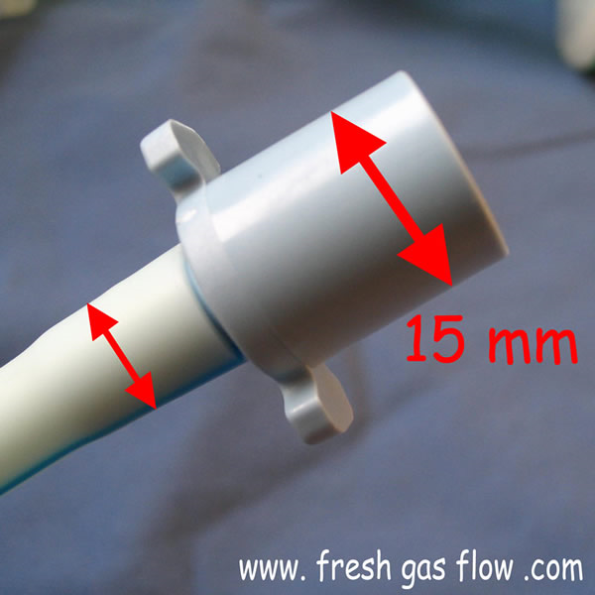
ISO

Slide 21
volumetr

Slide 22
CO2 absorber

Slide 23
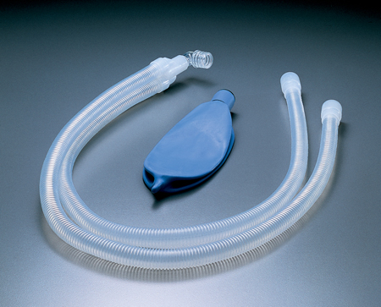
tubing

Slide 24
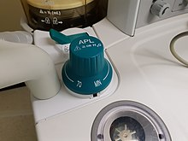
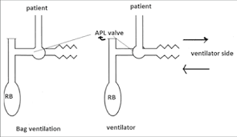
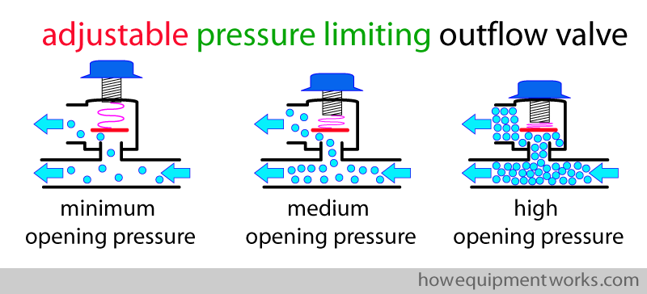
APL
Works during manual ventilation only

Slide 25
Adjustable Pressure Limiting valve
(APL, "pop-off" valve)
is located at a position such that it is in pneumatic conection with the breathing circuit only during manual ventilation
limits the amount of pressure buildup that can occur during manual ventilation. When the user adjusts the APL valve to trap more gas inside the breathing circuit, a spring inside the APL valve is compressed according to how much the user turns the APL valve. The degree of spring compression exerts a proportional force on a sealing diaphragm in the APL valve. The pressure inside the breathing circuit must generate a force that exceeds the spring compression force for the APL valve to open. As pressure continues to build from the combination of fresh gas flow and manual compression of the breathing bag, the opening pressure of the APL valve will be exceeded and excess gas will be vented to the scavenging system.

Slide 26
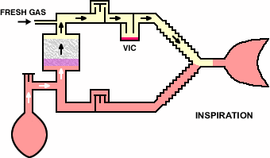
Breathing Circuit

Slide 27
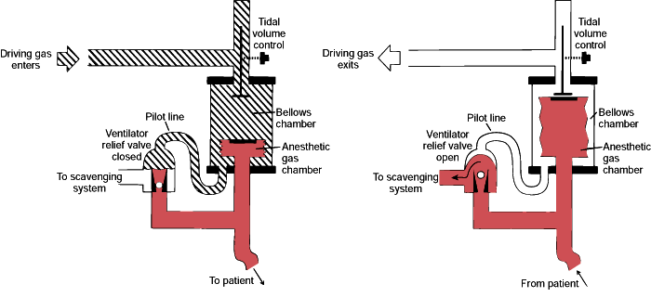
Ventilation system
ventilator (bellow, chamber)
(Volum Controled Ventilation, (PCV)
Vt 6 (..10) ml/kg,
f according EtCO2,
PEEP 5
fiO2 40%
I:E 1:2
manualy - bag

Slide 28
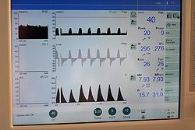
Ventilation system
power source
  gas
  electricity
  both
Drive Mechanism, Circuit degign
  double-circuit ventilator (patient and drive gas)

Slide 29
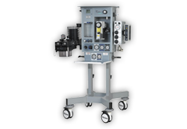
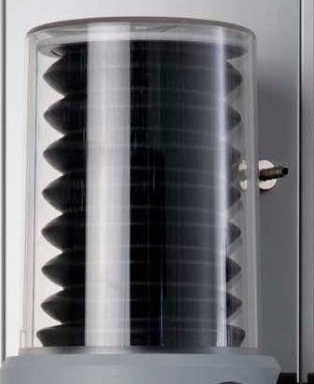
Bellow

Slide 30
Scavenging system
Keep clean OR atmosphere

Slide 31
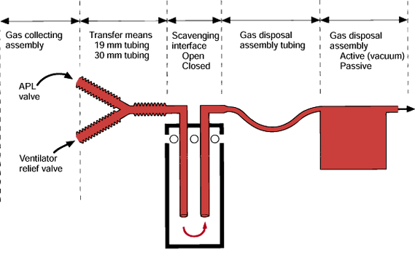
Scavenging system

Slide 32
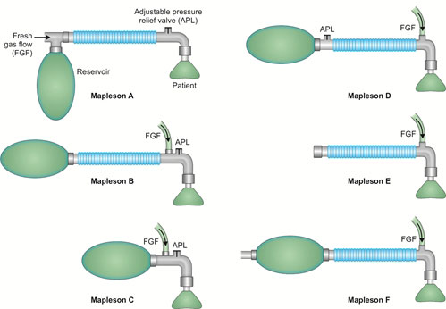
Non rebreathing systems
(do not learn)

Slide 33
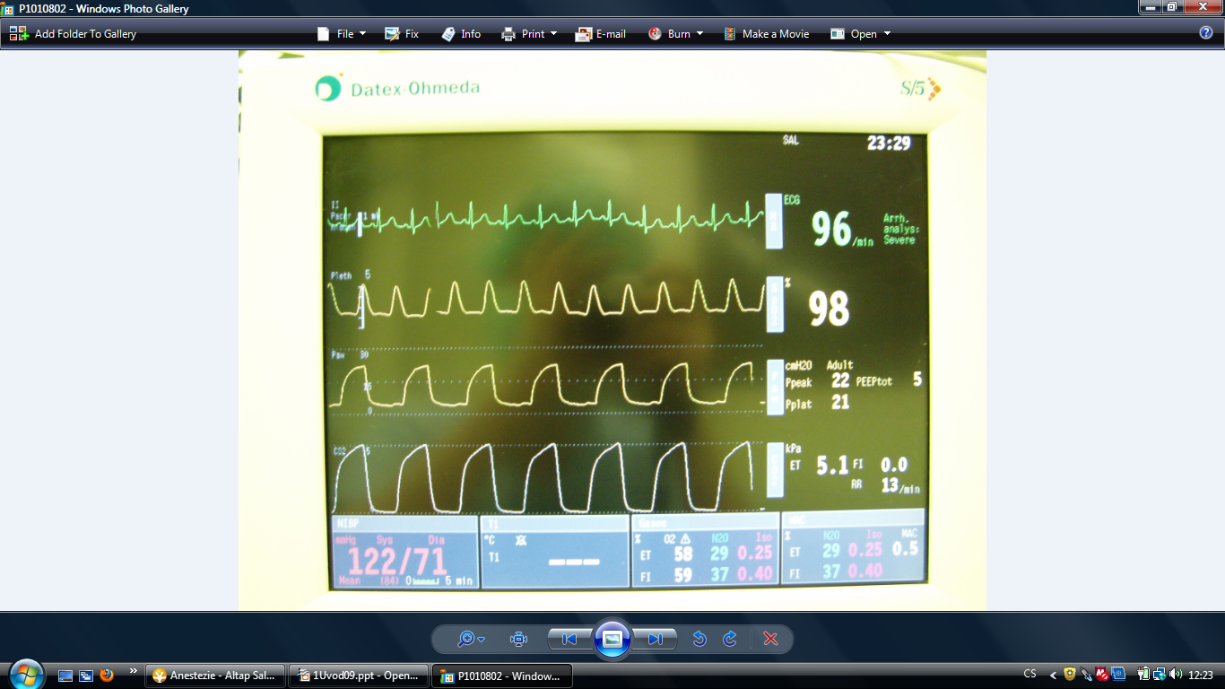

Slide 34
Monitoring system
monere, "to warn"
systematic control
Patient monitoring has been a key aspect of anesthesiology since its beginnings as a medical specialty.

Slide 35

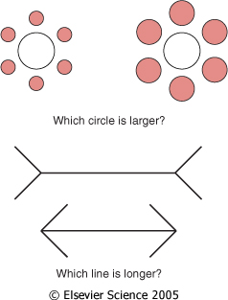
Optical illusions
… it is not possible without eye
Figure 30-1 Optical illusions. We perceive the circles to be different sizes because we infer the size by relative dimensions. The closeness of the smaller circles makes the inner circle appear smaller, and vice versa. The lines appear to be different sizes because we use straight-line perspective to estimate size and distance. This illusion reportedly does not work in cultures where straight lines are not used. Therefore, our internal perceptions lead us to err in estimating size and length. In the same way, the internal programming of our monitors can lead us to misinterpret results.
Downloaded from: Miller's Anesthesia (on 12 March 2009 08:22 PM)
© 2007 Elsevier

Slide 36
Monitoring
1) Presence of anesth. / nurse
Airway + Breathing
  patent A.
  quality of B., auscultation
Circulation
  quality, f, CRT, color of skin, BP
depth of A.
  pupils, sweating, movement
Goal: prevent problem

Slide 37
>>>> Alarm <<<<
< ?? What should I do ??>
  notice
  interpret
  reaction = change something
    alarm off?
    change limits of alarm?

Slide 38
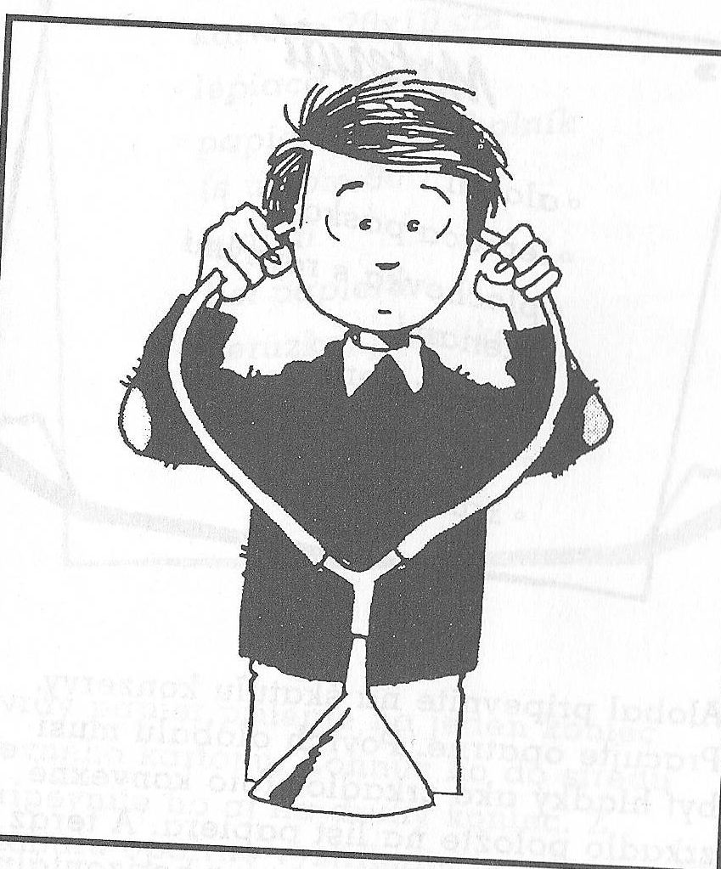
Auscultator
+ available
ventilatory problem
(bronchospasm, laryngospasm - LM)
- SpO2, EtCO2, ECG detect problem easier than continual auscultation.
Basic monitoring in case of Fail of Anest. Machine

Slide 39
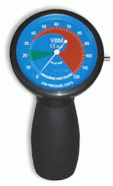
Manometr
Pressure in cuff
(tr. tube / TS kanyla)
… 20 cm H2O
Pressure in SGD cuff (LM, LT)
< 60 cm H2O

Slide 40
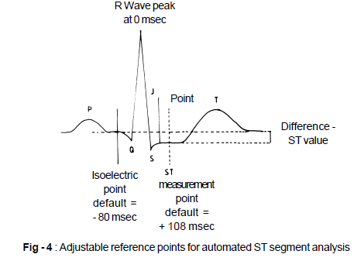
ECG
Heart Frequency
rhytm
extrasystols
ST
- ischemia

Slide 41
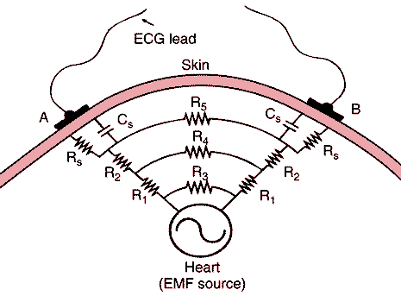
FIGURE 28–30 Why the ECG is so small. Multiple resistances and capacitances in the body decrease the potential and distort the waveform before the EMF reaches the surface.

Slide 42
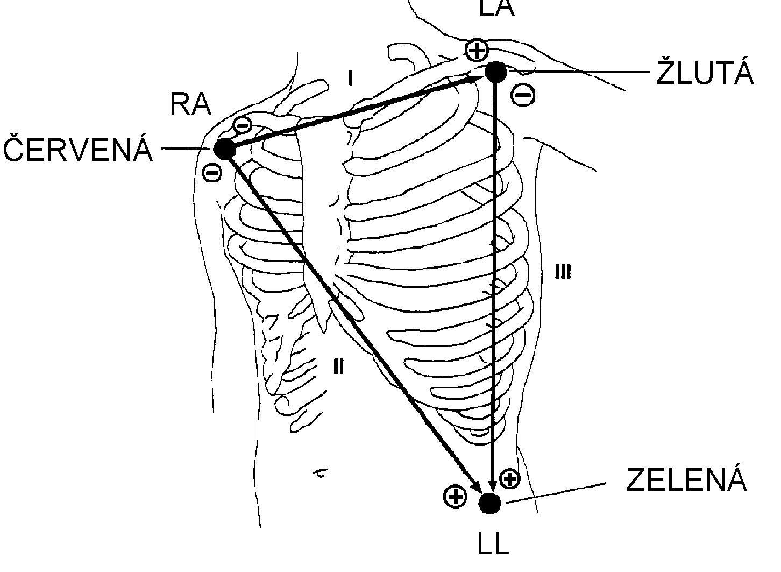
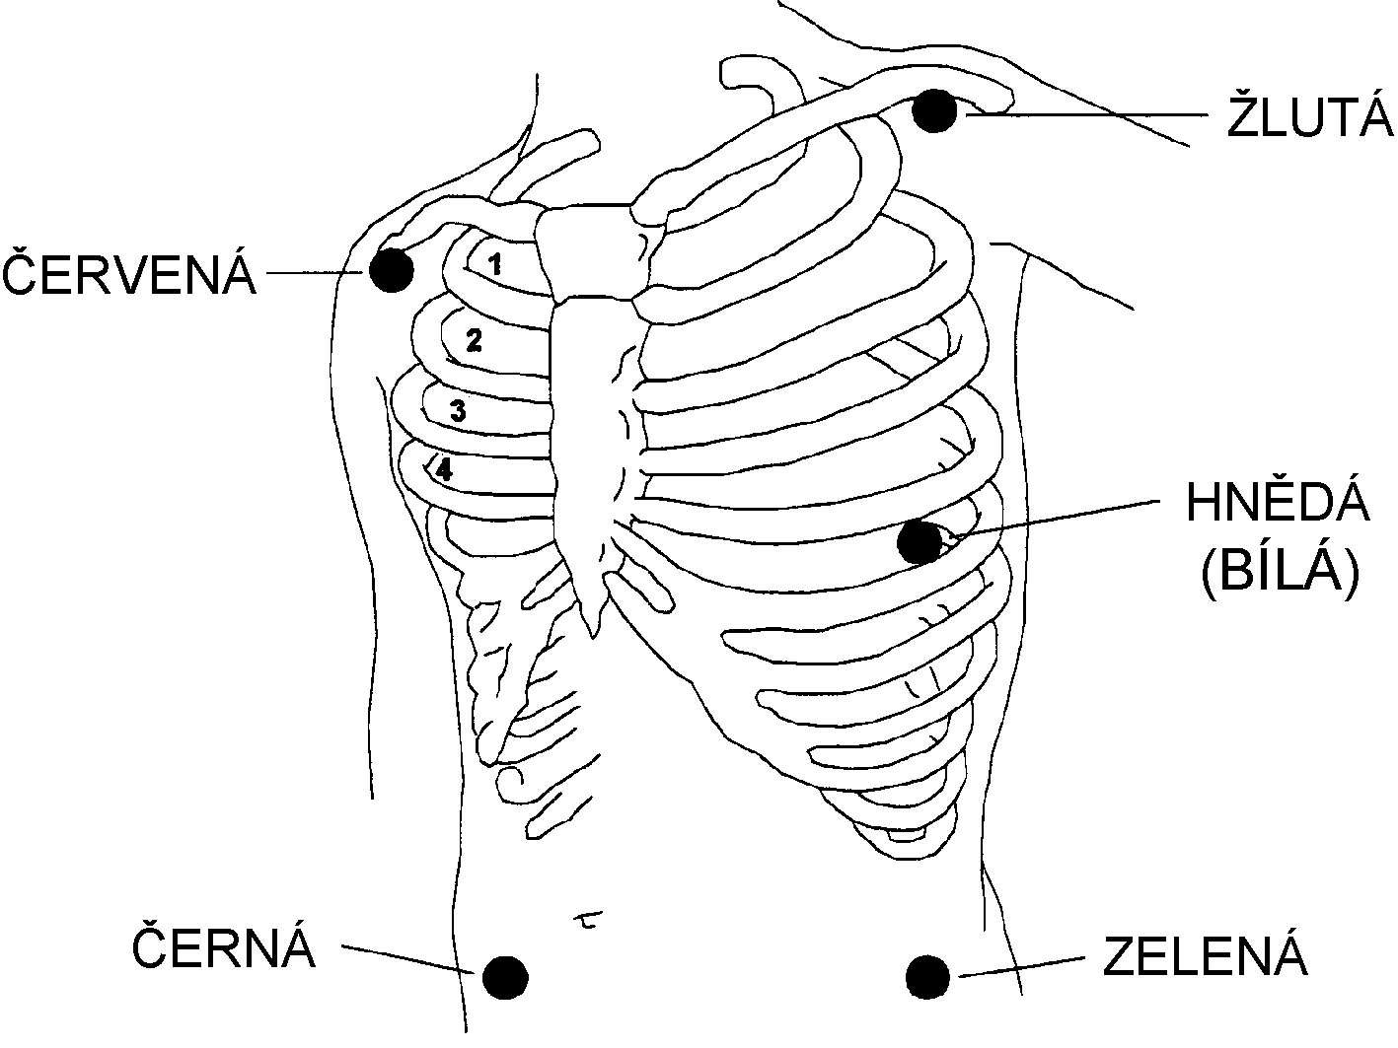
Positioning of electrodes

Slide 43
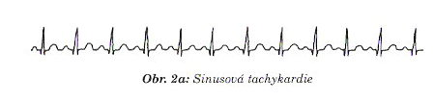
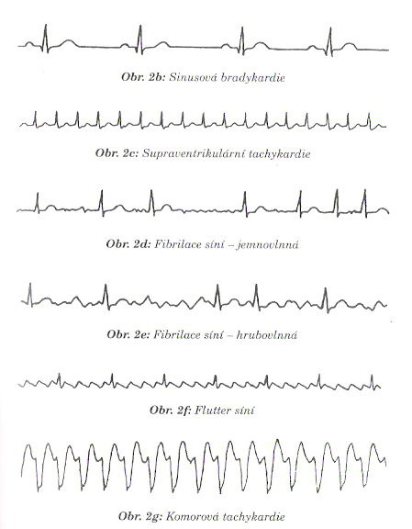
sinus rythm
SVT: (no P, QRS narrow, regular)

Slide 44
Fibrilation of Atrii
irregular , QRS narrow

Slide 45
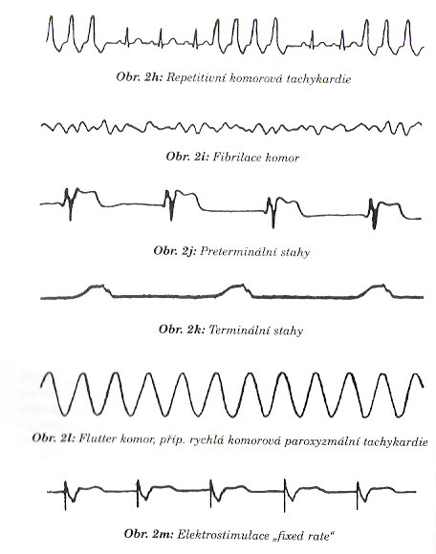
Ventricular rythm

Slide 46
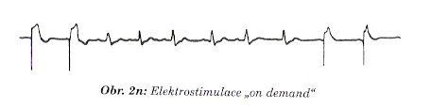
Stimulation
spike, komplex

Slide 47
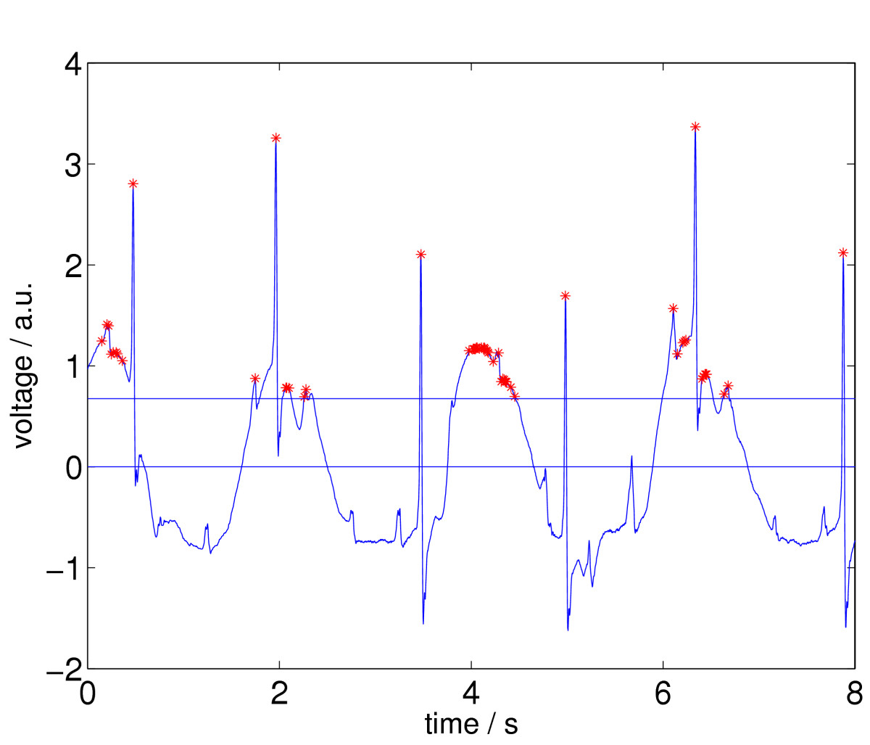
ECG … Heart frequency
45/min or 150/min or ??
Amann et al. BioMedical Engineering OnLine 2005 4:60 doi:10.1186/1475-925X-4-60

Slide 48
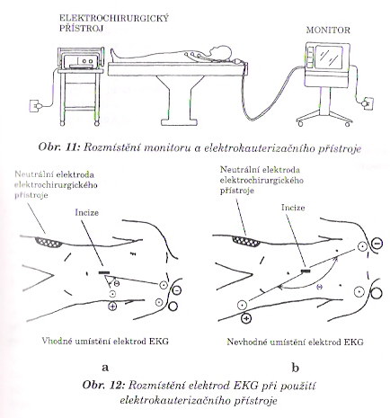
ECG – complication of monitoring
electric interference ()
50Hz coross ECG cabel
cabel as anntena (loop)
no signal 10s after defibrilation

Slide 49
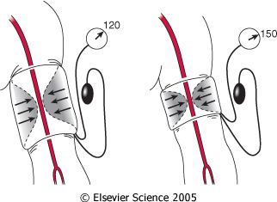
NIBP – effect of cuff size
Figure 32-2 Effect of cuff size on manual blood pressure measurement. An inappropriately small blood pressure cuff yields erroneously high values for blood pressure because the pressure within the cuff is incompletely transmitted to the underlying artery.
Downloaded from: Miller's Anesthesia (on 12 March 2009 08:22 PM)
© 2007 Elsevier

Slide 50
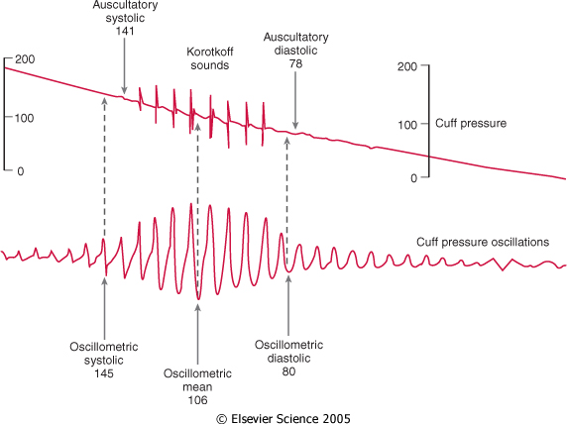
Figure 32-3 Comparison of blood pressure measurements by Korotkoff sounds and oscillometry. Oscillometric systolic blood pressure is recorded at the point where cuff pressure oscillations begin to increase, mean pressure corresponds to the point of maximal oscillations, and diastolic pressure is measured when the oscillations become attenuated. Note the correspondence between these measurements and the Korotkoff sounds that determine auscultatory systolic and diastolic pressure. (Redrawn from Geddes LA: Cardiovascular Devices and Their Applications. New York John Wiley, 1984, Fig 34-2. Reprinted by permission of John Wiley & Sons, Inc.)
Downloaded from: Miller's Anesthesia (on 12 March 2009 08:22 PM)
© 2007 Elsevier

Slide 51
NIBP
Complications :
Pain
Petechie
Edema of extremity
Venous stasis, thrombophlebitis
Peripheral neuropathy
Compartment syndrome
Uneasy measurement
movements
transport
bradycardia < 40/min
obesity
shock - vasoconstriction

Slide 52
IBP, Canylation of artery
real-time, beat to beat
rapid changes - drugs / mechanic
repeated bload samples [BGasses]
failure of NIBP
additional information from puls curve
    Pulse Pressure Variation

Slide 53
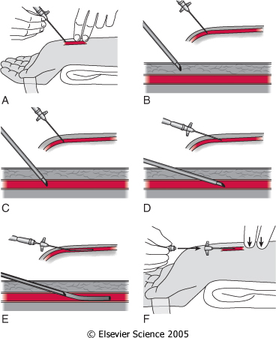
Figure 32-4 Percutaneous radial artery cannulation. A, The wrist is positioned and the artery identified by palpation. B, The catheter-over-needle assembly is introduced through the skin and advanced toward the artery. C, Entry of the needle tip into the artery is identified by the flash of arterial blood in the needle hub reservoir. D, The needle-catheter assembly is advanced at a lower angle to ensure entry of the catheter tip into the vessel. E, If blood flow continues into the needle reservoir, the catheter is advanced gently over the needle into the artery. F, The catheter is attached to pressure monitoring tubing while maintaining proximal occlusive pressure on the artery.
Downloaded from: Miller's Anesthesia (on 12 March 2009 08:22 PM)
© 2007 Elsevier

Slide 54


Invasive Pressure
a. radialis / a. femoralis / a. brachialis
arterie – hose – cell – infusion (cont. flush of cannyla ml/h)
fluid is not compressible X air
cloat of blood / cranking increase ressistance

Slide 55

!!Alarm!! Low BP
Figure 32-1 Digital heart rate (HR) displays may fail to warn of dangerous bradyarrhythmias. Direct observation of the electrocardiogram (ECG) and the arterial blood pressure traces reveals complete heart block and a 4-second period of asystole, whereas the digital display reports an HR of 49 beats/min. Note that the ECG filter (arrow) corrects the baseline drift so that the trace remains on the recording screen. (From Mark JB: Atlas of Cardiovascular Monitoring. New York, Churchill Livingstone, 1998, Fig. 13-2.)

Slide 56
HR: 49/min,
ECG: AV blok III

Slide 57

O2 in the body
Figure 36-1 Oxygen transport cascade. A schematic view of the steps in oxygen transport from the atmosphere to the site of utilization in the mitochondrion is shown here. Approximate Po2 values are shown for each step in the cascade, and factors determining those partial pressures are shown within the square brackets. There is a distribution of tissue Po2 values depending on local capillary blood flow, tissue oxygen consumption, and diffusion distances. Mitochondrial Po2 values are depicted as a range because reported levels vary widely. (Adapted from Nunn JF: Nunn's Applied Respiratory Physiology, 4th ed. Boston, Butterworth-Heinemann, 1993.)
Downloaded from: Miller's Anesthesia (on 12 March 2009 08:46 PM)
© 2007 Elsevier
Notes:
Figure 36-1 Oxygen transport cascade. A schematic view of the steps in oxygen transport from the atmosphere to the site of utilization in the mitochondrion is shown here. Approximate Po2 values are shown for each step in the cascade, and factors determining those partial pressures are shown within the square brackets. There is a distribution of tissue
Po2 values depending on local capillary blood flow, tissue oxygen consumption, and diffusion distances. Mitochondrial Po2 values are depicted as a range because reported levels vary widely. (Adapted from Nunn JF: Nunn's Applied Respiratory Physiology, 4th ed. Boston, Butterworth-Heinemann, 1993.)

Slide 58
Oxygenation of tissues
monitoring of inspired O2
SpO2
Arterial blood gasses
  low cardiac output and good oxygention function of lung

Slide 59

Saturation, SpO2
A pulse oximeter is a particularly convenient noninvasive measurement instrument. Typically it has a pair of small light-emitting diodes (LEDs) facing a photodiode through a translucent part of the patient's body, usually a fingertip or an earlobe. One LED is red, with wavelength of 660 nm, and the other is infrared, 905, 910, or 940 nm. Absorption at these wavelengths differs significantly between oxyhemoglobin and its deoxygenated form; therefore, the oxy/deoxyhemoglobin ratio can be calculated from the ratio of the absorption of the red and infrared light. The absorbance of oxyhemoglobin and deoxyhemoglobin is the same (isosbestic point) for the wavelengths of 590 and 805 nm; earlier oximeters used these wavelengths for correction for hemoglobin concentration.

Slide 60

Principle of pulse oximetry
1000 absorption of light of different wave lenght
Figure 36-10 Principle of pulse oximetry. Light passing through tissue containing blood is absorbed by tissue and by arterial, capillary, and venous blood. Usually, only the arterial blood is pulsatile. Light absorption may therefore be split into a pulsatile component (AC) and a constant or nonpulsatile component (DC). Hemoglobin O2 saturation may be obtained by application of Equation 19 in the text. (Data from Tremper KK, Barker SJ: Pulse oximetry. Anesthesiology 70:98, 1989.)
Downloaded from: Miller's Anesthesia (on 19 March 2009 11:18 PM)
© 2007 Elsevier
Notes:
Light passing through tissue containing blood is absorbed by tissue and by arterial, capillary, and venous blood. Usually, only the arterial blood is pulsatile. Light absorption may therefore be split into a pulsatile component (AC) and a constant or nonpulsatile component (DC). Hemoglobin O2 saturation may be obtained by application of Equation 19 in the text. (Data from Tremper KK, Barker SJ: Pulse oximetry. Anesthesiology 70:98, 1989.)Odlišit pulzující = arteriální
nepulzující = ..... absorbci světla

Slide 61

2 wavelength , 2 absorptions for Hb a HbO2
AC₆₆₀ / DC₆₆₀
S = ---------------- aprox. % HBO/(HB+HBO)
AC₉₄₀ / DC₉₄₀
Figure 30-34 Hemoglobin extinction curves. Pulse oximetry uses the wavelengths of 660 and 940 nm because they are available in solid-state emitters (not all wavelengths are able to be emitted from diodes). Unfortunately, HbCO and HbO2 absorb equally at 660 nm. Therefore, HbCO and HbO2 both read as Sao2 to a conventional pulse oximeter. In addition, Hbmet and reduced Hb share absorption at 660 nm and interfere with correct Sao2 measurement. (Courtesy of Susan Manson, Biox/Ohmeda, Boulder, Colorado, 1986.)
Downloaded from: Miller's Anesthesia (on 20 March 2009 08:47 AM)
© 2007 Elsevier
Notes:
Figure 30-34 Hemoglobin extinction curves. Pulse oximetry uses the wavelengths of 660 and 940 nm because they are available in solid-state emitters (not all wavelengths are able to be emitted from diodes). Unfortunately, HbCO and HbO2 absorb equally at 660 nm. Therefore, HbCO and HbO2 both read as Sao2 to a conventional pulse oximeter. In addition, Hbmet and reduced Hb share absorption at 660 nm and interfere with correct Sao2 measurement. (Courtesy of Susan Manson, Biox/Ohmeda, Boulder, Colorado, 1986.)

Slide 62

SpO2 = HbO2 = O2 in the tissue
oxygenation, not ventilation,
inaccuracy 5%
Falsely low readings:
hypoperfusion
incorrect sensor application;
highly calloused skin
movement (such as shivering)
Falsely high:
carbon monoxide poisoning

Slide 63

SpO2 and low temperature
Figure 36-11 Effect of pulse oximeter probe replacement on delay from onset of hypoxemia to a drop in the measured Spo2. During cold-induced peripheral vasoconstriction in normal volunteers, the onset of hypoxemia was detected more quickly using an oximeter probe on the forehead compared with the finger. Other studies have shown a similar advantage for pulse oximeter probes placed on the ear. (From Bebout DE, Mannheimer PD, Wun C-C: Site-dependent differences in the time to detect changes in saturation during low perfusion. Crit Care Med 29:A115, 2002.)
Downloaded from: Miller's Anesthesia (on 19 March 2009 11:18 PM)
© 2007 Elsevier

Slide 64

Ventilation
P,V, flow;
PV curve
Gas Analysis
  O2,
  EtCO2 – capnometry
  N2O, [%] volatile anesthetics

Slide 65

Flow

Slide 66

Figure 36-24 Flow (ordinate) versus volume (abscissa). A, Closed-chest positive-pressure ventilation under general anesthesia in a patient with severe airways obstruction and hyperinflation before surgery to reduce lung volume. The flow-volume curve shows inspiratory (negative) and expiratory (positive) flow on the ordinate, plotted clockwise from zero volume on the abscissa. Expiratory flow started with a sharp upward peak and then fell immediately to a low flow rate with convexity toward the volume axis, suggesting expiratory flow limitation. expiratory flow rate was so low that inflation of the next positive-pressure breath was initiated before expiratory flow reached zero. Because expiratory flow continued up to this point, there must have been intrinsic positive end-expiratory pressure (PEEPi). B, A similar closed-check flow-volume curve after lung resection shows that the characteristic pattern of expiratory flow limitation has disappeared and that expiratory flow rate fell to zero before inflation started for the next breath (i.e., no suggestion of PEEPi). (Adapted from Dueck R: Assessment and monitoring of flow limitation and other parameters from flow/volume loops. J Clin Monit Comput 16:425, 2000.)
Downloaded from: Miller's Anesthesia (on 19 March 2009 11:18 PM)
© 2007 Elsevier

Slide 67

PV curve during capnoperitoneum
Figure 57-1 Change in total respiratory compliance during pneumoperitoneum for laparoscopic cholecystectomy. The intra-abdominal pressure was 14 mm Hg, and the head-up tilt was 10 degrees. The airway pressure (Paw) versus volume (V) curves and data were obtained from the screen of a Datex Ultima monitoring device. Curves are generated for before insufflation (A) and 30 minutes after insufflation (B). Values are given for tidal volume (TV, in mL); peak airway pressure (Ppeak, in cm H2O); plateau airway pressure (Pplat, in cm H2O); total respiratory compliance (C, in mL/cm H2O); and end-tidal carbon dioxide tension (PetCO2, in mm Hg).
Downloaded from: Miller's Anesthesia (on 19 March 2009 11:18 PM)
© 2007 Elsevier

Slide 68


Flow in time
Pressure
Flow

Slide 69


Gas analyzers
Main-stream Side-stream
only CO2, méně přesné zpoždění
light

Slide 70
Monitoring of gas
Main-stream Side-stream

Slide 71

O2 paramagnetic gas
(side stream monitor)
Minimal fiO2: 21%
safe 30%
usualy : up to 60%
in case of hypoxy: 100%
preoxygenation: 100%
Figure 36-13 Paramagnetic oxygen analyzer. Two sealed spheres filled with nitrogen are suspended in a magnetic field. Nitrogen (N2) is slightly diamagnetic, and the resting position of the beam is such that the spheres are displaced away from the strongest portion of the field. If the surrounding gas contains oxygen, the spheres are pushed further out of the field by the relatively paramagnetic oxygen. The magnitude of the torque is related to the paramagnetism of the gas mixture and is proportional to the partial pressure of oxygen (Po2). Movement of the dumbbell is detected by photocells, and a feedback current is applied to the coil encircling the spheres, returning the dumbbell to the zero position. The restoring current and output voltage are proportional to the Po2. (Courtesy of Servomex Co., Norwood, MA.)
Downloaded from: Miller's Anesthesia (on 19 March 2009 11:18 PM)
© 2007 Elsevier

Slide 72

Capnometr, Capnograph
Infra-red Spectrography
http://www.capnography.com/Physics/Physicsphysical.htm

Slide 73


Slide 74

CO2 emits IR radiation

Slide 75

Figure 36-18 Examples of capnograph waves. A, Normal spontaneous breathing. B, Normal mechanical ventilation. C, Prolonged exhalation during spontaneous breathing. As CO2 diffuses from the mixed venous blood into the alveoli, its concentration progressively rises (see Fig. 36-19). D, Increased slope of phase III in a mechanically ventilated patient with emphysema. E, Added dead space during spontaneous ventilation. F, Dual plateau (i.e. tails-up pattern) caused by a leak in the sample line.325 The alveolar plateau is artifactually low because of dilution of exhaled gas with air leaking inward. During each mechanical breath, the leak is reduced because of higher pressure within the airway and tubing, explaining the rise in the CO2 concentration at the end of the alveolar plateau. This pattern is not seen during spontaneous ventilation because the required increase in airway pressure is absent. G, Exhausted CO2 absorbent produces an inhaled CO2 concentration greater than zero. H, Double peak for a patient with a single lung transplant. The first peak represents CO2 from the transplanted (normal) lung. CO2 exhalation from the remaining (obstructed) lung is delayed, producing the second peak. I, Inspiratory valve stuck open during spontaneous breathing. Some backflow into the inspired limb of the circuit causes a rise in the level of inspired CO2. J, Inspiratory valve stuck open during mechanical ventilation. The "slurred" downslope during inspiration represents a small amount of inspired CO2 in the inspired limb of the circuit. K and L, Expiratory valve stuck open during spontaneous breathing or mechanical ventilation. Inhalation of exhaled gas causes an increase in inspired CO2. M, Cardiogenic oscillations, when seen, usually occur with sidestream capnographs for spontaneously breathing patients at the end of each exhalation. Cardiac action causes to-and-fro movement of the interface between exhaled and fresh gas. The CO2 concentration in gas entering the sampling line therefore alternates between high and low values. N, Electrical noise resulting from a malfunctioning component. The seemingly random nature of the signal perturbations (about three per second) implies a nonbiologic cause.
Downloaded from: Miller's Anesthesia (on 19 March 2009 11:18 PM)
© 2007 Elsevier
Notes:
Figure 36-18 Examples of capnograph waves. A, Normal spontaneous breathing. B, Normal mechanical ventilation. C, Prolonged exhalation during spontaneous breathing. As CO2 diffuses from the mixed venous blood into the alveoli, its concentration progressively rises (see Fig. 36-19). D, Increased slope of phase III in a mechanically ventilated patient with emphysema. E, Added dead space during spontaneous ventilation. F, Dual plateau (i.e. tails-up pattern) caused by a leak in the sample line.325 The alveolar plateau is artifactually low because of dilution of exhaled gas with air leaking inward. During each mechanical breath, the leak is reduced because of higher pressure within the airway and tubing, explaining the rise in the CO2 concentration at the end of the alveolar plateau. This pattern is not seen during spontaneous ventilation because the required increase in airway pressure is absent. G, Exhausted CO2 absorbent produces an inhaled CO2 concentration greater than zero. H, Double peak for a patient with a single lung transplant. The first peak represents CO2 from the transplanted (normal) lung. CO2 exhalation from the remaining (obstructed) lung is delayed, producing the second peak. I, Inspiratory valve stuck open during spontaneous breathing. Some backflow into the inspired limb of the circuit causes a rise in the level of inspired CO2. J, Inspiratory valve stuck open during mechanical ventilation. The "slurred" downslope during inspiration represents a small amount of inspired CO2 in the inspired limb of the circuit. K and L, Expiratory valve stuck open during spontaneous breathing or mechanical ventilation. Inhalation of exhaled gas causes an increase in inspired CO2. M, Cardiogenic oscillations, when seen, usually occur with sidestream capnographs for spontaneously breathing patients at the end of each exhalation. Cardiac action causes to-and-fro movement of the interface between exhaled and fresh gas. The CO2 concentration in gas entering the sampling line therefore alternates between high and low values. N, Electrical noise resulting from a malfunctioning component. The seemingly random nature of the signal perturbations (about three per second) implies a nonbiologic cause.

Slide 76

Normal ventilation spont. mandatory
Downloaded from: Miller's Anesthesia (on 19 March 2009 11:18 PM)
© 2007 Elsevier
Notes:
Figure 36-18 Examples of capnograph waves. A, Normal spontaneous breathing. B, Normal mechanical ventilation. C, Prolonged exhalation during spontaneous breathing. As CO2 diffuses from the mixed venous blood into the alveoli, its concentration progressively rises (see Fig. 36-19). D, Increased slope of phase III in a mechanically ventilated patient with emphysema. E, Added dead space during spontaneous ventilation. F, Dual plateau (i.e. tails-up pattern) caused by a leak in the sample line.325 The alveolar plateau is artifactually low because of dilution of exhaled gas with air leaking inward. During each mechanical breath, the leak is reduced because of higher pressure within the airway and tubing, explaining the rise in the CO2 concentration at the end of the alveolar plateau. This pattern is not seen during spontaneous ventilation because the required increase in airway pressure is absent. G, Exhausted CO2 absorbent produces an inhaled CO2 concentration greater than zero. H, Double peak for a patient with a single lung transplant. The first peak represents CO2 from the transplanted (normal) lung. CO2 exhalation from the remaining (obstructed) lung is delayed, producing the second peak. I, Inspiratory valve stuck open during spontaneous breathing. Some backflow into the inspired limb of the circuit causes a rise in the level of inspired CO2. J, Inspiratory valve stuck open during mechanical ventilation. The "slurred" downslope during inspiration represents a small amount of inspired CO2 in the inspired limb of the circuit. K and L, Expiratory valve stuck open during spontaneous breathing or mechanical ventilation. Inhalation of exhaled gas causes an increase in inspired CO2. M, Cardiogenic oscillations, when seen, usually occur with sidestream capnographs for spontaneously breathing patients at the end of each exhalation. Cardiac action causes to-and-fro movement of the interface between exhaled and fresh gas. The CO2 concentration in gas entering the sampling line therefore alternates between high and low values. N, Electrical noise resulting from a malfunctioning component. The seemingly random nature of the signal perturbations (about three per second) implies a nonbiologic cause.

Slide 77




Slide 78


obstruction of airway
expirium
inspirium

Slide 79

Figure 36-19 Mechanisms of airways obstruction producing an upsloping phase III capnogram. In a normal, healthy person (upper panel), there is a narrow range of [Vdot]a/[Qdot] ratios with values close to 1. Gas exchange units therefore have similar Pco2 and tend to empty synchronously, and the expired Pco2 remains relatively constant. During the course of exhalation, the alveolar Pco2 slowly rises as CO2 continuously diffuses from the blood. This causes a slight increase in Pco2 toward the end of expiration, and this increase can be pronounced if the exhalation is prolonged (see Fig. 36-18C). In a patient with diffuse airways obstruction (lower panel), the airway pathology is heterogeneous, with gas exchange units having a wide range of [Vdot]a/[Qdot] ratios. Well-ventilated gas exchange units, with gas containing a lower Pco2, empty first; poorly ventilated units, with a higher Pco2, empty last. In addition to the continuous rise in Pco2 mentioned previously, there is a progressive increase caused by asynchronous exhalation.
Downloaded from: Miller's Anesthesia (on 19 March 2009 11:18 PM)
© 2007 Elsevier

Slide 80

CO2 during Capnoperitoneum
Figure 57-2 Ventilatory changes (pH, Paco2, and PetCO2) during CO2 pneumoperitoneum for laparoscopic cholecystectomy. For 13 American Society of Anesthesiologists (ASA) class I and II patients, minute ventilation was kept constant at 100 mL/kg/min with a respiratory rate of 12 per minute during the study. Intra-abdominal pressure was 14 mm Hg. Data are given as the mean &#177; SEM.*, P .05 compared with time 0.
Downloaded from: Miller's Anesthesia (on 19 March 2009 11:18 PM)
© 2007 Elsevier

Slide 81

Figure 36-20 The effect ofNaHCO3- administration on end-tidal Pco2. A continuous tracing of end-tidal Pco2 is shown as a function of time. Intravenous administration of 50 mEq followed by 30 mEq of NaHCO3 results in an abrupt increase in expired CO2 because of neutralization of bicarbonate by hydrogen ions.
Downloaded from: Miller's Anesthesia (on 19 March 2009 11:18 PM)
© 2007 Elsevier

Slide 82
Capnograph
Sudden fall to 0:
no ventilation - obstruction
error
gradual decrease:
partial obstruction
hyperventilation
decrease of metabolism
decrease of perfusion of the lung
0 etCO2
intubation to oesophagus

Slide 83
Body temperature
> 60 minut in anesthesia
children
active warming – bed, warm air

Slide 84

Redistribution of heat
peripheral vasodilatation
Lower generation of heat
constant heat loss
New steady state
Figure 40-7 Hypothermia during general anesthesia develops with a characteristic pattern. An initial rapid decrease in core temperature results from a core-to-peripheral redistribution of body heat. This redistribution is followed by a slow, linear reduction in core temperature that results simply from heat loss exceeding heat production. Finally, core temperature stabilizes and subsequently remains virtually unchanged. This plateau phase may be a passive thermal steady state or might result when sufficient hypothermia triggers thermoregulatory vasoconstriction. Results are presented as means &#177; SD.
Downloaded from: Miller's Anesthesia (on 19 March 2009 11:18 PM)
© 2007 Elsevier

Slide 85

15 minutes after EPI anestesia: decrease in core temperature, increase in feeling of thermal comfort (visual analog scale -VAS). Interestingly, however, maximal thermal comfort coincided with the minimum core temperature. Tympanally measured temperature. (Redrawn with modification from Sessler DI, Ponte J: Shivering during epidural anesthesia. Anesthesiology 72:816-821, 1990.)
Downloaded from: Miller's Anesthesia (on 19 March 2009 11:18 PM)
© 2007 Elsevier

Slide 86

Monitoring of muscle block
single-twitch
train-of-four (TOF)
tetanic, post-tetanic count (PTC)
double-burst stimulation (DBS)

Slide 87

Single-twitch
1Hz .. 0,1Hz, continually
Figure 39-1 Pattern of electrical stimulation and evoked muscle responses to single-twitch nerve stimulation (at frequencies of 0.1 to 1.0 Hz) after injection of nondepolarizing (Non-dep) and depolarizing (Dep) neuromuscular blocking drugs (arrows). Note that except for the difference in time factors, no differences in the strength of the evoked responses exist between the two types of block.
Downloaded from: Miller's Anesthesia (on 12 March 2009 08:46 PM)

Slide 88

TOF
4 stimuls á 0,5s (2Hz)
Figure 39-2 Pattern of electrical stimulation and evoked muscle responses to TOF nerve stimulation before and after injection of nondepolarizing (Non-dep) and depolarizing (Dep) neuromuscular blocking drugs (arrows).
Downloaded from: Miller's Anesthesia (on 12 March 2009 08:46 PM)

Slide 89
Tetanic stimulation
painfull;
50Hz na 5s

Slide 90

Posttetanic facilitation
Figure 39-3 Pattern of stimulation and evoked muscle responses to tetanic (50-Hz) nerve stimulation for 5 seconds (Te) and post-tetanic stimulation (1.0-Hz) twitch. Stimulation was applied before injection of neuromuscular blocking drugs and during moderate nondepolarizing and depolarizing blocks. Note fade in the response to tetanic stimulation, plus post-tetanic facilitation of transmission during nondepolarizing blockade. During depolarizing blockade, the tetanic response is well sustained and no post-tetanic facilitation of transmission occurs.
Downloaded from: Miller's Anesthesia (on 12 March 2009 08:46 PM)
© 2007 Elsevier

Slide 91

Figure 39-4 Pattern of electrical stimulation and evoked muscle responses to TOF nerve stimulation, 50-Hz tetanic nerve stimulation for 5 seconds (TE), and 1.0-Hz post-tetanic twitch stimulation (PTS) during four different levels of nondepolarizing neuromuscular blockade. During very intense blockade of the peripheral muscles (A), no response to any of the forms of stimulation occurs. During less pronounced blockade (B and C), there is still no response to stimulation, but post-tetanic facilitation of transmission is present. During surgical block (D), the first response to TOF appears and post-tetanic facilitation increases further. The post-tetanic count (see text) is 1 during intense block (B), 3 during less intense block (C), and 8 during surgical block (D).
Downloaded from: Miller's Anesthesia (on 12 March 2009 08:46 PM)
© 2007 Elsevier

Slide 92
Double-burst stimulation
2 short sequences of 50-Hz tetanic stimulation, separated by 750 ms pause
nonrelaxed muscle – 2 equal contractions
patialy relaxed m. – 2nd contr. is weaker

Slide 93

Figure 39-7 Pattern of electrical stimulation and evoked muscle responses to TOF nerve stimulation and double-burst nerve stimulation (i.e., three impulses in each of two tetanic bursts, DBS3,3) before injection of muscle relaxants (control) and during recovery from nondepolarizing neuromuscular blockade. TOF ratio is the amplitude of the fourth response to TOF divided by the amplitude of the first response. DBS3,3 ratio is the amplitude of the second response to DBS3,3 divided by the amplitude of the first response. (See text for further explanation.)
Downloaded from: Miller's Anesthesia (on 12 March 2009 09:47 PM)
© 2007 Elsevier

Slide 94
Awarrenes during GA
to remember moments of GA
0,1 – 0,2% population (1:800)
  Extracorporal circulation
  Caesarean operation
  trauma
report:
  filling of weakness, unable to move
  conversation
  anxiety, pain, powerlessness

Slide 95



Slide 96
Monitoring of depth of anaesthesia
EEG – matematics →
BIS .. Level of
awareness 100 .. 0

Slide 97



Slide 98
Next? ... pharmacology

