Slide 1

Surgical Oncology
J. Žaloudík
V. Fait
Department of Surgical Oncology
Masaryk Memorial Cancer Institute

Slide 2


Surgical Oncology
Understanding varies either in countries, but even individually
Surgical oncology cannot be simply divided from other surgical specialisations
Nearly in every surgical sub specialisation you can meet oncological problematic. On the other side the oncological cases can be solved only with very good knowledge of this specialisation.
So, there is no universal surgical oncology clinic and even no universal surgical oncologist. Always a surgical oncologist is a surgeon, who is mostly dealing with oncological cases and is appropriately educated

Slide 3
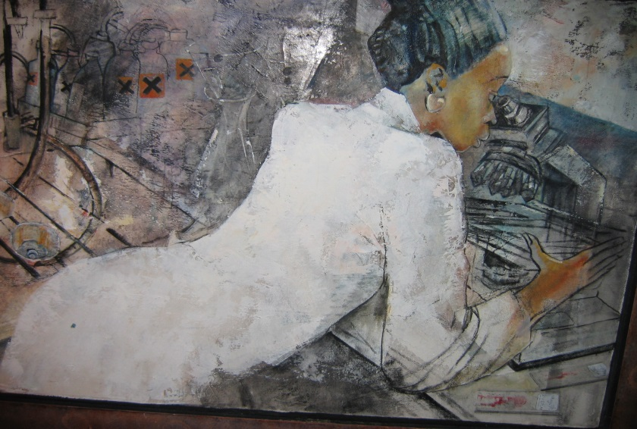
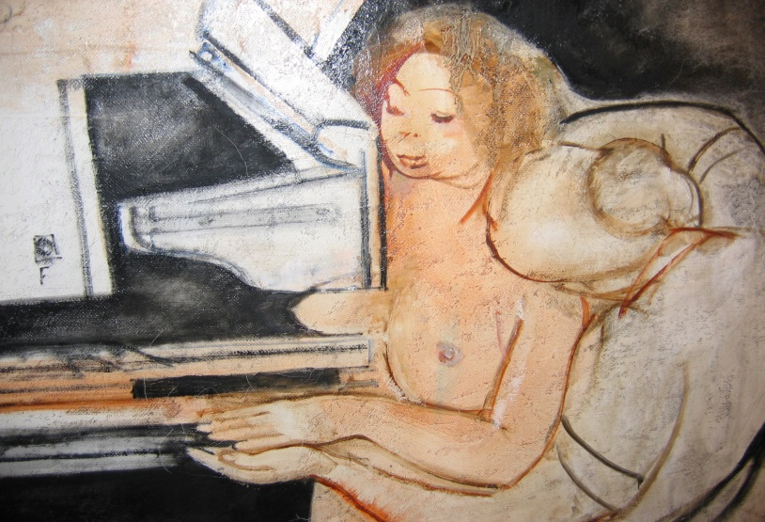
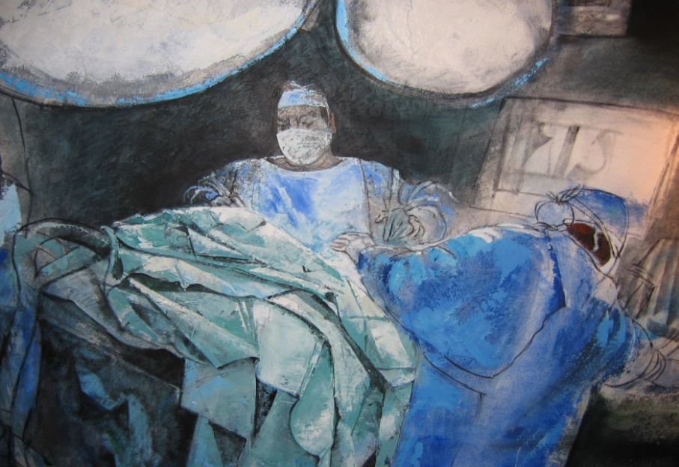
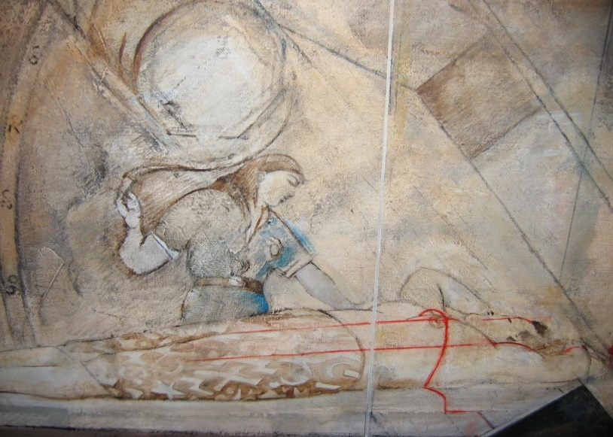

clinical oncology
Laboratory diagnostics
Indication boards
Imaging diagnostics
Surgical oncology
Radiation
oncology
Is mostly about
Multidisciplinary cooperation
Medical oncology

Slide 4
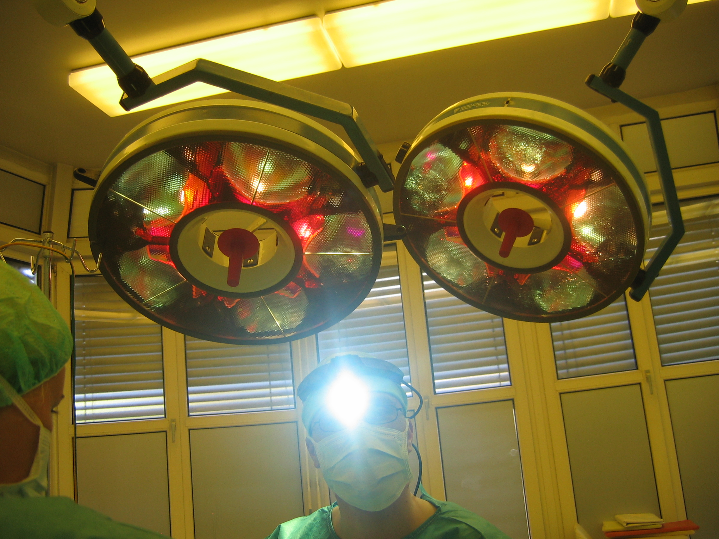
- Operation skills
- Knowledge of oncology
- Motivation
- Empathy
„enlightened
Surgical oncologist“

Slide 5
Before every oncological therapy should precede a complete diagnostic.
Typing – proofing of the tumor by biopsy
Staging – the TNM classification showing the extent of the disease The local amount of the tumor (T), regional nodal metastases (N), distant metastases (M)
Grading – The degree of histological dediferentiation and other crucial characteristics applicable for the treatment

Slide 6
Statistics in the Czech republic
97 diagnostic groups according to the International Classification of Diseases and Related Health Problems(ICD)
Incidence ( new tumors per year)
90 000
including:
6000 „liquid“ (haematological) malignancies, 500 tumors in children
Prevalence (total number of patien in therapy and after therapy)
560 000
Mortality (cancer caused deaths per year)
30 000
Letality (index mortality/incidence, MI index )
- deaths to diagnosed cases ratio per year
Figures different in various diagnoses, dependent on the effectivity of therapy and aerliness of diagnostic
(examples : lung cancer 0,90, pancreas 0,89, colorectal 0,49, ovary 0,76,
kidney 0,38, breast 0,30, prostate 0,26, testes 0,14, melanoma 0,17 etc.)

Slide 7
Timing of surgery in the combination therapy of solid tumors
Usually depends on the clinical stage of the disease
operation only (early stages)
Operation + afteroperation (adjuvant) chemo – radio-therapy
Before operation (neoadjuvant) chemo-radio-therapy + operation
Before operation ch-r-therapy + operation + afteroperation ch-r-therapy
Main therapy chemo-radio-therapy (late stages) + operation as a helping procedure
Notice : chemotherapy mens here any systhemic medical treatment by use of cytostatics, hormones, biotherapy or immunotherapy or combination

Slide 8
Three fases and goals of any oncological operation
3 in 1
Removal of the tumor
Reconstruction of the operated region
More specifying diagnostics
All the points are of the same validity!

Slide 9
Lymphatic nodes surgery- the most often first site of solid tumors metastasing
Diagnostic biopsy of suspect node (punction, open biopsy)
Targeted biopsy of the sentinel lymph node
Complete dissection (exenteration) of axilla, ilioinguinal region, neck trigonum
Retroperitoneal lymphfadenectomy (testicular and ovarial cancers )
Organ dependent regional lymphadenectomy (perigastric,
pericolic, iliac, mediastinal)
Extirpation of suspect juxtaregional nodes (supraclavicular,
mesenterical, retroperitoneal)

Slide 10
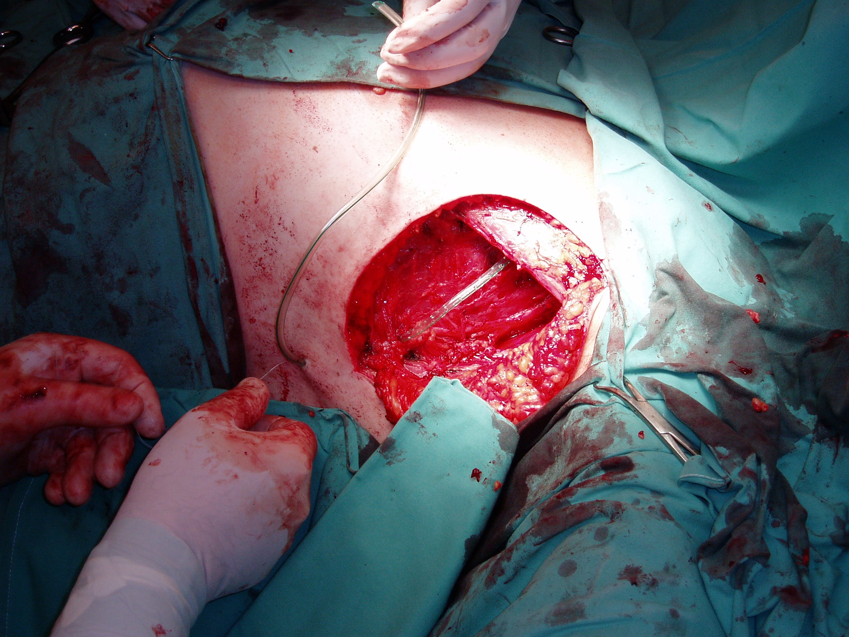
Axillary dissection

Slide 11
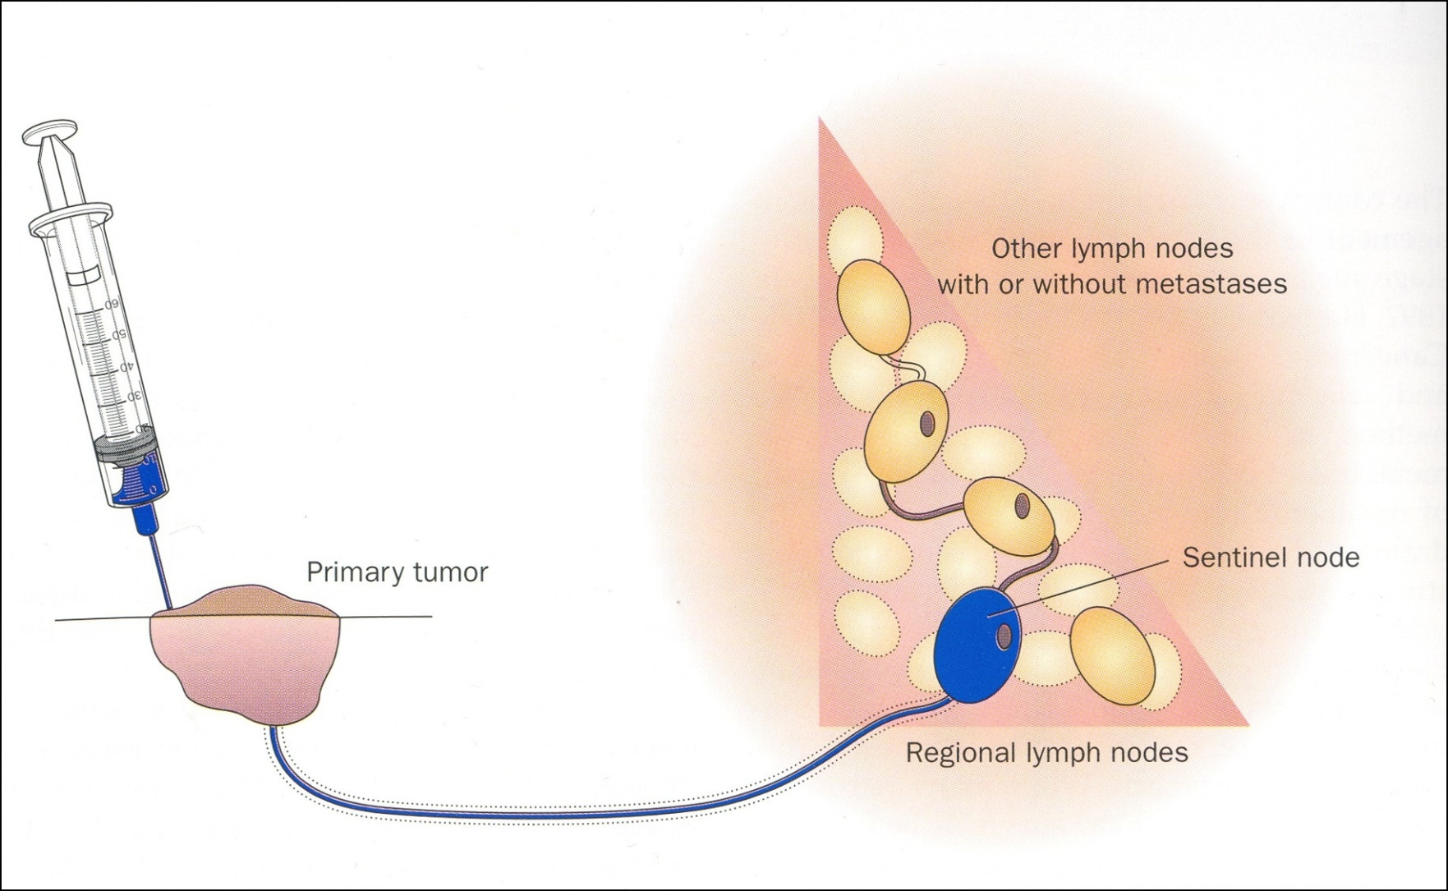
Sentinel node biopsy technique

Slide 12
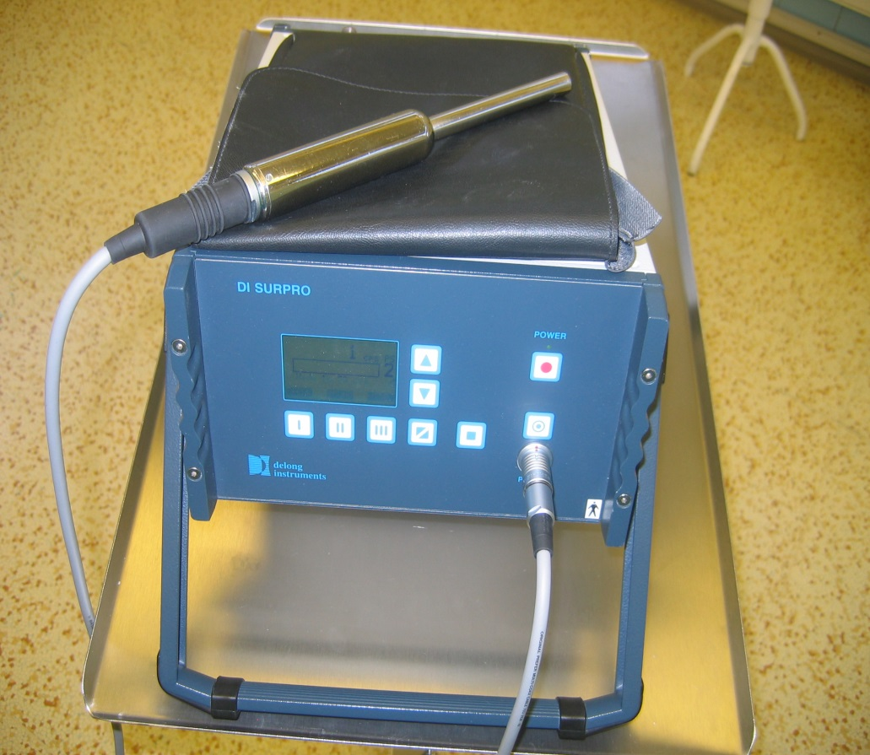
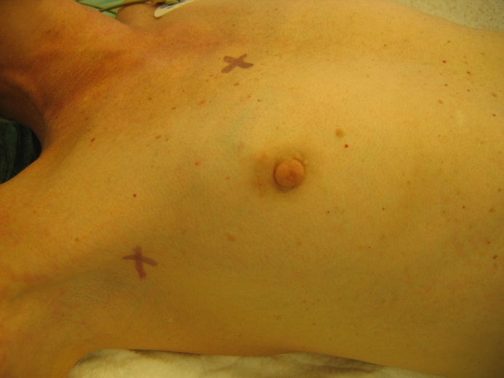
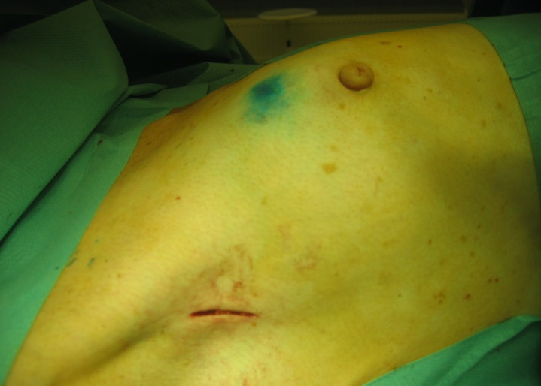
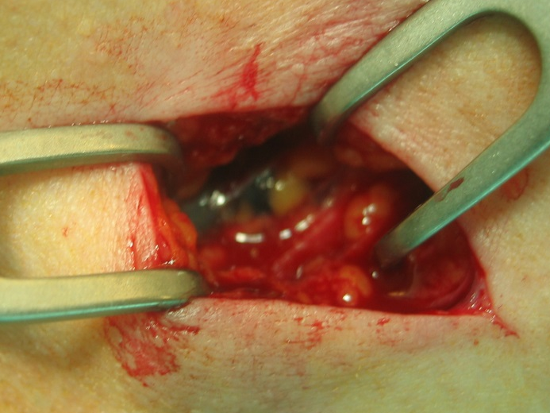
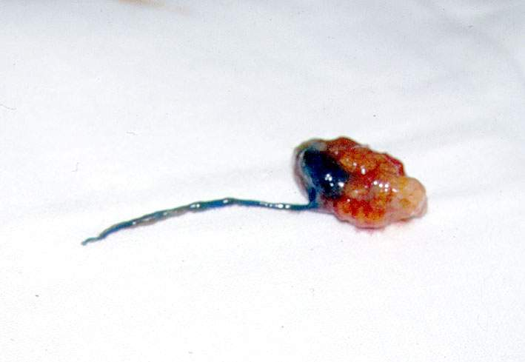
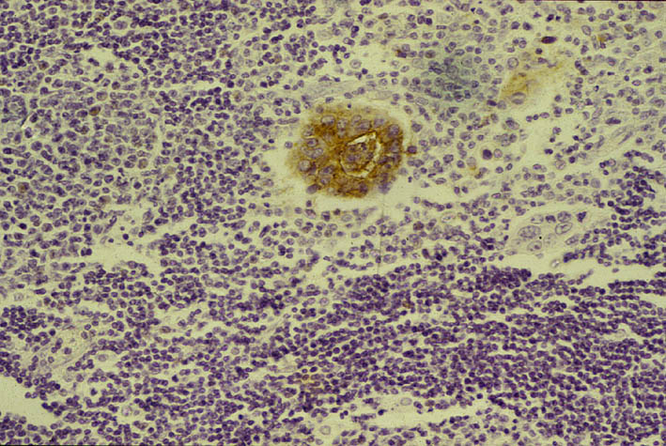
Radionavigated node surgery
microstaging

Slide 13
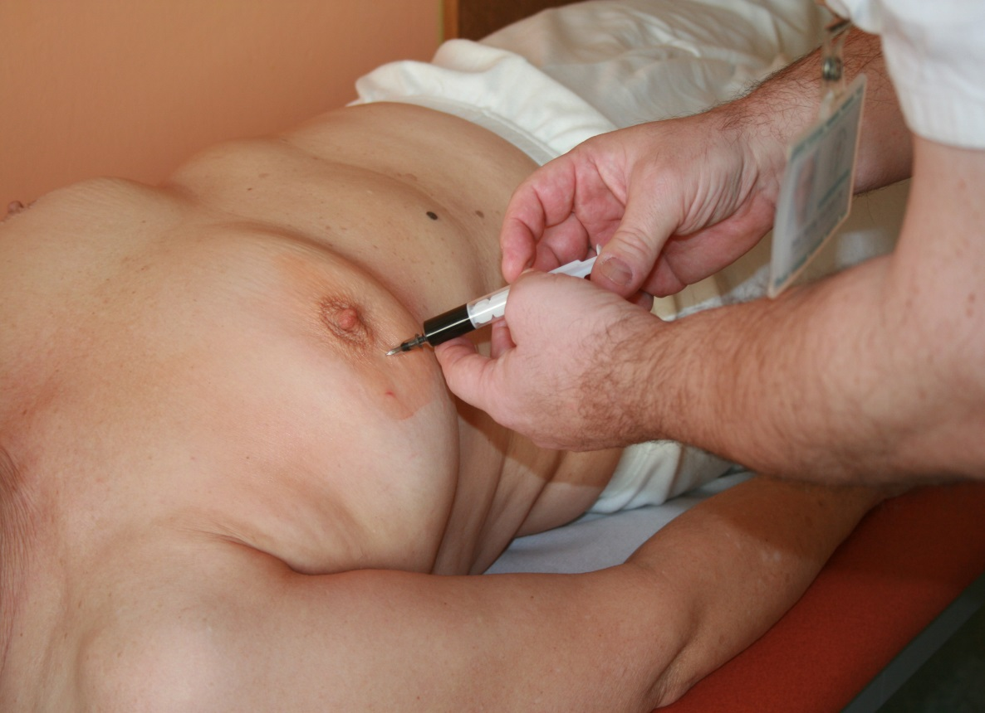
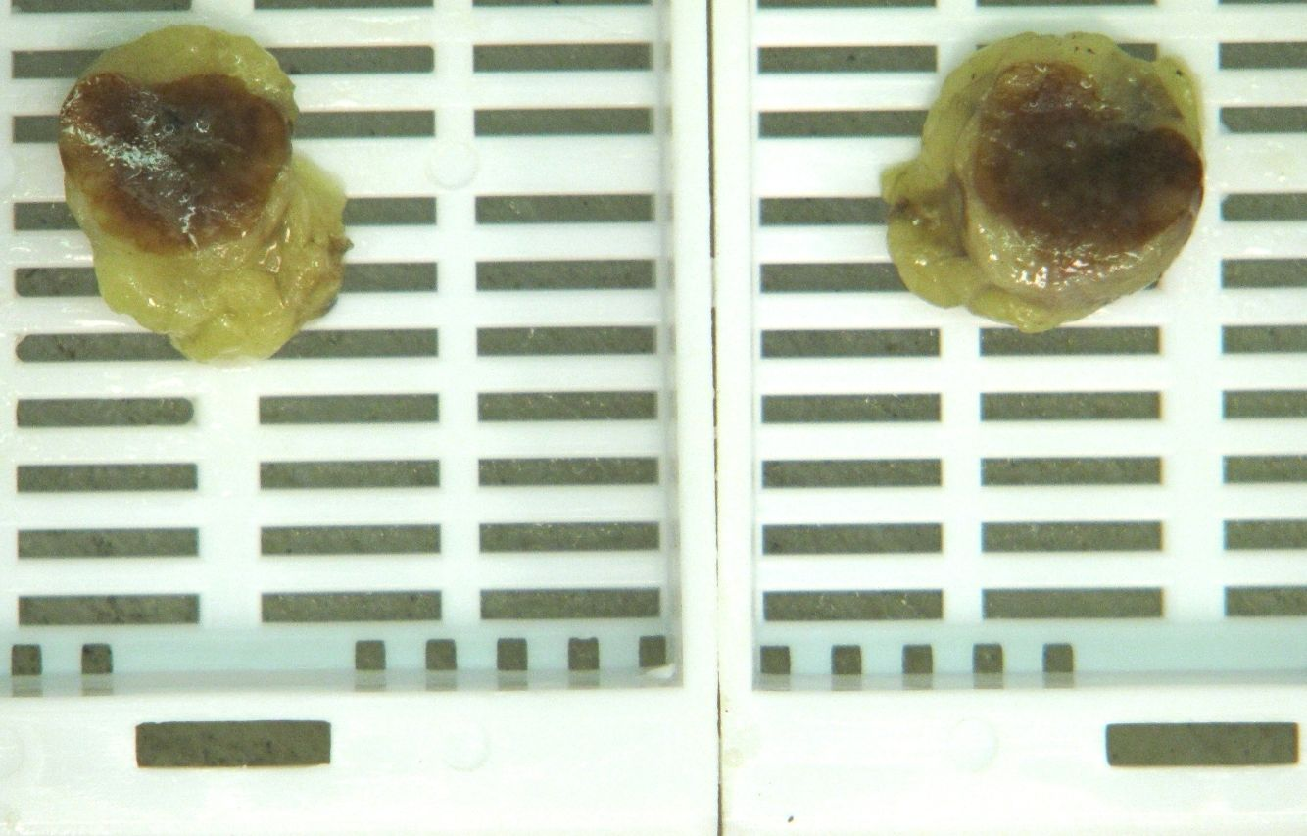
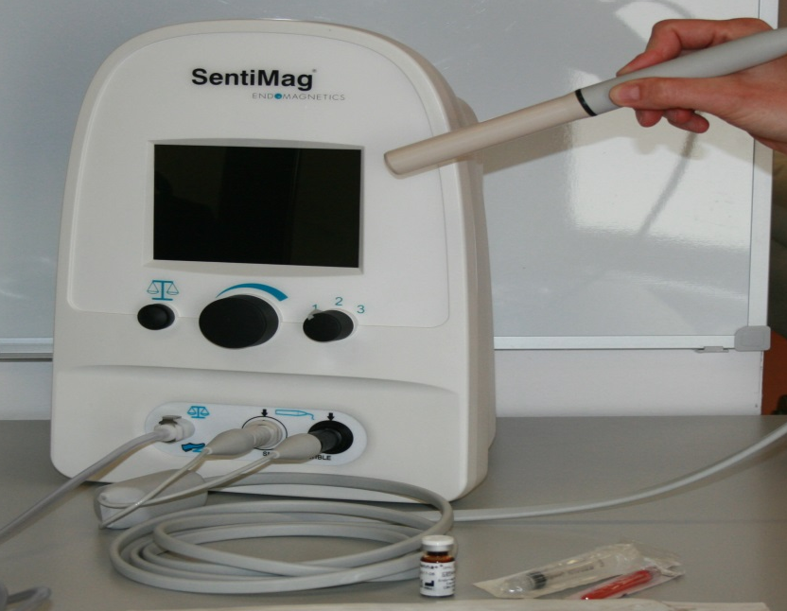
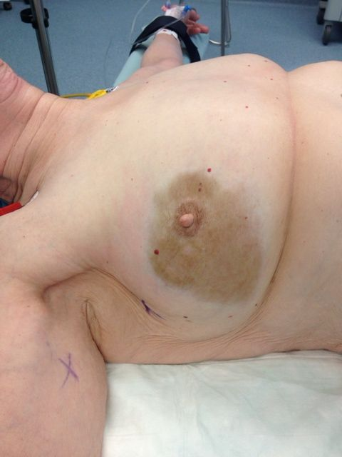
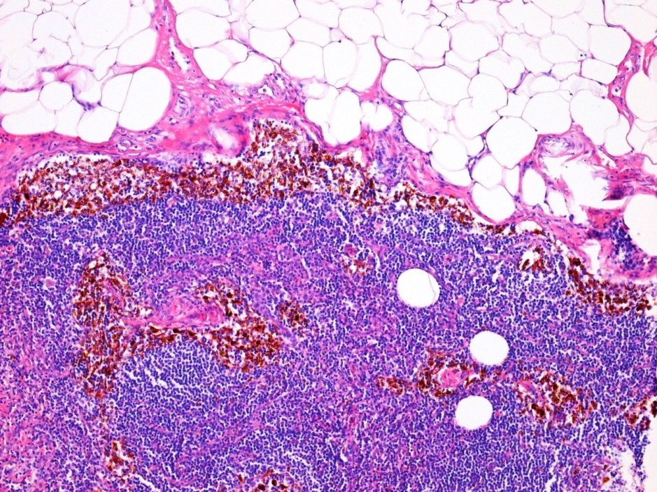
Magnetic detection of the sentinel node

Slide 14
Specific approaches and concepts in surgical ocolgy
Narrow cooperation wíth histopathologist even in the operation theatre
Pelvic surgery (cooperation of surgeon, gynecologist and urologist in the same time)
Oncoplastic surgery (using techniques of plastic surgery)
OpeDelayed operation after another therapy
Intraoperation intersticialí brachytherapy
Regional chemotherapy
Cytoreductive operations and HIPEC in localy advanced tumors
Miniinvasive and robotic operations
Kryosurgery - local destruction of tumors by low temperature
Direct cooperation in keeping the tissue bank

Slide 15
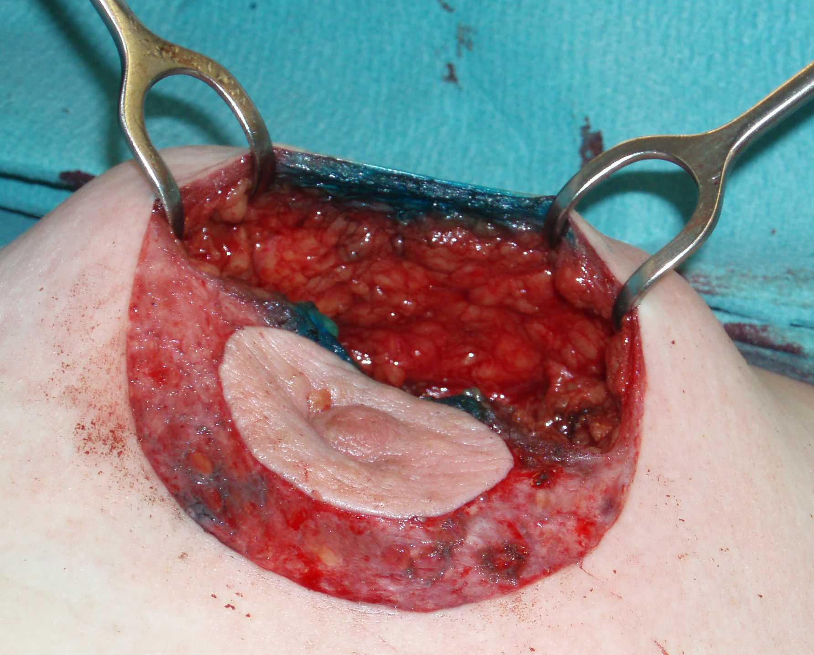
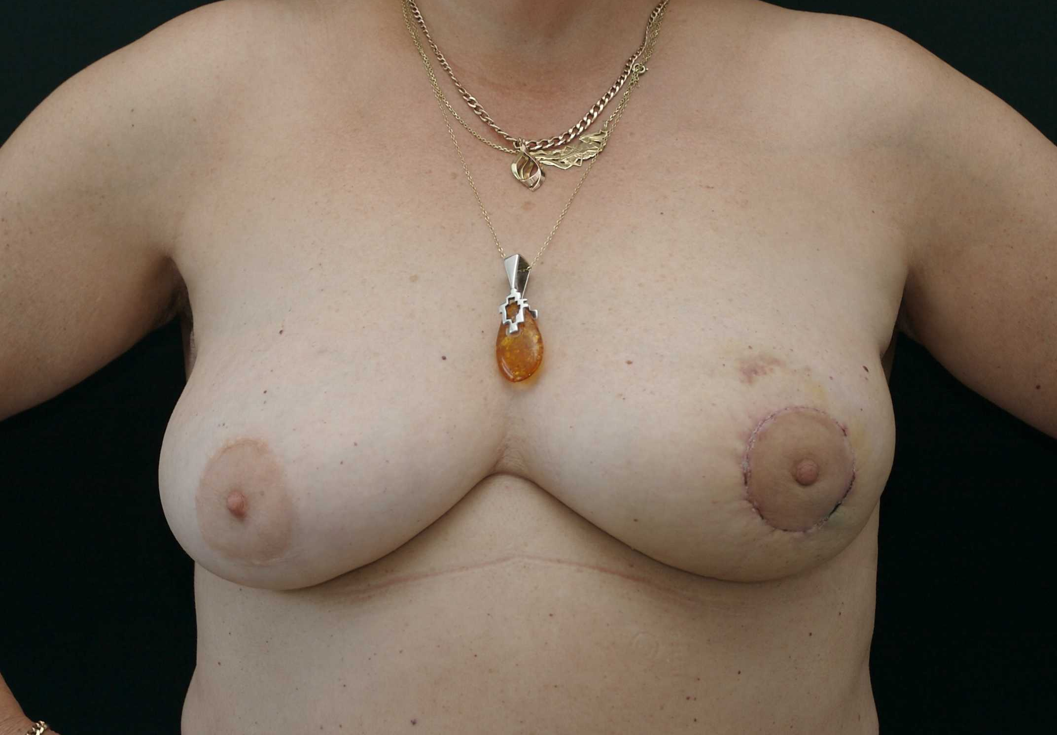
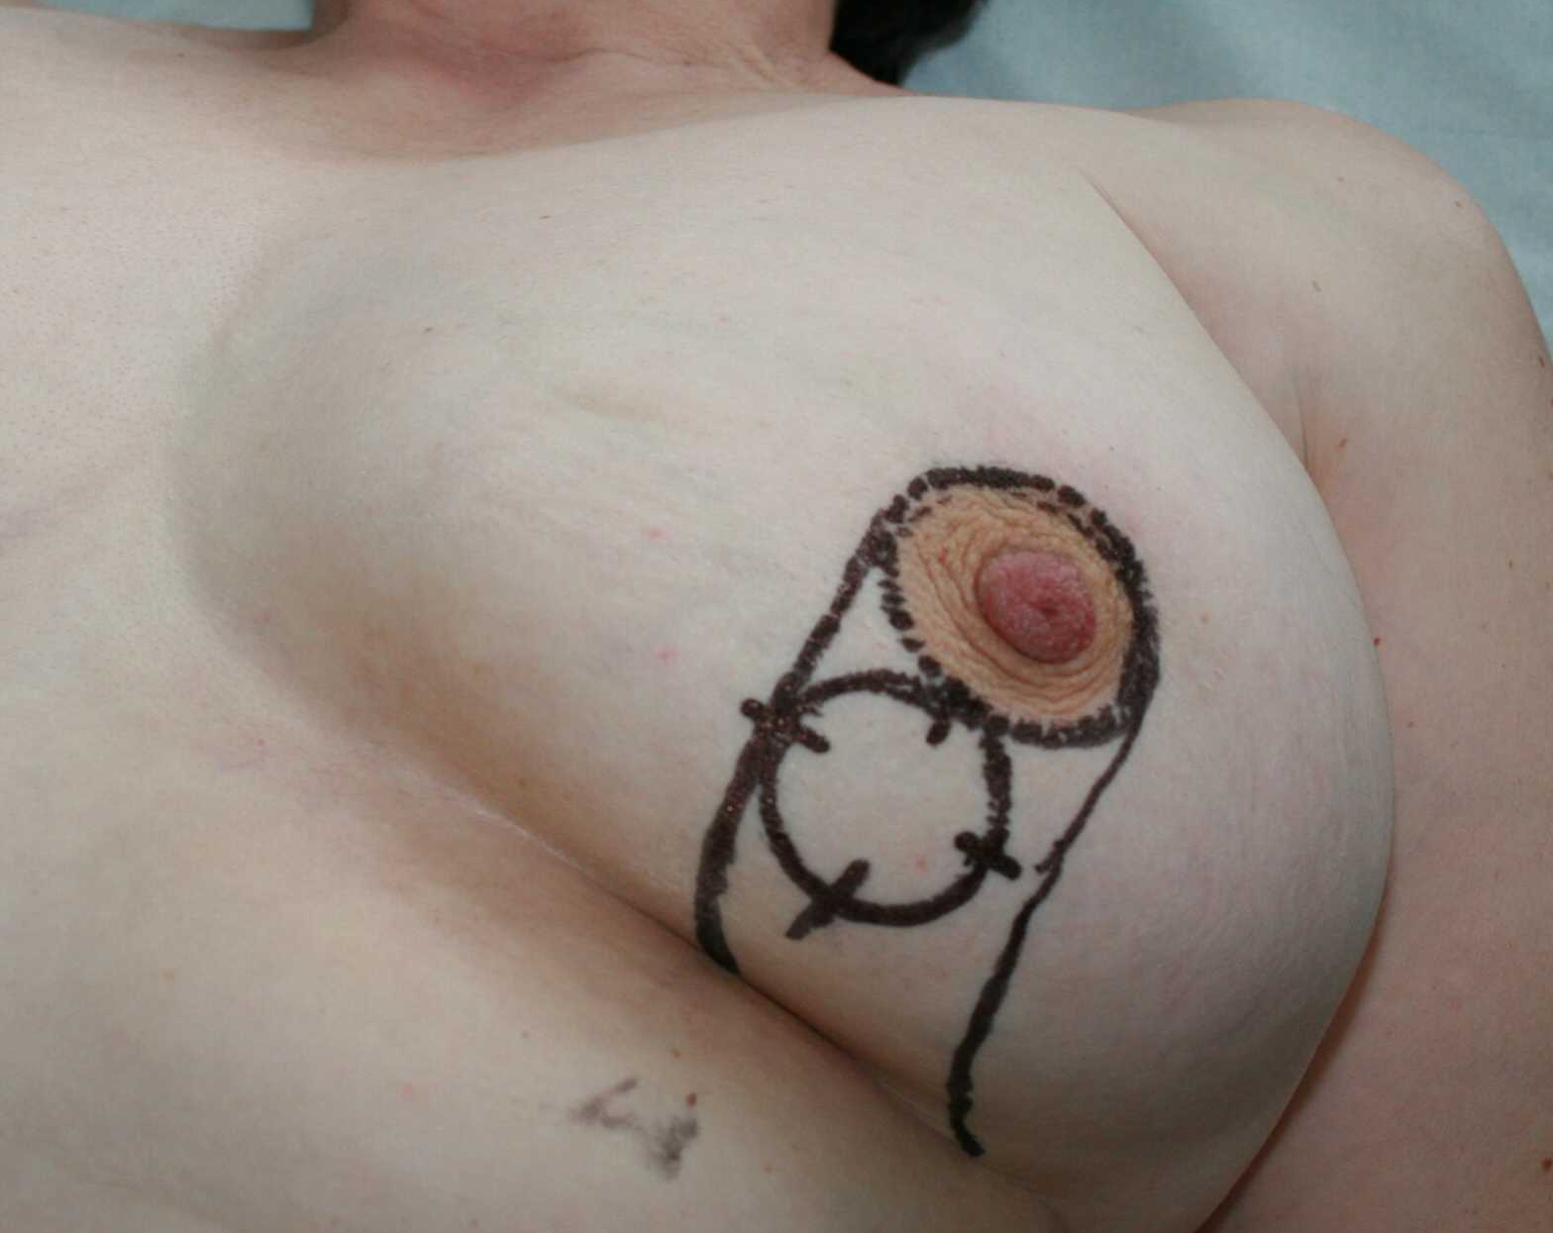
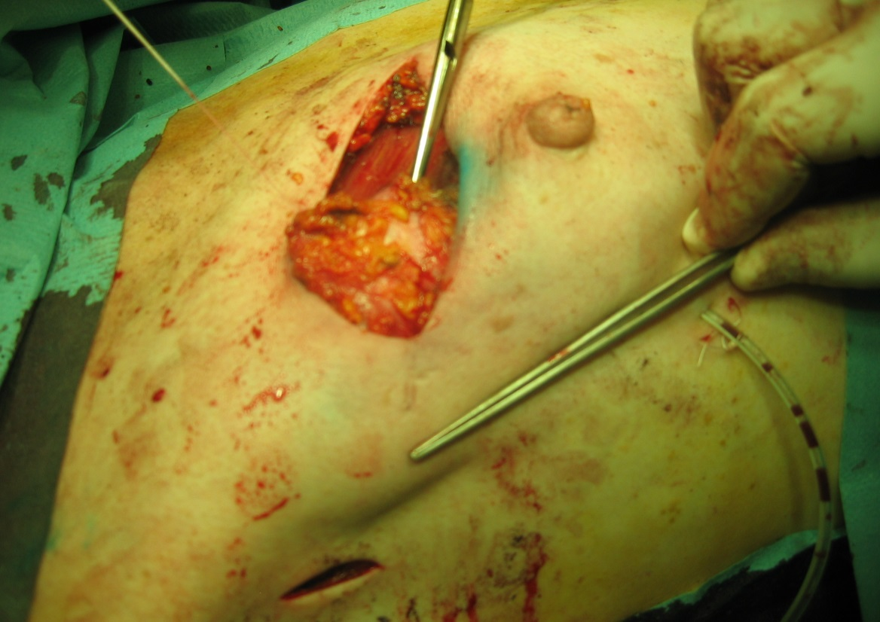
Oncoplastic surgery
Round-block resections
Parenchymal
flaps
Grisotti

Slide 16
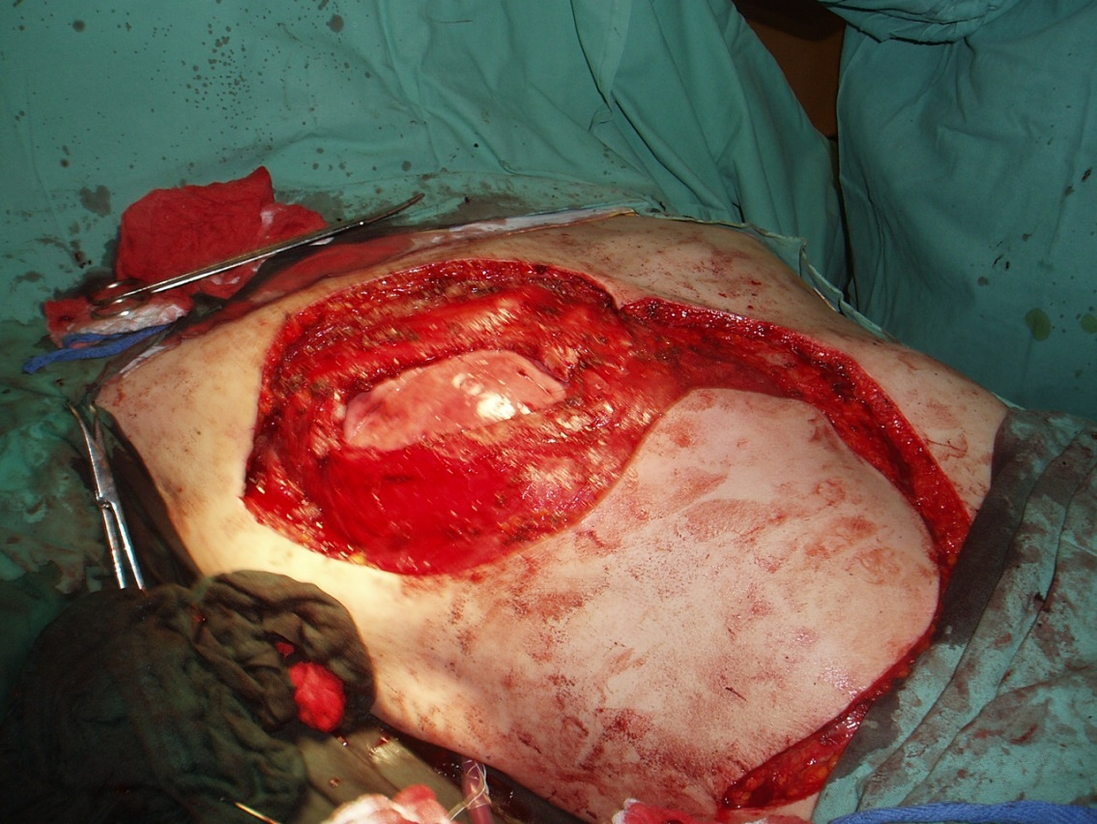
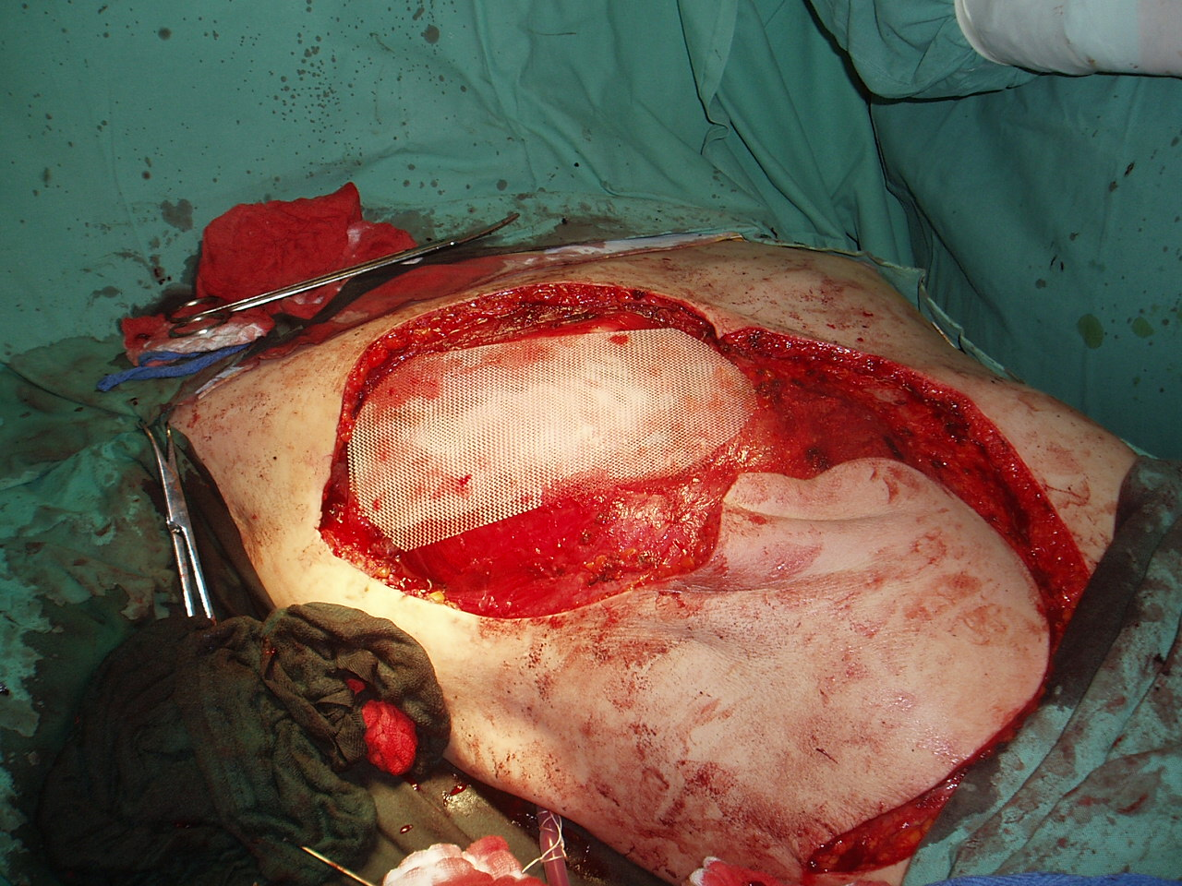
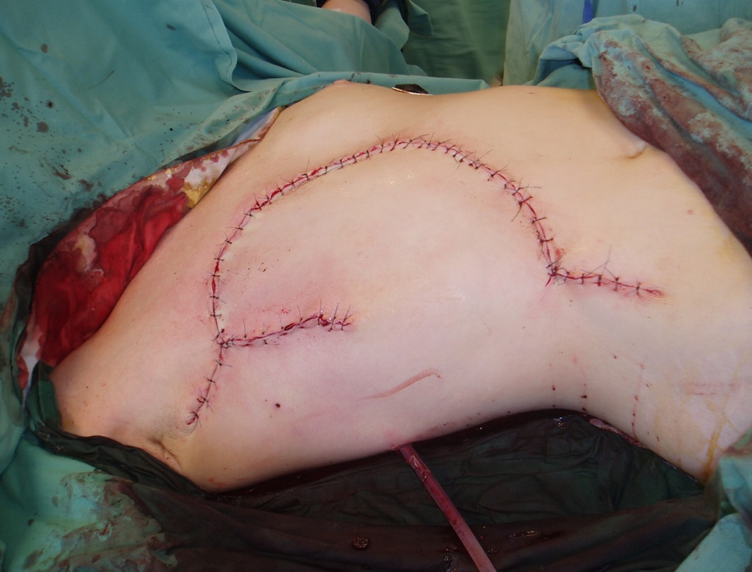
Huge recostruction
Covering of the chest wall defect
by use of a mesh and rotation skin
flap

Slide 17
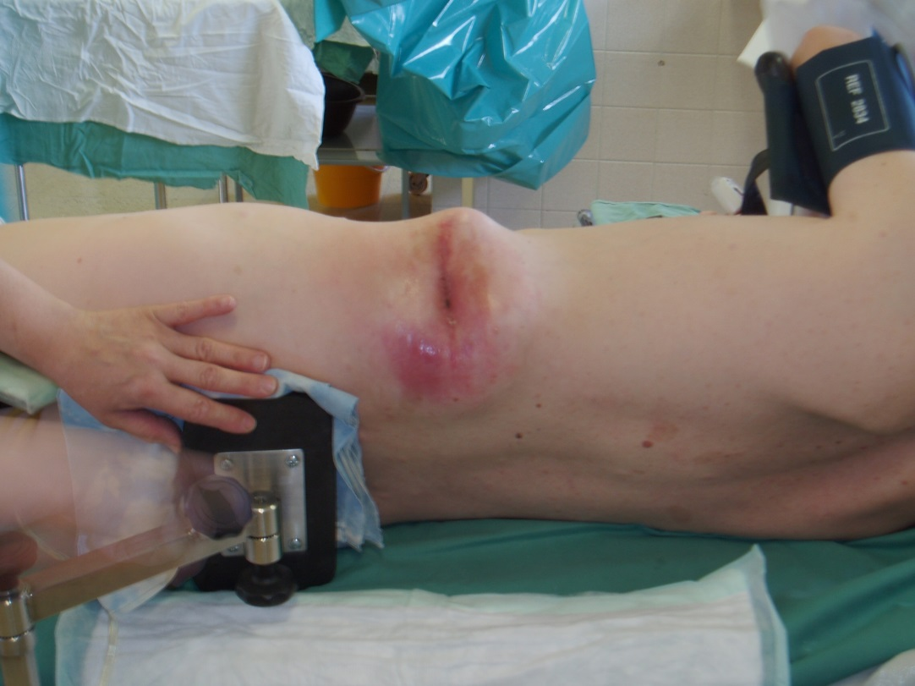
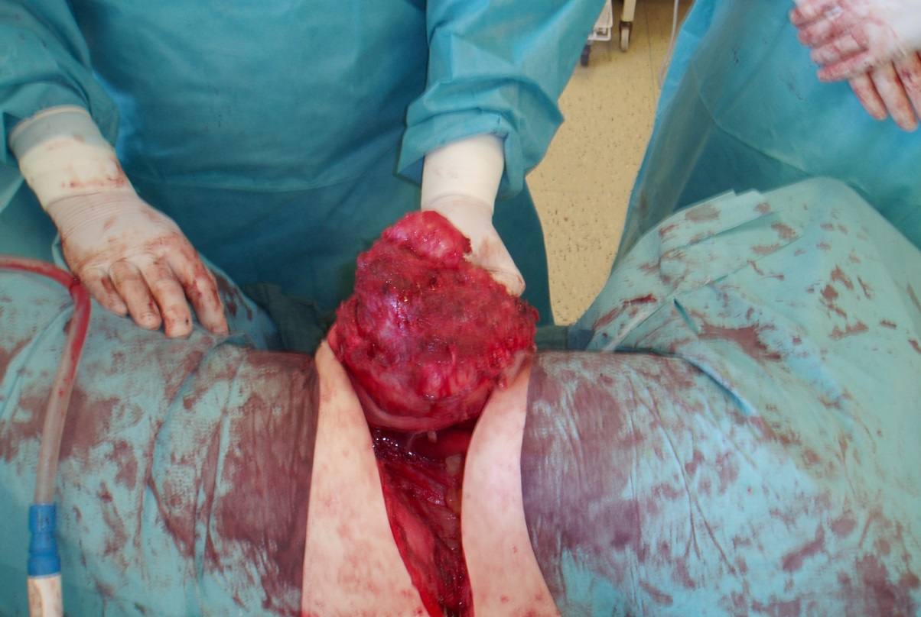
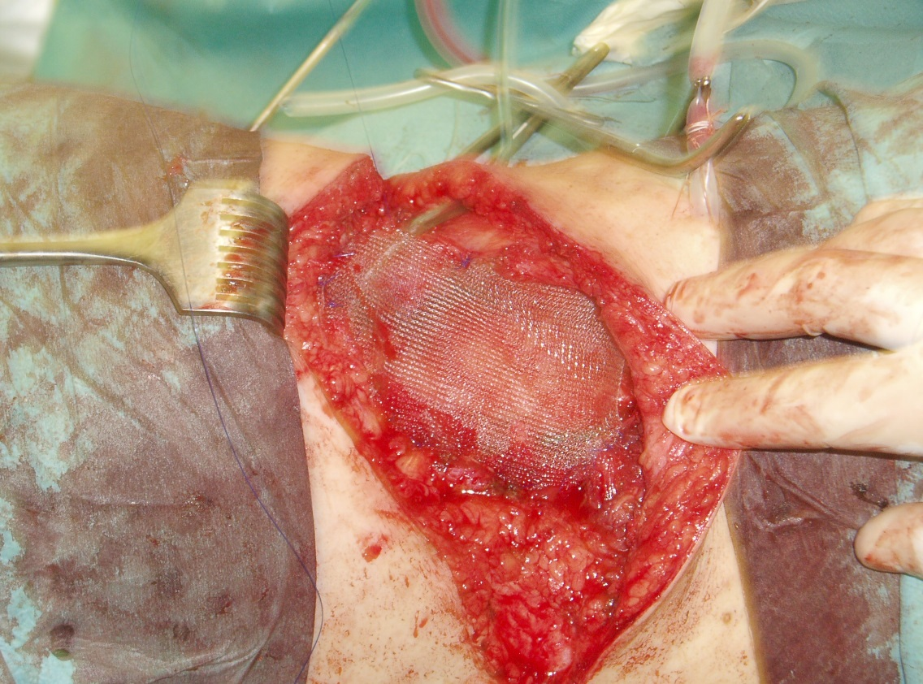
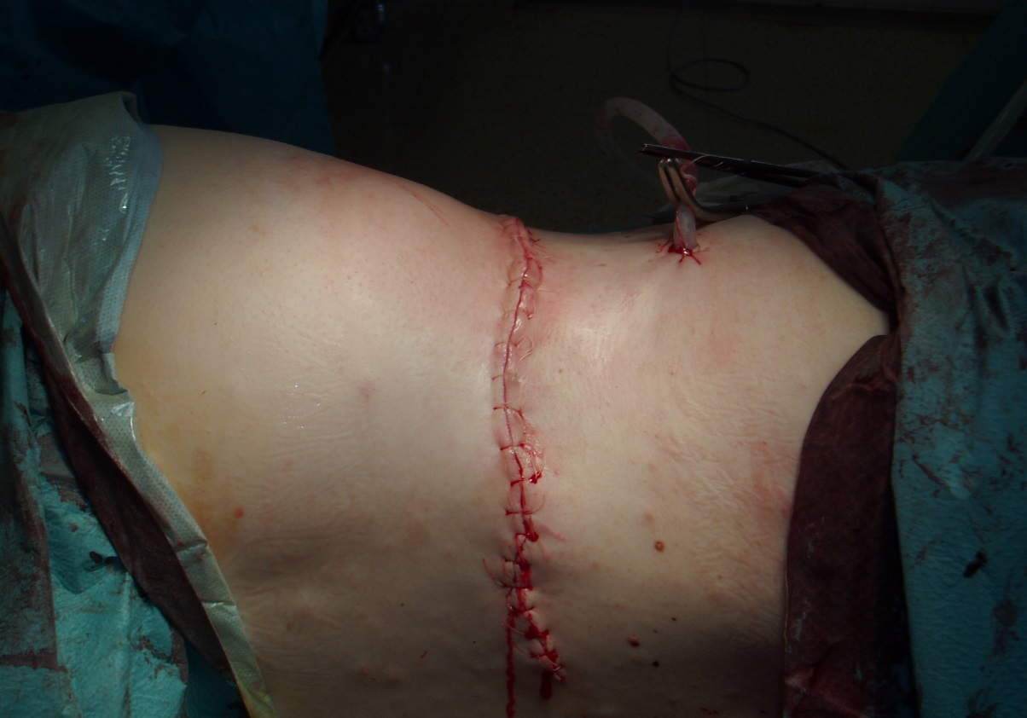
Radical and reconstructive operation
Mesh implantation

Slide 18
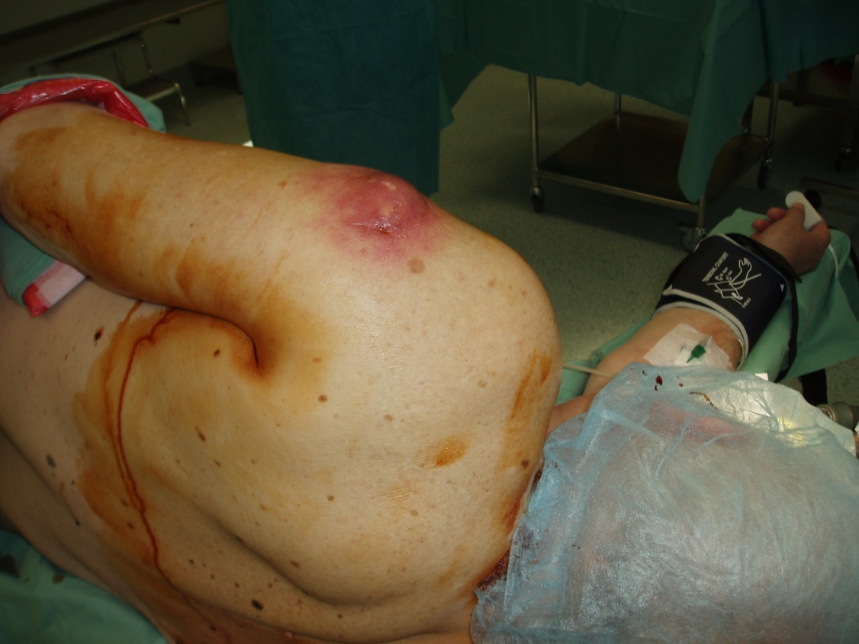
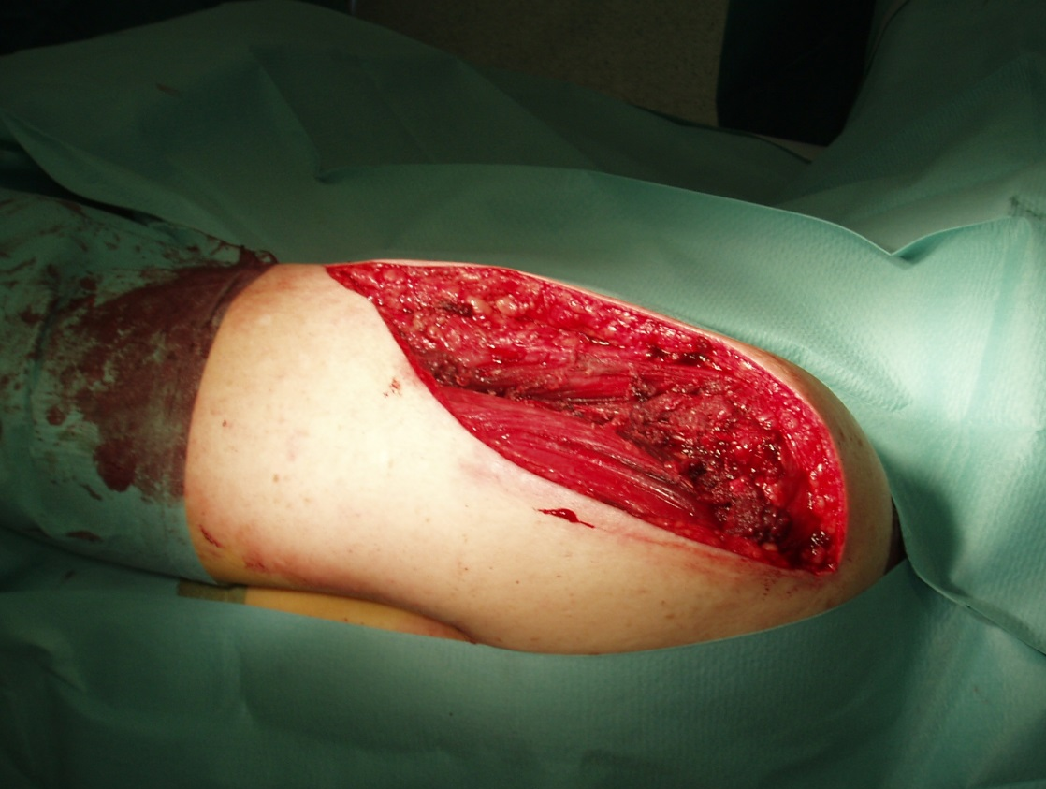
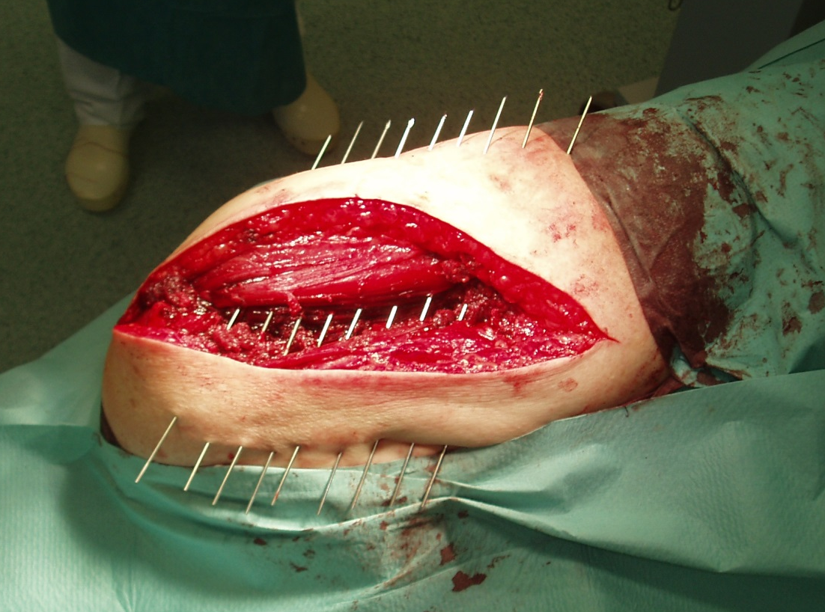
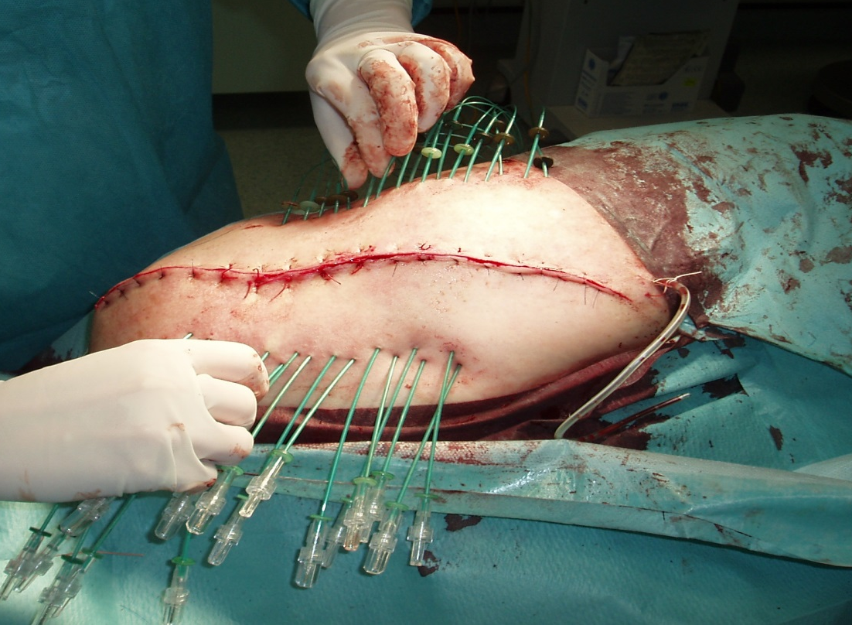
Intersticial intraoperation brachyradiotherapy
higher dose in the tumor site, lower dose in the skin,
lower number of local recurrencies

Slide 19
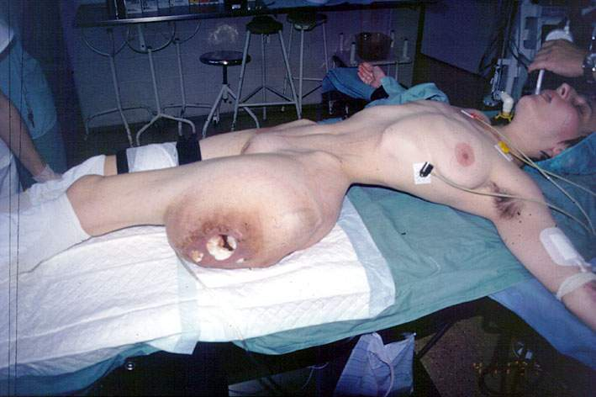
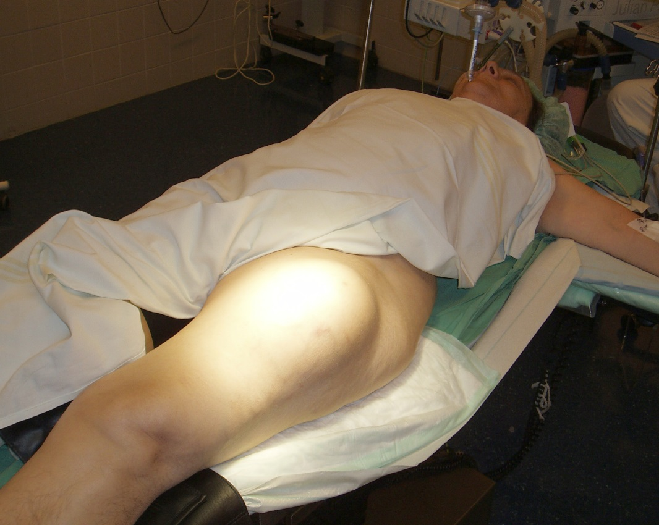
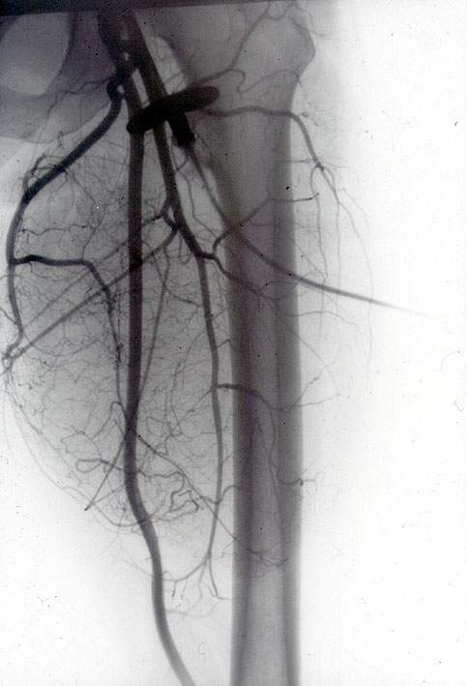
Regional
intraarterial
chemotherapy
G3

Slide 20
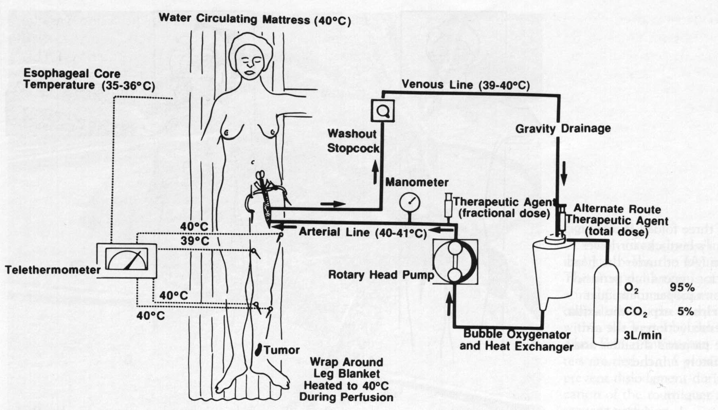
Isolated hyperthermic limb perfusion

Slide 21
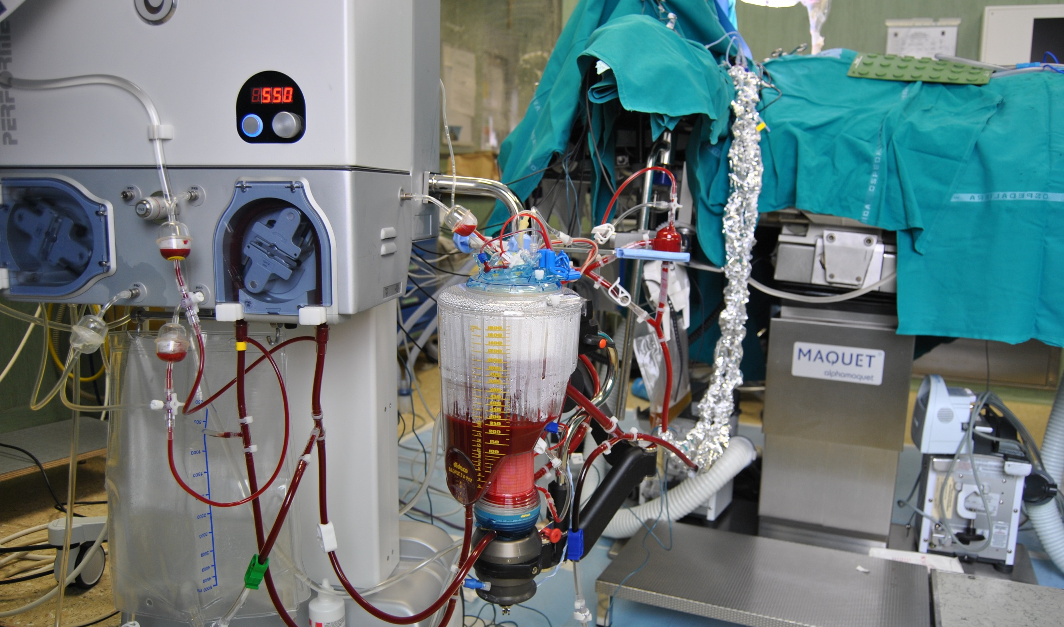
Isolated hyperthermic limb perfusion

Slide 22
Mutidisciplinary cooperation – proper timing
Adjuvant systhemic treatment
  „Classical“ – after radical surgical removement
  Neodjuvant– before radical surgical removement
Radiotherapy
  Preoperational
  Postoperational
  Perioperational
Multidisciplinary indication boards

Slide 23
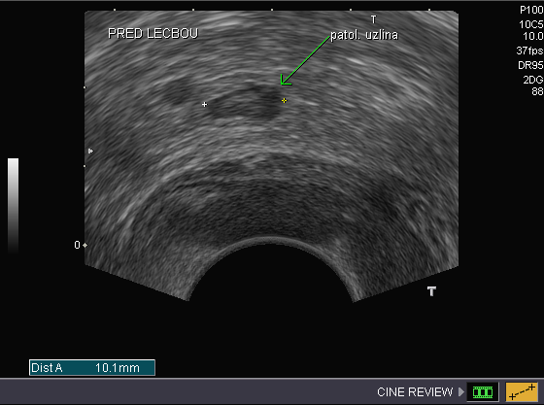
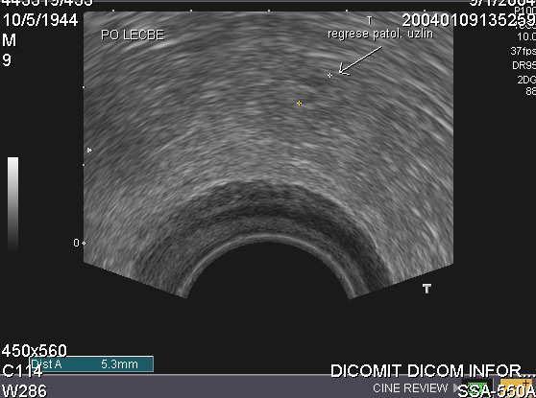
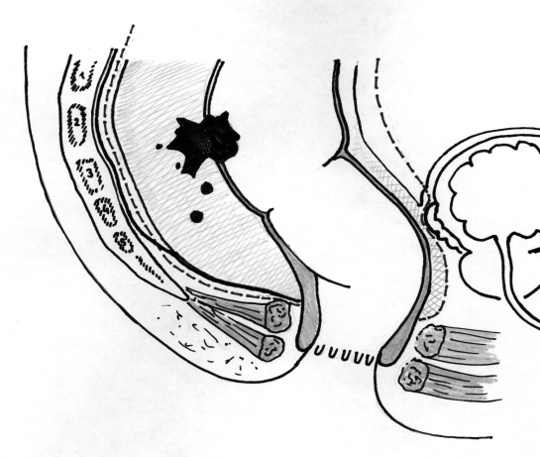
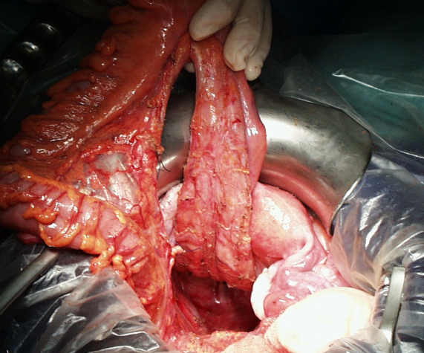
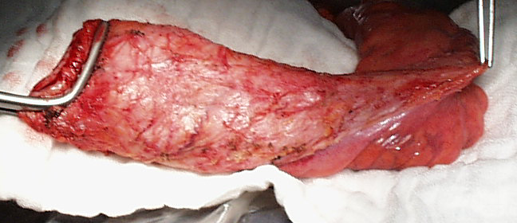
operation after neoadjuvant chemo
A) TRUS before treatment: localy advanced rectal cancer with involved regional lymph node
B) TRUS after neoadjuvantí chemoradiotherapy : lymph node regresion, node of a normalí echostructure

Slide 24
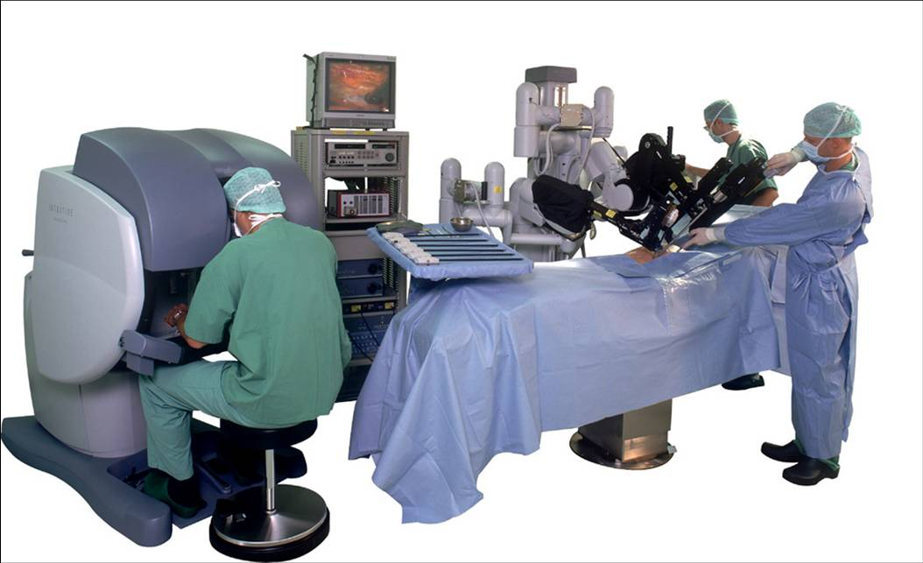
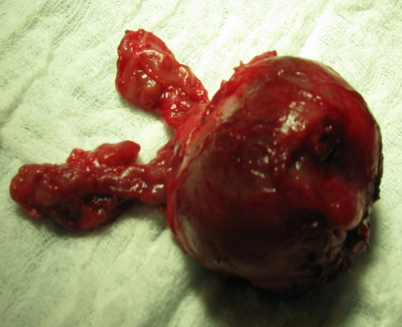
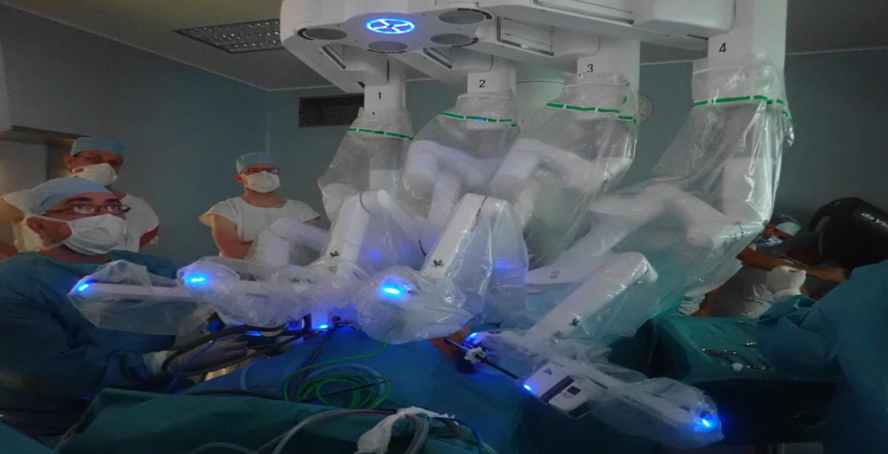
Prostate with cancer, removed
with use of robotic surgery
Robotic surgery
HI covers now:
Robotic radical prostatectomy
Robotic kidney resection
Robotic rectal resection
Robotic hysterectomy
Robotic lymfadenectomy
of iliac or retroperitoneal nodes

Slide 25
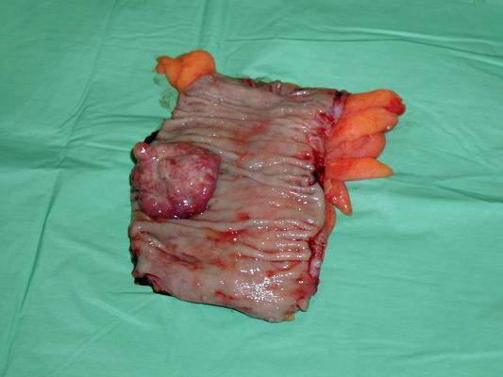
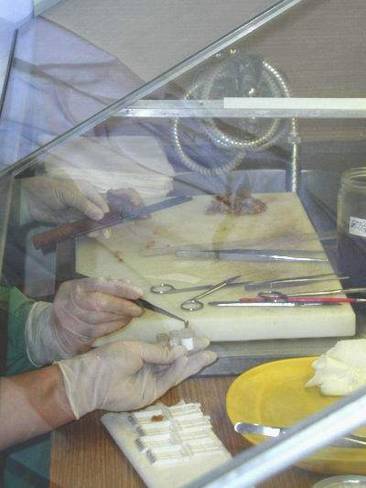
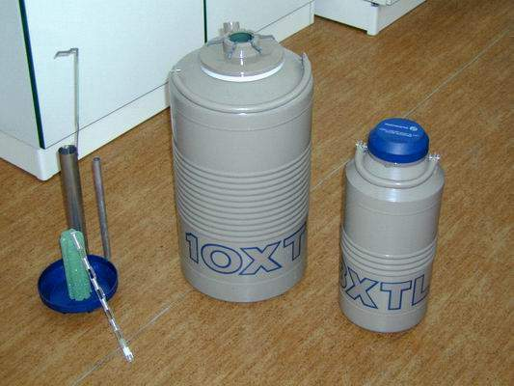
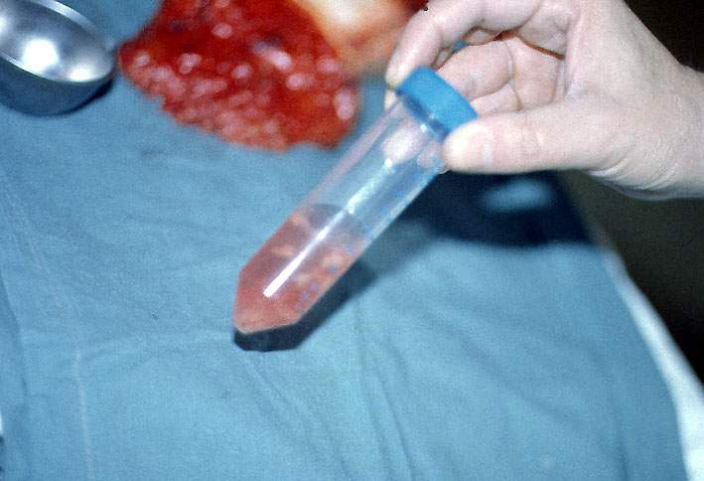



Tissue bank and predictive oncology
on-line cooperation with pathologist

Slide 26
Surgical treatments results evaluation
Subjective patient contentment
- operation after.effects, functional result, cosmetic result
Objective parameters
a) postperation complications
b) number of local recurrencies
c) PFS – progression-free survival
d) OS – overal survival – dependig on clinical stage
- comparing with the country or region average comparing with the world
- comparing own results in time
example : MMCI results for the most often diagnoses on www.mou.cz
c) a d) allways in context with another modalities !
3) Economical parameters
cost versus benefit ratio ( hard to use in individual – not used, cost effectivity can be judged statistically in bigger cohorts

Slide 27


Survival analysis ( MMCI ) :
Rectal cancet st. III
comparing 10-year survival
(MMCI)MOÚ a Czech rep(ČR)
MOÚ
průměr ČR
Rectal cancer st. III
comparing results in time
2000-2004
2005-2009
2010-2014

Slide 28
Mnemotechnical tool for use in the proffesional and private life
WHAT SHOULD I KNOW, if I, may nearets or my patient got a cancer? ?
No/T Re/St/InG Sur/GEO/Ns (J.Zaloudik, 2009)
8 parameters for surgical oncology, for patient information & decision making
Diagnostic criteria derived from surgeon and pathologist :
No – Nodes
T – Tumor : T cathegory/ histological Typing/
Re – Resection margins (as estimated by histopathologist)
St - postoperative Stage, pT pN pM
InG – Investigation on Grade (and also target molecules,receptors)
Performance of surgical department
Sur – Survival rates ( general, in particular hospital or team, if available )
GEO – Guaranteed Estimation by Oncologists ( multidisciplinary team)
Ns – Numbers of treated cases by team (volume effect)

Slide 29
Four levels of preventive dealing in the fight with cancers
and as a base for effective surgical intervention
primary prevention : „Not to allow the cancer to arise“
(precanceroses removal, vaccination – HBV, HPV)
secondary prevention : „if the cancer occurs,
to be found in time and curable by surgical removement
with low risk of recurrence “
(screening programs, systematic preventive investigations)
tertiary prevention : „if the cancer was not found and treated in time and comes
back, to find the still curable recurrency„
(consistent folow up, operative treatment of metachronous metastases )
quartery prevention : „ if the cancer is not curable ,
to prevent complications and useless suffering,
physical, psychical and social“
(palliative opertions, nutritional care, pain treatment, social care )

Slide 30
Useful webs
www.svod.cz data from the Czech national oncological registry
www.nccn.org international guidelines i oncology)
www.onconet.cz the Czech oncological web
www.linkos.cz Czech Oncological Society
www.mou.cz Masaryk Memorial Cancer Institute
www.prevencenadoru.cz preventive oncology
www.mamo.cz Czech mammological screening
www.kolorektum.cz Czech colorectal screening
www.cervix.cz Czech cervical cancer screening

Slide 31

Ve
?

