Slide 1
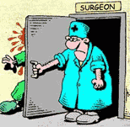
ACUTE ABDOMEN IN CHILDREN

Slide 2
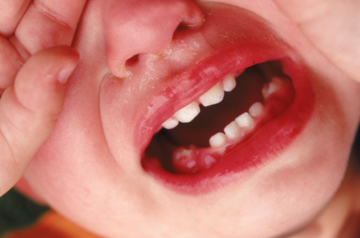
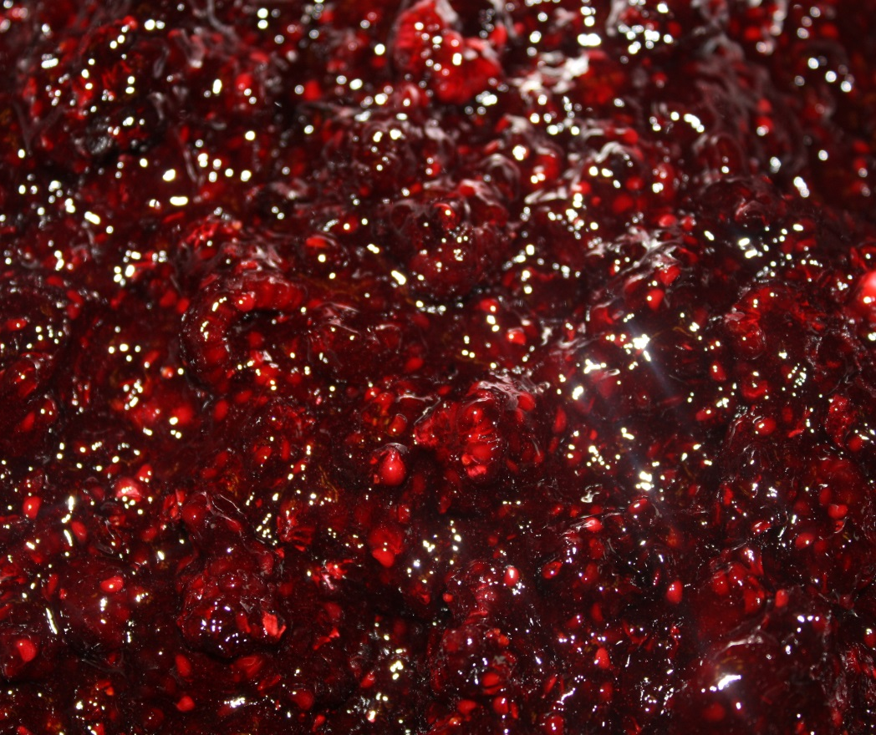
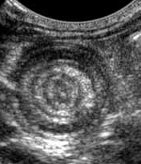
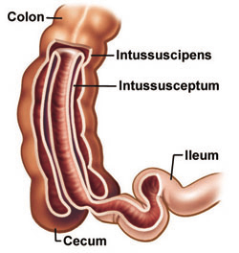
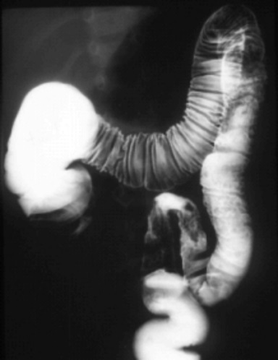
ILEOCOLIC INTUSSUSCEPTION
boy (2y), periodic abdominal pain, vomiting
palpable mass in right upper quadrant, pr: stool mixed with blood and mucus
HYDROSTATIC
REDUCTION

Slide 3
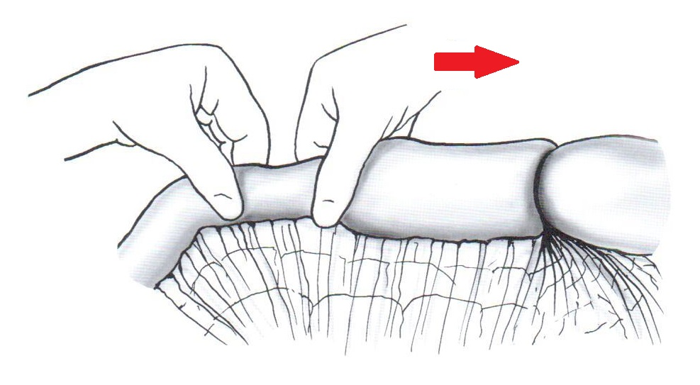
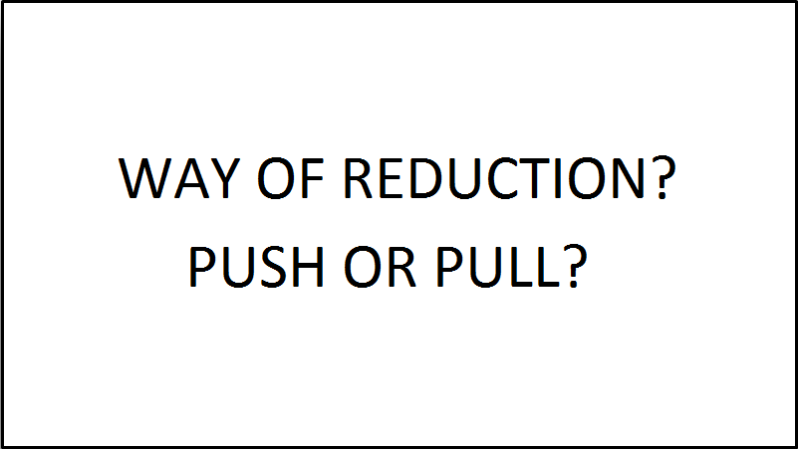
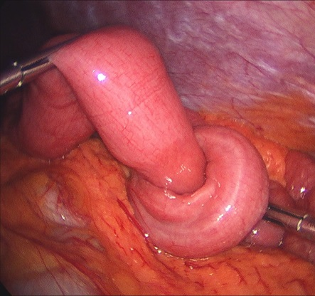
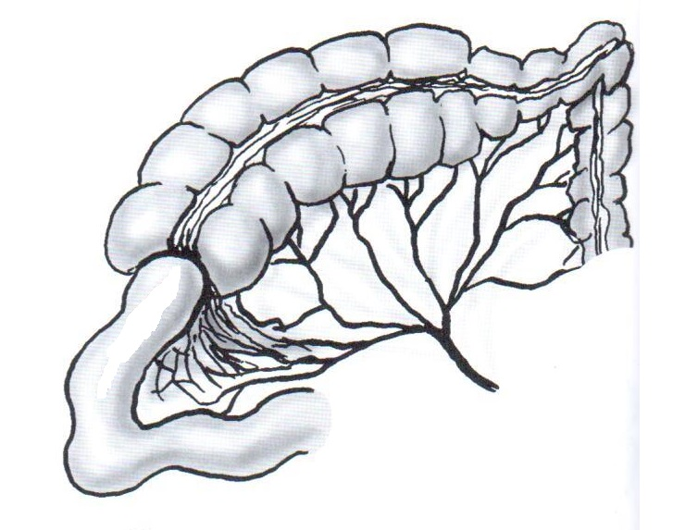
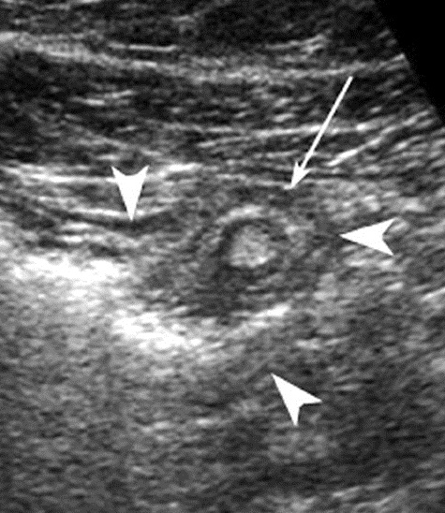
ILEOCOLIC INTUSSUSCEPTION
boy (2y), periodic abdominal pain, vomiting
palpable mass in right upper quadrant, pr: stool mixed with blood and mucus
next morning – relapse of abdominal pain
SURGERY

Slide 4
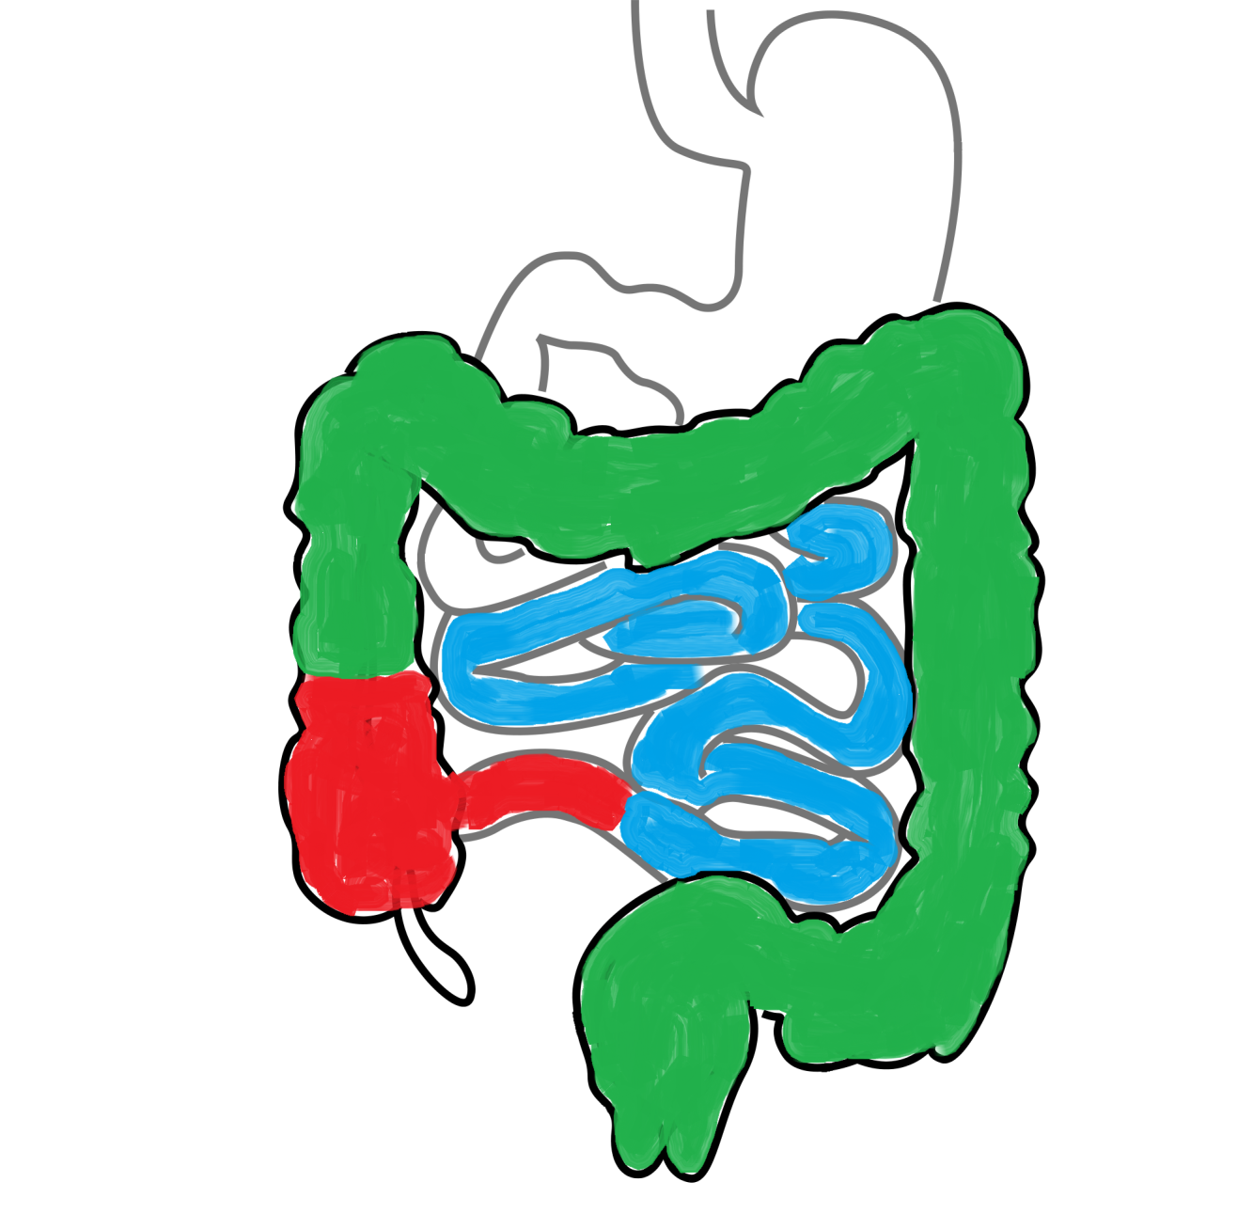
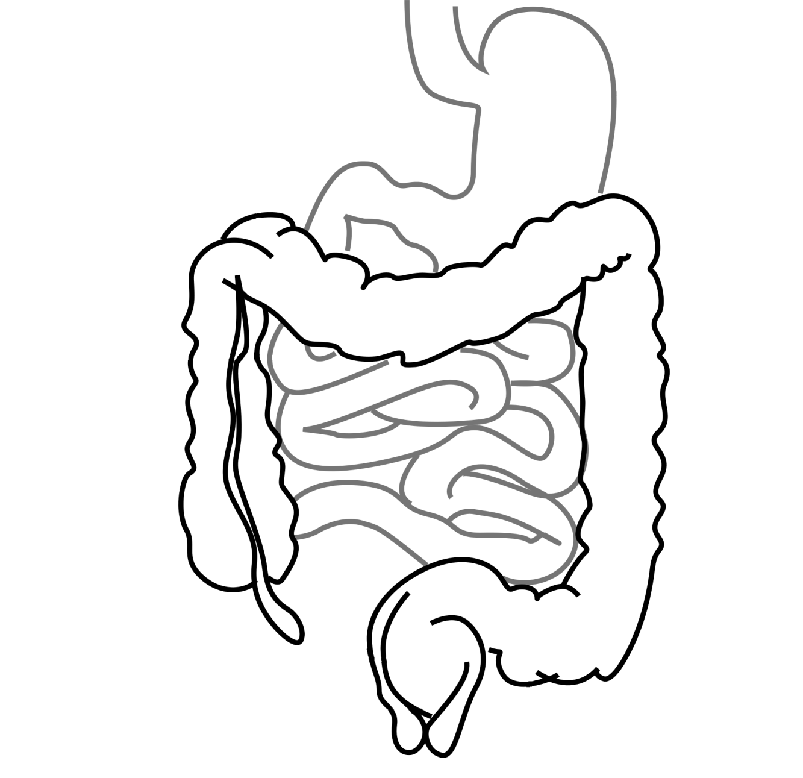
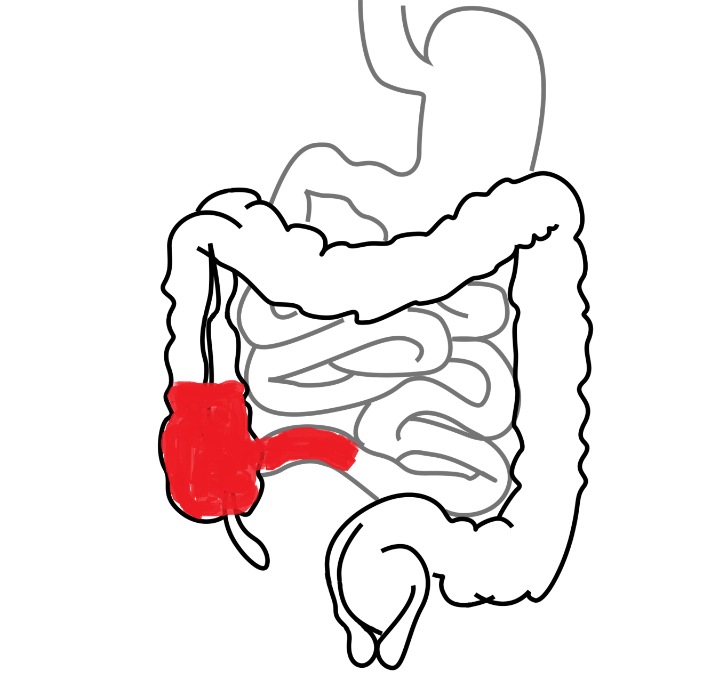
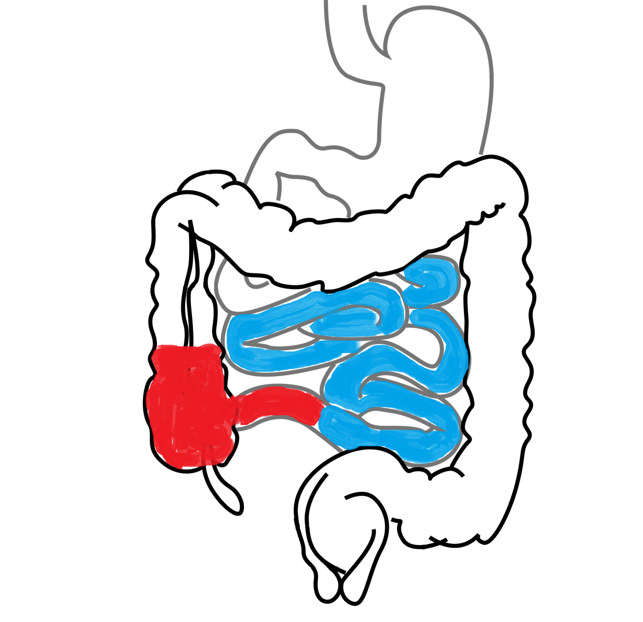
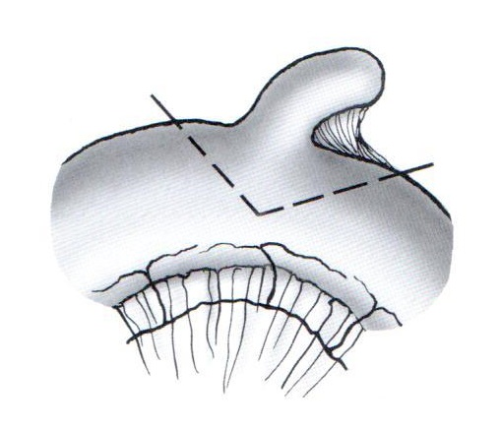
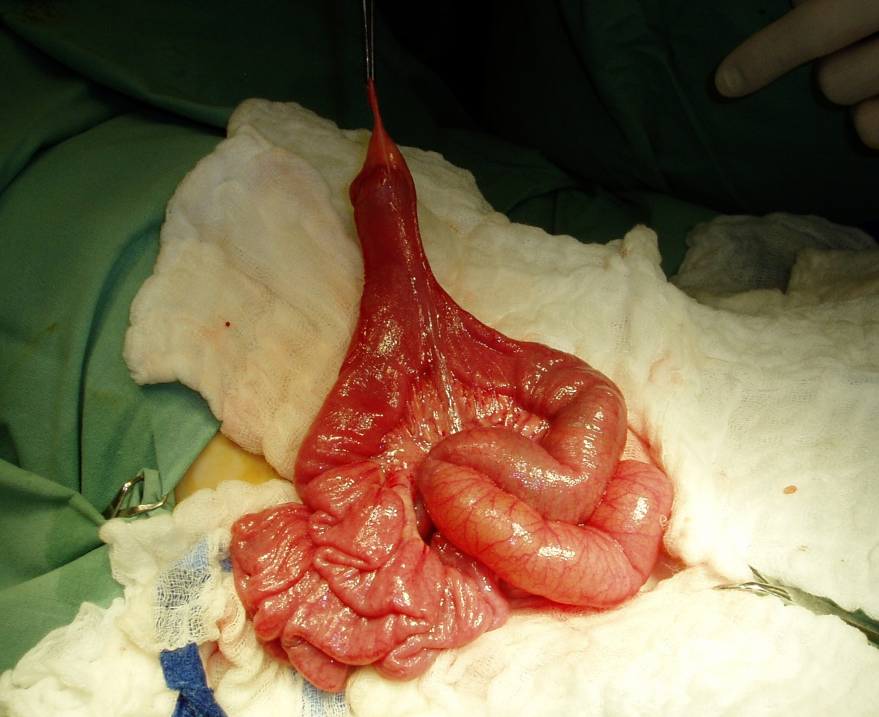
ILEOKOLICKÁ INVAGINACE
LOCALISATION OF INTUSSUSCEPTION
boy (2y), periodic abdominal pain, vomiting
palpable mass in right upper quadrant, pr: stool mixed with blood and mucus
next morning – relapse of abdominal pain
COLOCOLIC
ILEOILEAL
ILEOCOLIC INTUSUSSCEPTION IS MOSTLY IDIOPATHIC IN THIS AGE
BUT IN THIS CASE…
ILEOCOLIC
MECKEL‘S DIVERTICLUM RESECTION
AFTER REDUCTION

Slide 5
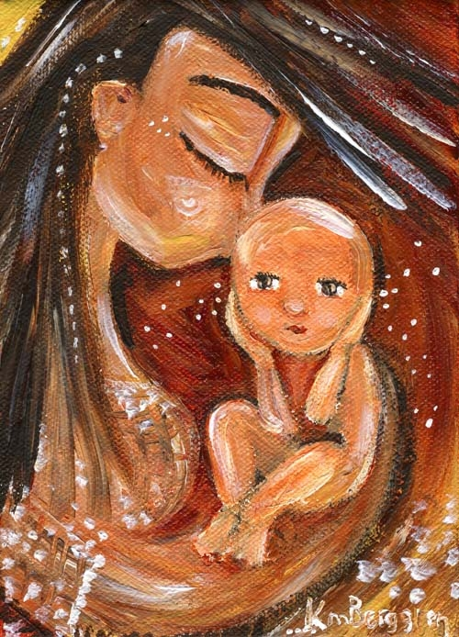
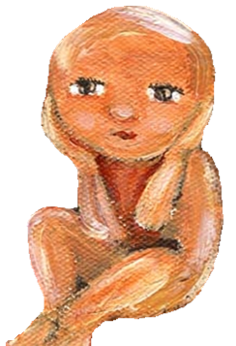
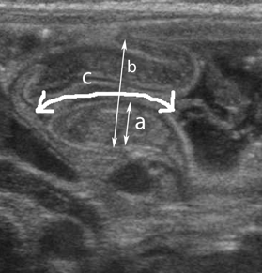
PYLORIC STENOSIS
infant (6w), healthy till nowadays
in the last few days vomiting
today projectile vomiting after each feeding
irritated; intensive peristalsis, bulk in right upper quadrant

Slide 6
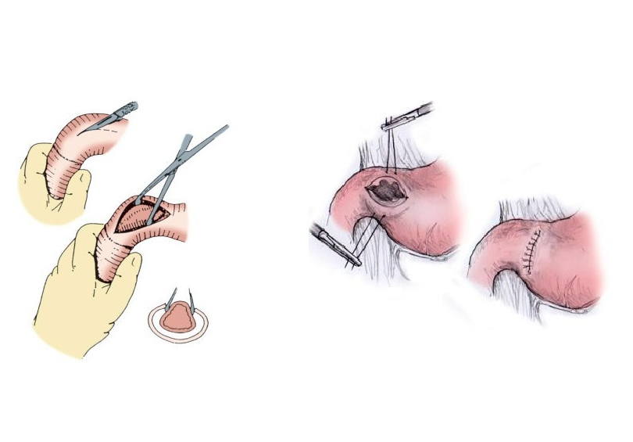
PYLORIC STENOSIS
WHICH SURGICAL PROCEDURE?
infant (6w), healthy till nowadays
in the last few days vomiting
today projectile vomiting after each feeding
irritated; intensive peristalsis, bulk in right upper quadrant
ASTRUP
pH 7,47
pCO2 5,3 kPa
BE 7 mmol/l
Na⁺ 132 mmol/l
Cl⁻ 86 mmol/l
K⁺ 3,1 mmol/l
H⁺
PYLOROMYOTOMY
PYLOROPLASTY
H⁺
H⁺
H⁺
H⁺
H⁺
H⁺
H⁺
H⁺
H⁺
H⁺
H⁺
H⁺
H⁺
H⁺

Slide 7
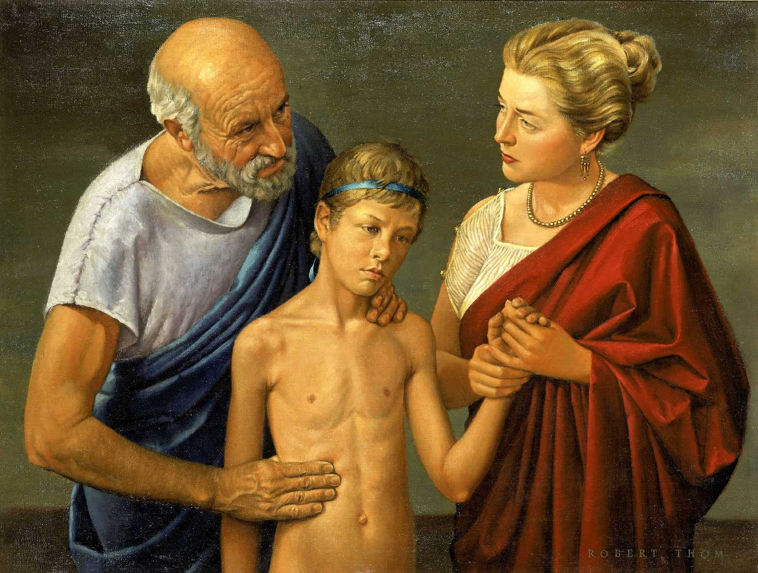
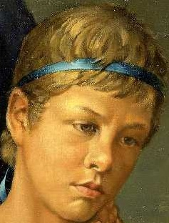
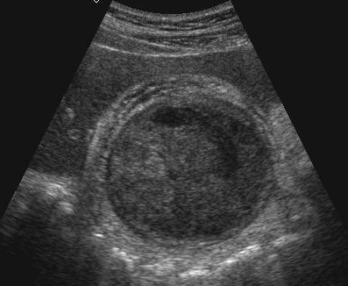
ACUTE CHOLECYSTITIS
boy (12y), progressive permanent pain in RUQ, vomiting
fever, tachycardia, tenderness in RUQ, Murphy sign
THICKEND BLADDER WALL
LEU 18 th. BILI 38 ALT 2,4 AST 1,3 CRP 94
HYDROPS OF GALLBLADDER

Slide 8
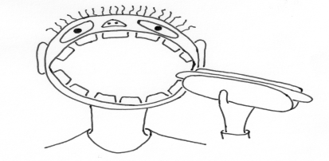
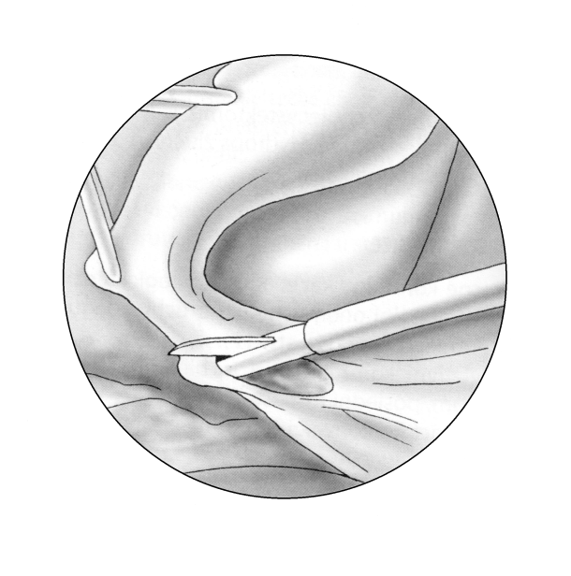
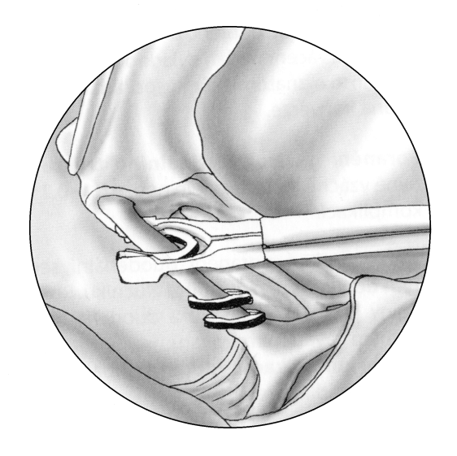
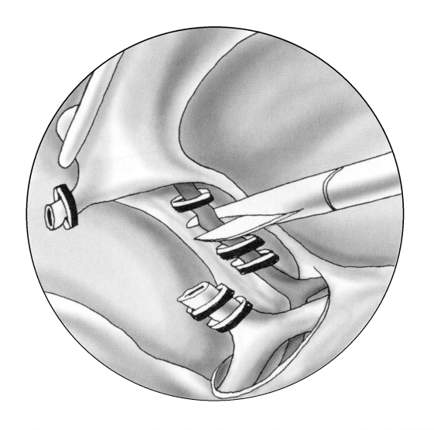
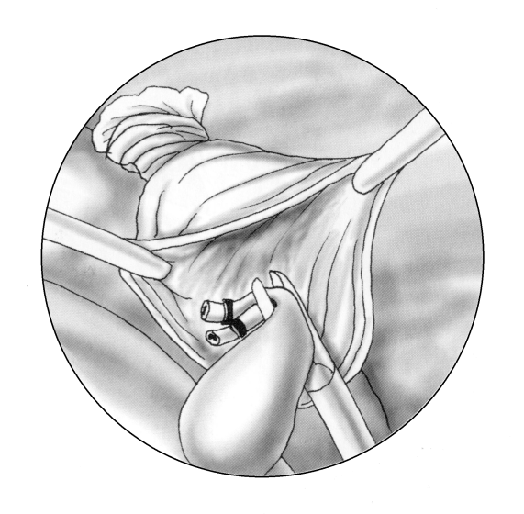
ACUTE CHOLECYSTITIS
C O N S E R V A T I V E T R E A T M E N T
REST
ICE
ATB
SPASMOLYTICS
LAPAROSCOPIC CHOLECYSTECTOMY
ACUTE CHCE
TIMING OF SURGERY?
DELAYED CHCE
4-40 DAY AFTER OUTSET OF SYMPTOMS

Slide 9
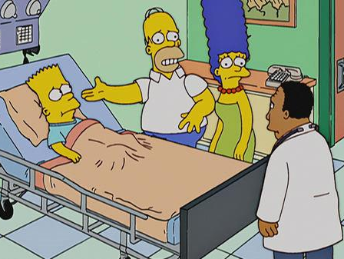
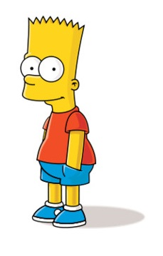
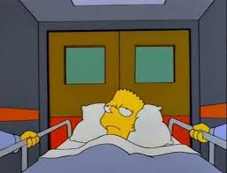
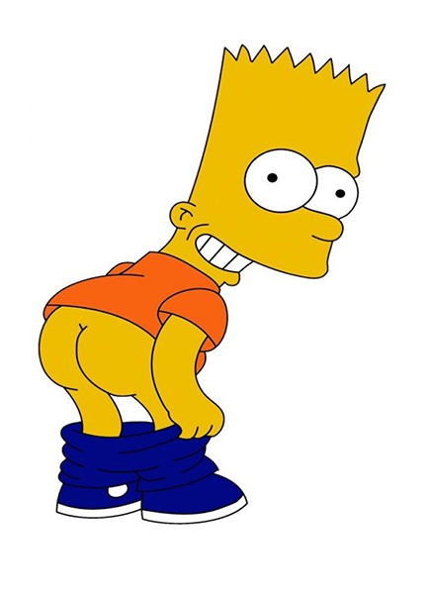
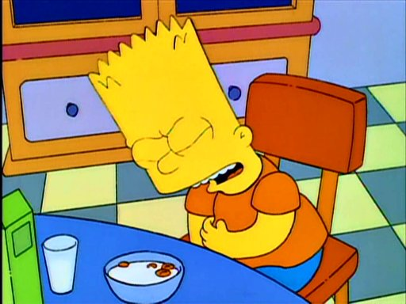
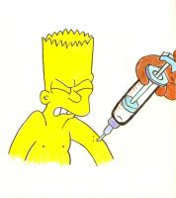
?
boy (12y)
, colic pain in RUQ, vomiting
jaundice
, 37.3°C, tenderness in RUQ
, clay-colored stools
bili 110; conj. b. 86; AST 0,9; ALT 1,1; ALP 7,2; GMT 0,8
I FEEL SICK

Slide 10
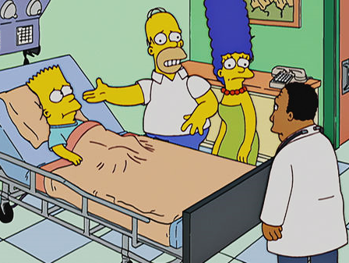
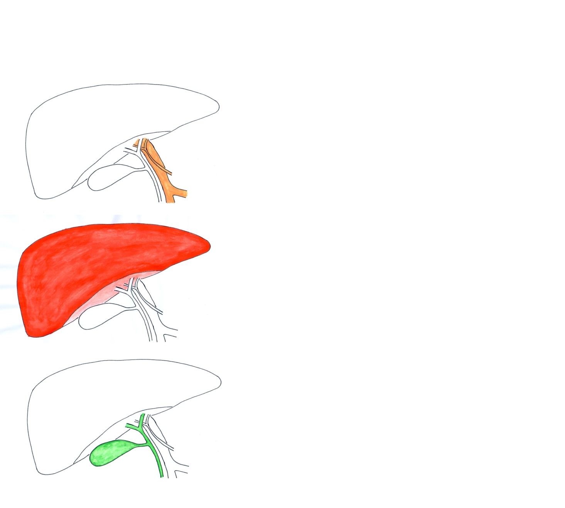
TYPES OF ICTERUS
PREHEPATAL
HEPATOCELLULAR
CHOLESTATIC

Slide 11
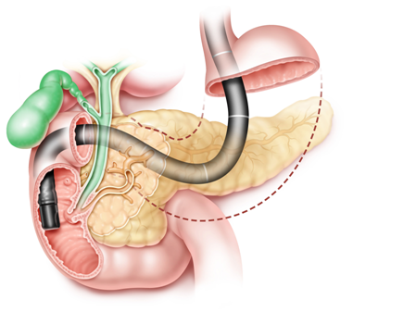
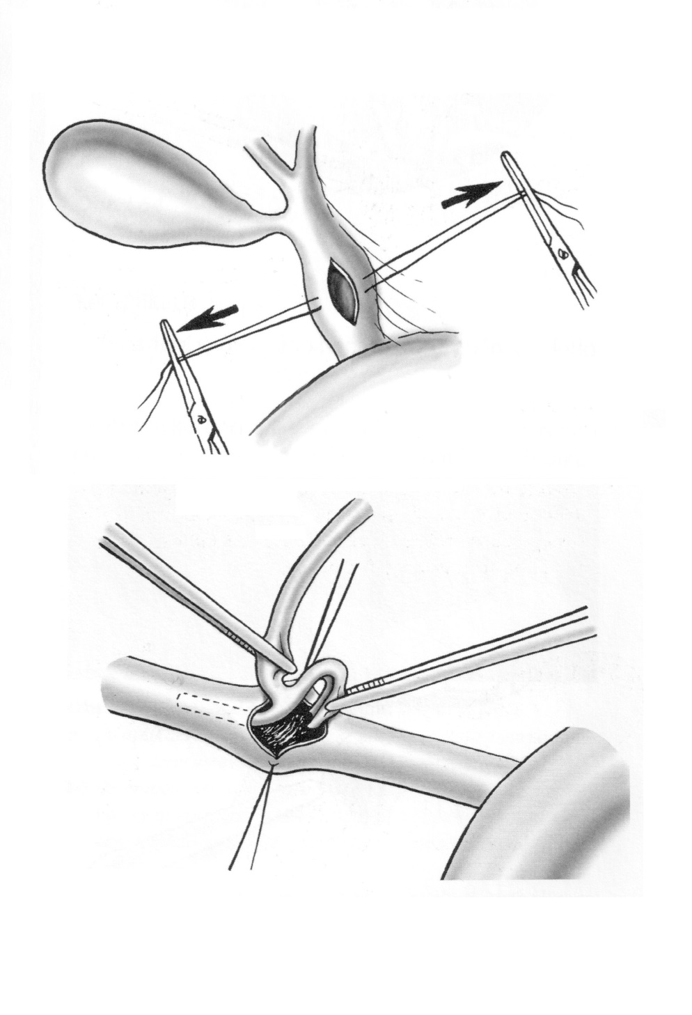

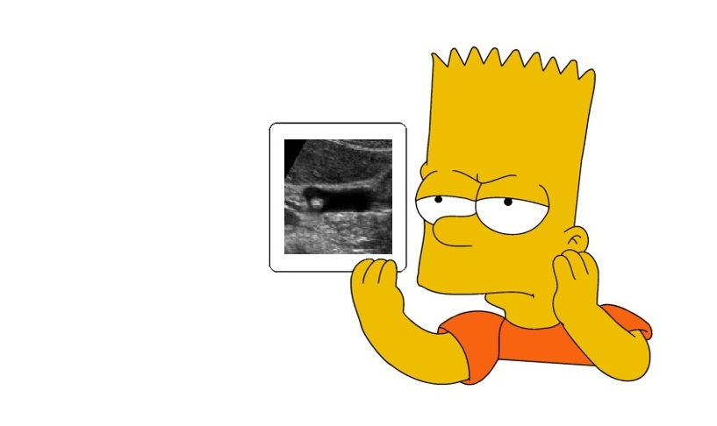
OBSTRUCTIVE JAUNDICE
IF ERCP FAILS…
common bile duct gallstone
common bile duct dilatation 14mm
ERCP
COMMON BILE DUCT
EXPLORATION

Slide 12

YELLOW SKIN + YELLOW STOOL -> ERCP
YELLOW SKIN + YELLOW STOOL -> ERCP
YELLOW SKIN + YELLOW STOOL -> ERCP
YELLOW SKIN + YELLOW STOOL -> ERCP
YELLOW SKIN + YELLOW STOOL -> ERCP
YELLOW SKIN + YELLOW STOOL -> ERC
YELLOW SKIN + YELLOW STOOL -> ER
YELLOW SKIN + YELLOW STOOL -> E
YELLOW SKIN + YELLOW STOOL -> ERC
YELLOW SKIN + YELLOW STOOL ->
YELLOW SKIN + YELLOW STOOL -> ER
YELLOW SKIN + YELLOW STOOL -> ER

Slide 13
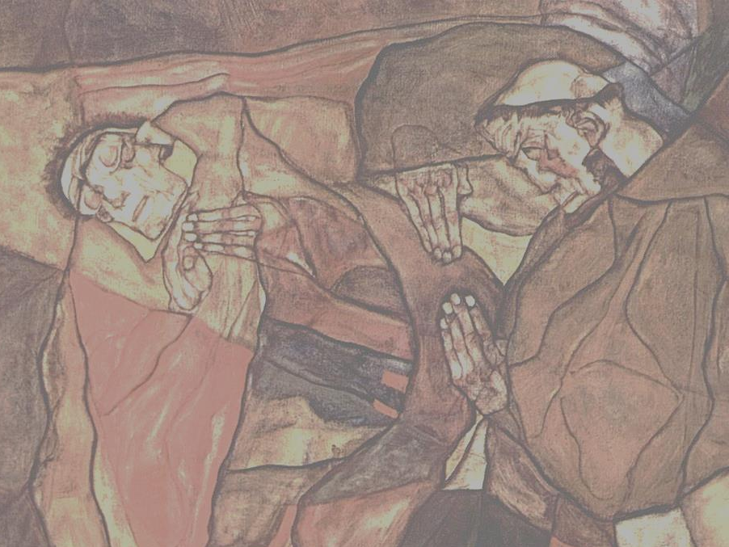
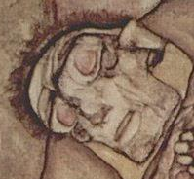
boy (16y), sudden severe sharp pain in epigastric region
subsequent shift of pain to the whole abdomen
exhaustion, antalgic position and restriction of motion, tachycardia
tenderness of whole abdomen, guarding in epigastrium
CLINICAL SUSPICION ON GIT PERFORATION
ABDOMINAL X-RAY
IN UPRIGHT POSITION

Slide 14
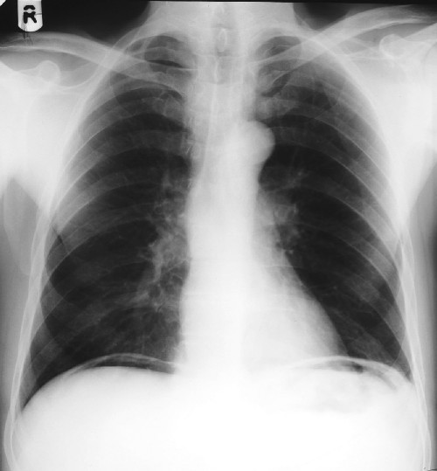

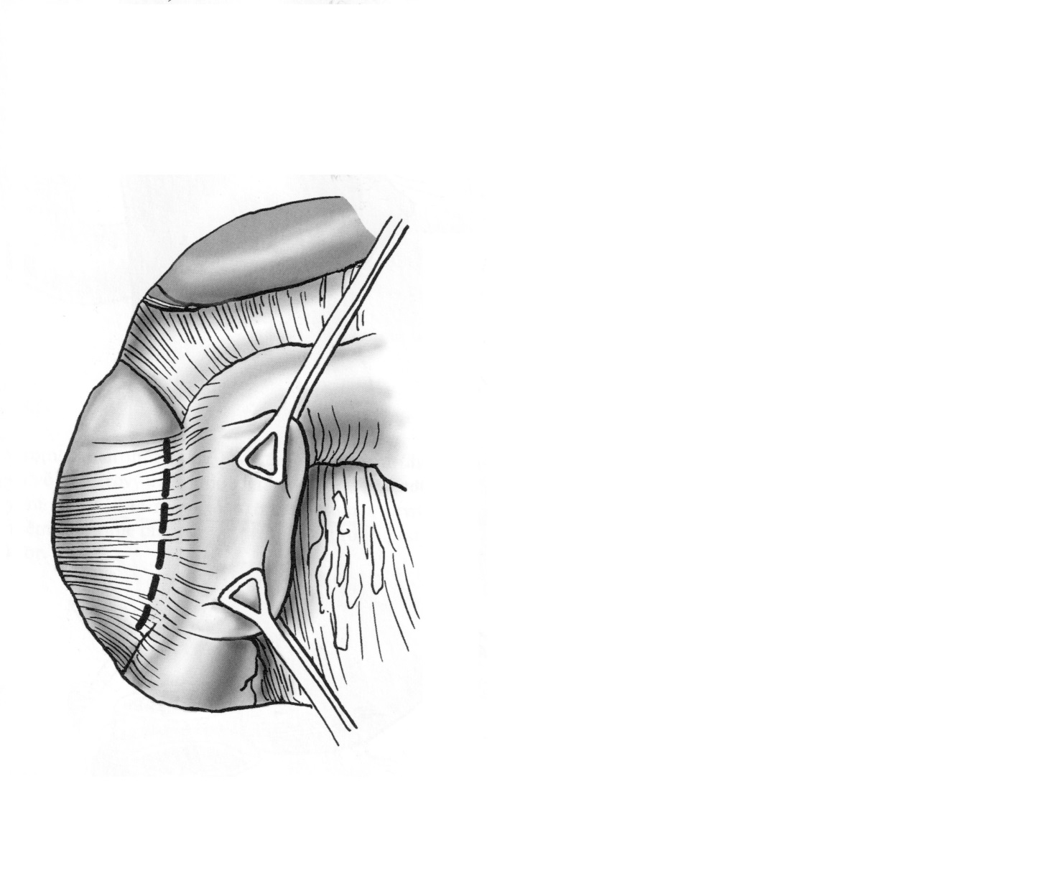
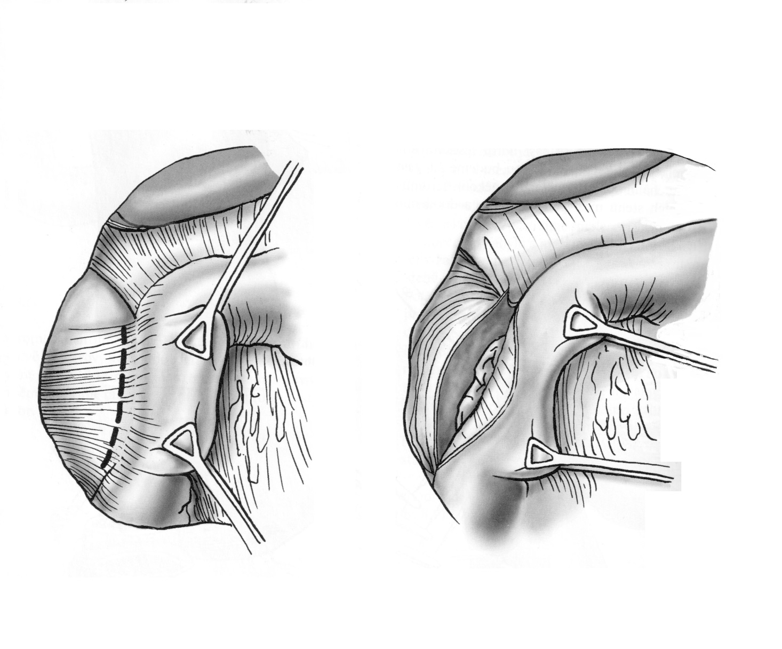
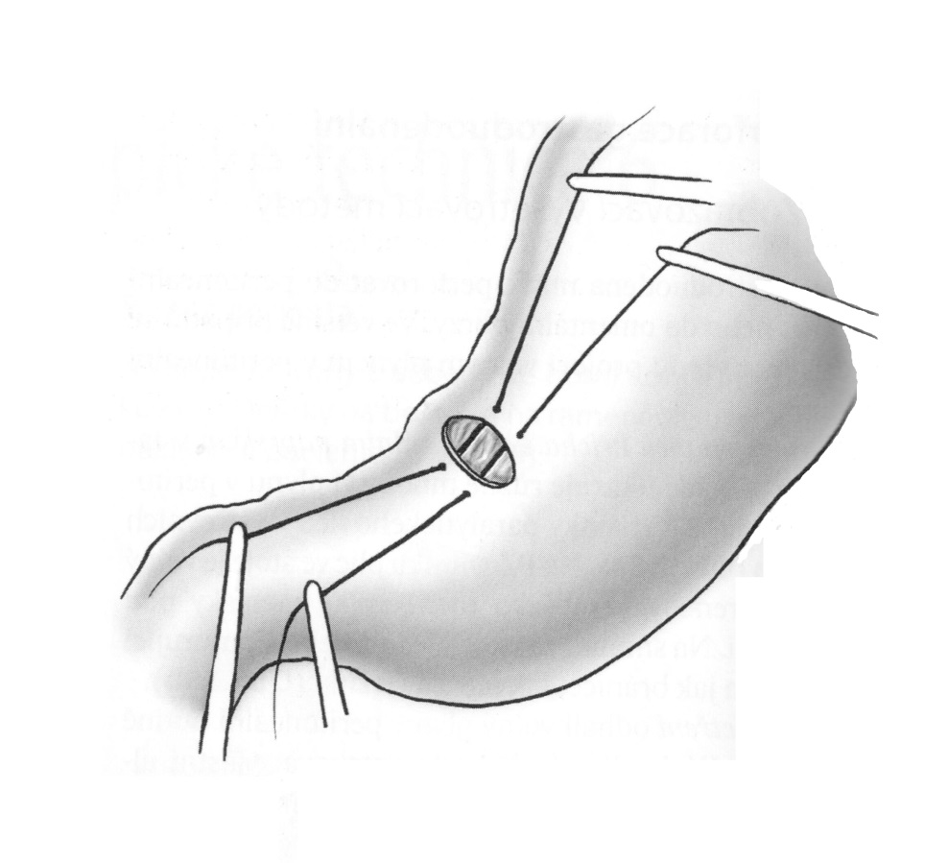
PEPTIC ULCER PERFORATION
90% OF PEPTIC ULCERS ARE IN
DUODENUM
TO EXPOSE POSTERIOR WALL OF DUODENUM:
LAPAROTOMY / LAPAROSCOPY
KOCHER MANEUVER
PNEUMOPERITONEUM
(GASTRIC BUBBLE)
PERFORATED ULCER SUTURE

Slide 15
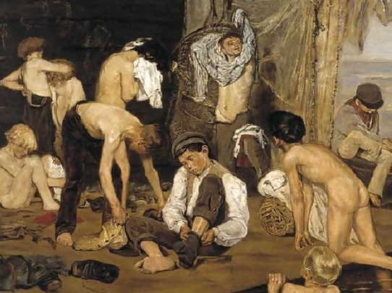
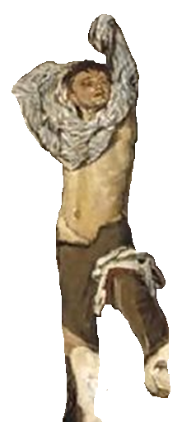

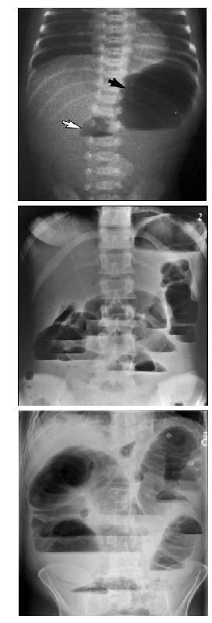
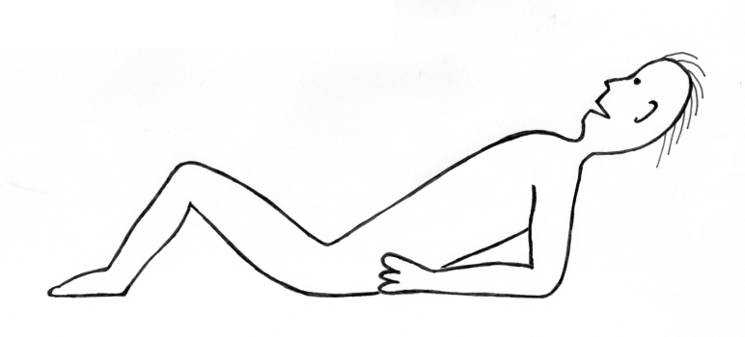








ILEUS
BP 110/70 HR 94
IN SPECIFIC TYPES OF ILEUS
CLINICAL SIGNS CORRESPOND WITH THE TYPE
in one of the boys
VOMITING
EG. ACCORDING TO THE HEIGHT OF OBSTRUCION:
- INTRALUMINAL
- INTRAMURAL
- EXTRAMURAL
- PROXIMAL
- SMALL BOWEL
- DISTAL
- VOLVULUS
- STRANGULATION
- INTUSSUSCEPTION
- PARALYTIC
- SPASTIC
- THROMBOSIS
- EMBOLISM
symptoms are worse than in the others
PROXIMAL OBSTRUCTION
DIFFUSE TENDERNESS OF ABDOMEN
INCREASED
PERISTALSIS
summer training camp of young swimmers
ABDOMINAL PAIN
VOMITING
APENDECTOMY SCAR
PAIN
SMALL BOWEL
… was visited by …
OBSTRUCTION
SWELLING
gastroenteritis
CLINICAL SUSPICION ON ILEUS
DISTAL OBSTRUCTION
CONSTIPATION
HYDROAERIC PHENOMENON
(LIQUID LEVELS)
X-RAY
IN UPRIGHT POSITION

Slide 16



ILEUS
BP 110/70 HR 94
CONSERVATIVE TREATMENT OF ILEUS
SYNTOSTIGMIN
VOMITING
K⁺
Na⁺
Cl⁻
DIFFUSE TENDERNESS OF ABDOMEN
INCREASED
PERISTALSIS
ABDOMINAL PAIN
APPENDECTOMY SCAR
DISSOLVE IONS AND MEDICAMENTS
EFFUSE
INFUSE LIQUID
INTO VENOUS SYSTEM
ACCUMULATED
LIQUID
ADMIT, THAT CONSERVATIVE TREATMENT MAY NOT BE SUFFICIENT
CONSERVATIVE TREATMENT
HYDROAERIC PHENOMENON
(LIQUID LEVELS)

Slide 17






ILEUS
STRANGULAČNÍ ILEUS
TK 110/70 P 94
100/50 P 112
VOMITING
SWELLING, GUARDING
ABDOMINAL PAIN
DIFFUSE TENDERNESS OF ABDOMEN
INCREASED PERISTALSIS
NO PERISTALSIS
ABDOMINAL PAIN
TO SEE A SURGEON
TO EXCLUDE
STRANGULATION ILEUS
+
APPENDECTOMY SCAR
VOMITING
LAPAROTOMY IS INDICATED DUE TO THE WORSENING OF THE COURSE OF THE DISEASE
+
LAPAROTOMY SCAR
3 HOURS LATER
BOWEL NECROSIS RESECTION
AND ANASTOMOSIS CONSTRUCTION
ADHESIOLYSIS

Slide 18




BASIC TYPES OF BLEEDING INTO GIT
HEMATEMESIS
CAUSES OF FAKE BLEEDING
past medical history: umbilical vein cannulation
boy (7y), black stool)
, weakness, breathlessness
pale, sweaty, HR 112/min, abdomen without clinical signs, pr: black tarry stool
UPPER
GI BLEEDING
during doctor¨s consideration the patient starts to vomit blood
MOSTLY
LESS SEVERE
MOSTLY
MORE SEVERE
LOWER
GI BLEEDING
HEMATOCHEZIA
MELENA

Slide 19






IN HOSPITAL
NASOGASTRIC TUBE
CAUSES OF BLEEDING INTO UPPER GIT
ICE-COLD IRRIGATION
BASIC MANAGEMENT OF SEVERE BLEEDING:
SIGNS OF
OXYGENOTHERAPY
REFLUX ESOPHAGITIS
SEVERE BLEEDING
ESOPHAGEAL VARICES
Leu
INTO GIT
TUMOR
Hb
Hct
DICYNONE (ETAMSYLAT)
KANAVIT
PAMBA (PARAAMINOBEN. A.)
HELICID (OMEPRAZOL)
REMESTYP (TERLIPRESIN)
BLOOD TRANSFUSION
FRESH FROZEN PLASMA
PLATELET CONCENTRATE
FIBRINOGEN
NOVOSEVEN (FACTOR VII)VII)
MALLORY-WEISS
(NOT WAITING FOR THE RESULTS)
PEPTIC ULCER
HEMOBILIA
EROSIVE GASTRITIS
ZOLLINGER-ELLISON

Slide 20







SENGSTAKEN – BLAKEMORE
(INTERIM MEASURE)
SENGSTAKEN – BLAKEMORE
(INTERIM MEASURE)
SENGSTAKEN – BLAKEMORE
(INTERIM MEASURE)
SENGSTAKEN – BLAKEMORE
(INTERIM MEASURE)
ESOPHAGEAL VARICES
BLEEDING SUCCESFULLY STOPPED
6 HOURS LATER HEMATEMESIS AGAIN
SCLEROTISATION
AFTER INITIAL STABILISATION THERE IS PLACE FOR
GASTROSCOPY
LIGATION

Slide 21



TIPSS
OTHER TREATMENT POSSIBILITIES
(EXCEPTIONALLY)
WARREN PROCEDURE
ESOPHAGEAL TRANSECTION

Slide 22

















ACUTE APPENDICITIS
ABDOMINAL PHYSICAL EXAMINATION:
PARACLINICAL TESTS:
IN SEVERE INFLAMMATION:
GENERAL APPEARANCE:
CAUSES OF ATYPICAL COURSE:
WHAT IS THE TYPICAL COURSE OF APPENDICITIS?
LEU
CRP
SONO
VOMITING (NAUSEA)
HALF OF APPENDICES DON‘T READ SURGERY TEXTBOOKS
BLUMBERG-ŠČOTKIN
ROVSING
DULL PAIN IN EPIGASTRIUM
PLENIÉS
IT COULD BE DIFFICULT
TENDERNESS
IN RIGHT LOWER QUADRANT
McBURNEY
ANALGESICS
CORTICOIDS
ATB
SHIFT OF PAIN TO RLQ
LANZ
EVEN FOR A SKILLED
TYPICAL APP. COULD BE DIAGNOSED BY DOORMAN
DIAGNOSTICIAN

Slide 23










ACUTE APPENDICITIS
LEONID ROGOZOV (1934-2000)
in May 1961 as the only doctor in an antarctic station diagnosed his own appendicitis and later on performed appendectomy on himself
RUDOLPH VALENTINO (1895-1926)
Hollywood actor
laparotomy for abdominal pain
catarrhal apendicitis
8. postoperative day passing away
section: duodenal ulcer perforation
DO YOU NEED TO KNOW THE APPENDECTOMY PROCEDURE?
CARDIAC FAILURE
PNEUMONIA
MESENTERIC LYMPHADENITIS
PANCREATITIS
HEMOPHILIA
DIABETES
WHAT COULD YOU CONFUSE APPENDICITIS WITH?
HENOCH-SCHONLEIN PURPURA
GASTROENTERITIS
WHAT IS THE MOST OFTEN CAUSE OF CONFUSION?
GASTROENTERITIS
TUMOR
TRAUMA
CROHN‘S DISEASE
MECKEL‘S DIVERTICULUM
MESENTERIAL LYMPHADENITIS
INTUSSUSCEPTION
OVARIAN TORSION
SALPINGITIS
PYELONEPHRITIS
ORCHITIS
TESTICULAR TORSION

Slide 24

AND WHO IS THIS GENTLEMAN?
ALFRED NOBEL
WAITING, WHEN
YOU DISCOVER RELIABLE
METHOD OF APPENDICITIS
DIAGNOSING

Slide 25

THE SUN SHOULD NOT BOTH RISE AND SET ON
ACUTE ABDOMEN
THANKS

