Slide 1
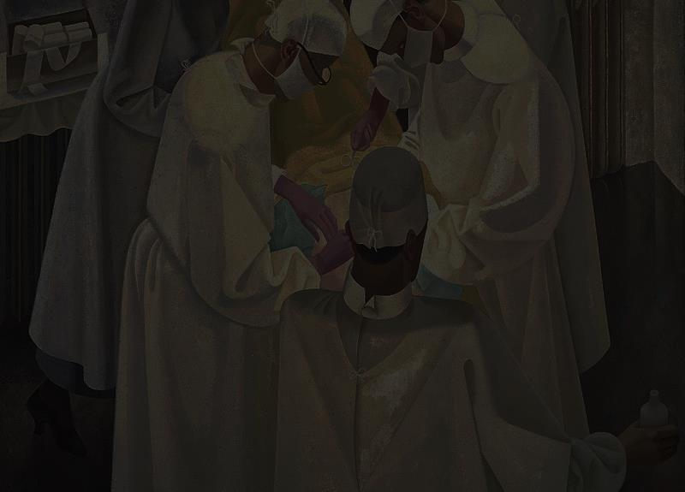
PEDIATRIC ONCOSURGERY

Slide 2
PEDIATRIC ONCOSURGERY

Slide 3
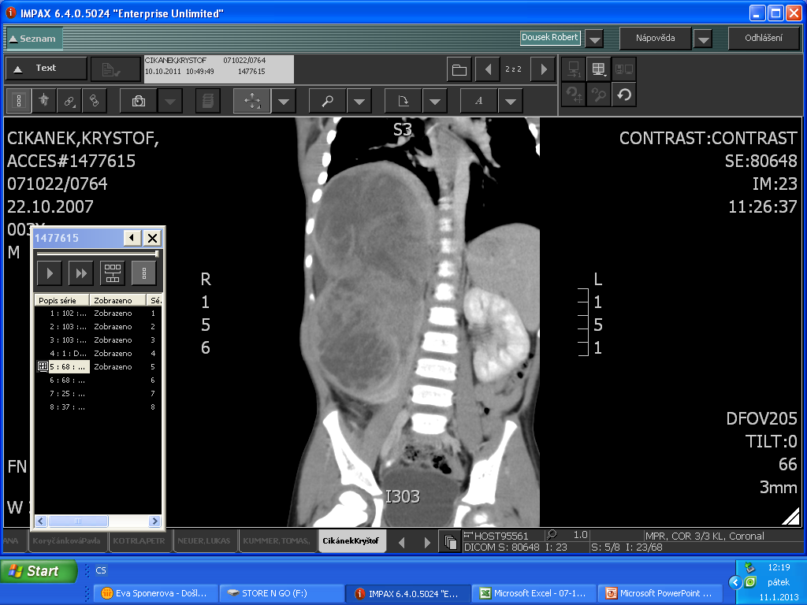
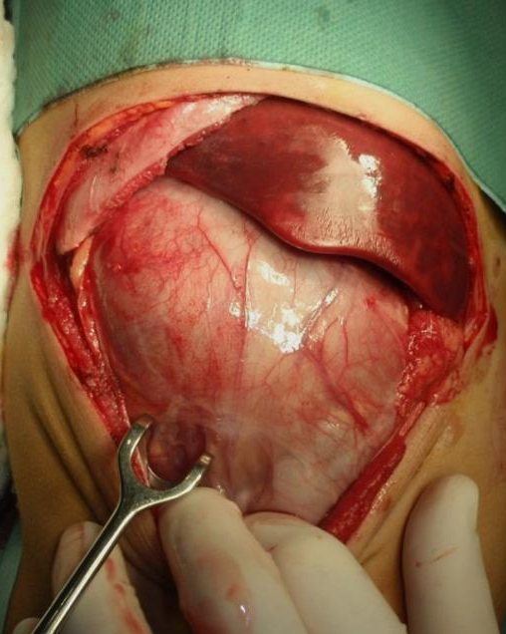
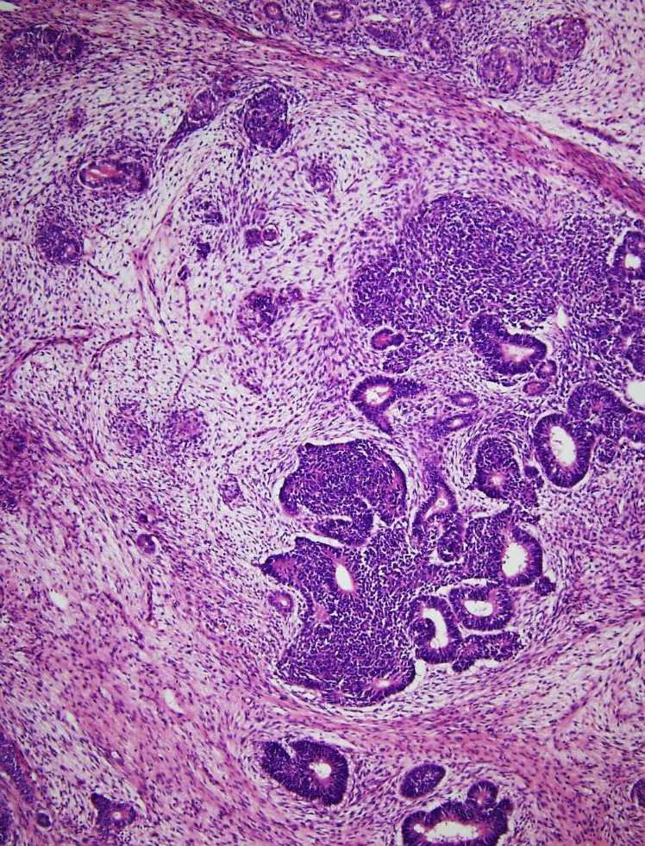
NEPHROBLASTOMA
a boy (3), parents found a „huge abdomen“ while bathing
large resistance of the right side of the abdomen
hypertension, microscopic hematuria
ARTERY LIGATION
VEIN LIGATION
CHEMOTERAPIE
NEFREKTOMIE

Slide 4
WILMS´ TUMOUR
- ANOTHER PATIENT

Slide 5
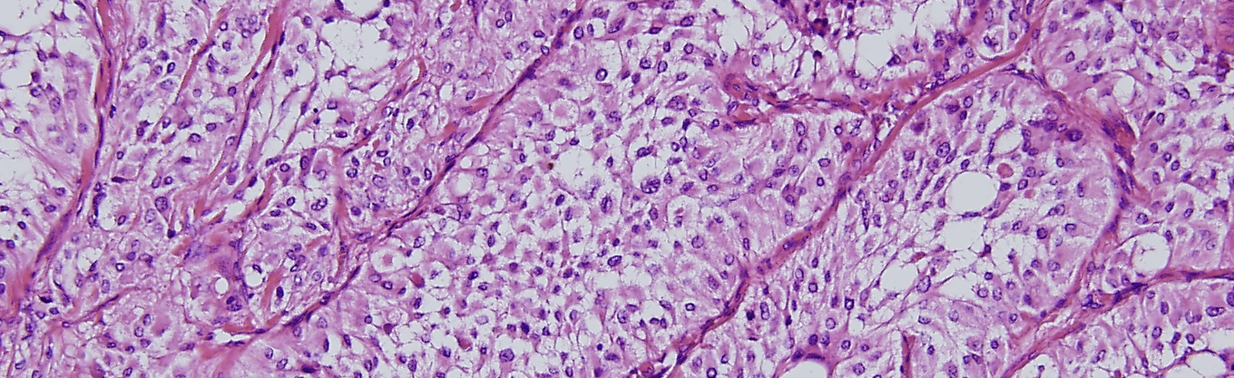
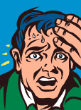
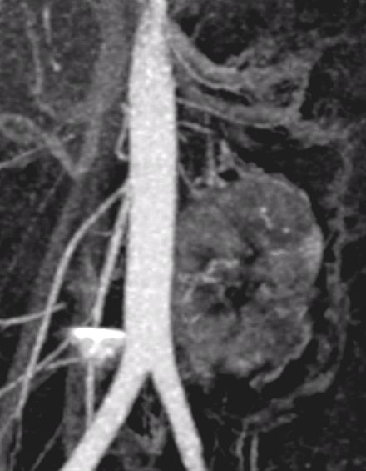
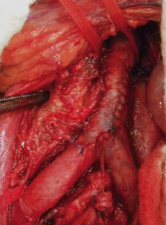
PHEOCHROMOCYTOMA
a boy (16), seizures - headaches, palpitation, sweating, anxiety
hypertension, paleness, hyperglycemia, loss of weight
prove of metabolites of catecholamines
10%
- MALIGNANT
- BILATERAL
- EXTRA ADRENAL
RISK OF PEROPERATIVE HYPERTENSION

Slide 6

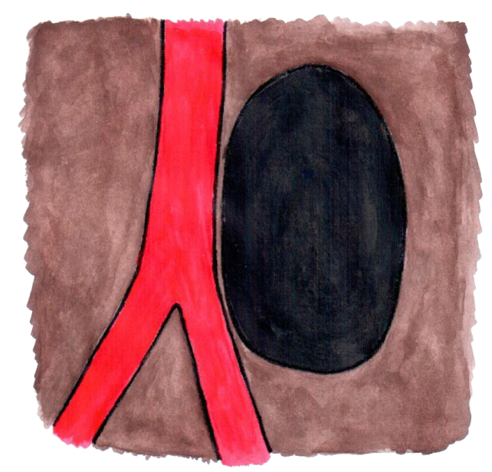
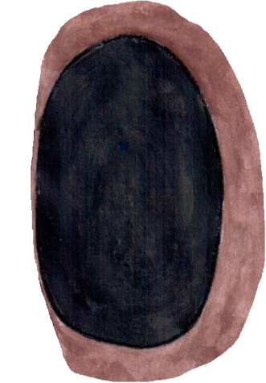
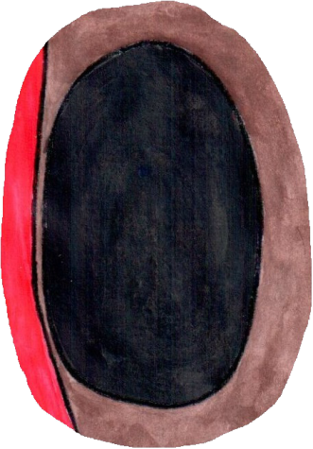
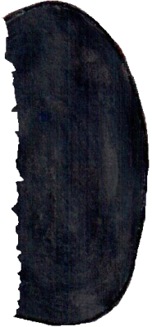
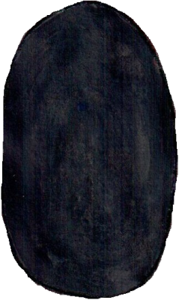

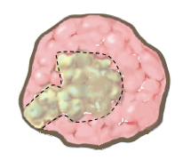
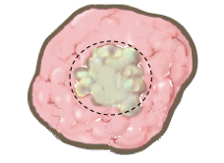
BIOPSY
R 2
RESECTION
R 1
EXSTIRPACE
RADICAL EXCISION
R 0
EXCISION IN PRACTICE – WITHOUT MUTILATION

Slide 7
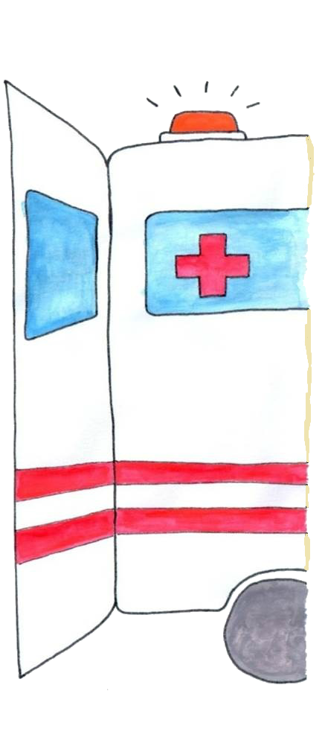
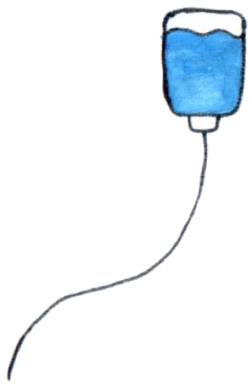
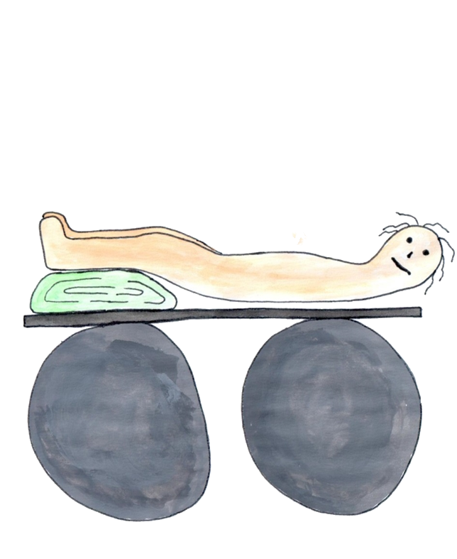
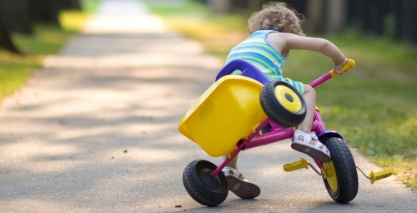
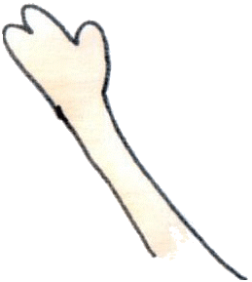
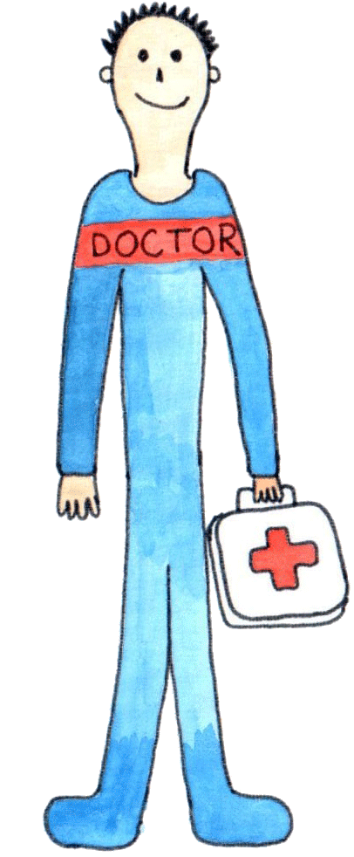
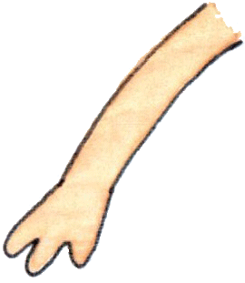
BASIC SANITATION
a girl (5) with stomach ache, according to a nurse, after fall of tricycle in a full waiting room
fall on the side of kerb; weakness, tiredness, breathlessness, stomach ache
pale, sweaty, bp 90/50, p 135
sensitivity in PHK , phrenic symptoms, brusising symptoms
PREFERENTIAL TREATMENT
HEMORRHAGIC SHOCK SUSPICION

Slide 8
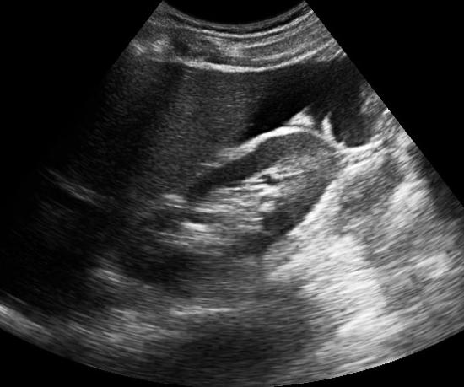
AT HOSPITAL ADMISSION
pale, somnolent, non measurable bp, p 160
UNSTABLE CIRCULATORY
Leu
Hb
Hct
URGENT LAPAROTOMY
(WE DO NOT WAIT FOR THE RESULT)

Slide 9
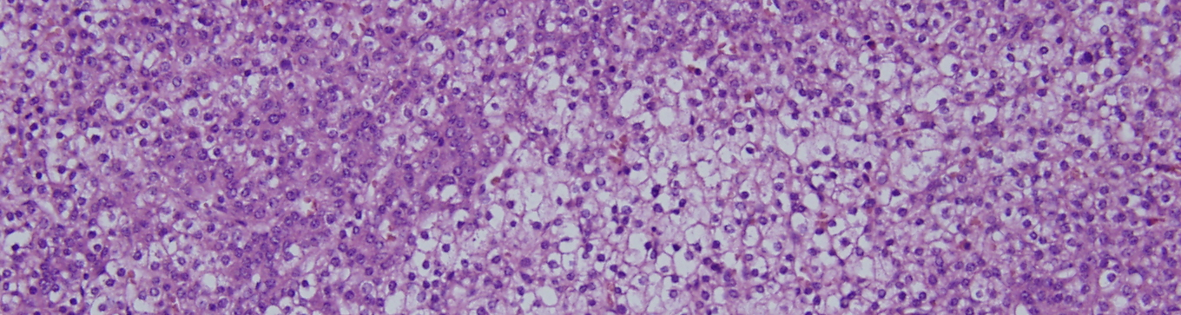
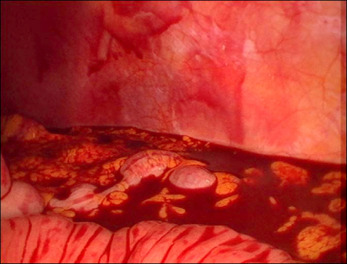
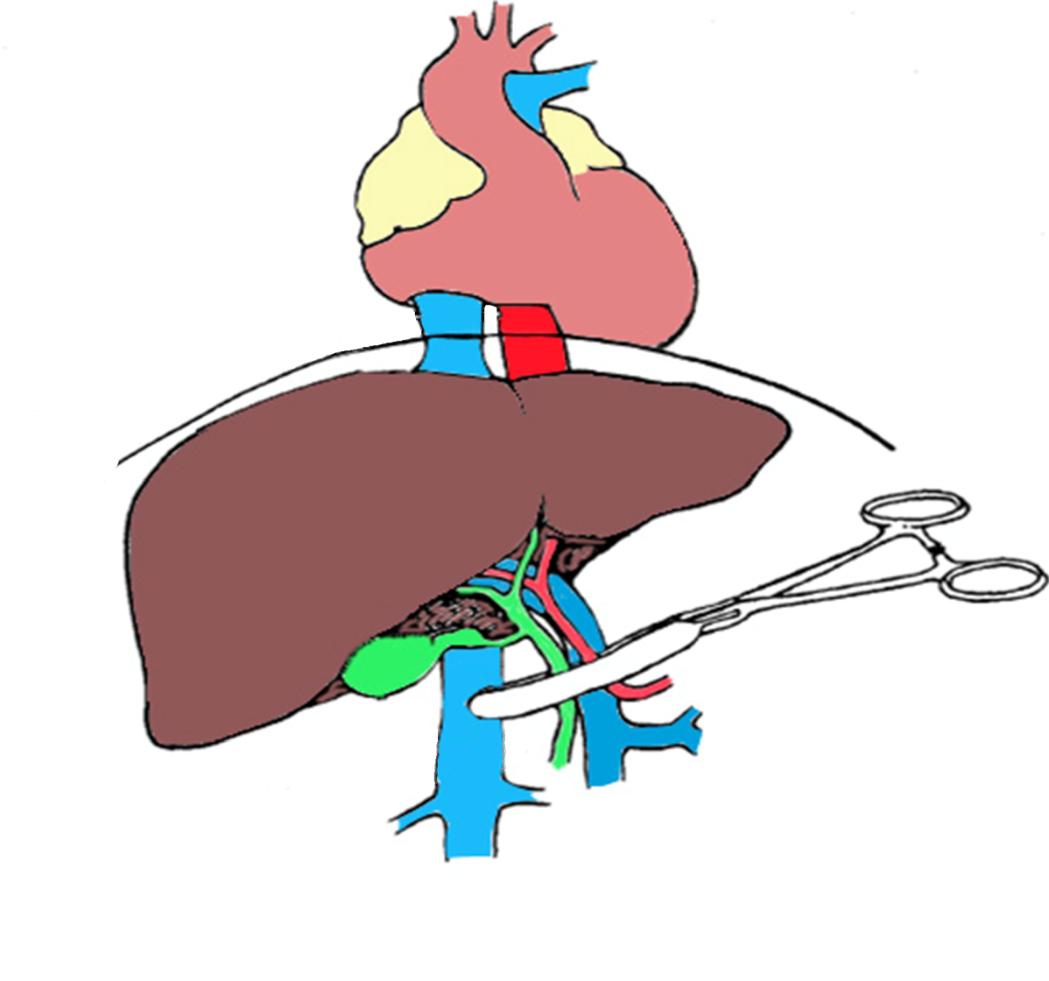
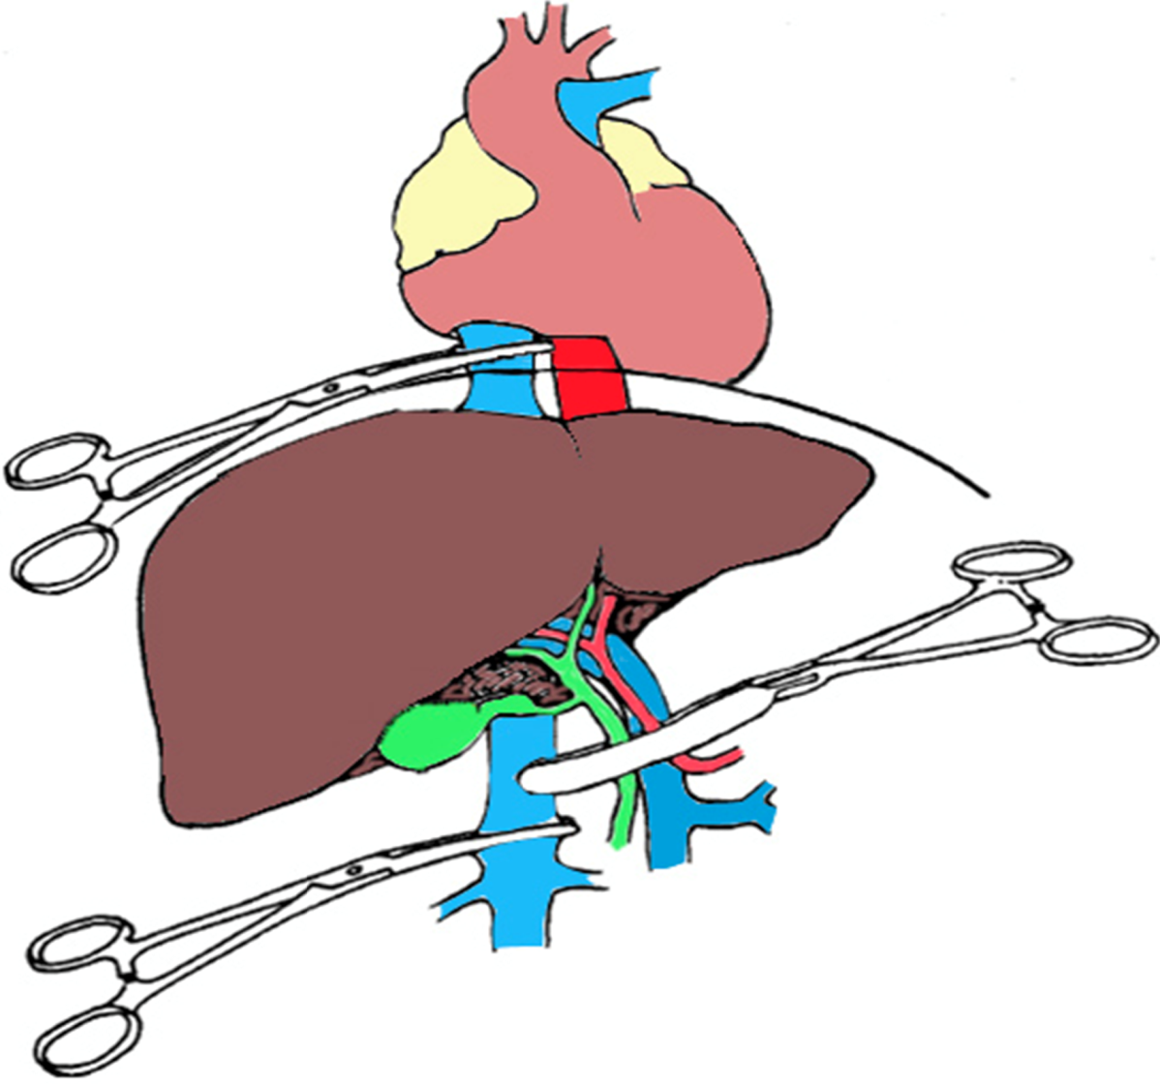
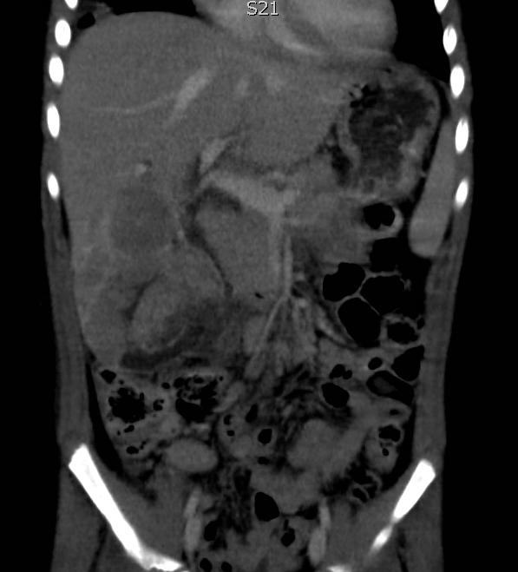
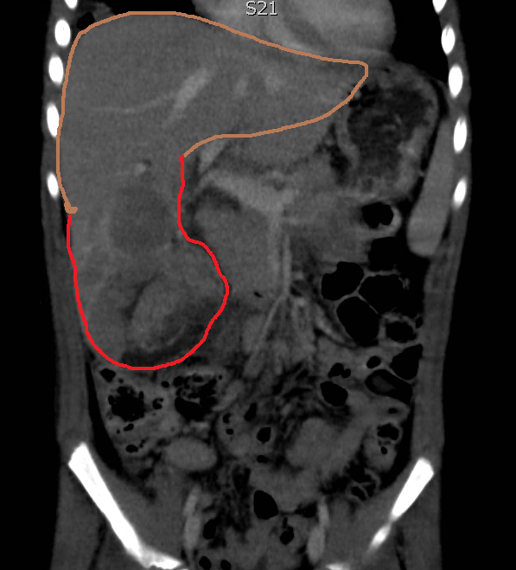
HEPATOBLASTOMA
TOTAL VASCULAR OCCLUSION
PRINGLE´S MANOEUVRE

Slide 10
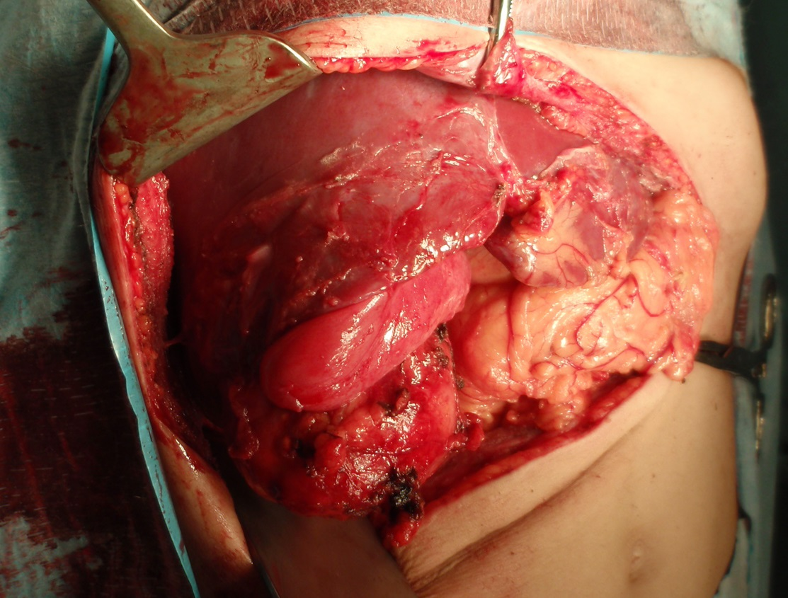
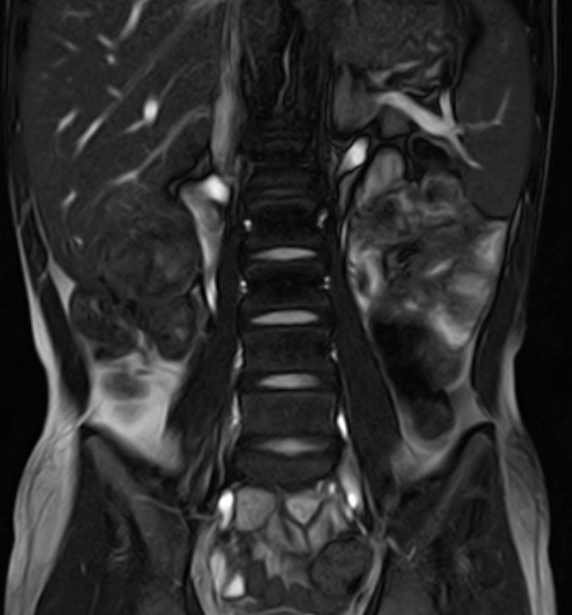
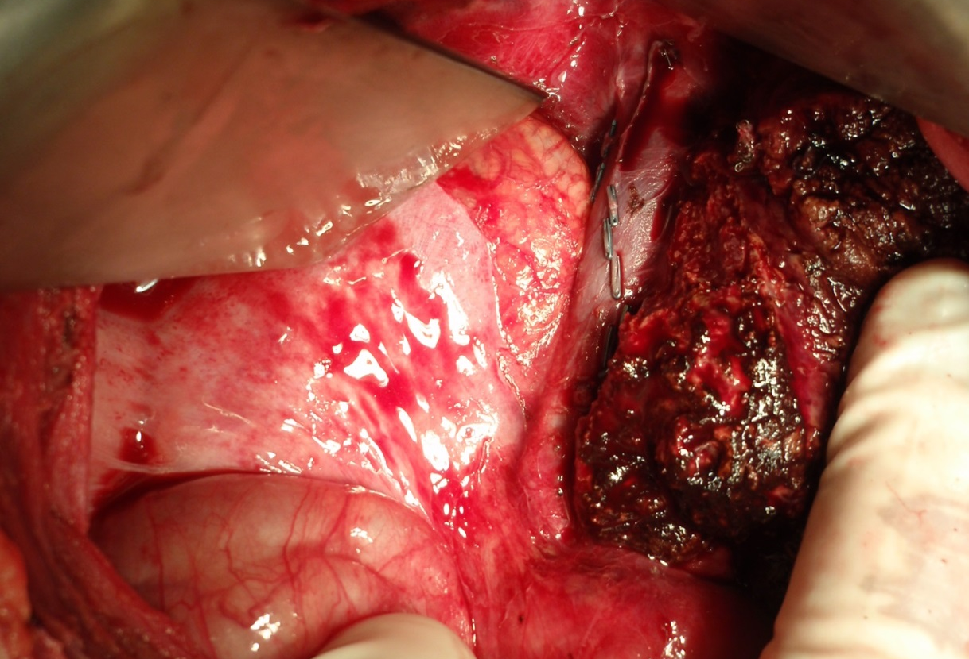

Slide 11
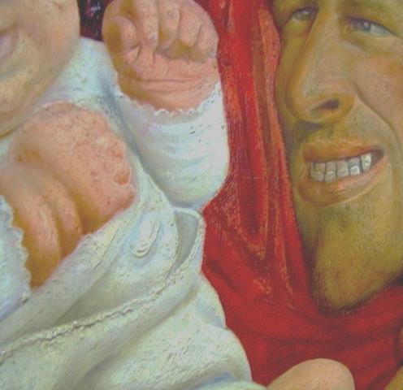

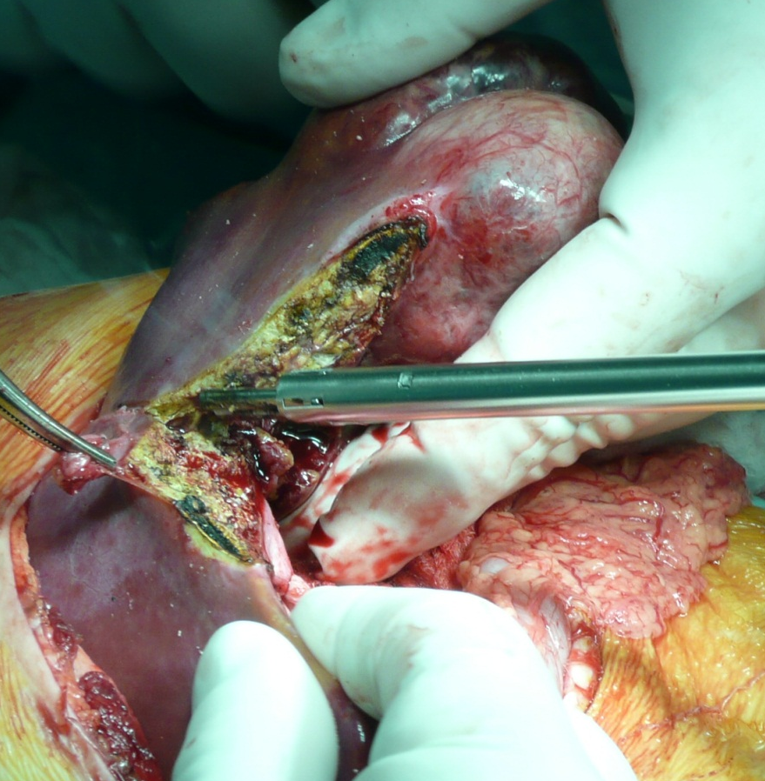
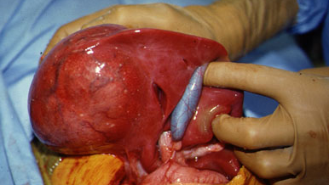
HEPATOBLASTOMA
HEPATOCELLULAR
CARCINOMA
INCIDENCE
AGE DISTRIBUTION
TUMOUR TYPES
ETIOLOGY
BIOLOGICAL BEHAVIOUR
RESPONSE TO THE TREATMENT
PROGNOSIS

Slide 12
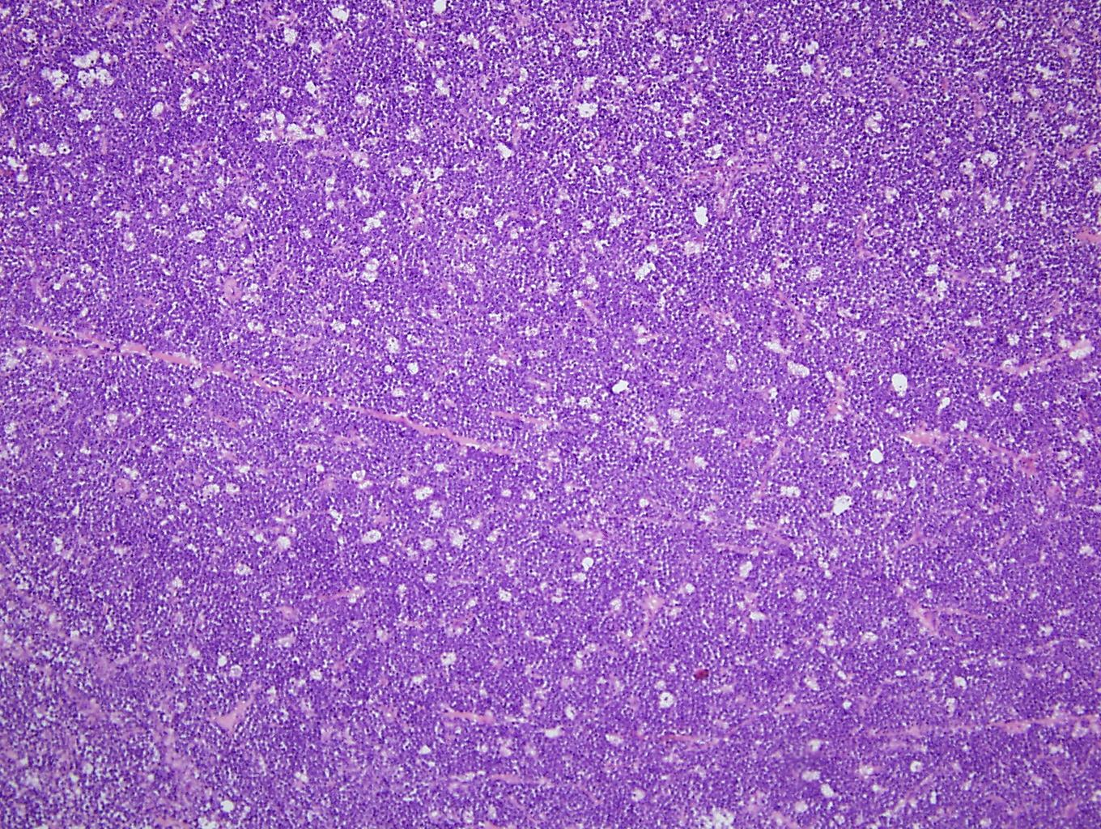
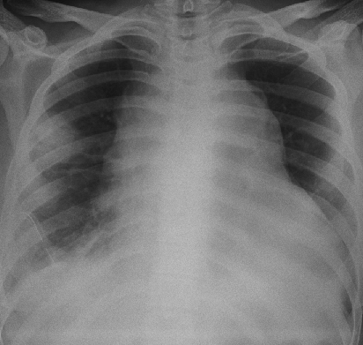
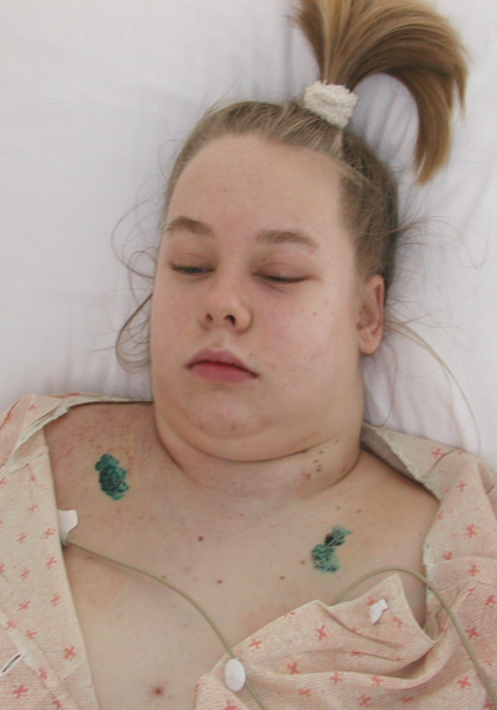
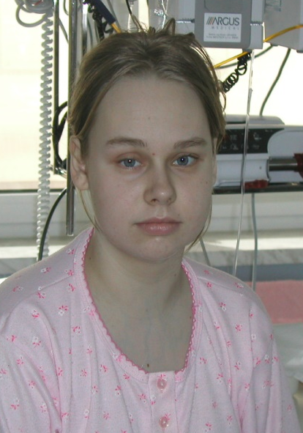
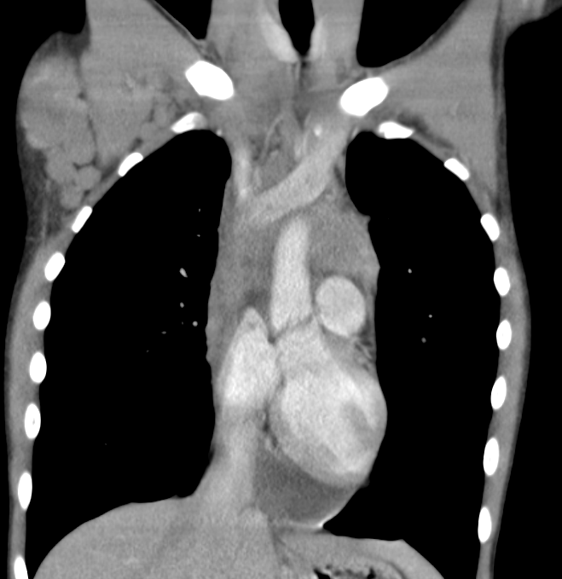
LYMPHOMA MEDIASTINUM
UPPER BODY ELEVATION
OXYGEN THERAPY
CORTICOIDS
DIURETIC
URGENT BIOPSY
CHEMOTHERAPY
a girl (14) with progressive breathlessness, cought and head and neck swelling
head, neck and upper limbs swelling
dilatation of subcutaneous veins of upper body
conjuctiva congestion
SUPERIOR VENA CAVA SYMPTOM

Slide 13
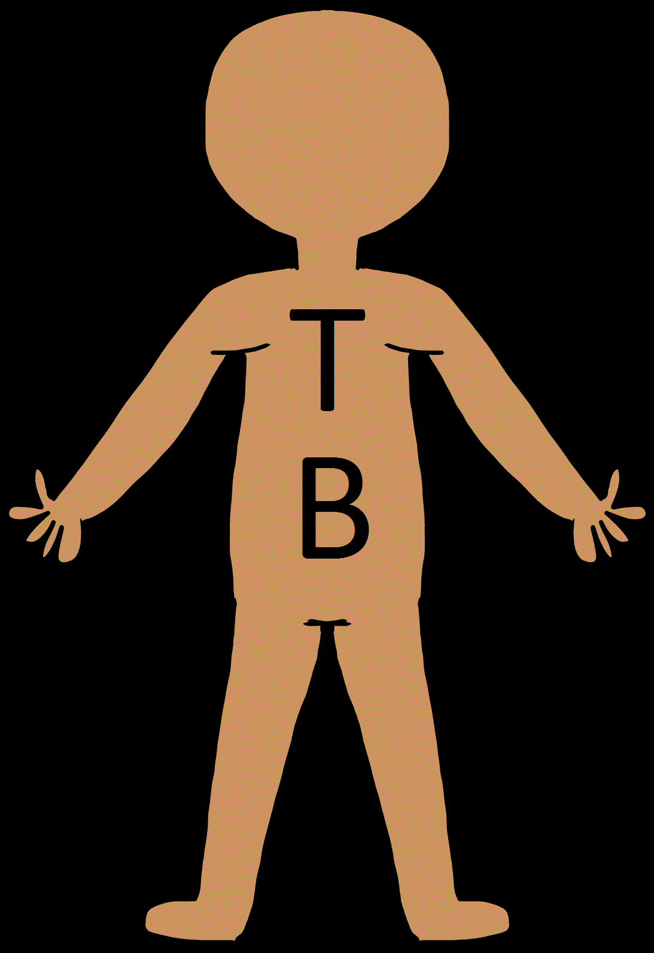

Slide 14
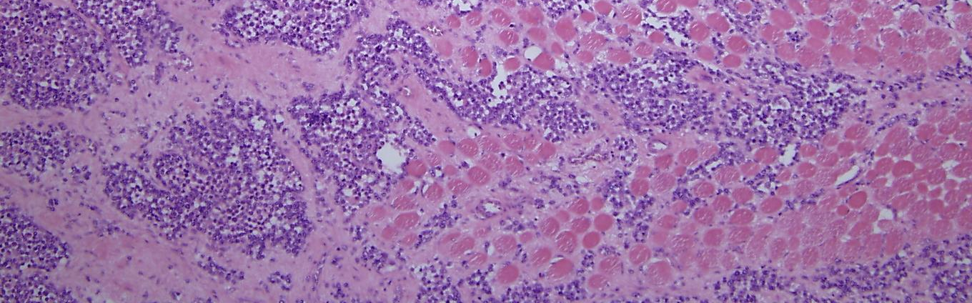
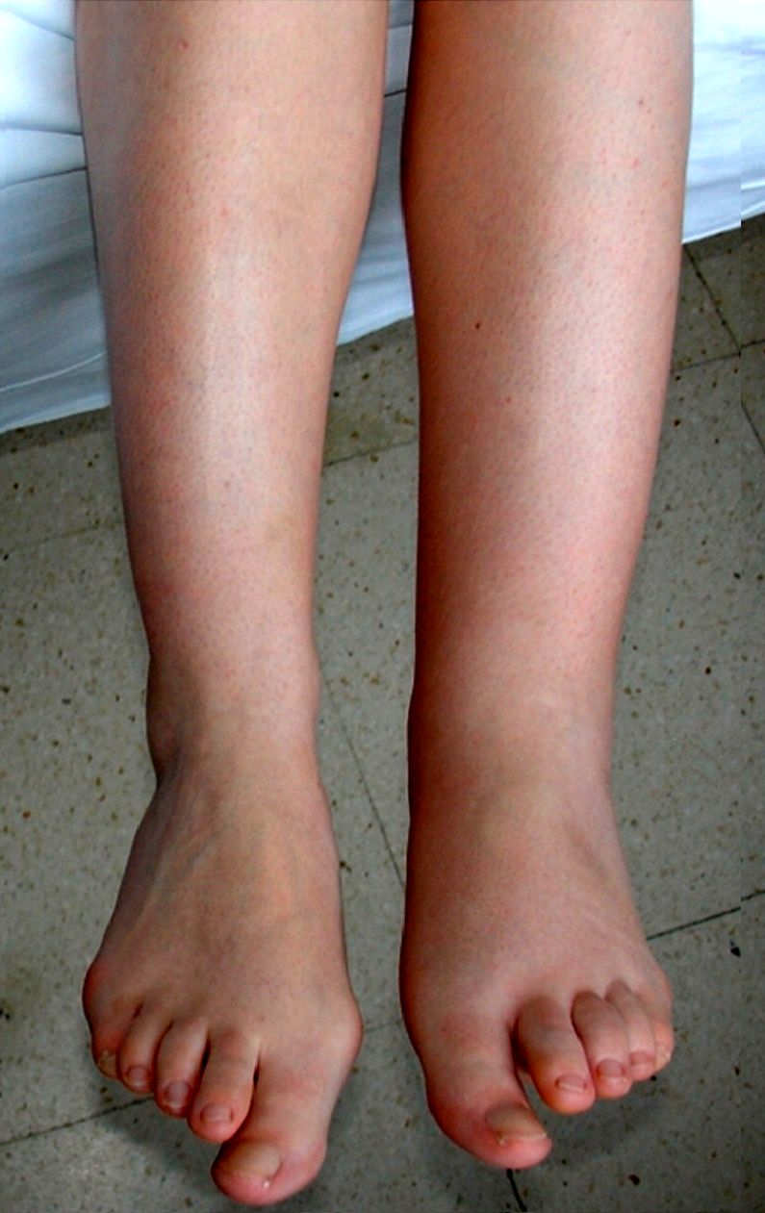
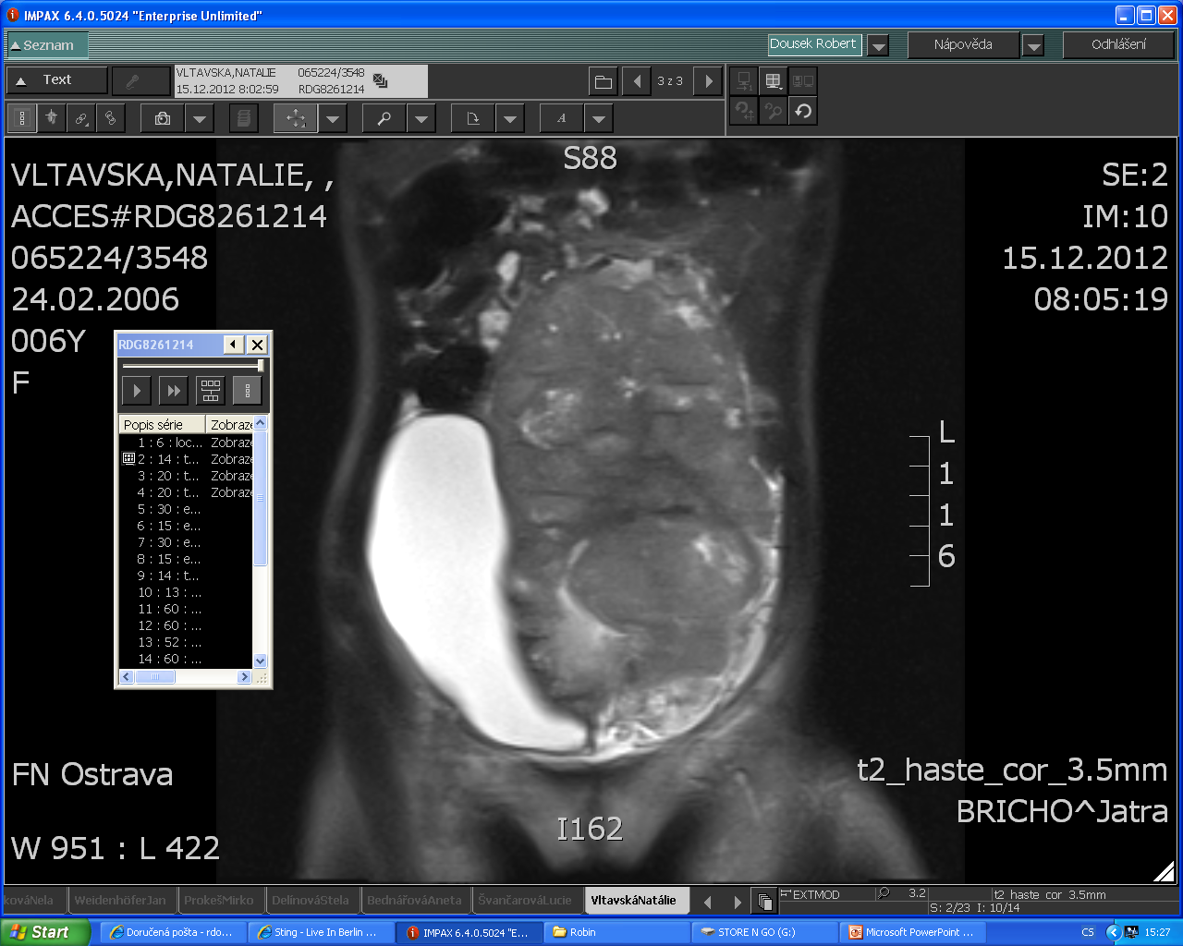
RHABDOMYOSARCOMA OF PELVIS
a girl (10) with lower left limb swelling, no urinate for 20 hours
soft swelling of LLL, great abdomen resistance

Slide 15

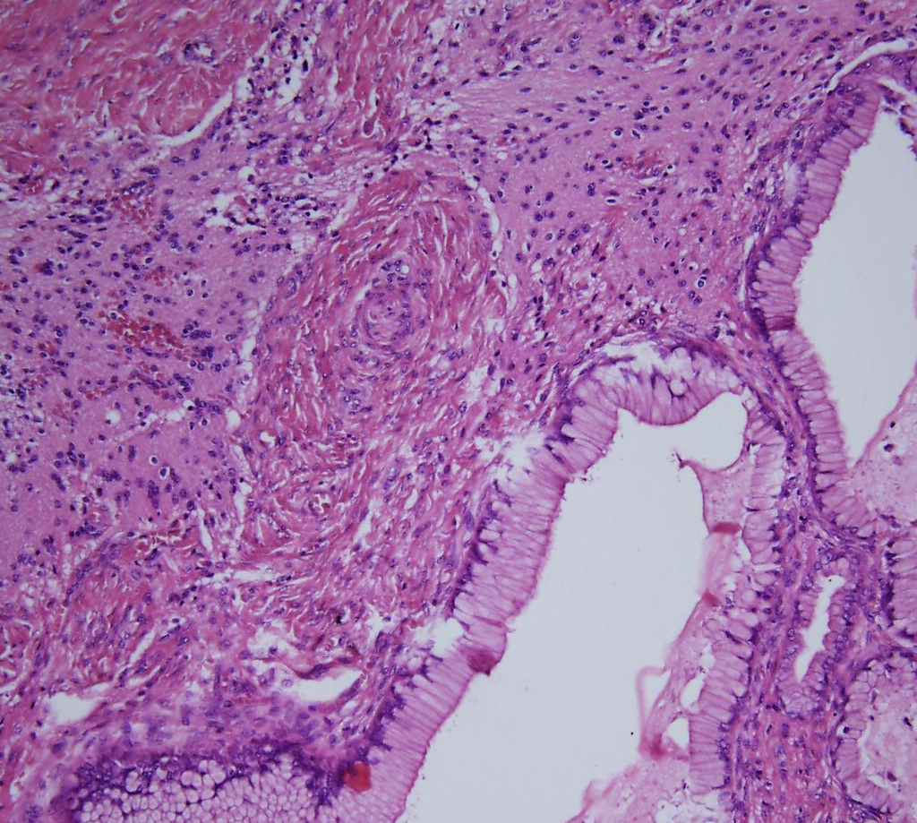
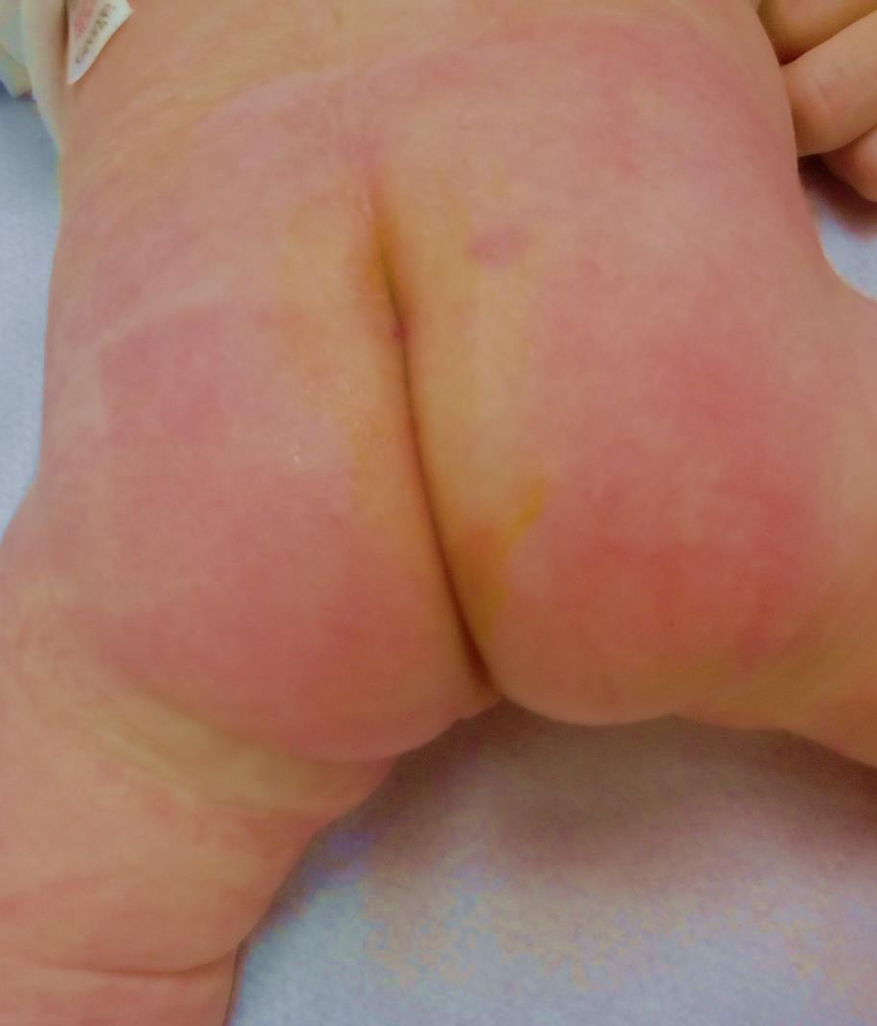
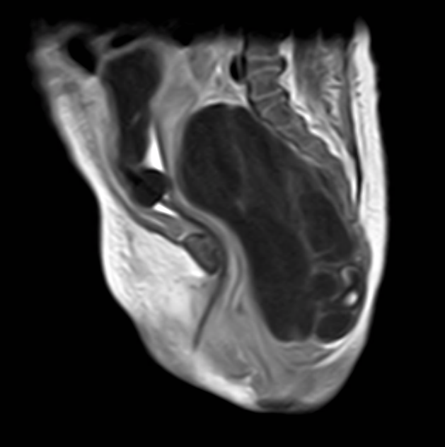
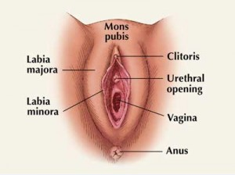
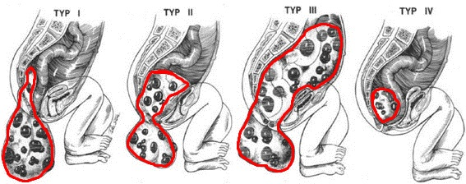
SACROCOCCYGEAL TERATOMA
novorozená dívka
ventrální dislokace anu
elastická rezistence intergluteálně

Slide 16
DALŠÍ TYPY SAKROKOKCYGEÁLNÍHO TERATOMU

Slide 17
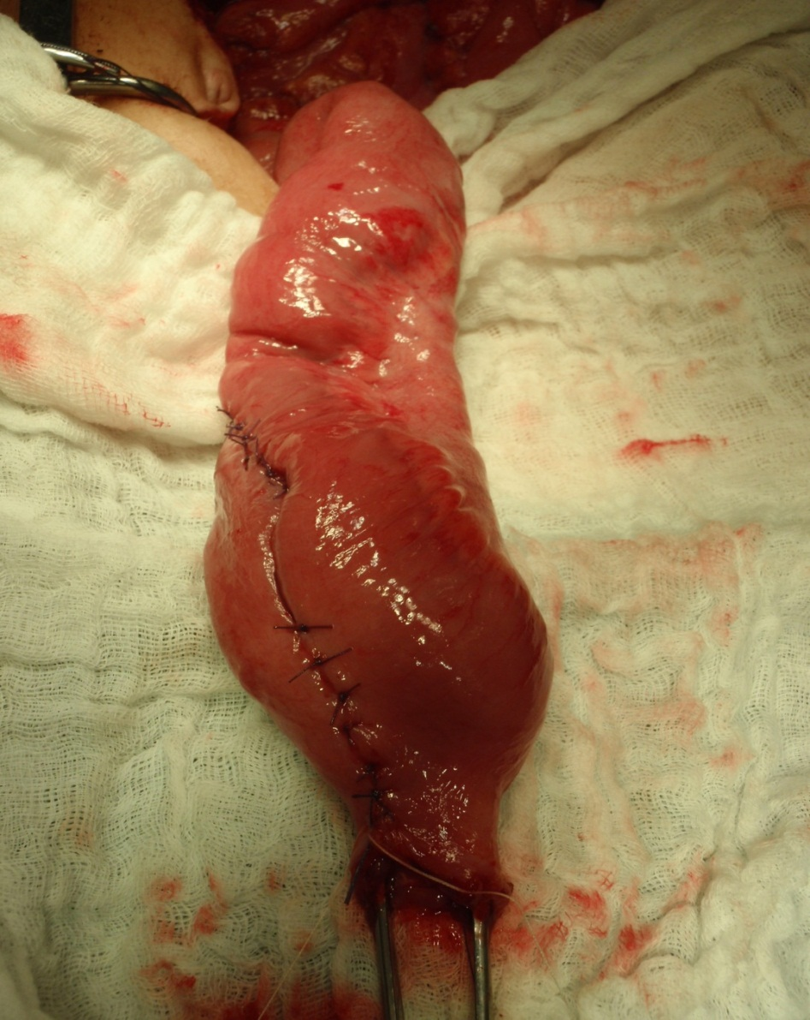





FAMILIAL COLON POLYPOSIS
RA: father and uncle died of CRC up to 30 years
HOW TO ATTACH THE REST OF THE GIT?
a girl (15) with occasional stomach ache, mucus and bleeding stool
OA: 2x hospitalized pro colocolic invagination
PROCTOCOLECTOMY – PREVENTIVE INTERVENTION
ILLEAL-POUCH-ANAL ANASTOMOSIS

Slide 18

LIP, ORAL CAVITY, FINGER PIGMENTATION
PEUTZ-JEGHERS SYNDROME (NOT FAP)

Slide 19




PULMONARY
METASTASIS
subjectively without complication
objective physiological clinical finding of torso
calm scar on the left shin after resection of Ewing´s sarcoma a.a.
DISPENSARIZATION
LOCAL RECURRENCES
METACHRONOUS MTS
COMPLICATION AND CONSEQUENCES

Slide 20













NEUROBLASTOM
NEUROBLASTOMA
IDRF
INRGSS
nMYC
HORNERŮV SYNDROM
BIOPSIE KRČNÍCH UZLIN
OBJEDNÁN K MR MOZKU
NEUROBLASTOMA
GANGLIONEUROBLASTOMA
GANGLIONEUROMA
MIBG

Slide 21










NEUROBLASTOM
DALŠÍ KLINICKÉ PROJEVY NEUROBLASTOMU
PO NEOADJUVANTNÍ CHEMOTERAPII
RACOON EYES
OPSOCLONUS/MYOCLONUS SYNDROM

Slide 22

EVEN CHILDREN CAN
HAVE TUMOUR
OFTEN LIFE THREATENING
EARLY DIAGNOSIS
IMPROVES PROGNOSIS

Slide 24


ARTERY LIGATION
VEIN LIGATION

Slide 25




Slide 26



NEUROBLASTOMA OF ADRENAL GLAND
EXPANSIVE GROWTH
a boy (2), tiredness, irritation, loss of appetite, loss of weight
great resistance of the right side of the abdomen
INVASIVE GROWTH

