Slide 1

Vascular trauma
Tomáš Novotný
II. chirurgická klinika LF MU a FN u sv. Anny

Slide 2
Vascular trauma
most vascular diseases may be observed and treated during prolonged periods
Vascular trauma is the opposite
very short time intervals for diagnosis and intervention
often incomplete and imperfect information

Slide 3
Vascular trauma an its evolution
The advances and developments are related to major conflicts or war
vascular trauma is associated with hemorrhage
  surgical practice evolved around the control of bleeding
Ligation of both arterial and venous injuries
  the standard of care through World War II
  World War I - repair attempted in 3.2 % of injuries
  World War II - repair attempted in 5 % of injuries

Slide 4
Vascular trauma an its evolution
Korean War
  88 % of injuries undergoing a vascular repair attempt
Vietnam War
  repair attempted in 93% of injuries
Iraq and Afghanistan
  high rate of extremity injury (53 %)
  decreased rate of major truncal injury (15 %)
  devastating nature of the extremity injuries and the inclusion of distal arterial injuries probably explain the increase in vascular ligations (35 %)

Slide 5
Vascular trauma in the civilian setting
historically relatively rare
the development of machinery and motorized vehicles
the increase in urban violence and weaponry
increased incidence of civilian vascular trauma
incidence 1-4% of all injuries (likely an underestimate)
  does not include patients who die at the trauma scene or before or immediately after hospital arrival
The majority of immediate deaths from vessel disruption are due to aortic injury (55%)
  78% leading to death within 15 minutes of injury
Source: http://www.secondscount.org/heart-condition-centers/info-detail-2/cardiac-embolism-stroke

Slide 6
Current Epidemiology of Vascular Injury
trauma as a cause of death (USA 2010)
  63% of patients aged 1 – 24 years
  42 % of patients aged 25 – 44 years
incidence of vascular injury
  1.6 % for adults
  0.6 % for children
  60 – 90 % due to penetrating mechanisms (mainly guns)
  blunt vascular injuries are uncommon
iatrogenic injuries
  percutaneous endovascular procedures
  laparoscopy
Source: http://www.secondscount.org/heart-condition-centers/info-detail-2/cardiac-embolism-stroke

Slide 7
Current Epidemiology of Vascular Injury
Epidemiologic trends
  The average age of all trauma patients is increasing
  “young and healthy” trauma patient replaced with elderly patients with a preexisting vascular disease
  more severely injured patients with major vascular injury reaching a hospital alive
  damage control surgery
  endovascular techniques

Slide 8
Mechanism of Injury
Direct
  penetrating injury (sharp)
  blunt injury
Indirect
  traction injury
  deceleration injury

Slide 9
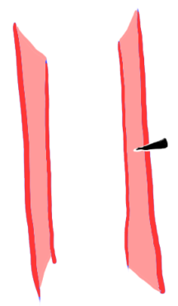
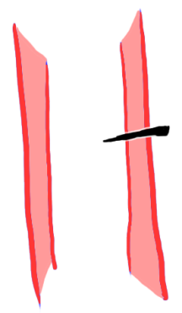


Penetrating injury (sharp)
grade I
  no bleeding
  no peripheral ischemia
  aneurysm might develop
grade II
  bleeding
  pseudoaneurysm formation
  with or without peripheral ischemia
grade III
  bleeding
  peripheral ischemia

Slide 10
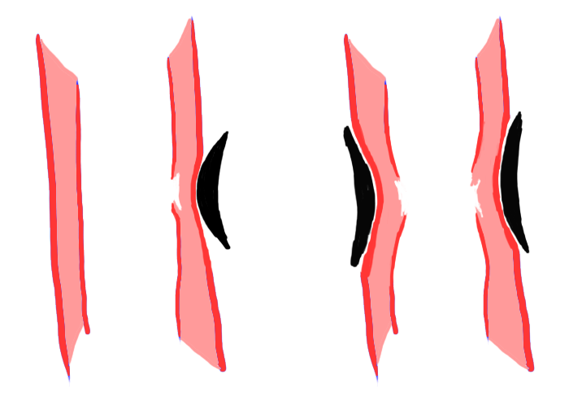
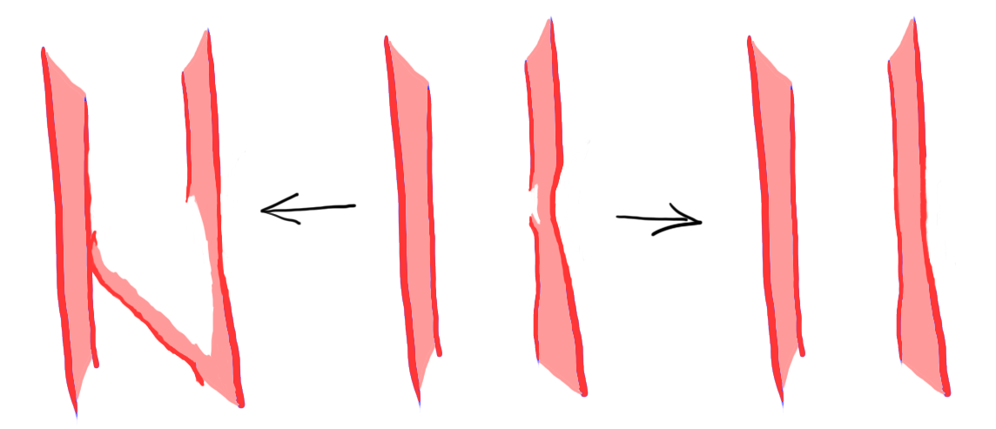
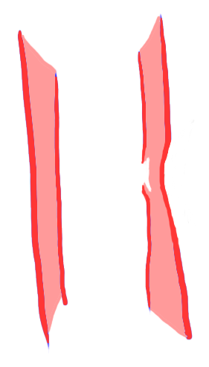
Blunt injury
contusion
compression/strangulation

Slide 11
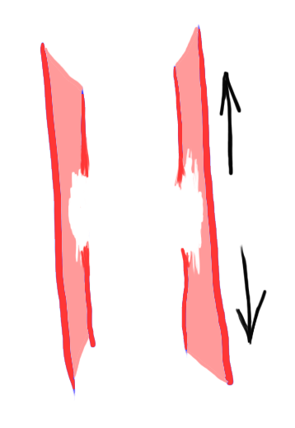
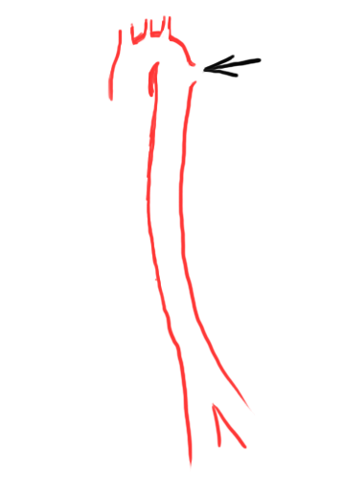
Indirect injury
traction injury
deceleration injury

Slide 12

Vascular Injury Classification and Scoring
has yet to be developed
Three-tier system
  tier 1 (peripheral or extremity)
    distal to axillary of common femoral vessels
  tier 2 (proximal groin or axillary wounds)
    junctional wounds
  tier 3 (intracavitary wounds)
    thorax, abdomen, pelvis

Slide 13
Clinical presentation
highly variable
  hard signs of vascular injury
    arterial bleeding
    pulsatile hematoma
    absence of pulses or limb ischemia
    bruit or thrill indicative of arteriovenous fistula
  soft signs
    non-pulsatile hematoma
    decreased pulses or pressure index
    unexplained anemia or hypotension
    injury to closely associated structures (typically nerves)
    injury close to the vessel

Slide 14
Clinical presentation
hard signs of vascular injury
  100 % specific, particularly with penetrating limb trauma
  nearly 100 % specific in penetrating neck trauma but present in only 20 % of patients
  much less applicable in intracavitary vascular injury
  hypotension will be the primary indicator
  are present in less than 10 % of vascular injuries
  majority will have soft signs, delayed presentation or be asymptomatic

Slide 15
Clinical presentation
Head
  intracranial injury is typically a combination of vessel and brain parenchyma injury
Face
  penetrating injuries to branches of external carotid artery
  blunt trauma associated with major facial fractures
  usually obvious with external or intraoral/intranasal bleeding

Slide 16
Clinical presentation - neck
Vascular injury incidence is
  20 % in penetrating trauma
  clinical examination is very reliable
  missed injury rate 0.7 %
  1 % in blunt trauma
  usually no hard signs
  immediate neurological deficits (up to 28 %)
  delayed neurological deficits (up to 78%)
  entirely asymptomatic (up to 40 %)
  CT angiography is study of choice

Slide 17
Clinical presentation - torso
Noncompressible truncal hemorrhage (NCTH)
  high associated mortality
Critical concepts for NCTH
  minimize delays in transfer to operating room
  permissive hypotension until vascular control
  balanced resuscitation with early use of plasma
  use of procoagulant drugs
  use of damage control surgery

Slide 18
Clinical presentation
Extremities
  vascular injury is common in penetrating or blunt mechanism
  incidence is 1 – 2 % of all trauma patients
  more common on lower (66 %) vs. upper (34 %) extremities
  clinical examination is very reliable in penetrating injuries
  missed injury rate is of 0.7 %
  blunt trauma
  hard signs in 66 % of patients; mainly absent distal pulses / limb ischemia
  in 95 % associated bone fracture or dislocation
  CT angiography is study of choice

Slide 19
Clinical assessment
History
mechanism of trauma
time interval
vascular symptoms
prior vascular injury
anticoagulation therapy
Physical findings
hard and soft signs of vascular injury
ankle-brachial index
Imaging
none
CT angiography
duplex ultrasound

Slide 20
Treatment
Conservative (observation + surveillance)
Vessel repair
  suture
  patch repair
  interposition graft / bypass
  endovascular repair

Slide 21
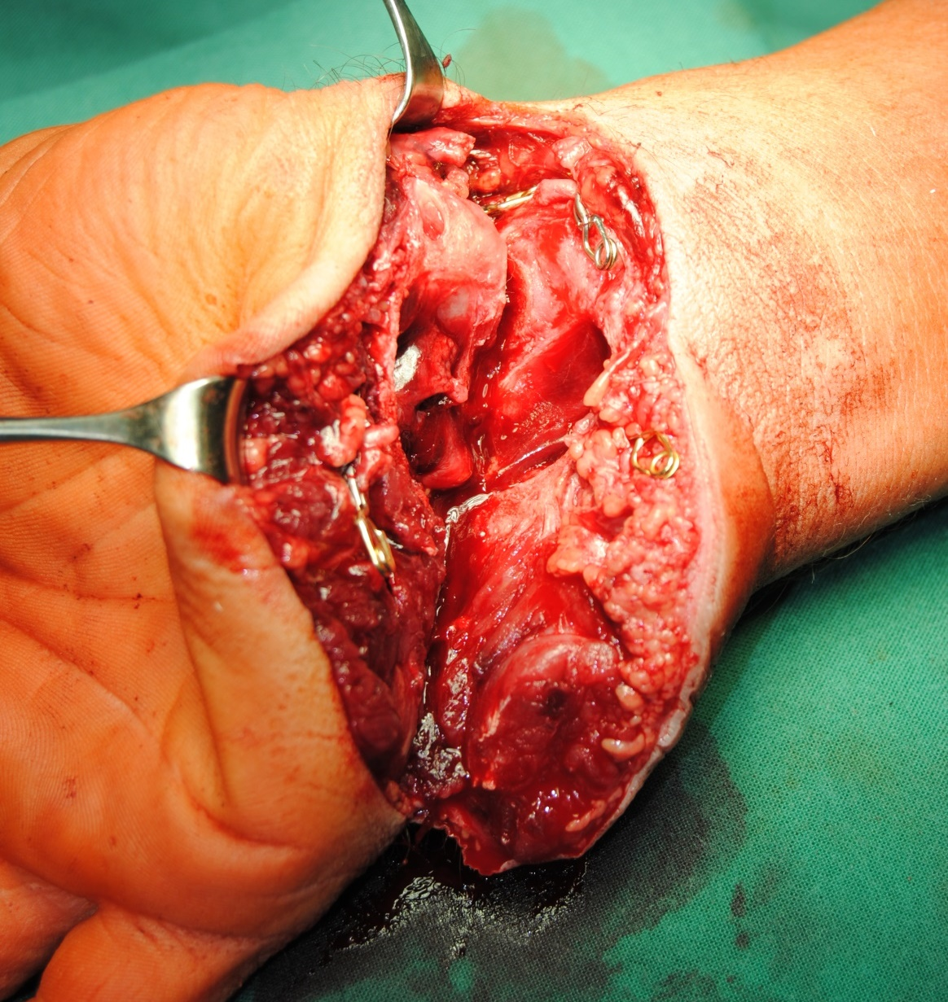
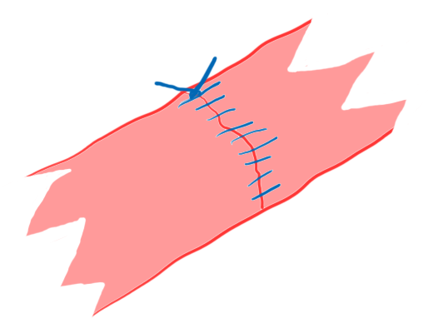
Vessel repair
suture

Slide 22
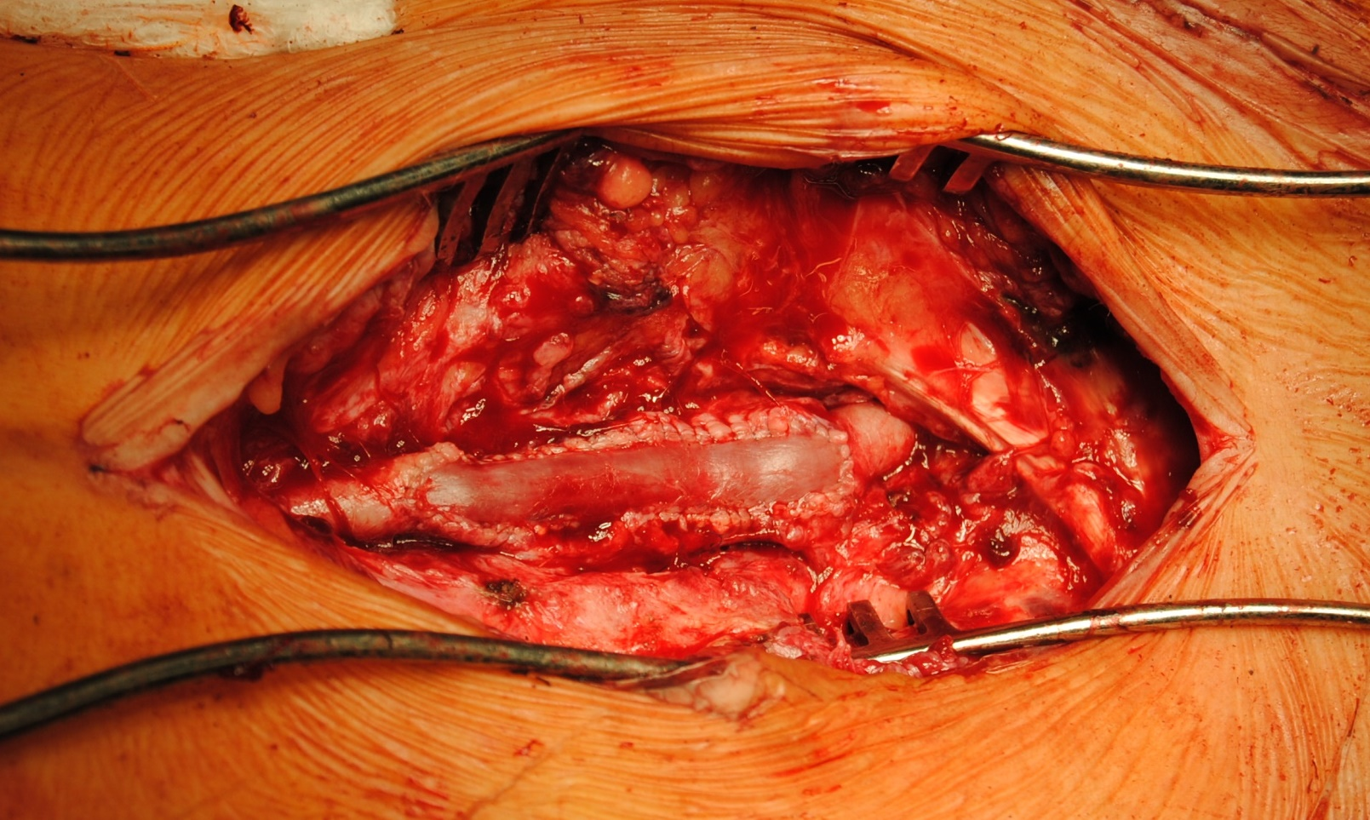
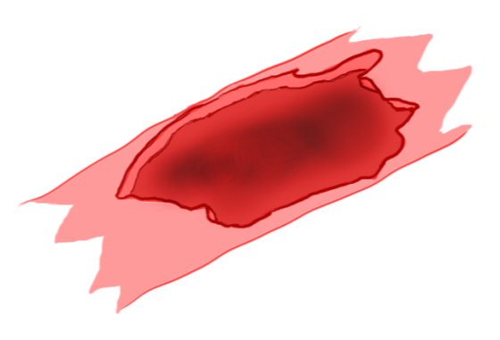
Vessel repair
vein patch angioplasty

Slide 23
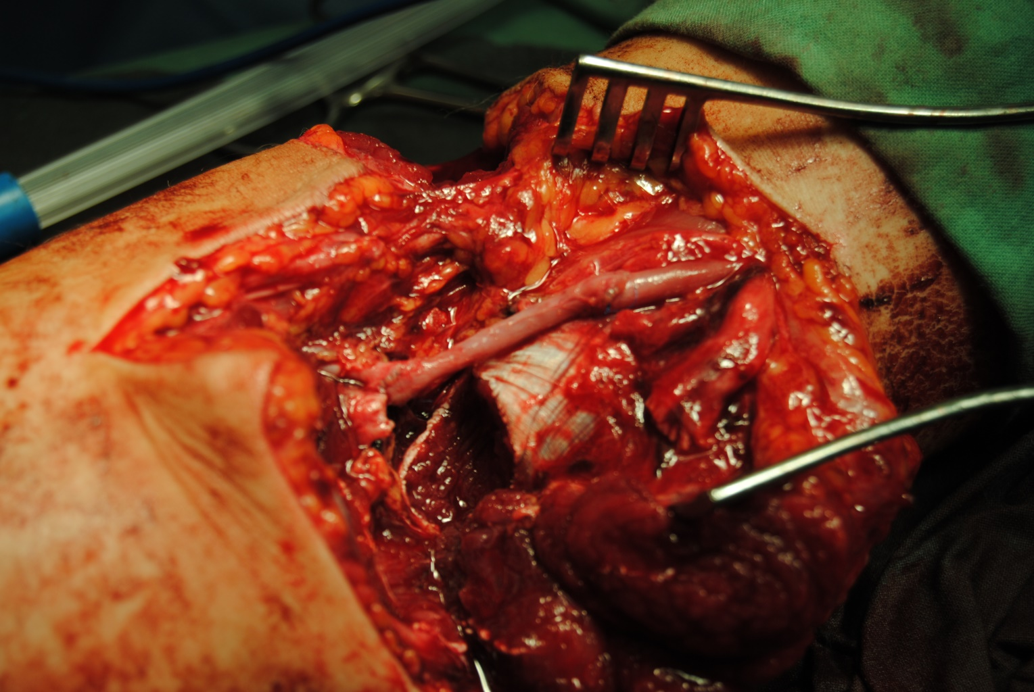
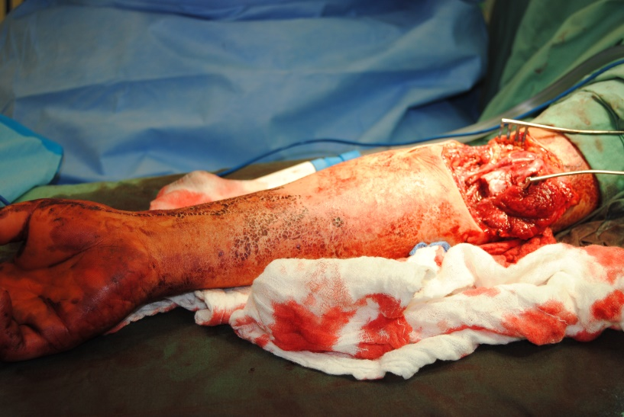
Vessel repair
  interposition graft

Slide 24
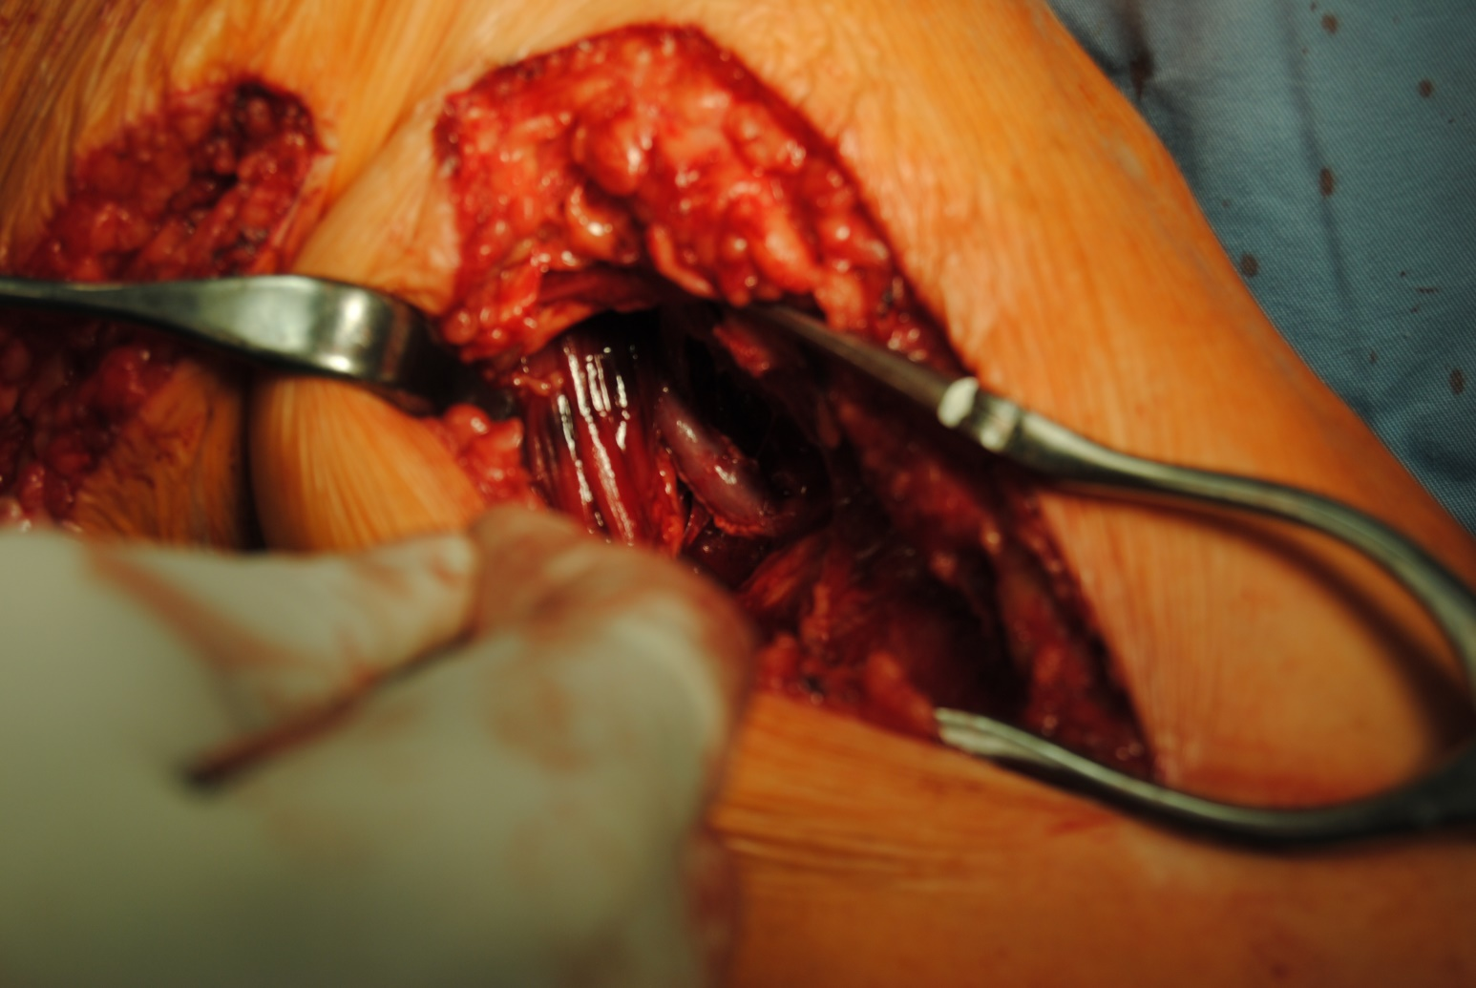
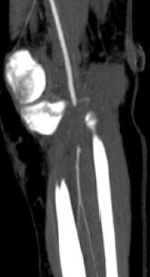
Vessel repair
  bypass

Slide 25
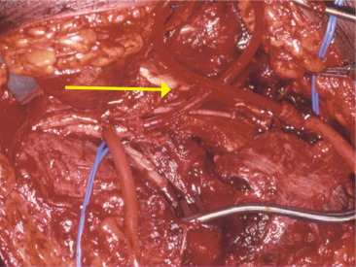
Vessel repair
temporary shunting
Source: Cristián Salas, D. Trauma vascular, visión del cirujano vascular. https://doi.org/10.1016/S0716-8640(11)70481-3

Slide 26
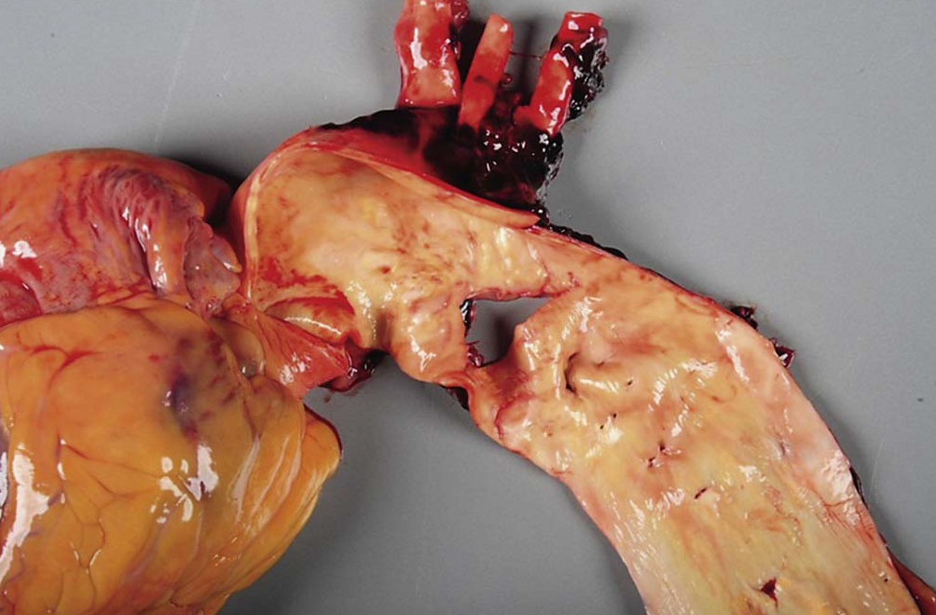
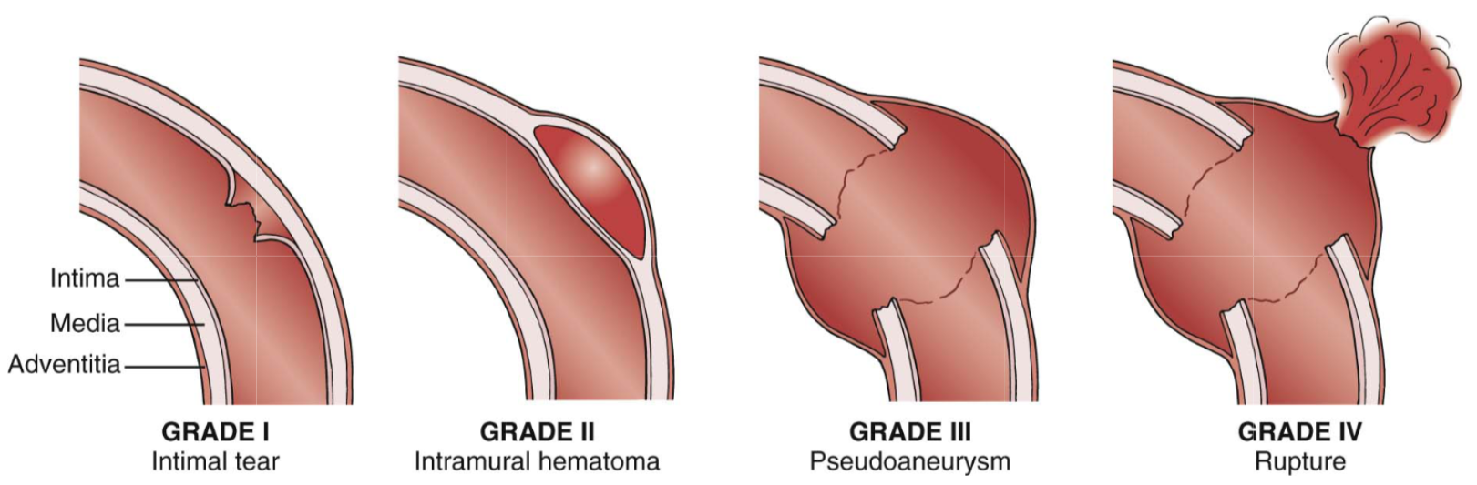
Vessel repair
endovascular repair
Source: Ruhterford‘s Vascular Surgery 8th Edition

Slide 27
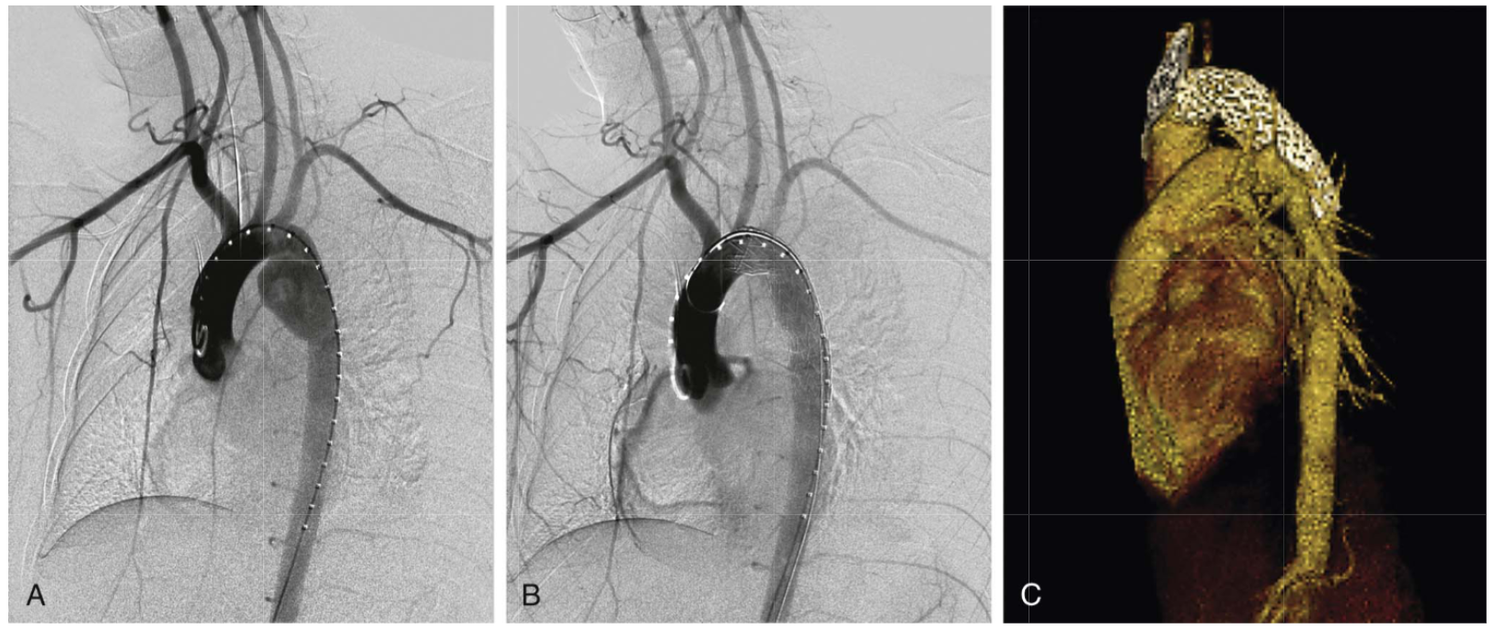
Vessel repair
endovascular repair
Source: Ruhterford‘s Vascular Surgery 8th Edition

Slide 28
Treatment
Conservative (observation)
Vessel repair
  direct arterial repair (suture)
  patch repair
  interposition graft repair
  bypass repair
  endovascular repair
Vessel ligation
Amputation

Slide 29
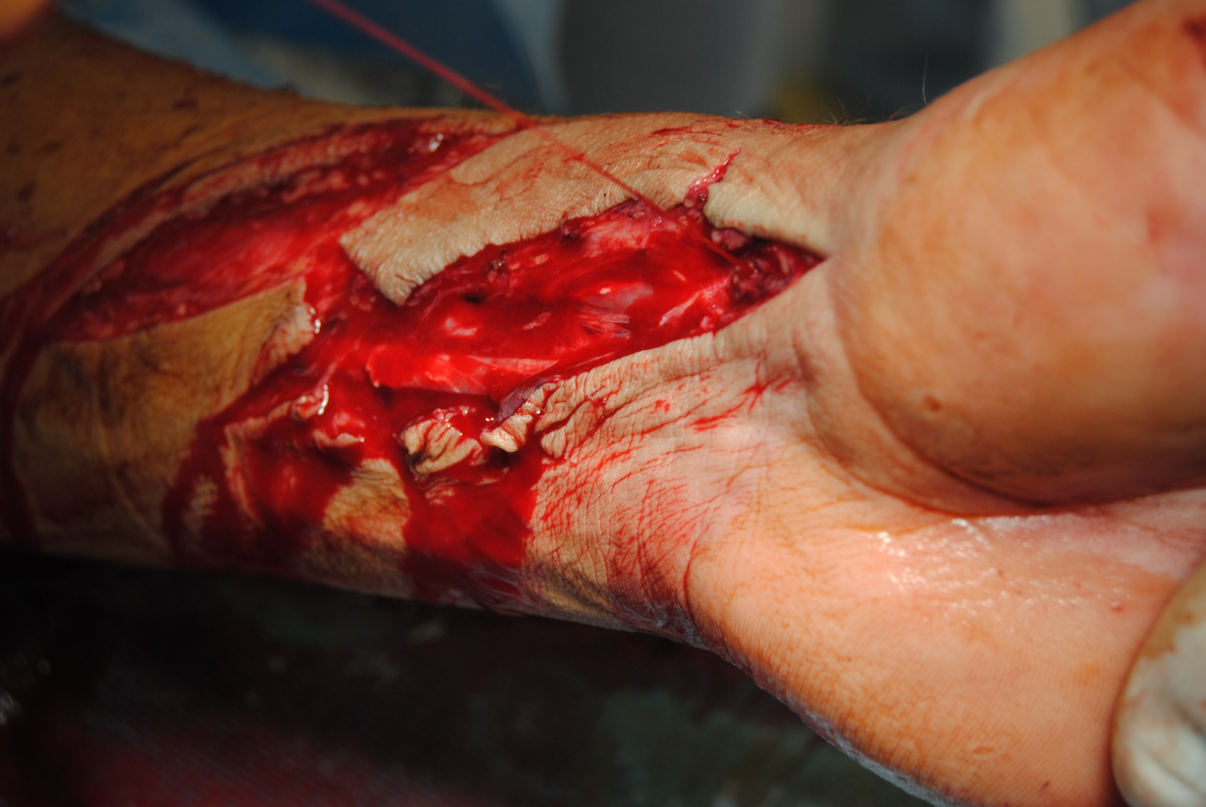
Thank you for your attention!

