Slide 1

Vagus nerve stimulation -
- intractable epilepsy therapy
Doc. MUDr. Eva Brichtová, Ph.D.
Dpt. of Neurosurgery
St. Anne University Hospital Brno and Masaryk University Brno
Epilepsy Center Brno

Slide 2
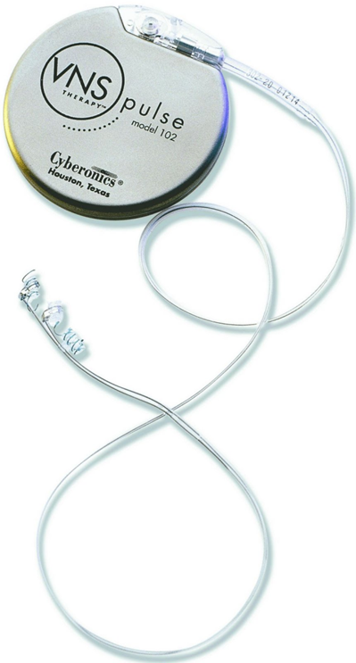
Nervus vagus stimulation
Long-term vagus nerve stimulation (VNS) is a palliative treatment method for inoperable refractory epilepsy
First implantation in humans in 1988
The first implantation in Czech Republic in 1997
Nowadays about 60,000 patients
Czech Republic about 500 patients

Slide 3
Indication
The VNS Therapy System is considered as supportive therapy
to reduce the frequency of seizures
in epileptic patients non-responding to antiepileptic drugs
with partial seizures (with or without secondary generalization) or generalized seizures

Slide 4
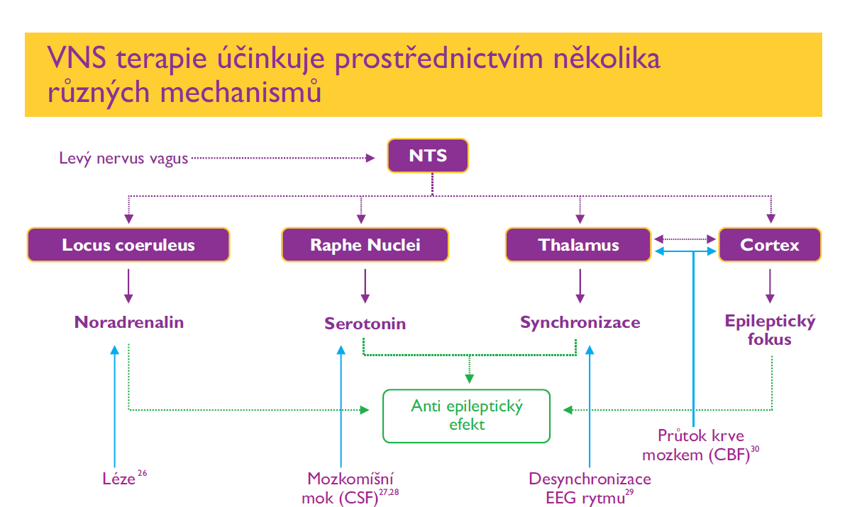
Mechanism of VNS effect
The method utilizes the ability of afferent vagus nerve fibres to transmit nerve impulses into the brain stem nuclei (especially the solitary tract nucleus) and in this way further into the the limbic system and thalamo-cortical circuits.

Slide 5
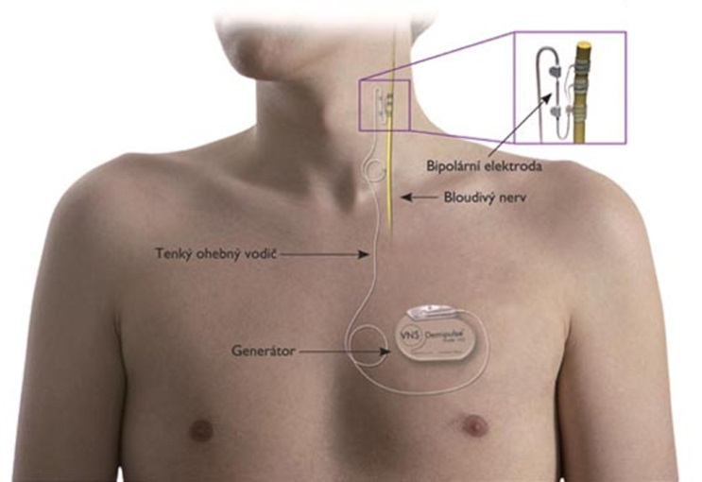
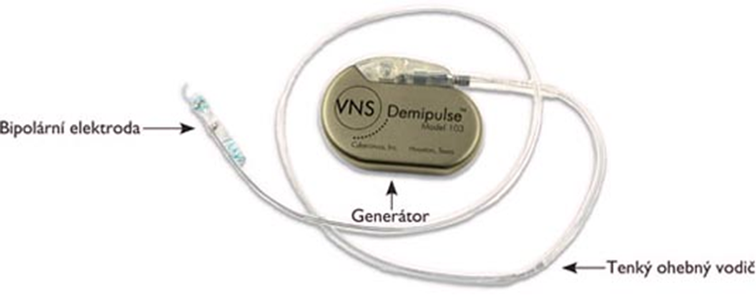
VNS implantation
The principle - electrical stimulation of the left vagus nerve
through the bipolar electrode, which is connected to
implantable pulse generator in the subclavian area.

Slide 6
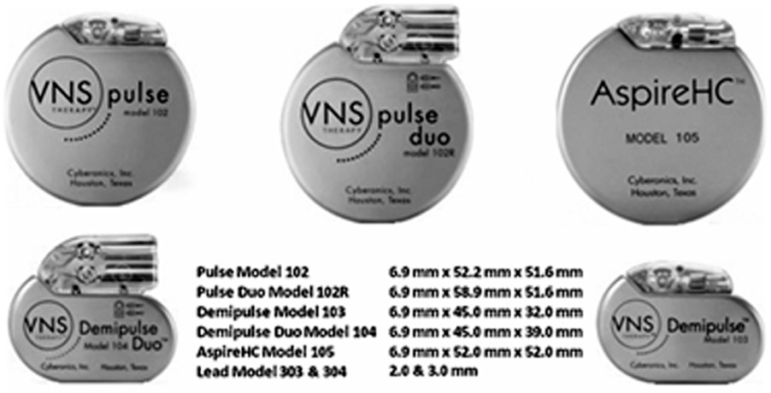

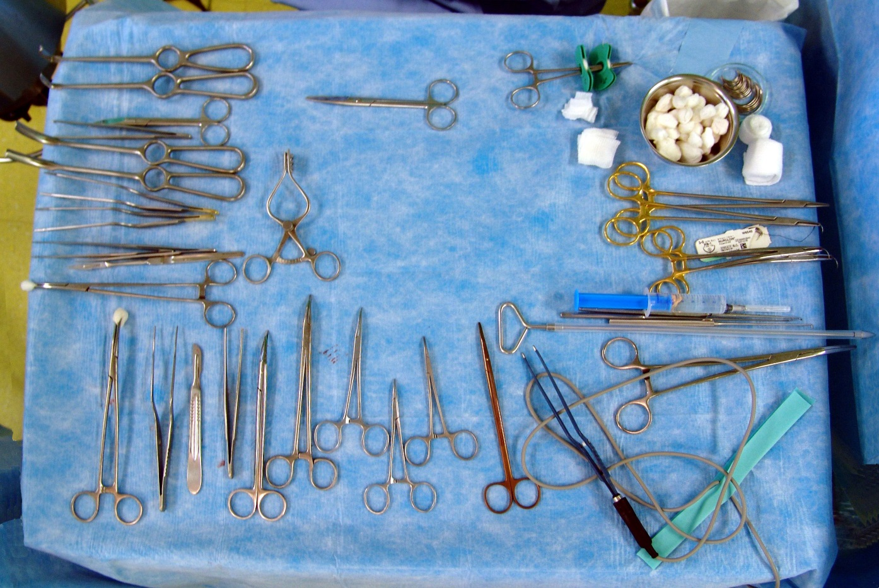
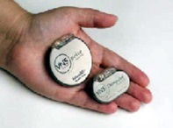
VNS implantation

Slide 7
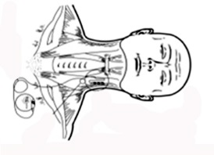
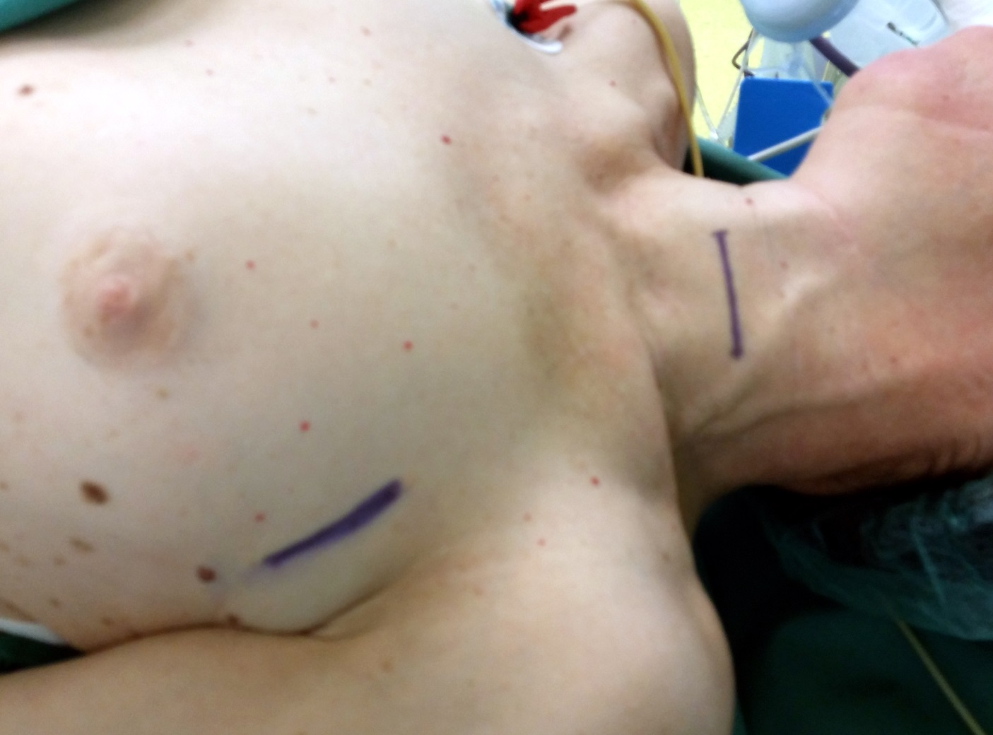
VNS implantation

Slide 8
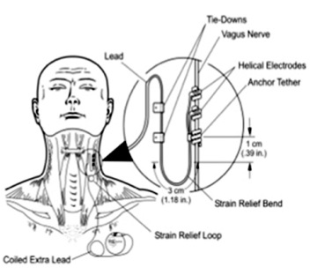
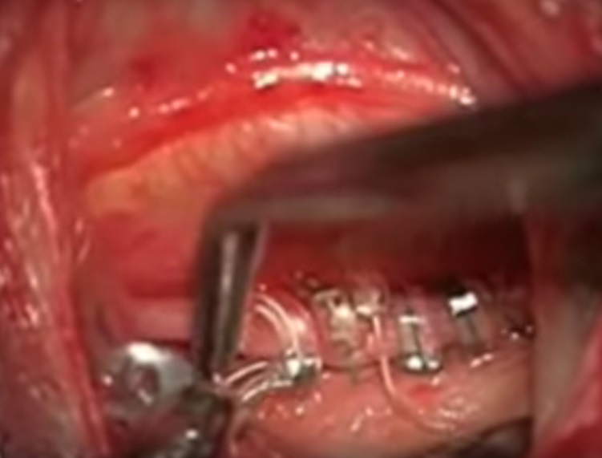
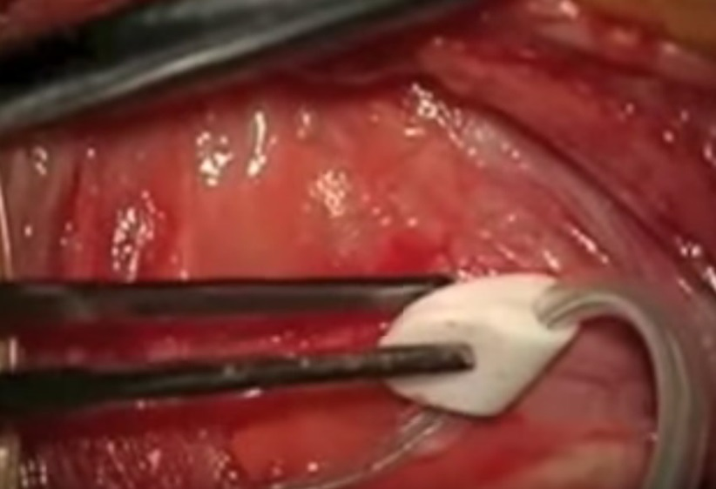
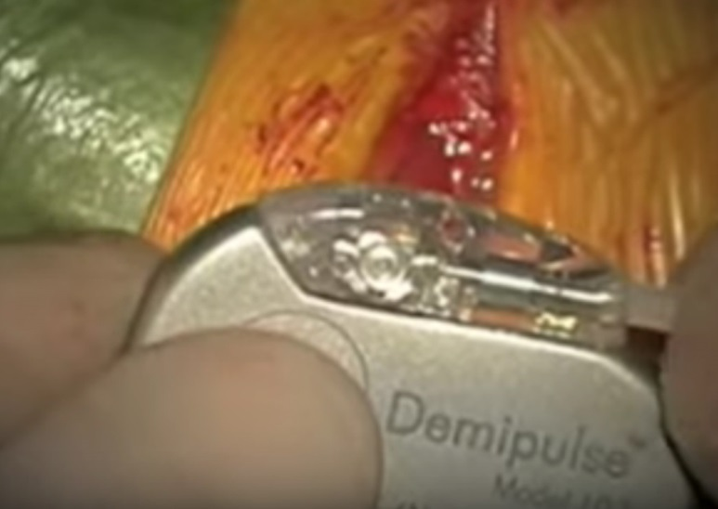
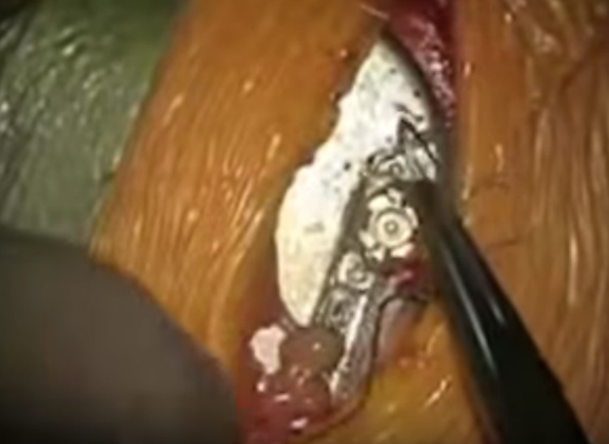
VNS implantation procedure

Slide 9
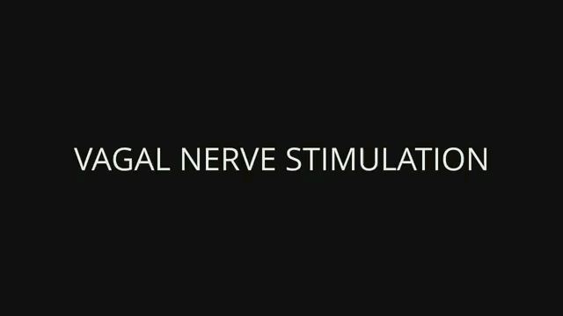
VNS implantation procedure
Neurochirurgie patru; https://www.youtube.com/watch?v=T_W5WNgyR6M

Slide 10
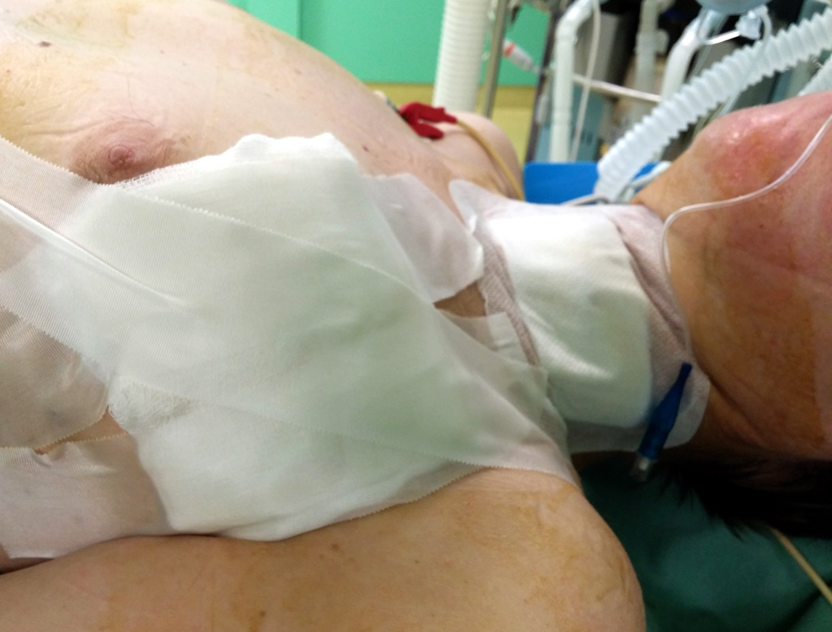
VNS implantation procedure

Slide 11
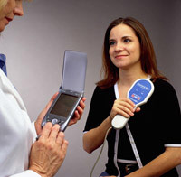
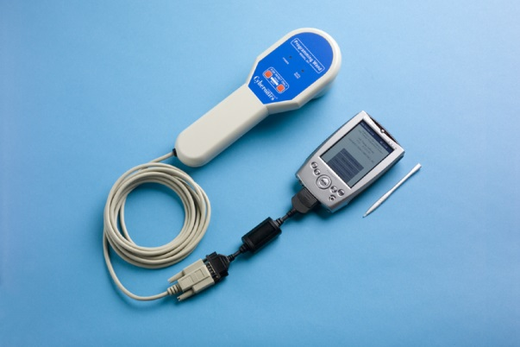
Setting VNS therapy parameters
using programming computer and
programming wand
Typical stimulation parameters:
Current output: 1.0 to 2.0 mA Frequency: 20 Hz or 30 Hz
Pulse width: 250 or 500 us
Time ON stimulation: 30s Stimulation OFF time: 3 or 5min

Slide 12
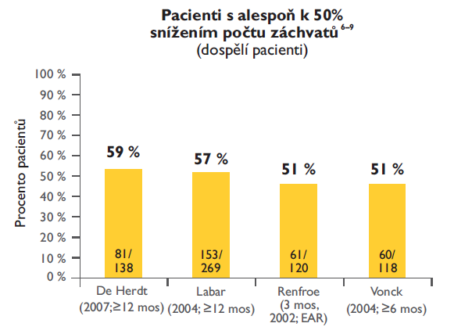
The effect of VNS therapy
Reduction in number and intensity of seizures
Patients with at least to 50%
seizure reduction
(adult pts)
63% responders after 1 year, 55% after 2 years
Kuba R. 2002 Neurologie pro praxi

Slide 13
VNS therapy in Czech republic
ČESKÁ REPUBLIKA
 | Brno |  | Brno dětská |  | NNH |  | FNM dětská |  | FNM dosp. |  | NNF |  | FTN dětská |  | FTN dosp. |  | ∑ | ∑ | ∑
 | primo | re | primo | re | primo | re | primo | re | primo | re | primo | re | primo | re | primo | re | primo | re
1997 |  |  |  |  |  |  |  |  |  |  | 1 |  | 1 |  |  |  | 2 | 0 | 2
1998 |  |  |  |  |  |  | 1 |  |  |  |  |  |  |  |  |  | 1 | 0 | 1
1999 | 17 |  |  |  | 8 |  | 1 |  |  |  | 6 |  | 2 |  |  |  | 34 | 0 | 34
2000 | 12 |  |  |  | 8 |  | 2 |  |  |  | 2 |  | 2 | 1 |  |  | 26 | 1 | 27
2001 | 9 |  |  |  | 4 |  | 6 | 2 | 1 |  | 1 |  | 4 |  |  |  | 25 | 2 | 27
2002 | 11 |  |  |  |  |  | 2 |  |  |  |  |  | 2 |  | 3 |  | 18 | 0 | 18
2003 | 9 | 5 |  |  | 6 | 1 | 5 |  | 8 |  | 4 | 3 | 3 |  | 1 |  | 36 | 9 | 45
2004 | 10 | 4 |  |  | 13 | 1 | 1 |  | 1 |  | 3 | 3 | 5 |  | 1 |  | 34 | 8 | 42
2005 | 11 | 3 |  |  | 3 | 2 | 1 |  | 1 |  | 1 |  | 1 |  | 1 |  | 19 | 5 | 24
2006 | 17 | 3 |  |  | 9 | 9 | 5 |  |  |  | 1 |  | 2 |  |  |  | 34 | 12 | 46
2007 | 13 | 2 |  |  | 3 | 4 | 1 |  | 4 | 1 | 1 |  |  |  |  | 1 | 22 | 8 | 30
2008 | 10 | 1 | 2 | 0 | 3 |  | 1 |  | 3 |  | 4 |  |  |  | 3 |  | 26 | 1 | 27
2009 | 17 | 3 | 2 | 0 | 7 |  | 4 |  | 7 | 1 | 3 |  | 2 | 2 | 2 |  | 44 | 6 | 50
2010 | 12 | 10 | 4 | 0 | 4 | 3 | 3 |  | 3 | 1 | 4 | 1 | 3 | 1 |  | 2 | 33 | 18 | 51
2011 | 18 | 8 | 2 | 0 | 6 | 5 | 4 | 0 | 3 | 1 | 1 | 0 | 0 | 0 | 1 | 4 | 35 | 18 | 53
2012 | 11 | 12 | 1 | 0 | 6 | 5 | 3 | 0 | 2 | 4 | 4 | 1 | 0 | 0 | 0 | 1 | 27 | 23 | 50
2013 | 13 | 5 | 3 | 1 | 4 | 4 | 1 | 1 | 4 | 4 | 5 | 4 | 0 | 0 | 0 | 2 | 30 | 21 | 51
2014 | 10 | 7 | 2 | 2 | 6 | 6 | 4 | 0 | 3 | 2 | 4 | 2 | 0 | 0 | 1 | 6 | 30 | 25 | 55
2015 | 8 | 17 | 3 | 2 | 5 | 7 | 2 | 1 | 3 | 2 | 2 | 1 |  |  | 1 | 4 | 24 | 34 | 58
2016 | 1 | 2 | 1 |  |  |  |  |  |  |  |  |  |  |  |  |  | 2 | 2 | 4
∑ | 209 | 82 | 20 | 5 | 95 | 47 | 47 | 4 | 43 | 16 | 47 | 15 | 27 | 4 | 14 | 20 | 476 | 157 | 633

Slide 14
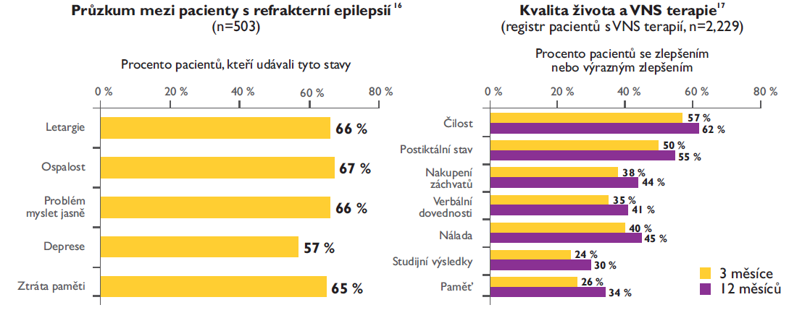
Quality of life and VNS Therapy
Patients with refractory epilepsy
(n=503)
Quality of life and VNS Therapy
(n=2 229)
% of pts with improvement or
significant improvement
% of pts reporting
Lethargy
Drowsiness
Difficulty
thinking
Depresion
Memory loss
Activity
Postictal state
Seizure cluster
Verbal skill
Mood
Study results
Memory
3 Months
12 Months

Slide 15

Kontakt:
eva.brichtova@fnusa.cz
Fakultní nemocnice u sv. Anny v Brně
Pekařská 53, Brno 656 91
Česká republika
Tel: + 420 543 181 111
www.fnusa.cz

