Slide 1

Temporal lobe epilepsy surgery
Doc. MUDr. Eva Brichtová, Ph.D.
Dpt. of Neurosurgery
St. Anne University Hospital Brno and Masaryk University Brno
Epilepsy Center Brno

Slide 2
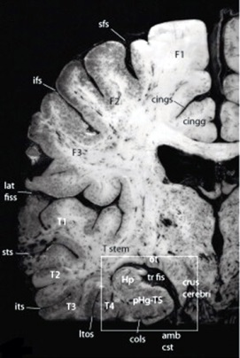
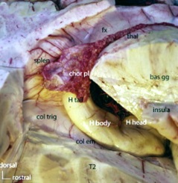
Temporal lobe anatomy
C. Destrieux, Surgical anatomy of the hippocampus,
Neurochirurgie 59 (2013) 149–158

Slide 3
Temporal lobe epilepsy surgery
Objective:
complete removal of functionally altered brain tissue causing clinical epileptic manifestation
no seizures after surgery, without any neurological deficit, i.e. without reducing the quality of life

Slide 4
Types of epilepsy surgery
Lesionectomy
Structural pathology removing - tumor (LGG, DNET, ganglioglioma), vascular malformation (cavernoma, AVM), gliosis (post-traumatic, post-inflammatory, post-stroke), cortical dysplasia
Cortical resection
Non- lesional epilepsy (mostly extratemporal localisation)
Standard temporal resections
MTLE mesial temporal lobe epilepsy
MTS mesiotemporal sclerosis

Slide 5
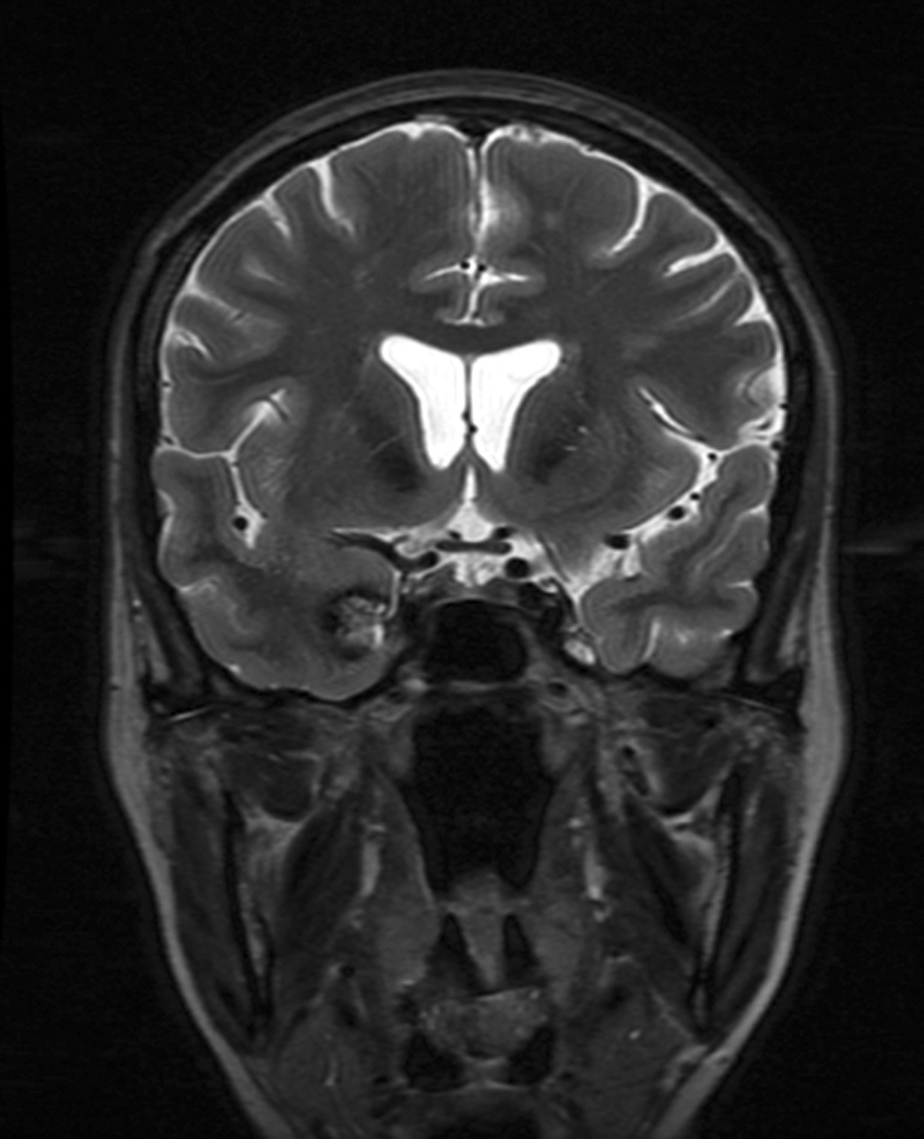
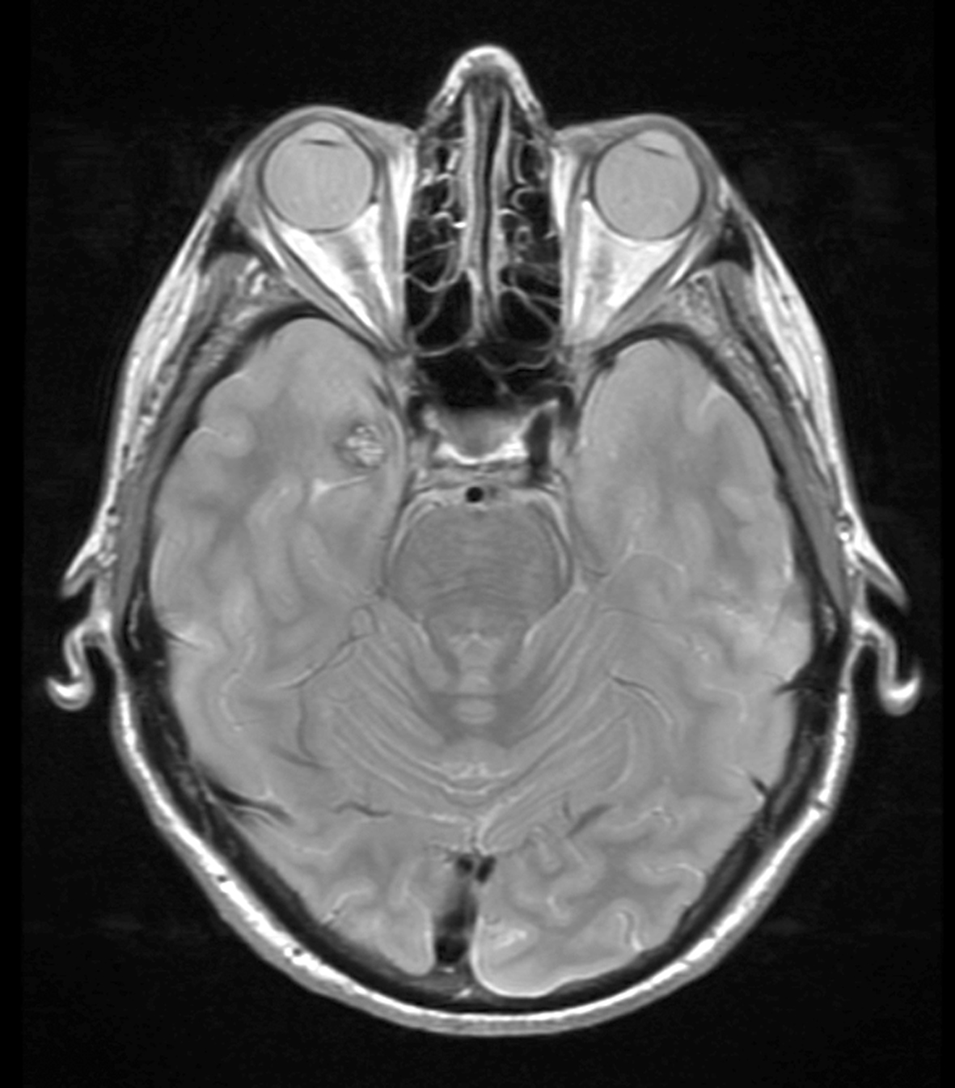
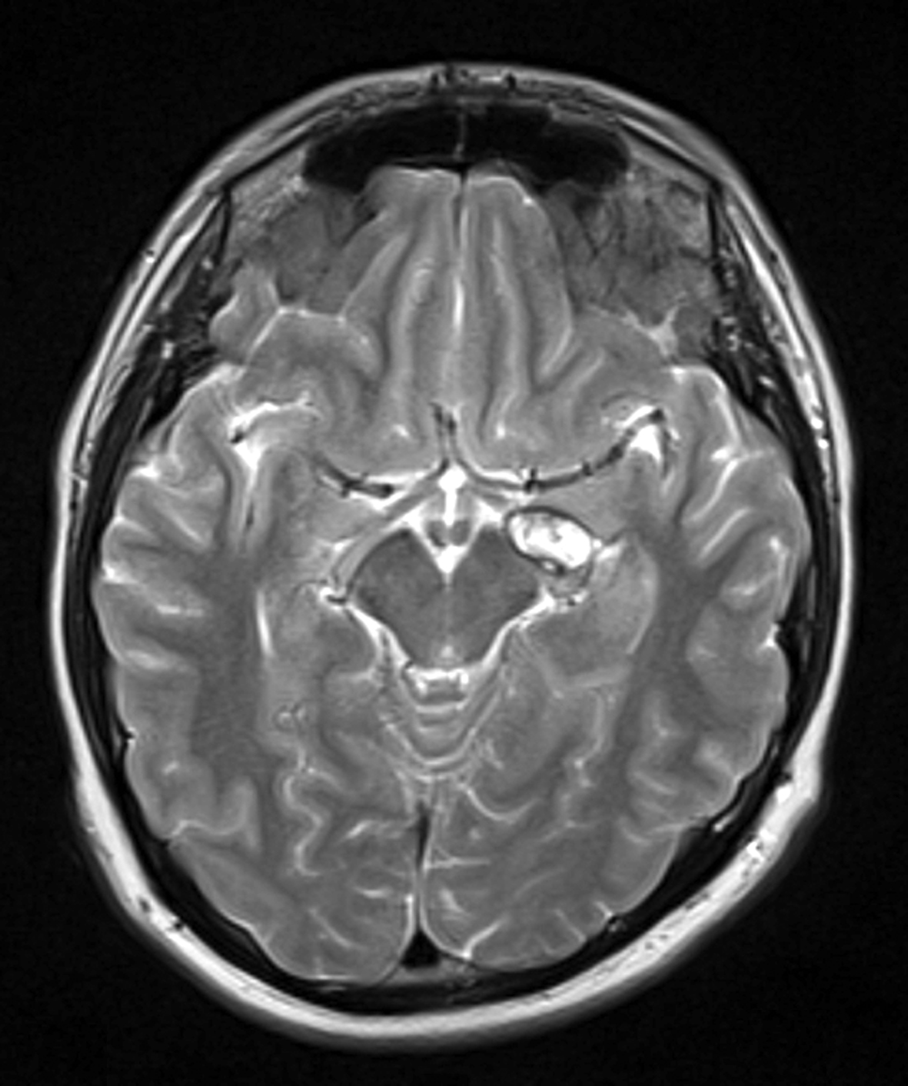
Cavernoma

Slide 6
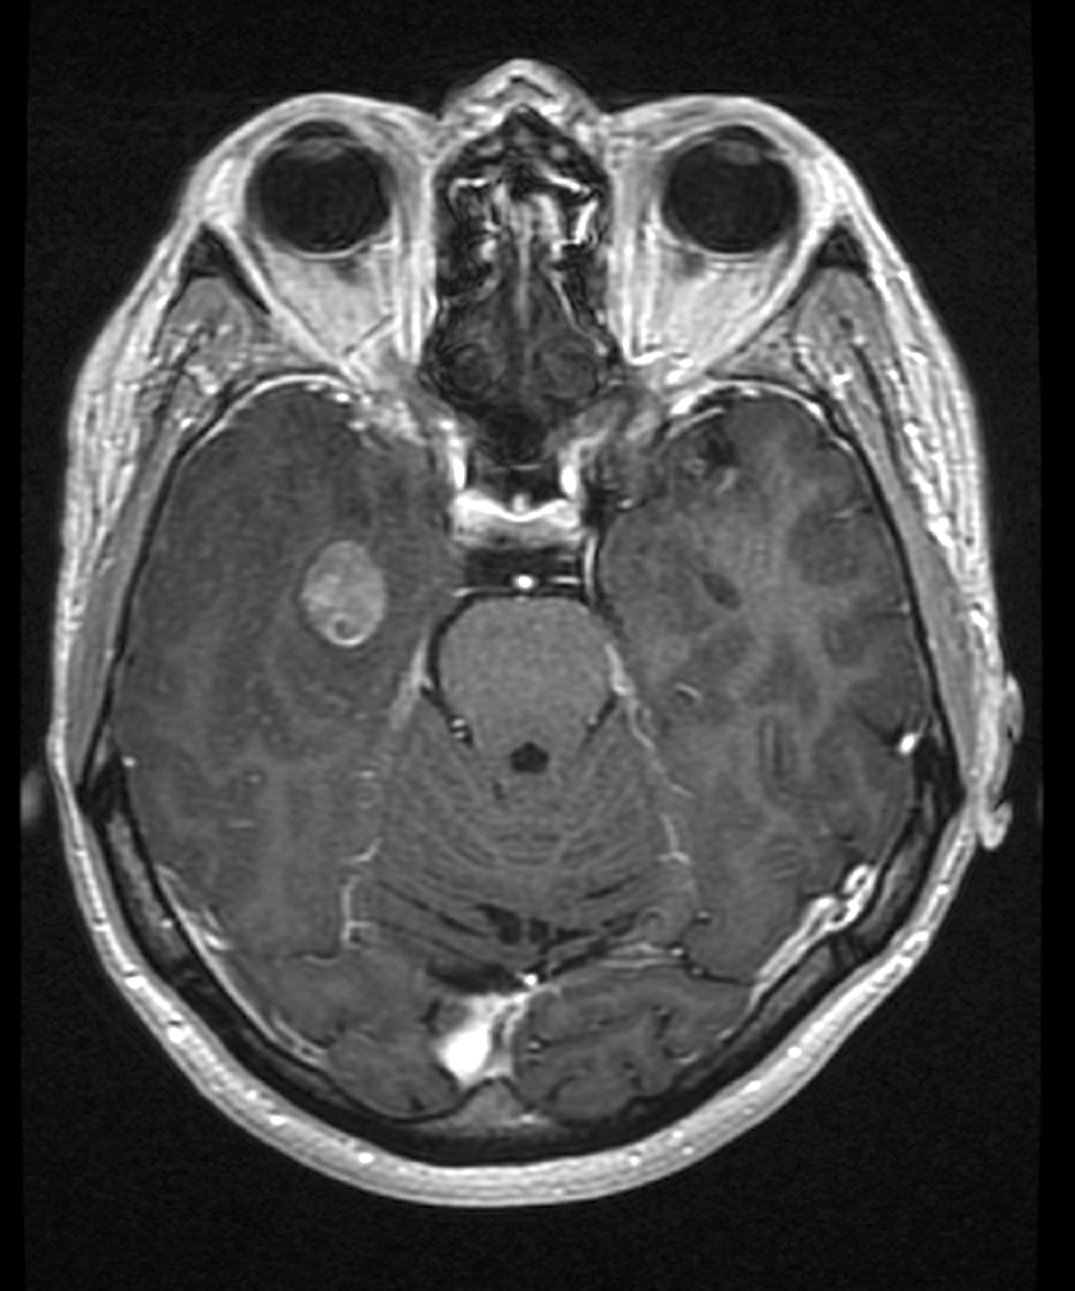
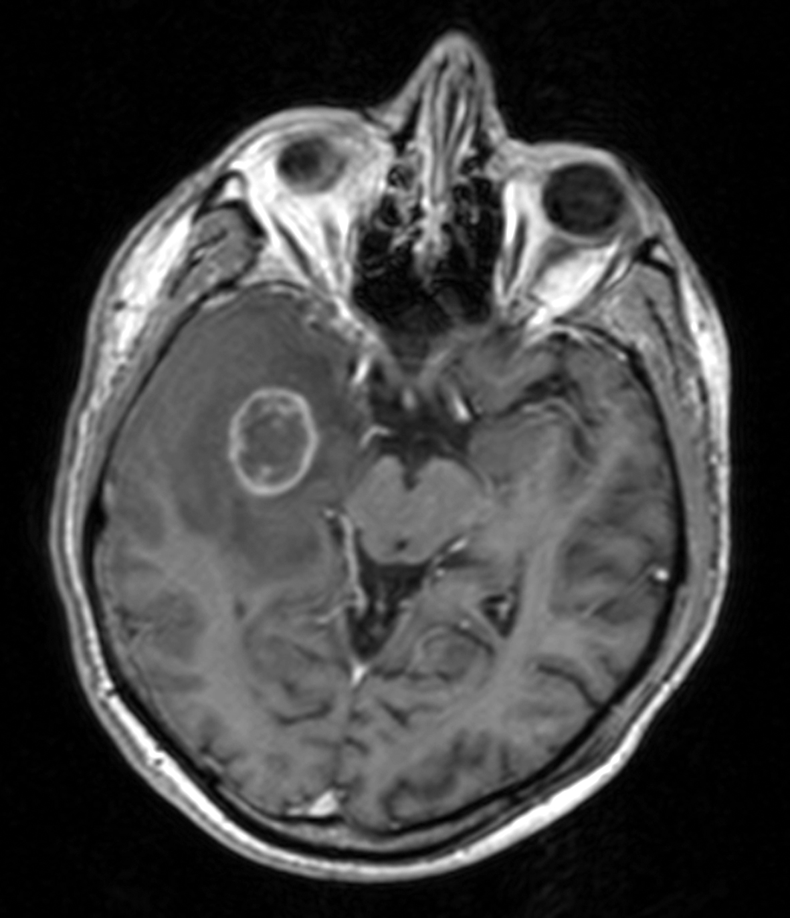
Glioblastoma multiforme

Slide 7
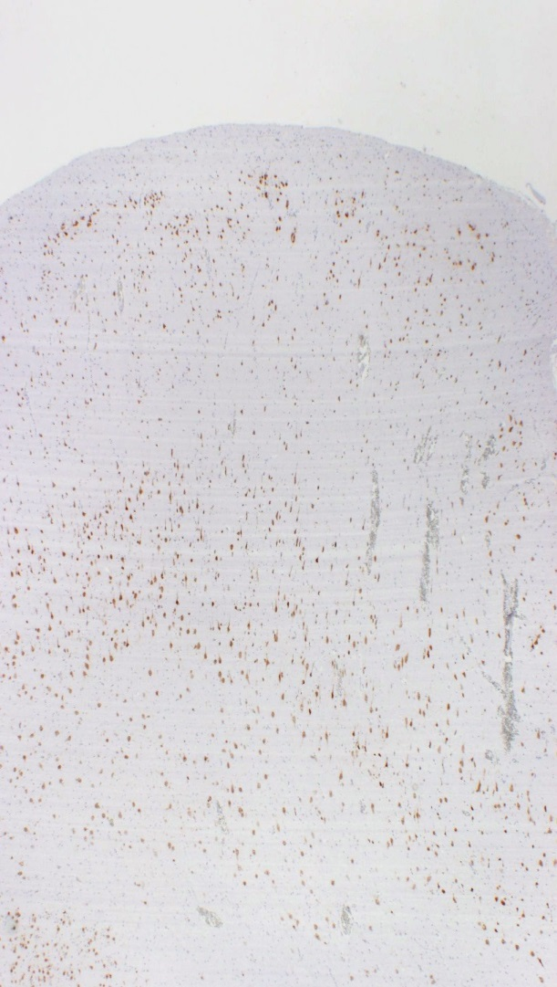
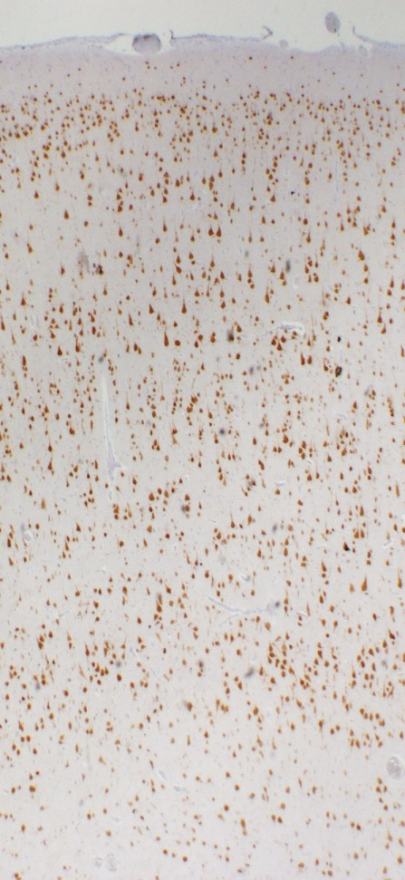
FCD Type Ib cortical dysplasia with abnormal tangential cortical lamination affecting 6-layered horizontal composition of the neocortex
FCD type 1b
Control, normal cortex
control
FCD Ib
abnormal layering of L2, L4, or both; L2 either missing or significantly depleted
blurred demarcation between L1 and L2, and between L2 and 3; L4 can be also missing
less sharply demarcated border toward white matter, immature small diameter neurons,
hypertrophic neurons outside L5

Slide 8
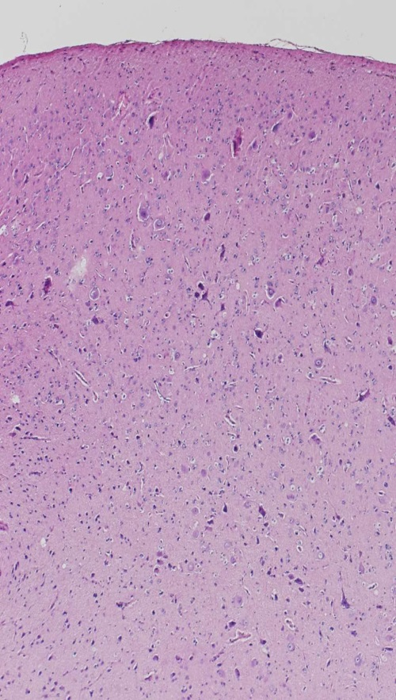
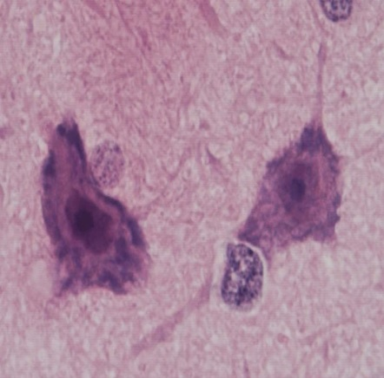
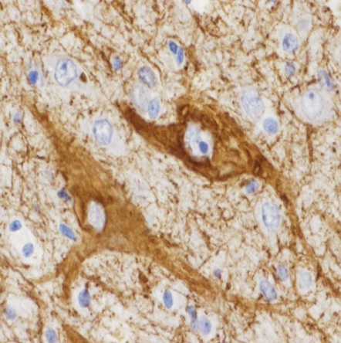
FCD Type IIa
cortical dysplasia with dysmorphic neurons
NF-01
severe cortical dyslamination
dysmorphic neurons: neuronal cell diameter enlarged, cell nucleus diameter enlarged,
aggregation of Nissl substance and its margination, accumulation of NFs (both
phosphorylated and nonphosphorylated)
- junction at gray/white matter blurred with heterotopic neurons in white matter

Slide 9
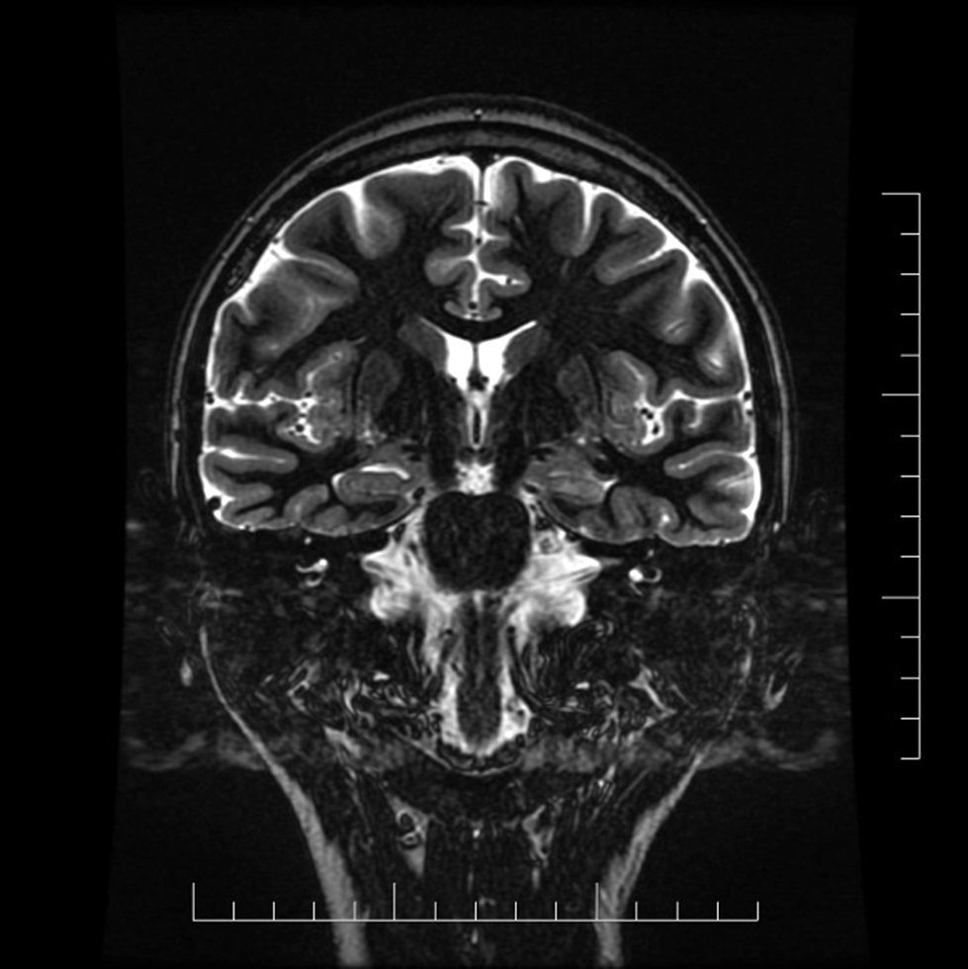
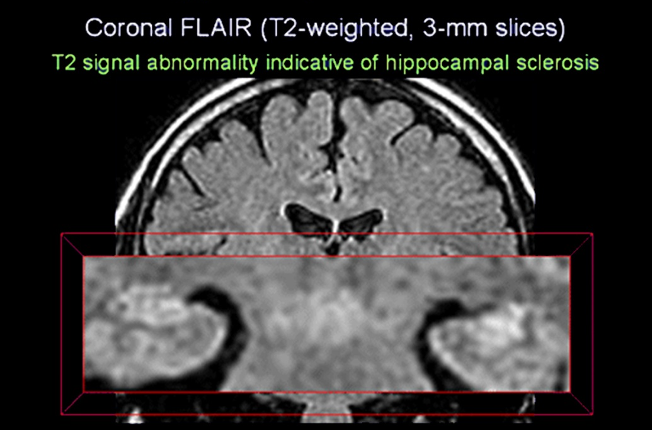
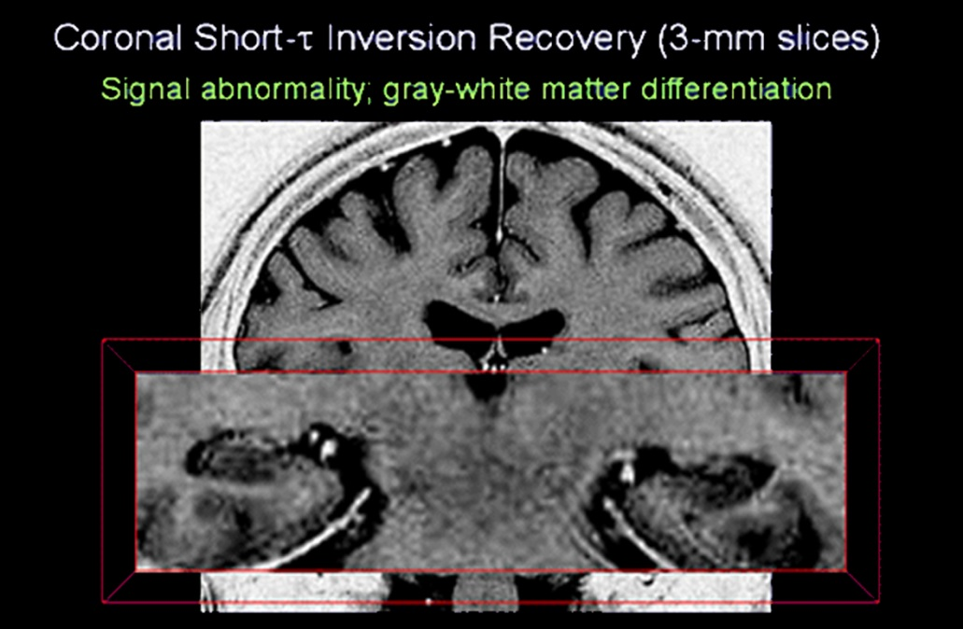
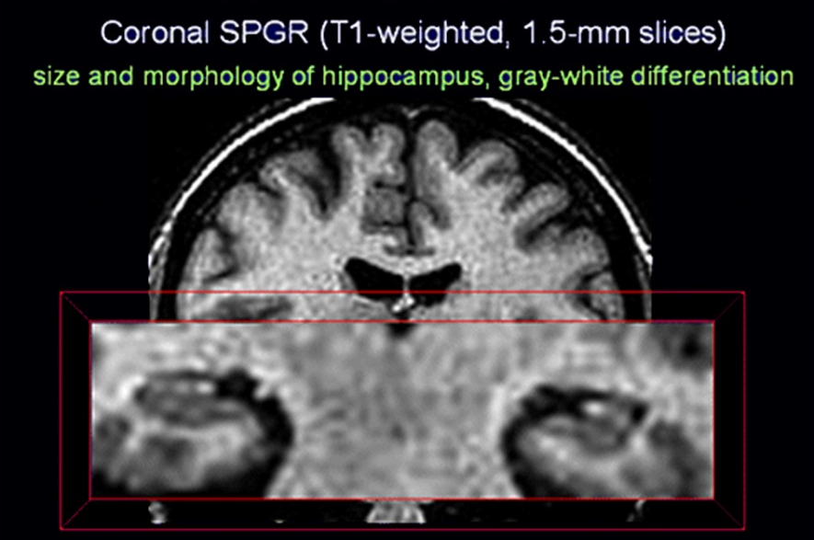
Hippocampal sclerosis
Imaging the Temporal Lobe, Pratik Mukherjee, http://www.medscape.org/viewarticle/468200_3

Slide 10
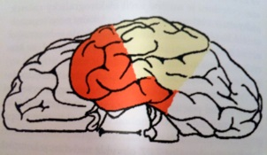
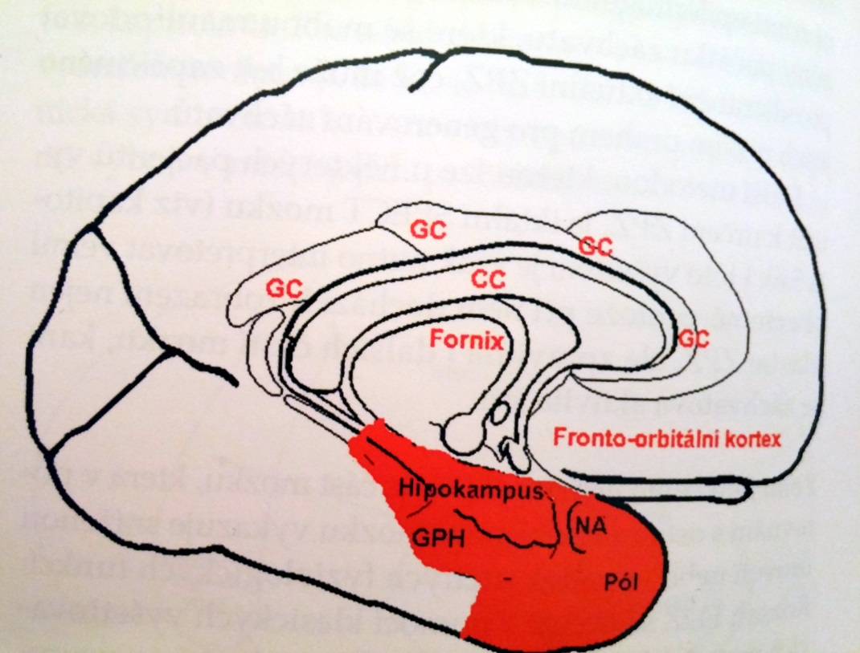
AMTR
Anteromedial temporal resection
Temporal pole approx 3.5 cm removal (without the superior temporal gyrus), the amygdala, part of the hippocampus and part of theparahippocampal gyrus.
M.Brázdil a kol., Farmakorezistentní epilepsie, Triton, 2004

Slide 11
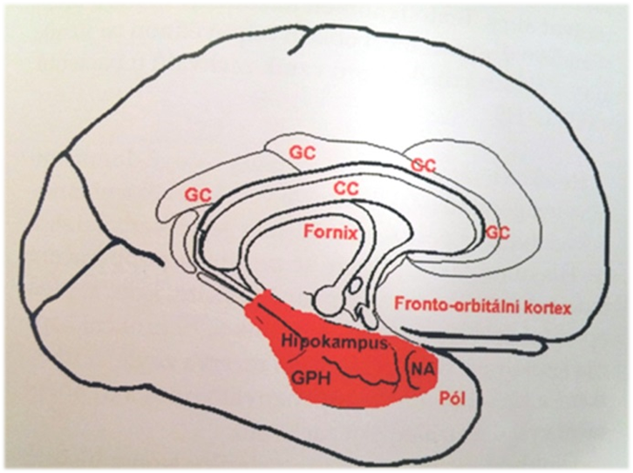
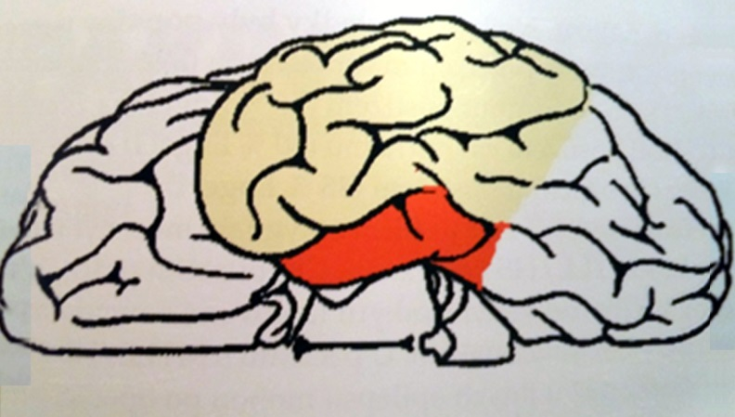
AHE
Selective amygdalohippocampectomy
Removal of the amygdala, part of the hippocampus and the parahippocampal gyrus
Temporal neocortex saved.
1958 Niermeyer - transcortical approach via gyrus temporalis medius
1985 Yasargil a Wieser - via fissura Sylvii
M.Brázdil a kol., Farmakorezistentní epilepsie, Triton, 2004

Slide 12
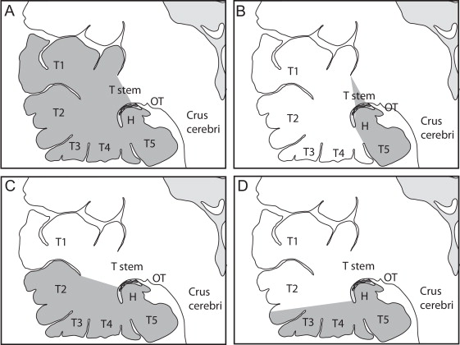
Types of temporal resection
C. Destrieux, Surgical anatomy of the hippocampus, Neurochirurgie 59 (2013) 149–158

Slide 13
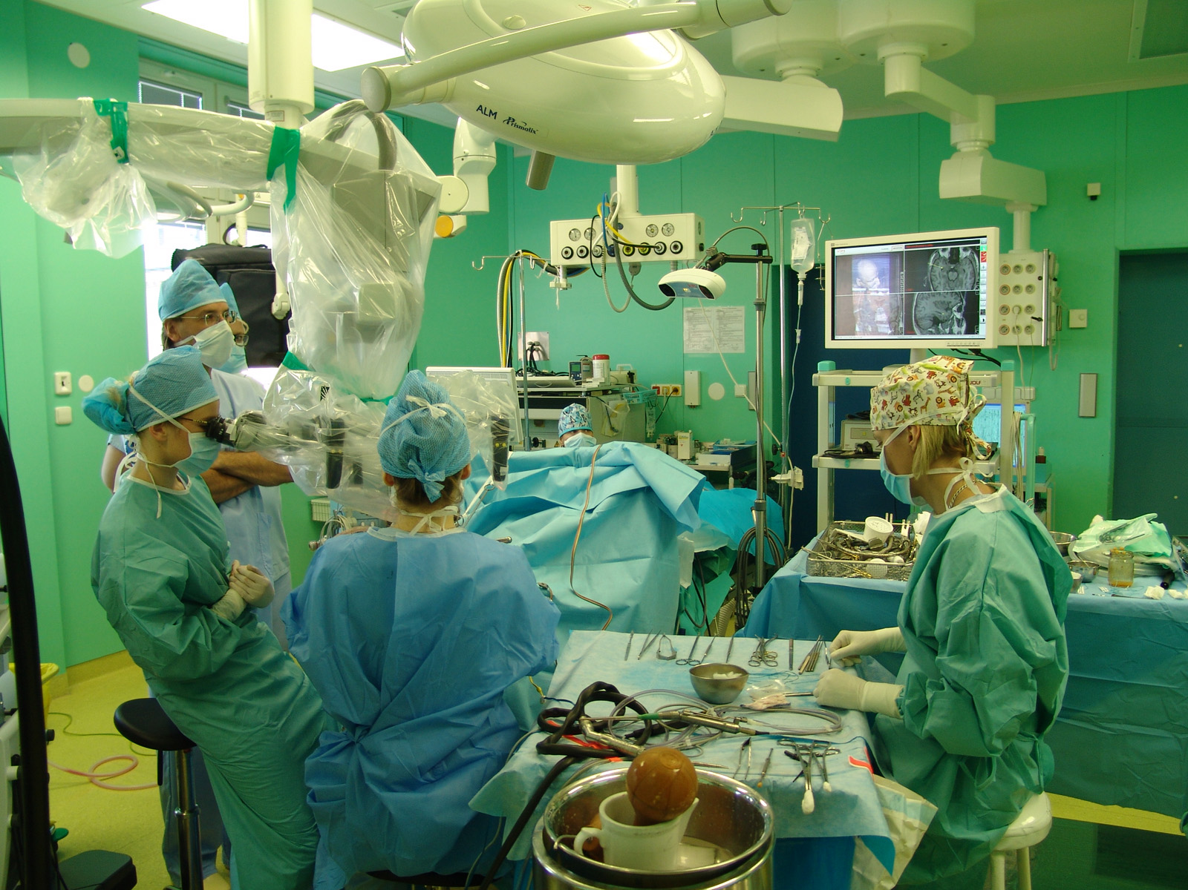

Slide 14
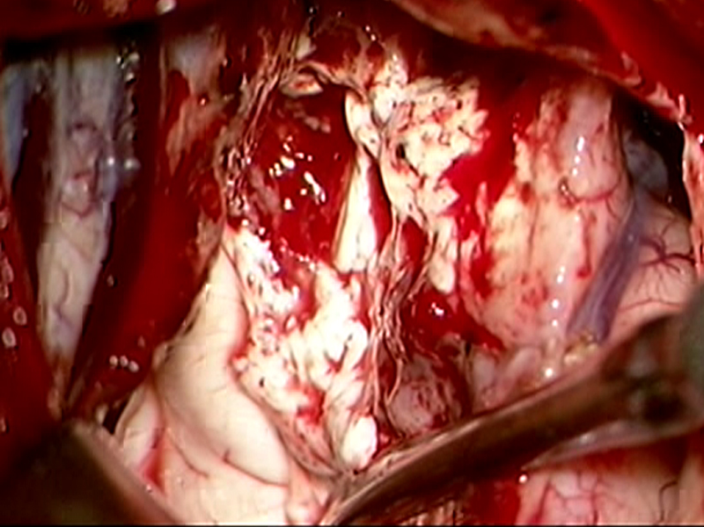
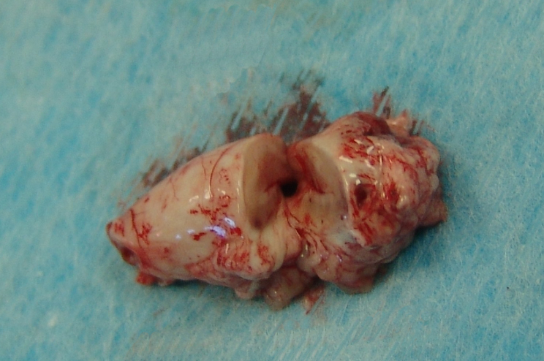
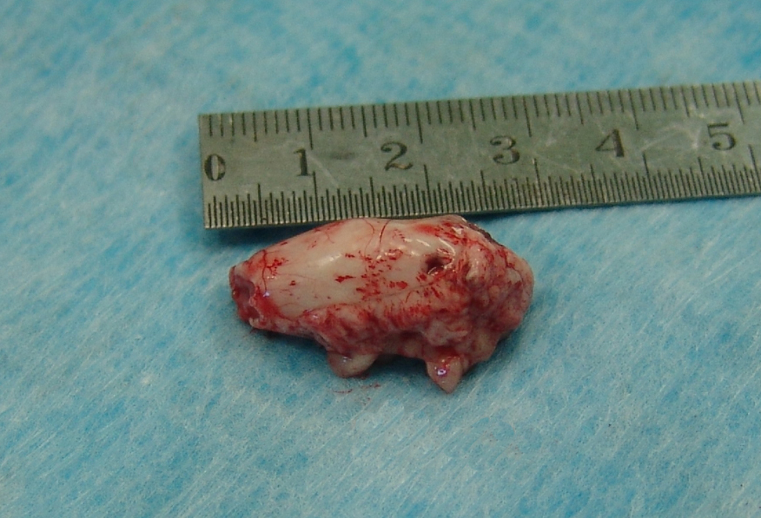

Slide 15
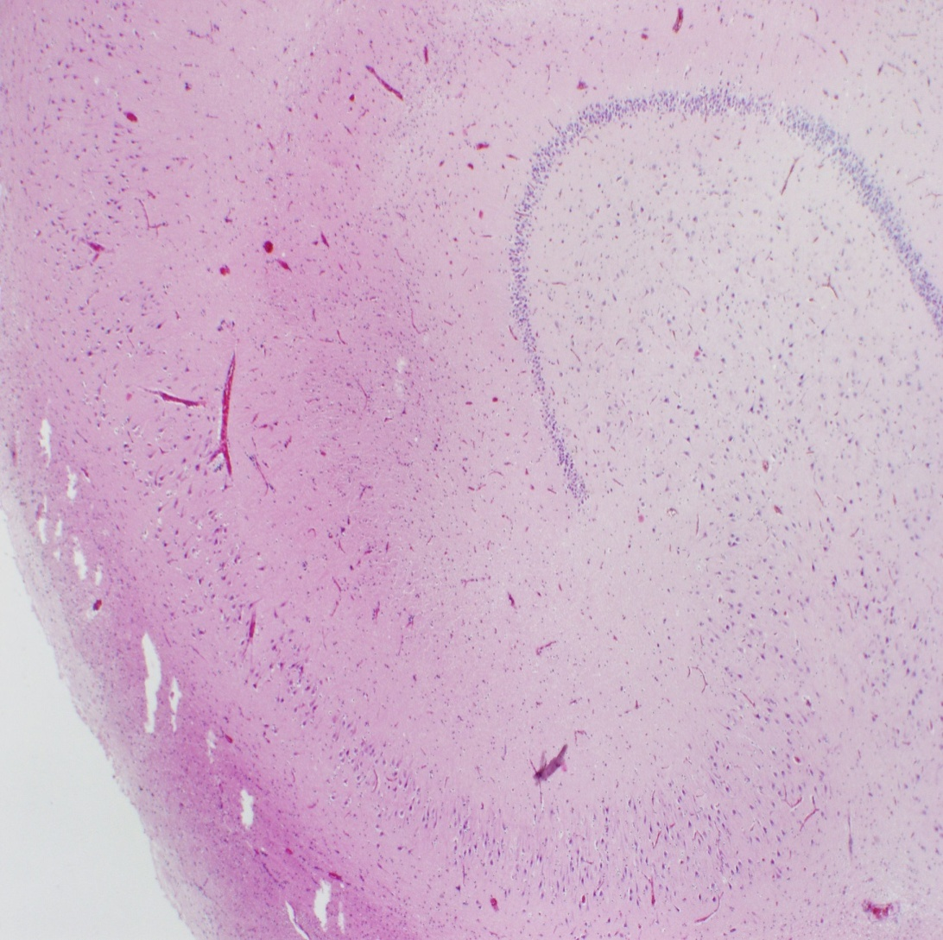
Hippocampus
CA1
CA4
CA2
CA3

Slide 16
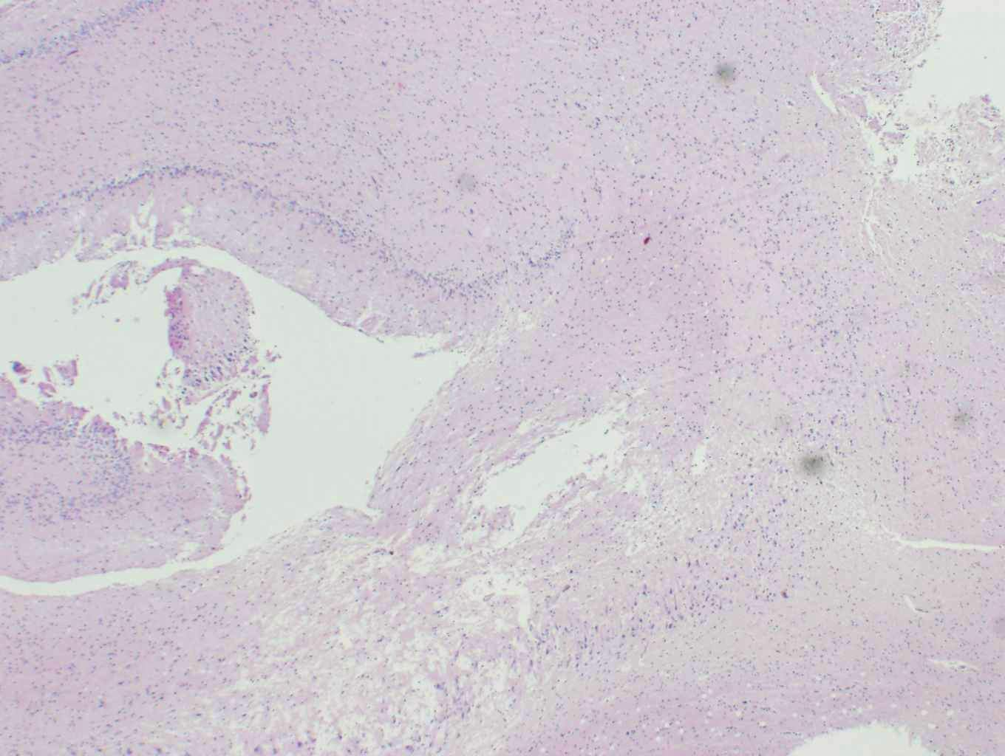
Hippocampal sclerosis, ILAE typ 1
CA3
CA4
CA2
CA1

Slide 17
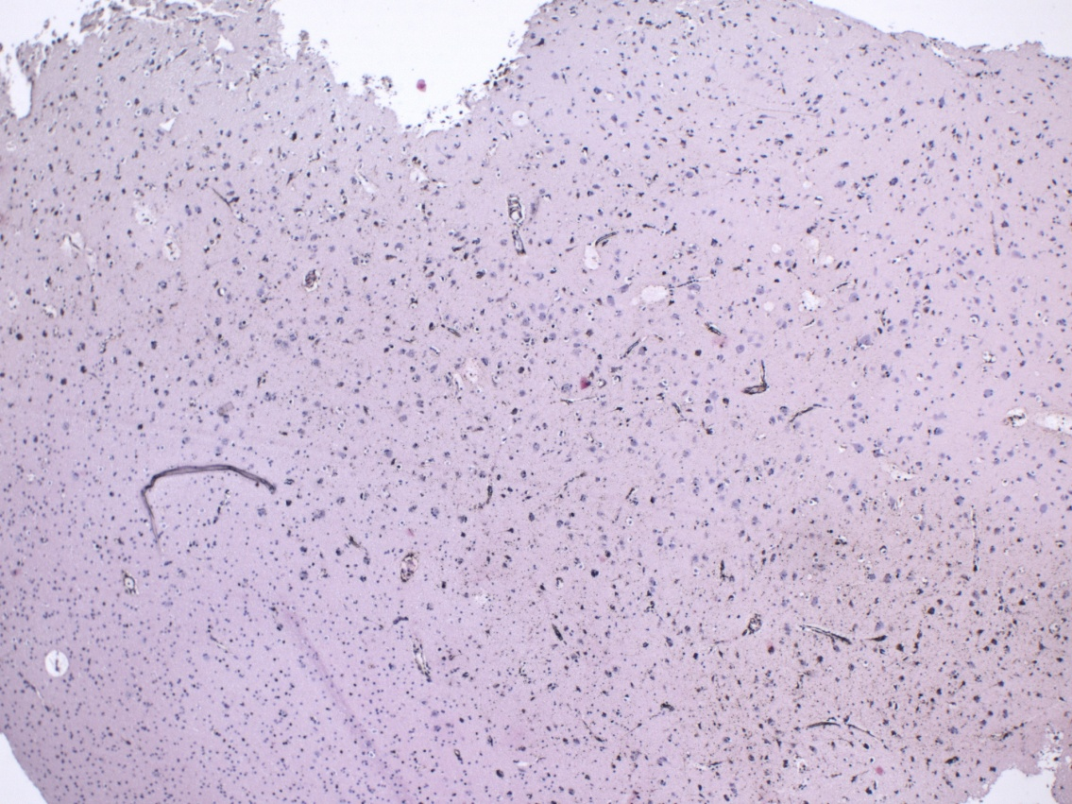
Amygdala

Slide 18
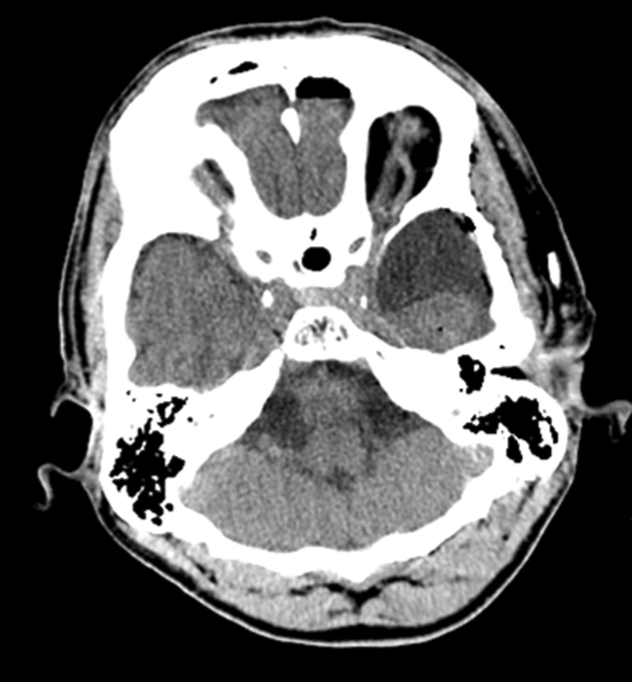
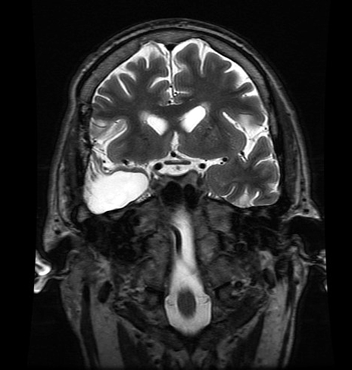
Postoperative CT and MRI scan

Slide 19
Engel's classification
Effect of surgery:
Engel I - no seizures
Engel II - nearly seizure-free, sporadic seizure
Engel III - a significant improvement
Engel IV - insignificant improvement, unchanged, worsening

Slide 20
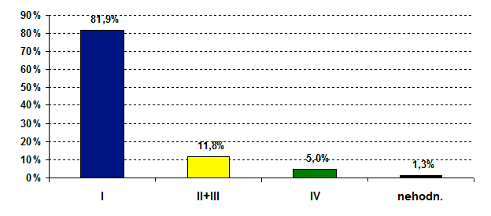
Temporal lobe epilepsy surgery- outcome
Epilepsy Center Brno
1995-2009
Total: 161 patients
Engel classification

Slide 21
Temporal lobe epilepsy surgery
Epilepsy Center Brno
2015
19 temporal resections
cortical resections
lesionectomy (4x cavernoma, 1x glioma)
AMTR
AMTR 5 men, 7 women, average age 32 yrs
7x l.dx., 5x l.sin.

Slide 22
Epilepsy surgery in Czech republic
2002 - 2014
 | 2002 | 2003 | 2004 | 2005 | 2006 | 2007 | 2008 | 2009 | 2010 | 2011 | 2012 | 2013 | 2014
ÚVN (Prague) | 26 | 25 | 28 | 29 | 35 | 39 | 38 | 29 | 38 | 25 | 14 | 23 | 16
Na Homolce (Prague) | 23 | 21 | 18 | 8 | 18 | 15 | 12 | 8 | 17 | 17 | 10 | 20 | 12
FN Motol (Prague) | 7 | 16 | 12 | 4 | 11 | 13 | 15 | 15 | 23 | 22 | 16 | 7 | 15
FN St.Anne (Brno) | 15 | 16 | 25 | 38 | 42 | 68 | 38 | 25 | 38 | 28 | 24 | 30 | 21
 | 71 | 78 | 88 | 81 | 106 | 135 | 103 | 77 | 116 | 67 | 64 | 80 | 64

Slide 23

Teamwork
EPILEPSY CENTER BRNO
Neurologist
Neurosurgeon
Neuroradiologist
Neuropsychologist
EEG technician
Histopathologist
Geneticist

Slide 24

Kontakt:
eva.brichtova@fnusa.cz
Fakultní nemocnice u sv. Anny v Brně
Pekařská 53, Brno 656 91
Česká republika
Tel: + 420 543 181 111
www.fnusa.cz

