Slide 1
basic phrases
based on textbook, p. 9

Slide 2
Informal
Ahoj. — Ahoj.
Čau. — Čau.
Zdar. — Zdar.

Slide 3
Useful phrases.
Já jsem Martin.
Já jsem učitel. (I am a teacher)
Já jsem student.

Slide 4
Literaly
It pleases me.

Slide 5
Use this phrase to ask about the meaning of czech words.

Slide 6
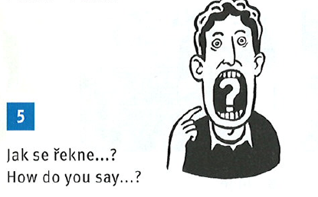
Use this phrase to ask for translation into czech language.
Task: think about one czech word you really need to know. Ask me for it using this phrase.

Slide 7
Spelling is not a big deal in Czech language.

Slide 8
Other important phrase.
Ano, rozumím. (Yes, I understand.)

Slide 9
Literaly
Once more / one more time, please.
Compare with ultra frequent phrase
Ještě jedno, prosím! (one more, please)
guess the context ☺

Slide 10
Important
Use this phrase when asking me a question. Combine it with „Jak se řekne …?“ phrase.
„I have a question“ question will be ignored. ☺

Slide 11
Interested in other languages? Ask me…

Slide 12
Why two forms? Or three…?
Děkuji = a bit more formal thank you
Děkuju = normal thank you
Díky = thanks

