Slide 1
verb to be (být)
how to work with this verb

Slide 2
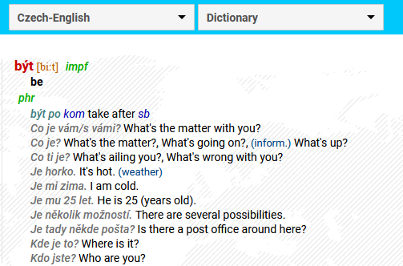
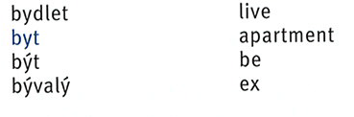
1 | the infinitive
what you can find in dictionaries
the basic dictionary form of a verb when used non-finitely

Slide 3
2 | finite verbs
different (= conjugated) forms
finite verb = a form of a verb that has a subject (expressed or implied)
jsem = I am
jsi = you are
je = he/she/it is
jsme = we are
jste = you are
jsou = they are

Slide 4
3 | negative forms
simply put NE to the beginning, with ONE (!) exception*
nejsem = I am not
nejsi = you are not
není * = he/she/it is not
nejsme = we are not
nejste = you are not
nejsou = they are not
* really, the only exception for negative form in the whole czech language

Slide 5
3 | pronouns & verbs
needed in English, not that important in czech
já = I
ty = you (singular, informal)
on / ona / to = he/she/it is
my = we
vy = you (plural, or formal)
oni = they

Slide 6
when (not) to use pronouns
simply: do not use them
using a pronouns = strong(er) emphasis on the subject
each form is different in its ending, no need to use pronouns
with pronouns
jsem = I am
jsi = you are
je = he/she/it is
jsme = we are
jste = you are
jsou = they are
já jsem = me, I am (and not David, e. g.)

Slide 7
Basic phrases with být
something you may already know
Jsem [name]. I am [name].
Jsem student. I am a student.
Odkud jste? Where are you from?
Jsem z … I am from.
Co je to? What is it?
To je dobře. It/that is good.

