Slide 1
verbs in czech language
how to conjugate the verbs in present tense

Slide 2
regular × somehow regular × irregular verbs
good for you, almost all the verbs are regular, except for few
irregular verbs: být (to be), chtít (to want) → whole set of forms must be learnt
somehow regular verbs: mít (to have) and some other verbs → the infinitive & first person form must be learnt
regular verbs (99 % of all the verbs you will ever need):

Slide 3
regular verbs: step 1
start with the infinitive
The infinitive always ends with -T
studovat, telefonovat (to call), pracovat (to work), dělat (to work), rozumět (to understand), vařit (to cook)

Slide 4
regular verbs: step 2
observe how it looks before T
studovat, telefonovat, pracovat, dělat, rozumět, vařit

Slide 5
regular verbs: step 3
3 possible groups
-at: dělat
-ět / it : rozumět, vařit
-ovat: studovat, telefonovat, pracovat

Slide 6
verb in the infinitive and present tense
form analysis
the stem type ending
infinitive: dělat = děl + a + t
present tense form: dělám = děl + á + m
the stem
the stem: it never changes (for regular verbs)
type: this element tells you about what type of the verb it is
ending: this identifies either: a) the infinitive (= T), or b) the subject (according to the personal ending)

Slide 7
making present tense: step 1
remove the ending
-at: děl-
-ět / it : rozum-, vař-
-ovat: stud-

Slide 8
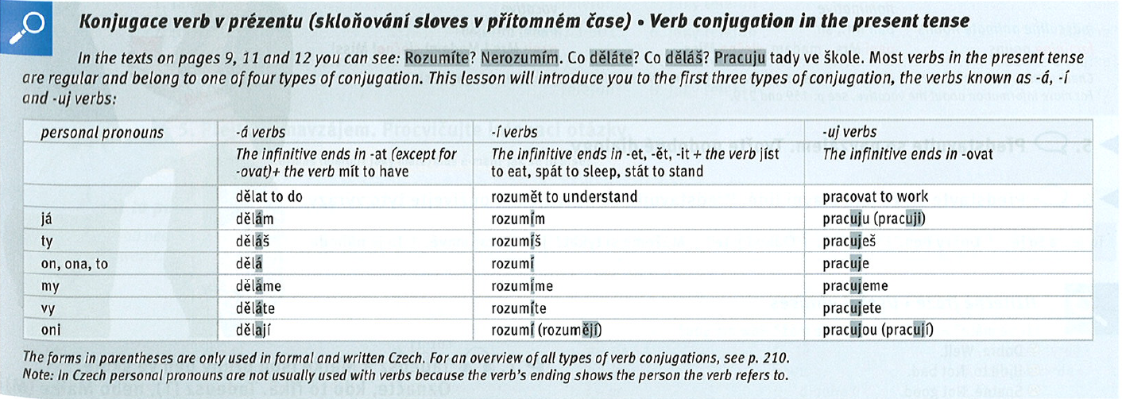
making present tense: step 2
apply personal endings, textbook, p. 13

Slide 9
making present tense: step 2
Adding something to the stem
-at: děl + á + [personal ending]
-ět / it : rozum- vař- + í + [personal ending]
-ovat: stud- + uj + [personal ending]

Slide 10
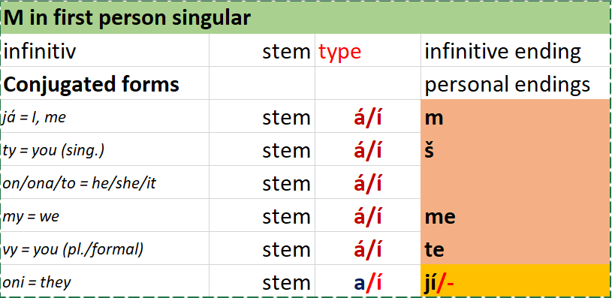
making present tense: step 3/M
Applying personal endings

Slide 11
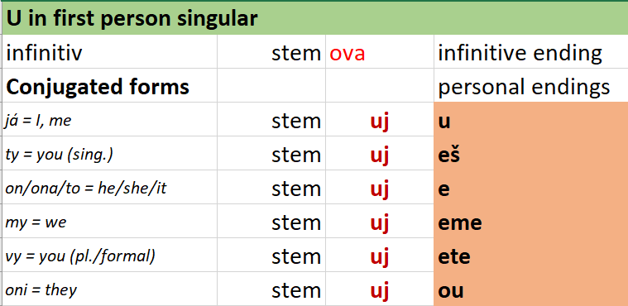
making present tense: step 3/U
Applying personal endings

Slide 12
summary
find the infinitive
recognize the verb type
apply the personal endings
This works with any regular verb.

Slide 13
examples: observe
playing with verbs
how the stems are different for different verbs
how the stems remain the same through the whole conjugation
how the personal endings for each person are the same for different verbs
how the personal endings are different for each person

Slide 14
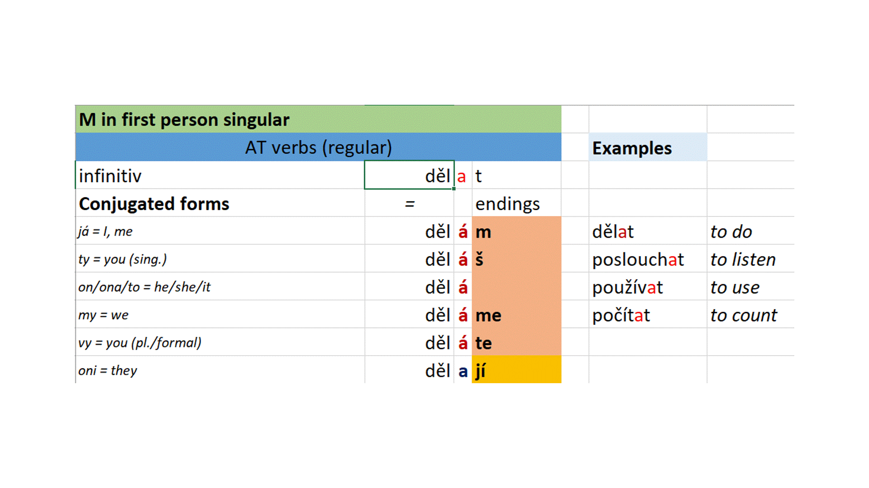
examples: Á verbs (M in the first person)

Slide 15
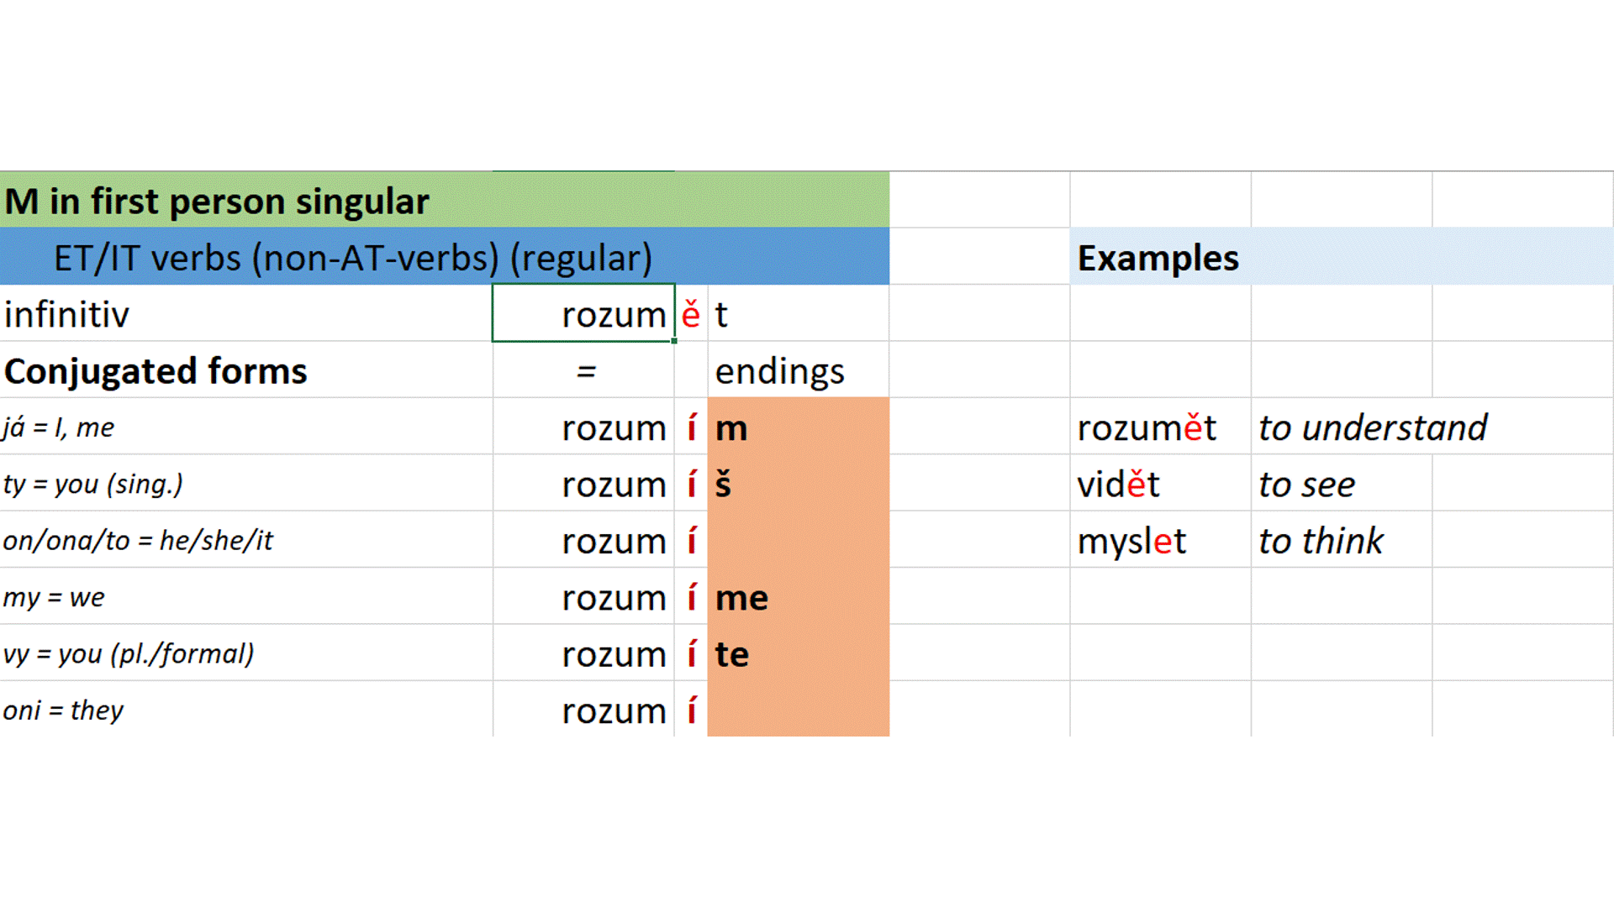
examples: Í verbs (M in the first person) 1

Slide 16
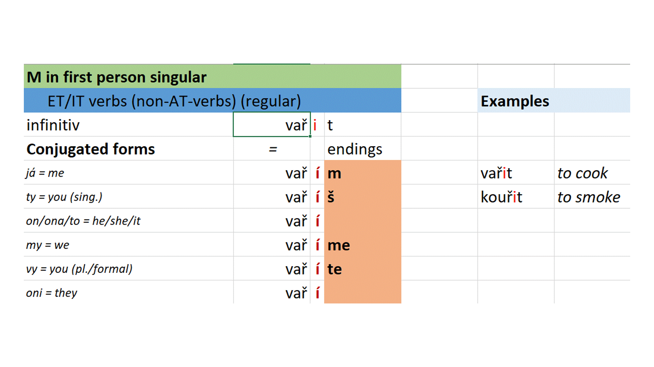
examples: Í verbs (M in the first person) 2

Slide 17
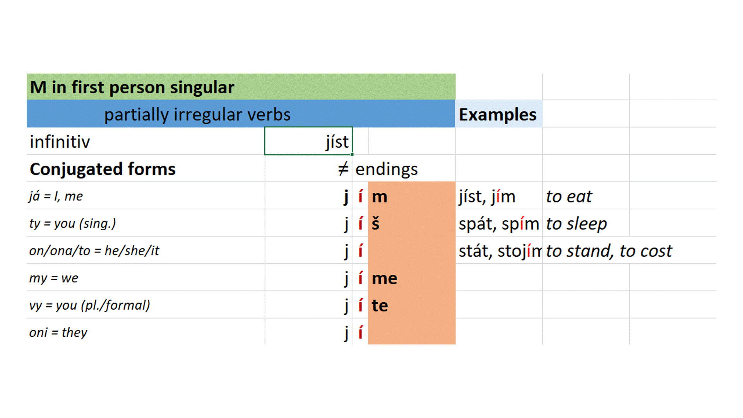
examples: Í verbs (M in the first person) 2

Slide 18
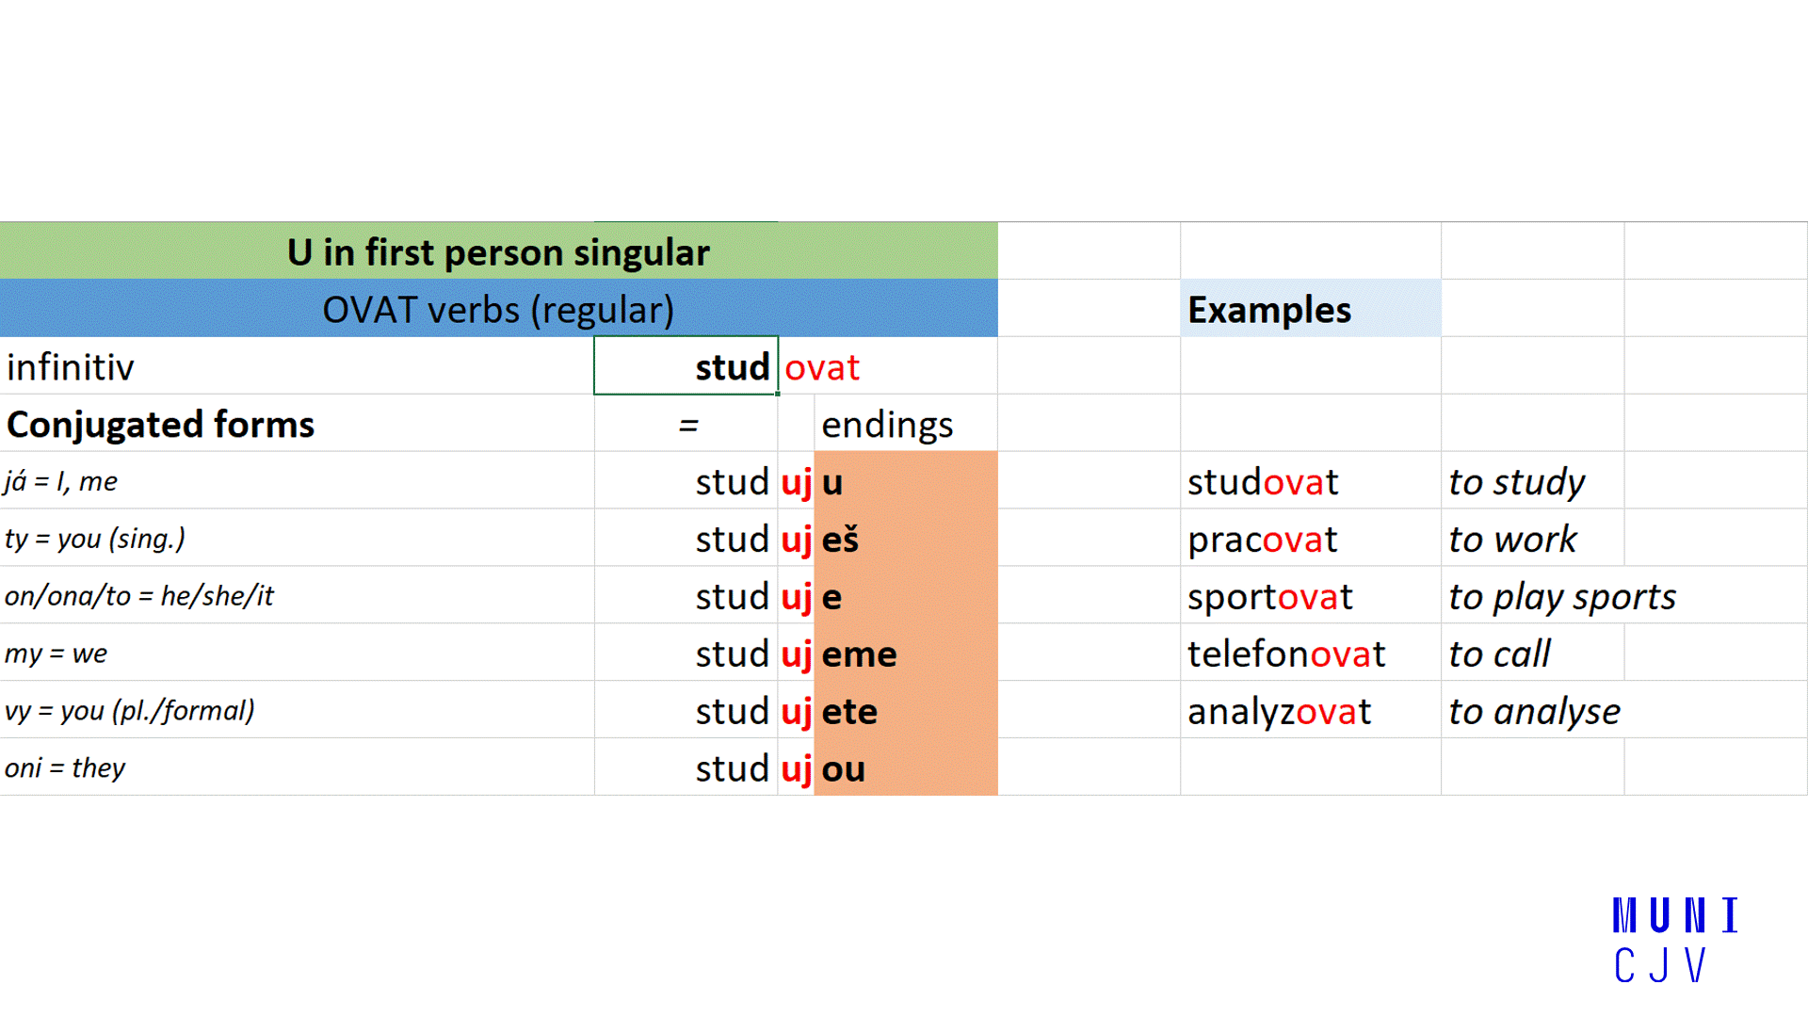
examples: OVAT verbs (U in the first person)

Slide 19
pronouns & verbs
needed in English, not that important in czech
já = I
ty = you (singular, informal)
on / ona / to = he/she/it is
my = we
vy = you (plural, or formal)
oni = they

Slide 20
when (not) to use pronouns
simply: do not use them; or use them ☺
using a pronouns = strong(er) emphasis on the subject
without pronouns: normal speaking
with pronouns
jsem student = I am a student
já jsem student = me (and not David, e. g.), I am a student

Slide 21
Děkuju za pozornost.
Thank you for your attention.

