Slide 1
Accusative case (singular)
also in textbook, p. 28

Slide 2
Cases in czech language
Case | Basic function | Example
1. nominative | subject | Martin Punčochář, univerzita
2. genitive | after prepositions, of-function | Martina Punčocháře, univerzity
3. dative | indirect object, after prepositions | Martinu Punčochářovi, univerzitě
4. accusative | direct object, after prepositions | Martina Punčocháře, univerzitu
5. vocative | calling people by name | Martine Punčocháři
6. locative | expressing location | o Martinu Punčochářovi, na univerzitě
7. instrumental | expressing „with“ | s Martinem Punčochářem, univerzitou

Slide 3
Forms
https://is.muni.cz/auth/el/med/podzim2020/aVLCJ0181/um/martin_s_groups/singular_accusative.xlsx
gender | adjectives | ending | nouns | endings | comment
M ANIMATES (people, animals, fish…) | dobrého moderního | ý > ého í > ího | doktora, Martina, kamaráda | +A | masculine animates (hard endings: H, CH, K, R, D, T, N)
 |  |  | lékaře, učitele, Ondřeje | +E | masculine animates (soft endings: Ž, Š, Č, Ř, Ň, C, J + TEL ending)
M INANIMATES (things, places, food...) | dobrý moderní | SAME AS NOMINATIV |  | SAME AS NOMINATIV
F | dobrou moderní | á > ou í = í | kávu, zmrzlinu, vodu | A > U | feminines ending with A
 |  |  | rýži, restauraci, nemocnici | E > I | feminines ending with E
 |  |  | tramvaj, kancelář | SAME AS NOMINATIV | feminines ending with consonant
 |  |  | kost |  | feminines ending with ST
N | dobré moderní | SAME AS NOMINATIV | jídlo, pivo, víno | SAME AS NOMINATIV
 |  |  | moře
 |  |  | kuře
 |  |  | nádraží, náměstí

Slide 4
Learning forms
choose a phrase you use a lot
use this phrase as a model
Dám si černou kávu. Studuju medicínu.
To je (nominative →) hezký a inteligentní Martin Punčochář
→ Ne/mám rád/a hezkého a inteligentního Martina Punčocháře

Slide 5
Why does it have to change
word order: kind of free in czech language → accusative identifies the object, nominative identifies the subject
without different form, we wouldn‘t know who is the subject (the active element, in charge of the action expressed with a verb) a who is the object (the passive element)

Slide 6
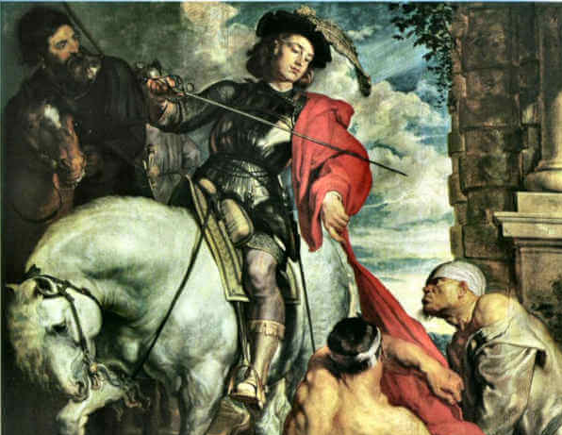
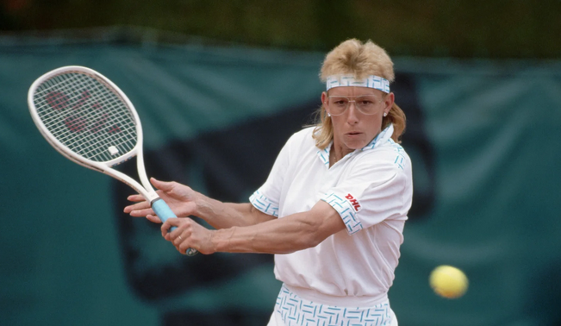
Situation: Let‘s have two people…
Martin
Martina
https://www.rct.uk/collection/405878/st-martin-dividing-his-cloak-0
https://www.glamour.com/story/most-powerful-female-athletes-of-all-time

Slide 7
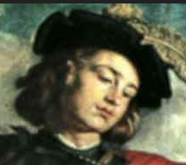
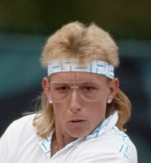
Nominative so far… it will be underlined.
To je Martin.
To je Martina.

Slide 8
Nominative so far…
Martin je voják (soldier).
Martina je sportovkyně.

Slide 9

… and now the romance starts…

Slide 10
… for romance, we need accusative (that will be bold) and the verb milovat (to love)

Slide 11
Martin miluje Martinu. = Martinu miluje Martin. = Miluje Martin Martinu.
Martin Martinu miluje. = Martinu Martin miluje. = Miluje Martinu Martin.

Slide 12
Martina miluje Martina. = Martina miluje Martina. = Miluje Martina Martina. =
Martina Martina miluje. = Martina Martina miluje. = Miluje Martina Martina.

Slide 13
… but Martina is actually lesbian

Slide 14
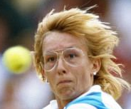
So…
To je taky Martina. Martina².
To je Martina. Martina¹.

Slide 15
Martina¹ miluje Martinu². = Martinu² miluje Martina¹. = Miluje Martina¹ Martinu².
Martina¹ Martinu² miluje. = Martinu² Martina¹ miluje. = Miluje Martinu² Martina¹.

Slide 16
Martina² miluje Martinu¹. = Martinu¹ miluje Martina². = Miluje Martina² Martinu¹.
Martina² Martinu¹ miluje. = Martinu¹ Martina² miluje. = Miluje Martinu¹ Martina².

