Slide 1
aVLCJ0383 Czech Language for Foreigners III
how to study czech online

Slide 2
Czech Language for Foreigners III
The main aim of the course Czech for Foreigners ?
discussion

Slide 3
Studying online: software
MS Teams - logging in with your ID (UČO) and primary password
do not use your personal account

Slide 4
Studying online: hardware
Internet connection ☺
camera: have it always on
microphone: have it muted, ready to turn it on when asked or having a question

Slide 5
Studying online: working with sources
interactive syllabus
learning materials
MS Teams platform

Slide 6
Interactive syllabus
https://is.muni.cz/auth/el/med/podzim2020/aVLCJ0383/index.qwarp
general info section (available all the time)
special chapter for each week (opens every Monday)
list of all the tutorials (updated weekly)
those to be studied for next week will in specific week chapter
those for revising only in tutorial list
list of all the homeworks

Slide 7
Interactive syllabus: week work
explanation / Q&A (from week 2 based on video tutorials)
following list of different tasks
book/PDF/handout based tasks, ROPOTs, online exercices, working/speaking in smaller groups, quizes…
homework
ROPOTs: revising vocabulary and grammar
tutorials: videos explaining different topics — watch before you attend your class; prepare questions if necessarry

Slide 8
Learning materials
https://is.muni.cz/auth/el/med/podzim2020/aVLCJ0383/um/klara_s_group/
your teachers‘ materials
https://is.muni.cz/auth/el/med/podzim2020/aVLCJ0383/index.qwarp
class materials

Slide 9
Studying online: the class (technical)
be logged in on time
have your camera on
have your microphone muted
if you have a question, raise your hand or write the question into the chat

Slide 10
Studying online: the class (mental)
participate
be active in completing the tasks
do not worry to ask any question

Slide 11
Studying at home: homework
completing the homework → reducing the passmark for the final test
but also other benefits (like, actually, learning something useful)

Slide 12
Studying at home: translations
use the book dictionaries (PDF on IS) for vocabulary in the exercises
if you use the (PDF) dictionaries, do not look for the exact form you do not understand; look for the most similar form → studovat (to study) could also look like: studuju (I study), studuješ (you study)...
use any online dictionaries for isolated words
try not to use google translator
do not use „camera“ translators

Slide 13
Studying in Czech republic
use the language everytime you can
it boosts your skills
it makes your learning easier

Slide 14
Getting the credit
attend the classes (you can miss 2 of them without proper excuse)
substitutions: ask the teacher of the group you want to substitute with
pass the final test: passmark 70 %
final test passmark can be reduced by:
passing the progress tests 1 written tests: if passed, will reduce your final test passmark by 2 %
1 oral test: if passed, it will reduce your final test passmark by 3 %
1 project: if passed, it will reduce your final test passmark by 3 %
completing homeworks: if you complete over 90 % of the assigned homework, your final test passmark will be reduced by 2 %

Slide 15
Motivation
credit ☹
being able to speak with czech patients later during clinical subjects
making your brain work a different was, thus training it
meeting interesting people & seeing interesting places
eating better food & drinking more interesting drinks
having better life

Slide 16
Questions?
Consultations (Friday 10-11) MS Teams) + anytime: within MS Teams, email (245691@mail.muni.cz)

Slide 17
Book
Česky krok za krokem 1 (textbook, including grammar and vocabulary appendix + workbook)
more information: https://www.czechstepbystep.cz/en
Talking medicine

Slide 18
Lesson 1

Slide 19
Lesson 1
Revision. Conversation ☺
Grammar: Revision of accusative forms in sg and plural, prepositions, verbs.
The locative sg.
The question KDE.
Medical Czech:
Revision: Parts of body.
At the doctor.

Slide 20
Warm up
answer teacher's questions:
Jaké je vaše jméno? Moje jméno je …. Já jsem …. Jsem….
Odkud pocházíte? + Jste nyní v Brně? (answer- ano or ne)

Slide 21
Accusative singular and plural
watch these two videos to remember the accusative and how use accusative in conjunction with verbs
https://www.youtube.com/watch?v=r6M7fd65XfQ (9:44)
https://www.youtube.com/watch?v=-pd79dsY7g4&t=187s (12:24)

Slide 22
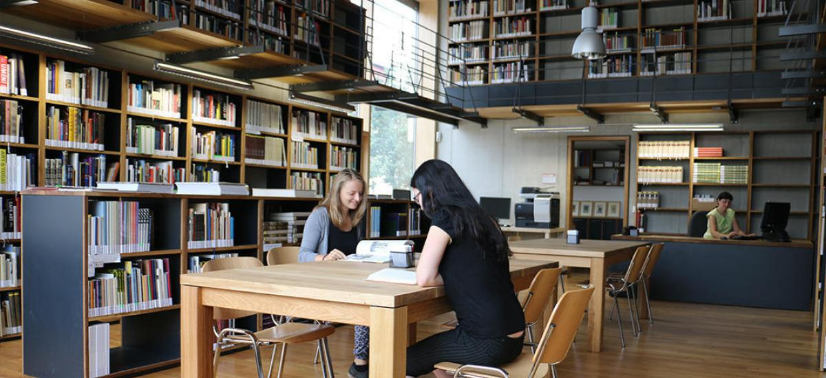
Group actvity - 3 or more sentences please
work in groups, describe the picture you will be given, present it
Vidím studentky. Ony
sedí v knihovně (třídě).
Studentky mají knihy.
Ta studentka má
černé triko (t-shirt).

Slide 23
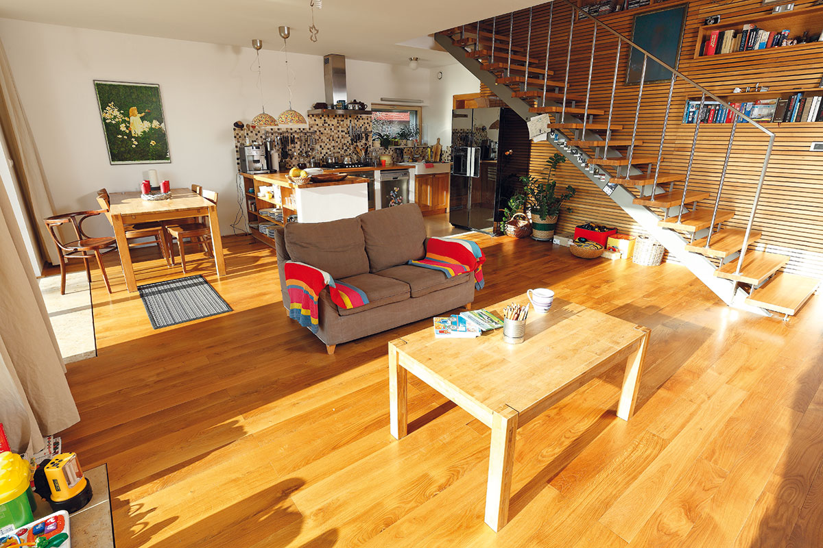

Slide 24
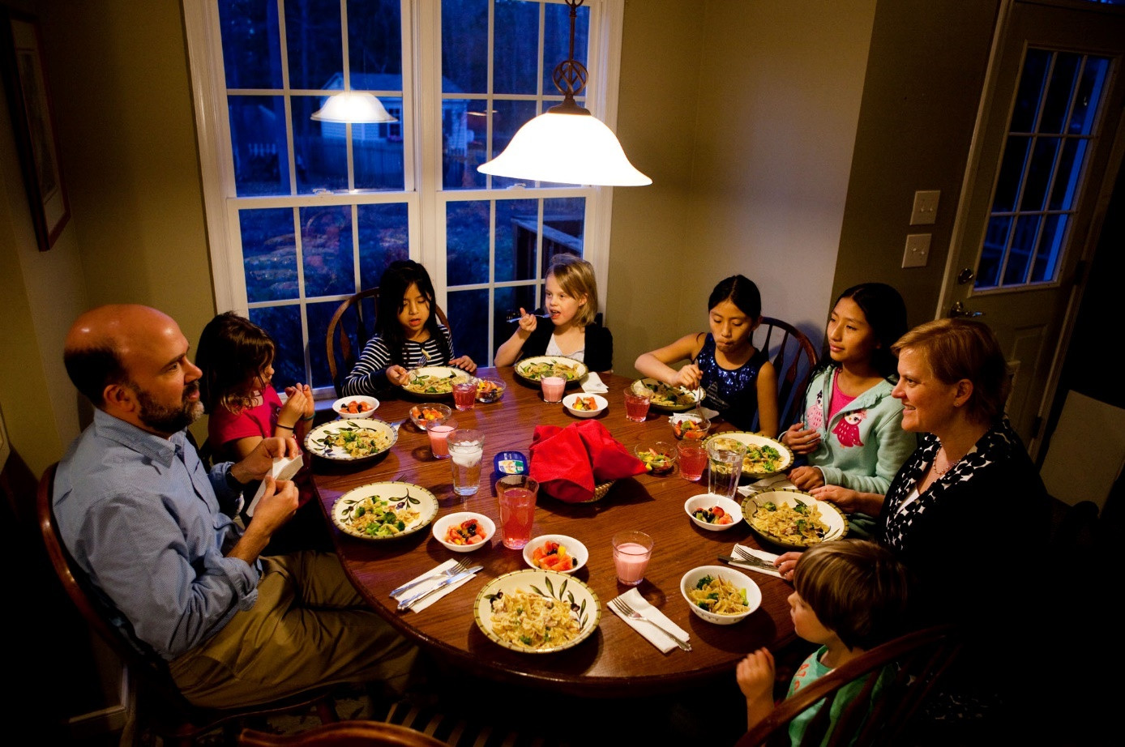

Slide 25
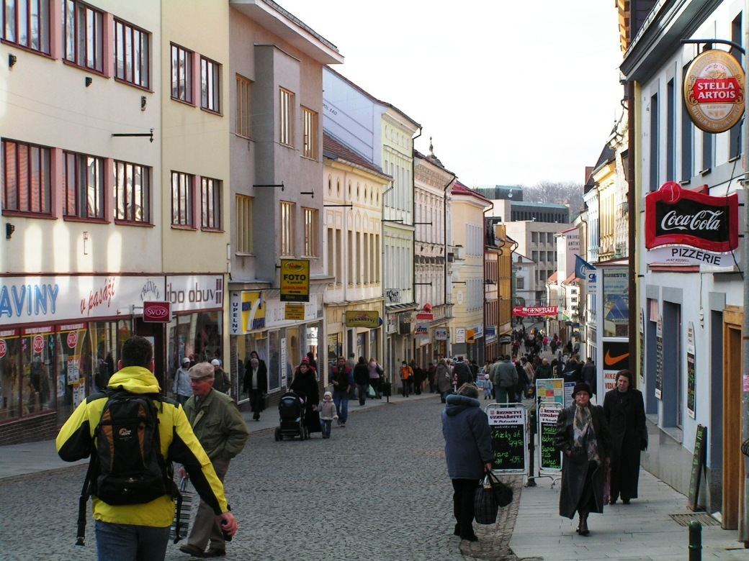

Slide 26
Verbs (vocabulary) and present tense
match the picture with the appropriate verb (5 minutes): link
sort the verbs out into four groups according to their type (5 minutes): link

Slide 27
Locative singular and verbs in present tense
sort the words out according to the ending they take in the locative case (5 minutes): link
Kde???

Slide 28
Verbs in paste tense
Co jste dělal(a) v létě? (What did you do during summer? )
2 or more sentences please
Byl jsem v Itálii se svou rodinou. Pracoval jsem. …..

Slide 29
Prepositions
ROPOT: Sort the words out with given prepositions (NA/DO/K) (5 minutes)
Sort the words out with given prepositions: link (A/V/U) (5 minutes)

Slide 30
At the doctor
at the doctor: what does the doctor say? and what the patient? link (5 minutes)
human body vocabulary (10 minutes):
what is it? (3 minutes) link

Slide 31
Homework
Homework (ROPOTs)
verbs in present tense: what do they like doing? Choose the suitable answer. Revise the vocabulary: link
verbs in present tense: sort the verbs out into four groups according their person: link

