Slide 1
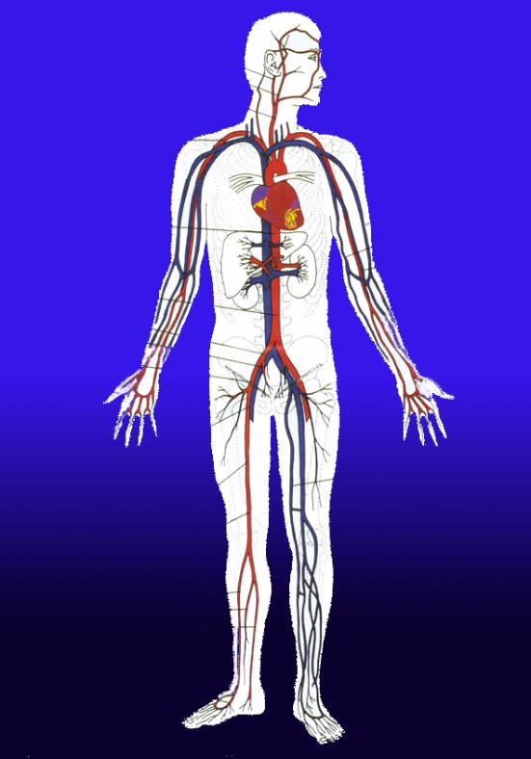
DIFFERENTIAL DIAGNOSIS the lower limb pain

Slide 2
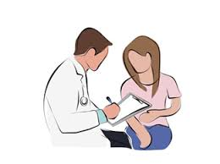
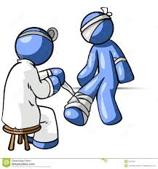
Differential diagnosis is an ability of ALL physicians
The specific treatment of the particular disease is the ablity a physician with the particular speciality

Slide 3

The principle of DD is reverse to learning
Learning – starts with organ systems and gets deeper into different pathologies with deifferent symptoms
DD – starts at a symptom and tries to find its origin – the diseae

Slide 4

The Leading Symptom vs
Accompanying symtpoms
e.g.
PAIN
Vs.
Local – mobility, neural disorder, skin colour and temperature, gathering
Distant – fever, headache, back pain…

Slide 5
Exclude life threatening conditions
Critical ischaemia
Deep venous thrombosis
Syndrome of cauda

Slide 6
Possible diseases
•Achilles tendinitis
•Achilles tendon rupture
•ACL injury (tearing of the anterior cruciate ligament in your knee)
•Ankylosing spondylitis
•Baker's cyst
•Bone cancer
•Broken leg
•Bursitis (joint inflammation)
•Chronic exertional compartment syndrome
•Claudication
•Deep vein thrombosis (DVT)
•Gout (arthritis related to excess uric acid)
•Growing pains
•Growth plate fractures
Hamstring injury
•Herniated disk
•Infection
•Juvenile idiopathic arthritis (formerly known as juvenile rheumatoid arthritis)
Knee bursitis (inflammation of fluid-filled sacs in the knee joint)
•Legg-Calve-Perthes disease
•Meralgia paresthetica
•Muscle cramp
•Muscle strain
•Night leg cramps
•Osgood-Schlatter disease
•Osteoarthritis (disease causing the breakdown of joints)

Slide 7
Possible diseases
Osteochondritis dissecans
•Osteomyelitis (a bone infection)
•Paget's disease of bone
•Patellar tendinitis
•Patellofemoral pain syndrome
•Peripheral artery disease
•Peripheral neuropathy
•Posterior cruciate ligament injury
•Pseudogout
Psoriatic arthritis
•Reactive arthritis
•Rheumatoid arthritis (inflammatory joint disease)
•
Sacroiliitis
•Sciatica
•Septic arthritis
•Shin splints
•Spinal stenosis
•Sprains
•Stress fractures
•Tendinitis
•Thrombophlebitis (a blood clot that usually occurs in the leg)
•Torn meniscus
•Varicose veins

Slide 8
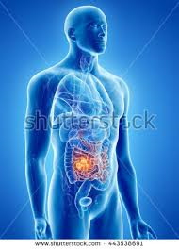
The problem arises from CNS to very periphery
Brain
Medulla
Spine
Peripheral nerves
vessels
Locomotory apparatus
Tissues

Slide 9
Origin
Locomotory app.
  Trauma, Inflammation,
CNS
  Tumours, neuralgias
Peripheral nerves
  Redicular et related. syndromes
Tissues
  Ischaemia, infection,
Cardiac
  Heart failure woth depressed Card.Output
Metabolic
  Acidaemia, Ca, PTH,
Vascular
  Thrombosis, embolia, stenosis

Slide 10

Specialist involved
Psychiatrist
Neurologist
Rheumatologist
Angiologist
Orthopedist
Surgeon
Traumatologist
Physiotherapist

Slide 11
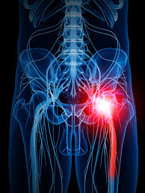
The leading symptom - pain
Sharp and hot - neuropathic
Well localised – somatic nerves affection
Blunt – inflammation, ischaemia
Pulsating – innflammation, disecting aneurysm
Cramps – hormonal and mineral disorders

Slide 12
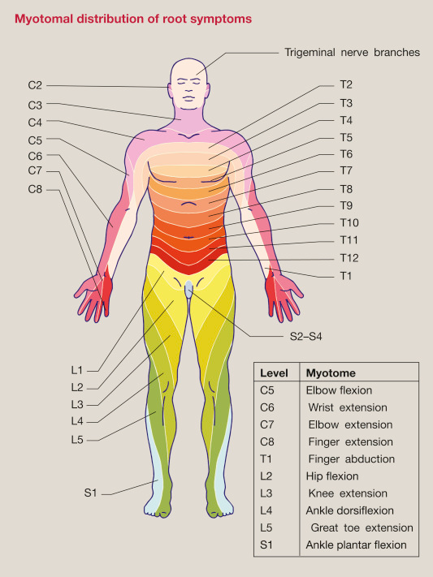
Location
In relation to visible affection

Slide 13
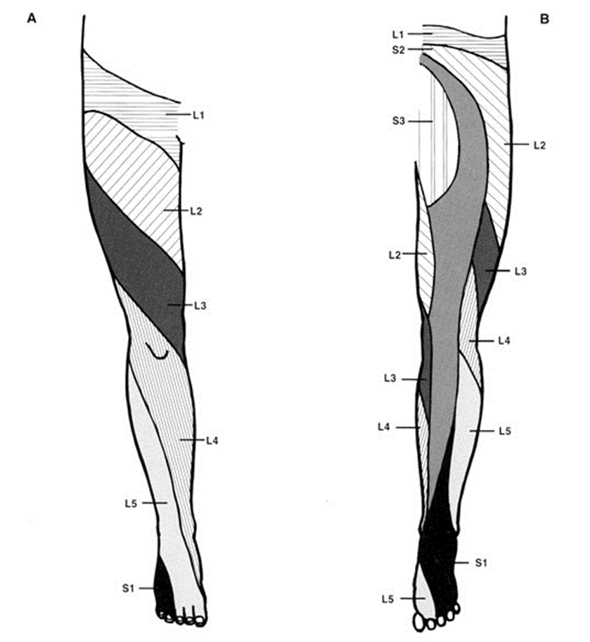
Irradiation
Within neurodermatoma
Along artery

Slide 14
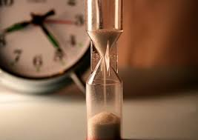
Duration and time pattern
All the time
Upon strain
In rest only
After some period of walking

Slide 15

Accompanying symtpoms
Skin discoloration – paleness,
Hypaesthesia/anaesthesia/paraesthesia
Back pain – neuropathic
Fever
Swelling

Slide 16
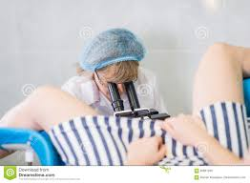
Examination methods
Anamnesis
Physical examination
Blood chemistry and count
Imaging methods – X-ray, US, CT, MRI, …
EMG

Slide 17
Anamnesis
Both family and personal
Thrombosis, embolisation, Atrial fibrilation, Horminal contraception, thrombophilia, Tobacco abuse (passive too)…
Daily routines, occupational anamnesis, trauma

Slide 18
Physical examination
Colour
Temperature
Swelling
Joint pain, extent of movements, fluctuation, balottement
Pulsations
Signs of DVT
Neurologic tests – Lassegue, irritation or depreciation
Treadmill test

Slide 19
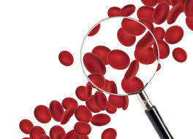
Blood chemistry
DD, LD, myoglobine
CRP, Leu, ASLO, CIK, ANA
Uric acid
ABR, Ca, Mg.
Calcitonine, Parathormone

Slide 20
Imaging methods
US
CTAg
MRI

Slide 21
Neurologic tests
EMG

Slide 22

Break or finish ☺ ☺ ☺

