Slide 1
Yellow fever
Ebola
Tomáš Gergel
Svatava Snopková

Slide 2
Yellow fever
  mosquito-borne viral hemorrhagic fever with a high case-fatality rate
  acute, systemic infection with organ dysfunction and hemorrhage
  vector: Aedes sp. in Africa, Haemagogus sp. in South America
  etiological agent:
    member of the family Flaviviridae, enveloped, positive-sense, single-stranded RNA virus that replicates in the cytoplasm of infected cells
    single serotype, antigenically conserved = vaccine protects against all strains of the virus
    1927 - first isolation from human. First proven mosquito-borne viral infection
    cause infection of human and primates (both serve as reservoir)
  life-long immunity develops after the infection

Slide 3
Epidemiology
WHO
from 1980 –↑ numbers of cases worldwide
200 000 reported cases/year (10 – 250x more in reality)
˃ 60 000 deaths/year
90 % of all cases in Africa (↑ inhabitants in city agglomeration + ↑ % infected mosquitoes + ↓ vaccinaton prevalence rate)
tropical regions of South America and sub-Saharan Africa where the disease is endemic
endemic YF has never been reported in Asia (only imported infections)

Slide 4
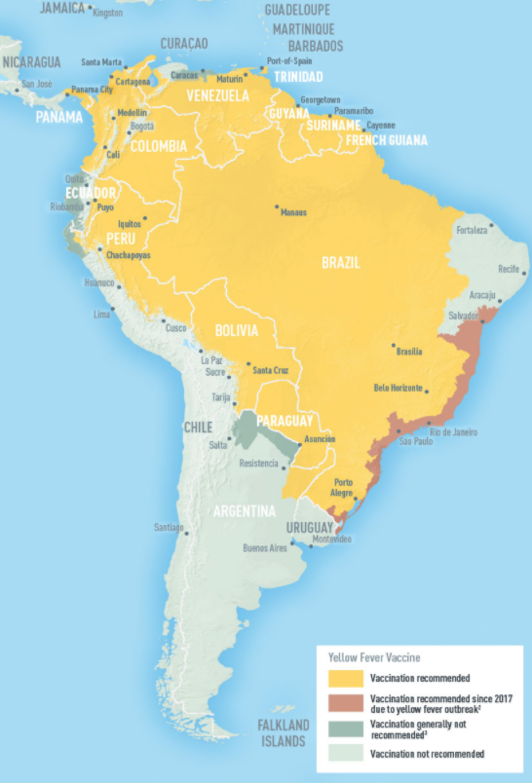

Slide 5
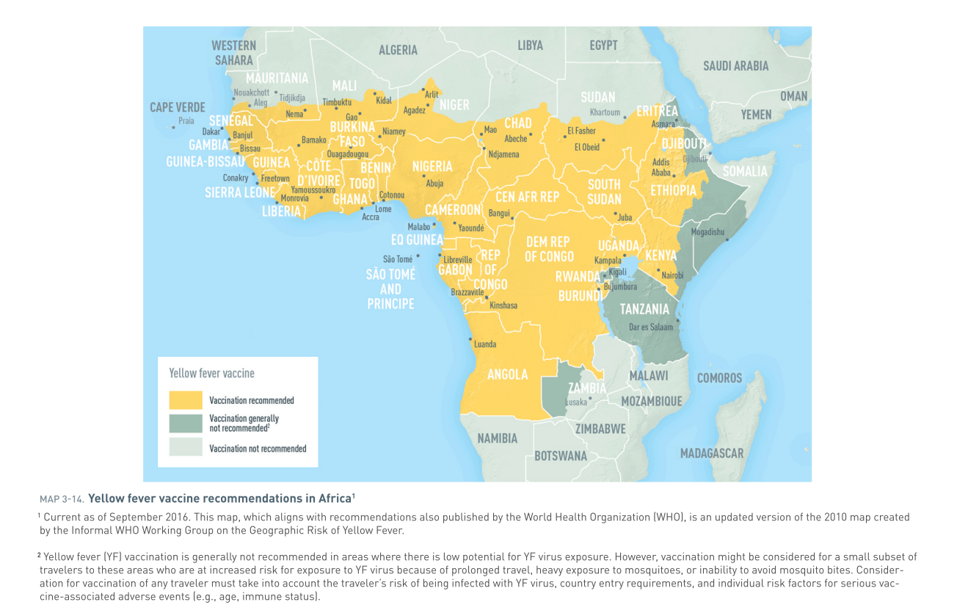

Slide 6
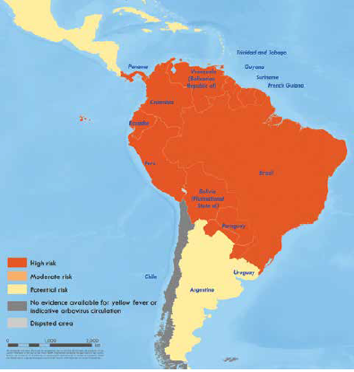
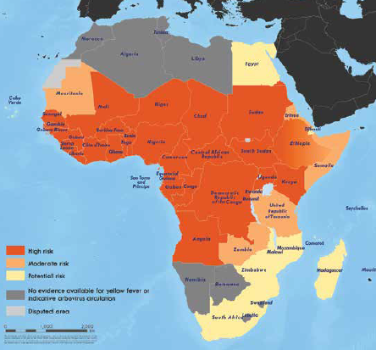
Spread of yellow fever
  17c. - transatlantic slave trade = most important way of spreading from Africa to western hemisphere
  1648 Yukatan – 1. epidemics at western hemisphere
  17c. – 19c. – multiple epidemics at North America and Europe (ports)
  1793 – Philadelphia – approx. 10 % of inhabitants died; 1880 – epid. related with Panama canal construction
A global strategy to Eliminate Yellow fever Epidemics (EYE) 2017-2026. WHO 2018. ISBN 978-92-4-151366-1. Bryant JE. Out of Africa. www.ncbi.nlm.nih.gov/pmc/articles/PMC1868956

Slide 7
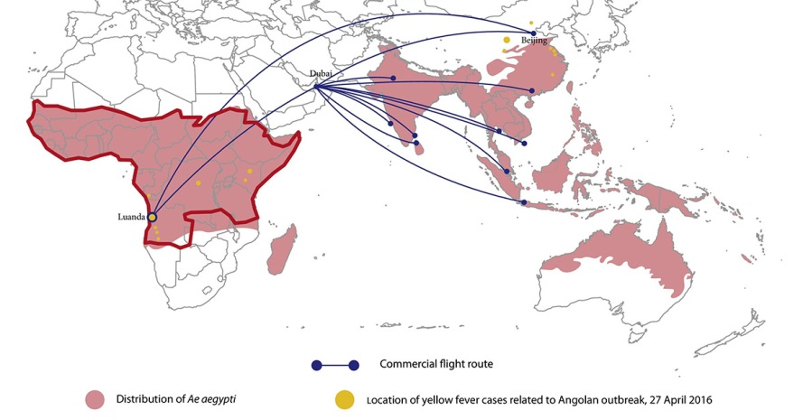
Pandemic potential of YF
2016
outbreak in Luanda, Angola → spreading to Kinshasa (DRC) and China (first cases in Asia) - 11 chinese workers returned from Angola
real danger of rapid spreading in Asia (air transport, non-immunised travelers, presence of vector – Aedes aegyptii)
there was no further spread in China - air temperatures were lower than necessary for vector activity

Slide 8
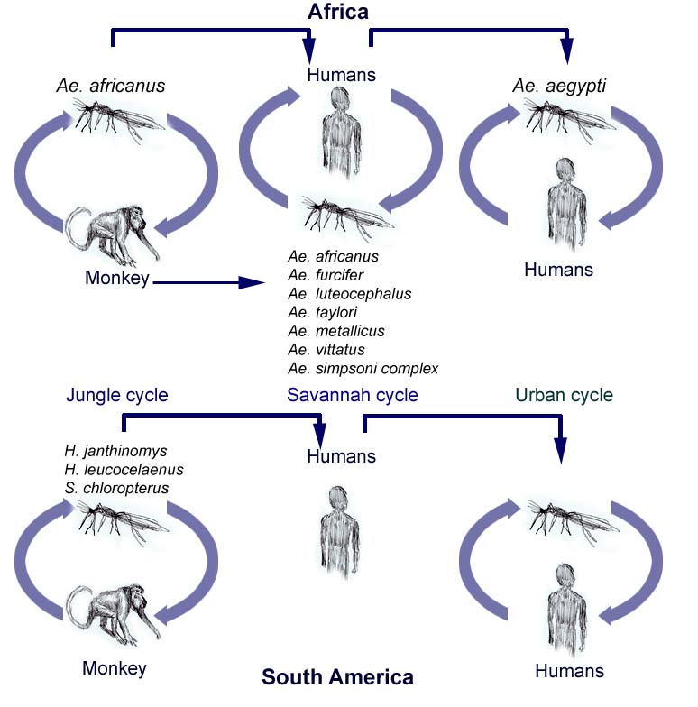
YF transmission cycles
Sylvatic cycle (ape-mosquito-human, "jungle yellow fever") – Africa, SA
Intermediate cycle („savanah cycle“)– Africa
Urban cycle (human-mosquito-human, "urban yellow fever„) – Africa, SA

Slide 9
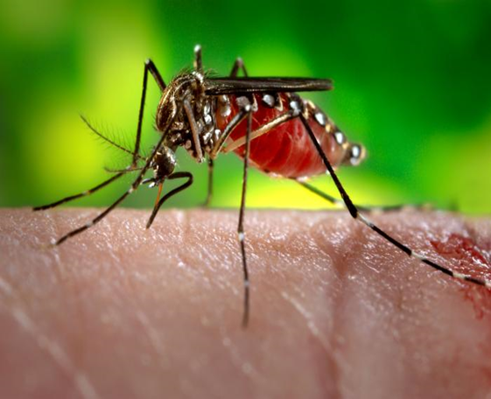
Transmission
infected female mosquito bite - virus replication at the site of inoculation (dendritic cells in epidermis) →
regional lymph nodes →
other organs via the lymph and then the bloodstream (viremia) →
other tissues (large amount replication of virus in the liver, lymph nodes, and spleen)
Incubation period: 3-6 days

Slide 10
Clinical manifastation
Subclinical infection
Abortive, nonspecific febrile illness without jaundice
Life-threatening disease with fever, jaundice, renal failure, and hemorrhage

Slide 11
Stages of classical illness
Period of infection („red period“)
3-4 days lasting viremia
malaise, headache, photophobia, pain in the lower extremities, myalgia, anorexia, nausea, vomiting, restlessness, irritability, and dizziness - nonspecific, impossible to distinguish yellow fever from other acute infections
PE: patient appears acutely ill, flushed skin, conjunctivitis, epigastric tenderness, +- hepatomegaly, tongue - red at the tip and sides with a white coating in the center, Faget's sign (↓puls rate relative to ↑temperature (39-41ºC)
Lab.: leukopenia (1500 to 2500 per ul) relative neutropenia; elevated serum transaminase

Slide 12
Period of remission
lasting up to 72 hours
abatement of fever and symptoms
patients with abortive infections recover at this stage

Slide 13
Period of intoxication (sever yellow fever, „yellow period“)
approxx. 15 % of infected enter this stage (˃50% travelers from nonendemic countries)
20 – 50% mortality (non-treated), 5% (treated)
survivors – without consequences + life-long immunity
return of fever, nausea, vomiting, epigastric pain, jaundice, oliguria and hemorrhagic diathesis (coffee-grounds hematemesis, melena, hematuria, metrorrhagia, petechiae, ecchymoses, epistaxis, oozing of blood from the gums, and bleeding from needle puncture sites)
↓viremia, ↑antibodies

Slide 14
Period of intoxication
Organ dysfuncion:
  Liver - apoptosis of hepatocytes in the midzone of the liver lobule, no disruption of the architecture of the liver, healing is complete without postnecrotic fibrosis (in nonfatal cases)
  Kidney - direct viral injury and nonspecific changes due to hypotension and the hepatorenal syndrome
  The hemorrhagic diathesis - decreased synthesis of vitamin K-dependent coagulation factors by the liver, disseminated intravascular coagulation, and platelet dysfunction
  Encefalopathy - result of microvascular dysfunction
  Myocardial injury - rare, arrythmias, myocardial insufficiency
  → MOF - high levels of proinflammatory cytokines (IL-1, IL-6, TNF-α - as in bacterial sepsis, SIRS)

Slide 15
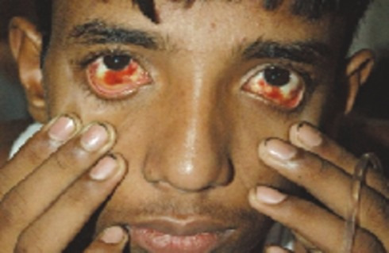
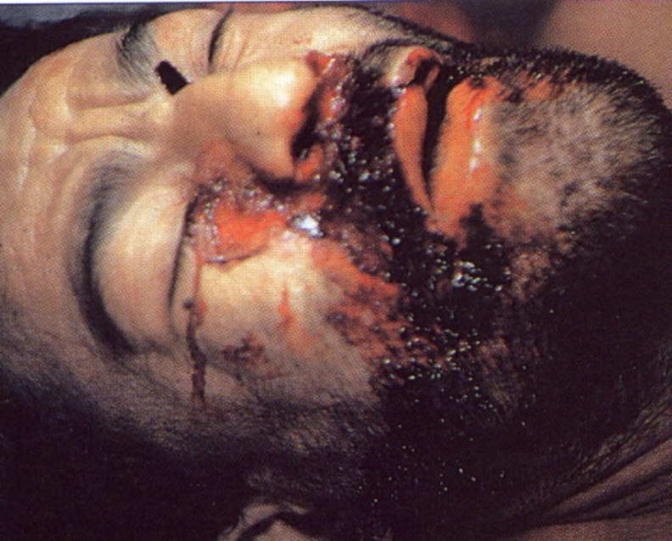
    Lab:
    ↓ Leuko, relat. lymfocytosis, ↓ PLT
    AST (↑↑) > ALT (due to concomitant viral injury to the myocardium and skeletal muscle)
    ALP normal
    ↑ bilirubin typically between 85-170 umol/L
    decreased synthesis of coagulation factors (f. II, V, VII, IX, X)
    ↑myoglobin +↑CK (myositis)

Slide 16
Yellow fever - diagnostic
sérology: ELISA - IgM antibodies, ↑ lvl in acute faze, ↓ in covalescens
  can be cross-reactions with other flaviviruses, particularly in Africa where multiple flaviviruses circulate
  the neutralization test is more specific but requires a specialized laboratory
PCR: viral genom detection from blood or tissue samples
Liver sample histology – only post mortem. During illness high risk of fatal bleeding (see Liver in organ dysfuncion, slide 14)
positive results must be confirmed by WHO or CDC certified laboratory

Slide 17
Yellow fever - treatment
no specific antiviral therapy available
supportive care = modern intensive care (generally not available in remote areas)
  maintenance of nutrition
  prevention of hypoglycemia
  nasogastric suction to prevent gastric distention and aspiration
  hypotension - fluid replacement and vasoactive drugs (norepinephrine, terlipressine)
  oxygen
  management of metabolic acidosis
  treatment of bleeding - fresh-frozen plasma
  renal failure - dialysis if indicated
  treatment of secondary infections

Slide 18
Yellow fever - prevention
Mosquito bite prevention (repelents (DEET), clothing, mosquito net etc.)
Vaccination:
  the primary tool for prevention of YF
  vaccine protects against all strains of the virus
  live-attenuated vaccine (f.e. Stamaril®)
  single dose provides lifelong protection for most people, booster is not recommended
  Vaccine is recommended for people aged 9 months or older and who are traveling to or living in areas at risk for yellow fever virus in Africa and SA
    CAVE !!! age ˂ 9 months, ˃ 60 years, pregnancy, immunocompromised patients – high risk of sever adver effects
    (as at all live vaccines)
  Yellow fever vaccine may be required for entry into certain countries

Slide 19
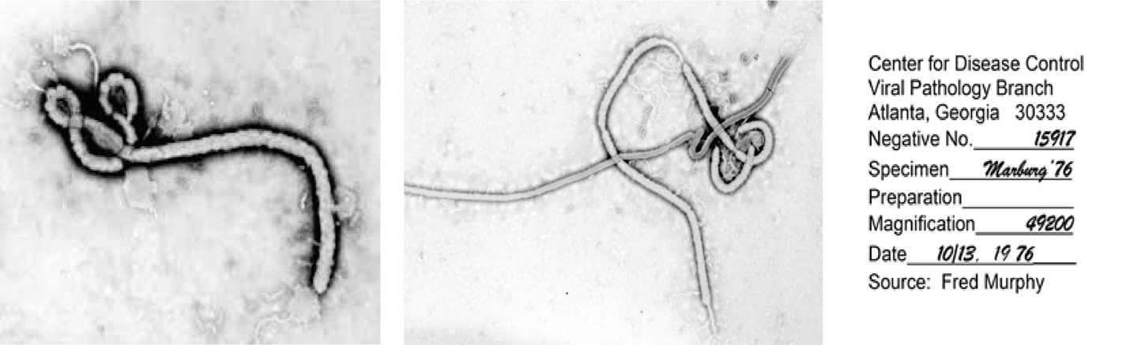
Ebola
RNA, non-segmented, family Filoviridae (from latin „filum“ = thread like)
6 types:
Zaire ebola virus – most common, the deadliest, mortality 55-88%, central and west Africa
Sudan ebola virus – mortality as in Zaire, Sudan (1970, 2004), Uganda (2000)
Tai Forest ebola virus (former Cote d´Ivoire ebola virus) – west Afrika
Bundibugyo ebola virus – mortality 22-30%, Uganda (2007), DRC (2012)
Reston ebola virus – in Phillipines (not in Africa), infects only nonhuman primates
Bombali ebola virus – newly izolated from bats, infectiosity for humans not known

Slide 20
Ebola
Ebolavirus – the most virulent patogen known
natural reservoirs are not yet identified (probably some species of bats)
stable for a long time at room temperature, in blood or water for
sensitive to high temperatures, UV light, γ radiation

Slide 21
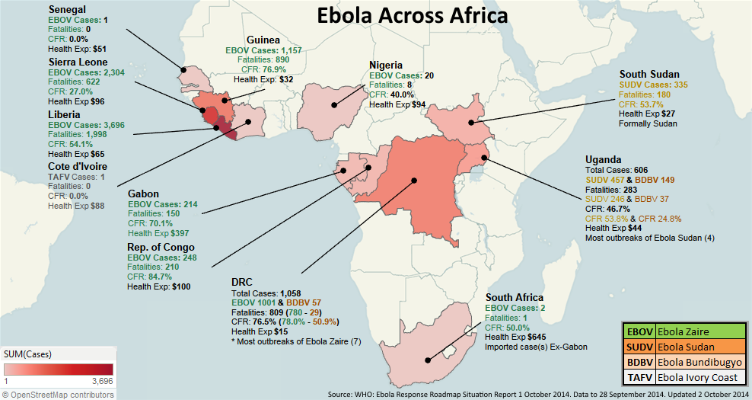
since 1976
several outbreaks, in remote, isolated areas of small villages, low population density, near rain forrests
Fewer than 100 cases, contained within a period of weeks to a few months
2013-2016
the biggest epidemy in history - Guineia, Liberia, Siera Leone, Nigeria, Senegal, and Mali (Zaire ebola virus)
Almost 29k confirmed cases, 11,000 deaths (40% mortality). 881 infected healthcare workers - 60 %percent died

Slide 22
August 2018 – June 2020
10. epidemy of ebola in DRC, 2. biggest in history
EBOV-Zaire
3470 confirmed cases with 2287 deaths, a fatality rate of 66 %
162 zdravotnických pracovníků

Slide 23
Patogenesis
most data obtained from laboratory experiments (mice, guinea pigs, nonhuman primates)
virus → musous membranes (mouth, eyes), broken skin → necrosis of macrophages and dendritic cells → release of large amount of new virions → virus-induced suppression of type I interferon responses → rapid spred to lymph nodes and bloodstream → infected almost all body cells
lymfocytes and neurons are only cell types not infected
failure of adaptive immunity (impaired dendritic cell function and lymphocyte apoptosis) → ability of filoviruses to cause a severe, frequently fatal illness

Slide 24
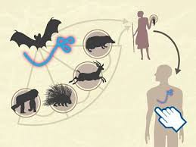
Transmission
Rezervoir and the mode of transmission
greatest mystery
data suggest bats and other wild animals
Transmission
Direct contact
body fluids of infected human and animal
high risk – blood, feces and vomitus
also detected in urine, semen, saliva, aqueous humor, vaginal fluid, and breast milk
Indirect contact
surfaces and objects – beding, clothes, needles …
Others
accidental infection of workers in any Biosafety-Level-4 (BSL-4) facility where filoviruses are being studied
bioterrorism
airbourne transmisson wasn´t proven

Slide 25
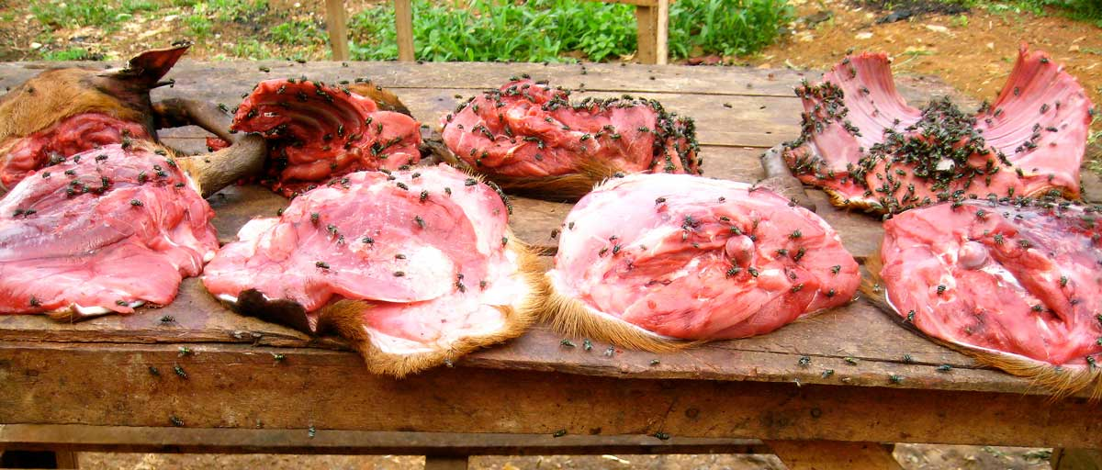
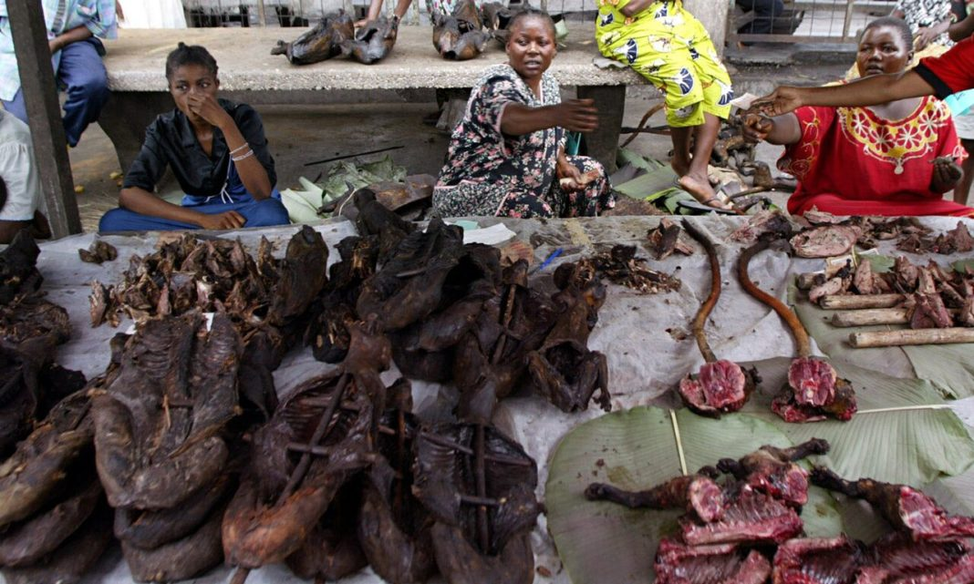
Transmission – „Bushmeat“
available source of livelihood
source of infection - insufficiently heat-treated meat of an infected animal (raw, dried), organs, body fluids (bat soup, grilled bat, primate meat…)
DRC – yearly hunted ˃6 mil tons of wildlife meat
  approx 90 tons of meat is illegaly imoprted to USA every yeatr
  ↑spreading infection risk

Slide 26
Clinical manifestation
Incubation: 6-12 days (range 2-21 days) – prolonged incubation = difficulty to find contacts, ↑ risk of spreading the infection
Symptoms:
abrupt onset of fever and chills, fatigue, headache, loss of appetite
Rash – diffuse erythematous, nonpruritic maculopapular rash by day 5 to 7 of illness, usually involves the face, neck, trunk, and arms, and can desquamate
Gastrointestinal –common, first few days of illness, watery diarrhea (up to 10 liters per day) nausea, vomiting, and abdominal pain → severe fluid loss → dehydration → hypotension → hypovolemic shock → death
Hemorrhage –blood in the stool, petechiae, ecchymoses, oozing from venipuncture sites, and/or mucosal bleeding
  clinically significant hemorrhage in the terminal phase of illness and in pregnancy

Slide 27
Clinical manifestation
Neurologic – meningoencephalitis, days 8 to 10 of illness.
Cardiac – relative bradycardia, pericarditis, myocarditis
Respiratory – tachypnea, shortness of breath, hypoxia, hypoventilation due to respiratory muscle fatigue
  respiratory failure also as consequence of fluid resuscitation
Ocular – conjuncitivitis, uveitis (also in convalescnece)
death usually during 2. week of illness
Lab.: leukopenia with lymphopenia, trombocytopenia, elevated ALT, AST, coagulation abnormalities (prolonged PT, aPTT, ↑fibrin degradation products), proteinuria, azotemia, electrolyte abnormalities (↓Na, ↓K, ↑K, ↓Mg, ↓Ca)

Slide 28
Clinical manifestation
Remember....
major hemorrhage is less common than previously described (usualy at the end of the fatal course)
volume losses from vomiting and diarrhea made a greater contribution to severe illness
Convalescence - can persist for more than two years
weakness, fatigue, muscle and joint pain, insomnia, headache, urinary frequency, memory loss, and failure to regain weight that was lost during illness

Slide 29
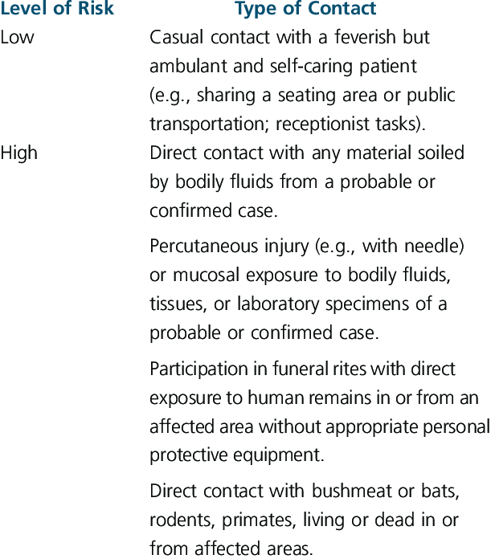
Diagnosis
Determine the risk of exposure

Slide 30
Diagnosis
Symptomatic patients with identifiable risk
infection control precautions should be used, health care workers - personal protective equipment recommended for the care of patients with Ebola virus disease (or highest available)
patients should be isolated in a single room with a private bathroom, closed door
inform the hospital infection control program, hospital leadership, local and state health departments
phlebotomy and laboratory testing limited to tests that are essential for diagnosing or ruling out Ebola virus
Ebola virus belongs to category bio-safety level 4 (BLS-4) („VNN - vysoce nebezpečné nákazy“ in czech)
only 2 hospitals in Czech republic are capable to take care of BLS-4 – Bulovka univerzity hospital Prague, Těchonin military hospital

Slide 31
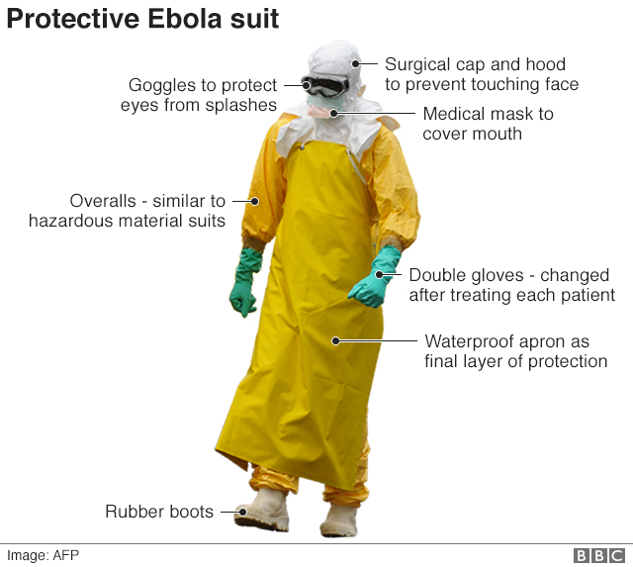

Slide 32
Diagnosis
Asymptomatic individuals with identifiable risk
monitoring for symptoms and signs of Ebola virus disease
should be monitored for 21 days after the last known exposure
immediately report the development of fever or other clinical manifestations suggestive of Ebola virus disease
self-monitoring and reporting versus direct observation by a designated health official
need for travel restrictions, restricted movement within the community, and/or quarantine

Slide 33
Diagnosis - testing
„OraQuick Ebola rapid Antigen Test“
  rapid diagnostic test–10/2019 FDA approval
  rapid patient isolation and treatment – epidemiologically significant
serology - ELISA – antigen and antibodies
PCR - blood, tissues
virus isolation - VERO cells
electron microscopy
skin biopsy → PCR

Slide 34
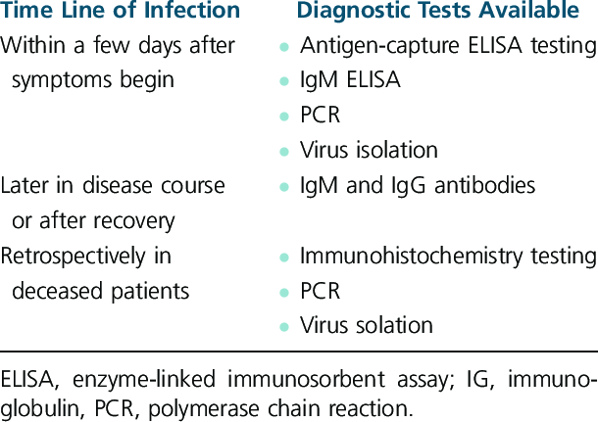
Diagnosis - testing

Slide 35
Treatment
Specific antivarals are not available
4 experimental drugs in trials
  3x monoclonal antibody
  1x nucleotide analgue - remdesivir
Supportive care
fluid and electrolytes replacement, transfusions
complex intensive care – oxygen, artificial ventilation, hemodialysis

Slide 36
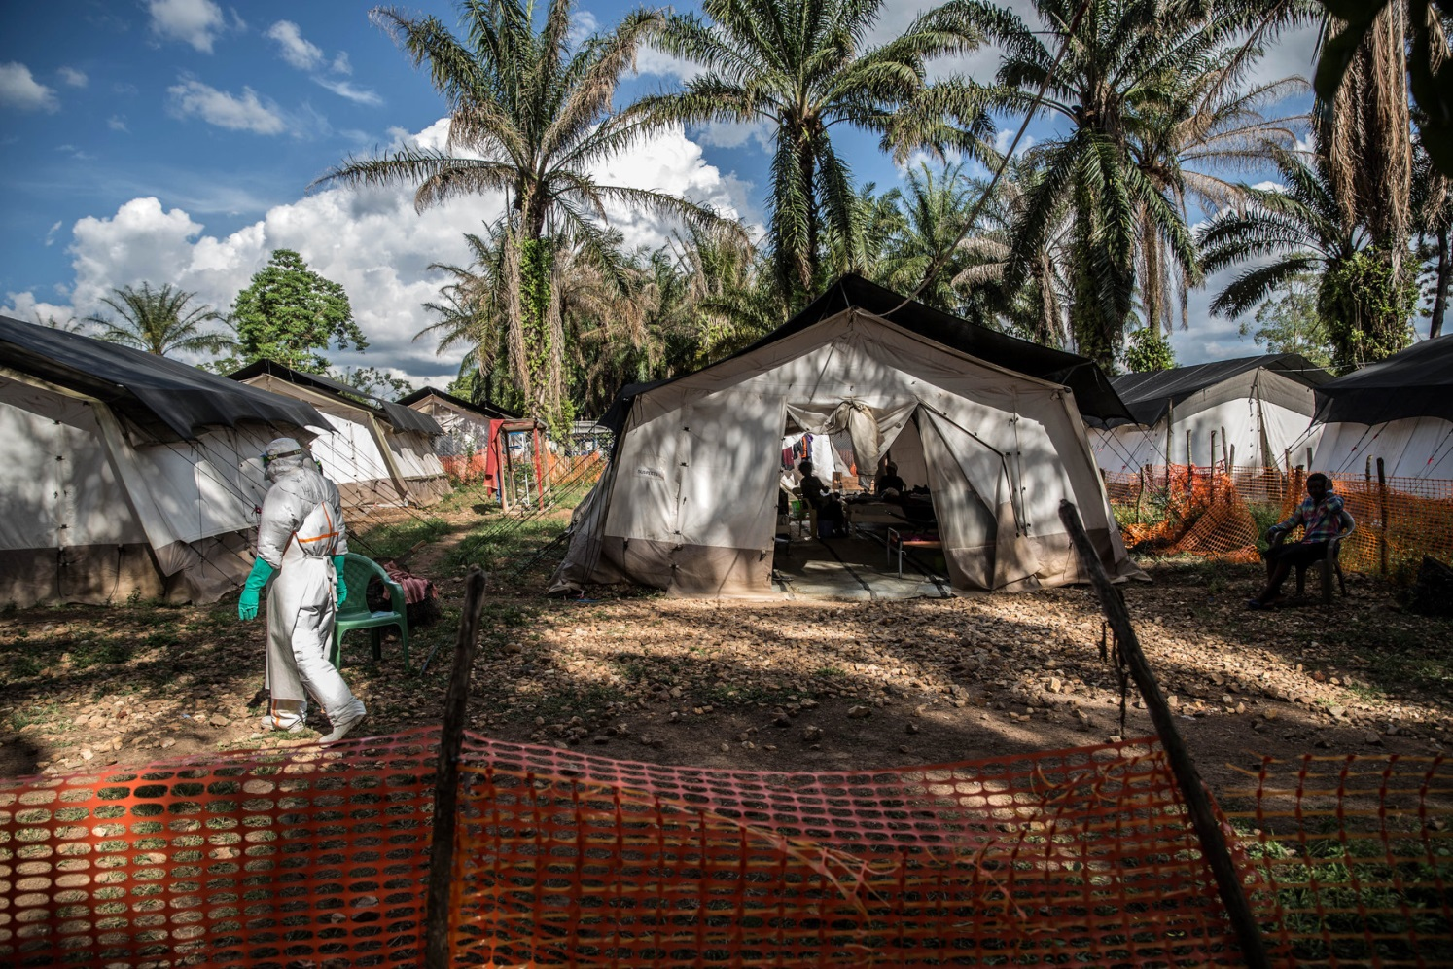

Slide 37
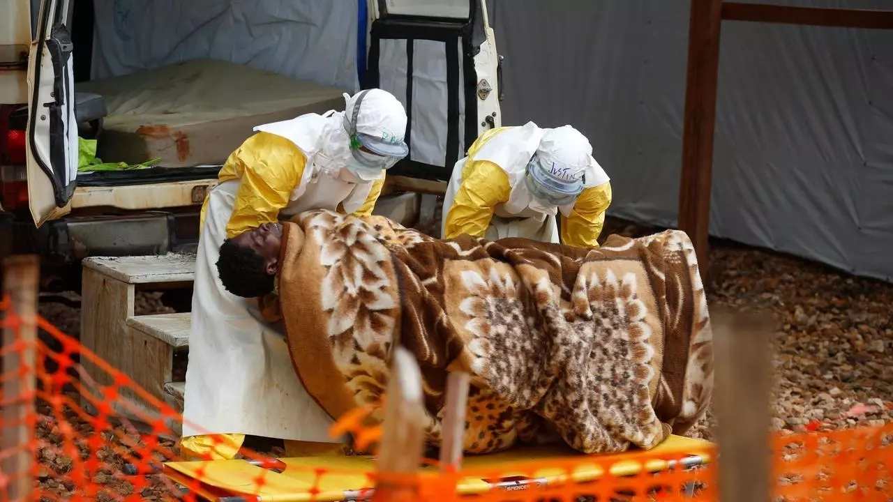

Slide 38
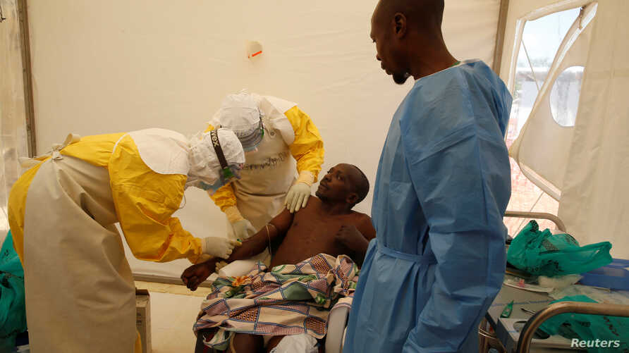

Slide 39
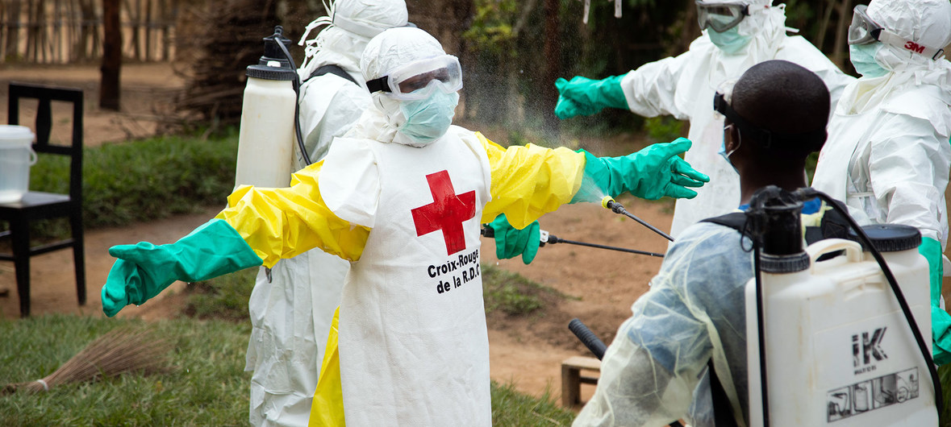

Slide 40
Prevention
protective personal equipement (see above)
strict isolation
desinfeciton of surfaces, body fluids
reproduction rate (RR) = 2-4
Vaccinaton
Ring vaccination strategy - contacts and their contacts = approx. 120-150 people in 1 ring

Slide 41
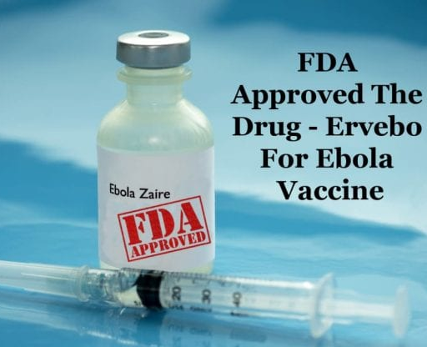
Prevention
2018 rVSV-ZEBOV-GP
2019 approved by FDA, EMA as ERVEBO®
live attenuated vesicular stomatitis virus (VSV) carries ebola Zaire surface glykoprotein
2 doses
antibodies at least for 1 year
even in pregnancy (100% mortality of ebola in pregnant women)
efficiency 95,8-98,5 %

Slide 42
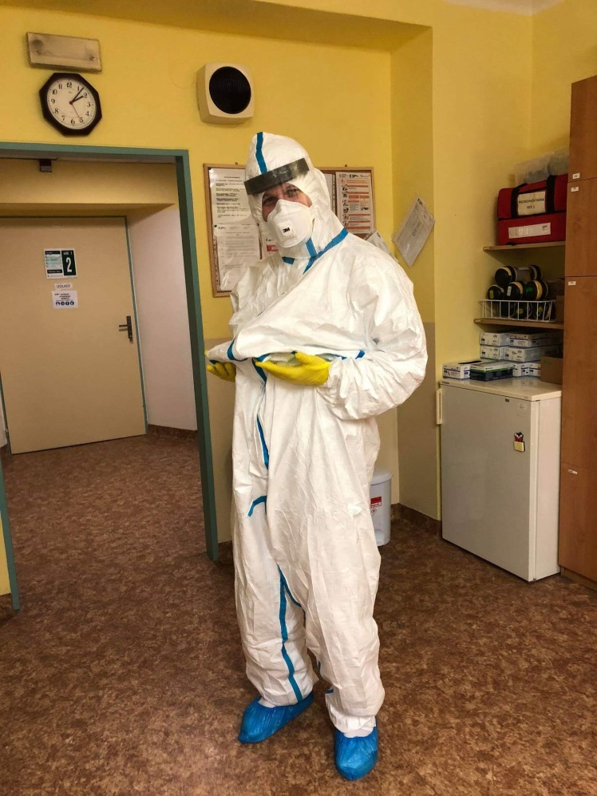
Thank you for your attention !

