Slide 1
Cardiac markers
Zdeňka Čermáková
KLM LF MU Brno
OKB FN Brno

Slide 2
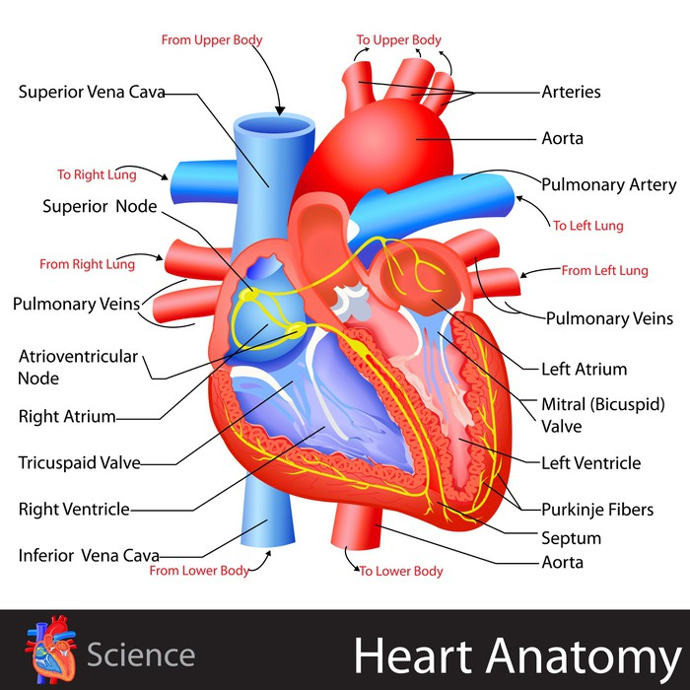
Cardiac markers
Ischemia, necrosis
volume overload
mechanical damage
toxic effects
Markers of acute coronary syndrom
Markers of chronic heart failure
Regulation: GDF-15,galektin3
Diagnosis Treatment Prognosis

Slide 3
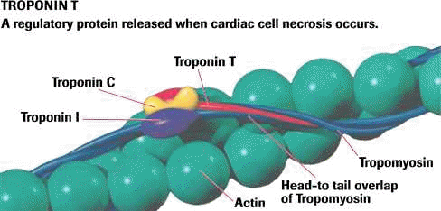
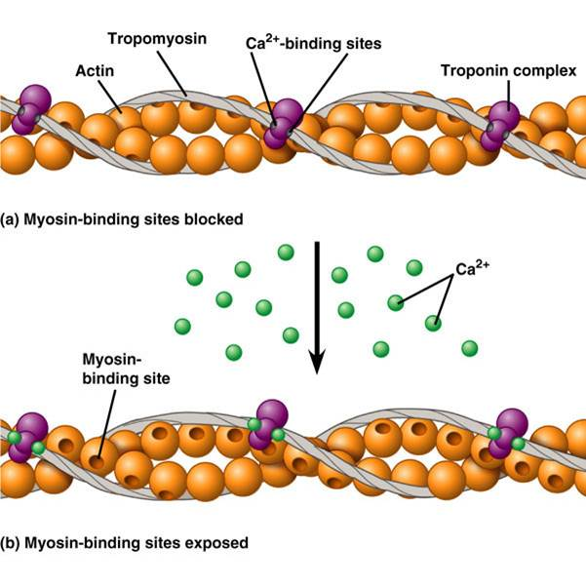
Tropomyosin complex
Strukture of TnT a TnI
Cardiac-specific isoforms
Imunochemical assay
TnC - no cardiac specificity

Slide 4
Possible causes of increased hypersensitive troponins

Slide 5
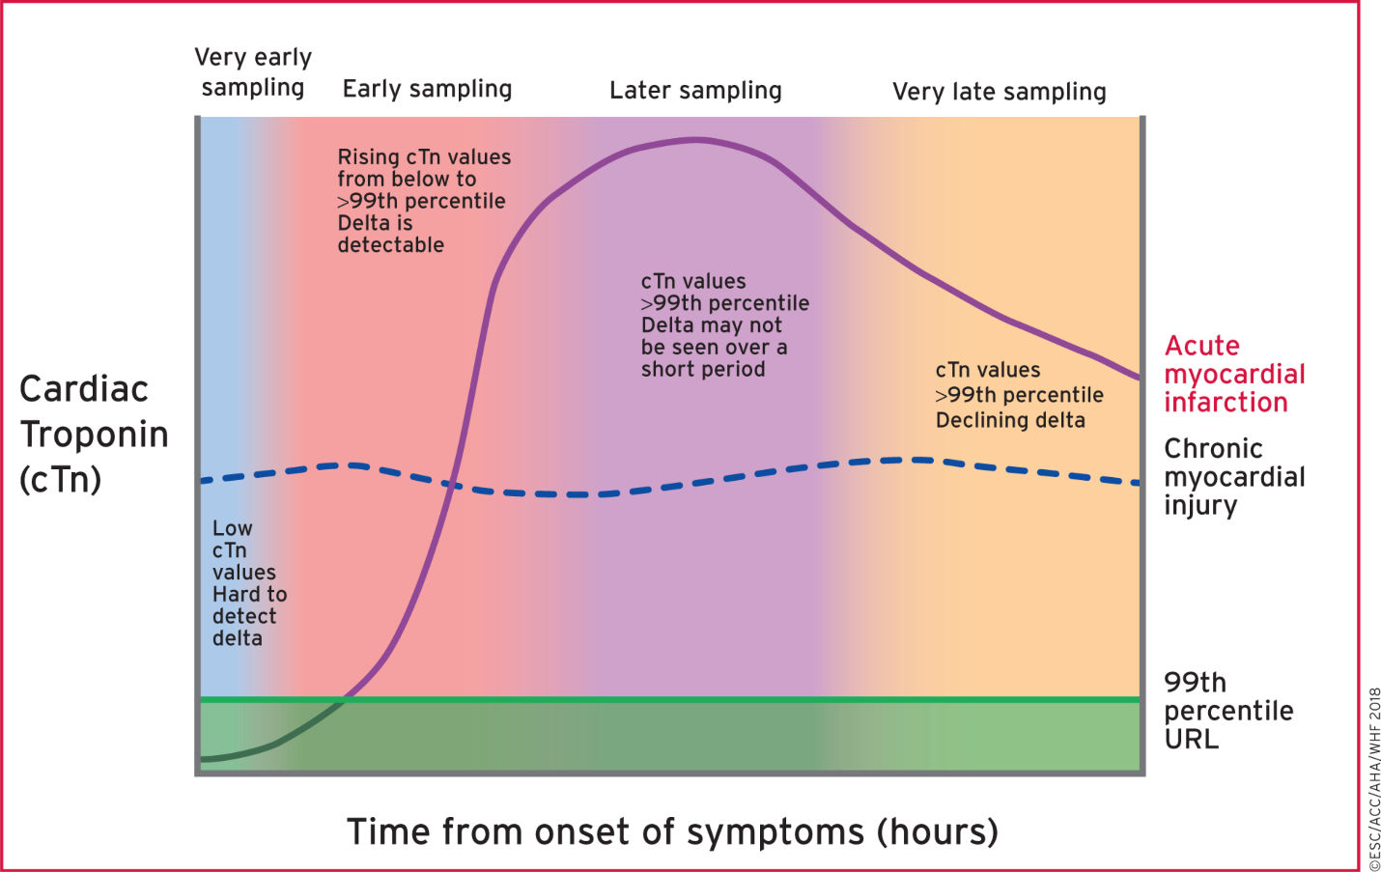
From: Fourth universal definition of myocardial infarction (2018)
Eur Heart J. Published online August 25, 2018. doi:10.1093/eurheartj/ehy462
Eur Heart J | This article has been co-published in European Heart Journal, Journal of the American College of Cardiology, Circulation, and Nature Reviews Cardiology. All rights reserved. © 2018 European Society of Cardiology, American College of Cardiology, American Heart Association, and World Heart Foundation. The articles are identical except for minor stylistic and spelling differences in keeping with each journal’s style. Any citation can be used when citing this article.This article is published and distributed under the terms of the Oxford University Press, Standard Journals Publication Model (https://academic.oup.com/journals/pages/open_access/funder_policies/chorus/standard_publication_model)
Notes:
Figure 7 Illustration of early cardiac troponin kinetics in patients after acute myocardial injury including acute myocardial infarction. The timing of biomarker release into the circulation is dependent on blood flow and how soon after the onset of symptoms samples are obtained. Thus, the ability to consider small changes as diagnostic can be problematic. In addition, many comorbidities increase cTn values and, in particular, hs-cTn values, so that elevations can be present at baseline even in those with myocardial infarction who present early after the onset of symptoms. Changes in cTn values or deltas can be used to define acute compared with chronic events, and the ability to detect these is indicated in the figure. Increased cTn values can often be detected for days after an acute event. cTn = cardiac troponin; URL = upper reference limit.
5

Slide 6
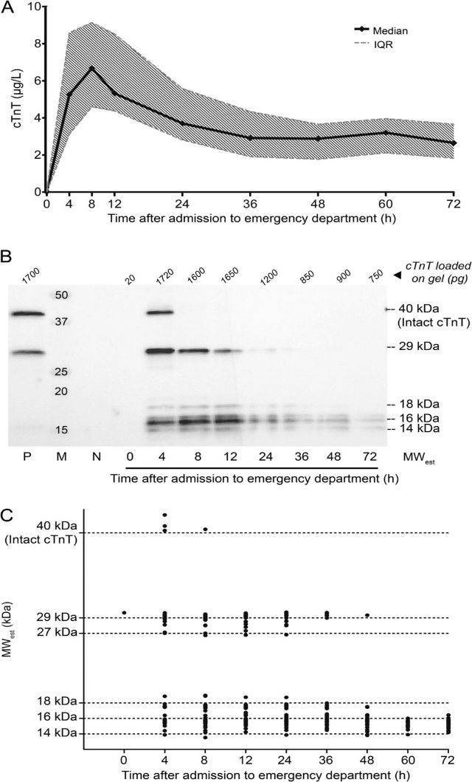
Troponin in the blood-mixture of intact molecules and grafts
Time-Dependent Degradation Pattern of Cardiac Troponin T Following Myocardial Infarction
Eline P.M. Cardinaels, Alma M.A. Mingels, Tom van Rooij, Paul O. Collinson, Frits W. Prinzen, Marja P. van Dieijen-Visser
DOI: 10.1373/clinchem.2012.200543 Published June 2013

Slide 7
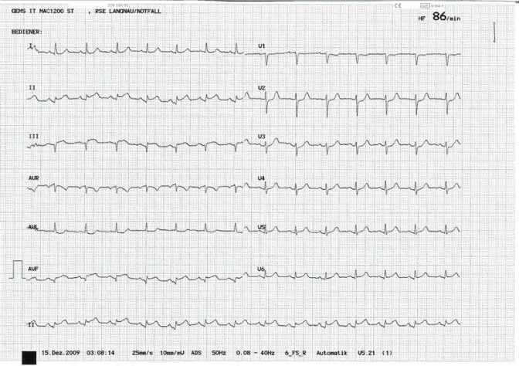
Diagnosis of AMI
Laboratory cTn
cTn >cut off
dynamics
History
ECG

Slide 8
Advantages of TnI, TnT in MI diagnostics
High specifity
Myocardial isoforms
High sensitivity
Very small MI lesions
Dynamics of Tn concentration changes
Multiple increase Tn level after MI
Increased Tn level continues 1-2 weeks
Delayed dignostics of MI

Slide 9
Clinical application of hs troponin T
First specimen at the time of first contact
Repeat specimen (to review the change) in 3 hours (1-2 hours)
99.percentil application
Application of the "delta" principle
Absolute - 10ng / l
Relative 20% (above 50ng / l)
50% 99(below 50ng/l)
Prognosis

Slide 10
Time course of cardiac markers
1000
100
10
Relative increase of markers
The upper limit of the reference values
1
0
Hours from the onset of stenocardia
Notes:
Lecture Notes

Slide 11
Casuistry 1
Men, 64 years old, brought by emergency medical service at 12:30
Strong retrosternal pain, spreading to the neck, sweating
(at 5 o´clock in the morning)
Duration about 20 minutes, relief after vomiting
In last 2 weeks occasional feeling of pressure on the chest during exercise (duration of about 10 minutes)

Slide 12
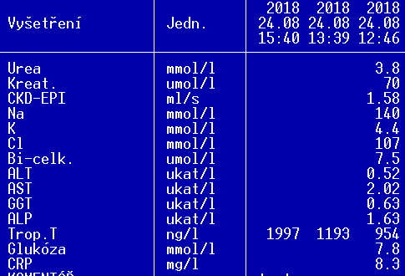
EKG: Q V1-5,elevation ST 0,5mm, negative T V1-V5
Dg: subacute transmural MI
PCI: prox. RIA +DES stent

Slide 13
Casuistry 2
Men, 44 years old
Retrosternal pains for about one year, spreading to the neck, troubles in the rest and also during excercise
Dg: IHD dg.VI/2018, sy AP, SKG - PCI ACS+DES,prox. RIA 30%,RC 40%
About 3 weeks after revascularization he was completely trouble-free, then it started to return

Slide 14
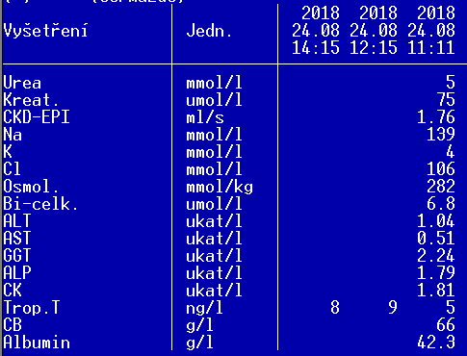
EKG : SR, TF 67/min
re SKG VIII/2018: complete revascularization
Ischemic heart disease without signs of ACS

Slide 15
Casuistry 3
Women 83 years old
Retrosternal pain, spreading do the neck and head
Now she feels uncomfortable, weakness, doesnt feel sure when walking

Slide 16
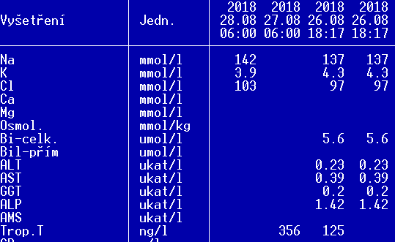
NSTEMI
EKG: SR, TF 79/min ,ST depression to 2 mm V3-V5
Therapy: dual antiagregation (ASA+clopidogrel)

Slide 17
Casuistry 5
Men 77 years old
Retrosternal pressure pain, duration about 30 minutes
Last few days same difficulties without dependence on exercise
EMS: supraventricular tachyarhrythmia 170/min, hypertensin

Slide 18
NSTEMI, supraventricular tachyarhythmia

Slide 19
Natriuretic peptides
Protein (peptide) hormones
Synthesis: myocard
Endothelium, kidney
Protect KV system against volume and pressure overload
Diuretic, natriuretic and hypotensive effects

Slide 20
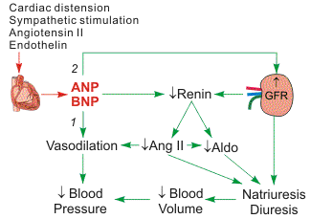
Mechanism of NP function
Kidney:
Inhibit Na reabsorption = natriuresis, diuresis
↓ blood volume
↓ renin secretion
↓ aldosteron
Blood vessels
Vasodilatation
CNS
↓ sympathetic

Slide 21
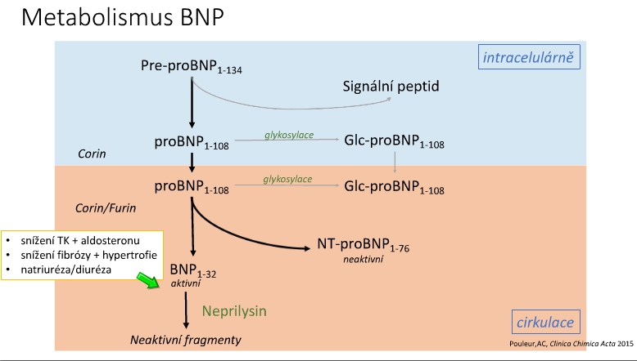

Slide 22
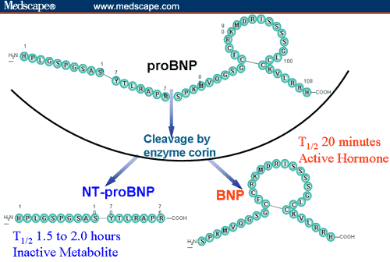
Synthesis of BNP: pro BNP
ProBNP - cleaved into 2 fragments: BNP, NT ProBNP
BNP: biological active polypeptide (32 AA)
NT-proBNP: biological inactive (76 amino acid, N-terminal)
Co-secreted with BNP
Half-life:
BNP: 18 min
NT-ProBNP: 2 h.

Slide 23
Clinical evaluation of NT-proBNP
Dg. of heart failure
Diff. dg. of dyspnoe
Cut-off levels for excluding heart failure (rule-out)
Chronic heart failure NT-proBNP < 125 pg/ml
Acute heart failure NT-proBNP < 300 pg/ml

Slide 24
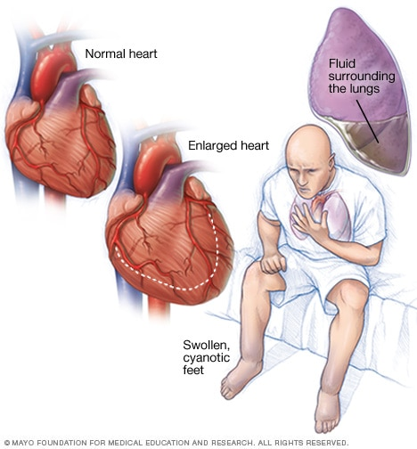
Acute heart failure – age dependance (NTpro BNP)
< 50 years cut-off 450 pg/ml
50-75 years cut-off 900 pg/ml
> 75 years cut-off 1800 pg/ml

Slide 25
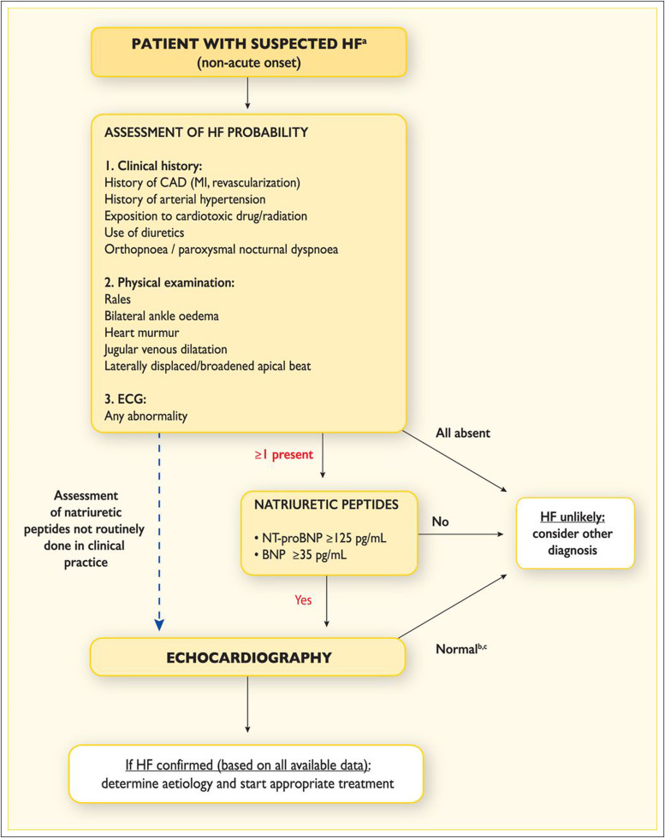

Slide 26
Casuistry 5
Woman,77 years old
Previously amputation of the lower limb for ischemic disease, atrial fibrillation
Symptoms: dyspnoe, febrilia, sweat

Slide 27
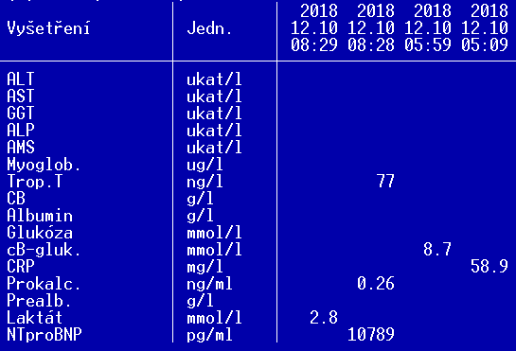
Atrial fibrillation with rapid ventricular response, heart failure

Slide 28
Kasuistika 6
Woman, 77 years old
Repeatedly hospitalized for chronic heart failure
Syndrom of angina pectoris, PCI -3x DES
NSTEMI (2008,2012)
Since the evening day before, shortness of breath, in the morning retrosternal pain (5:30). During the last week worsening of swelling of lower limbs.

Slide 29
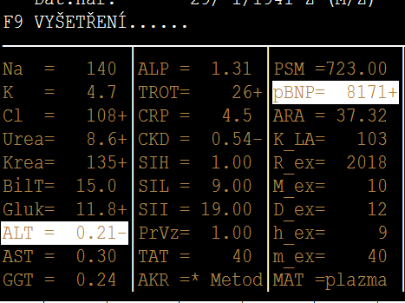
Obj: breathlessness, BP 170/60 SF 65 irreg
ECG atrial fibrillation 70/min ,
RTG: S+P – fluidothorax bilat.
Závěr: acute heart failure

