Slide 1
Metabolism of calcium and phosphates.
Regulation of bone remodelling.
Osteoporosis.
MUDr. Miroslava Hlaváčová, PhD.
Department of Biochemistry
Faculty of Medicine, Masaryk University

Slide 2
Calcium in the body:
the whole calcium
1.0 – 1.3 kg
body fluids
1 %
bones
99 %
ECF
0.1 %
ICF
0.9 %
Only free ionized calcium
is physiologically effective !!
ISF
blood plasma
375 mg
2.5 mmol/ l
50 % free, ionized Ca (1.25 mmol / l)
32 % Ca bound to albumin (pH dependent) (0.8 mmol / l)
8 % Ca bound to globulins (0.2 mmol / l)
10 % Ca in complexes with anions (0.25 mmol / l)
hydrogen carbonates,
lactate, phosphate, …

Slide 3
Biological effects of calcium:
signal transduction into cells (Ca – calmodulin complex)
building material (bones, teeth, calcifications)
neuromuscular irritability (hypocalcemia increase irritability, hypercalcemia increase contractility)
blood clotting

Slide 4
Daily need of calcium:
daily need of calcium is approx. 1g (≈ 25 mmol), older people and pregnant women 1.5g
(0.5l of milk or 65g of cheese or 250ml of yoghurt contains approx. 0.5g of calcium)
in childhood we can absorb 50% from daily intake, in adulthood only 10-40% (depend on need and vitamin D levels)

Slide 5
Sources of calcium:
appropriate sources
  dairy products from semi-skimmed milk
  fermented milk products (acidity improves absorption)
  some vegetable (cauliflower, endive, broccoli, Brussels sprout)
  marginal sources – poppy seeds, nuts, sardines, tap water (in Brno approx. 2-2.5 mmol Ca/l – 10% of daily need)
inappropriate sources
  spinach (formation of insoluble calcium oxalate)
  processed cheese (high content of phosphates → formation of insoluble calcium phosphates salts)
  high content of phosphates represent also Coca-Cola and similar beverages
  leafy vegetable with high content of magnesium (ideal ratio is 2:1)

Slide 6
Metabolism of bones:
1/ osteoblasts
formation of bones
2/ osteoclasts
resorption of bones
healthy bone has both processes in ballance
under pathological conditions predominates usually increased resorption

Slide 7
Bone remodelling :
complex process of coordinated activity of bone cells – osteoblasts, osteoclasts and osteocytes
functions:
  adaptation of bone to changing mechanical load
  reparation of small mechanical injuries, which accumulation can cause bone ageing
  replacement of old bone tissue by new one, mechanically more appropriate

Slide 8
Bone resorption:
osteoclasts resorb
the bone
border cells
covering the bone
the activation of bone resorption
~ 20 days
Notes:
Patofyziologie osteoporózy (3)
Pokud aktivita osteoklastu překročí osteblastickou aktivitu, kostní formace nemůže kompenzovat ztrátu kostní hmoty vzniklou resorpcí. Kostní hmota se jednoznačně zmenšuje. Mechanismus odpovědný za úbytek kosti obsahuje (American Medical Association, 2000) jevy
osteoklasty mohou tvořit nadměrně hluboké kvality, které nemohou být zaplněny osteoblasty
funkce osteoblastů může být oslabena do té míry, že normální lakuna není zaplněna
velký počet kostních remodelačních jednotek ve spojení s jedním ze dvou výše zmíněných bodů vede ke zvýšení ztráty kostní hmoty.

Slide 9
Bone formation:
osteoblasts placed a new osteoid
return osteoformation
~ 160 days
newly deposited osteoid is mineralizing for several month
Notes:
Patofyziologie osteoporózy (3)
Pokud aktivita osteoklastu překročí osteblastickou aktivitu, kostní formace nemůže kompenzovat ztrátu kostní hmoty vzniklou resorpcí. Kostní hmota se jednoznačně zmenšuje. Mechanismus odpovědný za úbytek kosti obsahuje (American Medical Association, 2000) jevy
osteoklasty mohou tvořit nadměrně hluboké kvality, které nemohou být zaplněny osteoblasty
funkce osteoblastů může být oslabena do té míry, že normální lakuna není zaplněna
velký počet kostních remodelačních jednotek ve spojení s jedním ze dvou výše zmíněných bodů vede ke zvýšení ztráty kostní hmoty.

Slide 10
Hydroxyapatite :
Ca₃(PO₄)₂
Ca₃(PO₄)₂
Ca²⁺
2 OH⁻
hydroxyapatite
is main structural part of the bones
≈ 65 % of weight of bones
Ca₃(PO₄)₂
3 Ca₃(PO₄)₂ • Ca(OH)₂
hydroxyapatite

Slide 11
Solubility product (K_{S}) :
 |  | K_{S}
calcium phosphate | Ca₃(PO₄)₂ | 2 • 10⁻³⁰
hydroxyapatite | Ca₅(PO₄)₃OH | 2,3 • 10⁻⁵⁹
fluorapatite | Ca₅(PO₄)₃F | 3,1 • 10⁻⁶⁰
[Ca²⁺]³ • [ PO₄³⁻ ]² = K_{S}

Slide 12
Inorganic phosphate ( P_{i} ) in serum:
[ P_{i} ] = 1 mmol / l
[ HPO₄²⁻ ]
= 4 : 1
( pH = 7.40 )
[ H₂PO₄⁻ ]
[ PO₄³⁻ ] = 0 !!
[Ca²⁺]³ • [ PO₄³⁻ ]² = K_{S}

Slide 13
Inorganic phosphate ( P_{i} ) in bones:
HPO₄²⁻ + OH⁻ → PO₄³⁻ + H₂O
H₂PO₄²⁻ + 2 OH⁻ → PO₄³⁻ + 2 H₂O
the formation of insoluble bone mineral → alkaline reaction
(remember ALP !!)
↑ [ PO₄³⁻ ]
[Ca²⁺]³ • [ PO₄³⁻ ]² = K_{S}
in the opposite in bone resorption

Slide 14
Osteocalcin:
= BGP = bone gamma carboxyglutamic acid-containig protein
contains 3 carboxyglutamates for calcium binding
regulates bone mineralisation
← (vitamin K)
γ-carboxy glutamic acid (Gla)
Ca²⁺ binding

Slide 15
Calcium homeostasis :
parathyrin (PTH, parathormone)
calcitonin (thyreocalcitonin)
calcitriol

Slide 16
parathyroid hormone (PTH)
most important regulator of extracellular level of Ca²⁺
formed in parathyroid glands, effective is 34-N-terminal end of the prohormone
secretion is tonic (cave hyperplasia!) and pulsatile
pulsatile secretion depends on calcemia, is also regulated by vitamin D3

Slide 17
Sensor of calcemia :
situated in parathyroid glands
receptor → G_{q} – protein → increase of calcemia in plasma cause increased influx of Ca²⁺ into cells → increased intracellular level of Ca²⁺ here has inhibitive effect (by contrast to others cells!)

Slide 18
Parathyrin - effects:
  defence against hypocalcemia
  bone:
    ↑ releasing of calcium and phosphorus from bones by effecting osteoclasts (through osteoblasts!)
  kidney:
    ↑ reabsorption of calcium from glomerular filtrate, ↓ reabsorption of phosphates (Ks!)
  ↑ synthesis of 1,25-vitamin D and this way increase an absorption of calcium from small intestine

Slide 19
Parathyrin – effects on bone:
  quick – in minutes
  slow – hours to days, continue even after decrease of PTH levels in plasma
  stimulates receptors of osteoblasts, they activate osteoclasts sequentially
  osteoblasts themselves are subdued at first, after several days PTH support their growth and osteoid formation
  PTH affects also osteocytes (mobilisation of calcium via osteocytic osteolysis)
  long-term permanent stimulation by PTH cause increased amount and activity of osteoclasts, low dosages of PTH intermittently applied increase bone formation!! (changed cellular signalling)

Slide 20
calcitonin
(thyreocalcitonin, 32 AA, C-cells of thyroid gland)
antagonist of PTH, effect is stimulated by estrogens
narrow significance for regulation – protection against sudden increase of calcemia (under physiological condition has minimal effect)
secretion is regulated by calcemia (sensor similar to parathyroid glands)
subdue bone resorption by inhibition of osteoclasts, support formation of bone matrix (therapy of osteoporosis)
inhibits resorption of calcium and phosphates in kidneys → increase calciuria and phosphaturia
analgesic effects on bone pain

Slide 21
calcitriol
calcidiol is main metabolite of vitamin D in plasma (< 10 μmol/l, seasonal differences, t_{1/2} ≈ 20-30 d, bond to vitamin D-binding protein)
7-dehydrocholesterol (liver)
calciol (skin, UV )
25 - calcidiol (liver, 25-hydroxylase)
1,25 - calcitriol (kidney, 1-hydroxylase)
inhibition: ↑ calcitriol and calcitonin
abundance of ingested calcium
stimulation: PTH during hypocalcemia
somatotropin, prolactin

Slide 22
Calcitriol – effects in calcium metabolism:
enterocytes
  increase absorption, transport through enterocytes and releasing to plasma
  increase also absorption of phosphates
kidneys
  increase resorption of calcium in renal tubules

Slide 23
Calcitriol – effects in calcium metabolism II
bones
  complex effects, maintain balance between formation and resorption of bones
  during hypocalcemia increases resorption of bones by coordinated activity of osteoblasts and osteoclasts
  under favourable conditions increases incorporation of calcium into bones
interaction with PTH
  calcitriol inhibits the synthesis and secretion of PTH – it serves as negative feedback on calcitriol synthesis (PTH stimulates the synthesis of calcitriol)

Slide 24
Calcitriol – other effects:
receptors are situated in many tissues (heart, vessels, stomach, liver, brain, ......)
regulates cellular differentiation and proliferation
inhibits cellular growth
stimulate the secretion of insulin
inhibits the production of renin
cells of immune system have a receptor for vitamin D, some of them even produce calcitriol
→ vitamin D has immunomodulatory effect!

Slide 25
calcitriol – other effects II:
deficit of calcitriol increase a risk of many diseases:
  autoimmune diseases (DM type I, sclerosis multiplex, rheumatiod arthritis)
  tumours (colorectal, prostatic and breast cancer)
  cardiovascular diseases
  DM type II
  psychiatric diseases (schizophrenia, depression)
in Europe have lack of vitamin D 30% of population, among older people it is even 75%

Slide 26
Additional regulators of bone metabolism
estrogens
growth hormone/somatotropin
thyroid hormones
glucotropic hormones cortisol and insulin
local factors (system RANK/OPG, Wnt/sclerostin)

Slide 27
estrogens
complex effect
decrease the effect of PTH and thyroid hormones
inhibit the releasing of cytokines from osteoblasts (and so decrease the activity of osteoclasts)
the effect on regulation of calcitonin and calcitriol is assumed
deficit of estrogens increase the production of TNF alfa, IL-1 a IL-6 which have pro-resorptive effect

Slide 28
growth hormone
it stimulates 1α- hydroxylase (vitamin D)
increase bone turnover with predominance of osteoformation
influences also absorption of calcium
stimulates proliferation of osteoblasts

Slide 29
thyroid hormones
important for bone development during fetal life, for bone remodelling in childhood and for remodelling cycles in adulthood (hyperthyreosis accelerates them, hypothyreosis decelerates)
necessary for formation and maturation of bone cells
they potentiate one another with growth hormone
stimulate production of IGF-1 (growth factor)

Slide 30
4a. insulin
anabolic hormone
supports osteoblastogenesis
inhibits the activity of osteoclasts
influences biomechanical qualities of bones
has synergic effect with other hormones
diabetics (type I) are in higher risk of osteoporosis

Slide 31
4b. cortisol
decreases the absorption of calcium from small intestine
decreases the formation of collagen in bones
influences formation and functions of osteoblasts in a negative way
limiting dose for osteoporosis development is 7.5 mg of prednison/d, osteoporosis can develop after several months of drug administration

Slide 32
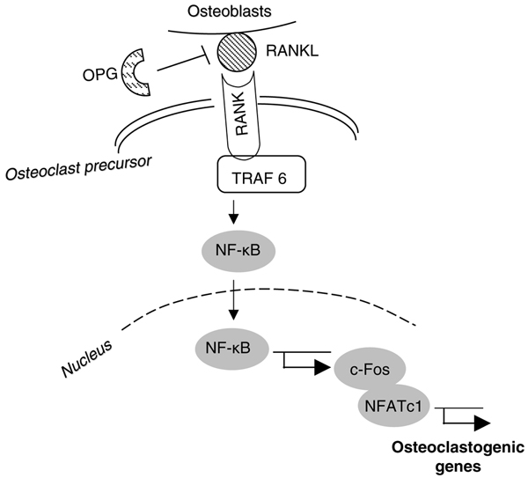
5a. system RANK/OPG
(receptor activator NF-κB)
(ligand)
(osteoprotegerin)
(adaptor protein)
(nuclear factor kappa B)

Slide 33
5b. sclerostin and Wnt
activation of Wnt signal pathway leads to increased proliferation and diferentiation of osteoblasts
main inhibitor of this pathway is sclerostin – glycoprotein produced by osteocytes
sclerostin defend Wnt from binding on its receptor and blocks bone formation

Slide 34
OSTEOPOROSIS

Slide 35
Osteoporosis :
systemic skeleton disease
decrease in bone density
disruption of microarchitecture of bone tissue
increase in bone fragility
higher risk of fractures
decrement of bone tissue is proportional!! (= decrement of minerals and proteins equally)
(in contrast to osteomalacia = defect in bone mineralisation, but organic matrix is untouched)

Slide 36
in Czech republic suffer from osteoporosis every 3rd woman and every 5th man

Slide 37
Common places of osteoporotic fractures:
spine*
hip*
distal radius*
proximal humerus
*places of BMD measurement

Slide 38
Risk factors of osteoporosis:
female gender
advancing age
Caucasian race
family history (especially in men)
low BMI
smoking and alcohol consuming
inadequate nutrition
previous fractures
immobilisation
use of glucocorticoids and other medicaments
endokrinopathies
noninfluencable factors
influencable factors

Slide 39
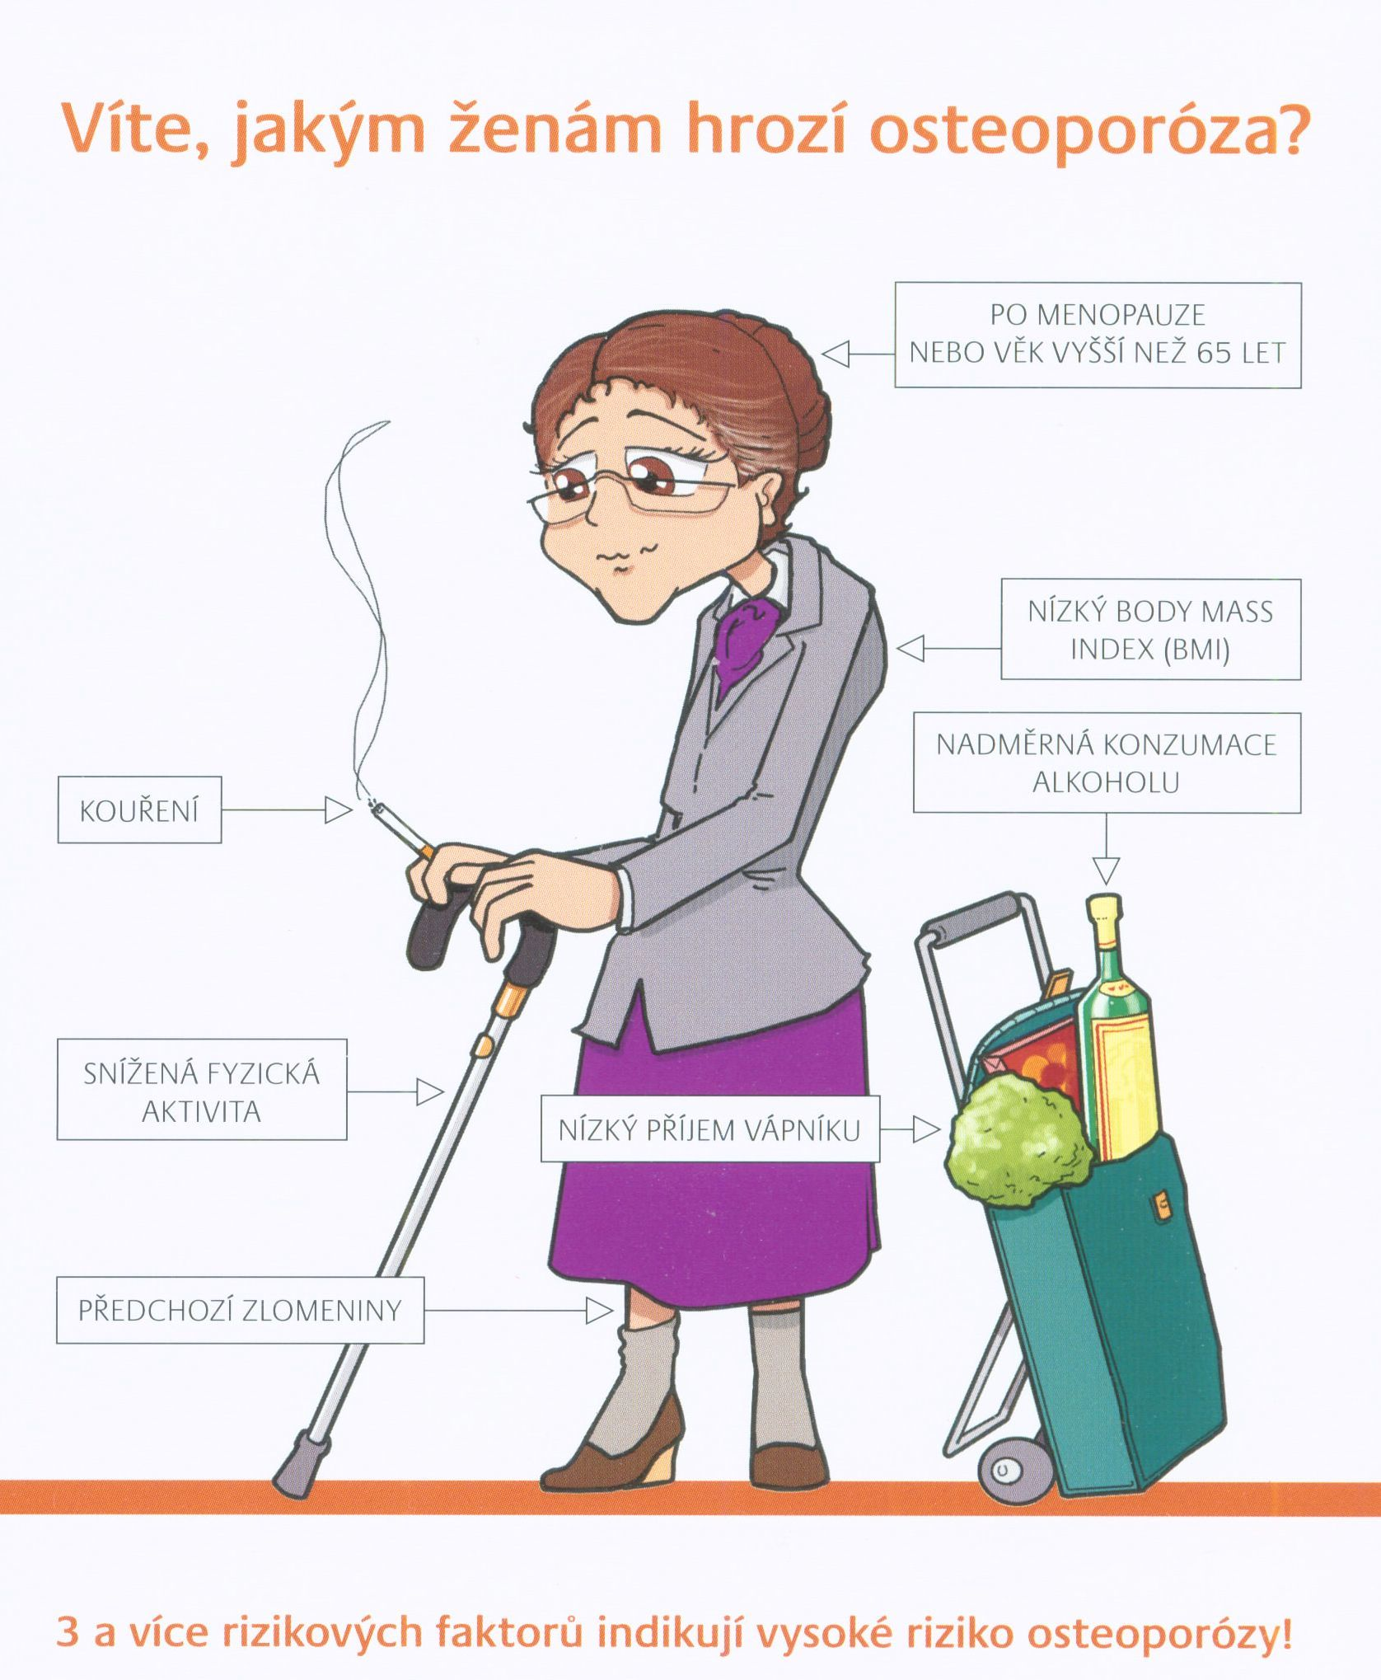
picture of typical patient in high risk of osteoporosis

Slide 40
Classification of osteoporosis:
1/ primary
• juvenile
• in adults postmenopausal
senile (involutional)
2/ secondary

Slide 41
Secondary osteoporosis:
endocrinopathies (hyperparathyreosis, m. Cushing, thyreotoxicosis)
systemic inflammatory diseases (rheumatoid arthritis)
nutrition disorders, asthenic habitus (BMI under 19)
renal osteodystrophy (→ secondary hyperparathyreosis)
inactivity
tumours (breast, ovarian, prostate, testicular, thyroid cancer)
drugs (corticosteroids, antiepileptics, heparin, loop diuretics, SSRI, inhibitiors of aromatase)

Slide 42
Diagnostics of osteoporosis
anamnesis and clinical investigation
bone mineral density (BMD) measurement
laboratory tests

Slide 43
BMD measurement
BMD is important and quantifiable risk factor of osteoporosis
BMD is expressed in:
  absolute values (g of mineral per cm²)
  standard deviation (SD)
  → T-score and Z-score – they express how is the value of BMD different from mean

Slide 44
T-score vs. Z-score
T-score is comparison of patient‘s BMD to mean BMD of healthy human between the ages of twenty and thirty, of the same gender and race
  used more often, correlates with risk of fracture
Z-score is comparison of patient‘s BMD to mean BMD of healthy human of the same age group, gender and race
  shows future development of BMD in patients
  normal distribution in statistics = Z distribution

Slide 45
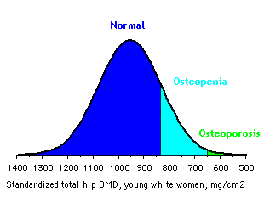
Diagnosis of osteoporosis (WHO) :
BMD (T-score, SD) | diagnosis
-1 and more | normal
-1 to -2.5 | osteopenia
-2.5 and less | osteoporosis
-2.5 and less + fx | severe osteoporosis

Slide 46
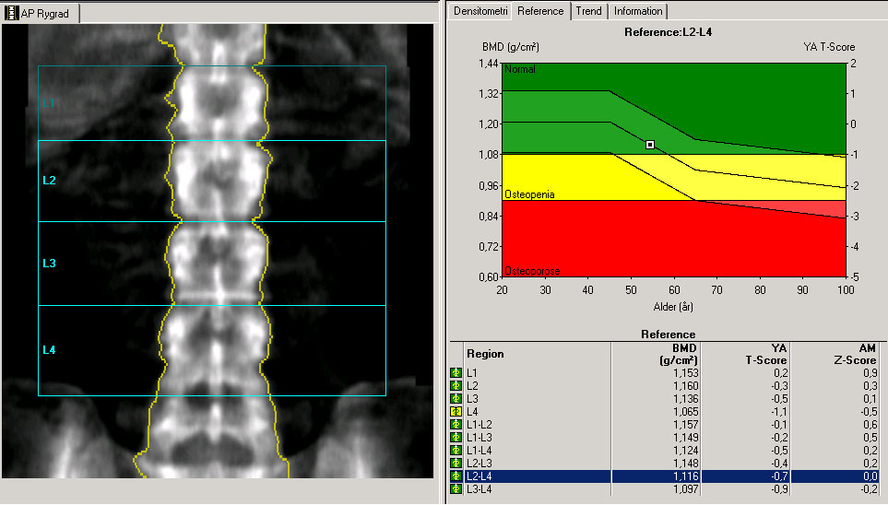
https://www.sundhed.dk/borger/sygdomme-a-aa/hormoner-og-stofskifte/illustrationer/billeddiagnostik/rygsoejle-dxa-skanning-normalbillede/

Slide 47
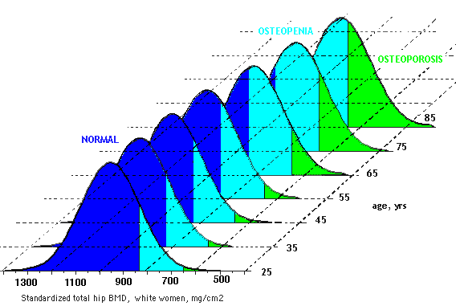
BMD, age and osteoporosis:
Notes:
Diagnosis and assessment (9)
Aging inevitably leads to a decline in bone mass, independent of sex. The 10-year probability of having a fracture of arm, spine or hip increases as much as 8-fold between the ages of 45 and 85.

Slide 48
Laboratory tests
basic tests
biochemical markers of bone turnover
tests within the scope of different diagnosis of secondary osteoporosis and other metabolic diseases of skeleton (indications depend on anamnesis)

Slide 49
Basic tests
calcium and phosphates in plasma
creatinin (renal function)
ALP
calciuria (for 24 hours)
vitamin D (total, izoforms)

Slide 50
Assessment of bone turnover
markers of resorption
  pyridinoline (PYR) and deoxypyridinoline (DPD) in urine
  hydroxyproline a hydroxylysine in urine
  tartrate-resistant acid phosphatase 5b (TRAP5b)
  C-terminal telopeptide of type I collagen (CTx or ICTP) in serum
  N-terminal telopeptide of type I collagen (NTx or INTP) in serum
  (sclerostin)
markers of formation
  bone isoenzyme of alkaline phosphatase (bALP) in serum
  osteocalcin in serum
  procollagen type I N-terminal propeptide (P1NP) in serum
  procollagen type I C-terminal propeptide (P1CP) in serum
less frequent
released from osteoblasts

Slide 51
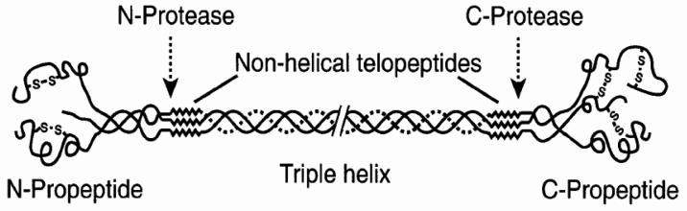
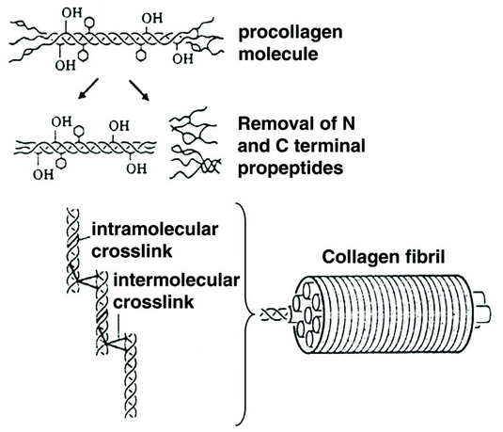
Procollagen type 1 - structure
Collagen 1 – cross links

Slide 52
Markers of bone formation and resorption:
P1NP
markers of formation
(propeptides)
P1CP
NTx
CTx
markers of resorption
(cross-linking telopeptides)

Slide 53
Clinical evidence of markers:
evaluation of bone remodelling severity
speed of bone density decrease („fast vs. slow bone losers“)
prediction of fracture risk independently from BMD value
monitoring of treatment (they react quickly by contrast to BMD)
NOT for differential diagnosis (most metabolic diseases of skeleton cause quantitative, not qualitative changes of bone remodelling)

Slide 54
Treatment of osteoporosis
nutrition, lifestyle, exercise
calcium + vitamin D
bisphosphonates
*strontium ranelate
*HRT – hormone replacement therapy
SERM – selective estrogen receptor modulator
*calcitonin
teriparatide and PTH
denosumab – monoclonal antibody against RANKL
romosozumab - monoclonal antibody against sclerostin
*less frequently used for treatment

Slide 55
1. Nutrition, lifestyle, exercise
important for every patient – minimisation of fracture risk
varied diet with enought calcium and vitamins
low phosphates and sodium intake (sodium increase renal elimination of calcium!)
appropriate BMI (both extremes are negative)
low consumption of alcohol, stop smoking
EXERCISE!!! (walking, hiking, cycling, swimming, pilates, yoga)
falls prevention

Slide 56
2. Calcium + vitamin D
automatically administered
calcium dose is 800 – 1200mg as calcium carbonate, citrate or lactate
vitamin D dose is 800 – 1000 IU as calciol, exist also formulations with active form of vitamin D (1,25-dihydroxyvitamin D3)

Slide 57
3. Bisphosphonates
most often treatment used not only of osteoporosis, but also in oncology and other branches
mechanism of action – they bind on bone surface and interfere with osteoclasts‘ enzymatic activity, disarray cytoskeletal structure and increase their apoptosis
effect continues months to years after treatment termination
side effects – mostly gastrointestinal discomfort, osteomyelitis and necrosis of jaw bone

Slide 58
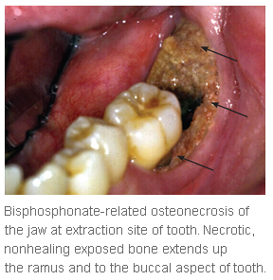
http://www.aafp.org/afp/2012/0615/p1134.html

Slide 59
4. Strontium ranelate
dual effect – it stimulates formation of bone and protects against decrease of BMD
improve mechanical characteristics of bone
side effects – contraindication is the anamnesis of venous thrombosis and the presence of risk factors of thrombosis or cardiovascular diseases, because higher incidence of heart attack was proved
dual effect was disputed lately
approved only as a last possibility when other treatment is impossible due some reasons

Slide 60
5. Hormone replacement therapy
artificial estrogens which balance hormone levels after menopause
due to higher risk of breast cancer and cardiovascular diseases (thrombosis, heart attack, stroke) is the only indication for their use climacteric syndrome (premature or surgically induced menopause)
phytoestrogens – plant derived compounds included in food supplements, effect on osteoporosis was not proved, but they can improve menopausal symptoms (hot flashes, night sweats)

Slide 61
6. Selective estrogen receptor modulators
effect is different in different receptors:
  estrogen agonists in bone and cardiovascular system (improve lipid profile in blood)
  estrogen antagonists in breast and uterus
appropriate mostly for younger women with higher risk of spinal fractures and breast cancer
from this group only ramoxifen approved specifically for osteroporosis treatment

Slide 62
7. Calcitonin
defend from bone resorption by direct effect on osteoclasts
salmon calcitonin is used
presently is not very used for treatment of osteoporosis
is used for short-term treatment of Paget disease and hypercalcemia because of bone metastases (here is the advantage its analgesic effect)

Slide 63
8. Teriparatide and PTH
teriparatide – terminal sequence of PTH with the highest biological effects
core of its effect is intermittent administration of small doses, which has osteoanabolic effects on trabecular and cortical bone
it changes the regulation of gene expression and system RANK/OPG
highly effective but expensive ☹ (very strict indication criteria)
subcutaneous administration can discourage patients from usage

Slide 64
9. Denosumab
specific monoclonal antibody against RANKL (act as osteoprotegerin)
effective and safe form of treatment without severe contraindications
administration is once per six months ☺
rare side effect is necrosis of jaw bone (similar to bisphosphonates)

Slide 65
10. Romosozumab
specific monoclonal antibody against sclerostin
it is simply inhibitor of inhibitor → inhibits the bond of sclerostin and supports osteoformation via Wnt signalling pathway
increase BMD more then bisphosphonates and PTH
clinical studies are still in progress
subcutaneous administration

Slide 66

Thank you for your attention.

