Slide 1
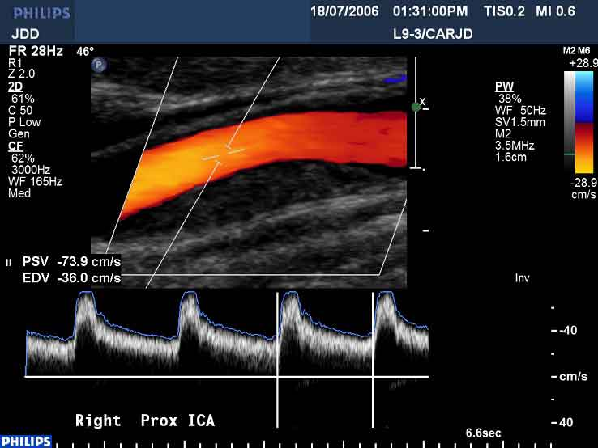
How to understand ultrasound diagnostics?
Vladan Bernard
Department of Biophysics
2020

Slide 2
Lecture outline
introduction to ultrasound
physical properties of ultrasound and medium
classification of methods
mode A, B and 3D, 4D imaging
doppler methods
contrast media
safety, risks

Slide 3

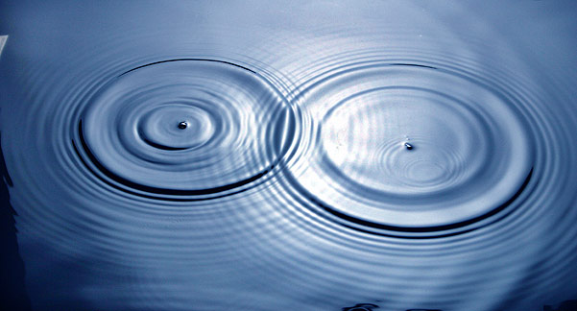
Ultrasound
listen to the comment, others are in better quality
Ultrasound (US) is mechanical oscillations with frequency above 20 kHz which propagate through an elastic medium.
Ultrasound is similar physical phenomenon as the sound; the sound is described by characteristic frequencies from 16 Hz to 16 kHz
In liquids and gases, US propagates as longitudinal waves.
In solids, US propagates also as transversal waves.
t
l
direction of propagation

Slide 4
Physical properties
Physical properties of ultrasound
wavelength: λ is usually determined by considering the distance between consecutive corresponding points of the same phase, such as crests, troughs, or zero crossings, and is a characteristic of both traveling waves and standing waves, as well as other spatial wave patterns.
frequency:f is the number of occurrences of a repeating event per unit time
intensity: intensity I of beam US at a point is the amount of energy passing through unit cross-sectional area perpendicularly to the beam per unit time at that point. Intensity is expresed in Joule/second/square centimetre.Intensity can be specified as Watts/square centimetre (W=J/s)

Slide 5
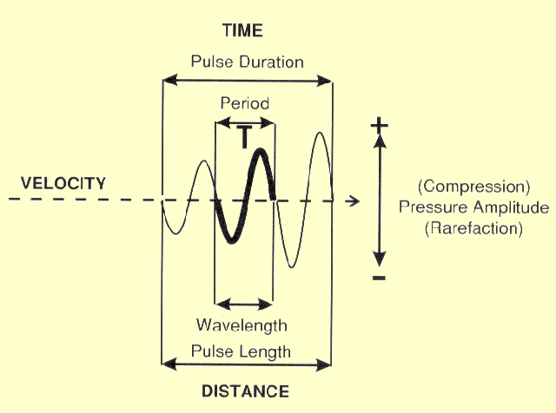
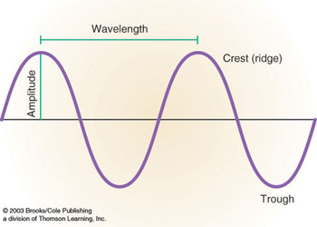
Physical properties
Amplitude may be in the case of ultrasound wave define as a sound pressure level at a given point, for example ( or as displacement of mass point in space).
pressure
time

Slide 6
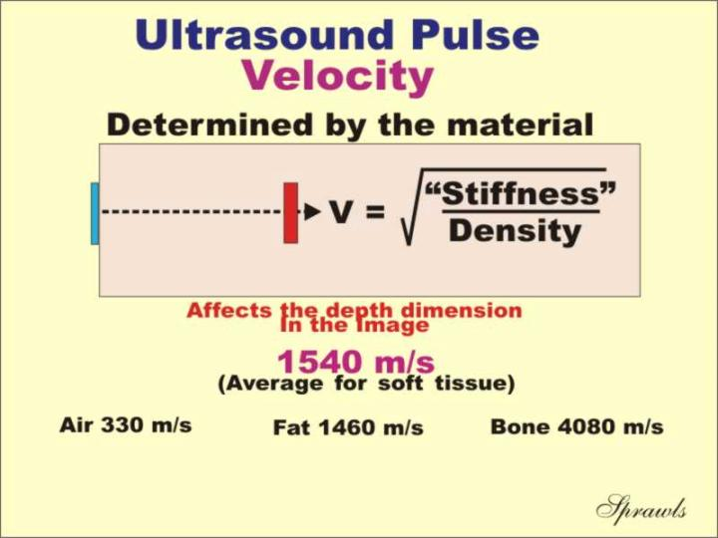
Physical properties
Speed of US c depends on elasticity and density ρ of the medium:
K - modulus of compression, in water and soft tissues c = 1500 - 1600 m.s⁻¹, in bone about 3600 m.s⁻¹
Approximate Velocity of Sound in Various Materials
Material | Velocity (m/sec)
Fat | 1450
Water | 1480
Soft tissue (average) | 1540
Bone | 4100

Slide 7
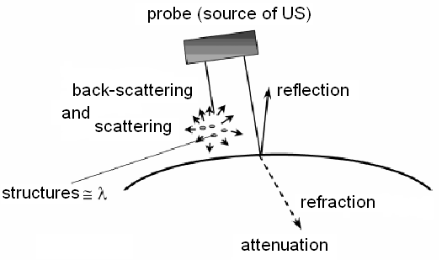
Physical properties
Physical properties of medium
Interaction of US with medium – reflection and back-scattering, refraction, attenuation (scattering and absorption)

Slide 8
Physical properties
Physical properties of medium
Attenuation of US expresses decrease of wave amplitude along its trajectory. It depends on frequency
I_{x} = I_{o} e^{-2αx} α = α´.f²
I_{x} – final intensity, Io – initial intensity, 2x – medium layer thickness (reflected wave travels „to and from“), α - linear attenuation coefficient (increases with frequency).
Since
α = log₁₀(I₀/I_{X})/2x
we can express α in units dB/cm. At 1 MHz: muscle 1.2, liver 0.5, brain 0.9, connective tissue 2.5, bone 8.0

Slide 9
Physical properties
Physical properties of medium
I or P
[dB]
attenuation
Attenuation of ultrasound
When expressing intensity of ultrasound in decibels, i.e. as a logarithm of I_{x}/I₀, we can see the amplitudes of echoes to decrease linearly.
depth [cm]

Slide 10
Physical properties
US reflection and transmission on interfaces
We suppose perpendicular incidence of US on an interface between two media with different Z (Acoustic impedance – following page) - a portion of waves will pass through and a portion will be reflected (the larger the difference in Z, the higher reflection).
P₁ Z ₂ - Z ₁
R = ------- = ---------------
P Z₂ + Z₁
P₂ 2 Z ₁
D = ------- = ---------------
P Z₂ + Z₁
P – acoustic pressure
Coefficient of reflection R – ratio of acoustic pressures of reflected and incident waves
Coefficient of transmission D – ratio of acoustic pressures of transmitted and incident waves

Slide 11
Physical properties
Acoustic parameters of medium
Acoustic impedance: product of US speed c and medium density ρ
Z = ρ . c (Pa. m/s)
Acoustic impedance Z: muscles 1.7, liver 1.65 brain 1.56, bone 6.1, water 1.48 (x 10⁻⁶)
Physical quantity describing the „willingness“ of tissue to transmit ultrasound. How to easy propagate ...

Slide 12
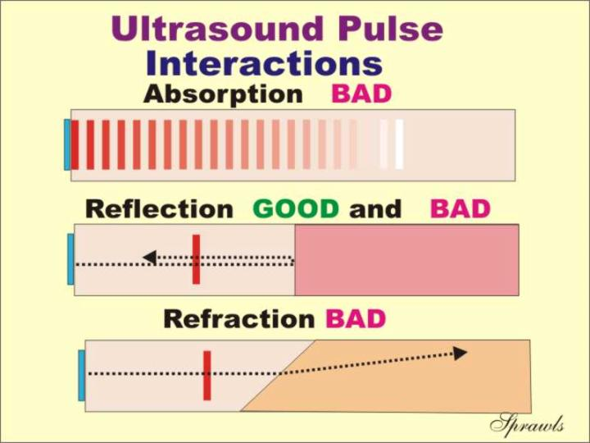
Types of Ultrasound Pulse Interactions
As an ultrasound pulse passes through matter, such as human tissue, it interacts in several different ways. Some of these interactions are necessary to form an ultrasound image, whereas others absorb much of the ultrasound energy or produce artifacts and are generally undesirable in diagnostic examinations. The ability to conduct and interpret the results of an ultrasound examination depends on a thorough understanding of these ultrasound interactions.

Slide 13
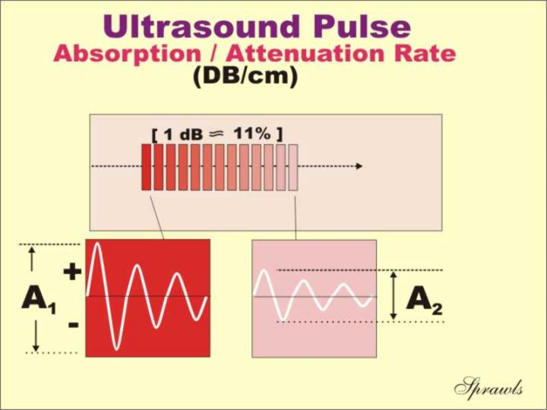
Absorption
As the ultrasound pulse moves through matter, it continuously loses energy. This is generally referred to as attenuation. Several factors contribute to this reduction in energy. One of the most significant is the absorption of the ultrasound energy by the material and its conversion into heat. Ultrasound pulses lose energy continuously as they move through matter. This is unlike x-ray photons, which lose energy in "one-shot" photoelectric or Compton interactions. Scattering and refraction interactions also remove some of the energy from the pulse and contribute to its overall attenuation, but absorption is the most significant.

Slide 14
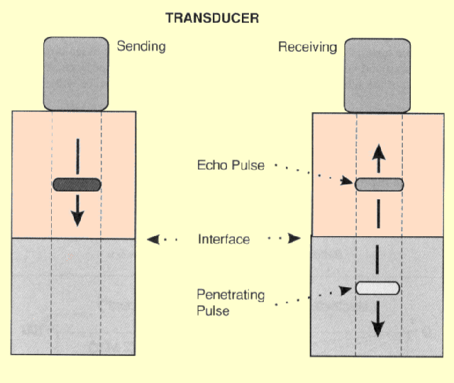
Reflection
At most interfaces within the body, only a portion of the ultrasound pulse is reflected. The pulse is divided into two pulses, and one pulse, the echo, is reflected back toward the transducer and the other penetrates into the other material, as shown in the figure. The brightness of a structure in an ultrasound image depends on the strength of the reflection, or echo. This in turn depends on how much the two materials differ in terms of acoustic impedance Z.

Slide 15
Ultrasonography X Ultrasound
Ultrasonography – diagnostic method, used reflection of ultrasound
Characteristic:
Passive US – low intensity waves which cannot cause substantial changes of medium.
In US diagnostics (ultrasonography = sonography = echography) - used frequencies are 2 - 40 MHz with (temporal average, spatial peak) intensity of about 1 kW/m²
Impulse reflection method: a probe with one transducer which is source as well as detector of US impulses. A portion of emitted US energy is reflected on the acoustic interfaces and the same probe then receives reflected signal. After processing, the signal is displayed on a screen.

Slide 16
Ultrasonography
US probe
-source
US wave
object
reflection
intensity
US probe
-detector
detection (time, intensity)
reflection
detection (time, intensity)
time

Slide 17
Ultrasonography
US probe
US wave
object
reflection
intensity
US probe
-detector
detection (time, intensity)
detection (time, intensity)
time

Slide 18
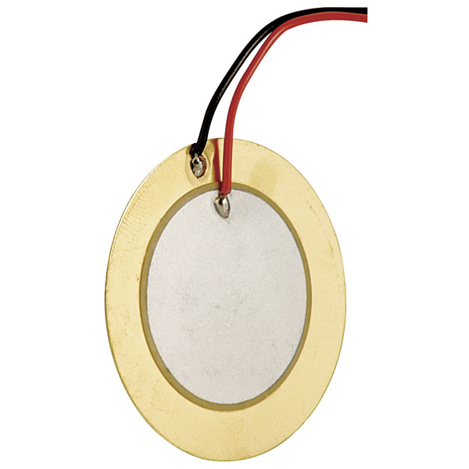
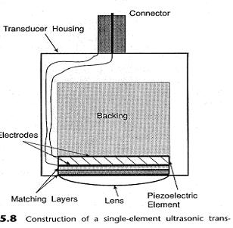
Supplement - piezo element
Material that changes its conformation when an electric pulse is present. Attached AC causes vibration of the material and following mechanic vibration of tissue.

Slide 19
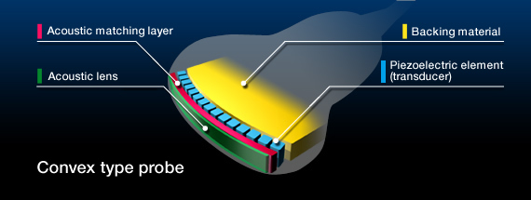
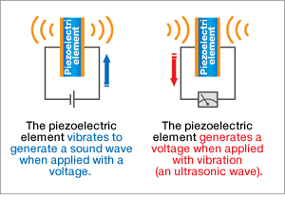
Supplement – ultrasound probe 1
The piezoelectric element is an essential part of the probe to generate ultrasonic waves. On both sides of the piezoelectric element electrodes are affixed and a voltage is applied. The element then oscillates by repeatedly expanding and contracting, generating a sound wave. When the element is externally applied with viblation (or an ultrasonic wave) in turn, it generates a voltage.
Among the several types of piezoelectric elements, piezoelectric ceramic (PZT: lead zirconate titanate) is most commonly used because of its high conversion efficiency.
http://www.ndk.com

Slide 20
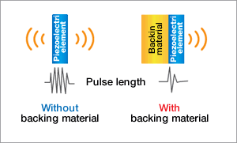
Supplement – ultrasound probe 2
The backing material is located behind the piezoelectric element to prevent excessive vibration.
Reducing excessive vibration will cause the element to generate ultrasonic waves with a shorter pulse length, improving axial resolution in images.
http://www.ndk.com

Slide 21
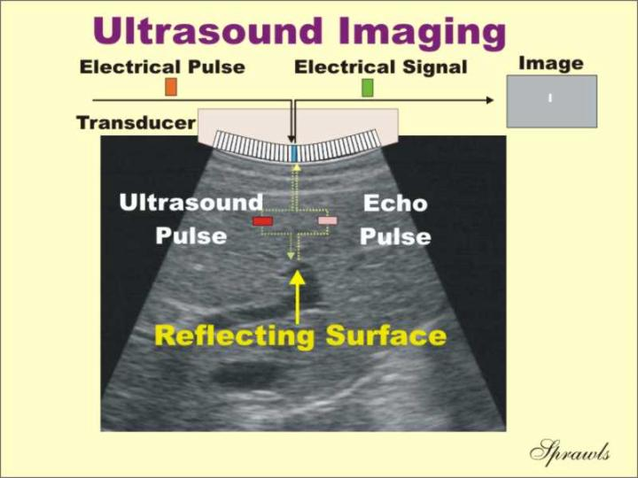
The Basic Ultrasound Imaging Process
The transducer is the component of the ultrasound imaging equipment that is placed in direct contact with the patient's body. It performs several functions. It's first function is to produce the ultrasound pulses when electrical pulses are applied to it. A short time later, when echo pulses return to the body surface they are picked up by the transducer and converted back into electrical pulses that are then processed by the system and formed into an image.

Slide 22
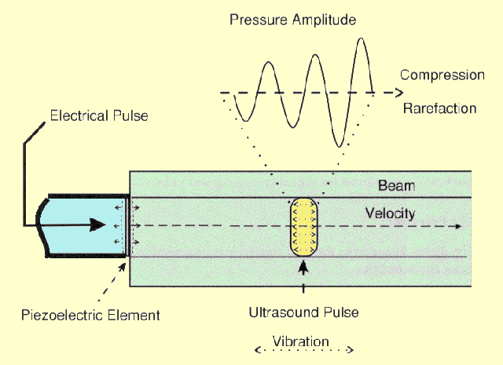
Principles of generation of ultrasound pulse
The source of sound is a vibrating object, the piezoelectric transducer element. Since the vibrating source is in contact with the tissue, it is caused to vibrate. The vibrations in the region of tissue next to the transducer are passed on to the adjacent tissue. This process continues, and the vibrations, or sound, is passed along from one region of tissue to another. The rate at which the tissue structures vibrate back and forth is the frequency of the sound. The rate at which the vibrations move through the tissue is the velocity of the sound.

Slide 23
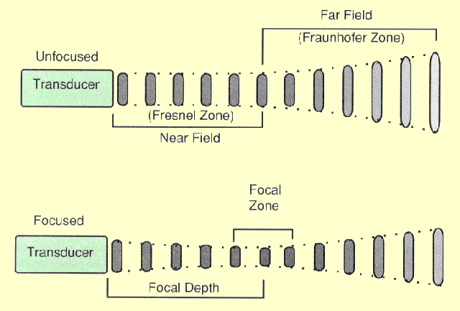
Transducer Focusing
Transducers can be designed to produce either a focused or non-focused beam, as shown in the following figure. A focused beam is desirable for most imaging applications because it produces pulses with a small diameter which in turn gives better visibility of detail in the image. The best detail will be obtained for structures within the focal zone. The distance between the transducer and the focal zone is the focal depth.

Slide 24
A-mode – one-dimensional
Distances between reflecting interfaces and the probe are shown.
Reflections from individual interfaces (boundaries of media with different acoustic impedances) are represented by vertical deflections of base line, i.e. the echoes.
Echo amplitude is proportional to the intensity of reflected waves (Amplitude modulation)
Distance between echoes shown on the screen is approx. proportional to real distance between tissue interfaces.
Today used mainly in ophthalmology.
A-mode shows reflections of ultrasound in the axis of US wave
intensity
time (s) - distance (m)

Slide 25
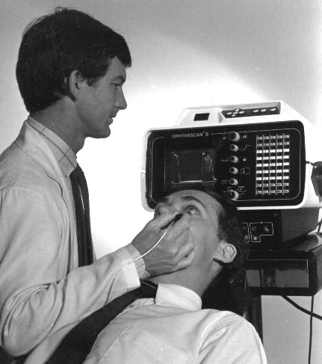
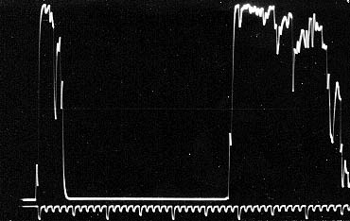
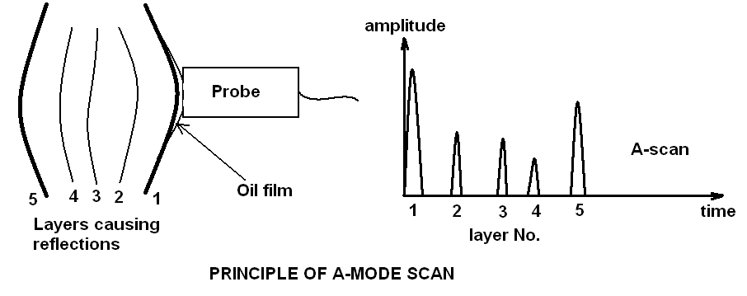
A-mode – one-dimensional

Slide 26
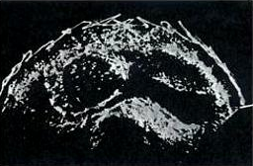
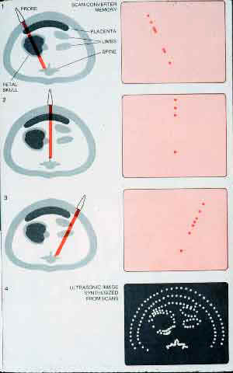
B-mode – two-dimensional
A tomogram is depicted.
Brightness of points on the screen represents intensity of reflected US waves (Brightness modulation).
Static B-scan: a cross-section image of examined area in the plane given by the beam axis and direction of manual movement of the probe on body surface. The method was used in 50‘ and 60‘ of 20th century

Slide 27
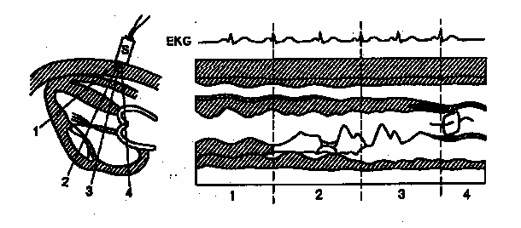
M-mode
One-dimensional static B-scan shows movement of reflecting tissues. The second dimension is time in this method.
Static probe detects reflections from moving structures. The bright points move vertically on the screen, horizontal shifting of the record is given by slow time-base.
Displayed curves represent movement of tissue structures

Slide 28
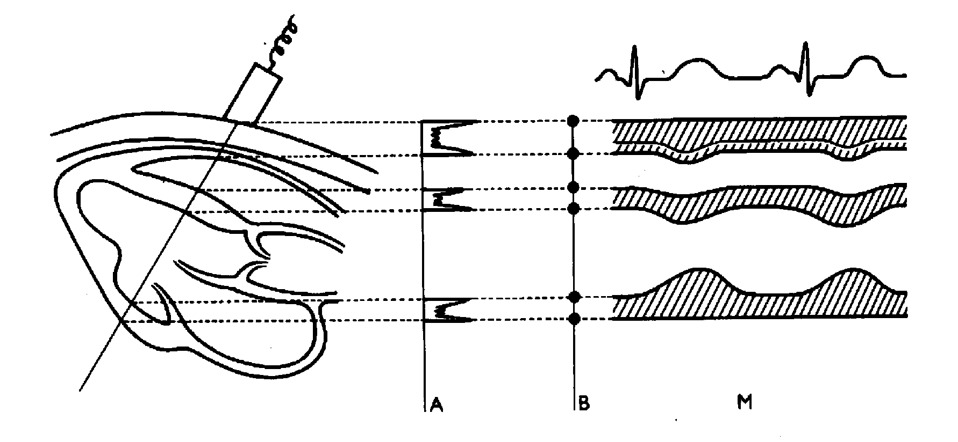
Comparison of A-, B- and M-mode principle

Slide 29
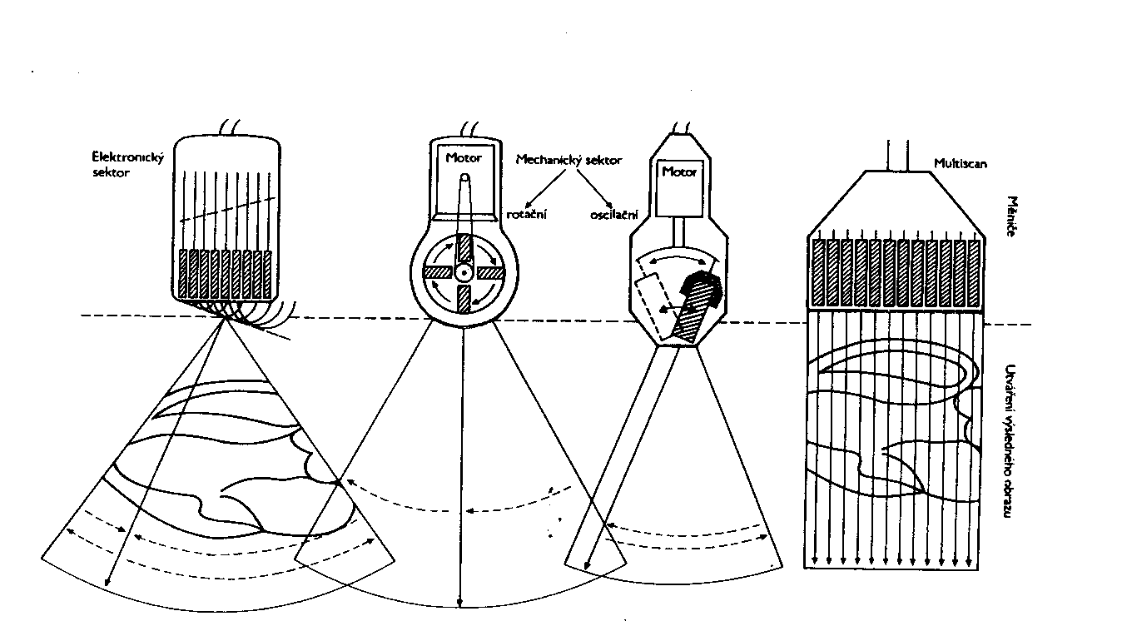
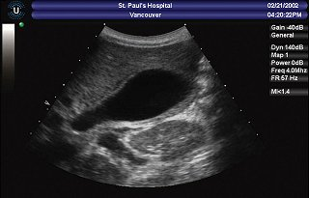
B-mode - dynamic
Repetitive formation of B-mode images of examined area by fast deflection of US beam mechanically (in the past) or electronically „in real time“ today.
Electronic probes consist of many piezoelectric transducers which are gradually activated.

Slide 30
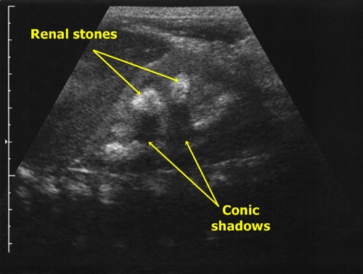
Basic characteristics of US images
Degree of reflectivity – echogenity. The images of cystic (liquid-filled) and solid structures are different. According to the intensity of reflection in the tissue bulk we can distinguish structures:
hyperechogenic, izoechogenic, hypoechogenic, anechogenic.
Solid structures – acoustic shadow (caused by absorption and reflection of US)
Air bubbles and other strongly reflecting interfaces cause repeating reflections (reverberation, „comet tail“).

Slide 31
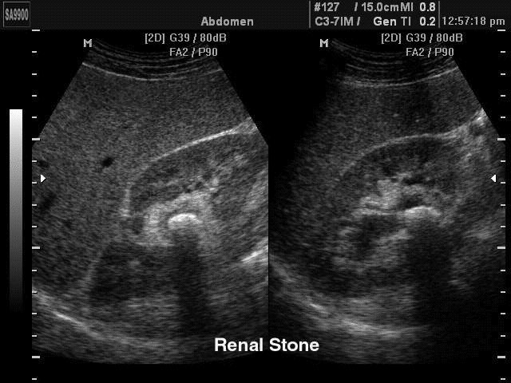
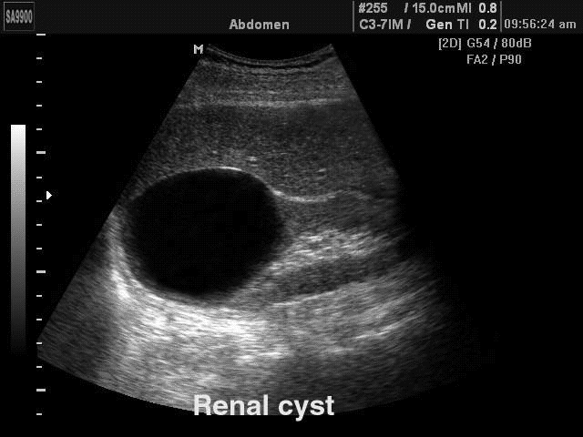
Acoustic shadow caused by absorption and reflection of US by a kidney stone (arrow)
Hyperechogenic area below a cyst (low attenuation of US during passage through the cyst compared with the surrounding tissues – arrow)

Slide 32
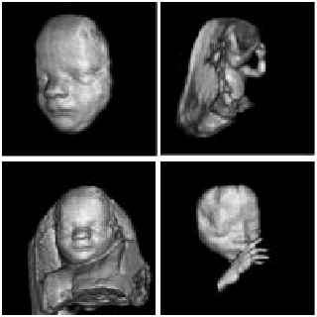
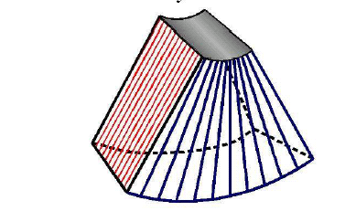
Three-dimensional (3D) imaging
- The probe is linearly shifted, tilted or rotated.
The data of reflected signals in individual planes are stored in memory of a powerful PC which consequently performs mathematical reconstruction of the image.
Disadvantages of some 3D imaging systems: relatively long time is needed for mathematical processing, price.

Slide 33
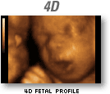
Four-dimensional (4D) image
The fourth dimension is time (x,y,z,t)
http://www.youtube.com/watch?v=NNHk3GJwN7o&feature=related

Slide 34
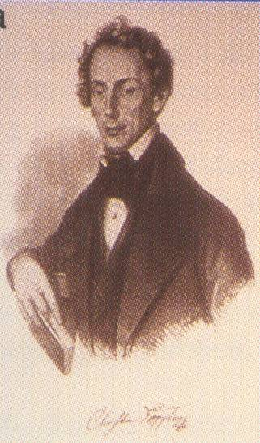
Doppler flow measurement
Christian. A. Doppler (1803-1853), Austrian physicist
and mathematician, formulated his theory in 1842
during his stay in Prague.
The Doppler effect (frequency shift of waves formed or reflected at a moving object) can be used for detection and measurement of blood flow, as well as, for detection and measurement of movements of some acoustical interfaces inside the body (foetal heart, blood vessel walls)

Slide 35
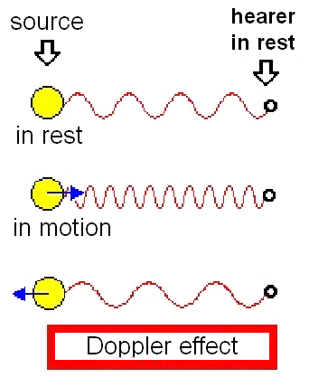
Principle of Doppler effect
perceived (detected) frequency corresponds with frequency of source in rest
perceived (sense) frequency is higher when source is in motion to the object
perceived frequency is lower when source is moving away

Slide 36
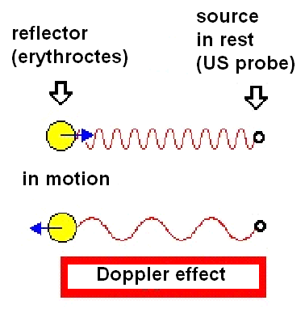
Principle of Doppler effect
Application of Doppler effect in blood flow velocity measurement
Moving reflector (back scatterer) = erythrocytes

Slide 37
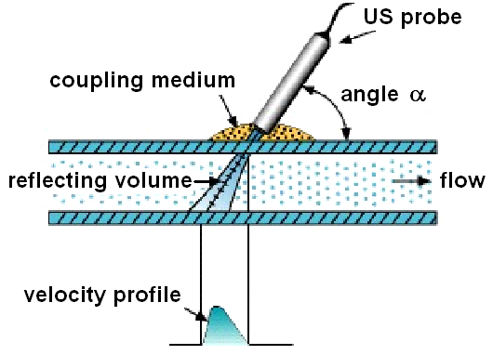
Doppler flow measurement
Calculation of Doppler frequency change f_{d}
Calculation of „reflector“ (erythrocytes) velocity v
1)
2)
f_{v} - frequency of emitted US waves
α - angle made by axis of emitted US beam and the velocity vector of the reflector
c – US speed in the given medium (about 1540 m/s in blood)

Slide 38
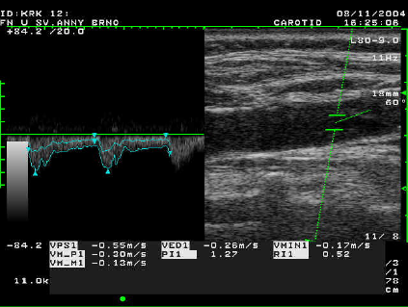
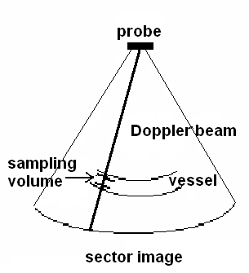
DUPLEX doppler method
is a combination of dynamic B-mode imaging (the morphology of examined area with blood vessels is depicted) and the PW Doppler system (measurement of velocity spectrum of blood flow).
It allows to examine blood flow inside heart or in deep blood vessels (flow velocity, direction and character)
Image of carotid with spectral analysis of blood flow velocity
Scheme: sector image
with sampling volume

Slide 39
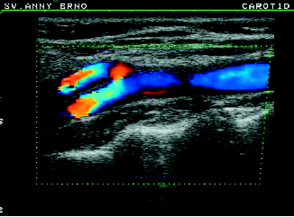
Colour Doppler imaging
The image consists of black-white and colour part.
The black-white part contains information about reflectivity and structure of tissues.
The colour part informs about movements in the examined section. (The colour is derived from average velocity of flow.)
The apparatus depicts distribution and direction of flowing blood as a two-dimensional image.
BART rule – blue away, red towards. The flow away from the probe is coded by blue colour, the flow towards the probe is coded by red colour. The brightness is proportional to the velocity, turbulences are depicted by green patterns.
Carotid bifurcation

Slide 40
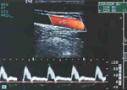
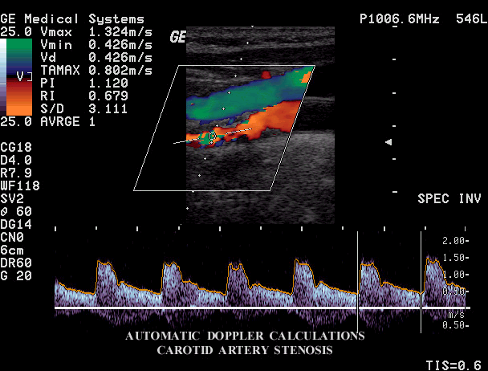
TRIPLEX doppler method
A combination of duplex method (B-mode imaging with PW Doppler) and colour flow mapping
Normal finding of blood flow in a. carotis communis

Slide 41
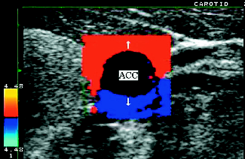
Tissue Doppler Imaging (TDI)
Colour coding of information about velocity and direction of movements of tissues
Velocities 1-10 mm/s
are depicted.
TDI of a. carotis
communis during
systole

Slide 42
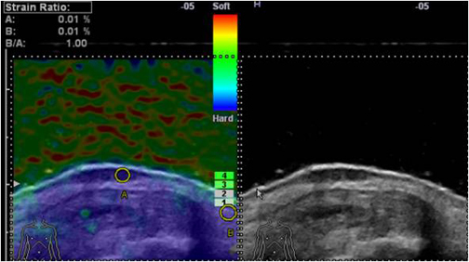
Ultrasound elastography
US elastography tracks tissue movement during compression by dynamic B-mode.
Finding the deformation of objects – measurement of value of eleasticity
deformation
Skin cancer is shown in an elastogram, with elasticity strain ratio on the left, and in an ultrasound image on the right.

Slide 43
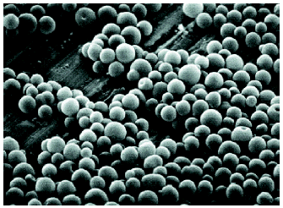
Echocontrast agents
increase echogenity of streaming blood
Gas microbubbles (mainly air or volatile hydrocarbons)
- free
- enclosed in biopolymer envelope
A SEM micrograph of encapsulated echocontrast agent

Slide 44
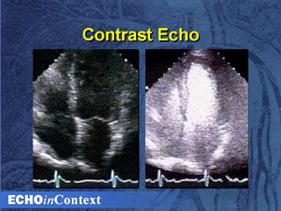
Echocontrast agents
Enhanced demarcation of heart ventricle after application of the echocontrast agent

Slide 45
Patient Safety
Reducing Ultrasound ‘Doses’
US is non-ionising BUT since many bioeffects of ultrasound have not yet been studied fully, ‘prudent’ use is recommended
ALARA – as low as reasonably achievable (exposure)
In practice ‘prudent’ = justification + optimisation

Slide 46
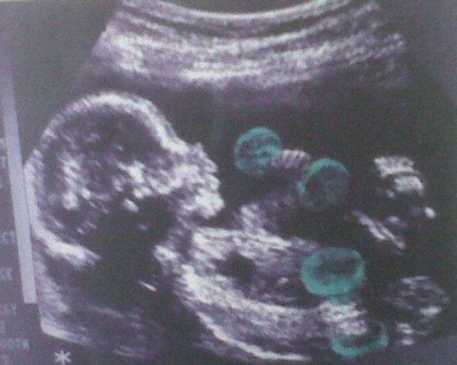
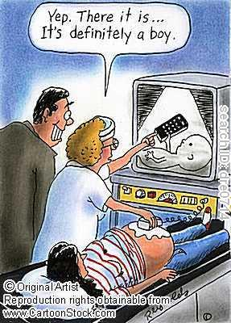
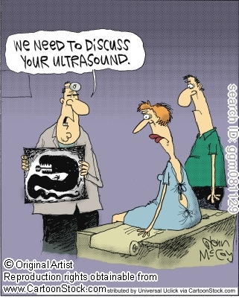
Sources:
Lecture of prof. Mornstein
Ultrasound Production and Interactions
Perry Sprawls, Ph.D.
Thank you for your attention

