Slide 1
Causation in Epidemiology
Public Health I

Slide 2
Seminar Outline I. Overview II. Etiology III. Sufficiency vs. Necessity V. Causal Factors VI. Causal Inference

Slide 3
Overview
Quick

Slide 4
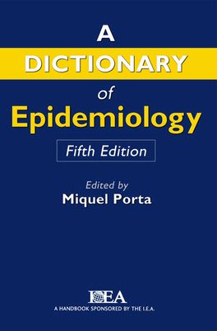
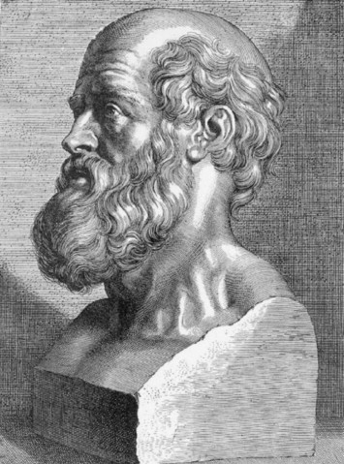
Etiology
Education
Age
Gender
Access to care
Socio-economic
Occupation
Physical activity
?
Literally, the science of causes, causality; in common usage, cause.
Diet
Risk behaviors
Race
Genetics
It is more important to know what sort of person has a disease than to know what sort of disease a person has.

Slide 5
Etiology
To learn the cause of a disease is as crucial as to treat it.
We can cure diseases that we do not know their causes till today!
We have failed to cure diseases that we do understand their etiology.
Etiology is the sacred science of Epidemiology!

Slide 6
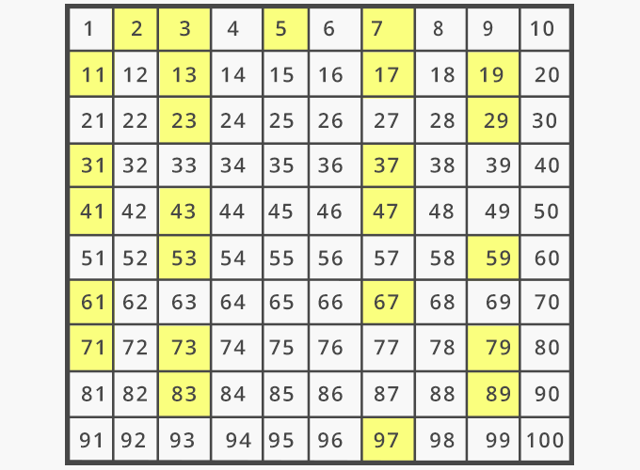
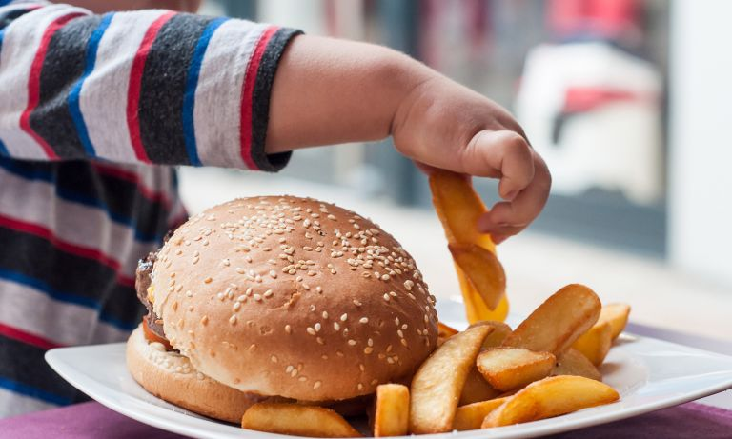
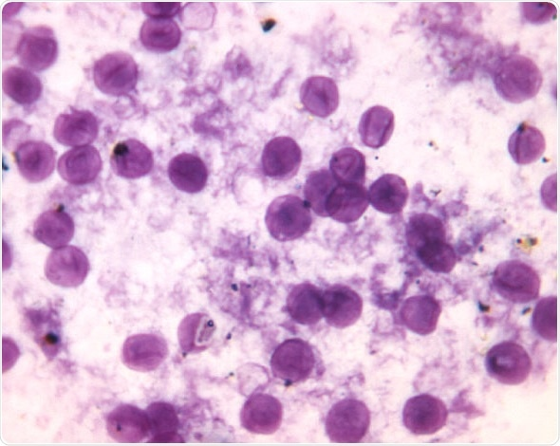
Sufficiency vs. Necessity
A cause is termed sufficient when it inevitably produces or initiates an outcome.
A cause is termed necessary if an outcome cannot develop in its absence.
It’s sufficient to know that “John is a king” to conclude that John is a male.
An occurrence of thunder is a sufficient condition for the occurrence of lightning.
For the whole numbers greater than two, being odd is necessary to being prime, since two is the only whole number that is both even and prime.
Oxygen is a necessary substance for our lives. We cannot live without it.
NO
Is Oxygen sufficient for life?
Being on an airplane is a sufficient cause to reach the airport; however, it’s not necessary because you can reach the airport by other means.
Eating fast food is a sufficient cause for children obesity; however, children can gain weight through other pathways including physical sedentary, etc.
Pneumocystis carinii is an organism that harmlessly colonizes the respiratory tract of some healthy persons, but can cause potentially lethal pneumonia in persons whose immune systems have been weakened by human immunodeficiency virus (HIV).
Necessary?
YES
Sufficient?
NO

Slide 7
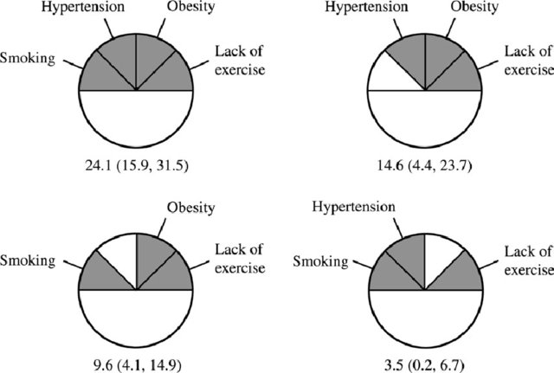
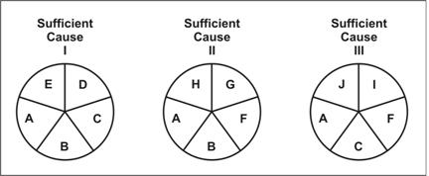
Sufficiency vs. Necessity
Hans-Olov Adami, Hunter DJ, Pagona Lagiou, Mucci LA. Textbook of Cancer Epidemiology. Oxford University Press; 2018. ‌
Rothman’s Causal Pies (1976)
Hoffmann K, Heidemann C, Weikert C, Schulze MB, Boeing H. Estimating the Proportion of Disease due to Classes of Sufficient Causes. American Journal of Epidemiology. 2005;163(1):76-83. doi:10.1093/aje/kwj011

Slide 8
Causal Factors
Enabling (or Disabling) Factors
These are factors affect health through environmental factor in either a positive or negative way.
Living conditions – Societal support – Services
Precipitating Factors
These are essential factors to the development of diseases, injuries, conditions, disabilities and death.
Predisposing Factors
These are the factors or conditions already present in a host that produce a susceptibility or disposition to a disease or condition without actually causing it.
Exposure to Pathogen – Lack of Seat Belt Use
Reinforcing Factors
These are factors which have the ability to support the production and transmission of disease or conditions.
Age – Gender – Previous illness – Immunization
Repetitive Patterns of Behavior: Smoking – Alcoholism – Physical Inactivity (negative) vs. Peer Education – Family Counseling – Support Groups (positive)

Slide 9
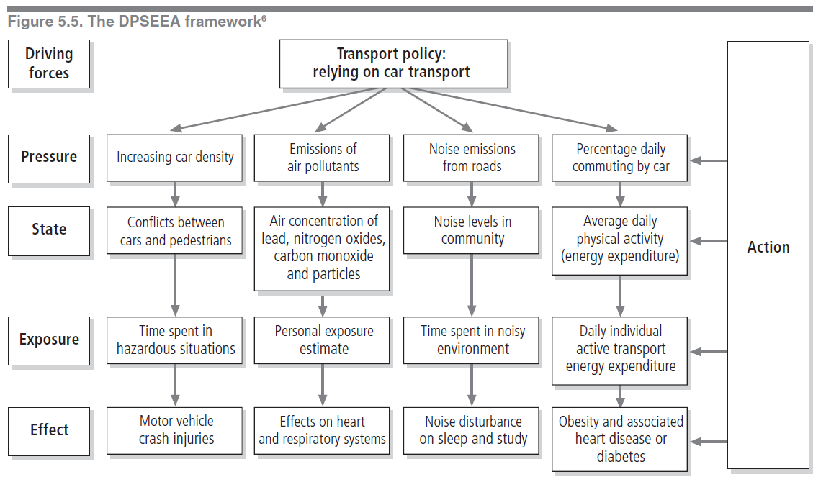
Causal Factors

Slide 10
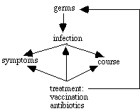
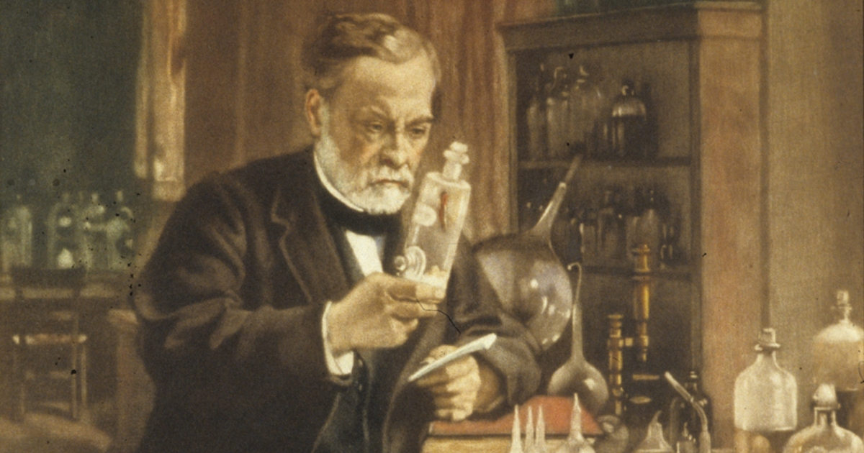
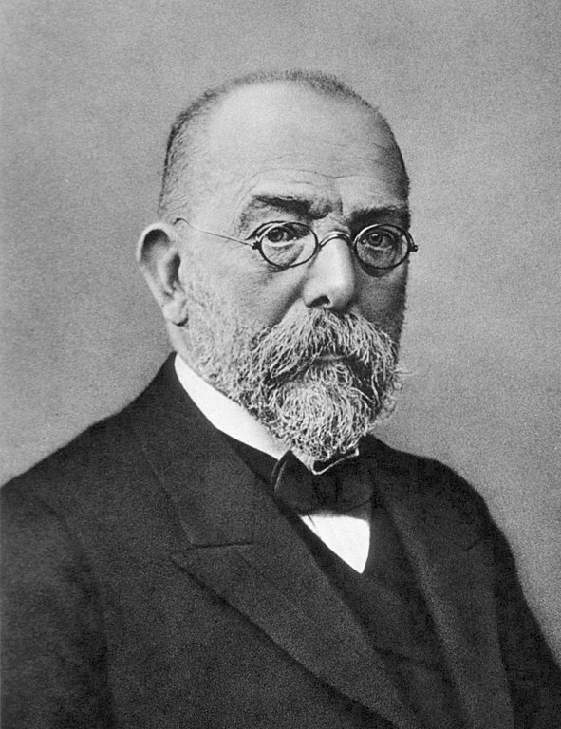
Causal Inference
Germ Theory
Louis Pasteur (1822 – 1895)
the organism must be present in every case of the disease;
the organism must be able to be isolated and grown in pure culture;
the organism must, when inoculated into a susceptible animal, cause the specific disease;
the organism must then be recovered from the animal and identified.
Robert Koch (1843 – 1910)

Slide 11
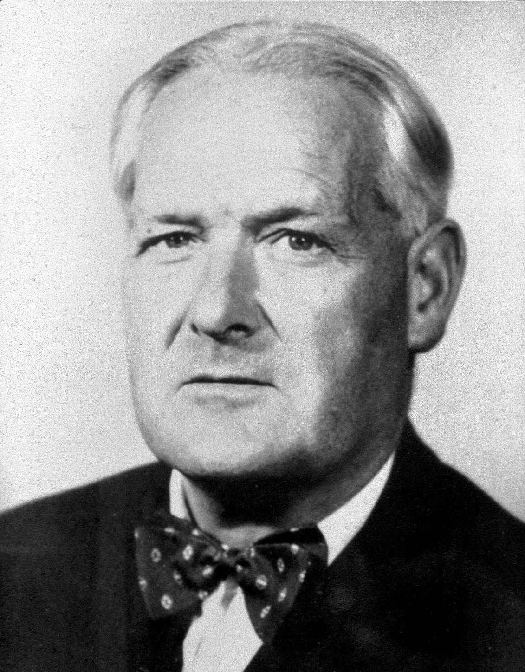
Causal Inference
Strength (Effect Size)
Consistency (Reliability)
Temporal Relation
Dose-response Relationship
Plausibility
Reversibility
Study design
Judging the Evidence
Strength
Consistency
Specificity
Temporality
Biological gradient
Biological plausibility
Coherence
Experiment
Analogy
Reversibility
Bradford Hill (1897 – 1991 )

Slide 12
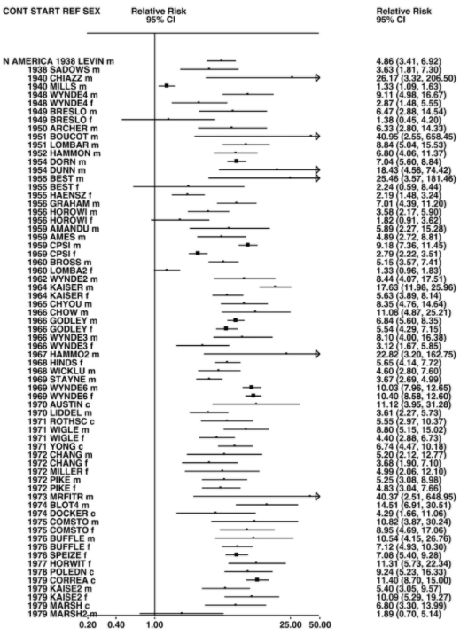
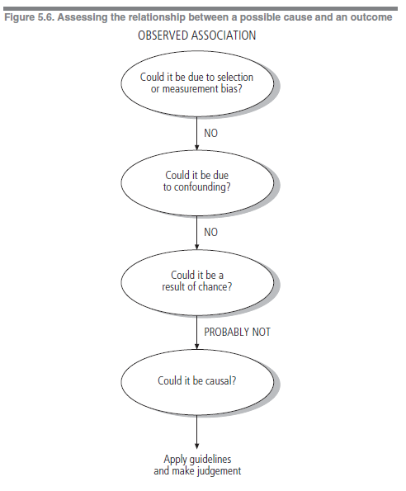
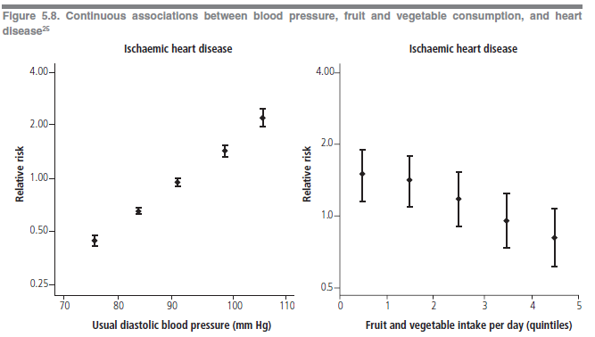
Causal Inference
Temporal Relation
The cause must precede the effect.
This is usually self-evident, although difficulties may arise in case-control and cross-sectional studies when measurements of the possible cause and effect are made at the same time.
Dose-response Relationship
A dose–response relationship occurs when changes in the level of a possible cause are associated with changes in the prevalence or incidence of the effect.
Strength (Effect Size)
A strong association between possible cause and effect, as measured by the size of the risk ratio (relative risk), is more likely to be causal than is a weak association, which could be influenced by confounding or bias.
Relative risks greater than 2 can be considered strong.
Plausibility
An association is plausible, and thus more likely to be causal, if consistent with other knowledge.
However, biological plausibility is a relative concept, and seemingly implausible associations may eventually be shown to be causal.
Consistency (Reliability)
Consistency is demonstrated by several studies giving the same result.
This is particularly important when a variety of designs are used in different settings, since the likelihood that all studies are making the same “mistake is thereby minimized.
Reversibility
When the removal of a possible cause results in a reduced disease risk, there is a greater likelihood that the association is causal.

Slide 13
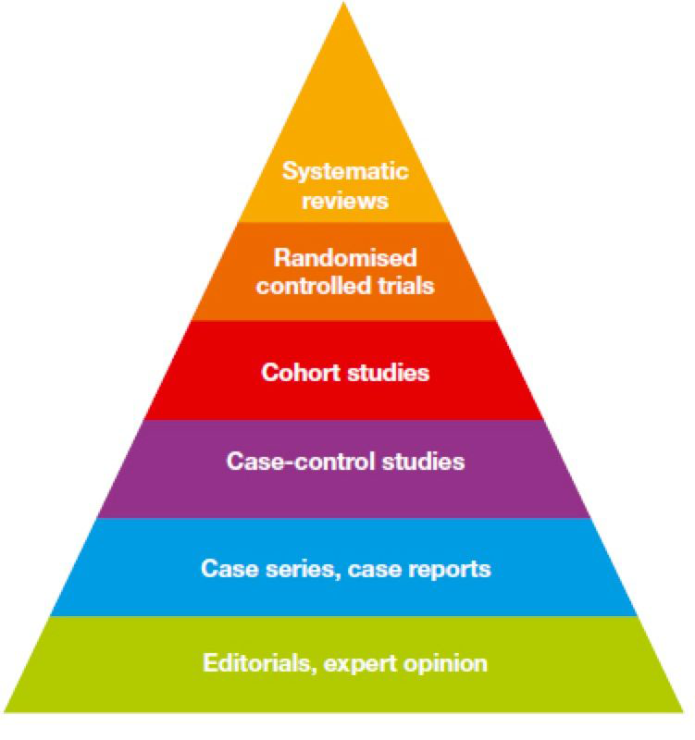
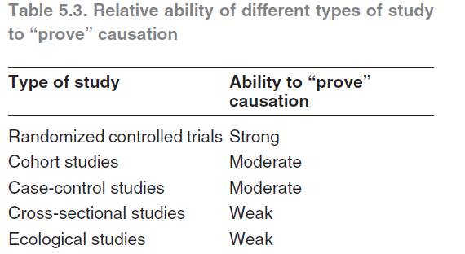
Causal Inference
Study Design
Judging the Evidence
There are no completely reliable criteria for determining whether an association is causal or not.
Evidence is often conflicting and due weight must be given to the different types when decisions are made. In judging the different aspects of causation referred to above, the correct temporal relationship is essential; once that has been established, the greatest weight may be given to plausibility, consistency and the dose–response relationship. The likelihood of a causal association is heightened when many different types of evidence lead to the same conclusion.

Slide 14
THANK YOU
abanoub.riad@med.muni.cz
Upon Request
Public Health I

