Slide 1
Health and Disease
Public Health I

Slide 2
abanoub.riad@med.muni.cz
Office Consultation (Upon Request)
Public Health I
Dr. Abanoub RIAD, DDS
Doctor of Dental Surgery (2016)
Research Fellow at Czech National Center of Evidence-based Healthcare and Knowledge Translation (CEBHC-KT)
Doctoral Candidate of Hygiene, Preventive Medicine, and Epidemiology (MED-MUNI)
Doctoral Candidate of Clinical Psychology (FSS-MUNI)

Slide 3
Seminar Outline I. Definition of Health II. Theory of Disease III. Global Burden of Disease BREAK IV. Measuring Disease Frequency V. Mortality

Slide 4
How do you define “Health”?
Health is a state of complete physical, mental and social well-being and not merely the absence of disease or infirmity.
Constitution of WHO as adopted by the International Health Conference, New York; signed on 22 July 1946
The definition has not been amended since 1948

Slide 5
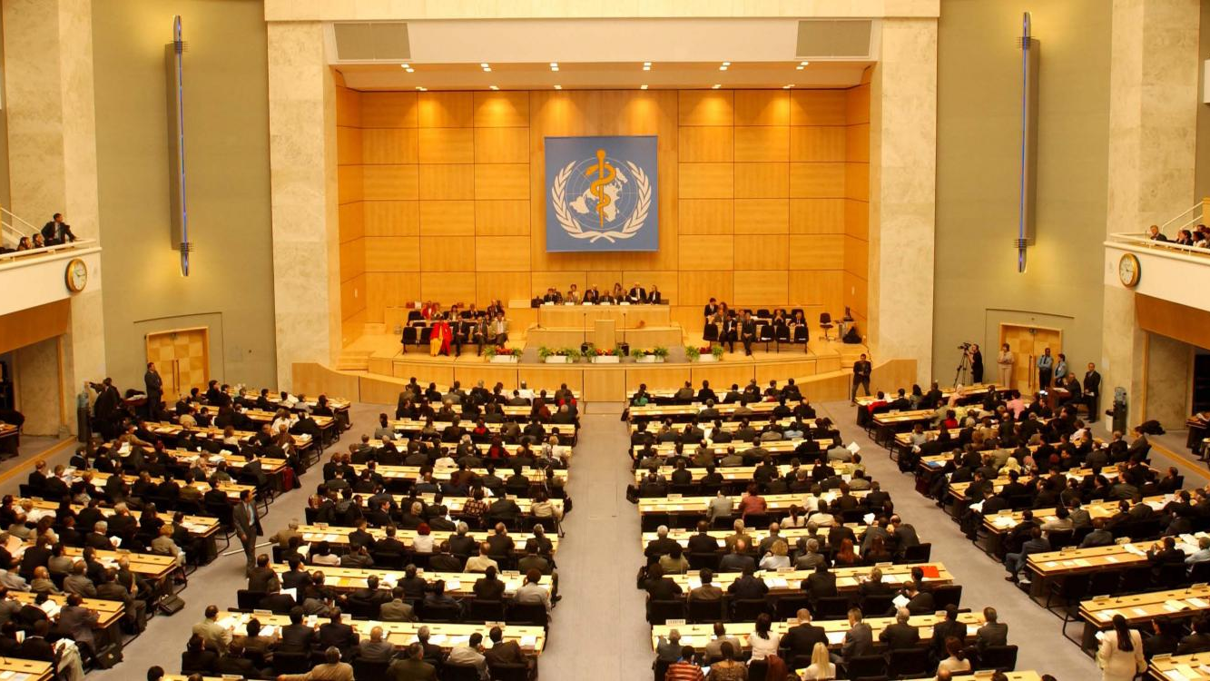
Exercise 1 Model of World Health Organization (MWHO)
You have been commissioned to represent your country at the 74th World Health Assembly (WHA) in Geneva, Switzerland ∼ May 2021. The agenda of Committee A highlights the definition of “Health” at WHO’s constitution for revision. What will be your critiques for the current definition?

Slide 6
Huber Machteld, Knottnerus J André, Green Lawrence, Horst Henriëtte van der, Jadad Alejandro R, Kromhout Daan et al. How should we define health? BMJ 2011; 343 :d4163
1. Medicalization of society
2. Incompliance with current demographics & disease burden
3. Operationalization of definition
How should we define health?

Slide 7
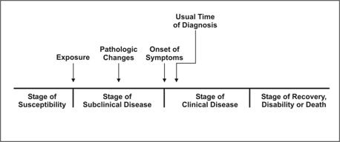
Natural History of Disease
PREDISEASE
Primary Prevention
Source: Centers for Disease Control and Prevention. Principles of epidemiology, 2nd ed. Atlanta: U.S. Department of Health and Human Services;1992.
secondary Prevention
tertiary Prevention
LATENT
SYMPTOMATIC

Slide 8
How disease occurs?
Supernatural Theories
Demonic Theory
Punitive Theory
Philosophical Theories
Humoral Theory
Miasmatic Theory
Contagion Theory
Scientific Theories
Germ Theory
Epidemiological Triad
Epidemiological Tetrad
Wheel Theory
Web of Causation

Slide 9
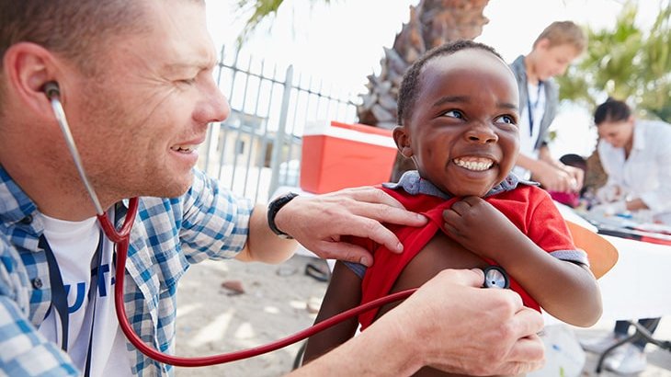
Exercise 2 BEINGS Model of Disease
BEINGS concept postulates that human diseases and its consequences are caused by a complex interplay of nine different factors. By coining the first letters of these factors the theory is called BEINGS theory. Explain the nine domains of BEINGS model with explanatory examples for each domain. (Homework Assignment 1)

Slide 10
How do we classify diseases?
Age (e.g. Pediatric, Geriatric)
Organ-specific (e.g. Liver, Kidney, Brain)
Communicable (Infectious) Diseases
POPULATION
TARGET
TRANSMISSION
Race
Occupation
Syndromic
Tissue-specific (Mucosal)
Gender (e.g. Gynecologic, Productive)
System-specific (e.g. Respiratory, Cardiovascular)
Non-Communicable (Chronic) Diseases

Slide 11
Global Burden of Disease (GBD)
Since 1990 (350 diseases, 195 countries, +3600 researchers)
The largest study for diseases distribution and their impact.
Quantifying mortality, and morbidity.
Symbol of coordinated “global health” efforts.
http://www.healthdata.org/gbd

Slide 12
Exercise 3 Global Burden of Disease
Go to: https://vizhub.healthdata.org/gbd-compare/
Click “Compare” – then “By Year”
Select “1990” for “Top Chare Settings”
What happened in the last 30 years?

Slide 13
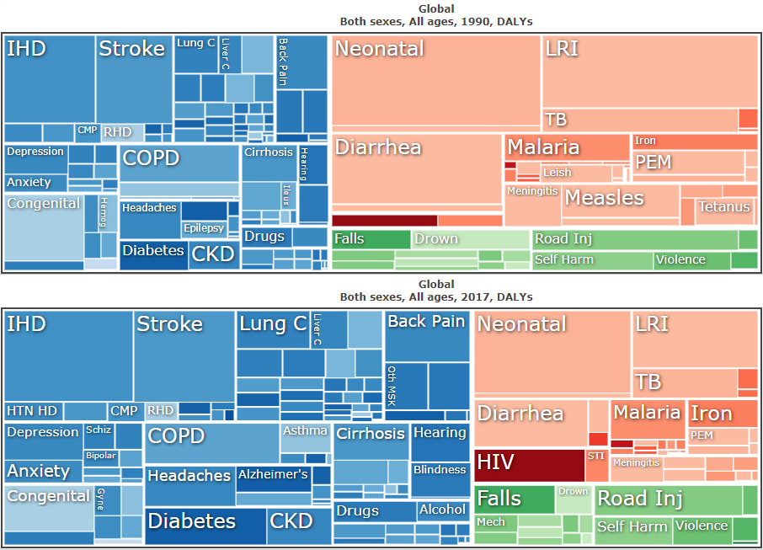
Exercise 3 Global Burden of Disease

Slide 14
BREAK

Slide 15
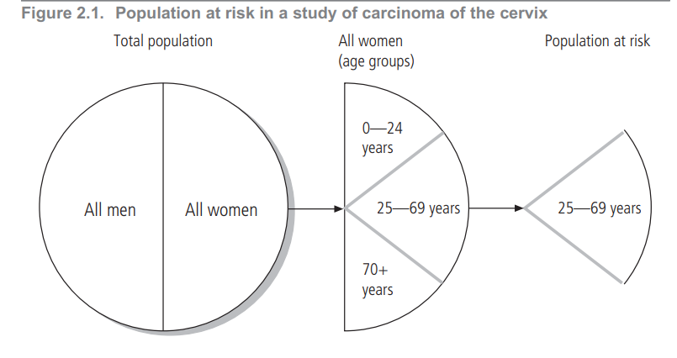
Disease Frequency
Population at Risk
Ratio vs. Rate
Incidence vs. Prevalence

Slide 16
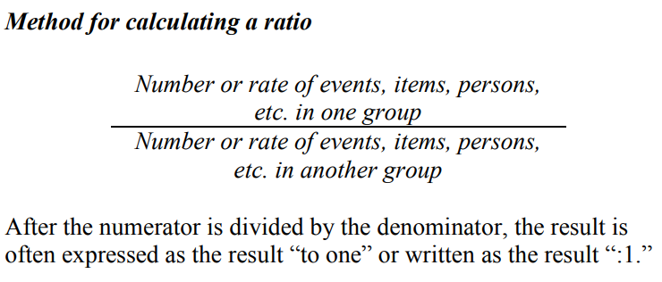
Ratio
A ratio is the relative magnitude of two quantities or a comparison of any two values.
It is calculated by dividing one interval- or ratio-scale variable by the other.
The numerator and denominator need not be related.

Slide 17
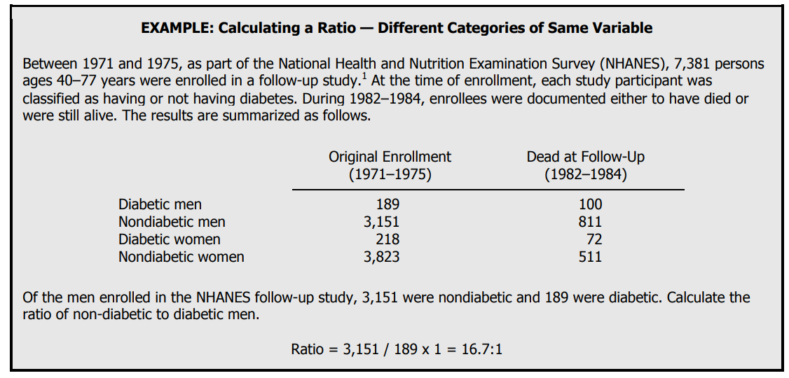
Female / Male
Gender

Slide 18
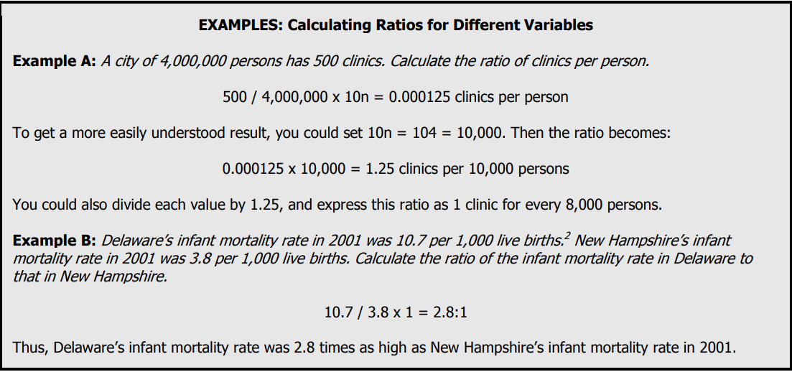
Population / Clinics

Slide 19
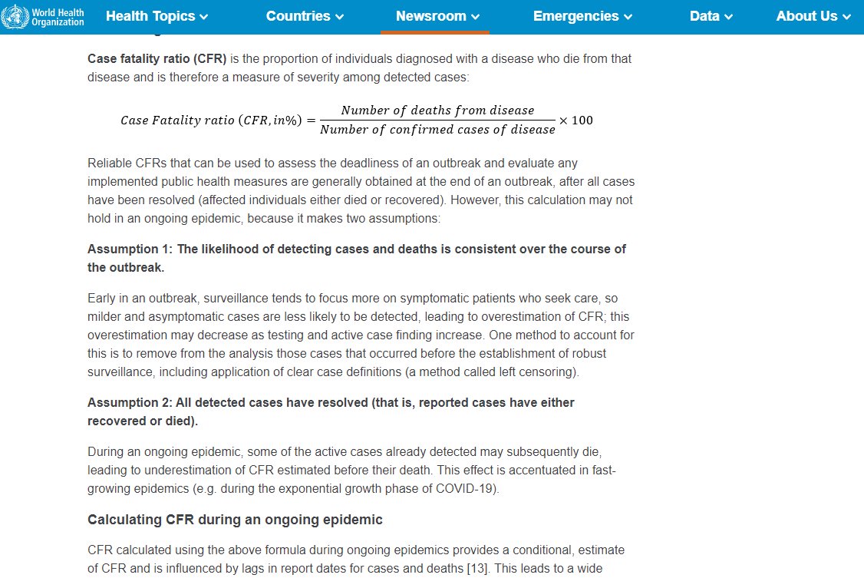
Case-to-death Ratio (Case-fatality ratio)
https://www.who.int/news-room/commentaries/detail/estimating-mortality-from-covid-19

Slide 20
Rate
Incidence Rate
Attack Rate
Incidence Proportion
In epidemiology, a rate is a measure of the frequency with which an event occurs in a defined population over a specified period of time.
Because rates put disease frequency in the perspective of the size of the population, rates are particularly useful for comparing disease frequency in different locations, at different times, or among different groups of persons with potentially different sized populations; that is, a rate is a measure of risk.

Slide 21
Ratio Vs. Rate
https://www.cdc.gov/csels/dsepd/ss1978/lesson3/section1.html

Slide 22
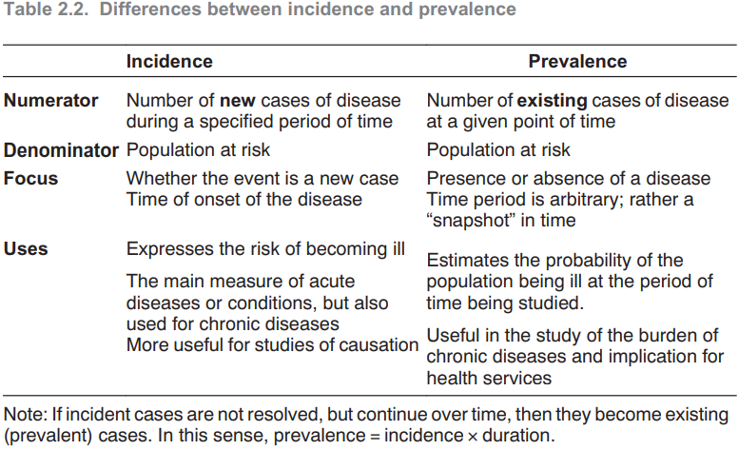
Incidence
The incidence of disease represents the rate of occurrence of new cases arising in a given period in a specified population
Prevalence
Prevalence is the frequency of existing cases in a defined population at a given point in time.

Slide 23
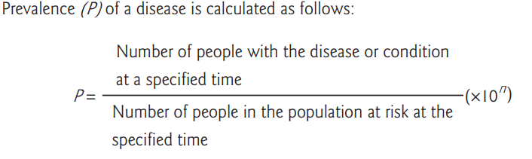
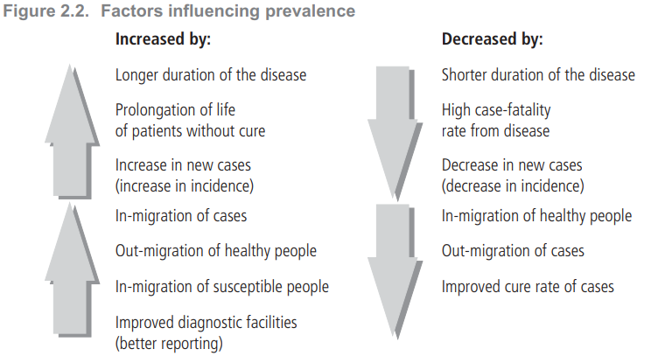
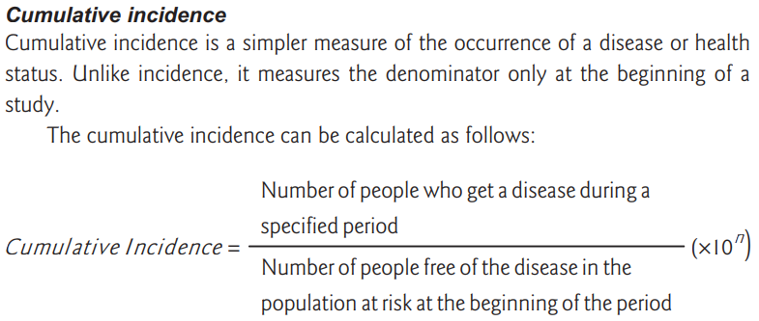

Slide 24
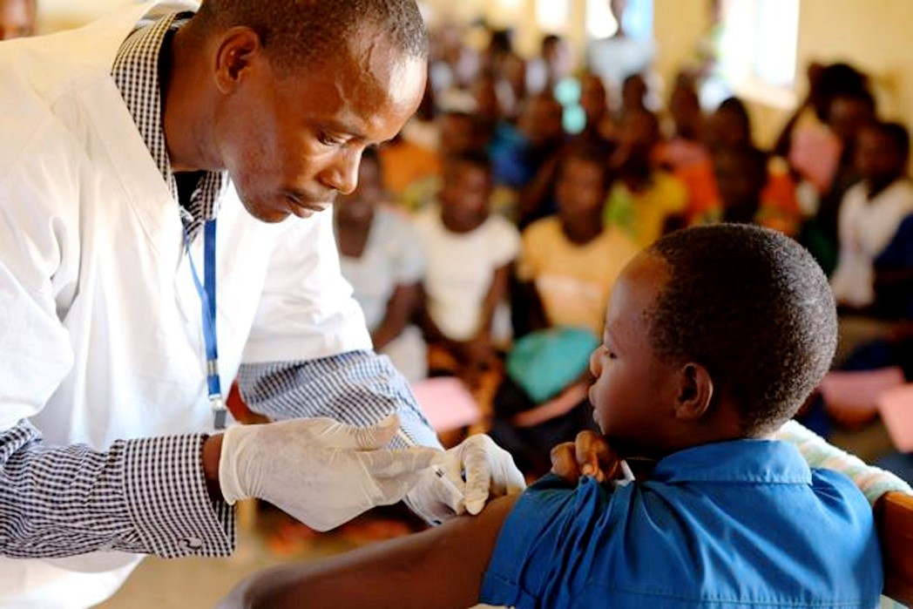
Exercise 4 Prostate Cancer
Black men in the United States have a substantially higher incidence of prostate cancer than U.S. white men. Let’s say there’s a variant of the androgen receptor gene that’s more common in black than white men in the United States — 50 % versus 30 % — that is also associated with a doubling of incidence of prostate cancer in American men of either race.
What would be the relative incidence of prostate cancer, black versus white American men, if the genetic marker were the sole risk factor for this disease that differed between the two races?

Slide 25
Exercise 4 Prostate Cancer in the U.S.

Slide 26
Exercise 4 Suicide of Physicians
The rate of suicide among American physicians, relative to the corresponding rate in the population as a whole, varies by gender. Among men, the rate in physicians is 1.5 times higher, whereas among women the corresponding relative rate is 3.0. It turns out that the rate of suicide in American male and female physicians is identical.
For American men and women in general, what is the relative rate of suicide in men compared to women?

Slide 27
Exercise 4 Suicide of Physicians

Slide 28
Exercise 4 Guillain-Barré syndrome
A population-based case-control study of Guillain-Barré syndrome (a neurological disease) conducted in 1992–1994 in 4 states estimated the risk of this disease to be 1.7 times greater among adults who had received influenza vaccine in the prior 6 weeks than those who had not. Th e investigators also estimated that the added risk of Guillain-Barré syndrome associated with the receipt of influenza vaccine was about one per million persons during the first 6 weeks after vaccination.
From these data, can you calculate the 6-week incidence among adults in the 4-state population who did not receive the vaccine? If yes, what is that incidence? If no, why not? (Homework Assignment 2)

Slide 29
Exercise 4 Stomach Cancer
The incidence of stomach cancer in country X is 8.0 per 100,000 per year. The incidence rate in nearby country Y, with a similar age-sex-race composition as country X, is 10.0. You are concerned with explaining this difference. You know that 5% of people in country Y drink tea containing suspected carcinogen A, whereas nobody in country X drinks this tea.
In order for this to be the sole explanation of the difference in the incidence rates of stomach cancer between the two countries, how strongly must carcinogen-A-tea drinking be associated with stomach cancer? (Homework Assignment 2)

Slide 30
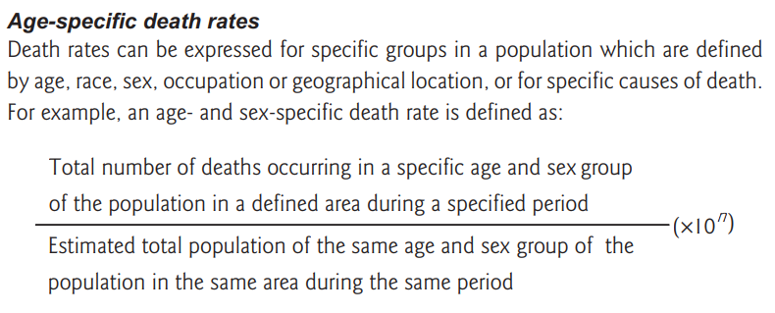
Mortality
Crude Mortality
Age-specific vs. Age-standardized Mortality
Proportionate Mortality
Infant Mortality
Maternal Mortality
Adult Mortality
Life Expectancy

Slide 31
Proportionate Mortality
Occasionally the mortality in a population is described by using proportionate mortality, which is actually a ratio: the number of deaths from a given cause per 100 or 1000 total deaths in the same period. Proportionate mortality does not express the risk of members of a population contracting or dying from a disease.
Unless the crude or age-group-specific mortality rates are known, it may not be clear whether a difference between groups relates to variations in the numerators or the denominators.
Example: Proportionate mortality rates for cancer would be much greater in high-income countries with many old people than in low- and middle-income countries with few old people, even if the actual lifetime risk of cancer is the same.

Slide 32
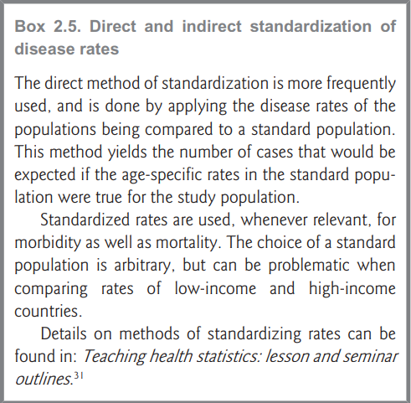
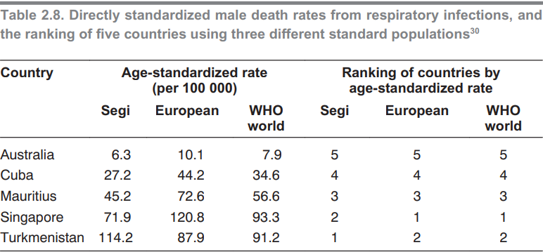
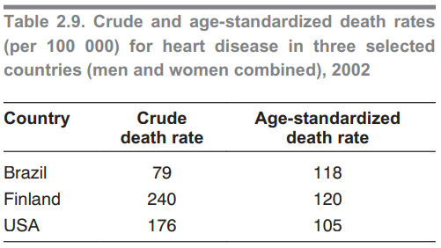
Age-standardized Rate
Age-adjusted rate

Slide 33
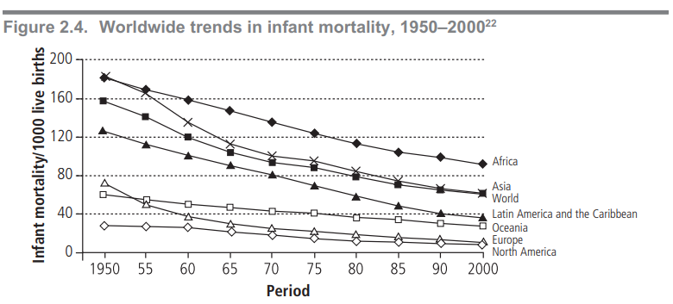
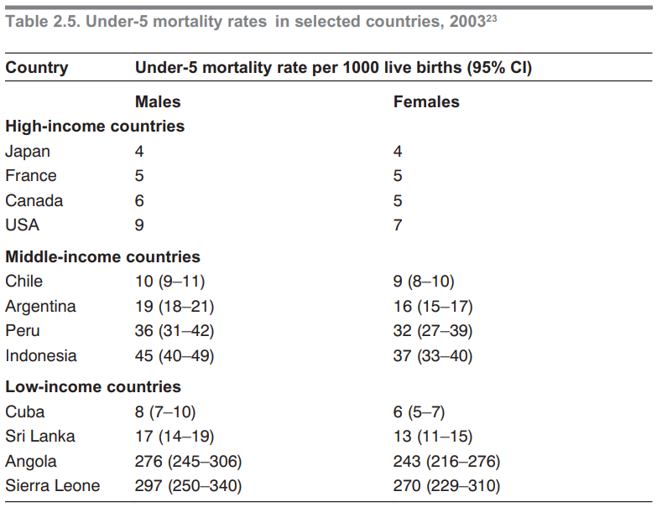
Infant Mortality
Rate
Rate
Child Mortality
The child mortality rate (under-5 mortality rate) is based on deaths of children aged 1–4 years, and is frequently used as a basic health indicator.
Injuries, malnutrition and infectious diseases are common causes of death in this age group.
The under-5 mortality rate describes the probability (expressed per 1000 live births) of a child dying before reaching 5 years of age.

Slide 34
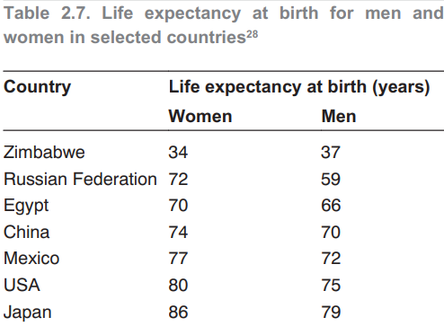
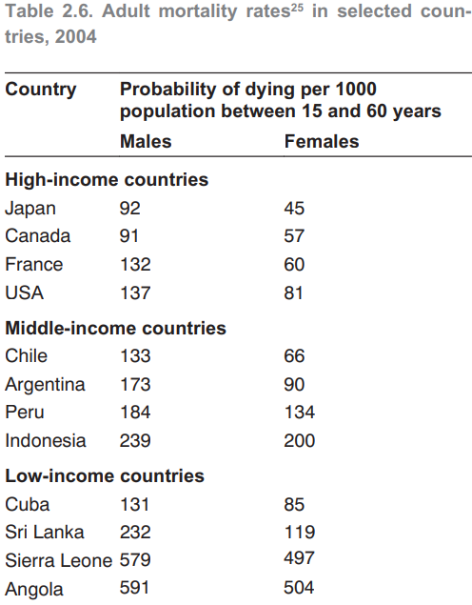
Maternal Mortality
Rate
Rate
Adult Mortality
Life Expectancy
is defined as the average number of years an individual of a given age is expected to live if current mortality rates continue.

Slide 35
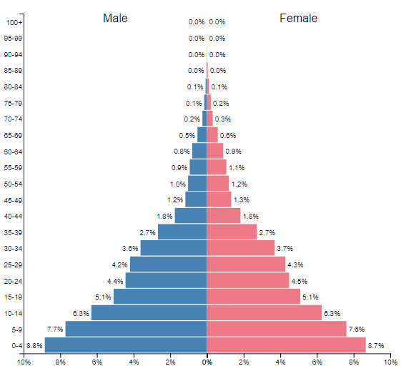
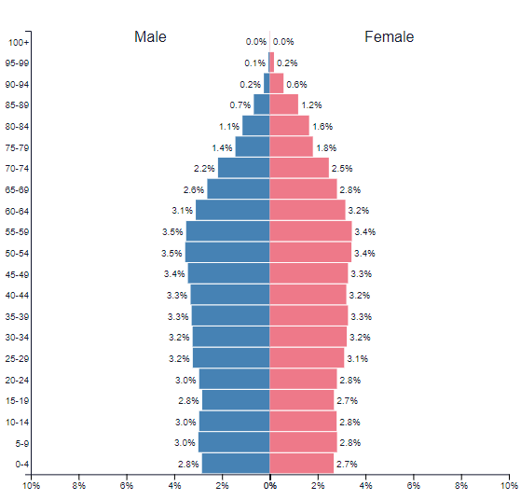
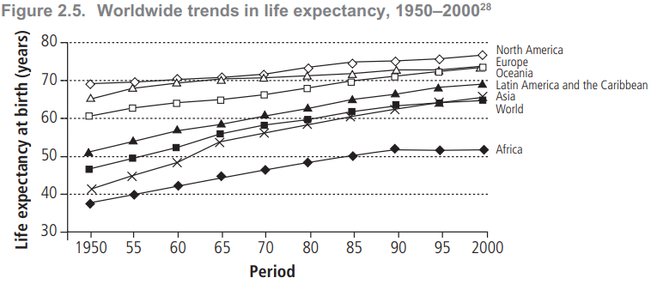
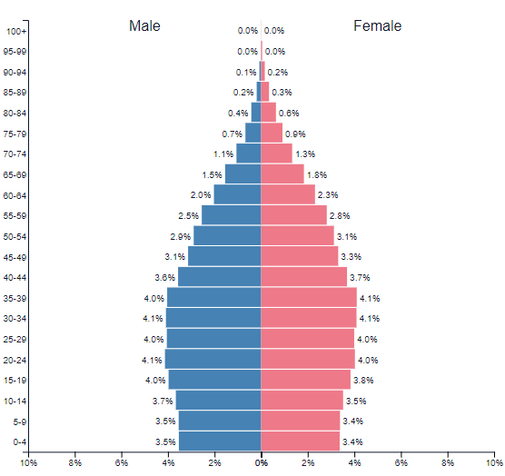
Life Expectancy
BELGIUM
BURUNDI
BELGIUM
BRAZIL
https://www.populationpyramid.net

Slide 36
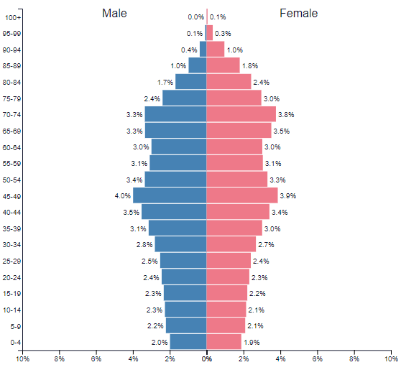
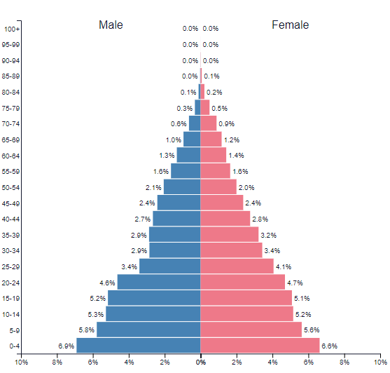
Life Expectancy in Japan
2019
1950
https://www.populationpyramid.net

Slide 37
Exercise 5 Homicide Death Rate
In 2001, a total of 15,555 homicide deaths occurred among males and 4,753 homicide deaths occurred among females. The estimated 2001 midyear populations for males and females were 139,813,000 and 144,984,000, respectively.
Calculate the homicide-related death rates for males and for females.
What type(s) of mortality rates did you calculate in Question 1?
Calculate the ratio of homicide-mortality rates for males compared to females.
Interpret the rate you calculated in Question 3 as if you were presenting information to a policymaker.

Slide 38
Exercise 5 Homicide Death Rate

Slide 39
THANK YOU
abanoub.riad@med.muni.cz
Office Consultation (Upon Request)
Public Health I

