Slide 1
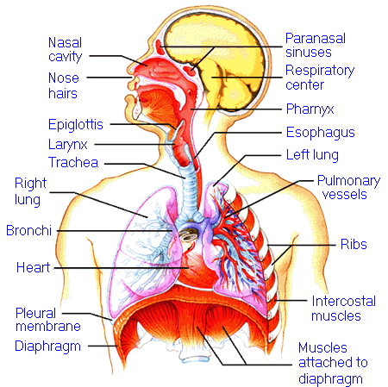
Lectures on Medical Biophysics
Department of Biophysics, Medical Faculty,
Masaryk University in Brno
Biophysics of breathing. Spirometry

Slide 2

Lecture outline
Mechanisms of gas exchange between organism and surroundings (respiratory movements – mechanics of breathing, diffusion and dissolution of gases)
Respiratory volumes and capacities
Respiratory resistances
Respiratory work
Spirometry
Some biophysical aspects of breathing

Slide 3
Respiratory movements
These movements are done mainly by intercostal muscles and diaphragm
Thoracic breathing (predominant in women) and abdominal breathing (predominant in men)
cfm?article_ID=ZZZ8PPLCGJC&sub_cat=285
Dle: http://www.medem.com/MedLB/article_detaillb.

Slide 4
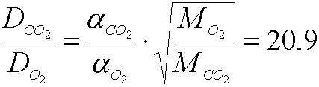
Diffusion of O₂ and CO₂ in plasma
Bunsen coefficients of solubility (α) for gases in blood under normal body temperature. The unit of solubility is (ml of gas under normal temperature and pressure) ∗ (ml of blood)⁻¹ ∗ (101.3 kPa)⁻¹
CO₂ | 0.52
CO | 0.018
N₂ | (Water: 0.013; Fat: 0.065)
O₂ | 0.022
Molecular weights:
M_{O2} = 32
M_{CO2} = 44

Slide 5
Gas exchange
Medium | Way of transport | pO₂ (kPa) | pCO₂ (kPa)
alveoli | streaming | 13.3 | 5.2
alveolar-capillary wall | diffusion | - | ­
Blood circulation: arteries veins | streaming | 12.7 5.3 | 5.5 6.0
Capillary wall cellular membrane | diffusion | - | ­
Living cell |  | 4.0 | 6.7

Slide 6
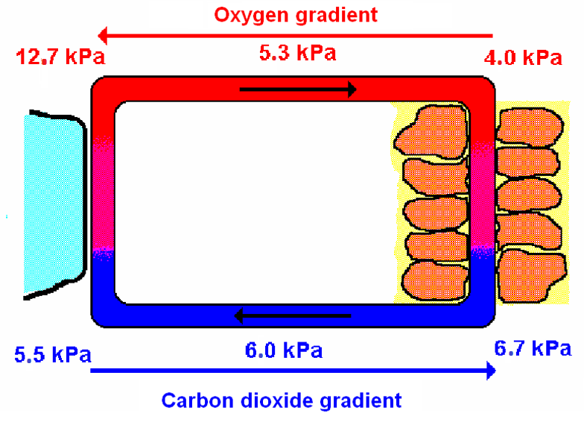
Exchange of O₂ and CO₂
Tissue
Alveolus

Slide 7
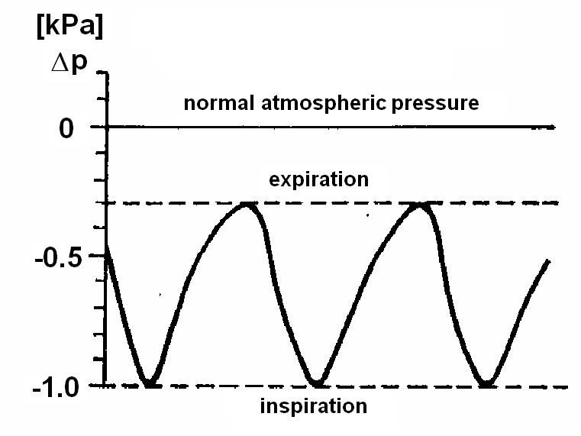
Changes of negative pleural pressure during respiration

Slide 8
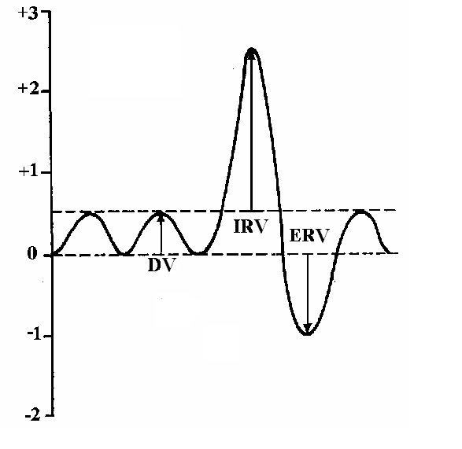
Respiratory volumes and capacities
Air in airways – death space - 150 ml
Residual air volume in alveoli - RV - 1 l
Expiration reserve volume - ERV – 1.5 l
Resting (tidal) respiratory volume - TV - 0.5 l
Inspiration reserve volume - IRV – 2.5 l
Vital capacity
VC = ERV + TV + IRV
Functional residual capacity
FRC = RV + ERV
Measure of lungs ventilation: minute volume
MV = Respiratory volume × breathing rate [l·min⁻¹]
V [l]
V [l]
Example of a spirogram

Slide 9
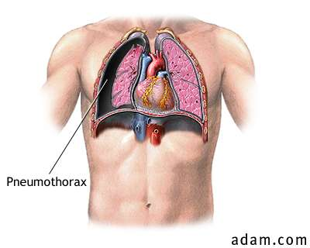
Pneumothorax
http://www.pennhealth.com/health/health_info/Surgery/graphics/Pneumothorax_2.jpg
Right lung is collapsed

Slide 10
Respiratory resistances
Elastic resistance of lungs and chest is given by tension of elastic fibres in pulmonary tissue. The surface tension of alveoli has similar effect.
Non-elastic resistance of tissues (also tissue viscous resistance). It arises due to friction of pulmonary tissues, chest, respiratory muscles and organs of abdominal cavity.
Flow resistance of airways – complex of resistances caused by air flow (effect of air viscosity, incl. turbulences). It increases substantially when the airways are narrowed.

Slide 11
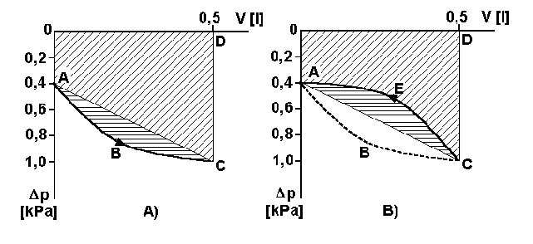
Respiratory work
(picture to consider)
This work is necessary to overcome all the respiratory resistances:
W = pΔV
p is the difference of intrapulmonary and pleural pressures, ΔV is the breathing volume
Respiratory work. A) – during inspiration, B) – during expiration. Area 0ACD0 – elastic work done at the expense of body energy (during inspiration) or at the expense of potential energy of distended elastic tissues (during expiration). Area ABCA represents active inspiration work against the non-elastic resistance. Area ACEA represents the work against the non-elastic resistance during expiration at the expense of body energy (after Pilawski).

Slide 12


How to calculate respiratory work?
At rest:
minute volume MV = 7 l
breathing rate BR = 14 min⁻¹
pressure p = 0.7 kPa
respiratory volume V = 0.5 l (5·10⁻⁴ m³)
work W = 0.35 J – for one inspiration
294 J per 1 hour
At great load:
MV = 200 l
BR 100 min⁻¹
p = 0,7 kPa
V = 2 l (2·10⁻³ m³)
W = 1.4 J - for one inspiration
8400 J per 1 hour

Slide 13
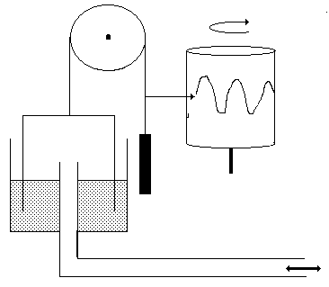
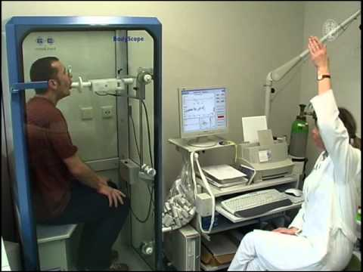
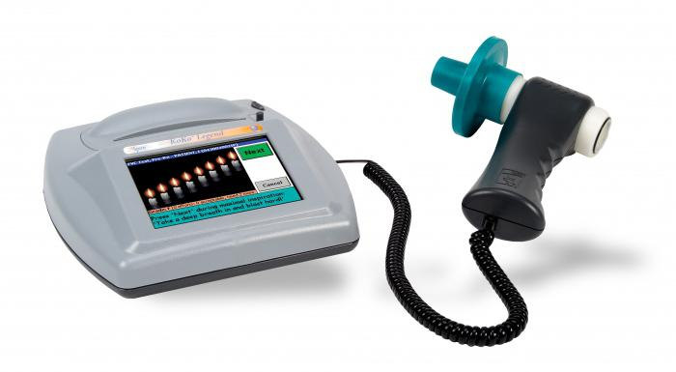
Measurement of respiratory volumes and speeds - spirometry

Slide 14
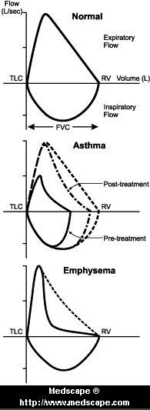
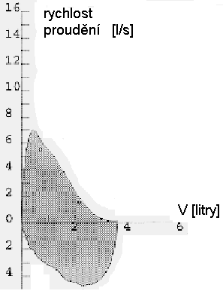
Spirogram
Flow rate
We can measure the dependence of volume on time
or
Flow rate on volume
[litres]

Slide 15
Some biophysical aspects of breathing
Physical properties of lungs and their manifestations in some areas of diagnostics and therapy:
The lungs represent the largest contact area with ambient medium
Many functions of organism can be influenced by rate or depth of breathing (hyperventilation)
Breathing movements can disturb e.g. X-ray diagnostics
Lungs have negative contrast in X-ray images
Physical properties of alveoli are similar to bubbles – lung tissue can be impaired by cavitation phenomena (risk in ultrasound diagnostics and lithotripsy)

Slide 16
Author:
Vojtěch Mornstein
Content collaboration and language revision:
Carmel J. Caruana
Last revision and addition of soundtrack: November 2020

