Slide 1


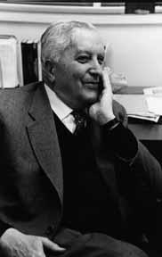
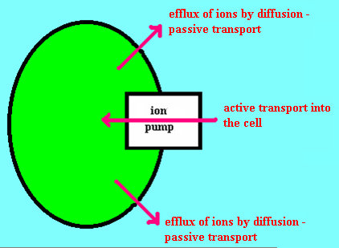
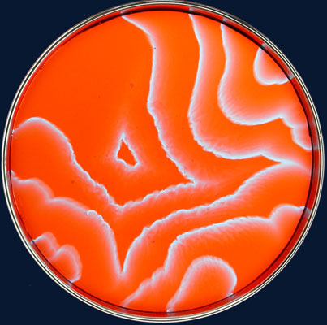
Lectures on Medical Biophysics
Dept. Biophysics, Medical Faculty,
Masaryk University
Ilya Prigogine
1917 - 2003
Thermodynamics and life

Slide 2
Lecture outline
Basic concepts of non-equilibrium thermodynamics of living systems
Diffusion
Osmosis and osmotic pressure

Slide 3
Basic concepts of non-equilibrium thermodynamics of living systems
There is an internal „source“ of entropy in non-equilibrium systems.
The amount of entropy „produced“ per unit volume in unit time is called the entropy production rate σ (sigma).

Slide 4
Prigogine principle
For states not too far from tmd. equilibrium, the Prigogine principle applies:
At constant external conditions, an open system spontaneously proceeds towards a state with a minimum entropy production rate.
This state is called a stationary state (in biology: state of dynamic equilibrium, homeostasis respectively).

Slide 5
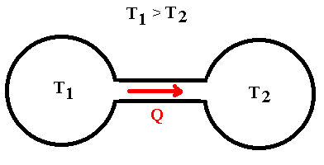
Difference between an equilibrium and stationary state
Is it possible to maintain a state with different temperatures in an isolated system?

Slide 6
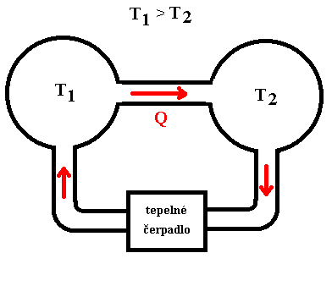
Difference between an equilibrium and stationary state
Heat pump
The temperature difference can be maintained only in an open system involving a heat pump which requires an energy input to function.

Slide 7
Difference between an equilibrium and stationary state
The ion pump maintains a constant difference in concentration of ions and/but requires energy.

Slide 8
Fluctuations and generalised le Chatelier principle
Fluctuations are small deviations from the equilibrium or stationary state arising from internal stochastic (random) processes. Small disturbances are small deviations from the equilibrium or stationary state arising from external processes.
Generalised le Chatelier principle:
  When a system is at a stationary state, any small fluctuations lead to fluxes of particles or energy which cause the system to return to the original stationary state.
Critical or bifurcation point (from this point the system can develop in two different ways – e.g. return to the original stationary state or go to another one)

Slide 9
Dissipative structures
Ordered non-equilibrium time-space structures are called dissipative structures. We cannot apply Boltzmann formula on them. According to Prigogine, they originate as a consequence of a fluctuation. They are stabilised by energy exchange with environment. The dissipative structures belong among problems solved by non-linear non-equilibrium thermodynamics. They can appear only in conditions far enough from equilibrium and a sufficient energy and substance flow is necessary. (Example: „Bénard instability“)

Slide 10
Autocatalytic reactions
A general equation of the autocatalytic reaction:
nA + X ←⎯→ 2X + (n - 1)A,
It can be followed by:
X ←⎯→ F
In the autocatalytic reaction, a compound X is formed from compound A under in presence of the substance X. It means that the substance X acts as a catalyst in its formation. When the substance A is available in sufficient amount, the amount of X grows exponentially. F can be a product formed from compound X.
Autocatalytic reaction of it's kind is also the replication of DNA. It should be admitted that it is a complex of „common“ chemical reactions can demonstrate itself as an autocatalytic reaction, i.e. a complex of metabolic processes which results in formation of a copy carrying the same genetic information.
Autocatalitic reaction is a chemical dissipative structure and behaves like a chemical oscillator.

Slide 11
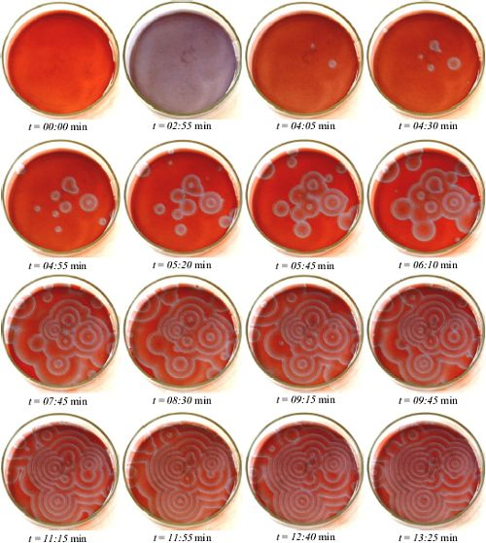
Belousov-Zhabotinsky reaction
http://www.jkrieger.de/bzr/2_4_versuch_raeuml.html#2_4

Slide 12
Examples of thermodynamic approach to problem solution:
Non-equilibrium thermodynamics:
Diffusion
Equilibrium thermodynamics:
Osmosis

Slide 13
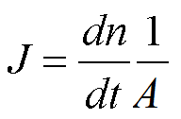
Diffusion as an irreversible process
Transport process - tmd. system proceeds towards equilibrium state, in which concentrations of all present substances are equalised in whole volume.
The flow of diffusing substance is constant when there is no significant change of its concentration on both sides of the (permeable) membrane (e.g., when the process is slow, volumes are large or active transport is present).
Density of diffusion flow J definition – amount of substance passing through unit area of a boundary in unit time:
A is total area of the boundary, dt is a small time interval during which substance amount dn is transported.

Slide 14
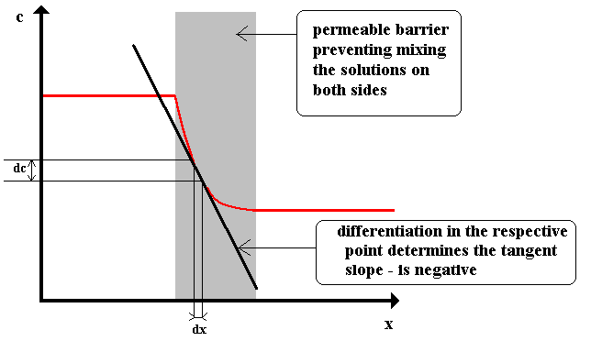
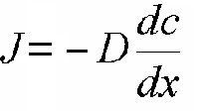
1st Fick law
Concentration gradient
A.E. Fick (1885):
(substance moves in the direction of the x-axis, one-dimensional case of diffusion):
D - diffusion coefficient
[m²·s⁻¹]
Typical values of D:
from 1·10⁻⁹ for small molecules to
1·10⁻¹² for big macromolecules

Slide 15

Diffusion coefficient
Approximate formula for the diffusion coefficient was derived by A. Einstein:
  k is Boltzmann constant
  T is thermodynamic temperature
  η is dynamic viscosity
  r is particle radius.
The term 6πηr is called friction or hydrodynamic coefficient f .

Slide 16

2nd Fick law
The 1st Fick law holds when the concentration gradient is constant over time. This condition is not fulfilled for most real processes, so that we need the 2nd Fick law to describe such diffusion:
The term d²c/dx² (second derivative of concentration c with respect to position x, d(dc/dx)/dx, or an infinitesimal change of concentration gradient along x-axis. We can say: the rate of change with time of substance concentration at a given point is proportional to the spatial change of the concentration gradient. The proportionality constant D is again the diffusion coefficient.

Slide 17
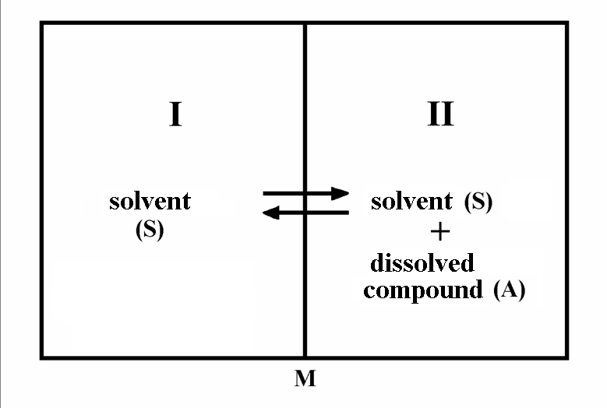
Osmosis and osmotic pressure
Solvent can pass through the membrane but not the solute. System proceeds to tmd. equilibrium by equalisation of concentrations of substances in the whole system by solvent diffusion from space I into the space II.
Result: pressure increase in space II when the membrane is rigid.

Slide 18
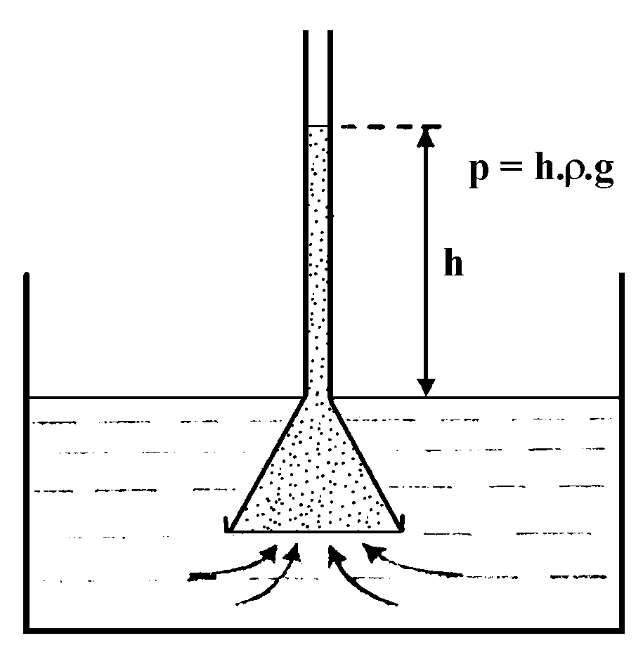
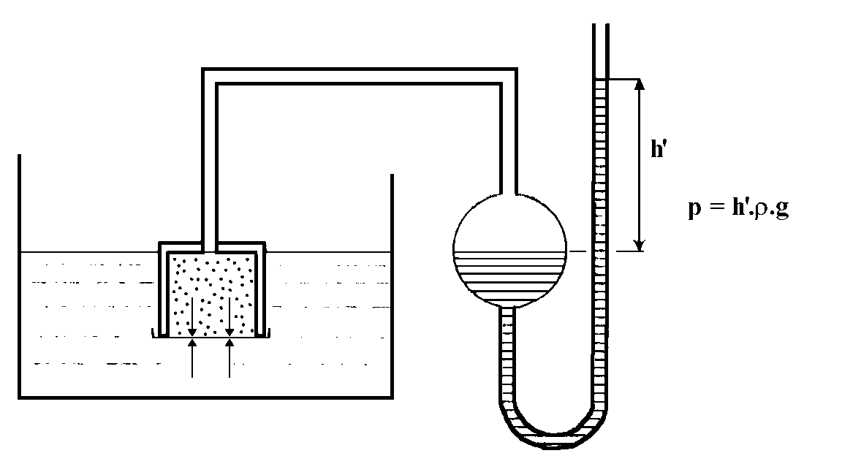
Pfeffer experiment

Slide 19
van't Hoff formula
Π = cRT
Π is osmotic pressure [Pa]
c concentration of dissolved compound (n/V)
R universal (molar) gas constant
T thermodynamic temperature
Better fitting (approaching) formula:
Π = m'RT
m' is molality (substance amount in 1 litre of solvent).

Slide 20
van't Hoff formula
For electrolytes:
Π = icRT
i is dimensionless van't Hoff correction factor, which says how many times more particles are present in solution than the original number of dissolved non-dissociated particles (molecules).
The product ic is sometimes called osmolar concentration or osmolarity with unit osmol·l⁻¹.
A strong electrolyte with concentration of 1 mol·l⁻¹, dissociating into two ions, has the osmolar concentration 2 osmol·l⁻¹ and double the osmotic pressure of a non-dissociating compound of the same concentration.
The osmotic pressure of blood plasma or interstitial fluid is about 770 kPa. (1 M solution of a non-dissociating compound has osmotic pressure 2.58 MPa at the same temperature).
Oncotic pressure (3.3 kPa)

Slide 21
Tonicity of solutions
solutions having osmotic pressure lower than blood plasma has are hypotonic, with the same pressure are isotonic, and with higher pressure than blood plasma are hypertonic.
endoosmosis: haemolysis
The range of concentrations of hypotonic solutions in which partial or full haemolysis does not occur = osmotic resistance of erythrocytes.
exoosmosis: plasmorrhysis (in plants - plasmolysis)
receptors (volumoreceptors in kidneys and osmoreceptors in hypothalamus)

Slide 22
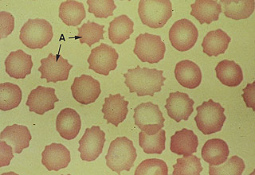
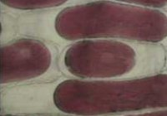
How does it look?
Echinocytes – erythrocytes exposed to a hypertonic solution. http://webteach.mccs.uky.edu/COM/pat823/online_materials/diglectures/rbcs/imgshtml/image36.html
Plasmolysis of epidermal cells of onion in hypertonic medium.
http://www.pgjr.alpine.k12.ut.us/science/whitaker/Cell_Chemistry/Plasmolysis.html

Slide 23
Author:
Vojtěch Mornstein
Language revision:
Carmel J. Caruana
Last revision and sound track addition: September 2020

