Slide 1
XXX. Vertigo and nystagmus
Practicals
Department of Physiology LF MU

Slide 2
Nystagmus
rhythmic eye-bulb movements, 2 components: slow deviation to one side and fast twitch to the opposite side (slow is vestibular, fast from brainstem structures)
Nystagmus at rest (unprovoked) – vestibular system, neural pathways or cerebellum is affected by some pathological process
Direction of the nystagmus is determined according to the fast twitch

Slide 3
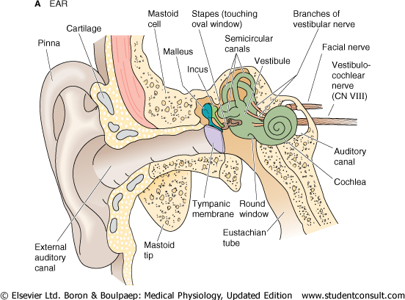
The Vestibular System structure

Slide 4
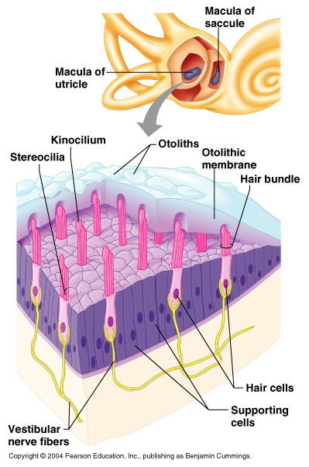
The Vestibular System
The vestibulo-ocular reflex (VOR) stabilizes retinal images during head motion by counter-rotating the eyes at the same speed as the head but in the opposite direction
Semicircular canals (kinetic sensor)
cristae ampullares, specialized for responding to rotational acceleration of the head
Utriculus, sacculus - maculae staticae (static sensor)
linear acceleration, head position in the gravitational field

Slide 5
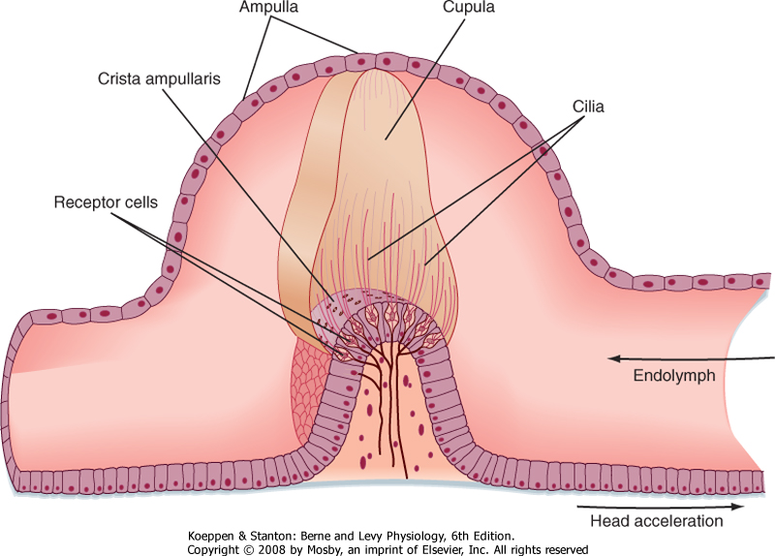
The Vestibular System – Semicircular canals
Each semicircular canal contains an ampulla containing hair cells embedded in sensory epithelium called crista ampullaris
Cilia of hair cells project into gelatinous cap called cupula
Head rotation results in inertial movement of endolymph in opposite direction, which inflects cilia
http://users.atw.hu/blp6/BLP6/HTML/C0089780323045827.htm

Slide 6
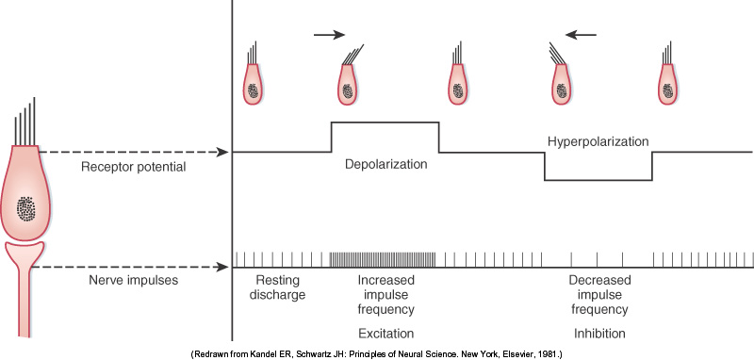
Semicircular canals: sensory transduction
Steriocilia maintain directionality on both sides of the head
Bending towards kinocilium → opens mechanically gated cation channels → K+ influx → depolarization
Bending away from kinocilium → closes channels that are open during resting state → hyperpolarization

Slide 7
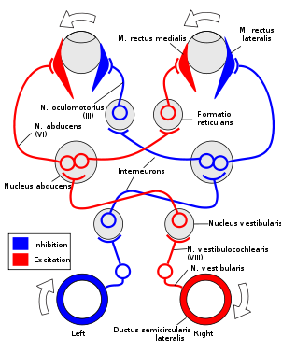
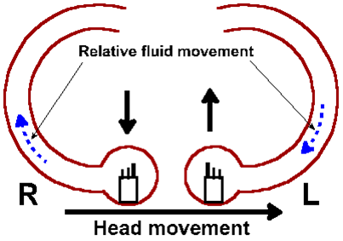
Head rotation results in inertial movement of endolymph in opposite direction
With turning of the head, hair cells on one side of the body send excitatory signals to the brain while hair cells on the opposite side are inhibited
Each channel is associated with a pair of peculiar muscles that moves the eye in its plane

Slide 8
Tests for provocation of nystagmus
semicircular canals are stimulated by:
post-rotational
Caloric (application of external auditorial tube either with cold=27 C or warm=47 C water)
Galvanic (stimulation with electric current)

Slide 9
Post-rotational nystagmus
Examined subject with eyes closed and head inclined frontally by about 30 degrees is sitting in the swivel chair – lateral channel is in horizontal plane
Rotate the chair 10 times during 10 s and than suddenly stop chair
The rotation is suddenly stopped and movements of subject’s eyes are observed
Observe post-rotational nystagmus
Slow eye movement – initiated from vestibular system, in direction of endolymphe flow
Fast eye movement – initiated from brain stem, returns the bulb to the starting position (direction of nystagmus)
Various head inclinations stimulate different channels – influence on plane and direction of nystagmus

Slide 10
Evaluation of the post-rotational nystagmus in practicals
In practical: direction (horizontal, vertical, diagonal, rotational) – according to the fast eye movement
Other possible parameters
amplitude (in degrees)
frequency (Hz)
duration (s, min)
head inclination | direction of rotation | plane of nystagm | direction of nystagmus
frontally by about 30°
on the left by 90°
on the right by 90°
maximally back
maximally frontally

Slide 11
Vertigo
Vertigo (dizziness)– subjective loss of stability in space, rotation of surrounding space or rotation of body in space
connected with objective symptoms – disturbances of equilibrium and nystagmus – by stimulation of the labyrinths
Hautant test (differential diagnosis of vestibular, cervicogenic, and ischemic dysfunction)
subject closes eyes and stretch arms forwards
tonic deviations of the arms are associated with deviation of the body in the same direction
deviations of the arms are in direction of impaired labyrinth (according to the slow part of nystagmus)
In practical: Hautant test after rotation – observe the direction of the arms deflection in the relation to the direction of rotation

