Slide 1

Isolation of the operating field
Restorative dentistry 3rd year
Lecture 2

Slide 2

Dry field in oral environment?
Access
View
Setting of materials
Notes:
tt

Slide 3
What does complicate the treatment?
Saliva
Cooling water spray
Blood

Slide 4
Dry field management
Relative dry field
Absolute dry field

Slide 5
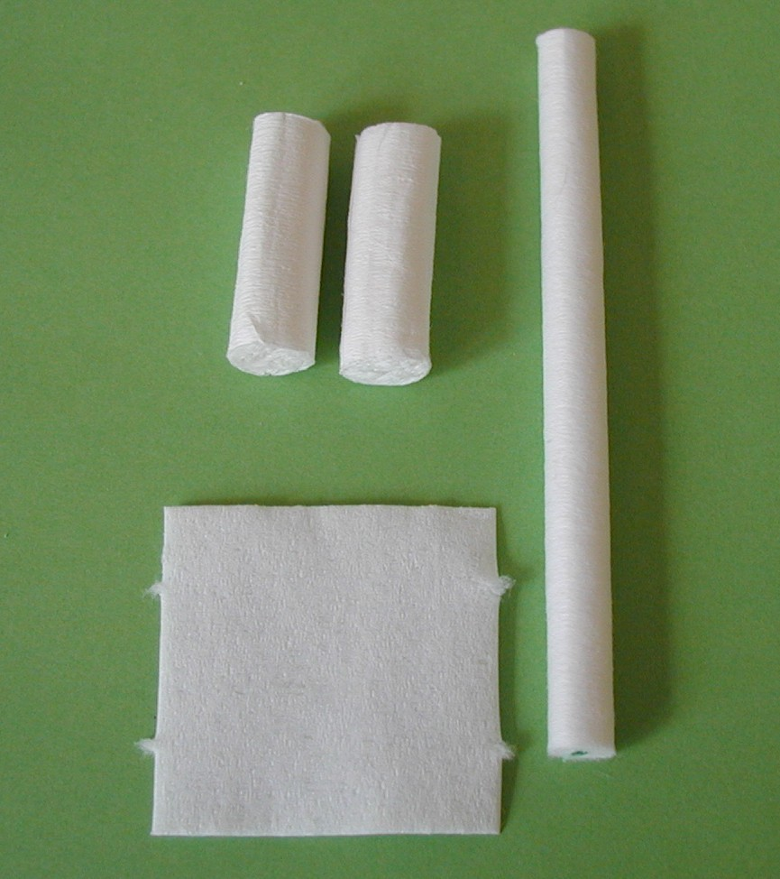
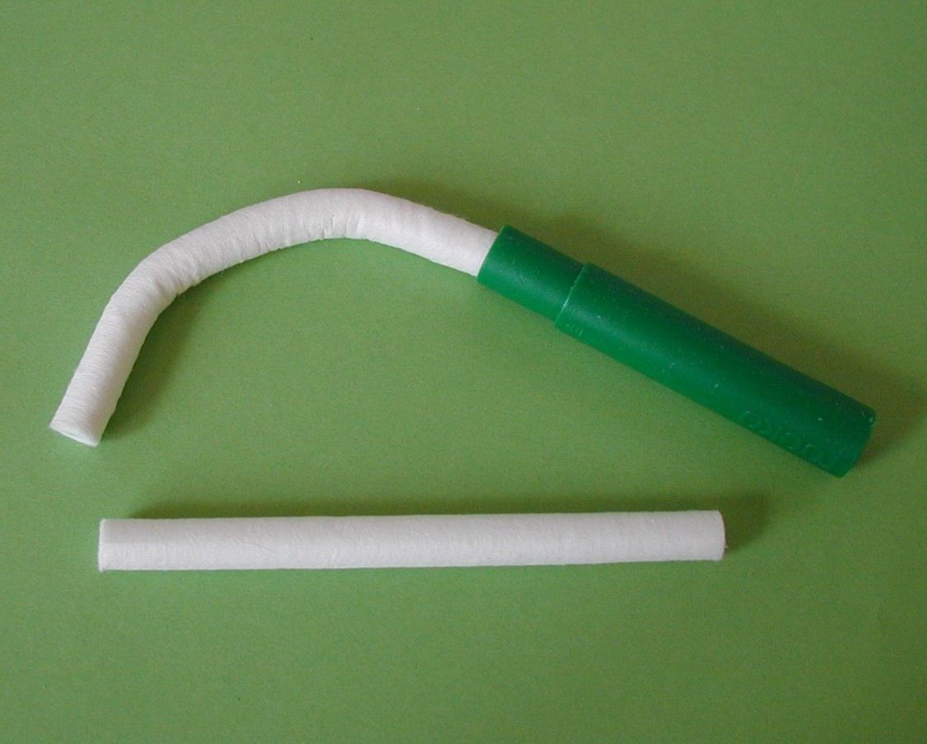
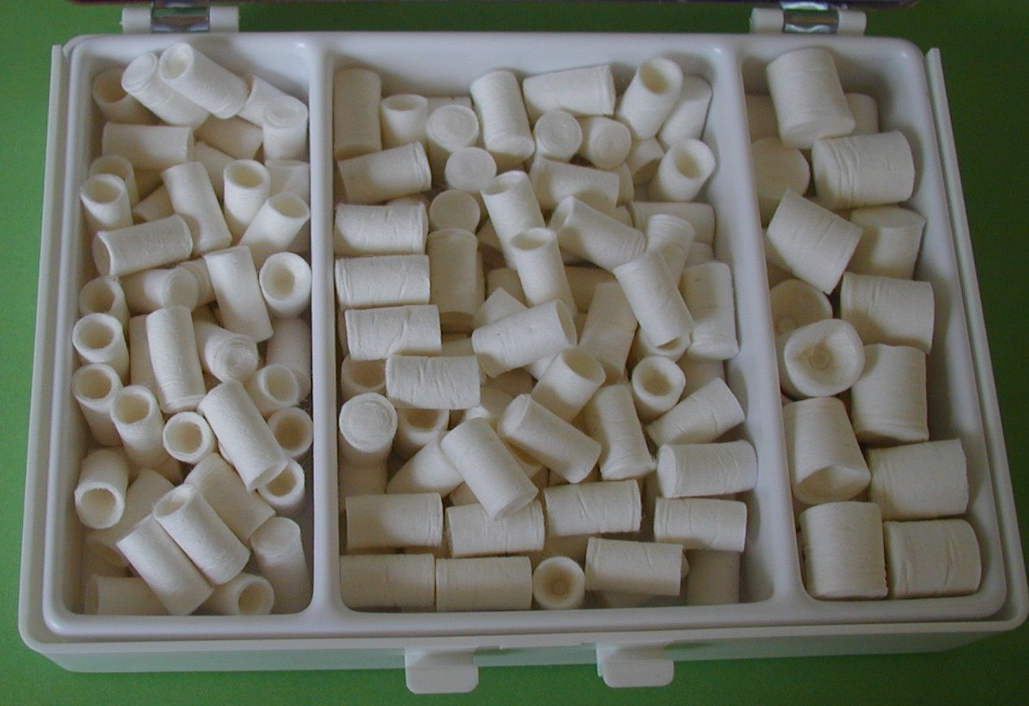
Relatively dry field
Cotton rollers
Cotton squares
Cotton cups

Slide 6
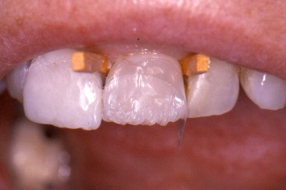
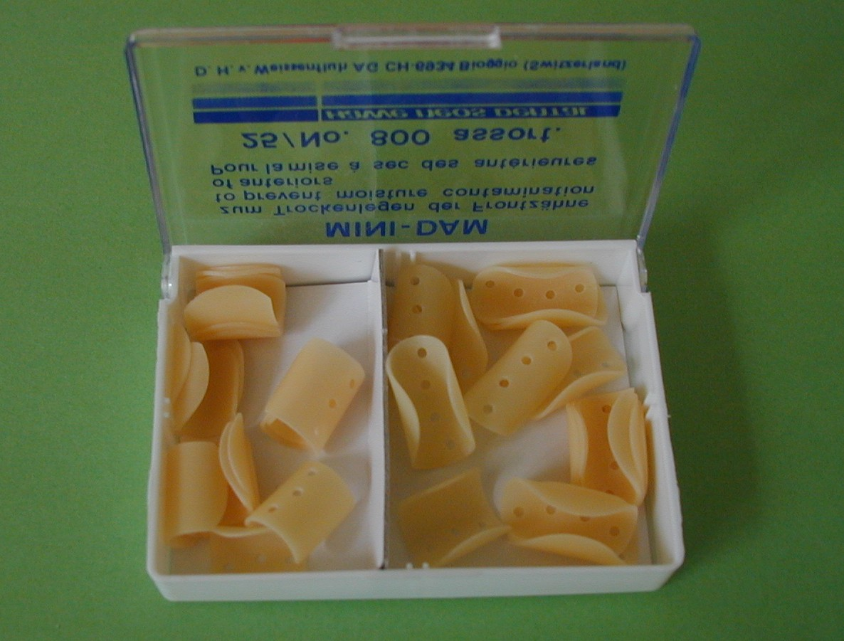
Relative dry operating field
Belvedere matrix
Wooden wedges
Minidam

Slide 7
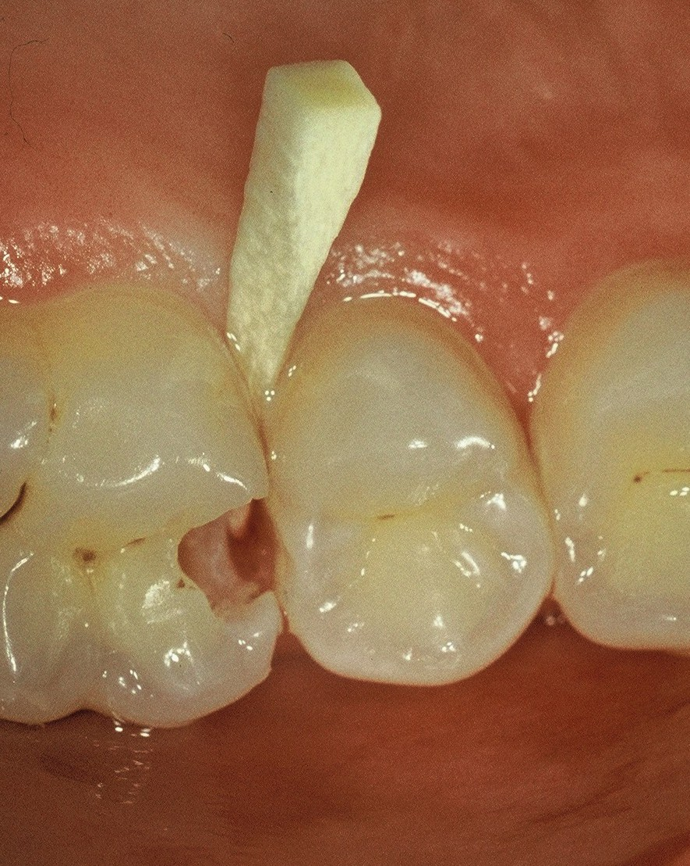
d
Wooden wedge
Access to the cavity
(retracts the gingiva)
Dry field
(stops bleeding)
Matrix adaptation
(presses the strip tightly)
Ix

Slide 8
Absolutely dry oparating field
Rubber dam (kofferdam)
A membrane which isolates the operation field
from oral envionment.

Slide 9
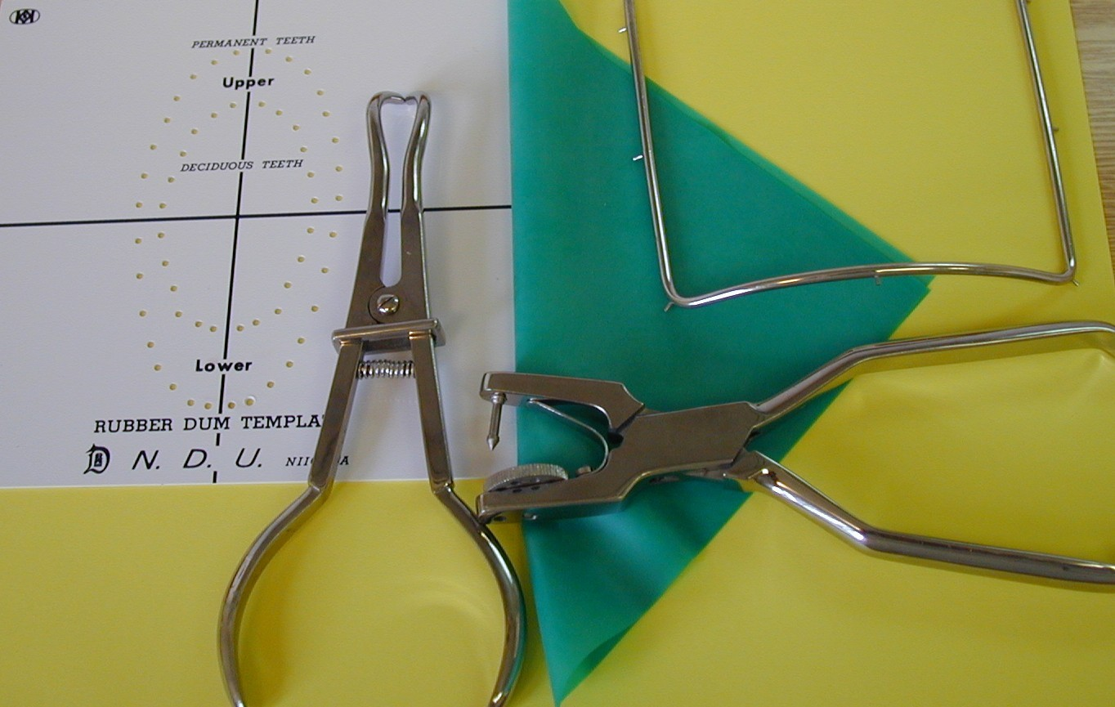
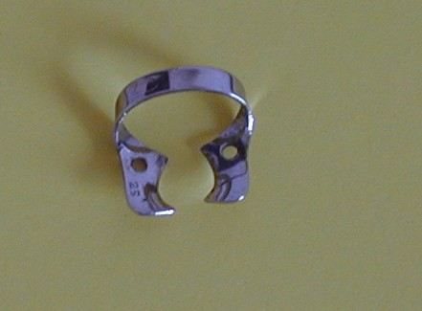
Frame
Rubber
Sheet
Punch forcep
Components
Clamp
Clamp forceps

Slide 10
Benefits
Protection of patient against gulp or aspiration
Protection of dentist and assistant against infection
Aseptic approach
Absolute dry field
Retraction of soft tissues
Protection of soft tissues
Better access to the operation field

Slide 11
RISKS
Limitation of oral breathing
Fear
Latex allergy
Aspiration or gulp of the clamp
Damage of hard and soft tissues

Slide 12
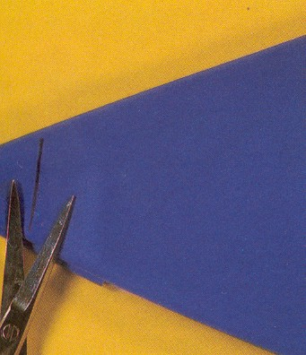
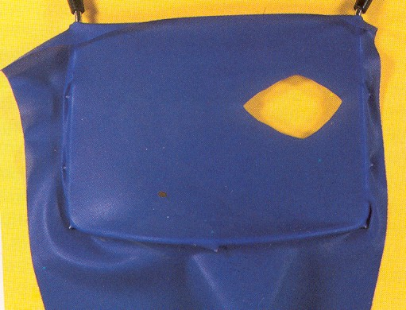
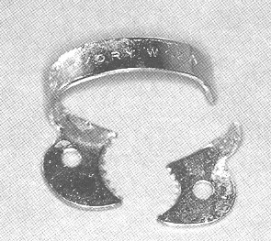
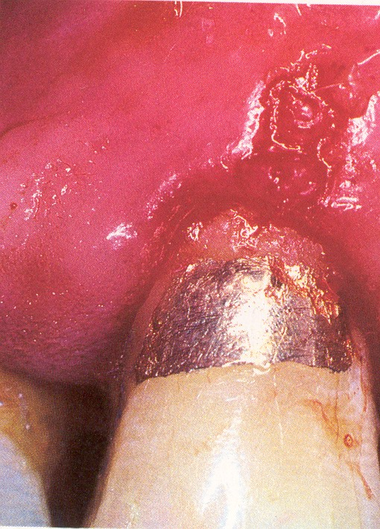
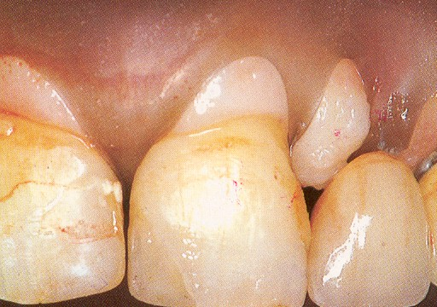
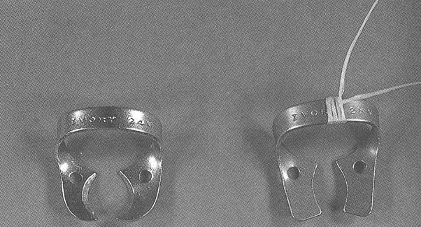

Slide 13
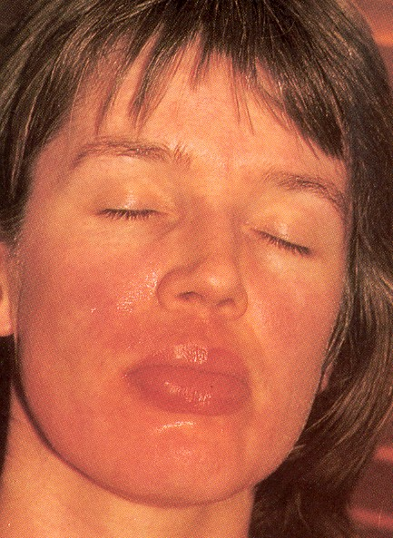
Contact allergy

Slide 14
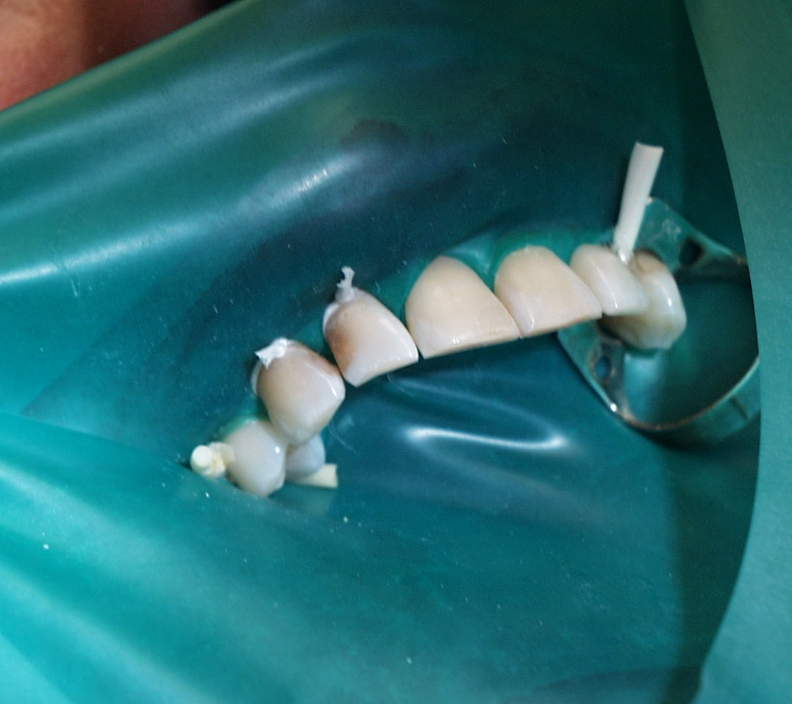
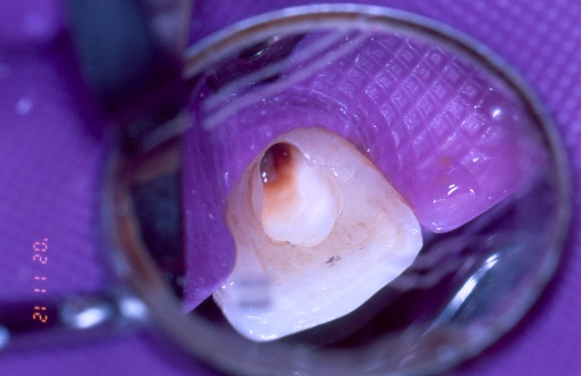

Slide 15
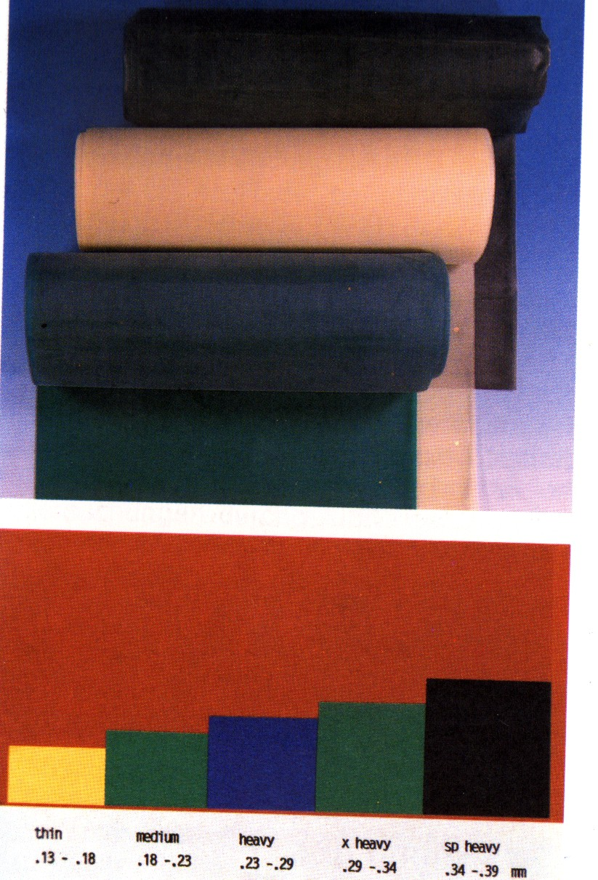
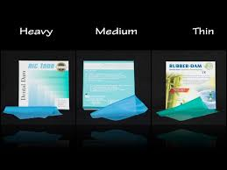
Rubber
Roll
Square (blank)

Slide 16
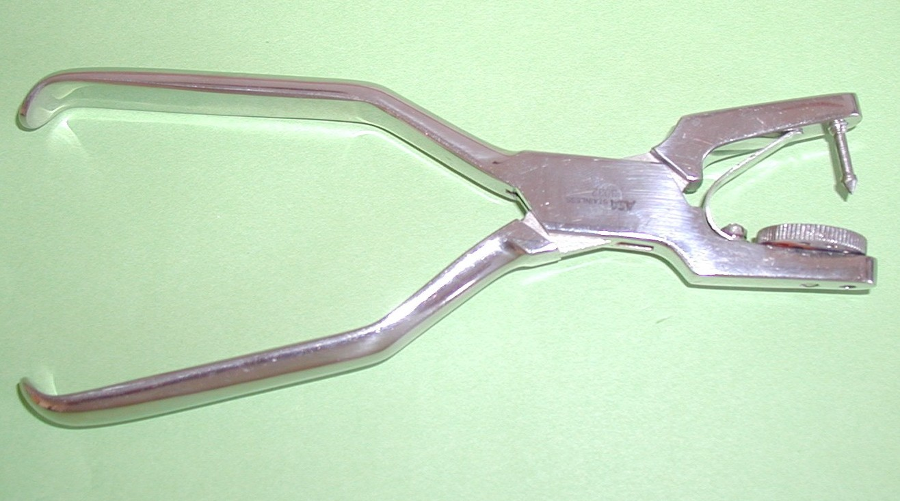
Perforation
Round aperture

Slide 17
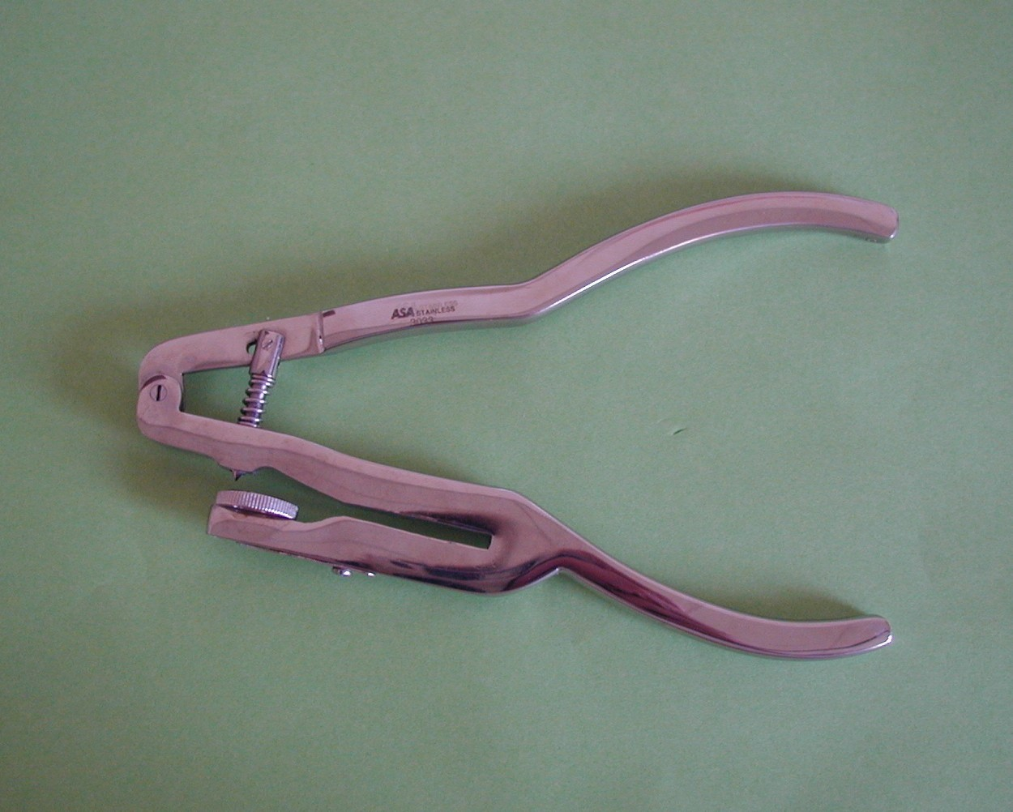
Ainsworth
Ivory

Slide 18
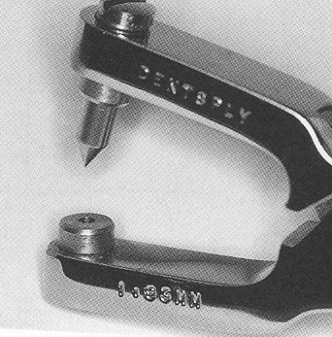
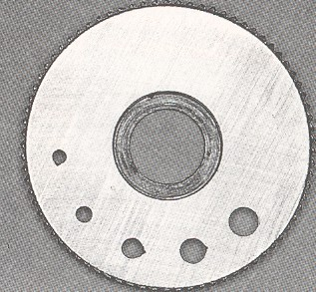
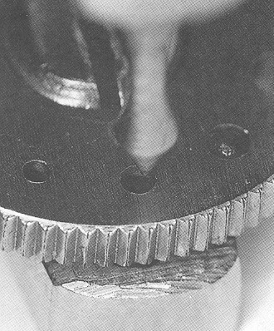
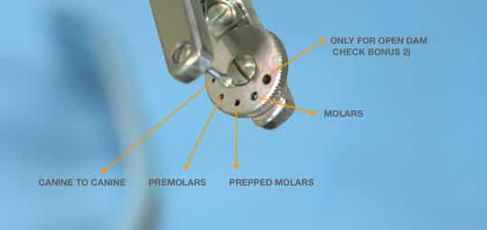
Perforation plate

Slide 19
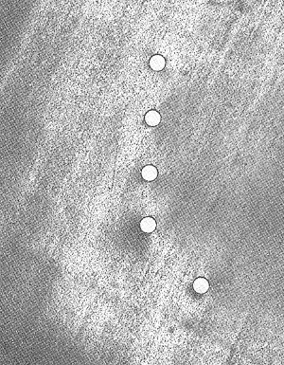
How big will the perforation be?
According to:
Size of the tooth
Thickness and kind of the rubber dam
Mode ofapplication

Slide 20
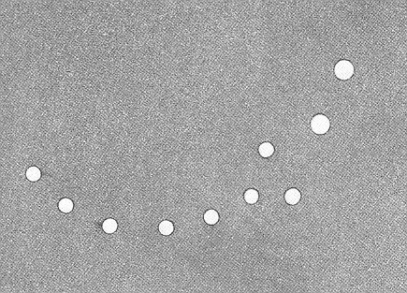
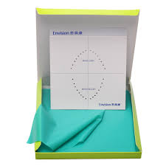
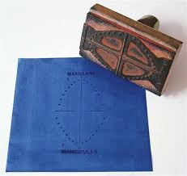
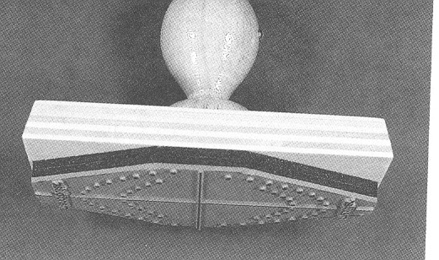

Slide 21
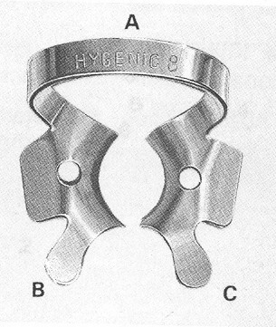
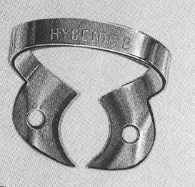
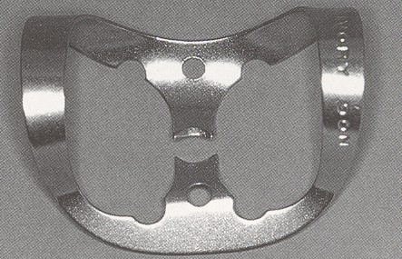
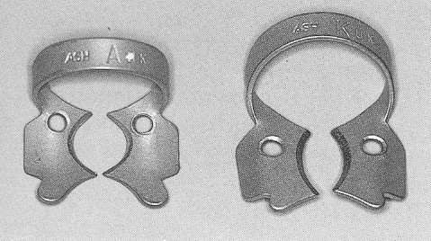
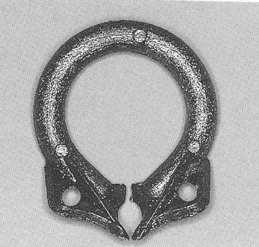
arch
wings
Arch, wings,

Slide 22
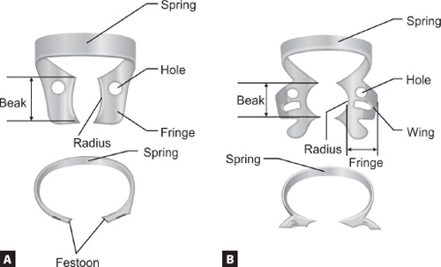
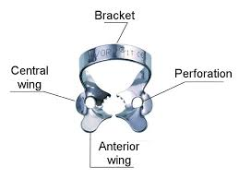
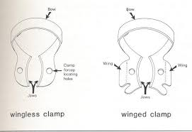

Slide 23
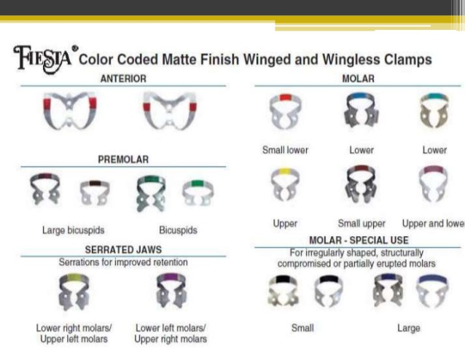

Slide 24
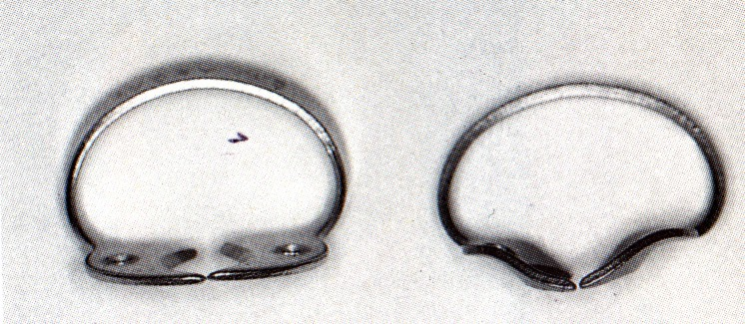
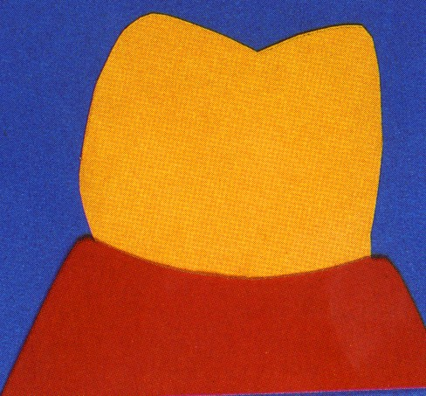
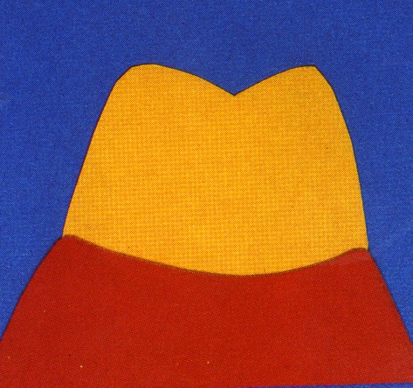
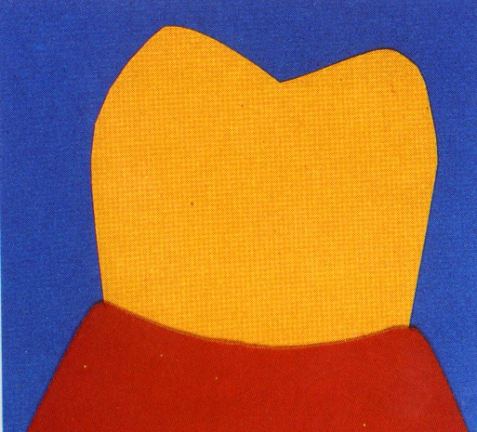
Clamps for retention
Clamps for retraction

Slide 25
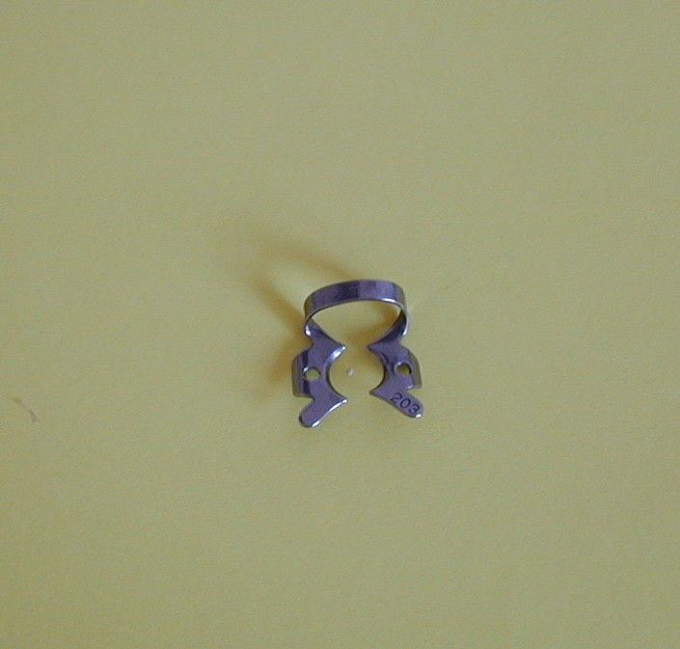

Slide 26
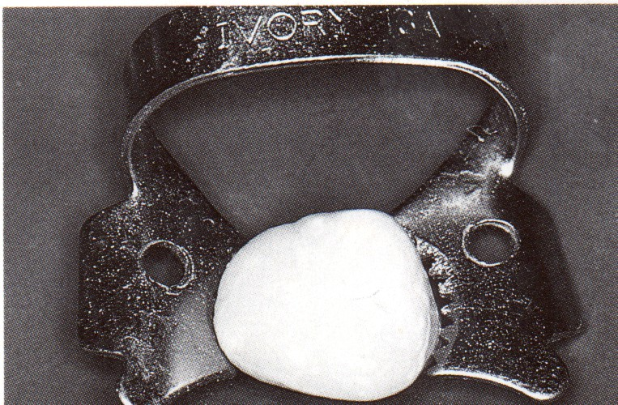
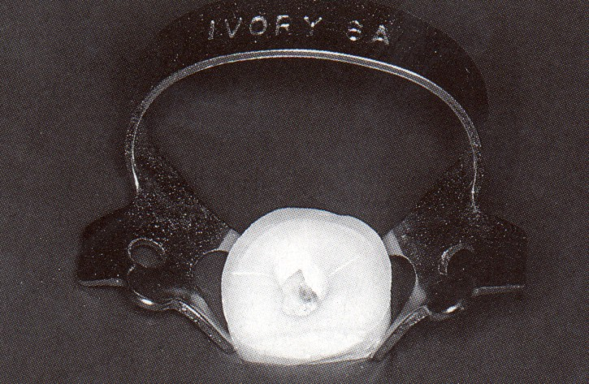
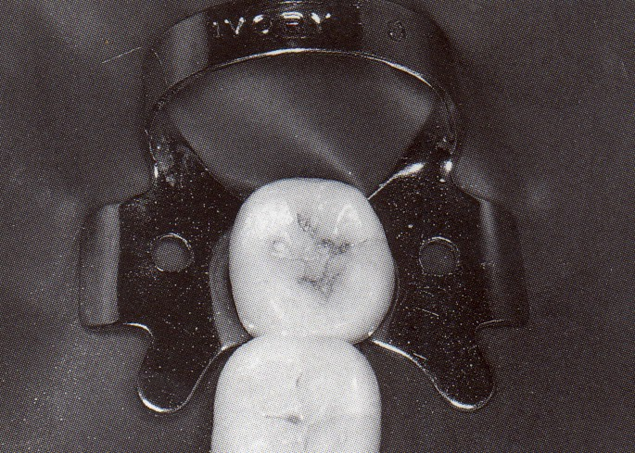
Contact – areal
4 pointed

Slide 27
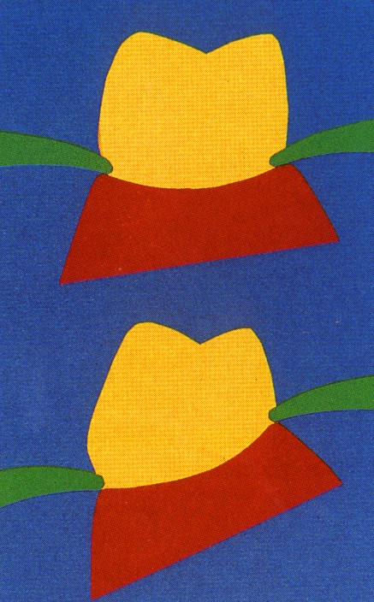
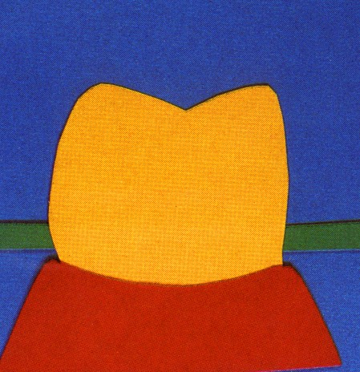
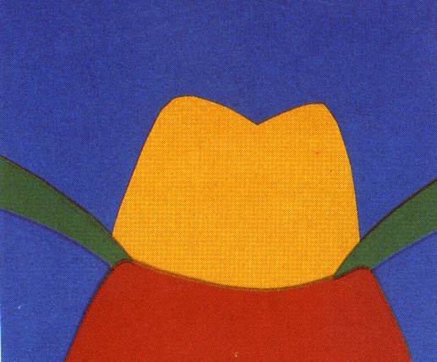

Slide 28





Slide 29






Slide 30

Rubber dam frame

Slide 31




Slide 32



Slide 33


Latex rollers - wedjets
Ligaturs

Slide 34


Slide 35


Slide 36



Slide 37


Slide 38

How many teeth
should be isolated?

Slide 39


Slide 40


Slide 41
Mode of application
Rubber first
Clamp first
Clamp and rubber dam together
Application in seconds

Slide 42


Rubber first

Slide 43


Clamp first

Slide 44

Rubber and clamp together

Slide 45

Rubber, clamp and frame together – application in seconds

Slide 46





Interdental adaptation

Slide 47


Interdentál adaptation

Slide 48


Slide 49


inversion

Slide 50




Slide 51
Latex rollers - wedjets
Ligaturs

Slide 52




Thermoplastic impression material

Slide 53



Elongation of the clinical crown before application od the clamp

Slide 54



Napkin
Lubrication

Slide 55
Modifications
Optidam
Optradam
Minidam

Slide 56




Optidam

Slide 57



Optradam

Slide 58


lenka.roubalikova@tiscali.cz

Slide 59

Minidam

