Slide 1
Restorative dentistry III.
Repetition

Slide 2
Composite materials
Chemically bonded mixture of organic
matrix and inorganic fillers

Slide 3
Coupling agent – binds organic matrix and the filler together
Homogenous distribution of the filler particles in the material
Excellent mechanical properties

Slide 4
Binding of the coupling agents to glass particles
CH2=C(CH3)-R
CH2=C(CH3)-R
CH2=C(CH3)-R
H O-Si
H O-Si
H O-Si
Double bond -polymerizable
Glass particle

Slide 5
Importance of the components
matrix – a transfer mechanical loading on inorganic fillers, protects the filler against moisture
filler - a support of the material, carries the loading
coupling agents - a homogenous distribution of the filler in matrix

Slide 6
Kompozitní materiály podle plniva
Makroplnivo - makrofilní
Mikroplnivo – mikrofilní
Kombinace – hybridní
konvenční hybridní
mikrohybridní
Kompozity s nanoplnivem

Slide 7
Composition - matrix
Bis GMA – Bowen´s monomer • (2,2-bis[4-(2hydroxy-3-metakryloyloxypropoxy) • fenyl]propan)
• Bis DMA
• UDMA
• TEGMA /triethylenglykoldimethacrylate
• EGMA ethylenglykoldimethacrylate
• eBis –GMA
• HDMA hexandioldimethacrylate
Dimethacrylates

Slide 8
Composition – matrix
- Acid modified resins (compomers)
Polysiloxan chains with
polymerizable groups (ormocers)
- Silorans (ring opening monomers)

Slide 9
Filler
Milled quartz
Aluminimum silicate glass
Silicium dioxide
Prepolymer
Complexes of microfiller (aglomerates)

Slide 10
Macrofiller
Particles µm or tenths of µm
Good mechanical resistance , abrasion resistance, bad polishability.

Slide 11
Microfiller
• Silicium dioxide (pyrogenous)
• Particles hundreths µm
Less amount of filler due to big surface
Lower mechanical resistence, good polishability.

Slide 12
Microfiller in complex particles
Prepolymer
Aglomerates
- Higher amount of filler, good mechanical resistance, good polishability

Slide 13
Nanoparticles
Particles 10 nm and less
Special technology, size, shape and binding to monomer

Slide 14
Coupling agent
G -methacryloxypropyltrimetoxysilan (A 174)

Slide 15
Other components
Activator and initiator
Pigments
Fluorescents
Absorbers of light
Inhibitors

Slide 16
Selfcuring composites
Dibenzolyperoxide Tertiary amine
Initiator Activator

Slide 17
Light curing composites
Initiator and sometimes also activator
Camphorchinon CQ
Phenylpropandion PPP
Trimetylbenzoylphosphino xid TPO

Slide 18
Camphorchinon - CQ
Yellow colour
Activator: etyl-4-(N,N’-dimetylamino)benzoát (4EDMAB), N,N’-dimetylaminoetylmetakrylát (DMAEMA)
Light shades of composites: combination of CQ and other initiators.

Slide 19
Composite materials – basic characteristics
Matrix Filler
Compressive strength
Elasticity
Polymerization shrinkage
Polymerization stress
Water sorption

Slide 20
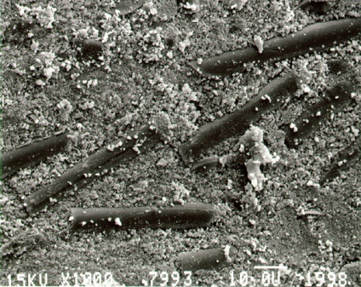
Classification of composite filling materials
Size of the filler particles
Macrofilled, microfilled (homogenous, non homogenous, hybrid)
Matrix (monomers)
Dimethacrylate, acid modifies, ormocers, silorans
Viskosity (flowable, thick)

Slide 21
History
Dimetacrylates
Bowen 1960 – Bowen´s monomer
Buoconore 1955 – acid etching

Slide 22
History
Fusayama 1979
Adhesion to dentin
Yoshida. Nakabaiashi
Van Meerbeck

Slide 23
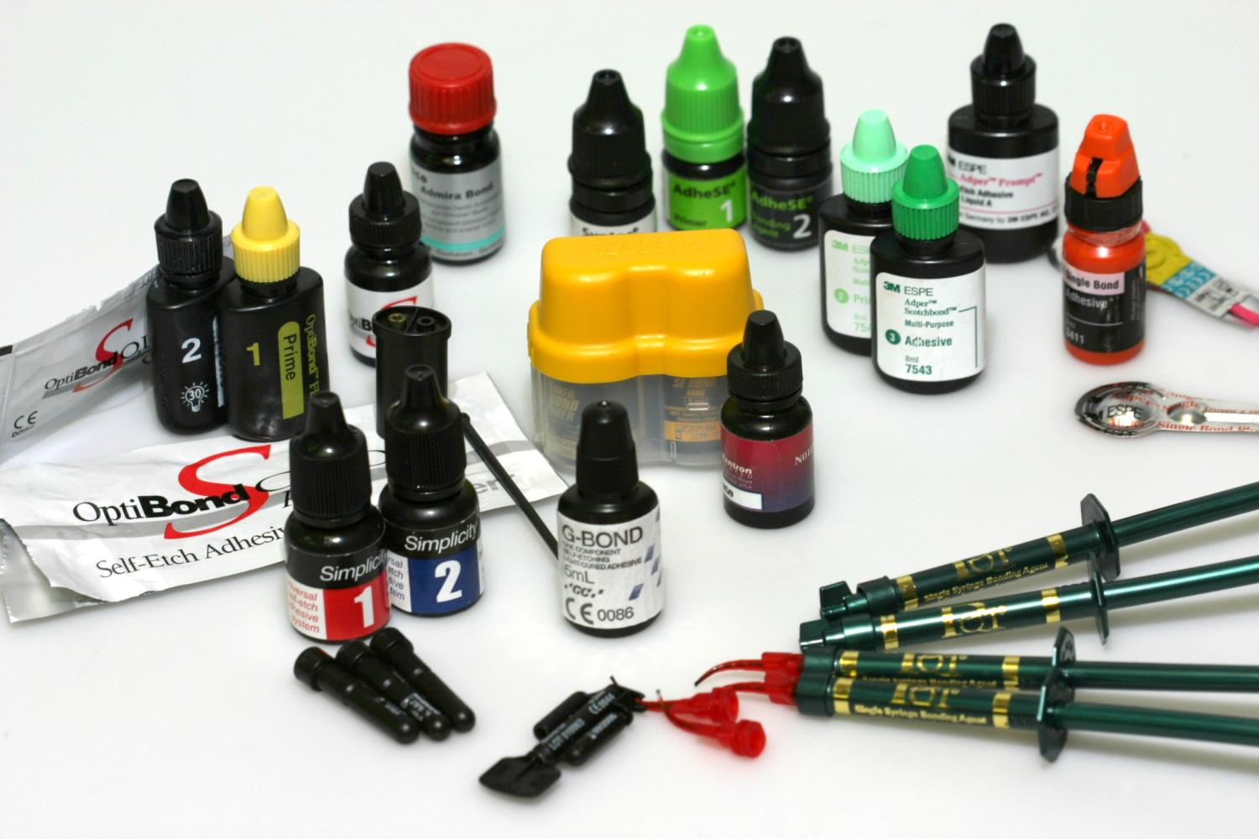

Slide 24
Adhesion
Mechanical adhesion
Specific adhesion
Intermolecular forces
Chemical binding

Slide 25
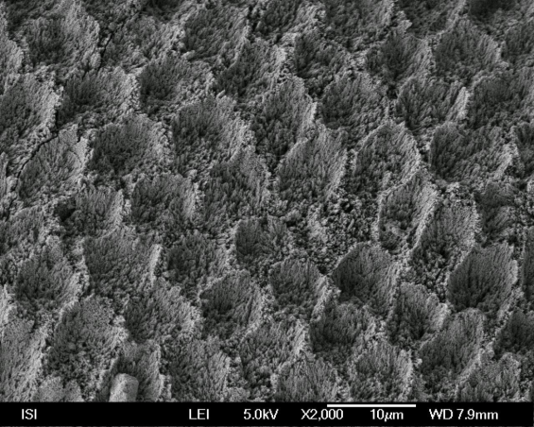
Enamel

Slide 26
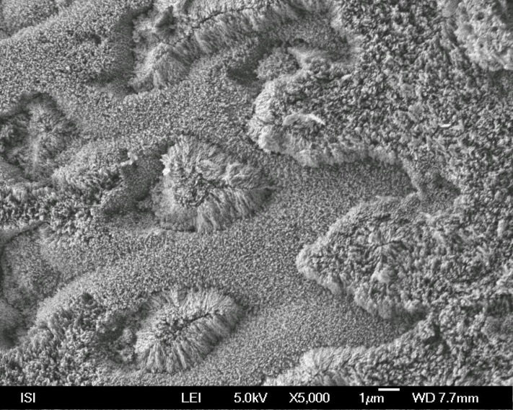
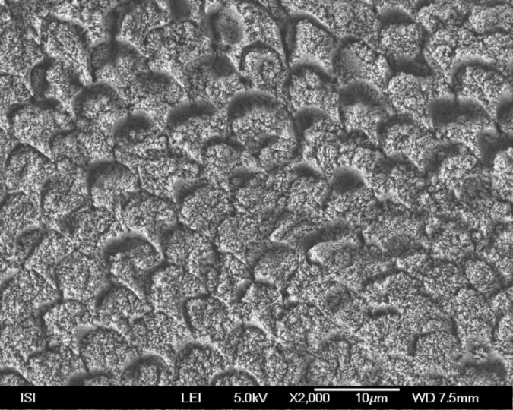
Acid on aprismatic enamel
Acid on prismatic enamel

Slide 27
Dentin – special composition
More water – always wett
Less minerals
Low surface energy
Smear layer
Composite is hydrophobic, we need hydrofilic substance

Slide 28
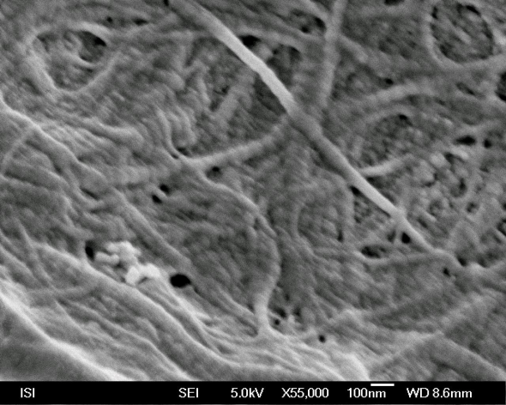
Dentin
Bonding agent

Slide 29
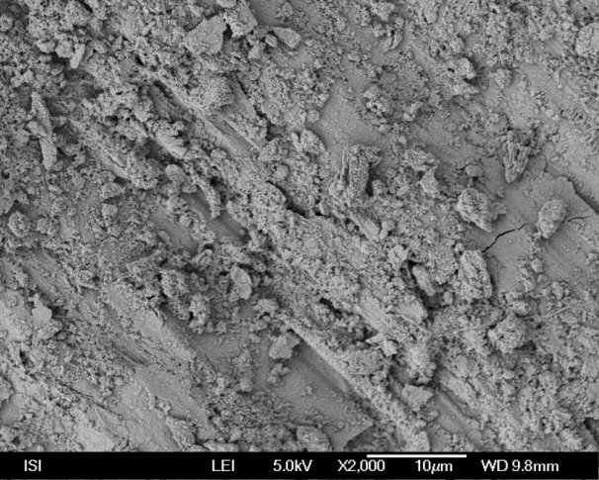
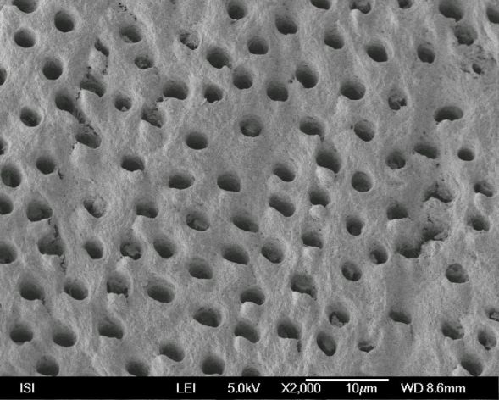
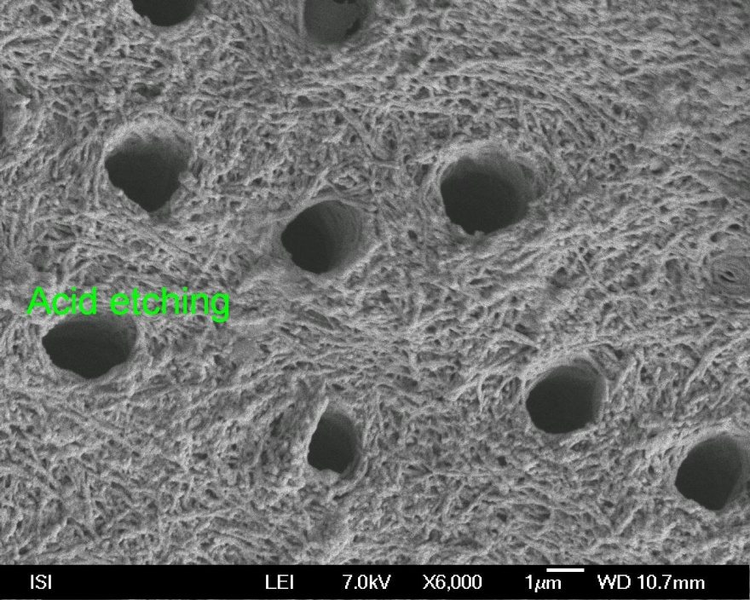
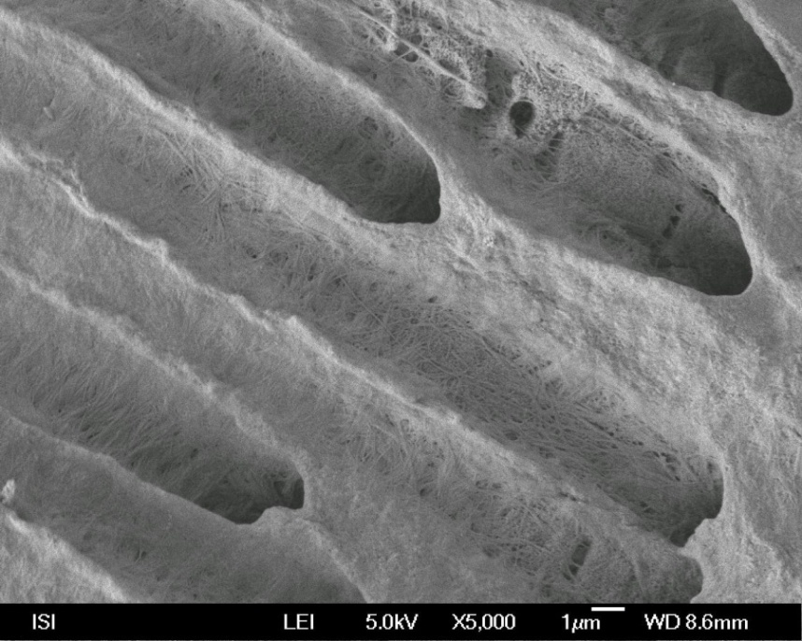

Slide 30
Adhesive systems contain resin monomers
4-META •
HEMA •
TEGMA •
PENTA P •
5-NMSA •
Bis-GMA

Slide 31
Adhesive systems contain resin monomers
Hydrophobic monomers - bond Works in enamel Does not work in dentin without primer
• Amphiphilic monomers – hydrophobic + hydrophilic part - primer
Primer is necesssary for dentin. If applied on enamel – residual of water can be removed.
lroubalikova

Slide 32
Dissolving agents
Aceton
Alcohol
Water
Water/alcohol

Slide 33
Clinically oriented classification of
the adhesive systems acc
to number of steps
Acid etching | Rinsing | Priming |  | Bonding
Acod etchin | Rinsing | Priming a bonding
Selfetching priming |  |  | Bonding
Selfetching bonding)

Slide 34
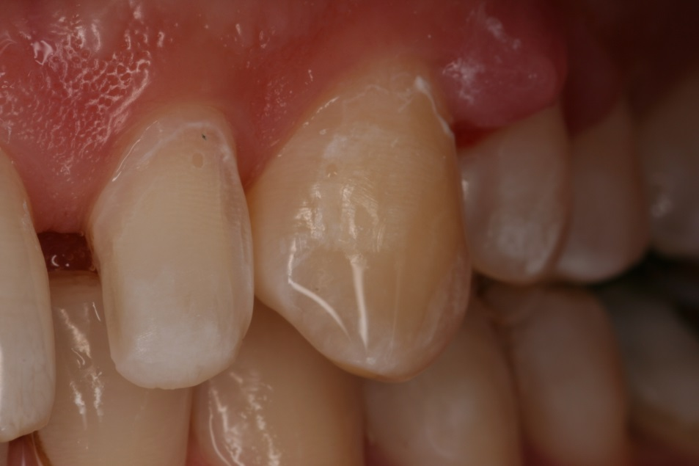
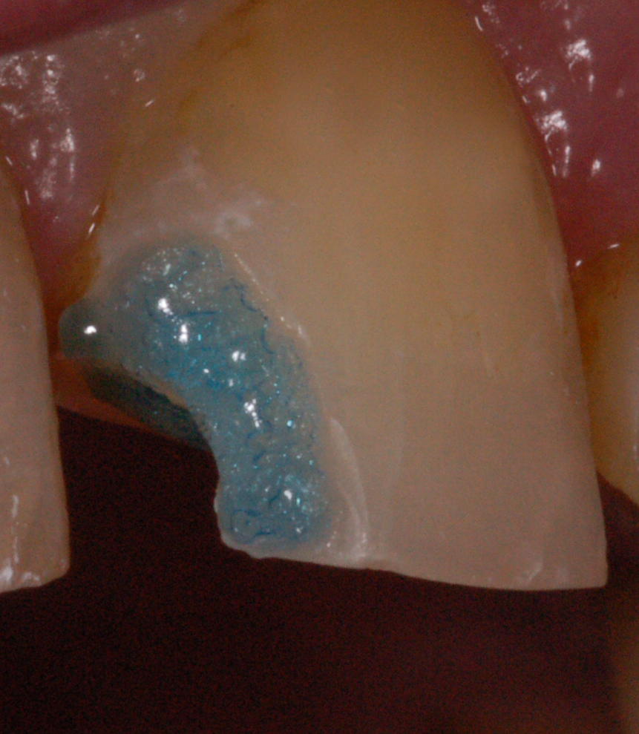
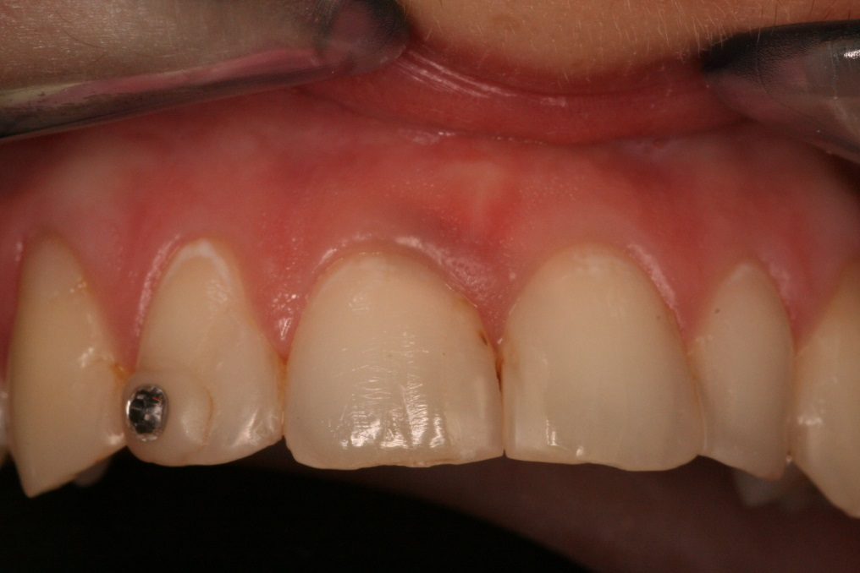

Slide 35
Srelfetching bonding agents

Slide 36
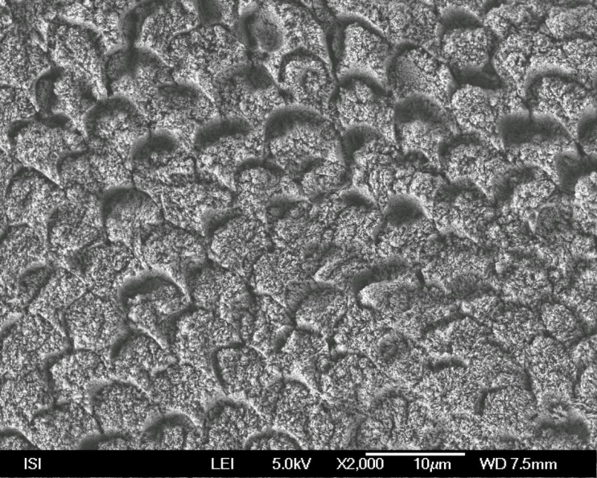
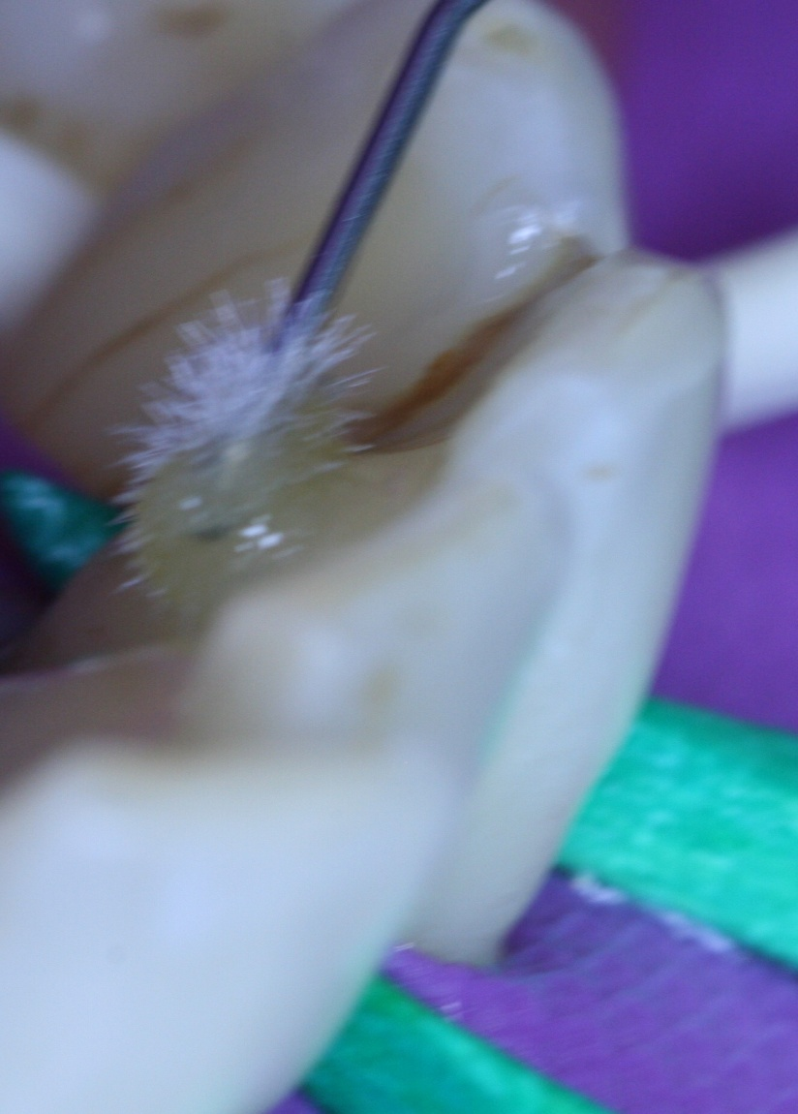
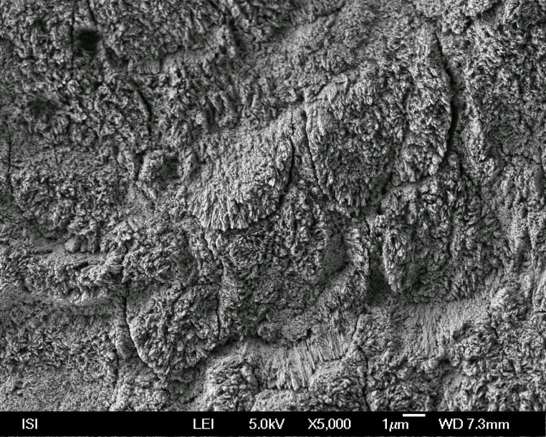
TE – Total etch,
ERA
SE – Self etching
SEA

Slide 37
Two steps selfetching agents
Acidic hydrophilic primer – evaporation of the solvant, penetration, dissolving of the smear layer
Hydrofobic bond – sealing of the surface

Slide 38
One step selfetching agents
More vulnerable bonding, risk of hydrolysis
FAKT !!!

Slide 39
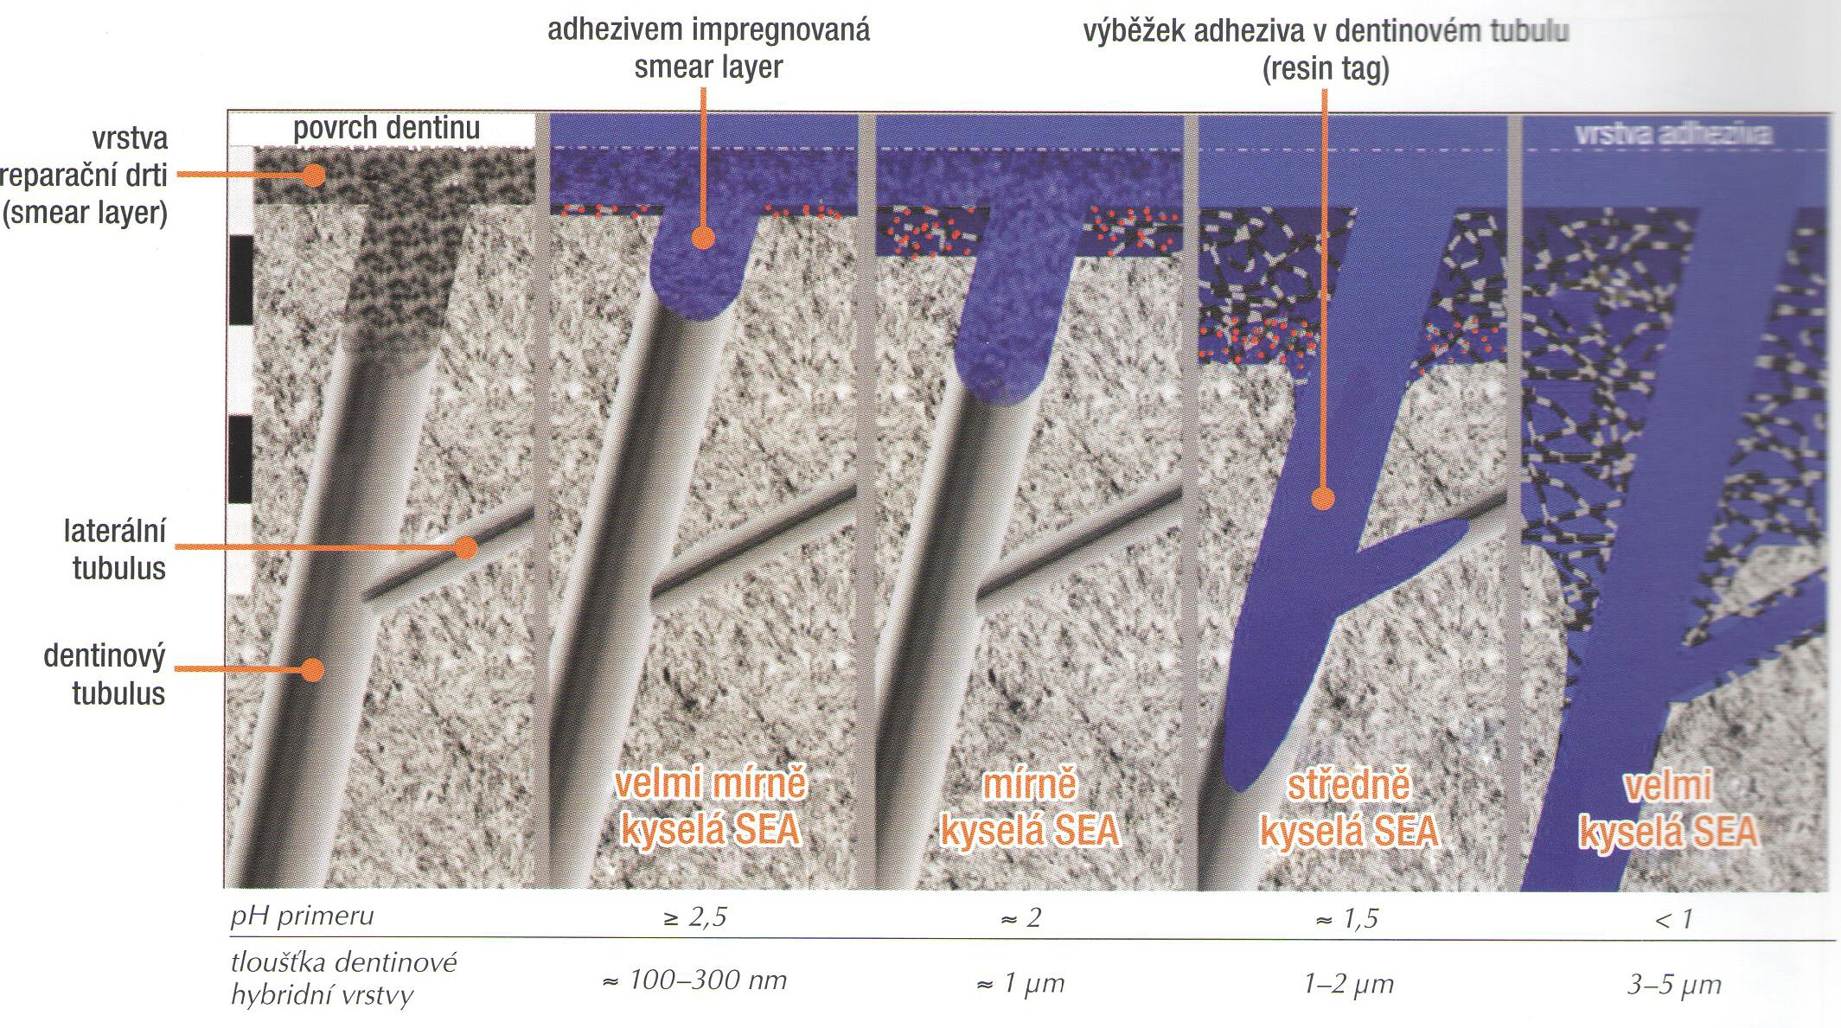
surface of dentin smear layer impregnated resin tag
with the adhesive system
Smear layer layer
Dentin
tubules
very mild acidic sea
mild acidic sea
acidic sea
strong acidic sea
pH of the adhesive system
thickness of the hybrid layer
Source: Dudek M. Adhezivní spoj
a adhezivní systémy I. LKS 11/2013

Slide 40
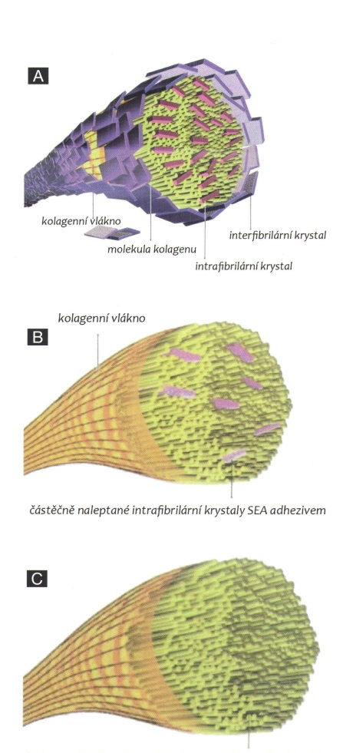
Colagen fibers with interfibrilar and
Instrafibrilar crystals od hydroxyapatite
Colagen fibers with intrafibrilas crystals
of hydrpoxyapatite only
Colagen fibers without crystals
of hydroxyapatites
Zdroj obrázku: Dudek M. Adhezivní spoj
a adhezivní systémy I. LKS 11/2013

Slide 41
Importance of hydroxyapatite
Protection of collagen against hydrolysis
as well as enzymatic degradation of collagen (due to activation of matrix metaloproteinasis)
Strong mineral acid id dangereous for good long term bonding
Clorhexidin for one minute can stabilize collagen

Slide 42
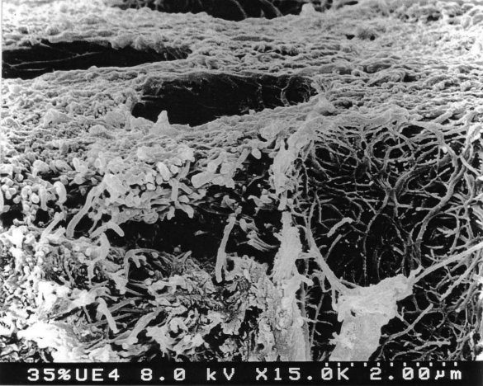
Enzymatic degradation of
collagen

Slide 43
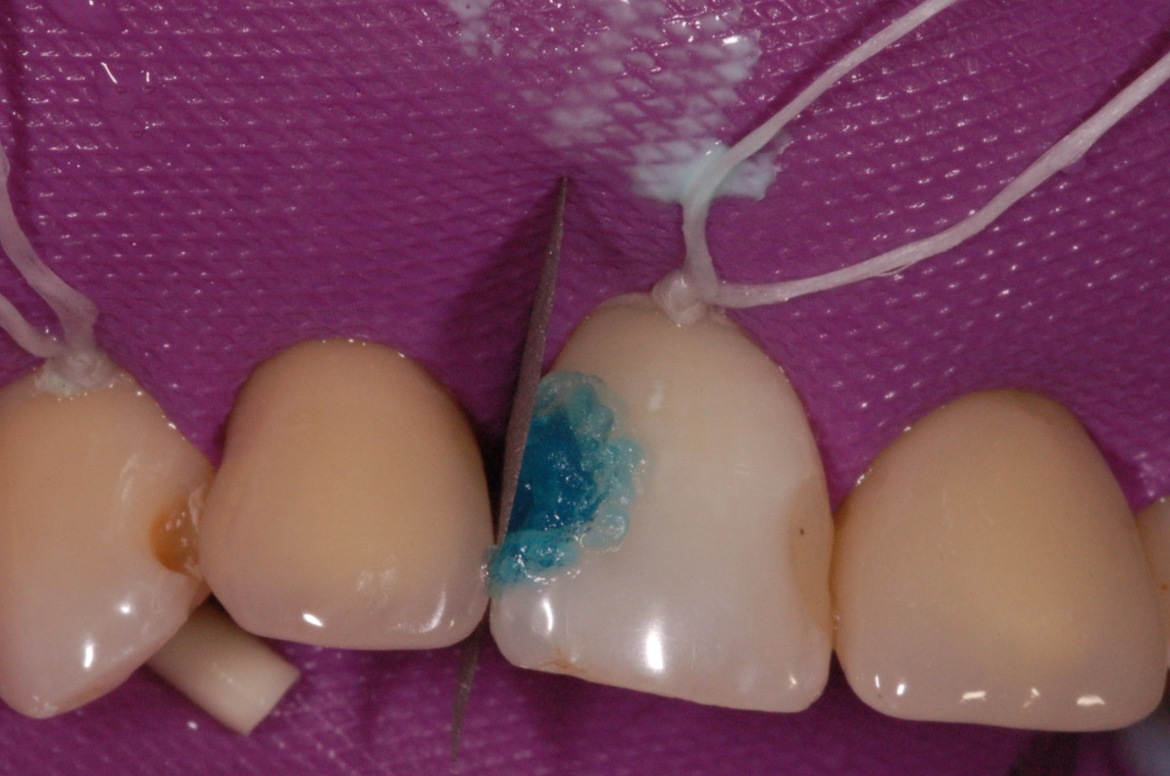
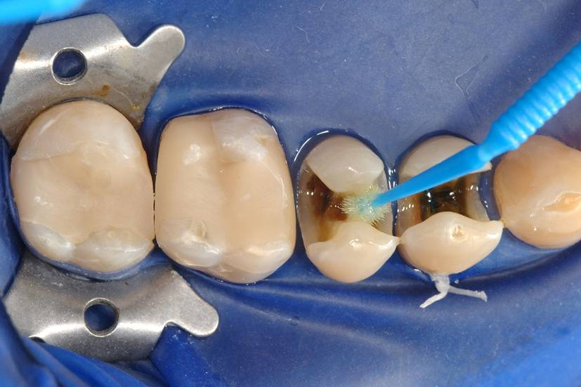

Slide 44
Factor that influence the quality of bonding
Structure and composition of hard dental tissues
Quality of their surface – esp. presence of smear layer, contamination with moisture, saliva and blood
Configuration factor – C- factor
Mechanical loading of the adhesive connection
Oral environment and external chemical materials (tooth pastes, asntiseptics, bleaching agent rtc.)

Slide 45
Polymerization stress depends on
Quality of the material
C- factor
Mode of application
Mode of polymerization

Slide 46
Polymerization stress depends on
Quality of the material
C- factor
Mode of application
Mode of polymerization

Slide 47
Polymerization stress depends on
Quality of the material
C- factor
Mode of application
Mode of polymerization

Slide 48
High content of filler increases the modulus of elasticity
High modulus of elasticity increases the polymerization stress
High content of filler decreases the polymerization shrinkage
Polym. Stress
Modulus of elasticity
Polymerization shrinkage

Slide 49
Polymerization stress depends on
Quality of the material
C- factor
Mode of application
Mode of polymerization

Slide 50
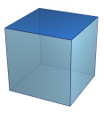
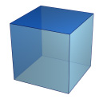
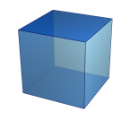
5
2
1
Bonded area : Free area
1:1 and less - optimal

Slide 51
Polymerization stress depends on
Quality of the material
C- factor
Mode of application
Mode of polymerization

Slide 52
Mode of application
Incremental technique
Layer by layer with big free surface
Importance of flowables
Thin layer of flowable first –big free surface
Good marginal adaptation
Compensation of the stress of the other layers
Bulk fill materials do not solve the problem with polymerization stress

Slide 53
Placement of the material

Slide 54
Polymerization stress depends on
Quality of the material
C- factor
Mode of application
Mode of polymerization

Slide 55
Light
Polymerization
Monomer
Polymer

Slide 56
Pre gel phase should be long – soft start !!!!
Pre –gel
Gel
Post -gel

Slide 57
Three phases
Phases
Pre-gel – material is soft
Gel-point – material became hard
Post –gel – material is not soft, postgel shrinkage

Slide 58
48μm
Fotokompozit
102μm

Slide 59
57 μm
Photocpomosite
3mm
3,2mm
8,5mm

Slide 60
42μm
Selfcuring material
434343
43μm

Slide 61
Duration of pre-gel phase
Longer pre-gel phase is better for releasing of polymerization stress
Soft start
Combination of materials (selfcuring composite materials have longer pre gel phase)

