Slide 1

Preclinical dentistry II.
Temporary crowns and bridges.

Slide 2

After preparation the teeth must be protected with the temporary treatment
Protection of dentin wound
Prevention of changes in position of the teeth
Aesthetics

Slide 3

Temporary crowns and bridges
Made of methylmetacrylate resin in dental lab
Made in dental office of special material („stamping method“)
Prefabricated crowns
3D printed temporaries

Slide 4

Temporary crowns and bridges
Made of methylmetacrylate resin in dental lab
After preparation the aginate impression is made in addition to elastomeric impression.
In dental lab the temporary bridge of the methylmetacrylate resin is made (wax pattern, flasking, polymerization)
The bridge is cemented using the temporary cement.

Slide 5
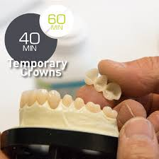
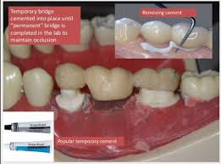


Slide 6

Temporary crowns and bridges
Made in dental office of special material („stamping method“)

Slide 7
Operations
Temporary crown and bridge resins are used to provide immediate temporary coverage following tooth preparation for crowns or bridges.
The usual technique is to record an initial impression in an alginate material prior to tooth preparation. The major impression may be recorded then or subsequently using an elastomeric impression material.

Slide 8

The mixed temporary crown or bridge resin is applied to the prepared areas by placing it into the desired area of the alginate impression which is reseated in the patient’s mouth. After initial setting, the impression and the resin are removed and final hardening occurs outside the mouth.

Slide 9

Temporary crowns can also be fabricated by placing the resins on to prepared teeth in clear plastic crown formers.
The temporary crowns and bridges are cemented into place with temporary cements.

Slide 10
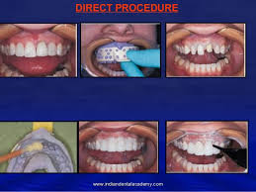
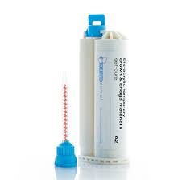


Slide 11
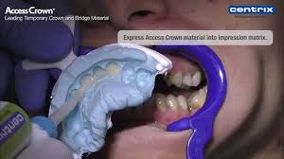
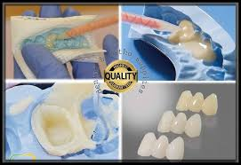


Slide 12
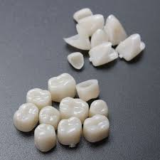

Temporary crowns and bridges
Prefabricated crowns

Slide 13
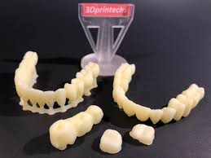

Temporary crowns and bridges
3D printed temporaries

Slide 14

Temporary cement
Zink oxide eugenol cements
Eugenol free cements (oil cements)

