Slide 1
ELECTRODIAGNOSTICS IN PHYSICAL THERAPY
Electrogymnastic and Electrostimulation

Slide 2
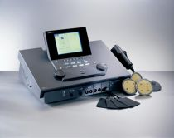
Electrodiognostics in Physical Therapy
Electrodiagnostics = determination of optimal parameters of impulses for stimulation of denervated muscles (electrostimulation) and continuous evaluation of the degree of reinnervation using the accommodation quotient.
performed using the Hoorveg-Weiss I / t curve - classical or in an abbreviated version.
https://www.google.com/url?sa=i&url=http%3A%2F%2Fwww.medwow.com%2Fmed%2Fultrasound_and_electrical_stimulation_unit%2Fgymna_uniphy%2Fguidance_c%2F6453.model-spec&psig=AOvVaw2uYUHQ7iOIdtyAE0_zjktV&ust=1606168390672000&source=images&cd=vfe&ved=0CAIQjRxqFwoTCIi-o9-Rl-0CFQAAAAAdAAAAABAD

Slide 3
Electrodiognostics in Physical Therapy
I / t curve - used to measure the minimum intensity of rectangular and oblique pulses, causing visible or palpable contraction of the irritated muscle
Chronaxia:
irritant pulse threshold time with two times higher than rheobase intensity (shortest time required to contract at double reobase)
Reobase:
threshold intensity of the irritating pulse (the lowest intensity that can cause irritation with a sufficiently long pulse duration); low rheobase means high irritability and vice versa

Slide 4
Electrodiognostics in Physical Therapy
Accommodation quotient (AQ):
the ratio of the minimum intensity by an oblique and a rectangular pulse causing the contraction at a pulse length (time) of 1000 ms.
AQ = oblique pulse ∕ rectangular pulse
for healthy muscle it is 2 to 6
partially denervated 1 to 2
completely denervated around 1
if the AQ is above 6 - a symptom of vegetative dystonia

Slide 5
Hoorveg-Weiss I/t curve in Physical Therapy
I / t curve - used to measure the minimum intensity of rectangular and oblique pulses, causing visible or palpable contraction of the irritated muscle
Classical Hoorveg-Weiss I / t curve
a complex form of irritability assessment
the minimum intensity of rectangular and oblique pulses of standard length (time) is measured, causing a visible or palpable contraction of the irritated muscle
pulse length (time) is 0.01; 0.05; 0.1; 0.5; 1; 5; 10; 50; 100; 500; 1000 ms
44 measurements (very long timeduration method and unpleasant for the patient)

Slide 6
Hoorveg-Weiss I/t curve in Physical Therapy
Abbreviated I / t curve
measuring the minimum intensity causing contraction at a pulse length of 1000 ms for oblique and rectangular pulses
comparing the results
determination the AQ to make sure that we irritate a healthy or denervated muscle
measurements for oblique pulses with a length of 100 and 500 ms (values ​​for 1000 ms are already measured), both for denervated and healthy muscle
total 6 measurements
semialgorithmic graph

Slide 7
Hoorveg-Weiss I/t curve in Physical Therapy
According the target (stimulated) structure, the I / t curve can be divided into:
neurogenic (0.03 to 1.0 ms)
transient (1.0 to 10.0 ms)
myogenic (10.0 to 1000 ms) – for denerved muscle of our diagnostic by I/t curve most important

Slide 8
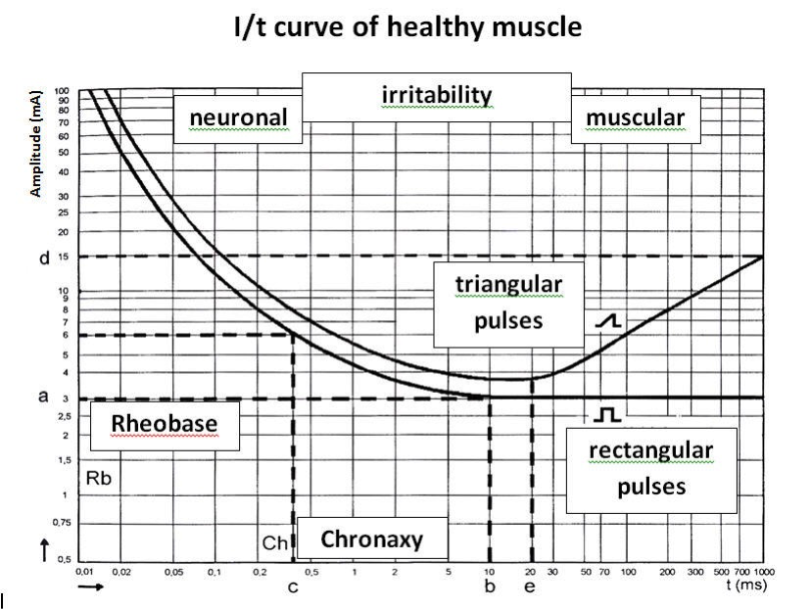
Hoorveg-Weiss I/t curve
OBLIQUE=
https://www.google.com/url?sa=i&url=https%3A%2F%2Fwww.wikilectures.eu%2Fw%2FELECTRO_THERAPY&psig=AOvVaw10sjwmN5aJbfPa7Bk4drId&ust=1605996330372000&source=images&cd=vfe&ved=2ahUKEwi12MPXkJLtAhUL-RQKHUS4DqMQjRx6BAgAEAc

Slide 9
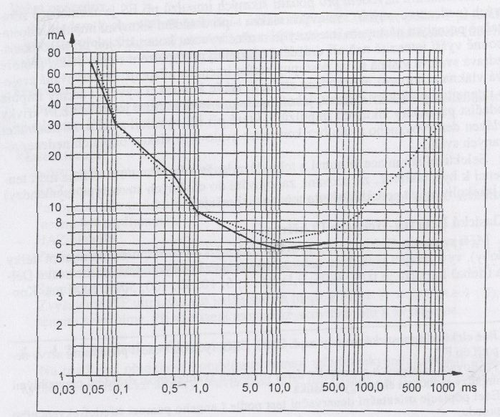
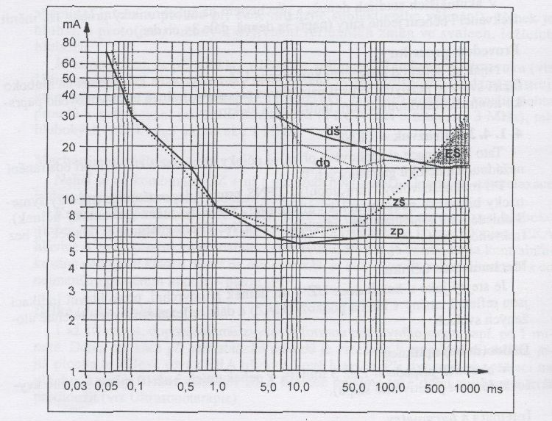
Hoorveg-Weiss I/t curve
I/t curve, determination of parameters for electrostimulation
► zp - curve for healthy muscle - rectangular impulses
► zš - curve for healthy muscle - oblique impulses
► dp - curve for denervated muscle - rectangular pulses
► dš - curve for denervated muscle - oblique pulses, AQ = 1
► ES - range of pulse parameters suitable for electrostimulation (for example 600 ms, 20 mA)
I/t curve of the health muscle ► solid line - rectangular pulses; dotted line - oblique pulses; AQ = 30/6= 5

Slide 10
Electrodiognostics in Physical Therapy
ELECTROTHERAPY is a type of physical therapy in which the healing effect of various forms of electrical energy is used. Electric currents or impulses are applied to the body for the purposes of therapy or diagnostics.
Division of electrotherapy used in electrostimulation a electrogymnastics:
GALVANOTHERAPY (direct current)
resting galvanization, limb galvanic bath, electrotherapy bath, iontophoresis
LOW-FREQUENCY THERAPY (nf) f = 0 –1 kHz
diadynamics, TENS, special currents
MED-FREQUENCY THERAPY (sf) f = 1 - 100 kHz
bipolar application
tetrapolar application: classical interference
isoplanar vector field
dipole vector field

Slide 11
Electrogymnastic and Electrostimulation
Electrostimulation/electrogymnastics = impulse therapy
Electrostimulation = stimulation of denervated muscles, we use oblique pulses with a slow onset of intensity and a longer pulse length (time). Muscle test degree 0-1
Electrogymnastics = strengthening of weakened, not denervated muscles by means of rectangular impulses. Muscle test equal or higher then degree 2

Slide 12
Practical application
Contraction-relaxation time:
phasic muscles - contraction 3-6 s, pause 2-3 times longer, (in case of extreme weakening we start with contraction 1s and increase with step 1s)
tonic muscles - contraction 10-40s, relaxation at least same long, optimally two times longer

Slide 13
Electrostimulation – practical implementation
Stimulation - monopolary, with a ball (pen) electrode (cathode) in the place of the motor point of the muscle and anode with a significantly larger area is placed proximally or distally on the muscle
Bipolar stimulation with two equally large electrodes (anode proximal, cathode distal) – when a motor point cannot be found or for prolonged stimulation
CV mode
The motor point of a muscle is the anatomically defined site from which contraction can be induced by percutaneous stimulation with the least intensity of irritating current. It is usually located in the proximal third of the muscle and is the site of nerve entry and the largest accumulation of neuromuscular discs. In denervated muscle, the motor point is located more distally
For practice, it is important to follow the principle of the same electrode

Slide 14
Electrostimulation
Length of the procedure
strictly individual.
prevent energetic exhaustion of the muscle, which is manifested by a change in the quality of contraction and/or the need to increase the intensity
better to perform electrostimulation for a shorter time:
1 to 3 minutes or 5 to 15 contractions per motor point
several times a day or to alternate individual muscles after 1 to 3 minutes during one session.

Slide 15
Electrostimulation
Frequency of procedures
started immidiately after diagnosis
daily for a period proportional to the length of the regenerating axon (max. 3 mm per day)
At intervals of 2 to 3 weeks
control examination of the I/t curve of denervated muscle for rectangular pulses – if restored by rectangular pulses of 1 to 10 ms – change therapy on electrogymnastics

Slide 16
Electrostimulation
Intensity
always above the motor threshold (visible twitch of the muscle)
Contraction time - relaxation
Phasic muscles - 3-6 s, in extreme weakness we start with 1s, we increase the length with a positive step of 1s, depending on how the muscle strength increases.
The pause is 2-3 times longer than the contractions
The duration of the procedure is 1-3 min. for each muscle, sports strengthening gradually, max 15 min.
Tonic muscles - contraction - 10-40s, pause - min. equally long, optimally 2x longer, procedure time - 5-15min. not longer than 30 min.

Slide 17
Electrostimulation - Low frequency currents
unpleasant perception by patients
DD-RS
sinusoidal MF mounted on the galvanic component, 1s MF, 1s pause, frequency 50 Hz, pulse -10ms, pause 10ms
poorly tolerated, painful contractions
Trabert
Pulse, rectangular, monophasic, pulse 2ms, pause 5ms frequency 142.9 Hz is not frequency modulated - pleasant
intensity at the margin of tolerance (subthreshold algic)
TENS surge (subjectively most pleasant, induced contraction is most similar to free contraction)
Pulse length 100 - 500 microseconds (0.1-0.5 ms), (increasing pulse length, increases discomfort, therefore pulse length should be as short as possible, but must induce the required subjective intensity) optimal frequency is 50 Hz

Slide 18
Electrostimulation - Mid-frequency currents
better subjectively tolerated
Carrier frequency from 2500 Hz, up to 12000 Hz
frequency modulation 50Hz constant or better 30-60 Hz (prevention of muscle fiber adaptation)
Kotz currents - Russian stimulation

Slide 19
Electrostimulation - indications
strengthening of weakened muscles without reflex changes, which the patient is not able to consciously contract
Activation of the denervation muscles

Slide 20
Electrostimulation - contraindications
febrile conditions of any etiology
general cachexia of any etiology
patients with an implanted pacemaker
haemorrhagic diathesis
metal objects under the application site or in a jet path
trophic skin changes at the application site
scars or fresh damage to the skin
pregnancy (exept TENS)
laryngeal and thyroid area
primary tuberculosis deposits, primary tumors without signs of metastasis below the site of application or in the current pathway
area of ​​large sympathetic plexuses
manifest cardiac or respiratory insufficiency
Sensitivity disorders at the application site

Slide 21
Electrogymnastics
Exercise for weakened muscles
For muscles´ strength higher than level 2
mostly rectangular currents

Slide 22
Electrogymnastics
Intensity
always above the motor threshold (visible twitch of the muscle)
Contraction time - relaxation
Phasic muscles - 3-6 s, in extreme weakness we start with 1s, we increase the length with a positive step of 1s, depending on how the muscle strength increases.
The pause is 2-3 times longer than the contractions
The duration of the procedure is 1-3 min. for each muscle, sports strengthening gradually, max 15 min.
Tonic muscles - contraction - 10-40s, pause - min. equally long, optimally 2x longer, procedure time - 5-15min. not longer than 30 min.

Slide 23
Electrogymnastics
Methods of application:
bipolar EG: with two equally large electrodes placed over a given muscle - can only be accepted for long-term stimulation

Slide 24
Electrogymnastics – most used currents
TENS surge (wave) - pulse length 100 - 500 μs, frequency 50 Hz, most pleasant for the patient
Middle frequencies currents - carrier frequency 2.5 kHz (Kotz currents= Russian stimulation ) -12 kHz, frequency modulation 30-60 Hz (modulation to avoid adaptation)
Low frequencies currents - Träbert currents, DD currents of the RS type - unpleasant, not used much

Slide 25
Electrogymnastics - indications
strengthening of weakened muscles without reflex changes
muscle strength according muscle test: grade 2 and higher
creating the right gradual involvement of certain muscles (timing) in the optimal stereotypes of a certain movement in sport

Slide 26
Electrogymnastics - contraindications
Contraindication:
febrile conditions of any etiology
general cachexia of any etiology
patients with an implanted pacemaker
haemorrhagic diathesis
metal objects under the application site or in a jet path
trophic skin changes at the application site
scars or fresh damage to the skin
pregnancy (exept TENS)
laryngeal and thyroid area
primary tuberculosis deposits, primary tumors without signs of metastasis below the site of application or in the current pathway
area of ​​large sympathetic plexuses
manifest cardiac or respiratory insufficiency
Sensitivity disorders at the application site

Slide 27
Examples of specific use - neurology
Electrostimulation
It is important to start as soon as possible
according to the I / t curve, within 2-3 weeks a control examination is performed using rectangular impulse currents
light paresis - lower intensity, shorter and steeper pulses
heavy paresis - relatively high intensity, impulse rise slower, longer lasting
Cerebral palsy
Spastic paresis – stimulation of the agonistic muscle group
Sclerosis multiplex
Parkinson disease

Slide 28
NEXT LECTURE – ONLINE TEST
Short online test – next Monday (30th November), 7 p.m.
check University Information system (Interactive syllabi)
Information in following days (Wednesday)

Slide 29
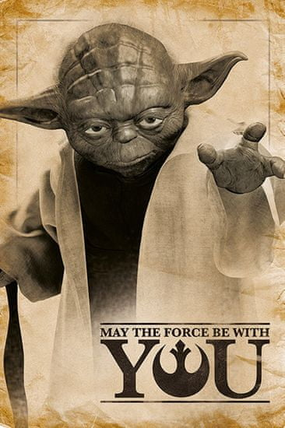
Thank you for your attention
https://www.google.com/url?sa=i&url=https%3A%2F%2Fwww.mall.cz%2Ffilmove-predmety%2Fcurepink-plakat-star-wars-hvezdne-valky-yoda-may-the-force-be-with-you-61-x-91-5-cm-100028703944&psig=AOvVaw3giqGGvOnLeRuYvl_ryufw&ust=1606172542794000&source=images&cd=vfe&ved=0CAIQjRxqFwoTCPDu3aWhl-0CFQAAAAAdAAAAABAK

