Slide 1
Examination methods in rehabilitation, 6.12.2021
The conclusion
Mgr. Veronika Mrkvicová, Ph.D.
Physiotherapy departement, MF MU

Slide 2
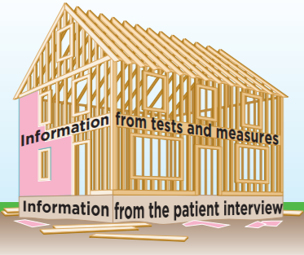
Introduction
At the core of each new patient meeting in any physical therapy setting is the patient examination. This is the first component in a cycle that includes the entire physical therapy episode of care
The patient examination consists of:
  the patient history (the informations relevant to the patient’s condition are gathered. The physiotherapist begins to formulate hypotheses about the patient’s condition)
  a systems review (a brief assessment of the cardiovascular/pulmonary, integumentary, musculoskeletal, and neuromuscular systems, the patient’s cognitive, language and learning abilities)
  tests and measures (selected based on hypotheses formed during the history-taking process and findings during the systems review)

Slide 3
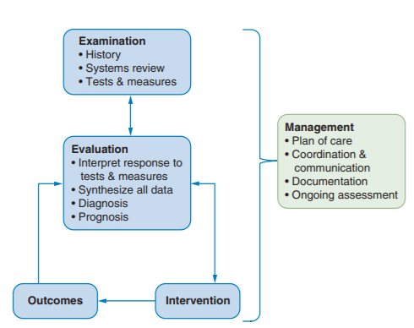
Patient assessment

Slide 4
Patient assessment
Often a patient is referred for a “prescribed” physical therapy by a medical doctor following a medical diagnosis
The physical therapist should certainly analyze this biomedical diagnosis but under no circumstances can the diagnosis replace the physical therapist’s own careful examination
Only the physiotherapist´s examination can accurately define this particular patient’s individual combination of symptoms, their intensity and expression (physiotherapy diagnosis)

Slide 5
Patient assessment
If the physiotherapists examination is thoughtful, purposeful, skilled, and efficient, forming evaluative opinions and making decisions about, a patient’s care plan should not be difficult
If the examination is lacking in quality or substance, then the evaluation, care plan, and possibly the patient’s outcomes may suffer
What separates experienced physiotherapist from beginner physiotherapist is the ability to apply knowledge and skill, in conjunction with the ability to intuitively alter the examination or intervention based on self-reflection, prior experience, and individual patient characteristics

Slide 6
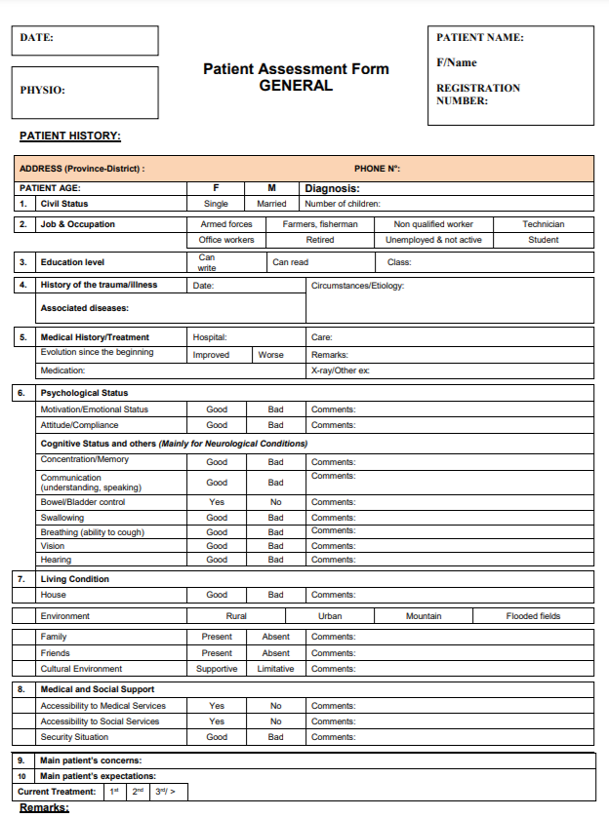
Patient assessment - overview
Patients history
  Present illness
  Medical history
  Family history
  Social history
  Sport history
  Rehabilitation history
  Medications
  Physiological functions
  Allergies
  Abusus

Slide 7
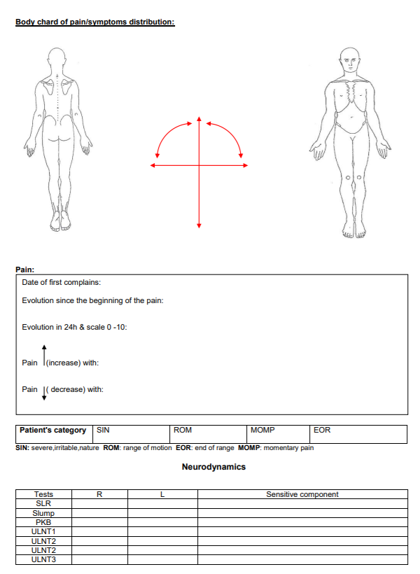
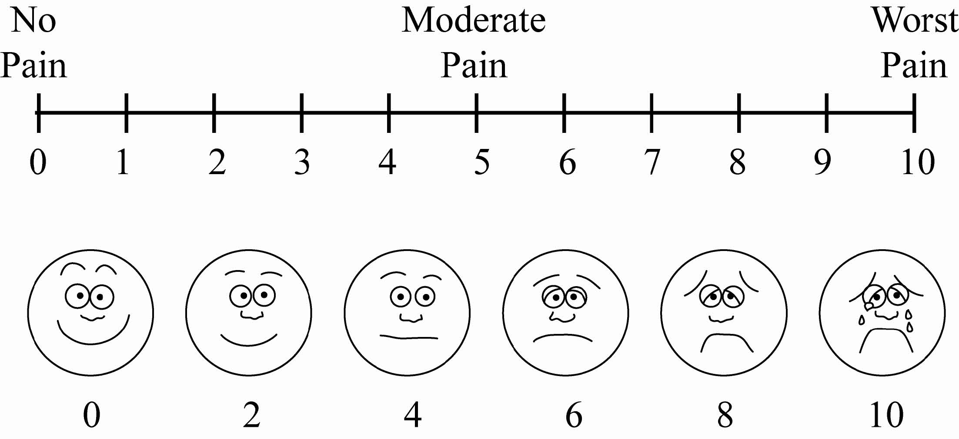
Patient assessment - overview
Pain analysis
  Intensity, location, quality, onset, duration, alleviating and aggravating factors
  VAS

Slide 8
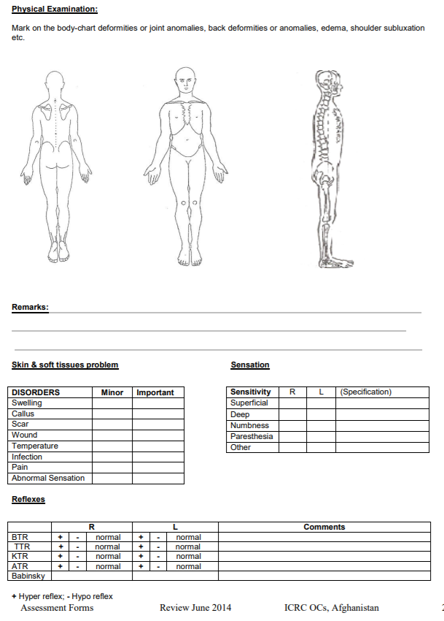
Patient assessment - overview
Physical examination
  Overall aspection
  Body type
  Temperature
  Heart rate and breathing rate
  Blood pressure
Neurological examination
  Cognitive functions
  Motor exam and reflexes
  Sensitivity exam
  Special tests

Slide 9
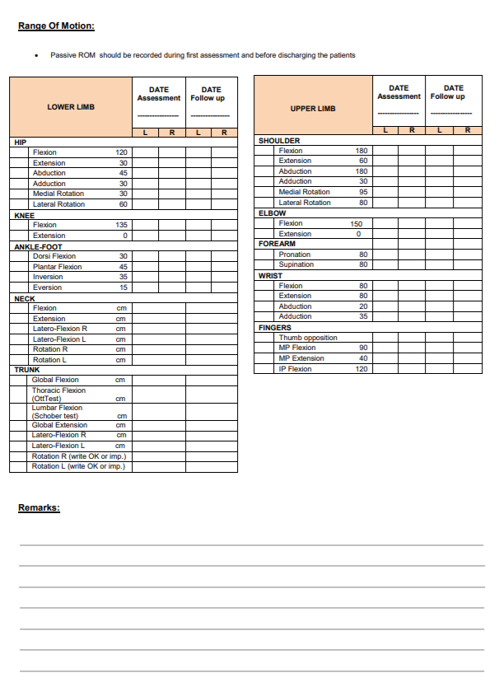
Patient assessment - overview
Range of motion (ROM)
  Upper limbs
  Lower limbs
  Spine
Normal/decreased/increased ROM (hypermobility)

Slide 10
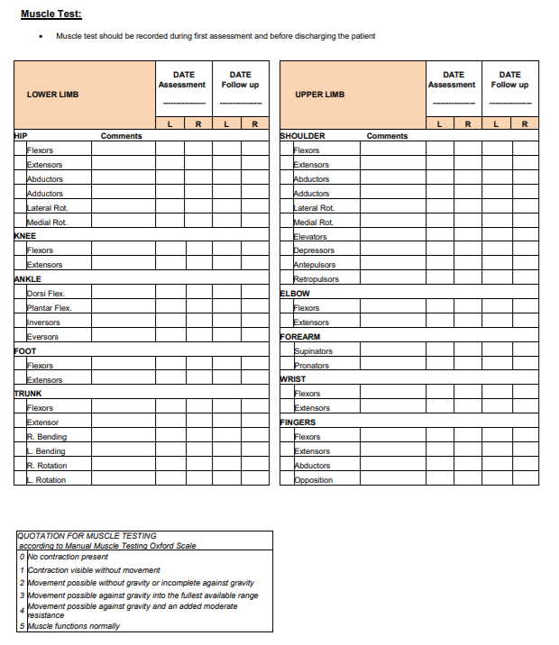
Patient assessment - overview
Muscle strength testing
Muscle shortness testing
Movement pattern testing

Slide 11
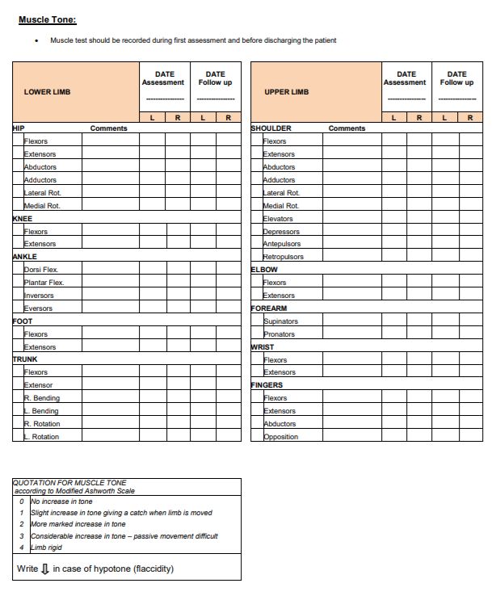
Patient assessment - overview
Muscle tone testing

Slide 12
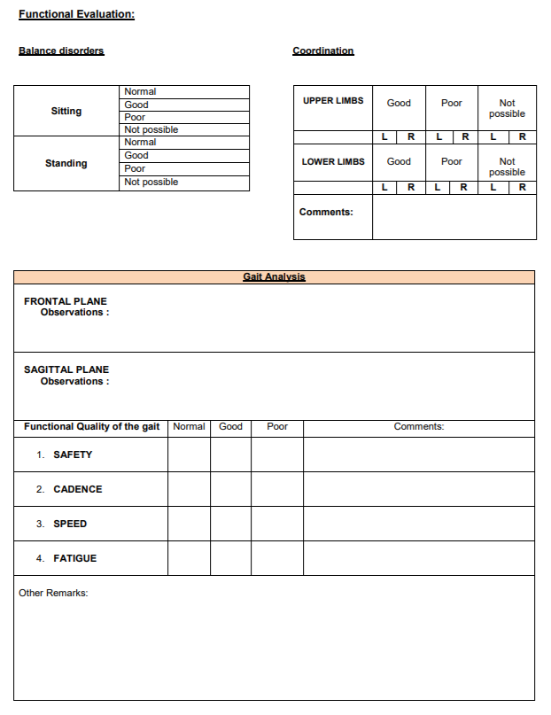
Patient assessment - overview
Functional evaluation
  Balance
  Coordination
  Gait

Slide 13
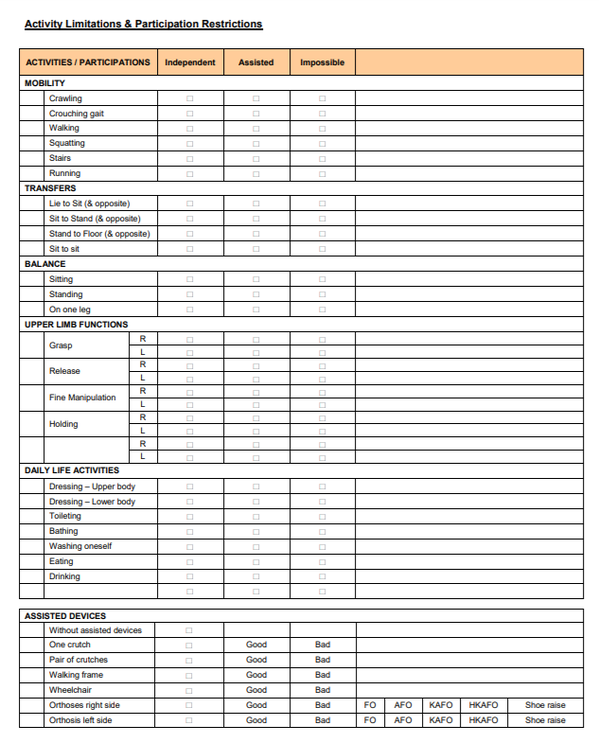
Patient assessment - overview
Activity limitations and participation restrictions
  Mobility
  Transfers
  Balance
  ADL (activities of daily living)
  The use of assisted devices

Slide 14
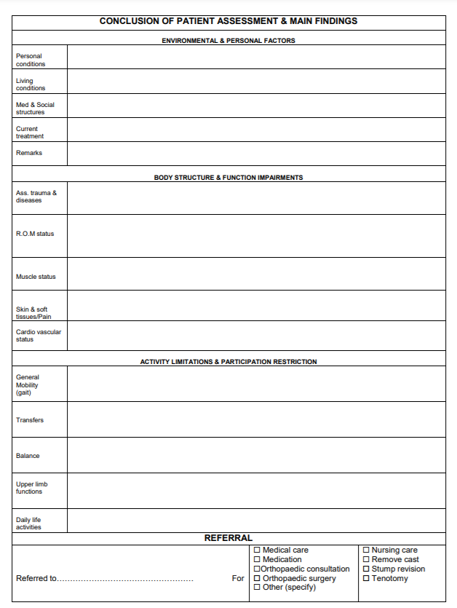
Patient assessment - overview
Conclusion and main findings
  Environmental and personal factors
  Body structure and function impairments
  Activity limitations and participation restriction

Slide 15
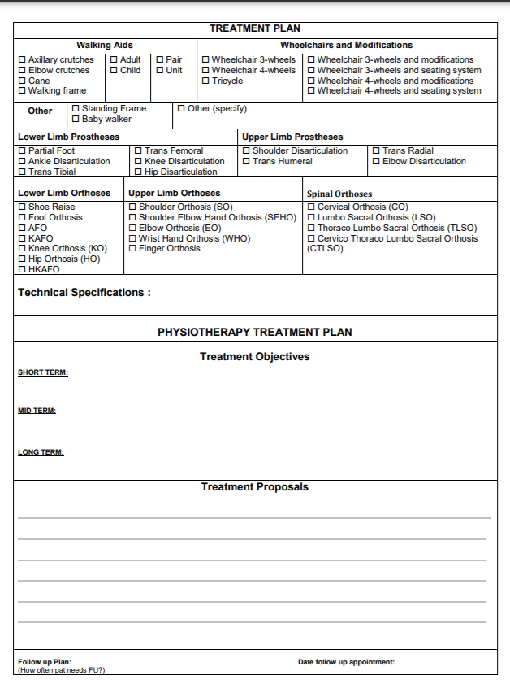
Patient assessment - overview
Treatment plan (short and long term)

Slide 16
Musculoskeletal assessment
Posture assessment – standing/sitting posture, single leg stance posture (body proportions, alignment of body parts, muscle contours, condition and creases of the skin)
Palpation (bony tissues – alignment and position, and soft tissues – temperature, consistency, pain)
ROM assessment
Muscle assessment – strength, length
Movement patterns, gait, functional evaluation

Slide 17
Musculoskeletal assessment
The focus of observation is not only on objectively verifiable data and dysfunctions, but also on the significance of these dysfunctions for the patient’s quality of life and living conditions
In other words, physical therapists not only adhere to the rules of biomedical thinking frequent in clinical medicine, they also base their intervention on a biopsychosocial view (such as that expressed in the ICF (= International Classification of Functioning, Disability, and Health)
Just as important as the extent to which movement is restricted, and how this restriction could be reduced or even resolved, is the issue of everyday activities for which the patient urgently requires unrestricted movement
Does restriction mean incapacity for employment or is it, despite being inconvenient, of secondary importance to quality of life?

Slide 18
Musculoskeletal assessment
The motivation and cooperation of the patient are influenced quite decisively by such subjective factors and finding out about them is therefore an indispensable step in the examination and treatment process
All this applies equally, if not even more so, if the patient accesses the physical therapist directly without a referral or “prescription.”

Slide 19
Musculoskeletal assessment
The experienced therapist succeeds in maintaining a constant interplay between the examination and treatment process because the results of the one determine the form of the other, and at certain points of the treatment a reexamination becomes necessary
For the therapist who is still learning (= student), this is too ambitious – student first learn and practice the steps and techniques of careful physical therapeutic diagnosis, just as the student also learns and practices the steps and techniques of the therapeutic process
Then, with increasing practice and experience, the physiotherapy student will be able to bring them both into line and structure the transitions smoothly

Slide 20
Conclusion
a physical therapeutic diagnosis is a prerequisite for treating patients individually and effectively in order to help them to enjoy the best possible participation in life in the best-case scenario
careful examination ensures that treatment starts with the patient’s main problem, takes advantage of the patient’s own resources and—in the best-case scenario—leads to the intended result

Slide 21

Thank you for your attention
“Physiotherapy without careful examination is like a tree without roots.”

