Slide 1
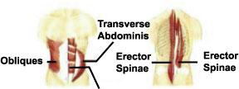
Examination Methods in Rehabilitation, 20.9.2021
Manual muscle test:
Neck, Trunk, Pelvis
Rectus abdominis
Mgr. Veronika Mrkvicová, Ph.D. (physiotherapist)

Slide 2
Content
Neck
Back
Abdomen
Pelvis

Slide 3
Neck muscles
Possible causes of neck muscles weakness:
Muscular imbalances (upper crossed syndrome)
Neurological conditions (cervical dystonia, Guillain-Barré syndrome, multiple sclerosis etc.)
Spine injuries (whiplash syndrome)
Muscular diseases (dropped head syndrome, fibromyalgia, myasthenia gravis)
etc.

Slide 4
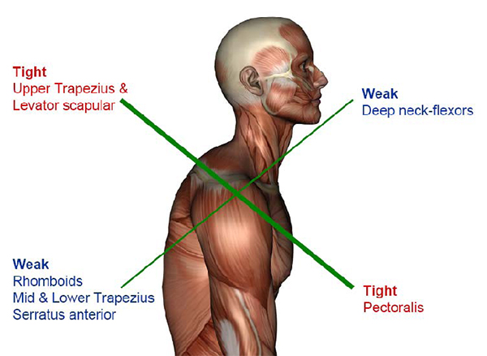
Upper crossed syndrome

Slide 5
Upper crossed syndrome
impairment in the deep cervical muscles, which are considered to be functionally important for joint support and control
deficits in muscle coordination which could result in poor support and potential overload on cervical structures
insufficiency in the pre-programmed activation of cervical muscles
inefficient neuromuscular activation
greater fatigability of superficial cervical muscles

Slide 6
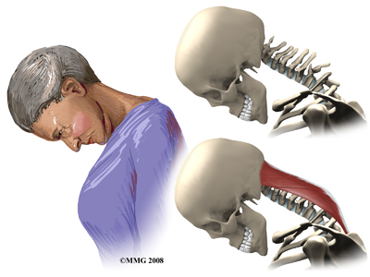
Dropped Head Syndrome

Slide 7
Dropped Head Syndrome
(Floppy Head Syndrome or Head Ptosis)
is characterized by severe weakness of the muscles of the back of the neck
this causes the chin to rest on the chest in standing or sitting
most of the time it is caused by a specific generalized neuromuscular diagnosis
when the cause is not known, it is called isolated neck extensor myopathy, or INEM

Slide 8
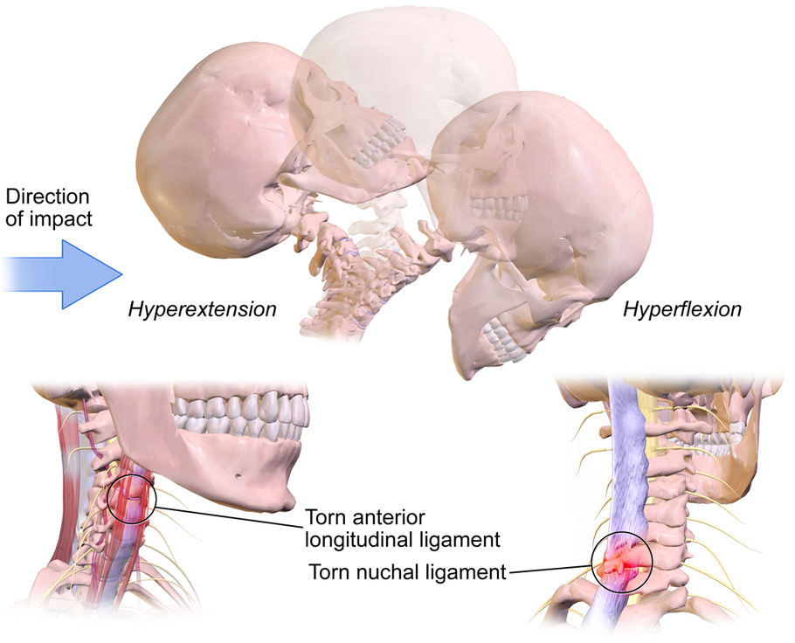
Whiplash injury

Slide 9
Whiplash injury
a relatively common injury that occurs to a person's neck following a sudden acceleration-deceleration force that causes unrestrained, rapid forward and backward movement of the head and neck, most commonly from motor vehicle accidents
it describes damage to both the bone structures and soft tissues

Slide 10
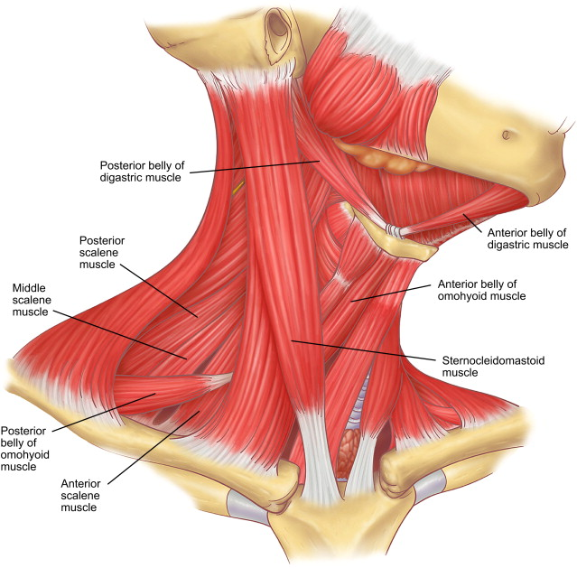
Muscles of the neck

Slide 11
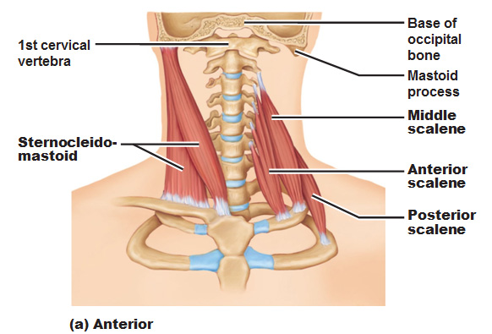
Neck flexion (bow)
Scaleni muscles (ant., med., post.)
Sternocleidomastoid
M. longus colli, m. longus capitis

Slide 12
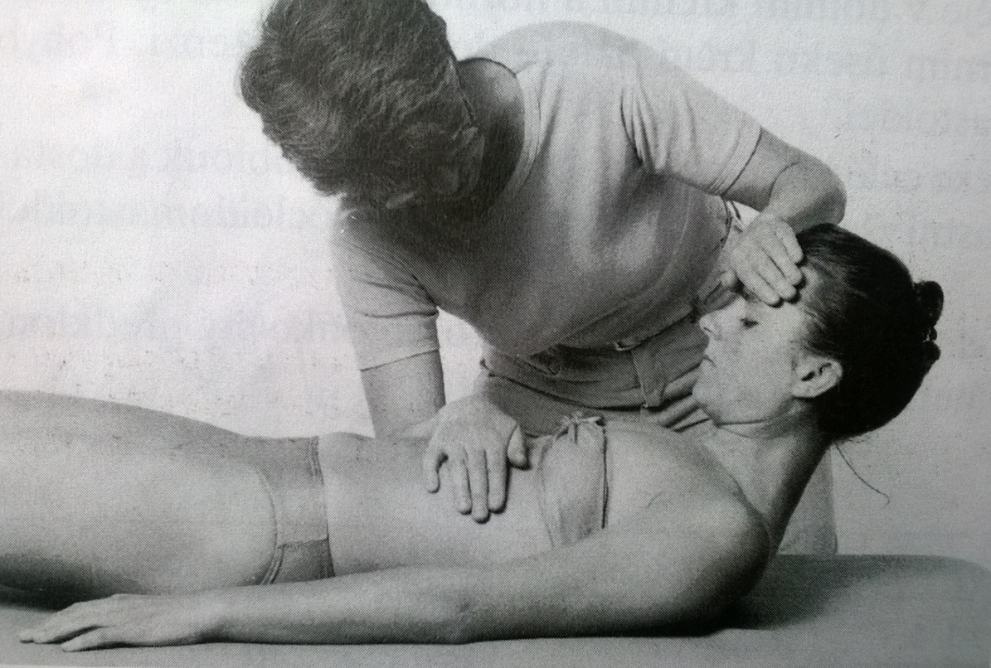
Neck flexion (bow)
Grade 5,4
Position: supine position, lower limbs slightly bended, upper limbs relaxed, lying along the body side
Fixation: PT fix the patients lower part of the chest with one hand
Movement: fluent flexion of the neck spine (bow)
Resistance: PT put resistance using one hand on the patients´ forehead (arched) against the movement

Slide 13
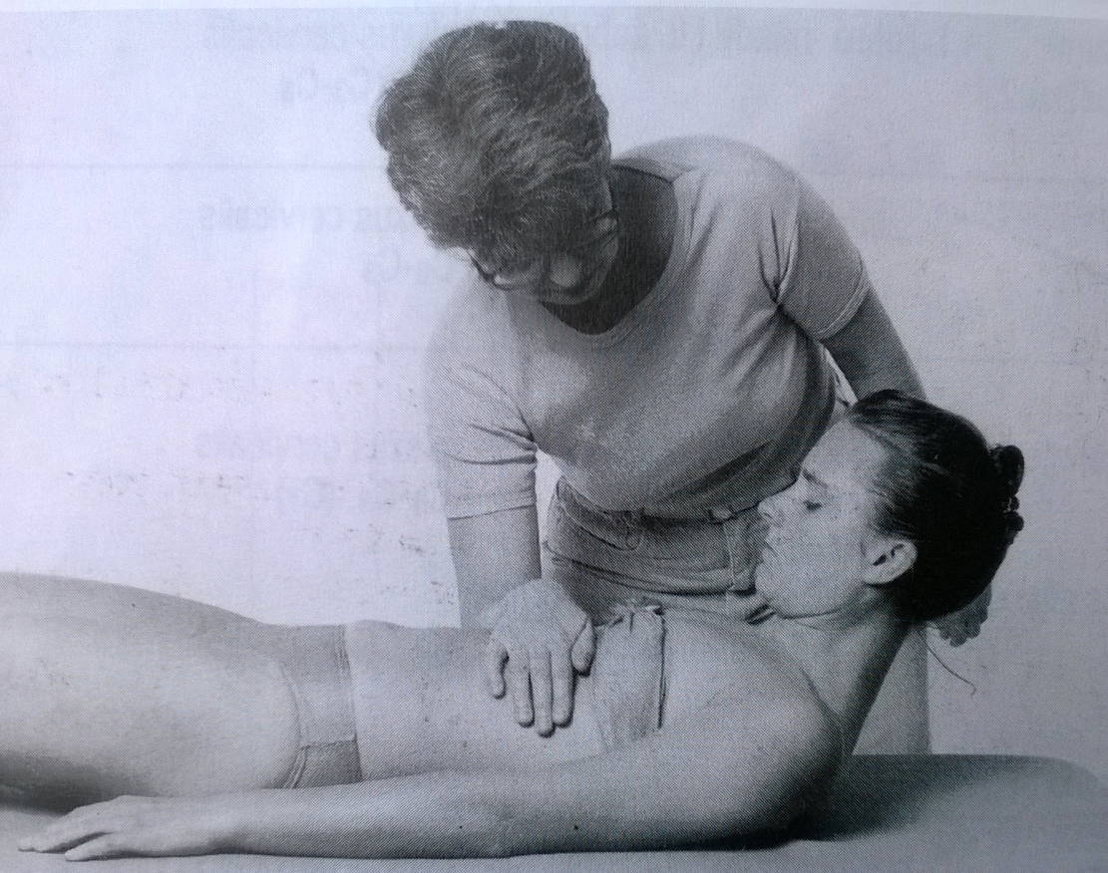
Neck flexion (bow)
Grade 3
Position: supine position, lower limbs slightly bended, upper limbs relaxed, lying along the body side
Fixation: PT fix the patients lower part of the chest with one hand
Movement: fluent flexion of the neck spine (bow)

Slide 14
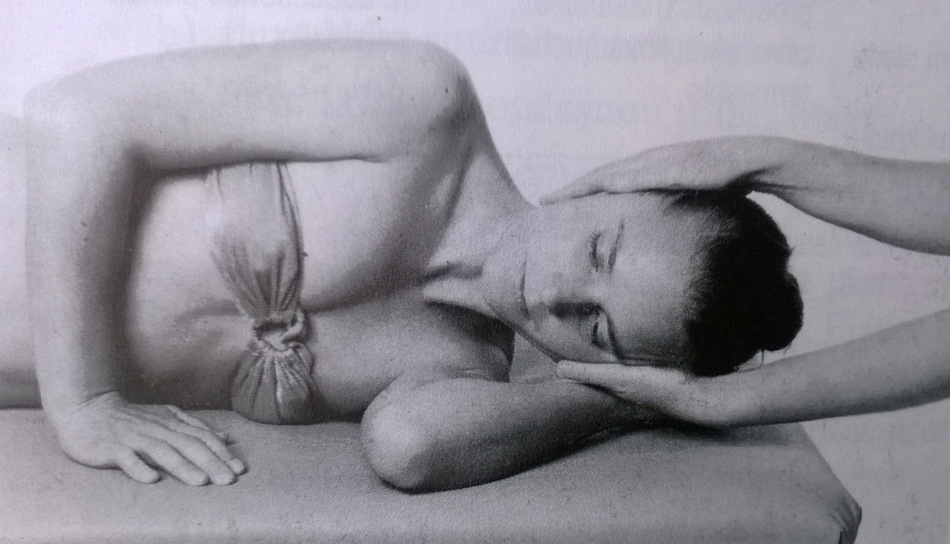
Neck flexion (bow)
Grade 2
Position: lying on the side, patient hold with his/her upper hand the table, the lower hand is relaxed, lying in flexed position below the patients´ head
Fixation: PT supports patients head, in central position
Movement: patient flexes the neck spine in full range of motion, with constant support of PT

Slide 15
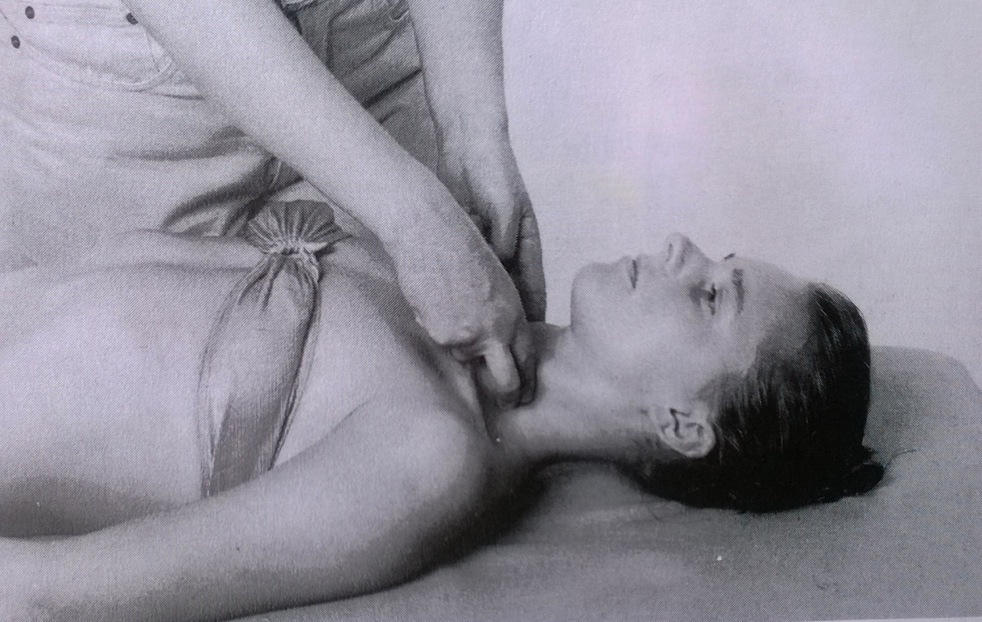
Neck flexion (bow)
Grade 1,0
Position: supine position, lower limbs slightly bended, upper limbs relaxed, lying along the body side
Attempt to move: patient tries to elevate the head, PT palpates the trace of contraction of the neck flexors

Slide 16
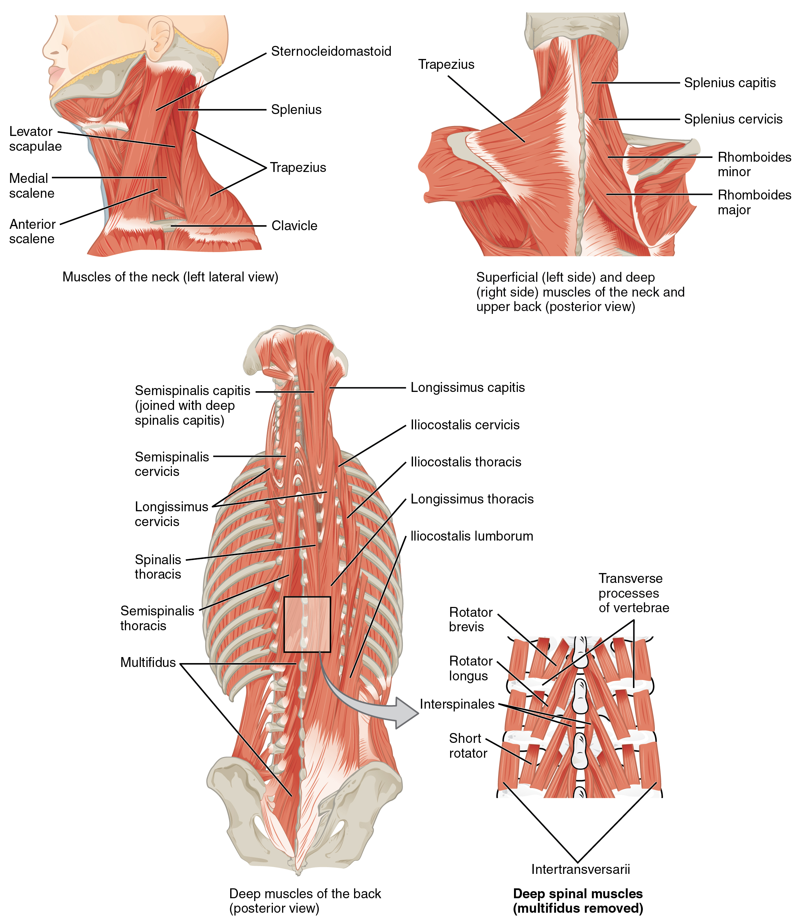
Neck flexion (move forward)
Sternocleidomastoid muscle

Slide 17
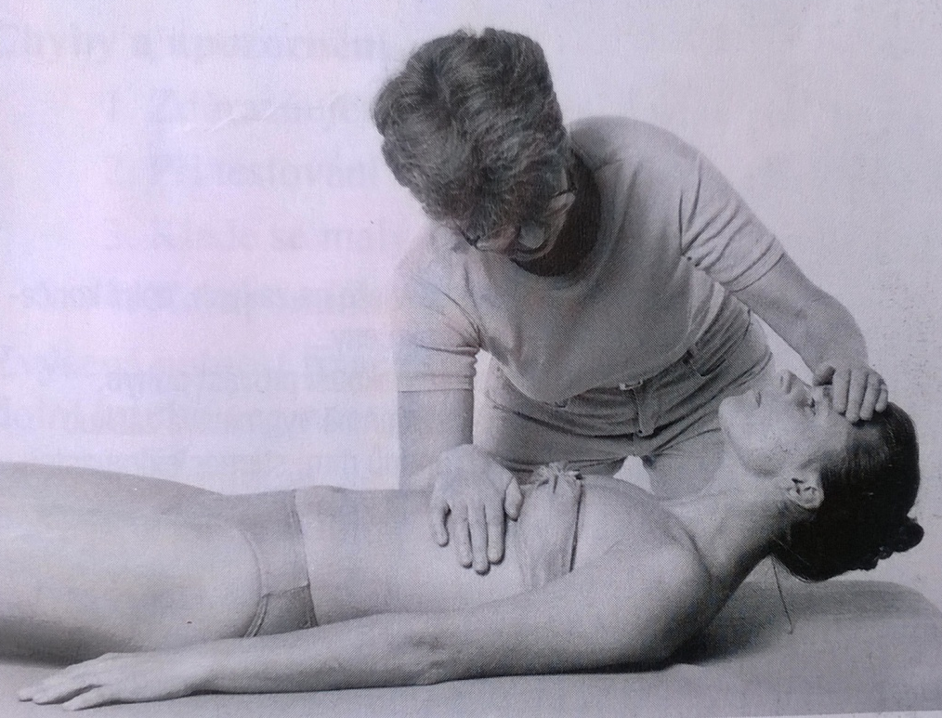
Neck flexion (move forward)
Grade 5,4
Position: supine position, lower limbs slightly bended, upper limbs relaxed, lying along the body side
Fixation: PT fix the patients lower part of the chest with one hand
Movement: flexion of the neck spine – moving the head forward
Resistance: PT put resistance using one hand on the patients´ forehead against the movement

Slide 18
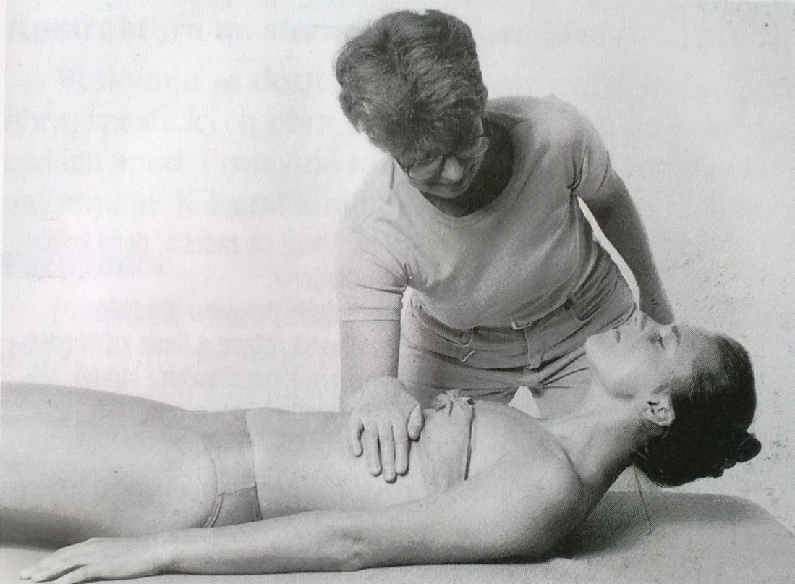
Neck flexion (move forward)
Grade 3
Position: supine position, lower limbs slightly bended, upper limbs relaxed, lying along the body side
Fixation: PT fix the patients lower part of the chest with one hand
Movement: flexion of the neck spine – moving the head forward

Slide 19
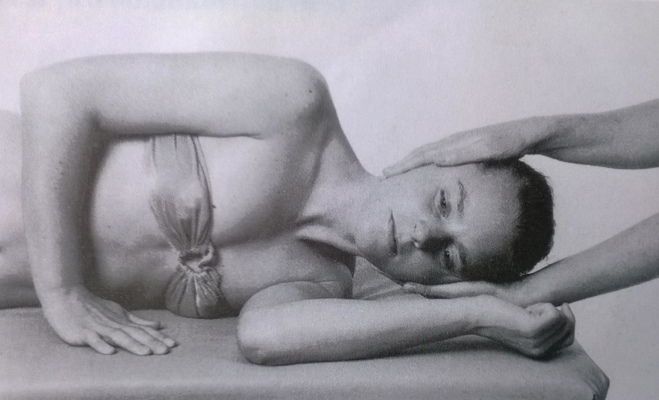
Neck flexion (move forward)
Grade 2
Position: lying on the side, patient hold with his/her upper hand the table, the lower hand is relaxed, lying in flexed position below the patients´ head
Fixation: PT supports patients head, in central position
Movement: patient flexes the neck spine in full range of motion, moving the head forward, with constant support of PT

Slide 20
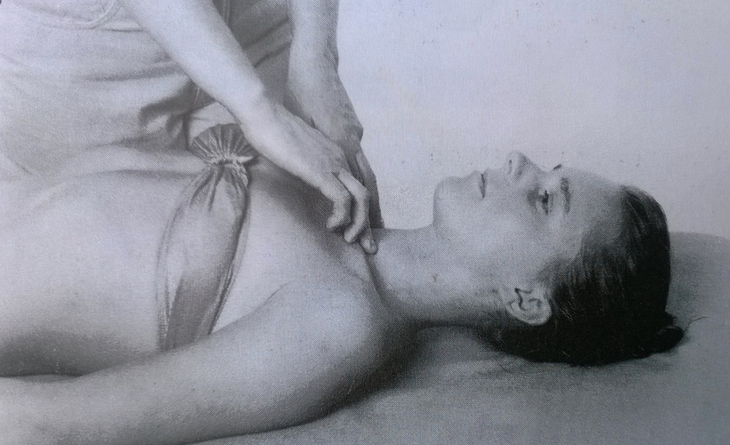
Neck flexion (move forward)
Grade 1,0
Position: supine position, lower limbs slightly bended, upper limbs relaxed, lying along the body side
Attempt to move: patient tries to elevate the head, PT palpates the trace of contraction of the sternocleidomastoideid

Slide 21
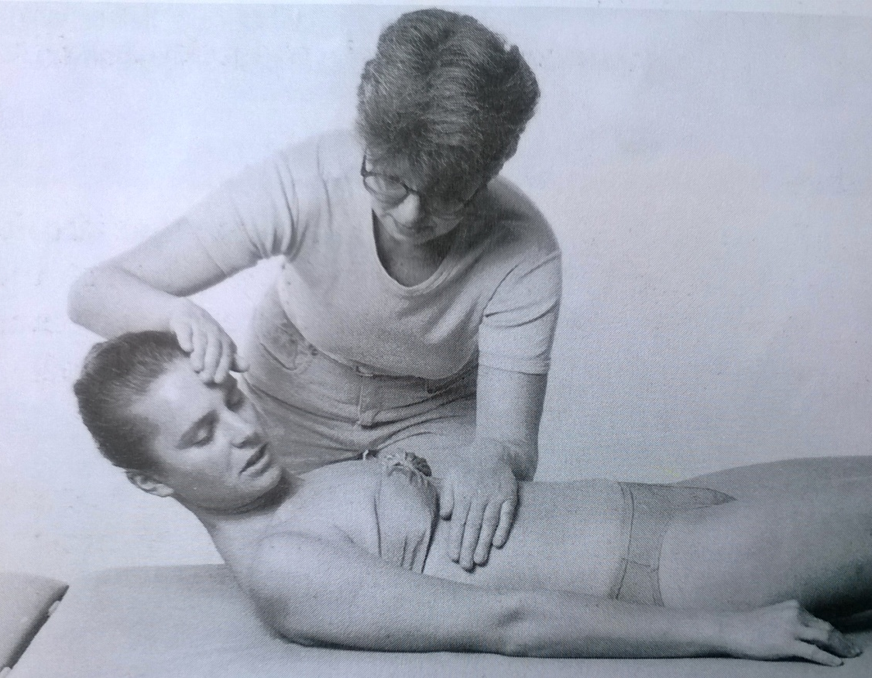
Neck flexion – unilateral test
Grade 5,4
Position: supine position, lower limbs slightly bended, upper limbs relaxed, lying along the body side
Fixation: PT fix the patients lower part of the chest with one hand
Movement: flexion of the neck spine combined with rotation to the untested side
Resistance: PT put resistance using one hand on the patients´ lateral part of the forehead (on the tested side)

Slide 22
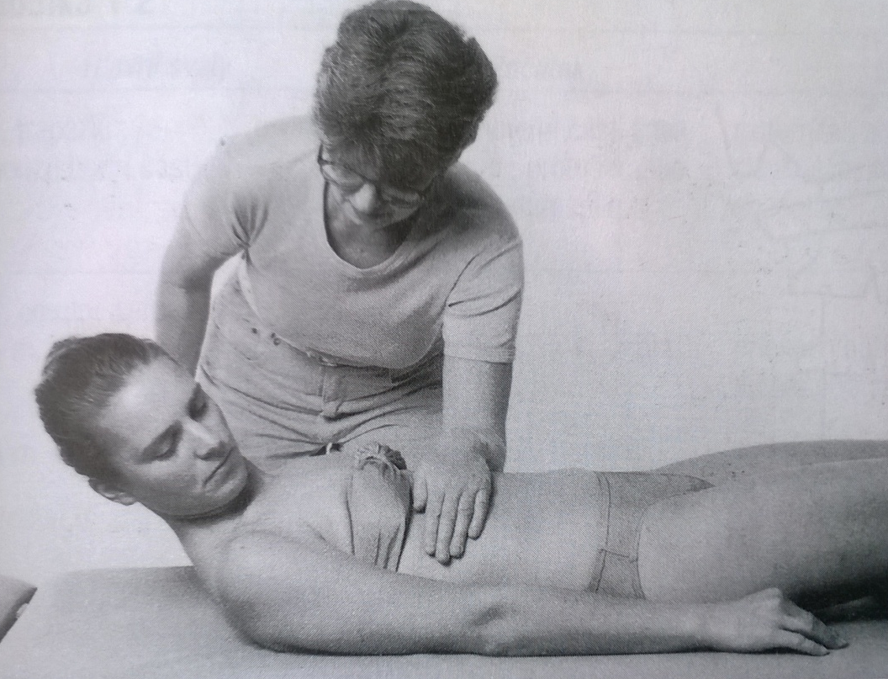
Neck flexion – unilateral test
Grade 3
Position: supine position, lower limbs slightly bended, upper limbs relaxed, lying along the body side
Fixation: PT fix the patients lower part of the chest with one hand
Movement: flexion of the neck spine combined with rotation to the untested side
Note: grade 2, 1, 0 is not tested

Slide 23
Neck flexion – notes:
The movement should be done fluently, no rotation to the side, no asisstance of the arms of patient
During one-side testing – do the movement in combination of flexion and rotation
The fixation of the trunk, especially when the neck flexors are week, is necessary
Contracture, usually of the SCM, is relativelly common – rotation and inclination of the head is typical
Spasm of the scaleni muscles can be sometimes found

Slide 24

Neck extension
Trapezius
Iliocostalis cervicis
Longissimus capitis et cervicis
Spinalis capitis et cervicis

Slide 25
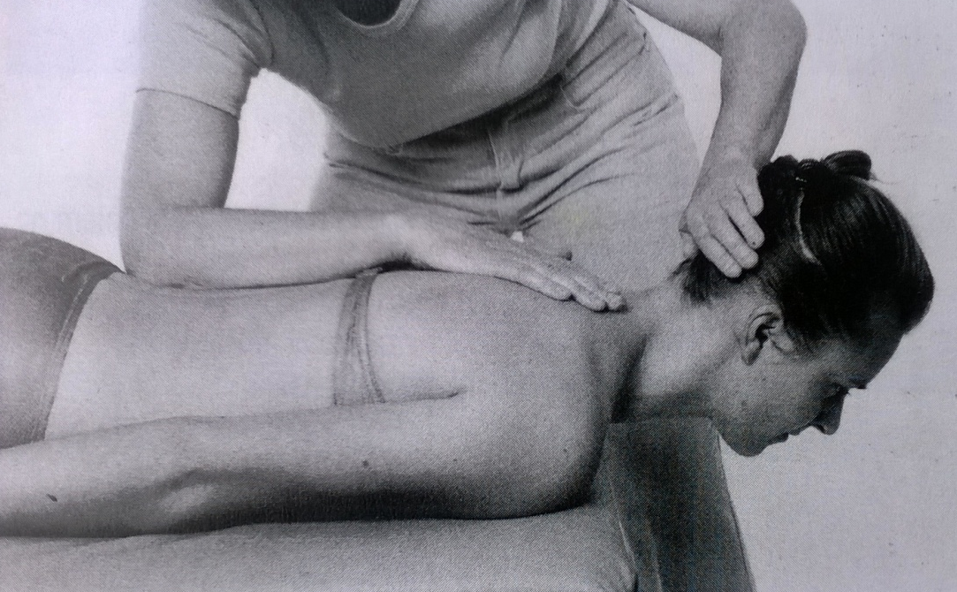
Neck extension
Grade 5,4
Position: prone position, upper limbs lying relaxed along the body side, the head away from the table, neck spine fully flexed
Fixation: PT uses the whole forearm and palm to fix the thoracical part of the spine
Movement: fluent extension of the neck in full range of motion
Resistance: PT put resistance with the palm at the back of the patients´ head

Slide 26
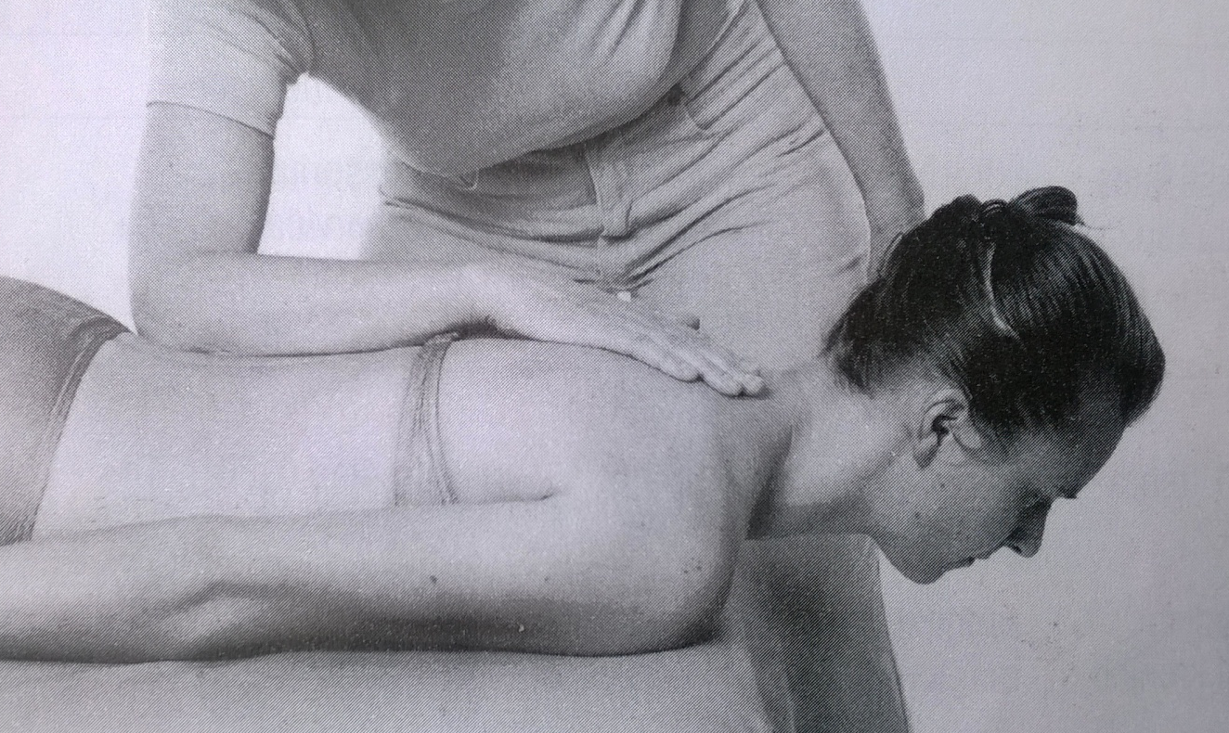
Neck extension
Grade 3
Position: prone position, upper limbs lying relaxed along the body side, the head away from the table, neck spine fully flexed
Fixation: PT uses the whole forearm and palm to fix the thoracical part of the spine
Movement: fluent extension of the neck in full range of motion

Slide 27
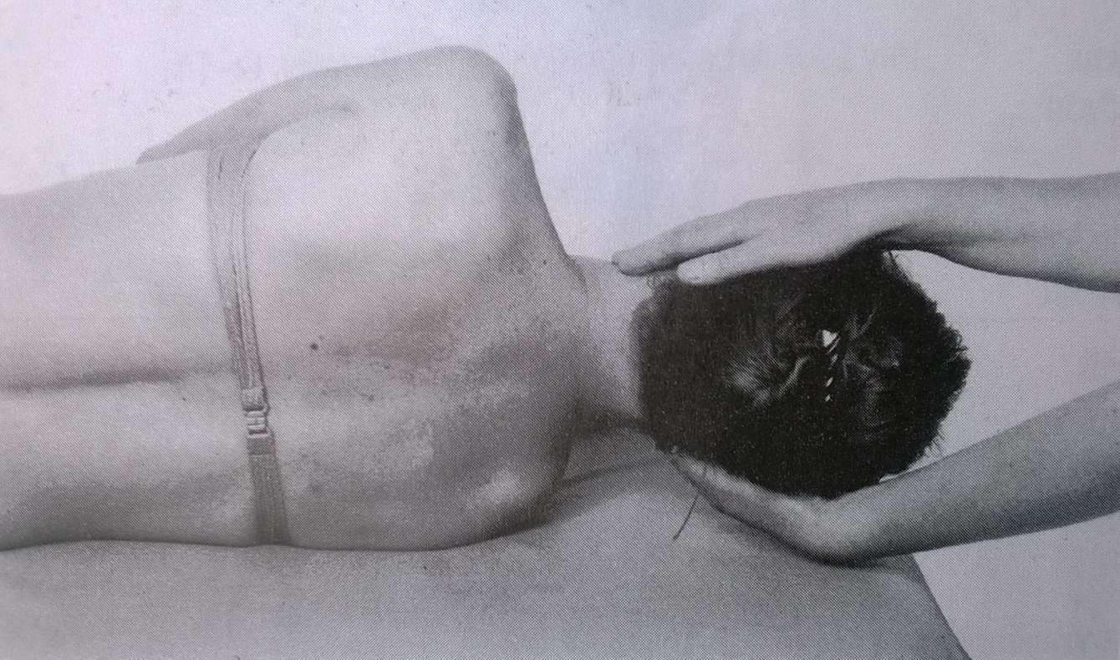
Neck extension
Grade 2
Position: lying on the side, patient hold with his/her upper hand the edge of the table, the lower hand is relaxed, lying in flexed position, neck spine in full flexion
Fixation: PT supports patients head, in central position
Movement: patient extends the neck spine in full range of motion, with constant support of PT

Slide 28
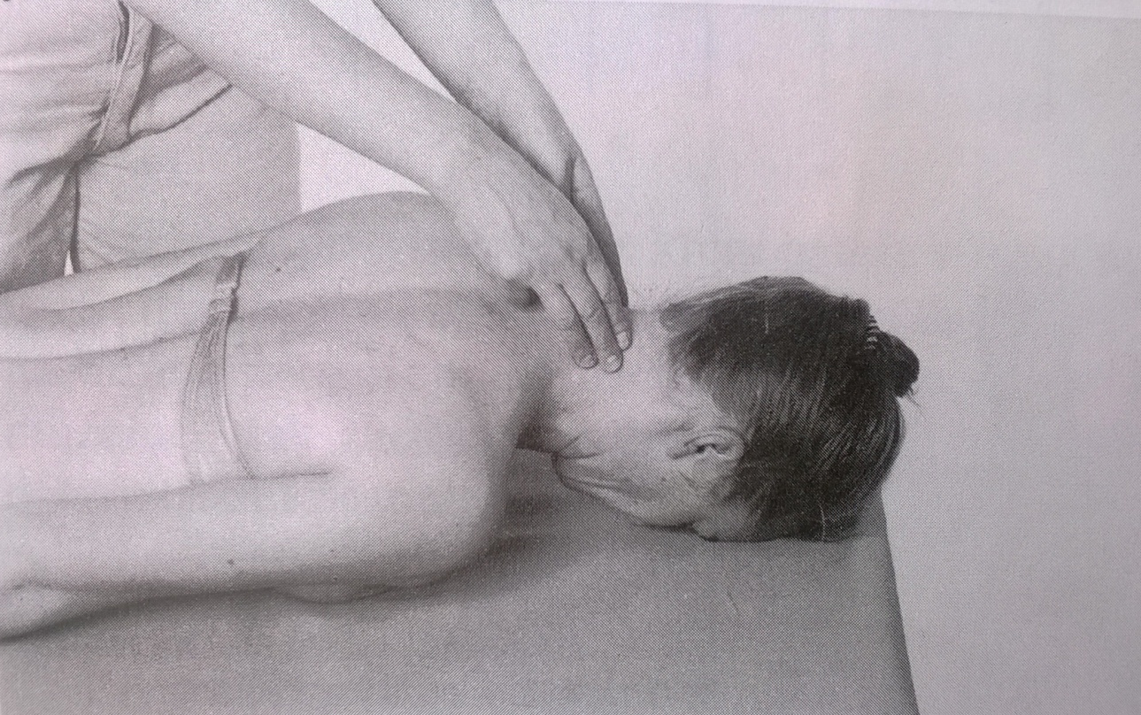
Neck extension
Grade 1,0
Position: prone lying, head on the table, upper limbs extended, lying relaxed along the body side
Attempt to move: patient tries to elevate the head, PT palpates the trace of contraction of the extensors

Slide 29
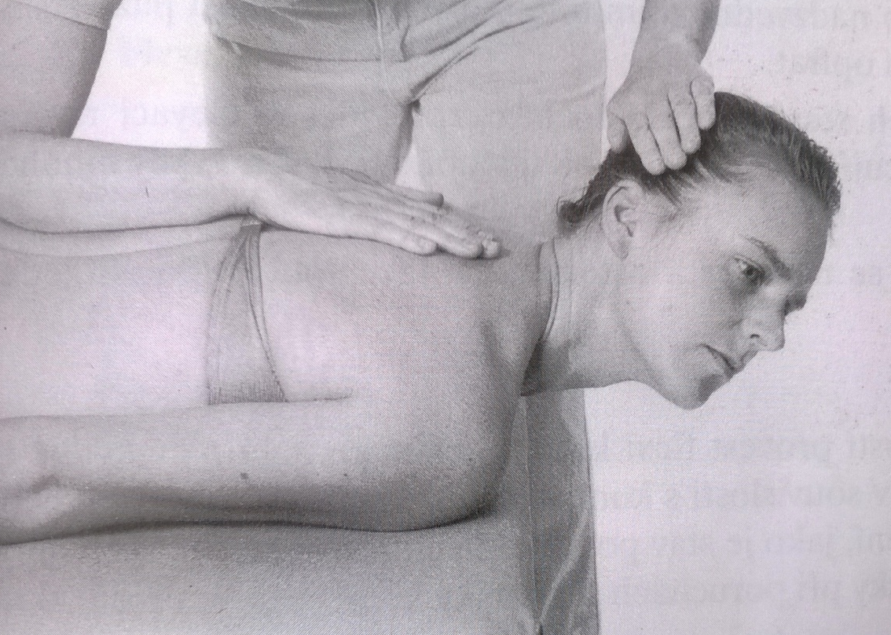
Neck extension – unilateral test
Grade 5,4
Position: prone position, upper limbs lying relaxed along the body side, the head away from the table, neck spine fully flexed, and rotated to the side
Fixation: PT uses the whole forearm and palm to fix the thoracical part of the spine
Movement: fluent extension of the neck in full range of motion, when the neck spine is rotated to the tested side
Resistance: PT put resistance with the palm at the lateral side of the patients´ head

Slide 30
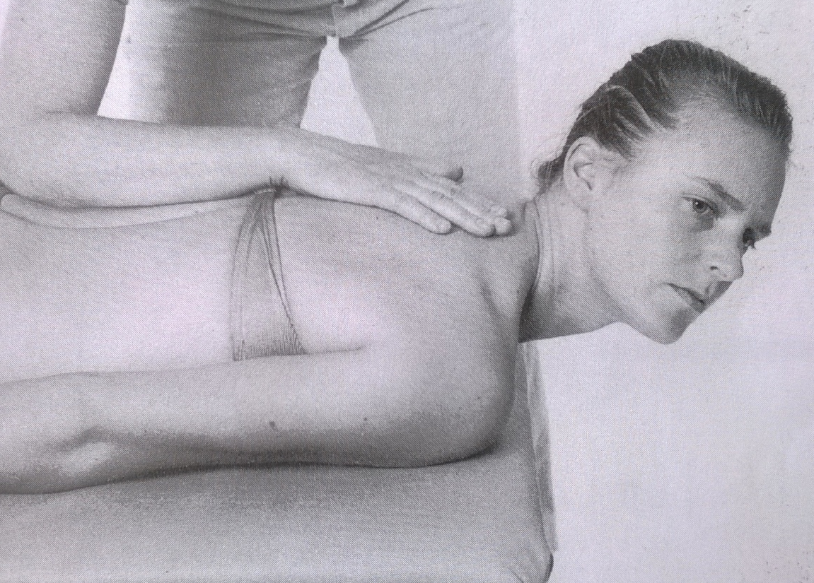
Neck extension – unilateral test
Grade 3
Position: prone position, upper limbs lying relaxed along the body side, the head away from the table, neck spine fully flexed, and rotated to the side
Fixation: PT uses the whole forearm and palm to fix the thoracical part of the spine
Movement: fluent extension of the neck in full range of motion, when the neck spine is rotated to the tested side

Slide 31
Neck extension – notes:
A lot of substitutions can occur during neck extension: don´t allow the patient to use the muscles of the scapula and the arm (abduction of scapula, elevation of shoulders)
If the contracture of neck extensors is present, patient is not able to do flexion of the neck in full range of motion

Slide 32
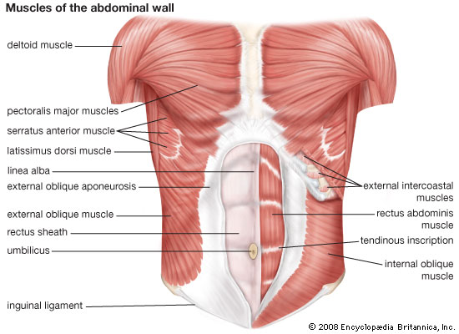
Muscles of the abdominal wall

Slide 33
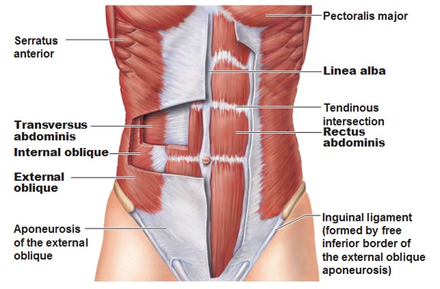
Abdominal muscles
any of the muscles of the anterolateral wall of the abdominal cavity
composed of 3 flat muscular sheets, from without inward:
  external oblique
  internal oblique
  transverse abdominis
  rectus abdominis

Slide 34
Abdominal muscles
The first 3 muscle layers extend between the vertebral column behind, the lower ribs above, and the iliac crest and pubis of the hip bone below
Their fibres all merge toward the midline, where they surround the rectus abdominis in a sheath before they meet the fibres from the opposite side at the linea alba
Strength is developed in these rather thin walls by the crisscrossing of fibres
Thus, the fibres of the external oblique are directed downward and forward, those of the internal oblique upward and forward, and those of the transverse horizontally forward

Slide 35
Abdominal muscles – function:
The muscles of the abdominal wall perform a variety of functions:
(1) provide a tonic, elastic muscular support for the viscera and, by their recoil, pull down the rib cage in expiration
(2) They contract against blows to form a rigid protective wall for the viscera
(3) When the glottis is closed and the thorax and pelvis are fixed, these muscles take part in the expulsive efforts of urination, defecation, childbirth, vomiting, and of singing and coughing
(4) When the pelvis is fixed, they initiate the movement of bending the trunk forward. Thereafter, gravity comes into play, the abdominal muscles relax, and the muscles of the back then take on the strain
(5) Conversely, the abdominal muscles come into play in preventing hyperextension
(6) When the thorax is fixed, the abdominals can pull up the pelvis and lower limbs
(7) The muscles of one side can bend the vertebral column sideways and assist in its rotation.

Slide 36
Abdominal muscles weakness
Muscular imbalances (lower crossed syndrome, abdominal diastasis)
Neurological conditions (abdominal wall paralysis, multiple sclerosis)
Spine injuries
Muscular diseases

Slide 37
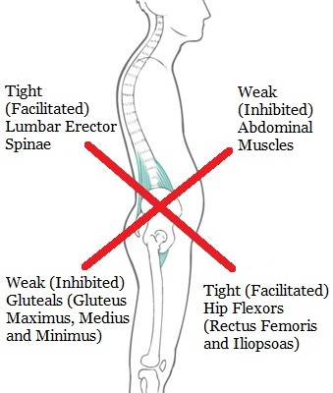
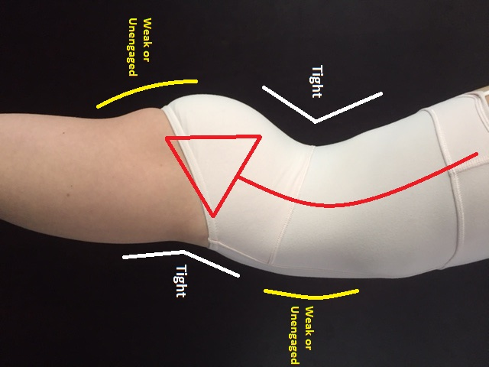
Weak abdominal wall
Muscular imbalances (lower crossed syndrome)

Slide 38
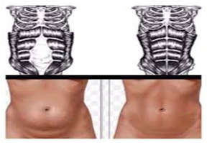
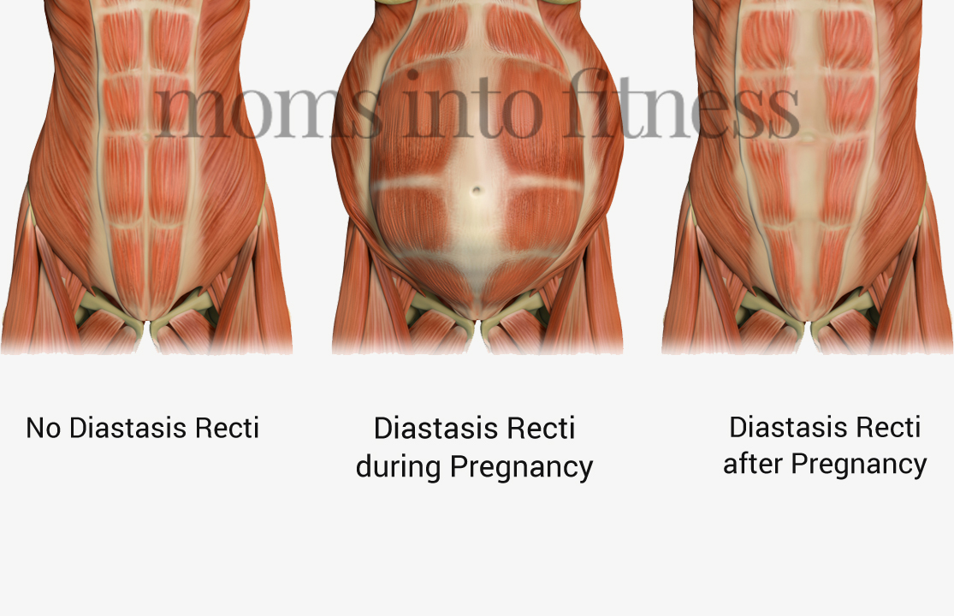
Abdominal diastasis

Slide 39
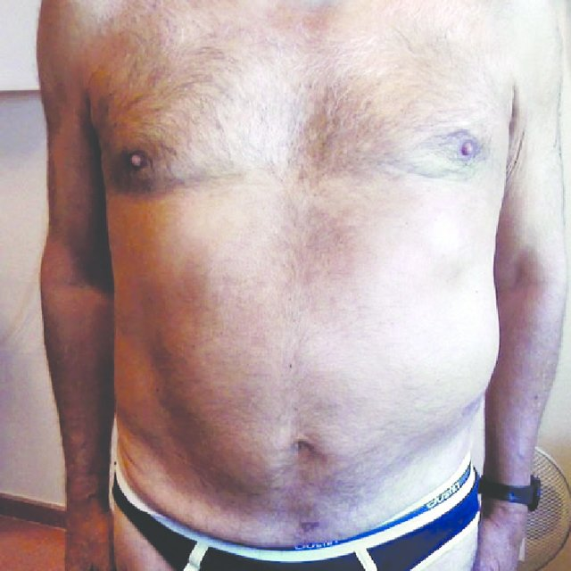
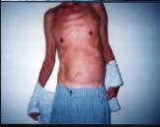
Abdominal muscles paralysis

Slide 40
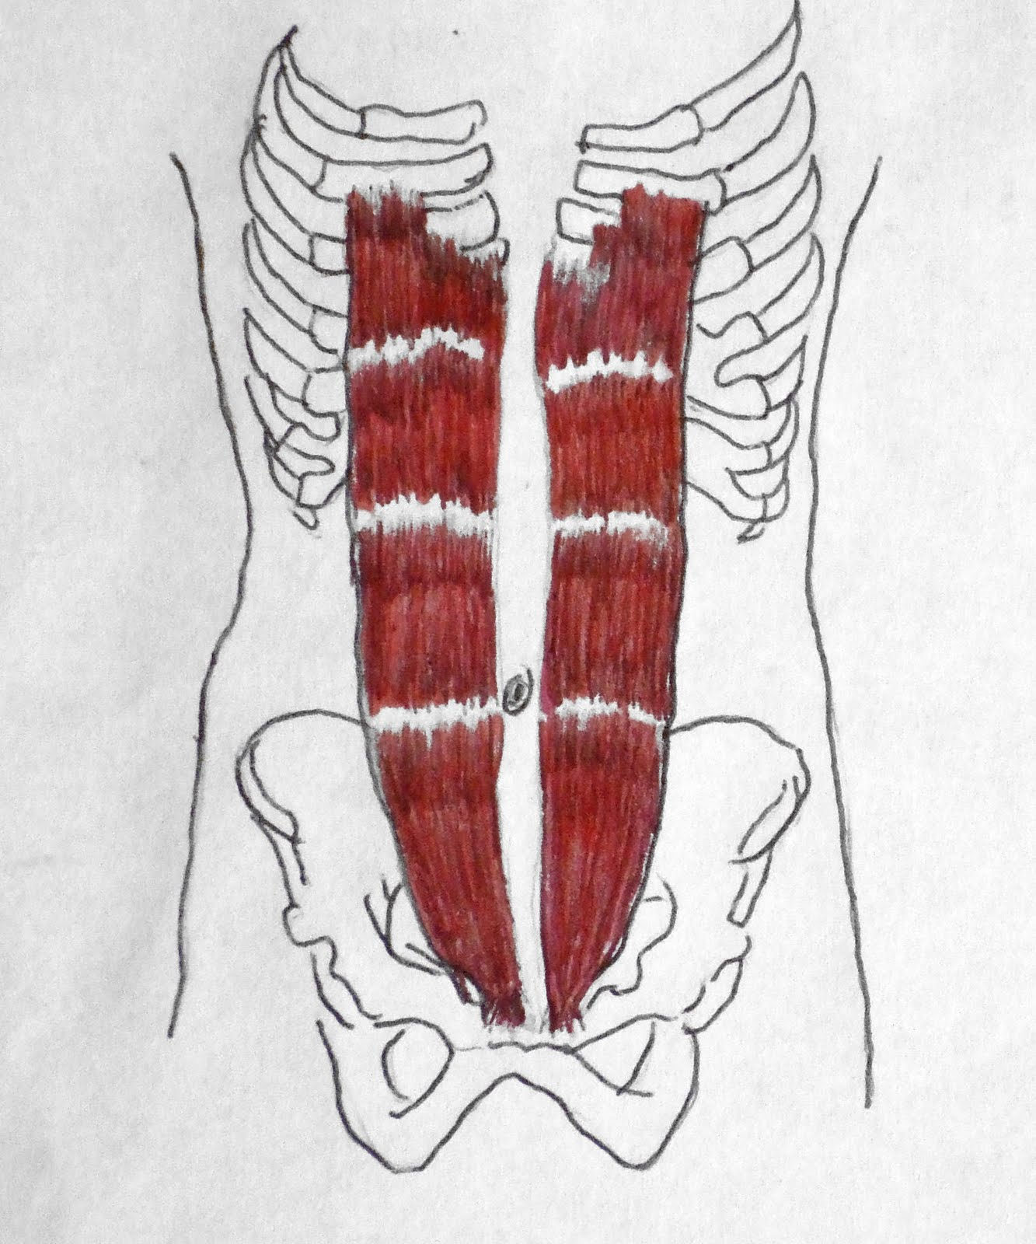
Trunk flexion
Rectus abdominis muscle

Slide 41
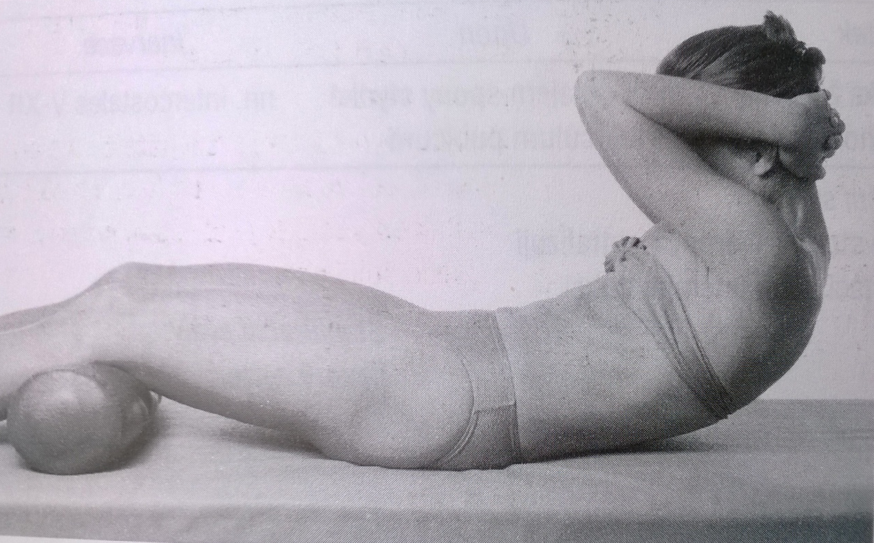
Trunk flexion
Grade 5
Note: before the test, do the mark on the spine at the level of lower part of scapula
Position: supine position, lower limbs relaxed in knee semiflexion position, upper limbs bended and placed below the head, elbows forward
Fixation: not necessary
Movement: fluent flexion of the trunk (bow), without moving of the pelvis in such an extend, that the distance between the table and the mark is at least 5cm
Resistance: no resistance

Slide 42
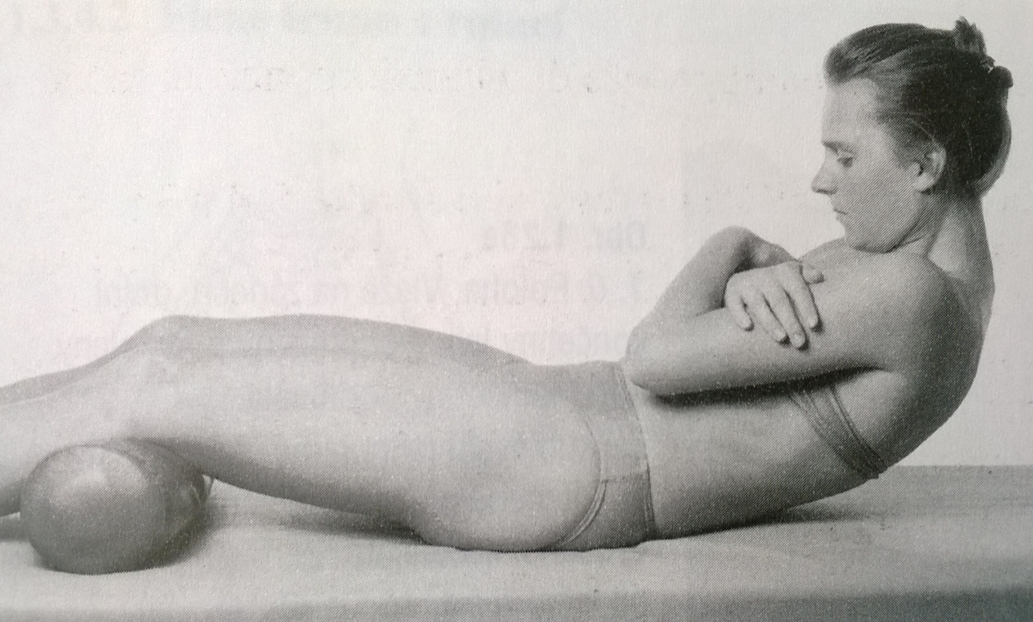
Trunk flexion
Grade 4
Position: supine position, lower limbs relaxed in knee semiflexion position, upper limbs bended and placed crossed at the chest
Fixation: not necessary
Movement: fluent flexion of the trunk (bow), without moving of the pelvis in such an extend, that the distance between the table and the mark is at least 5cm
Resistance: no resistance

Slide 43
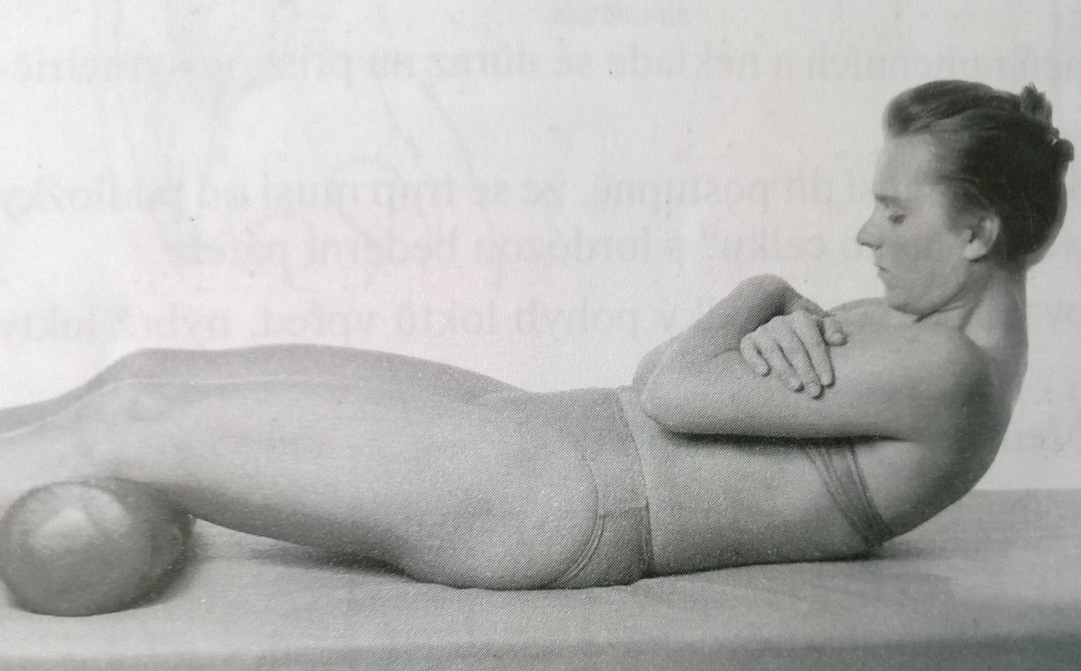
Trunk flexion
Grade 3
Position: supine position, lower limbs relaxed in knee semiflexion position, upper limbs bended and placed crossed at the chest
Fixation: not necessary
Movement: fluent flexion of the trunk (bow), without moving of the pelvis in such an extend, that the mark can at least be seen
Resistance: no resistance

Slide 44
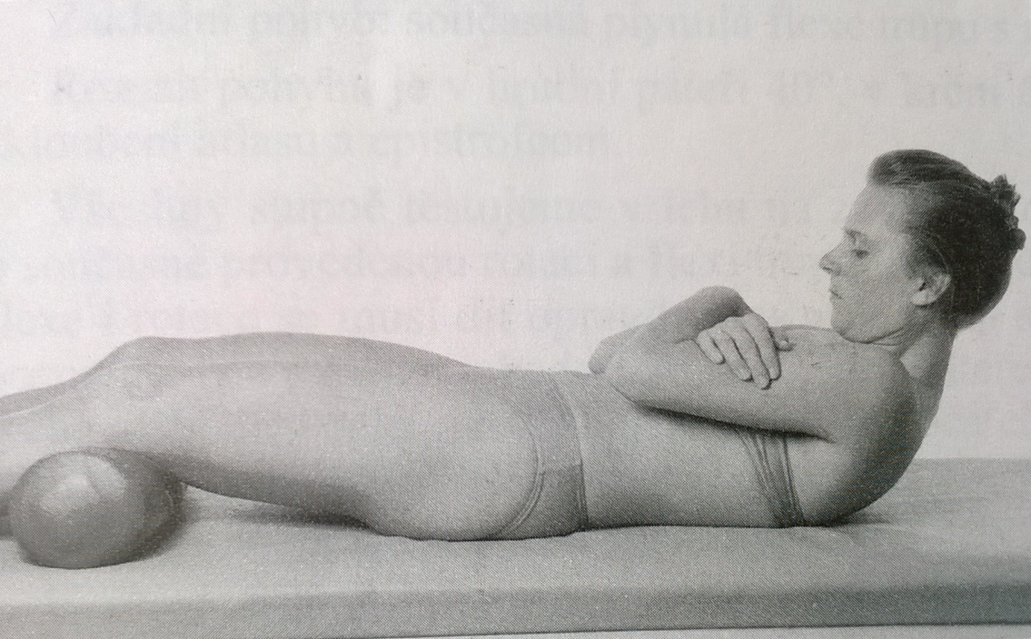
Trunk flexion
Grade 2
Position: supine position, lower limbs relaxed in knee semiflexion position, upper limbs bended and placed crossed at the chest
Fixation: not necessary
Movement: fluent flexion of the neck (bow) in full range of motion, elevation of the upper part of scapulas (the chest depression, lumbar applanation)
Resistance: no resistance

Slide 45
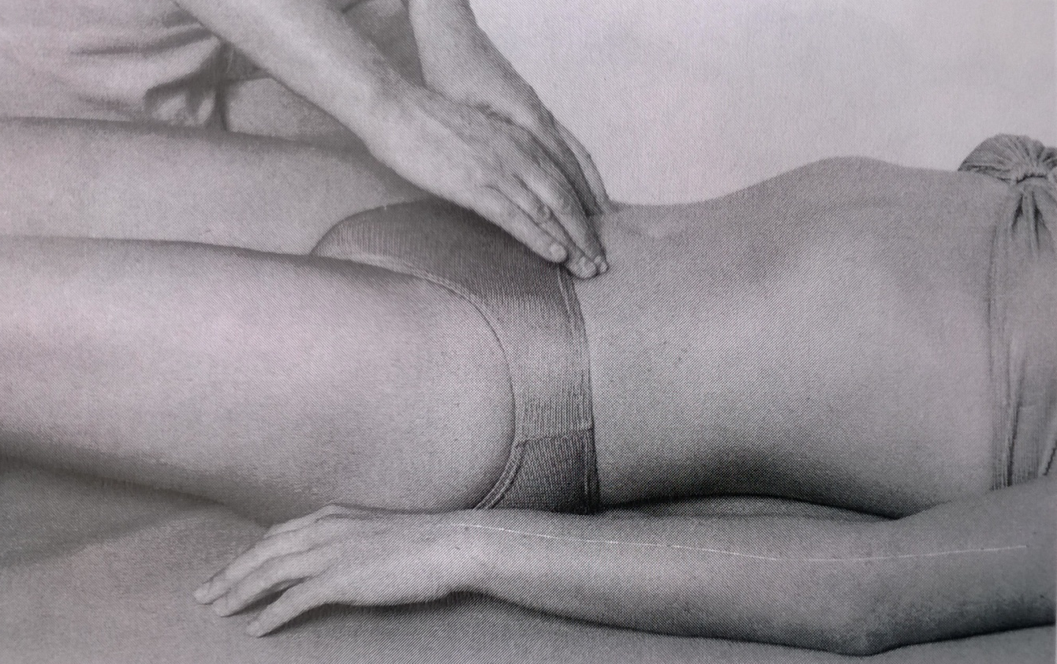
Trunk flexion
Grade 1,0
Position: supine position, lower limbs relaxed in knee semiflexion position, upper limbs extended, lying relaxed along the body side
Attempt to move: patient tries to cought or deeply breath out, PT palpates the trace of abdominal muscles contraction

Slide 46
Trunk flexion – note:
The tested movement should be fluent, no swing at the start should be allowed
The movement should be done symetrically (without rotation to the side)
Lower limbs have to be flexed and relaxed (to avoid iliopsoas muscles to take over the function)
Finish the movement to flexion of the trunk when the pelvis starts to move (anteflexion)
Shortening of the abdominal muscles is not common, but TrPs or spasms can occur

Slide 47
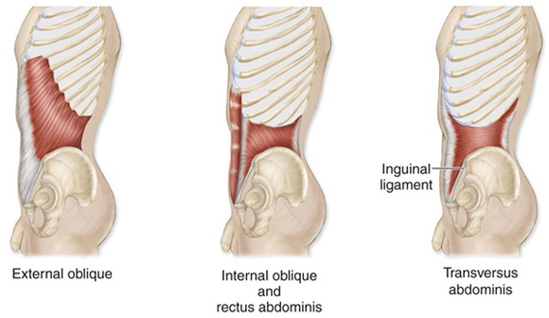
Trunk flexion with rotation

Slide 48
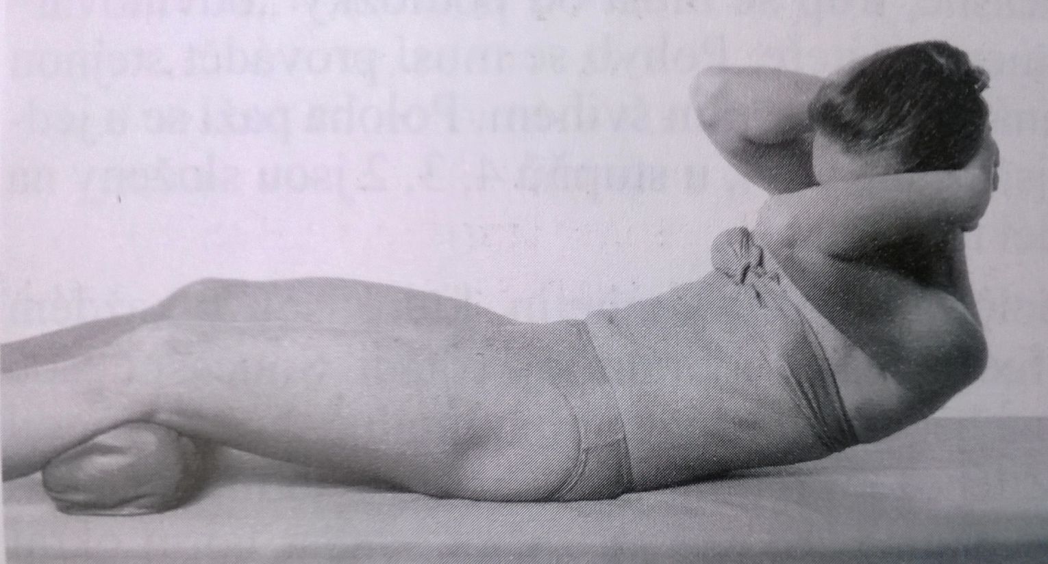
Trunk flexion with rotation
Grade 5
Note: before the test, do the mark on the spine at the level of lower part of scapula
Position: supine position, lower limbs relaxed in knee semiflexion position, 25° hip abduction, upper limbs bended and placed below the head, elbows forward
Fixation: not necessary
Movement: fluent combined flexion and rotation of the trunk (bow), without moving of the pelvis in such an extend, that the distance between the table and the mark is at least 5cm
Resistance: no resistance

Slide 49
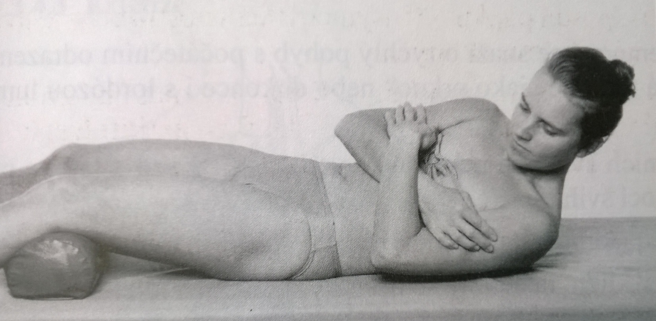
Trunk flexion with rotation
Grade 4
Position: supine position, lower limbs relaxed in knee semiflexion position, 25° hip abduction, upper limbs bended and placed crossed at the chest
Fixation: not necessary
Movement: fluent combined flexion and rotation of the trunk (bow), without moving of the pelvis in such an extend, that the distance between the table and the mark is at least 5cm
Resistance: no resistance

Slide 50
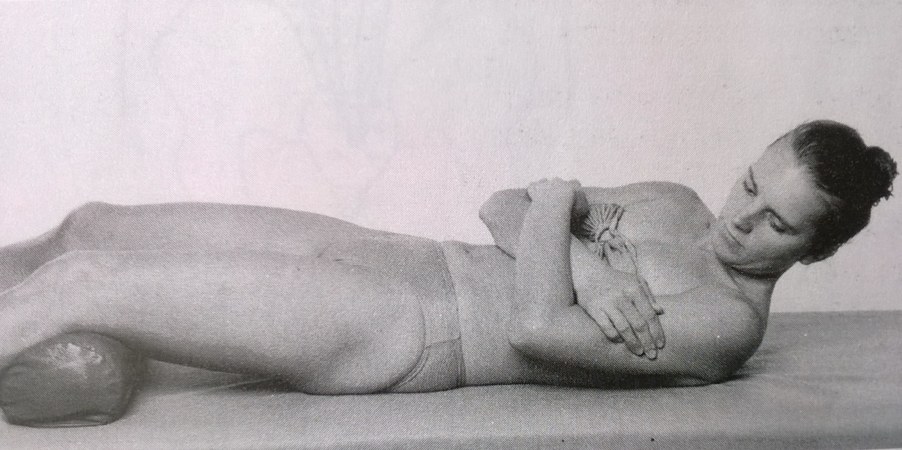
Trunk flexion with rotation
Grade 3, 2
Position: supine position, lower limbs relaxed in knee semiflexion position, 25° hip abduction, upper limbs bended and placed crossed at the chest
Fixation: not necessary
Movement: fluent combined flexion and rotation of the trunk (bow), without moving of the pelvis in such an extend, that the mark can be at least seen
Resistance: no resistance
Grade 2: the same as grade 3, the patient should at least elevate the head, shoulder and the upper thorax

Slide 51
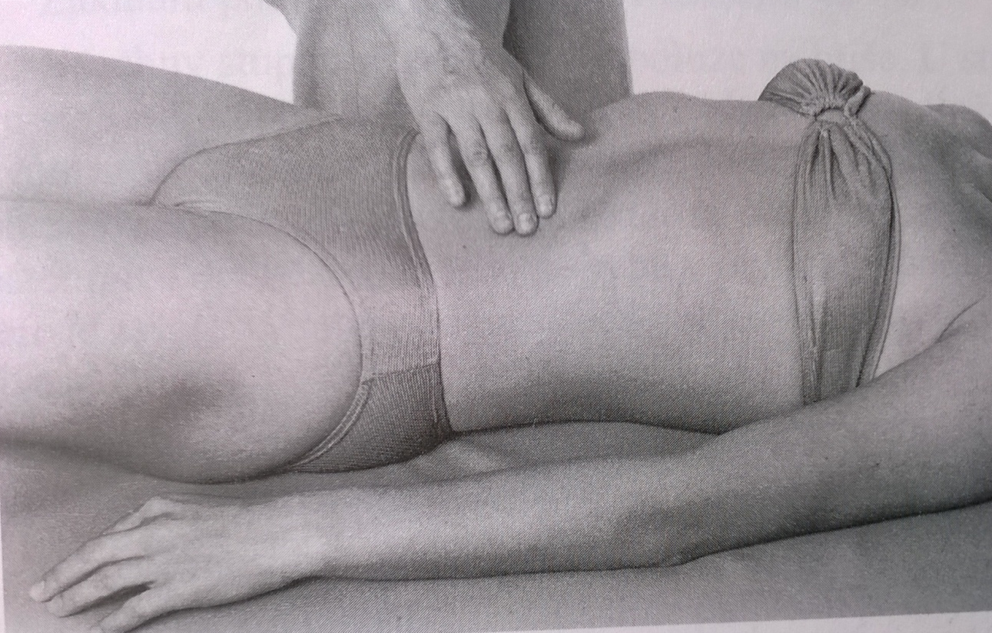
Trunk flexion with rotation
Grade 1,0
Position: supine position, lower limbs relaxed in knee semiflexion position, 25° hip abduction, upper limbs extended, lying relaxed along the body side
Attempt to move: patient tries to do rotation with flexion of the trunk, PT palpates the trace of contraction of abdominal muscles

Slide 52
Trunk flexion with rotation – notes:
The movement should be fluent – combination of flexion and rotation, try to avoid lumbar hyperextension or lumbar lateroflexion
The lower limbs has to be flexed, abduct and relaxed
Contracture of abdominal muscles is not common, sometimes hypertonus occur at deep stabilization muscles insuficiention

Slide 53
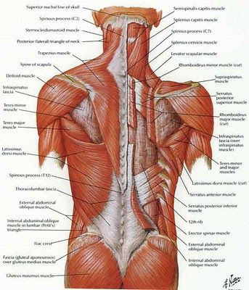
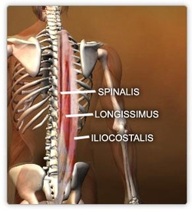
Muscles of the back

Slide 54
The erector spinae
a muscle group of the back, which extends the vertebral column (a more modern term is extensor spinae)
it is not just one muscle, but a bundle of muscles and tendons
it is paired and runs more or less vertically
it extends throughout the lumbar, thoracic and cervical regions, and lies in the groove to the side of the vertebral column
it is covered in the lumbar and thoracic regions by the thoracolumbar fascia, and in the cervical region by the nuchal ligament

Slide 55
Iliocostalis
originates from the sacrum, erector spinae aponeurosis and iliac crest
has three different insertions according to the parts:
  iliocostalis lumborum has the lumbar part(where its insertion is in the 12th to 7th ribs)
  iliocostalis thoracis where its insertion runs from the last 6 ribs to the first 6 ribs.
  iliocostalis cervicis which runs from the first 6 ribs to the posterior tubercle of the transverse process of C6-C4.

Slide 56
Longissimus
is the intermediate and the largest of the three columns
it has three parts with different origin and insertion:
  longissimus thoracis originates from the sacrum, spinous processes of the lumbar vertebrae and transverse process of the last thoracic vertebra and inserts in the transverse processes of the lumbar vertebrae, erector spinae aponeurosis, ribs and costal processes of the thoracic vertebrae.
  longissimus cervicis originates from the transverse processes of T6-T1 and inserts in the transverse processes of C7-C2.
  longissimus capitis originates from the transverse processes of T3-T1 runs through C7-C3 and inserts in the mastoid process of the temporal bone.

Slide 57
Spinalis
it is the most medial and the smallest column
it has three parts:
  spinalis thoracis which originates from the spinous process of L3-T10 and inserts in the spinous process of T8-T2.
  spinalis cervicis originates from the spinous process of T2-C6 and inserts in the spinous process of C4-C2.
  spinalis capitis is an inconstant muscles fibres that runs from the cervical and upper thoracic that then inserts in the external occipital protuberance.

Slide 58
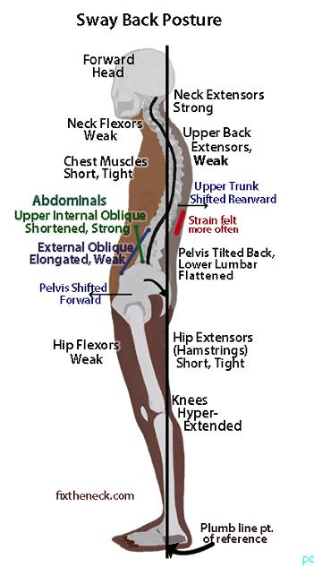
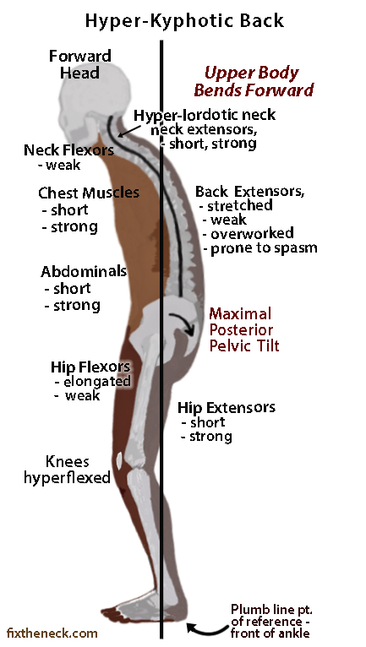
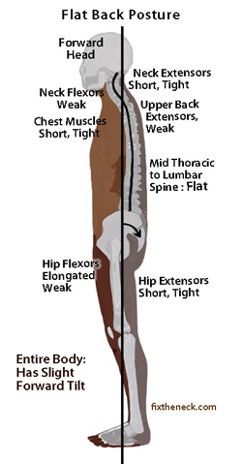
Weak back extensors

Slide 59
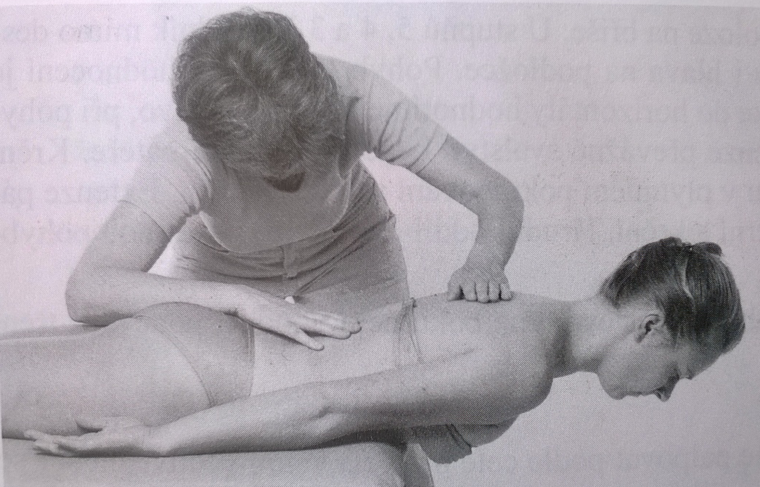
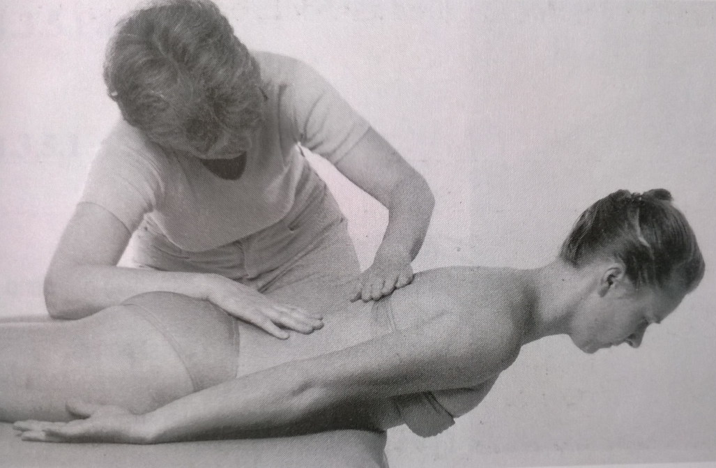
Trunk extension
Grade 5,4
Position: prone position, the chest away from the table, trunk in flexion (30°), arm along body side, palms up
Fixation: to fix the buttocks, pelvis and lumbar part of the spine
Movement: from forward bending position the patient extends the spine fully (thoracal and lumbal spine)
Resistance: put up resistance between scapula using a palm (first phase), to the lower ribs (second phase)

Slide 60
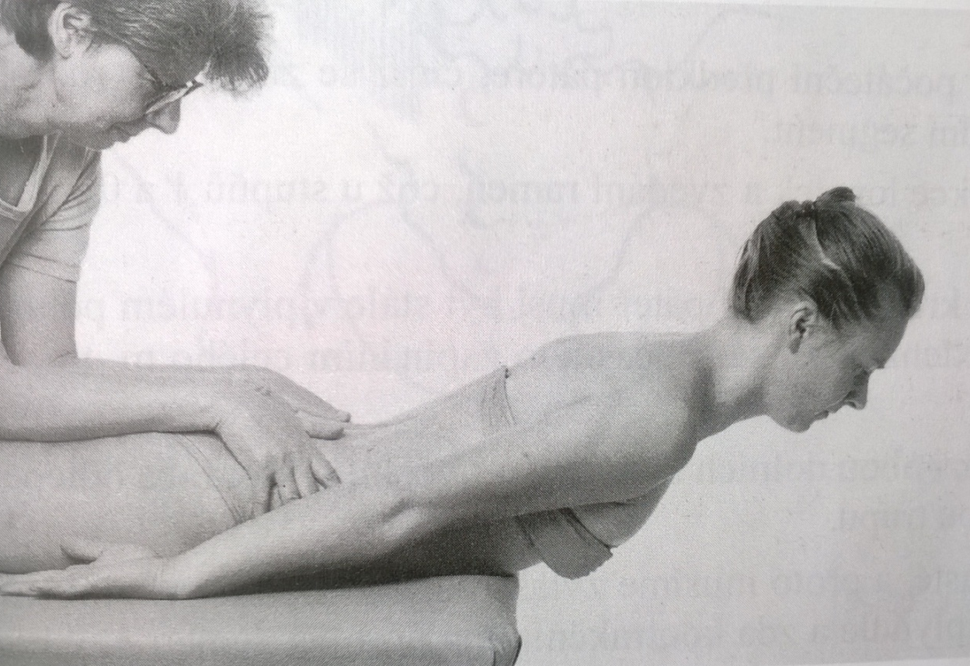
Trunk extension
Grade 3
Position: prone position, the chest away from the table, trunk in flexion (30°), arm along body side, palms up
Fixation: to fix the buttocks and pelvis, firmly, using both hands
Movement: from forward bending position the patient extends the spine fully

Slide 61

Trunk extension
Grade 2
Position: prone position, arm along body side, palms up, head laying down on the forehead
Fixation: to fix the buttocks and pelvis, using both hands
Movement: the patient extends the spine to elevate the head and shoulders

Slide 62

Trunk extension
Grade 1,0
Position: prone position, arm along body side, palms up, head laying down on the forehead
Attempt to move: the patient tries to extend the spine, at least to elevate the head.
PT tries to palpate the trace of contraction of the extensors along the whole spine

Slide 63

Quadratus lumborum

Slide 64

Quadratus lumborum
a muscle in the lower back
irregular and quadrilateral in shape, and broader below than above
originates via aponeurotic fibers into the iliolumbar ligament and the internal lip of the iliac crest for about 5 cm
inserts from the lower border of the last rib for about half its length, and by four small tendons from the apices of the transverse processes of the upper four lumbar vertebrae
Occasionally a second portion of this muscle is found in front of the preceding. It arises from the upper borders of the transverse processes of the lower three or four lumbar vertebræ, and is inserted into the lower margin of the last rib

Slide 65

Quadratus lumborum - function
Lateral flexion of vertebral column, with ipsilateral contraction
Extension of lumbar vertebral column, with bilateral contraction
Fixes the 12th rib during forced expiration
Elevates the Ilium (bone), with ipsilateral contraction

Slide 66


Quadratus lumborum weakness

Slide 67

Pelvis elevation
Grade 5,4,3
Position: supine position, lower limb extended, 25° hip abduction
Fixation: patient holds the edge of the table both hands
Movement: to elevate one side of the pelvis to the chest
Resistance: PT holds the tested lower limb around the ankle and pull it distally (the grades differentiate acording to the resistance PT uses)

Slide 68

Pelvis elevation
Grade 2
Position: supine position, lower limb extended, 25° hip abduction
Fixation: patient holds the edge of the table both hands
Movement: to elevate one side of the pelvis to the chest in full range of motion

Slide 69

Pelvis elevation
Grade 1,0
Position: supine position, lower limb extended, hip in slight abduction
Fixation: PT supports the tight slightly
Attempt to move: patient tries to move one side of the pelvis to the chest, PT palpates the trace of contraction at the lateral side of the trunk

Slide 70
Pelvis elevation – note:
Position: dont´ forget an abduction of the lower limbs
Movement: dont´ allow the patient to do a trunk lateroflexion during testing
Quadratus lumborum shortening: elevation of pelvis, scoliosis, lumbar spine doesn´t expand to lateral flexion to the other side

Slide 71
Literature, e-sources
http://www.britannica.com/science/abdominal-muscle
https://en.wikipedia.org/wiki/Quadratus_lumborum_muscle
http://www.britannica.com/science/erector-spinae

Slide 72

Thank you for your attention ☺

