Slide 1
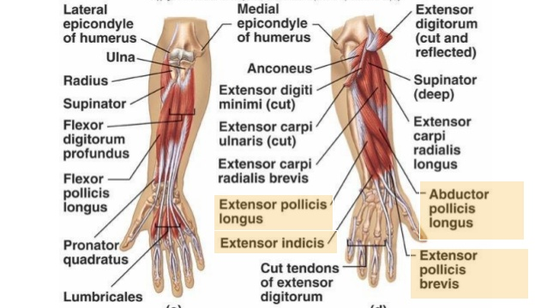
Examination Methods in Rehabilitation (4.10.2021)
Manual muscle test:
Elbow, forearm, wrist, fingers
Mgr. Veronika Mrkvicová, Ph.D. (physiotherapist)

Slide 2
Elbow

Slide 3
Muscles of the elbow

Slide 4
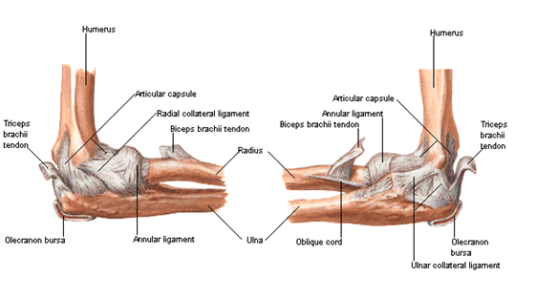
Ligaments and tendons of the elbow

Slide 5
Movements of the elbow

Slide 6
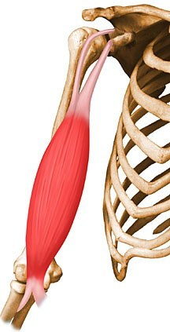
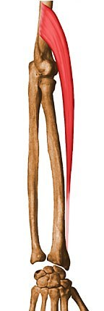
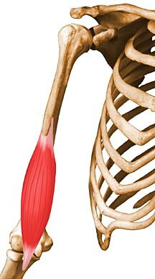
Elbow flexion
Biceps brachii
Brachialis
Brachioradialis

Slide 7
Biceps brachii
Origin
Short head: tip of coracoid process of scapula;
Long head: supraglenoid tubercle of scapula
Insertion
Tuberosity of radius and fascia of forearm via bicipital aponeurosis
Action
Supinates forearm and, when it is supine, flexes forearm
Innervation
Musculocutaneous nerve (C5 and C6 ) (C5, C6)

Slide 8
Brachialis
Origin
Distal half of anterior surface of humerus
Insertion
Coronoid process and tuberosity of ulna
Action
Major flexor of forearm - flexes forearm in all positions
Innervation
Musculocutaneous nerve (C5 and C6) (C5, C6)

Slide 9
Brachioradialis
Origin
Proximal 2/3 of lateral supracondyle ridge of humerus
Insertion
Lateral surface of distal end of radius
Action
Flexes forearm
Innervation
Radial nerve (C5, C6 and C7) (C5, C6, C7)

Slide 10
Elbow flexion – grade 5,4
Position: patient sits, tested upper limb extended along body side, forearm: a. supine (m. biceps brachii), b. in central position (brachioradialis), c. prone (brachialis)
Fixation: lower part of the arm from behing
Movement: elbow flexion in full range of motion
Resistance: PT puts resistance on distal part of forearm (arched)

Slide 11
Elbow flexion – grade 3
Position: patient sits, tested upper limb extended along body side, forearm: a. supine (m. biceps brachii), b. in central position (brachioradialis), c. prone (brachialis)
Fixation: lower part of the arm from behing, and scapula (by the other hand) if needed
Movement: elbow flexion in full range of motion

Slide 12
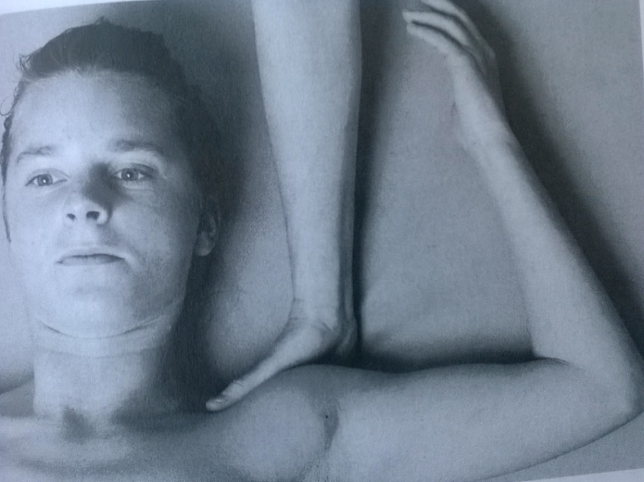
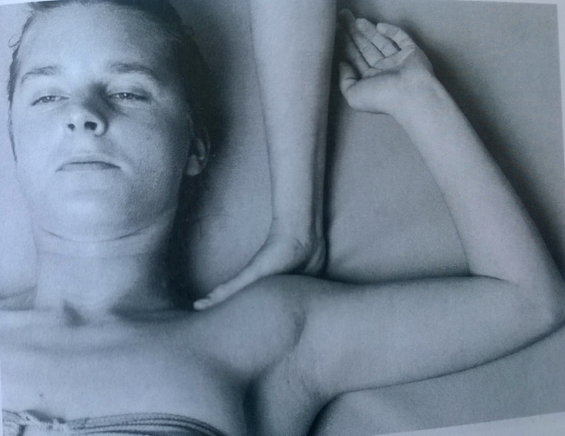
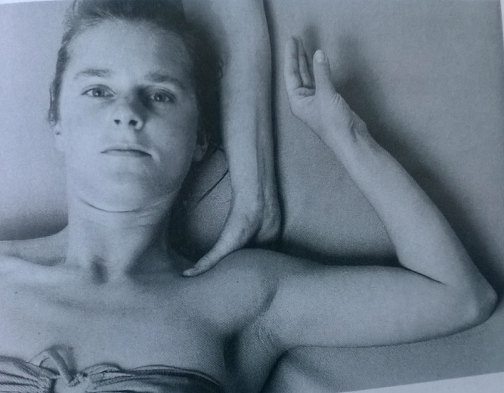
Elbow flexion – grade 2
Position: lying supine, 90° shoulder abduction, external rotation, elbow extended, forearm on the table: a. radial side (biceps brachii), b. dorsal side (brachioradialis), c. ulnar side (brachialis)
Fixation: shoulder, or lower part of the arm if needed
Movement: elbow flexion in full range of motion

Slide 13
Elbow flexion – grade 2
Position: patient sits next to the table, 90° shoulder abduction, elbow extended, forearm on the table: a. ulnar side (biceps brachii), b. palm down (brachioradialis), c. radial side (brachialis)
Fixation: one hand on the scapula, the other hand at the middle part of the arm
Movement: elbow flexion in full range of motion, pushing the forearm on the table

Slide 14
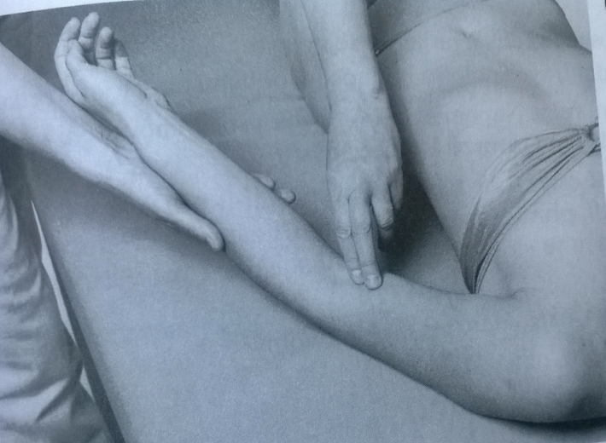
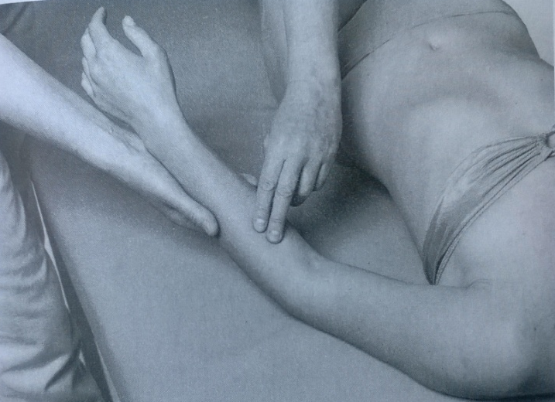
Elbow flexion – grade 1,0
Position: lying supine, shoulder slightly abducted and external rotated, elbow in semiflexion, forearm: a. supine (biceps brachii), b. central position (brachioradialis), c. prone (brachialis)
Attempt to move: PT palpates a trace of contraction of the muscles

Slide 15
Elbow flexion – notes:
Biceps brachii, brachialis, brachioradialis need to be tested separately
Dont´ allow the patient to contract the muscles of the forearm (flexors and extensors of the wrist)
Elbow should stay stable, but should move independently

Slide 16
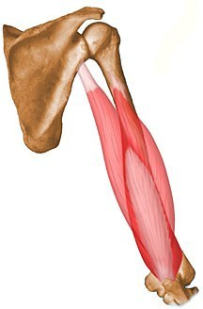
Elbow extension
Triceps brachii

Slide 17
Triceps brachii
Origin
Long head: infraglenoid tubercle of scapula;
Lateral head: posterior surface of humerus, superior to radial groove
Medial head: posterior surface of humerus, inferior to radial groove
Insertion
Proximal end of olecranon process of ulna and fascia of forearm
Action
Chief extensor of forearm
long head steadies head of abducted humerus
Innervation
Radial nerve (C6, C7 and C8) (C6, C7, C8)

Slide 18
Elbow extension – grade 5,4
Position: lying prone, head on the forehead, tested upper limb in 90° shoulder abduction, forearm hanging relaxed down the table
Fixation: distal part of the arm from ventral side
Movement: elbow extension
Resistance: on the distal part of forearm (arched)

Slide 19
Elbow extension – grade 3
Position: lying prone, head on the forehead, tested upper limb in 90° shoulder abduction, forearm hanging relaxed down the table
Fixation: distal part of the arm from ventral side
Movement: elbow extension

Slide 20
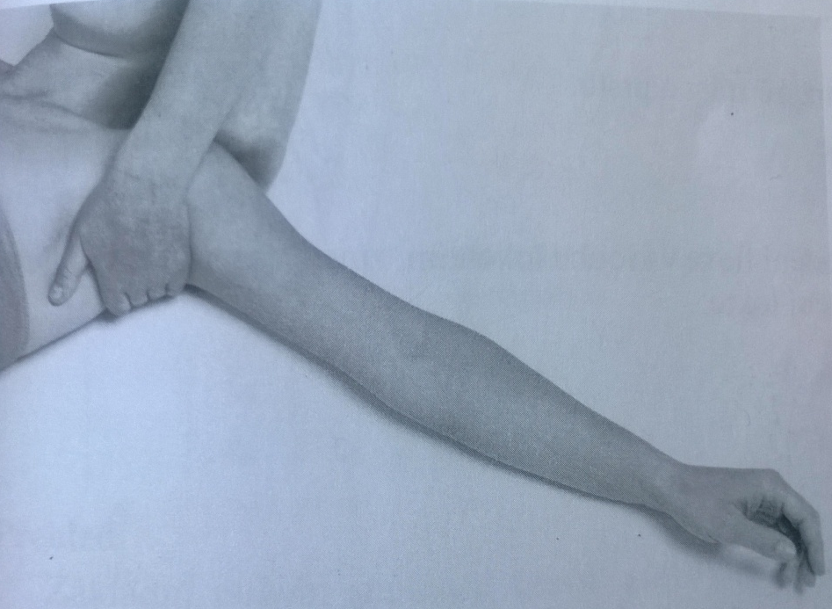
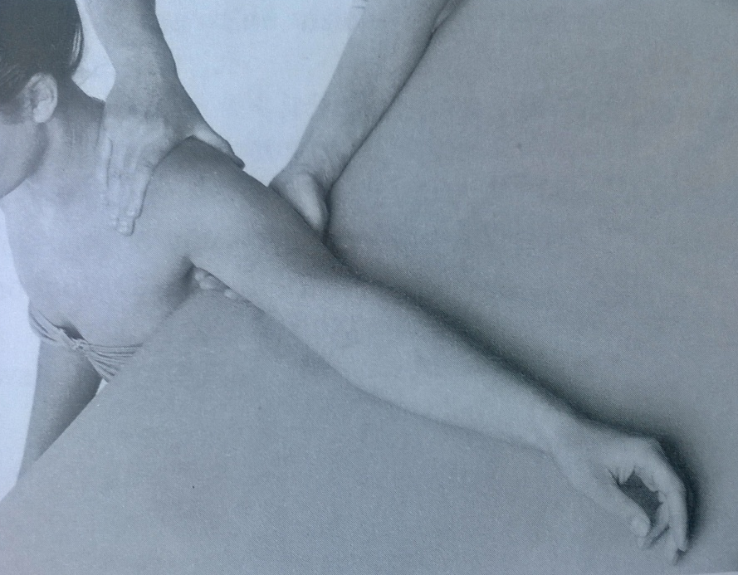
Elbow extension – grade 2
Position A: lying supine, tested upper limb in 90° shoulder abduction and external rotation, elbow in 90° flexion, forearm supine
Fixation: arm and the scapula
Movement: elbow extension by pushing the forearm on the table
Position A: sitting next to the table, tested upper limb in 90° shoulder abduction, elbow in 90° flexion, forearm in the central position
Fixation: arm and the scapula
Movement: elbow extension by pushing the forearm on the table

Slide 21
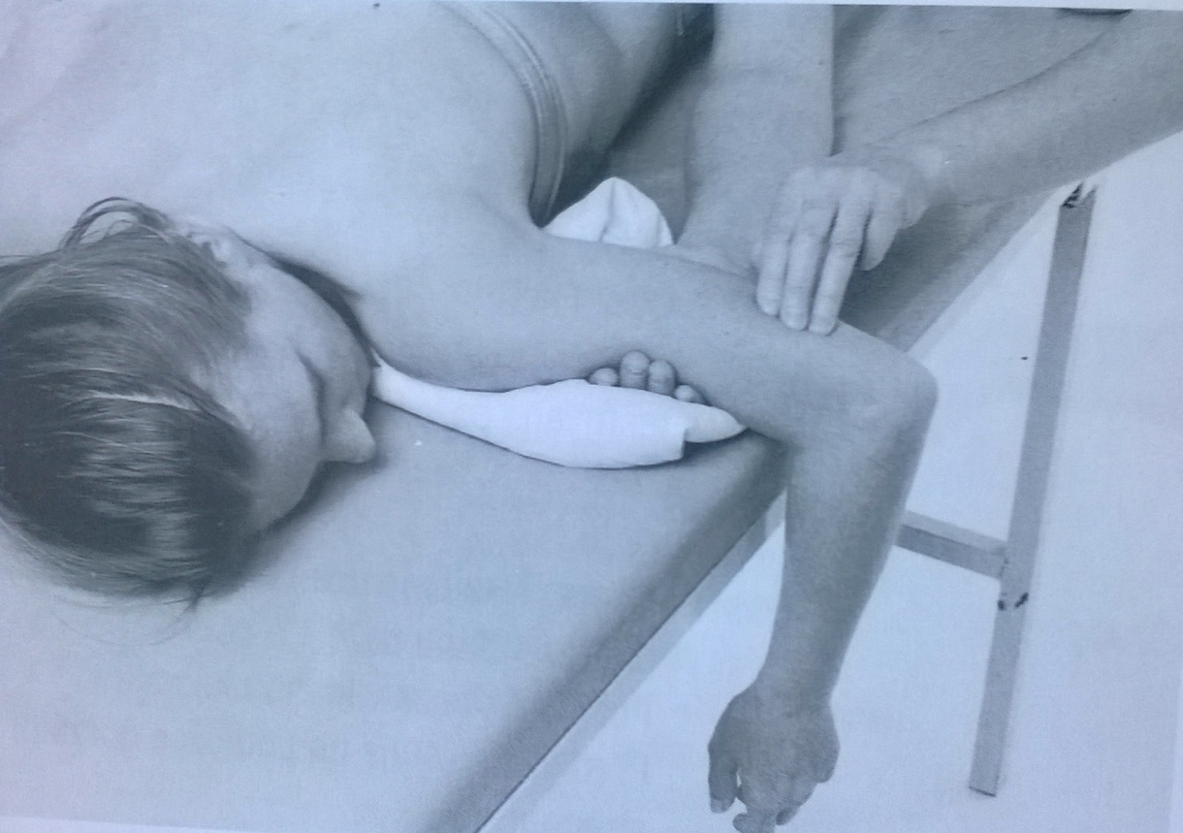
Elbow extension – grade 1,0
Position: lying prone, head lying rotated to the tested side, tested upper limb in 90° shoulder abduction, forearm hanging relaxed down the table, 90° elbow flexion
Attempt to move: PT palpates the trace of contraction of triceps

Slide 22
Elbow extension – notes:
Dont´ allow the patient to use extensors of the wrist
No protraction of the shoulder should be allowed

Slide 23
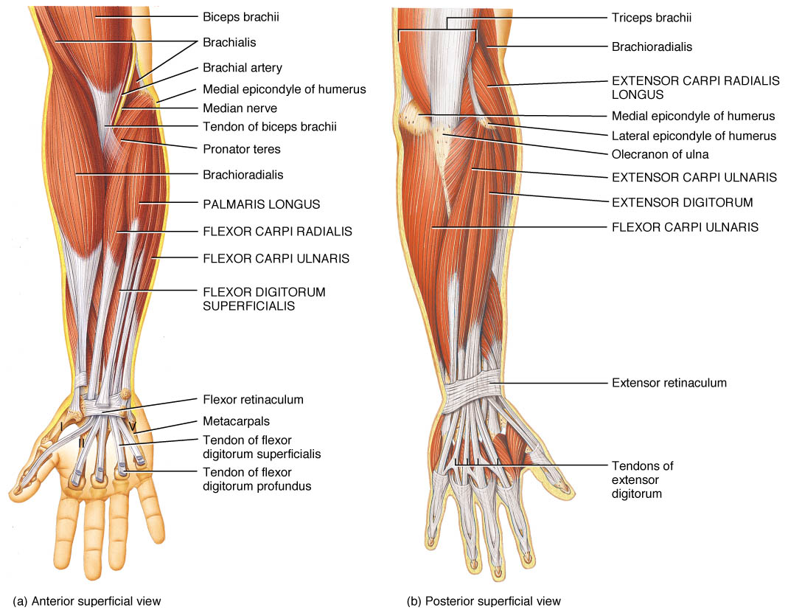
Forearm

Slide 24
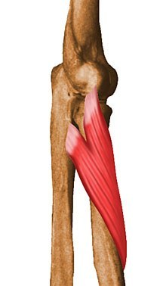
Supination
Supinator
Biceps brachii

Slide 25
Supinator
Origin
Lateral epicondyle of humerus, radial collateral and annular ligaments, supinator fossa and crest of ulna
Insertion
Lateral, posterior and anterior surfaces of proximal 1/3 of radius
Action
Supinates forearm (i.e., rotates radius to turn palm anteriorly)
Innervation
Deep branch of radial nerve (C5 and C6) (C5, C6)

Slide 26
Biceps brachii
Origin
Short head: tip of coracoid process of scapula;
Long head: supraglenoid tubercle of scapula
Insertion
Tuberosity of radius and fascia of forearm via bicipital aponeurosis
Action
Supinates forearm and, when it is supine, flexes forearm
Innervation
Musculocutaneous nerve (C5 and C6 ) (C5, C6)

Slide 27
Supination – grade 5,4
Position: patient sits, arms relaxed along body side, tested upper limb 90° flexed, forearm in prone position, muscles of the wrist and fingers relaxed
Fixation: lower part of the arm
Movement: supination in full range of motion
Resistance: PT puts resistance against the movement, holding patients hand like at the picture (main resistance by using PTs´ point finger on the patients´ processus styloideus ulnae)

Slide 28
Supination – grade 3
Position: patient sits, arms relaxed along body side, tested upper limb 90° flexed, forearm in prone position, muscles of the wrist and fingers relaxed
Fixation: at the lower part of patients´ arm and support the forearm by the other hand
Movement: supination in full range of motion

Slide 29
Supination – grade 2
Position: lying prone, 90° shoulder abduction, 90° elbow flexion, forearm prone hanging from the table, muscle of the wrist and fingers relaxed
Fixation: the lower part of the arm
Movement: supination in full range of motion

Slide 30
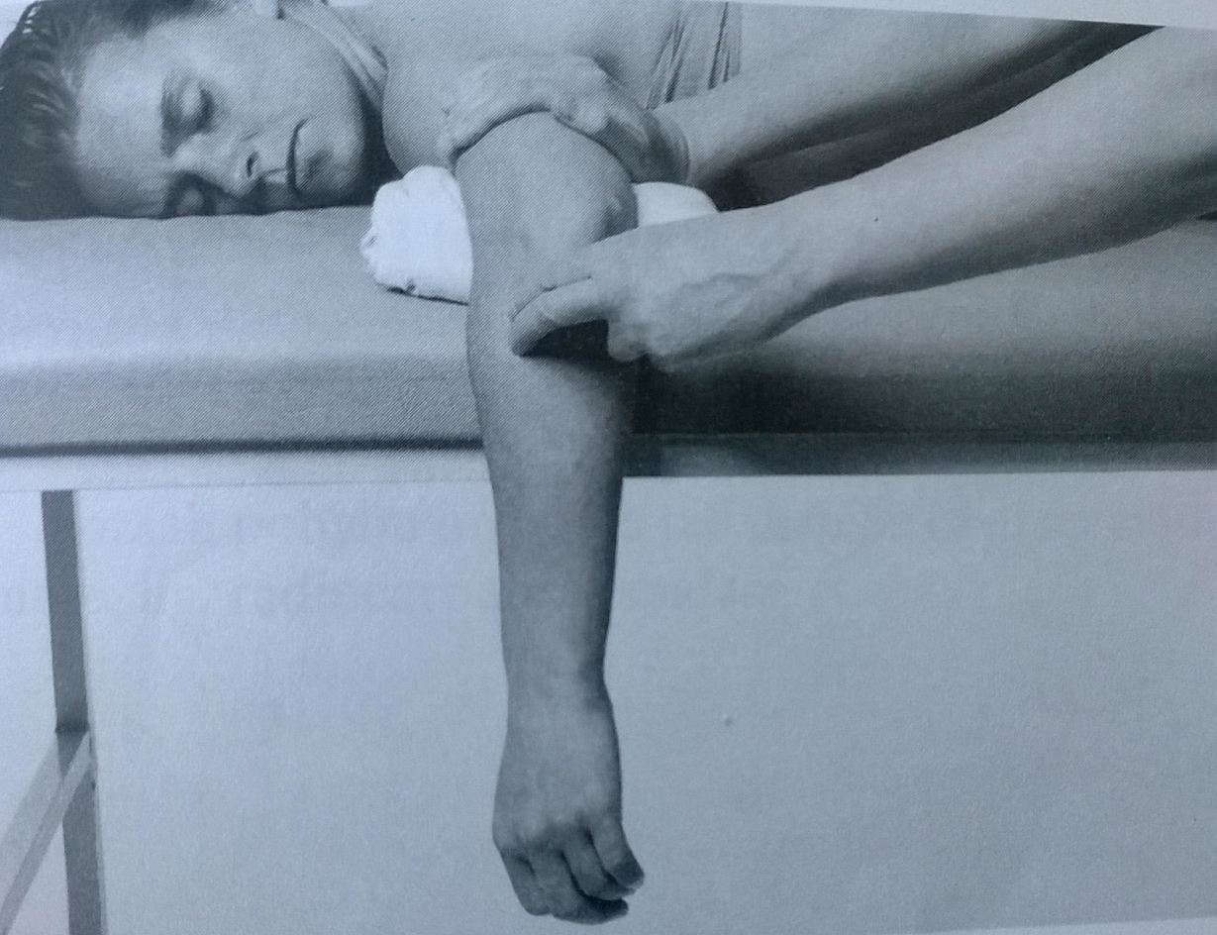
Supination – grade 1,0
Position: lying prone, 90° shoulder abduction, 90° elbow flexion, forearm prone hanging from the table, muscle of the wrist and fingers relaxed
Attempt to move: PT palpates the trace of contraction of supinator and biceps during patients´ attempt to supinate the forearm

Slide 31
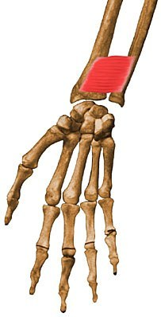
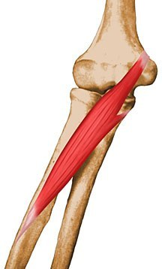
Pronation
Pronator quadratus
Pronator teres

Slide 32
Pronator quadratus
Origin
Distal 1/4 of anterior surface of ulna
Insertion
Distal 1/4 of anterior surface of radius
Action
Pronates forearm; deep fibers bind radius and ulna together
Innervation
Anterior interosseous nerve from median nerve (C8 and T1) (C8, T1)

Slide 33
Pronator teres
Origin
Medial epicondyle of humerus and coronoid process of ulna
Insertion
Middle of lateral surface of radius
Action
Pronates and flexes forearm (at elbow)
Innervation
Median nerve (C6 and C7) (C6, C7)

Slide 34
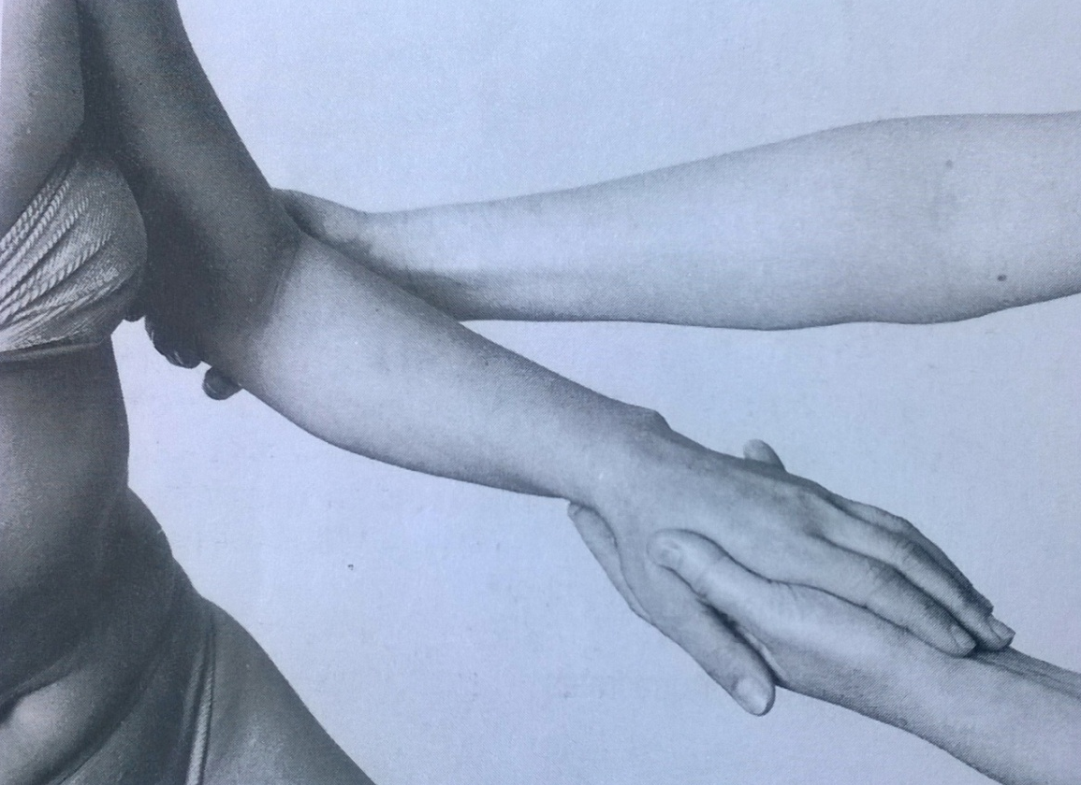
Pronation – grade 5,4
Position: patient sits, arms relaxed along body side, tested upper limb 90° flexed, forearm in prone position, muscles of the wrist and fingers relaxed
Fixation: lower part of the arm
Movement: pronation in full range of motion
Resistance: PT puts resistance against the movement, holding patients hand like at the picture (main resistance by using PTs´ point finger and middle finger on the patients´ processus styloideus radii)

Slide 35
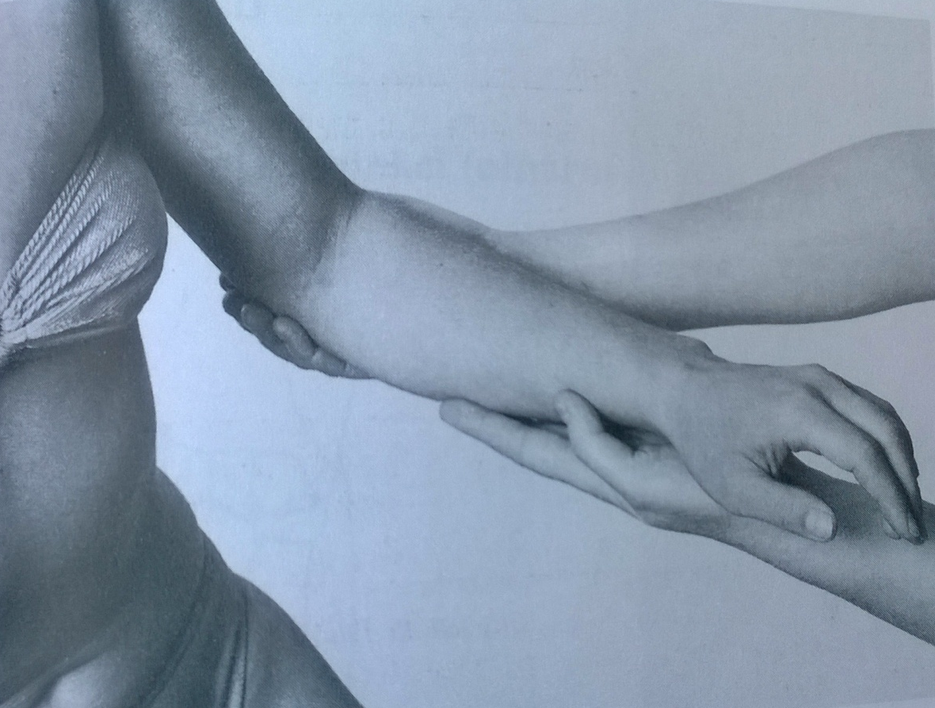
Pronation – grade 3
Position: patient sits, arms relaxed along body side, tested upper limb 90° flexed, forearm in prone position, muscles of the wrist and fingers relaxed
Fixation: lower part of the arm, support the forearm by the other hand
Movement: pronation in full range of motion

Slide 36
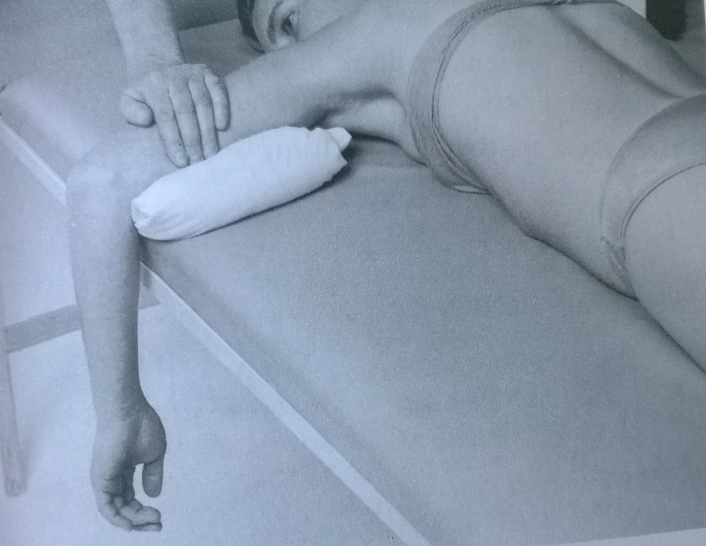
Pronation – grade 2
Position: lying prone, 90° shoulder abduction, 90° elbow flexion, forearm supine hanging from the table, muscle of the wrist and fingers relaxed
Fixation: the lower part of the arm
Movement: pronation in full range of motion

Slide 37
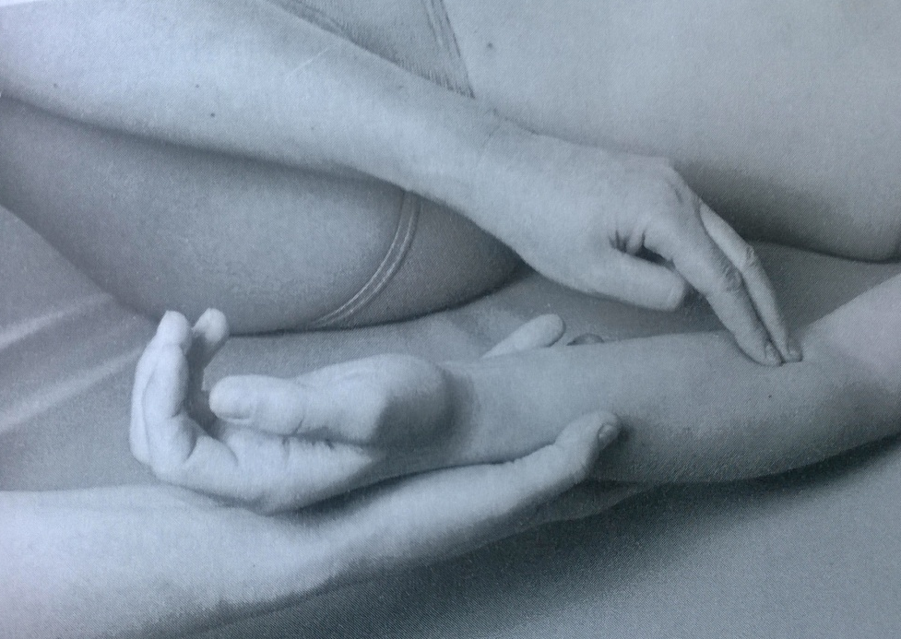
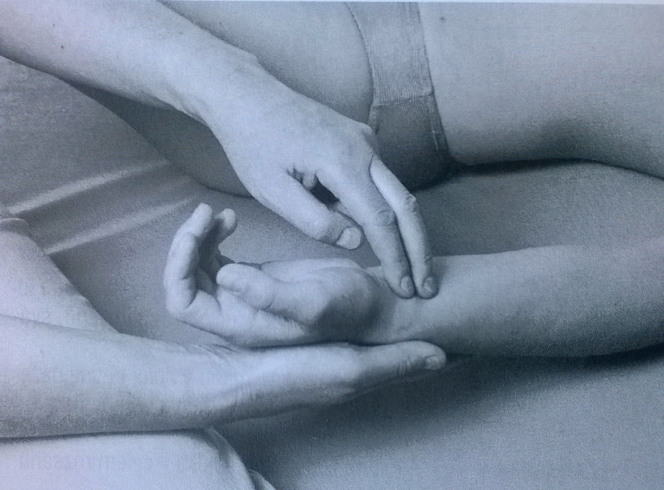
Pronation – grade 1,0
Position: lying supine, elbow slightly flexed and supinated
Attempt to move: PT palpates the trace of contraction of pronator teres and pronator quadratus during patients´ attempt to pronate the forearm

Slide 38
Pronation and supination – notes:
Elbow should stay in 90° flexion during whole tested movement
No movement of the shoulder should be allowed – fix the arm properly
No activity of muscles of the wrist and fingers
Proper grip of the hand
Palpation of cotraction of supinator, pronator teres and pronator quadratus muscle is difficult

Slide 39
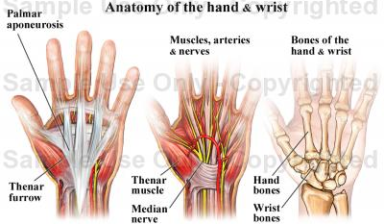
Wrist

Slide 40
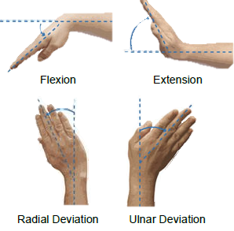
Movements of the wrist joint

Slide 41
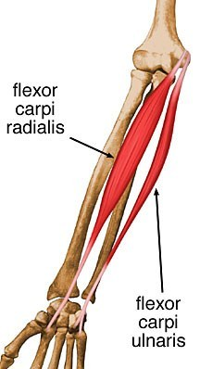
Wrist flexion
Flexor carpi radialis
Flexor carpi ulnaris

Slide 42
Flexor carpi radialis
Origin
Medial epicondyle of humerus
Insertion
Base of 2nd metacarpal
Action
Flexes and abducts hand (at wrist)
Innervation
Median nerve (C6 and C7) (C6, C7)

Slide 43
Flexor carpi ulnaris
Origin
Humeral head: medial epicondyle of humerus;
Ulnar head: olecranon and posterior border of ulna
Insertion
Pisiform bone, hook of hamate bone, and 5th metacarpal bone
Action
Flexes and adducts hand (at wrist)
Innervation
Ulnar nerve (C7 and C8) (C7, C8)

Slide 44
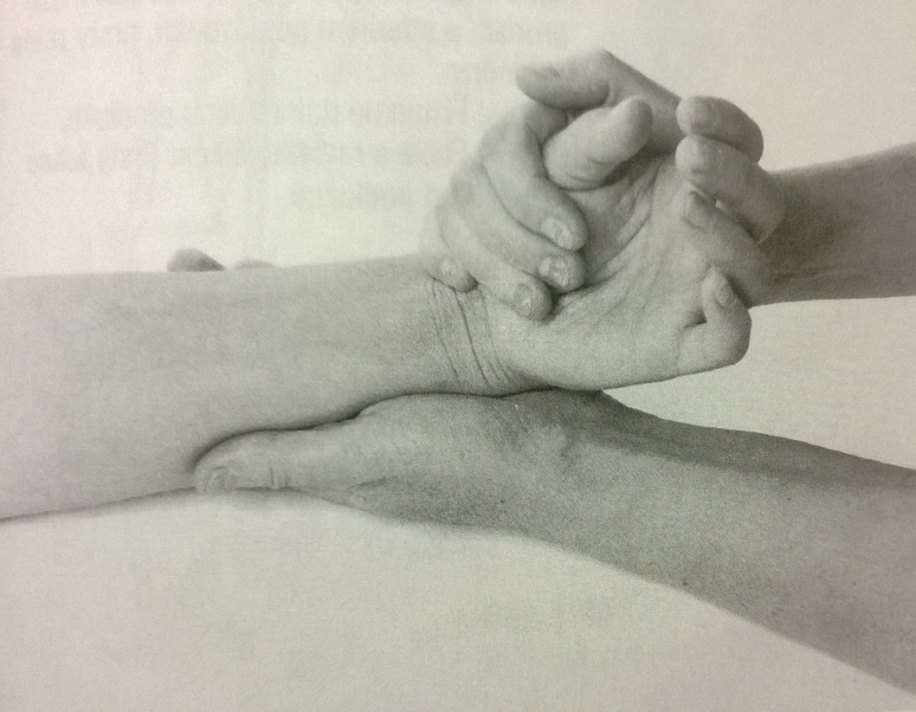
Wrist flexion with radial duction – grade 5,4
Position: patient sits (or lies supine), tested upper limb on the table – slightly flexed in the elbow, forearm between supination and pronation, wrist in the central position, fingers relaxed
Fixation: fix the lower part of the forearm (dont´t touch the main muscle)
Movement: flex and abduct the wrist (both together), fingers relaxed
Resistance: PT puts resistance on the thenar against the movement

Slide 45
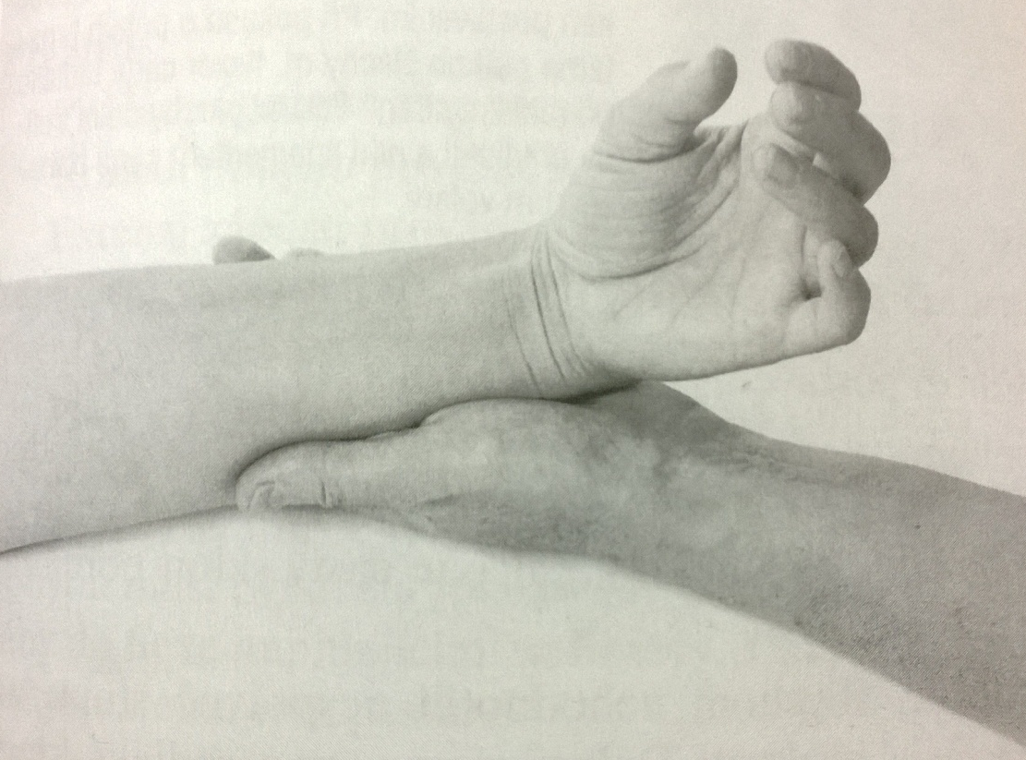
Wrist flexion with radial duction – grade 3
Position: patient sits (or lies supine), tested upper limb on the table – slightly flexed in the elbow, forearm between supination and pronation, wrist in the central position, fingers relaxed
Fixation: fix the lower part of the forearm (dont´t touch the main muscle)
Movement: flex and abduct the wrist (both together), fingers relaxed

Slide 46
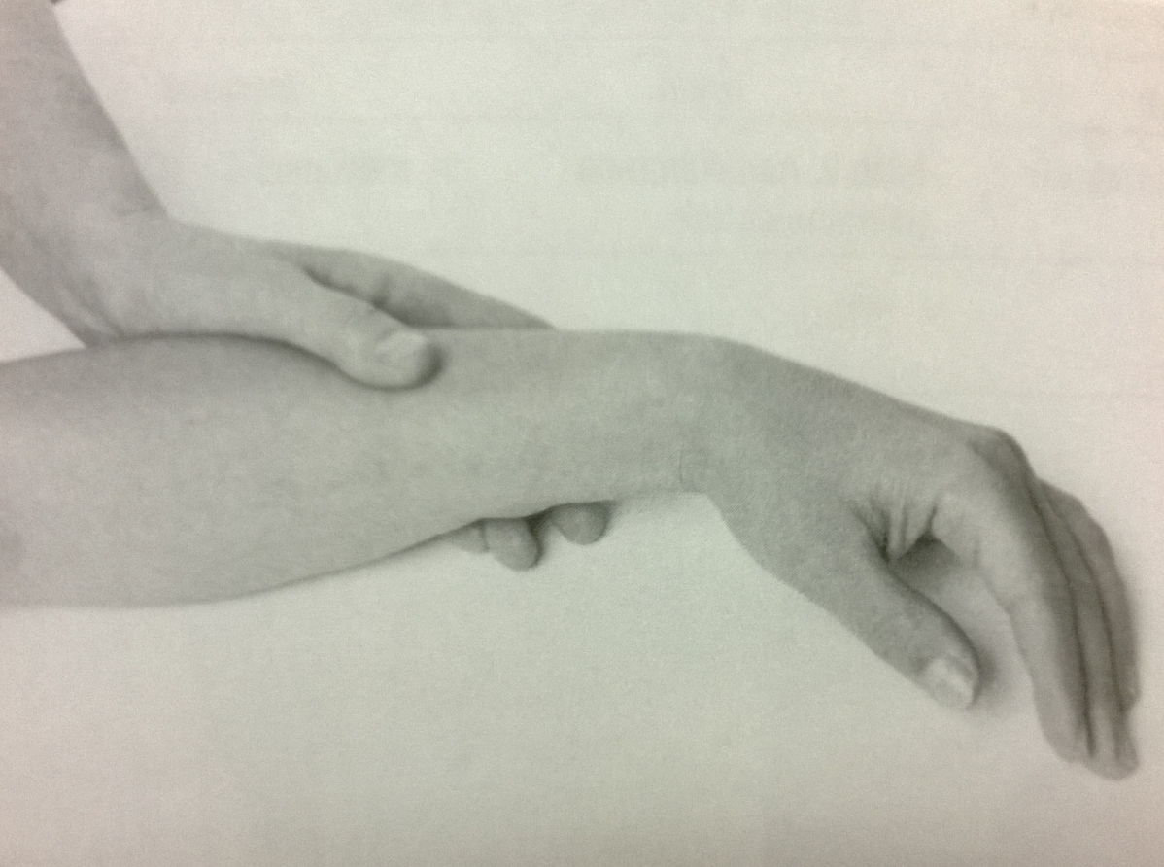
Wrist flexion with radial duction – grade 2
Position: patient sits (or lies supine), tested upper limb on the table – slightly flexed in the elbow, forearm between supination and pronation, wrist in the central position, fingers relaxed
Fixation: fix the lower part of the forearm (dont´t touch the main muscle)
Movement: flex and radial duction of the wrist (both together) by pushing the hand on the ulnar side, fingers relaxed

Slide 47
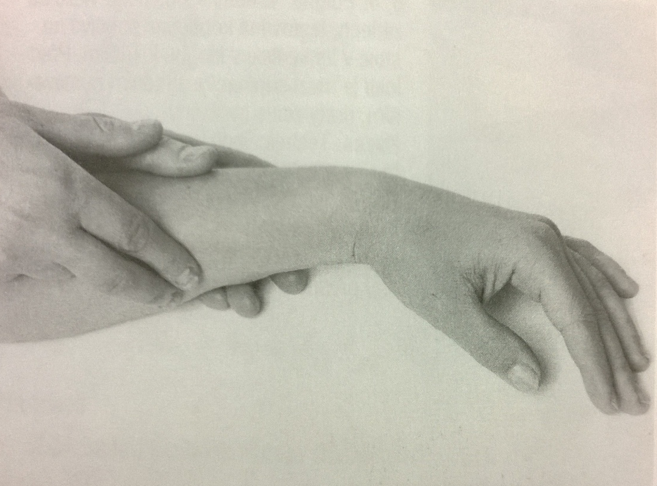
Wrist flexion with radial duction – grade 1,0
Position: patient sits (or lies supine), tested upper limb on the table – slightly flexed in the elbow, forearm between supination and pronation, wrist in the central position, fingers relaxed
Attempt to move: PT palpates the trace of contraction of the flexor carpi radialis during patients attempt to do flexion and abduction of the wrist

Slide 48
Wrist flexion with ulnar duction – grade 5,4
Position: patient sits (or lies supine), tested upper limb on the table – slightly flexed in the elbow, forearm supinated, wrist in the central position, fingers relaxed
Fixation: fix the lower part of the forearm (dont´t touch the main muscle)
Movement: flex and adduct the wrist (both together), fingers relaxed
Resistance: PT puts resistance on the hypotenar against the movement

Slide 49
Wrist flexion with ulnar duction – grade 3
Position: patient sits (or lies supine), tested upper limb on the table – slightly flexed in the elbow, forearm supinated, wrist in the central position, fingers relaxed
Fixation: fix the lower part of the forearm (dont´t touch the main muscle)
Movement: flex and adduct the wrist (both together), fingers relaxed

Slide 50
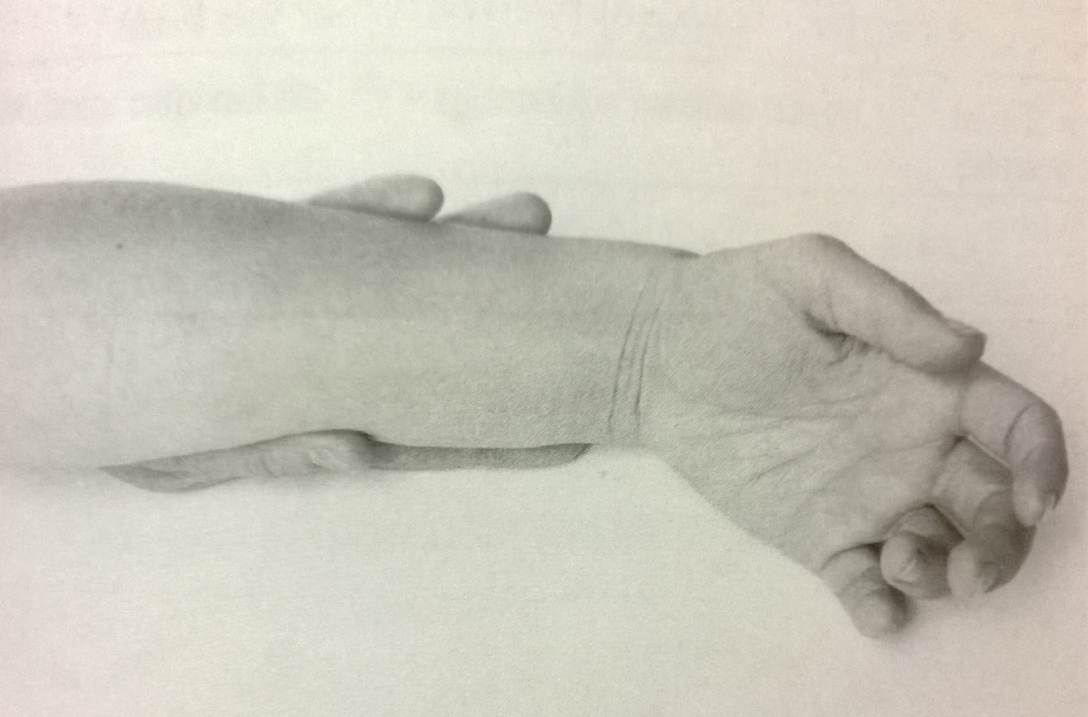
Wrist flexion with ulnar duction – grade 2
Position: patient sits (or lies supine), tested upper limb on the table – slightly flexed in the elbow, forearm between supination and pronation, wrist in the central position, fingers relaxed
Fixation: fix the lower part of the forearm (dont´t touch the main muscle)
Movement: flex and adduct the wrist (both together) by pushing the hand on the ulnar side, fingers relaxed

Slide 51
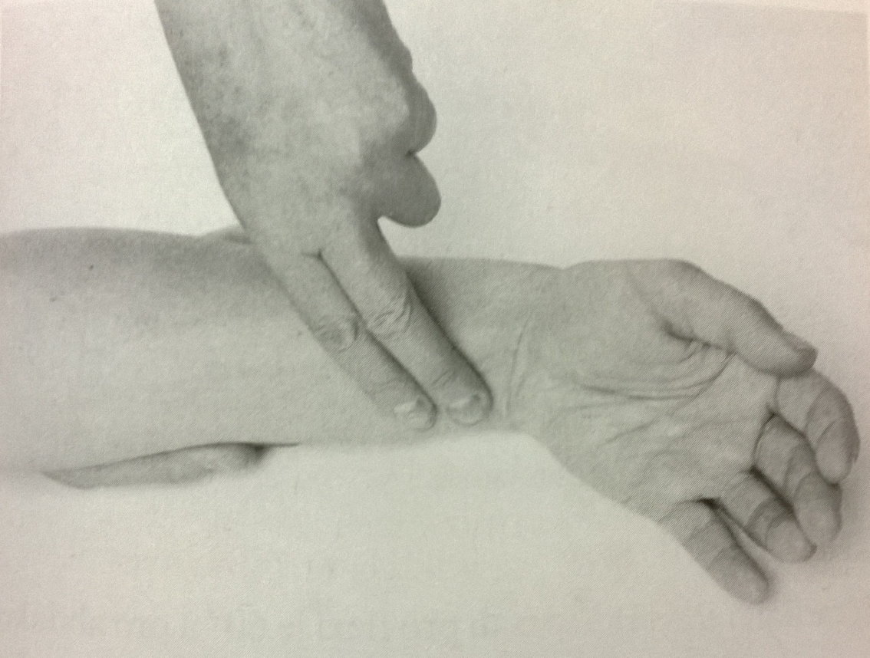
Wrist flexion with ulnar duction – grade 1,0
Position: patient sits (or lies supine), tested upper limb on the table – slightly flexed in the elbow, forearm between supination and pronation, wrist in the central position, fingers relaxed
Attempt to move: PT palpates the trace of contraction of the flexor carpi ulnaris during patients attempt to do flexion and adduction of the wrist

Slide 52
Wrist flexion – notes:
Initial position of the wrist should be maintained
Relaxation of the fingers is necessary as a prevention of substitution
Palpate the trace of contraction of the muscles properly

Slide 53
Wrist extension
Extensor carpi
radialis brevis
Extensor carpi
radialis longus
Extensor carpi
ulnaris

Slide 54
Extensor carpi radialis brevis
Origin
Lateral epicondyle of humerus
Insertion
Base of 3rd metacarpal
Action
Extend and abduct hand at wrist joint
Innervation
Deep branch of radial nerve (C7 and C8) (C7, C8)

Slide 55
Extensor carpi radialis longus
Origin
Lateral supracondyle ridge of humerus
Insertion
Base of 2nd metacarpal
Action
Extend and abduct hand at wrist joint
Innervation
Radial nerve (C6 and C7) (C7, C6)

Slide 56
Extesor carpi ulnaris
Origin
Lateral epicondyle of humerus and posterior border of ulna
Insertion
Base of 5th metacarpal
Action
Extends and adducts hand at wrist joint
Innervation
Posterior interosseous nerve (C7 and C8), the continuation of the deep branch of the radial nerve (C7, C8)

Slide 57
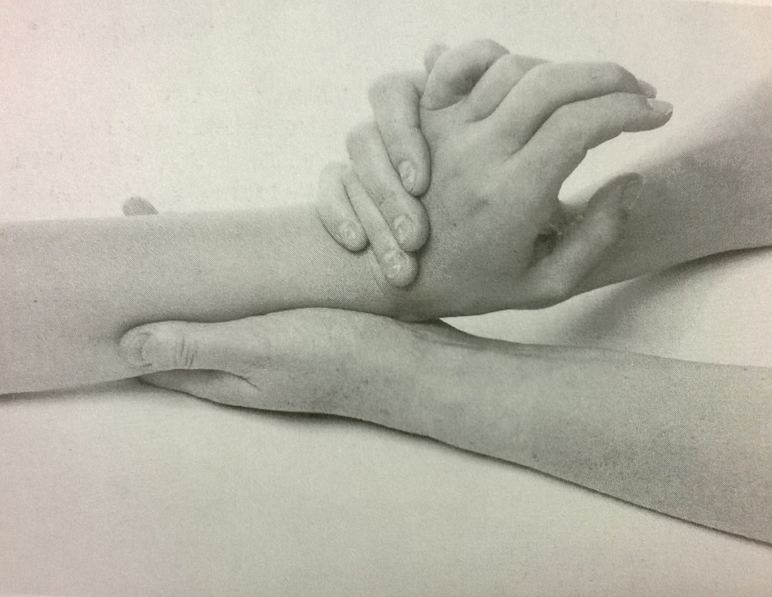
Wrist extension with ulnar duction – grade 5,4
Position: patient sits (or lies supine), tested upper limb on the table – slightly flexed in the elbow, forearm pronated, wrist in the central position, fingers relaxed
Fixation: fix the lower part of the forearm from the palmar side (dont´t touch the main muscle)
Movement: extension and ulnar duction of the wrist (both together), fingers relaxed
Resistance: PT puts resistance on the back of the hand (V. metatars) against the movement

Slide 58
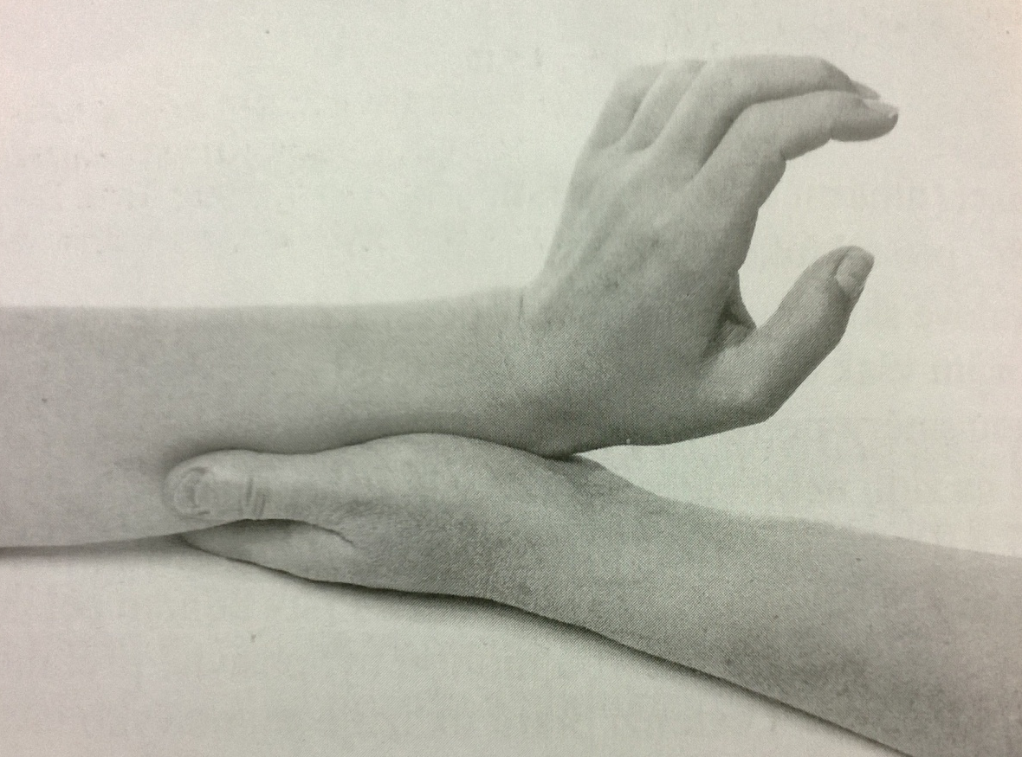
Wrist extension with ulnar duction – grade 3
Position: patient sits (or lies supine), tested upper limb on the table – slightly flexed in the elbow, forearm pronated, wrist in the central position, fingers relaxed
Fixation: fix the lower part of the forearm from the palmar side (dont´t touch the main muscle)
Movement: extension and ulnar duction of the wrist (both together), fingers relaxed

Slide 59
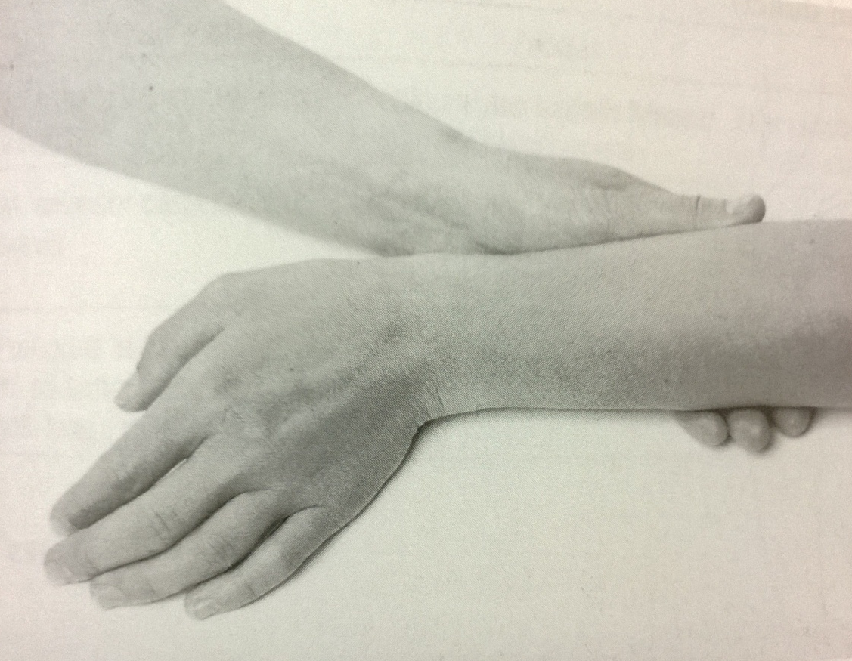
Wrist extension with ulnar duction – grade 2
Position: patient sits (or lies supine), tested upper limb on the table – slightly flexed in the elbow, forearm between pronation and suupination, wrist in the central position, fingers relaxed
Fixation: fix the lower part of the forearm from the palmar side (dont´t touch the main muscle)
Movement: extension and ulnar duction of the wrist (both together) by pushing the hand on the ulnar side of the hand, fingers relaxed

Slide 60
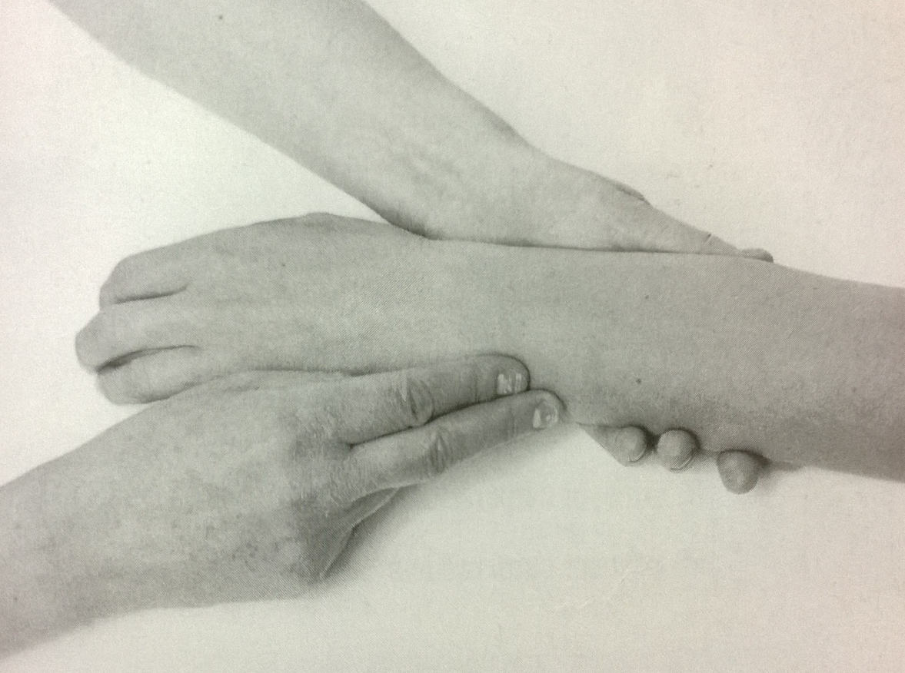
Wrist extension with ulnar duction – grade 1,0
Position: the same as testing before
Fixation: the lower part of the forearm from the palmar side
Attempt to move: during patients attempt of extension and ulnar duction of the wrist PT palpates the trace of contraction of extensor carpi ulnaris (at the back of the hand, at the processus slyloideus ulnae area)

Slide 61
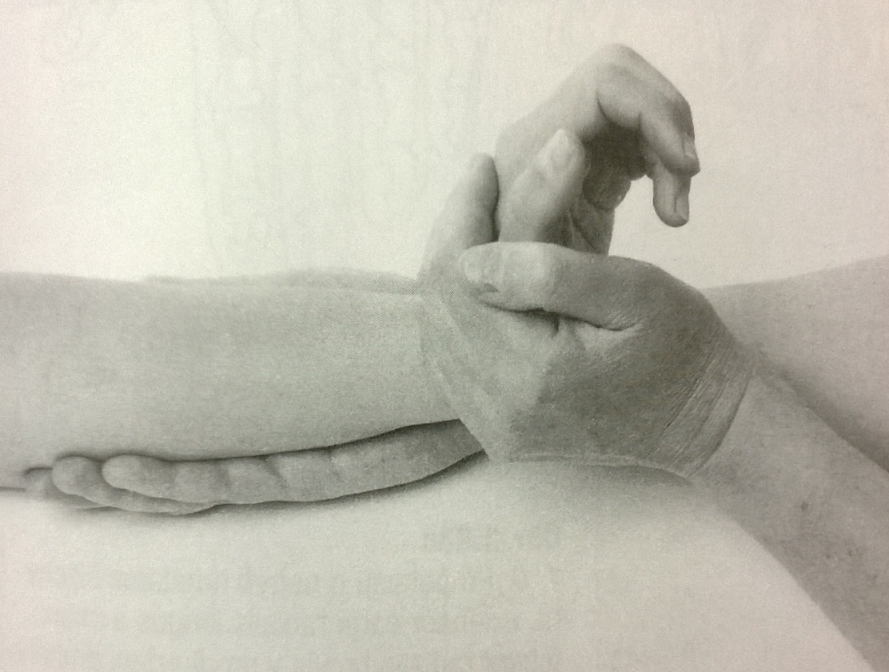
Wrist extension with radial duction – grade 5,4
Position: patient sits (or lies supine), tested upper limb on the table – slightly flexed in the elbow, forearm pronated, wrist in the central position, fingers relaxed
Fixation: fix the lower part of the forearm from the palmar side (dont´t touch the main muscle)
Movement: extension and radial duction of the wrist (both together), fingers relaxed
Resistance: PT puts resistance on the back of the hand (II. metatars) against the movement

Slide 62
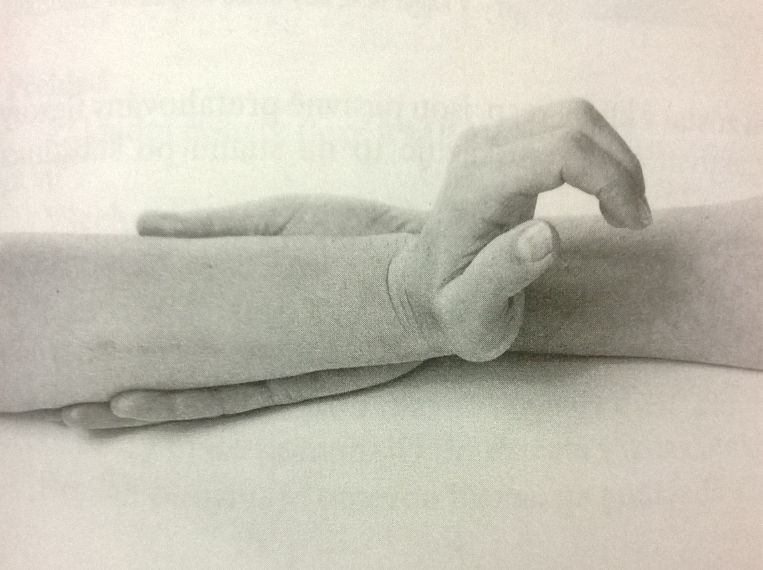
Wrist extension with radial duction – grade 3
Position: patient sits (or lies supine), tested upper limb on the table – slightly flexed in the elbow, forearm pronated, wrist in the central position, fingers relaxed
Fixation: fix the lower part of the forearm from the palmar side (dont´t touch the main muscle)
Movement: extension and radial duction of the wrist (both together), fingers relaxed

Slide 63
Wrist extension with radial duction – grade 2
Position: patient sits (or lies supine), tested upper limb on the table – slightly flexed in the elbow, forearm between pronation and supination, wrist in the central position, fingers relaxed
Fixation: fix the lower part of the forearm from the ulnar side
Movement: extension and radial duction of the wrist (both together) by pushing the hand on the ulnar side on the table, fingers relaxed

Slide 64
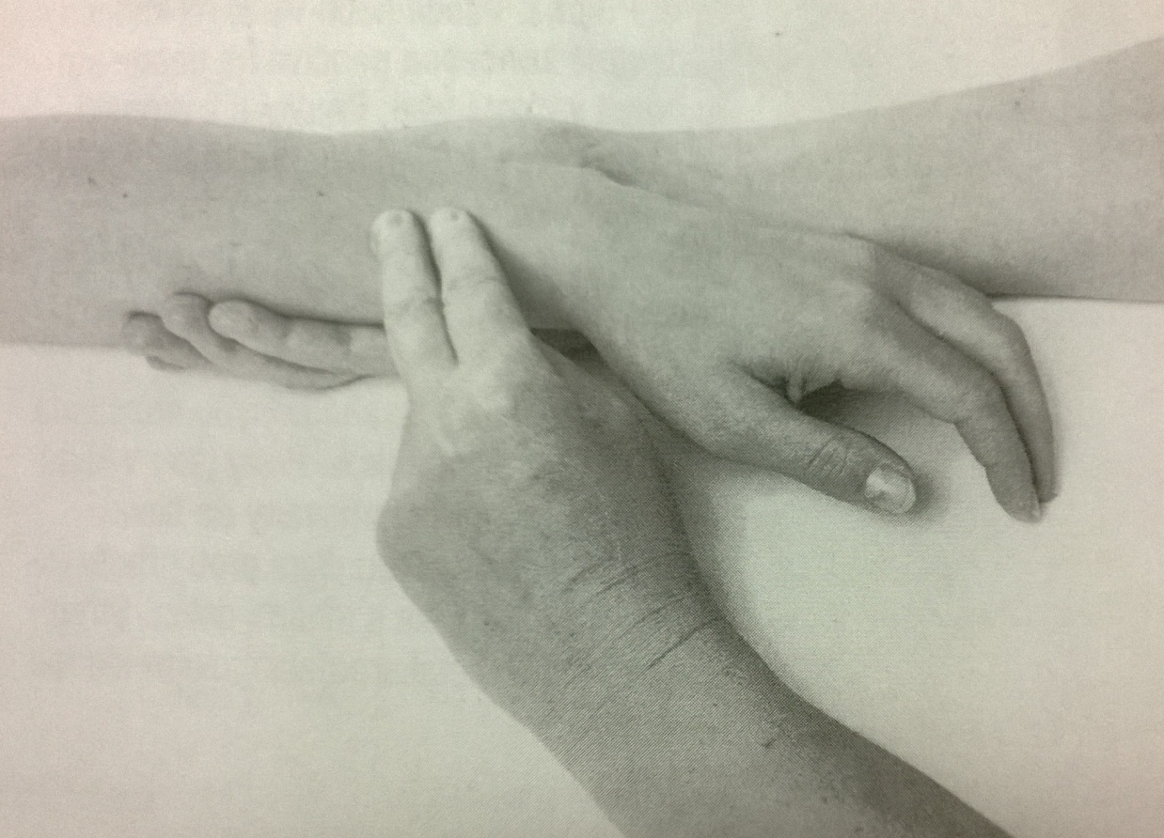
Wrist extension with radial duction – grade 1, 0
Position: the same as testing before
Fixation: the lower part of the forearm from the palmar side
Attempt to move: during patients attempt of extension and radial duction of the wrist (both together) PT palpates the trace of contraction of extensor radialis longus and brevis (radial side of the back of the wrist), fingers relaxed

Slide 65
Wrist extension – notes:
Elbow should be slightly flexed
Fingers should be relaxed during the whole tested movement

Slide 66
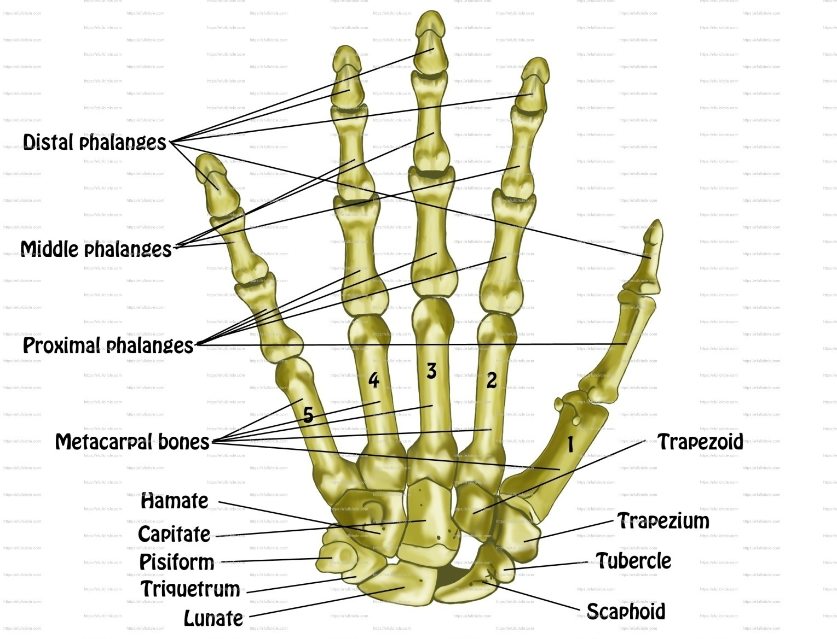
Hand

Slide 67
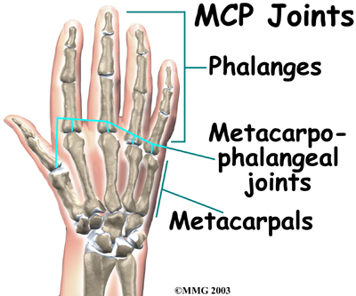
Metacarpophalangeal joints of the fingers (MCP)

Slide 68
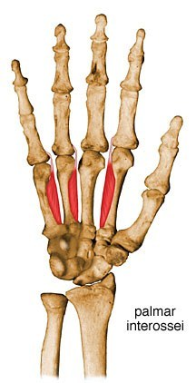
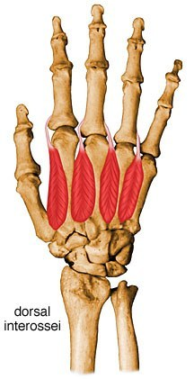
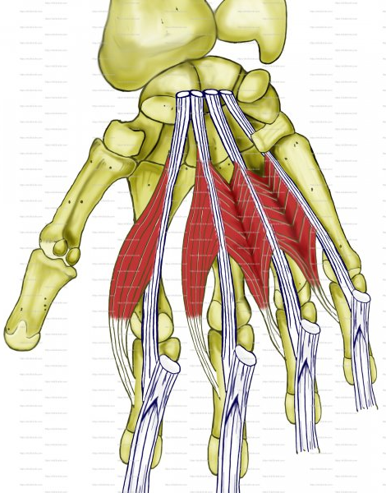
MCP flexion
Interosseals
palmares
Interosseals
dorsales
Lumbicales

Slide 69
Interosseus muscles, palmar (1-3)
Origin
Palmar surfaces of 2nd, 4th and 5th metacarpals (unipennate muscles)
Insertion
Extensor expansions of digits and bases of proximal phalanges of digits 2, 4 and 5
Action
Adduct digits toward axial line and assist lumbricals in flexing MCP joints and extending interphalangeal joints
Innervation
Deep branch of ulnar nerve (C8 and T1) (C8, T1)

Slide 70
Interosseus muscles, dorsal (1-4)
Origin
Adjacent sides of two metacarpals (bipennate muscles)
Insertion
Extensor expansions and bases of proximal phalanges of digits 2 – 4
Action
Abduct digits from axial line and act with lumbricals to flex MCP joints and extend interphalangeal joints
Innervation
Deep branch of ulnar nerve (C8 and T1) (C8, T1)

Slide 71
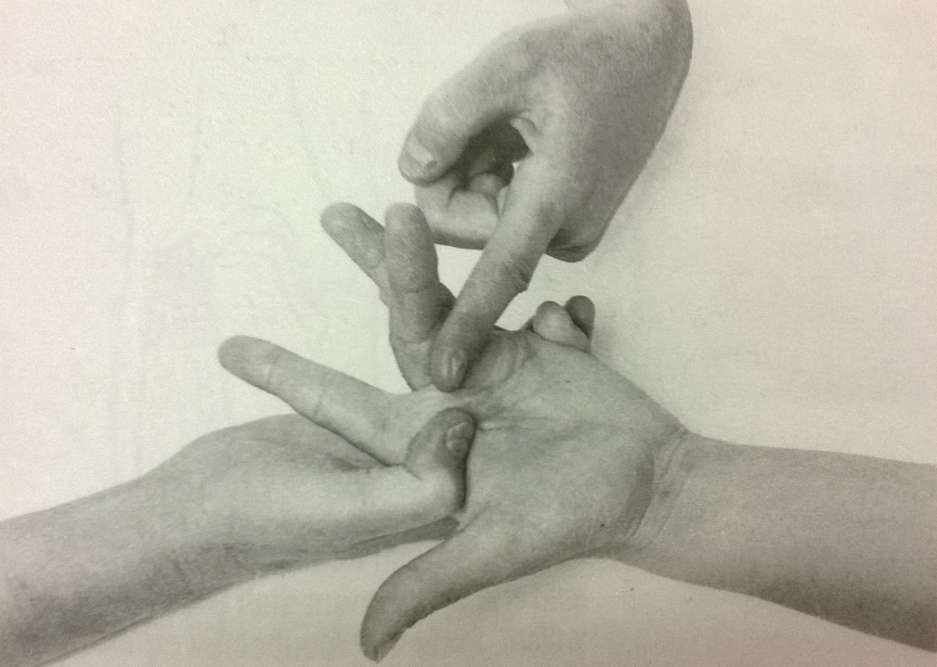
MCP flexion – grade 5,4
Position: patient sits (or lies supine), elbow slightly flexed, forearm lying supine on the table, fingers extended
Fixation: the head of metacarps
Movement: MCP flexion (except of the thumb) – all fingers together (a.), or one by one (b.), IP joints extended
Resistance: PT puts resistance on the volar side of proximal phalangs

Slide 72
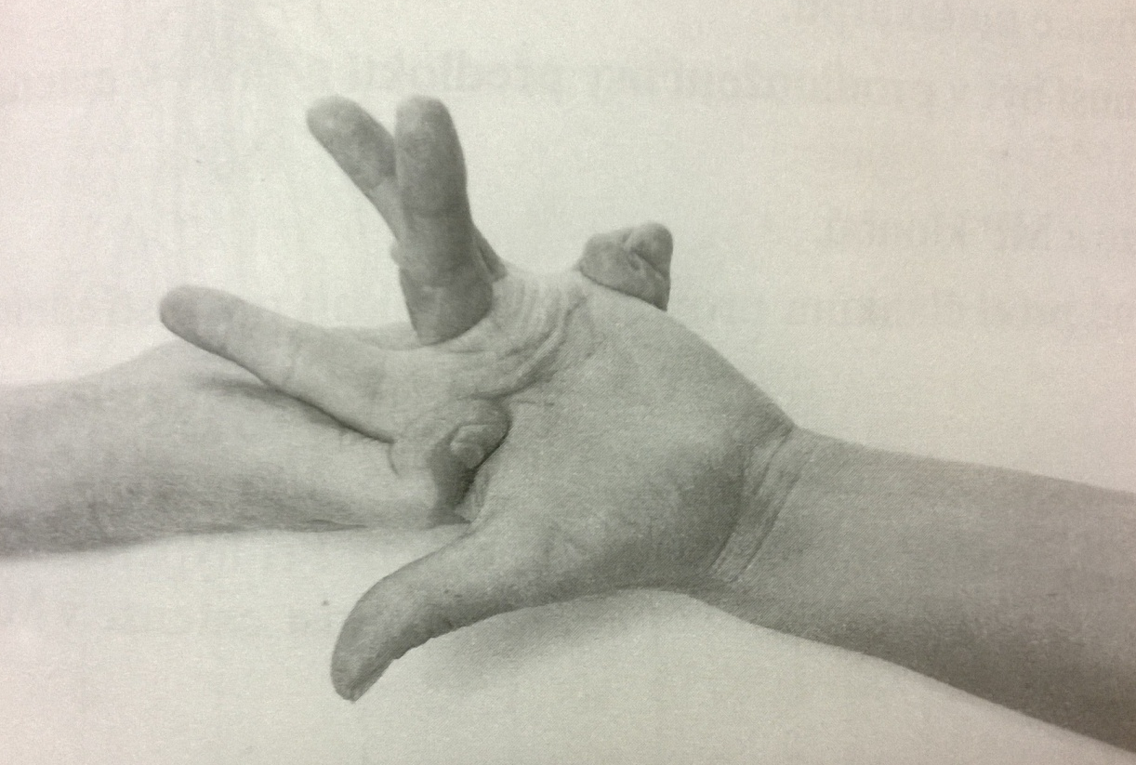
MCP flexion – grade 3
Position: patient sits (or lies supine), elbow slightly flexed, forearm lying supine on the table, fingers extended
Fixation: the head of metacarps
Movement: MCP flexion (except of the thumb) – all fingers together, or one by one, IP joints extended

Slide 73
MCP flexion – grade 2
Position: patient sits (or lies supine), forearm lying on the table between pronation and supination, fingers extended
Fixation: the head of metacarps
Movement: MCP flexion (except of the thumb) – all fingers together, IP joints extended

Slide 74
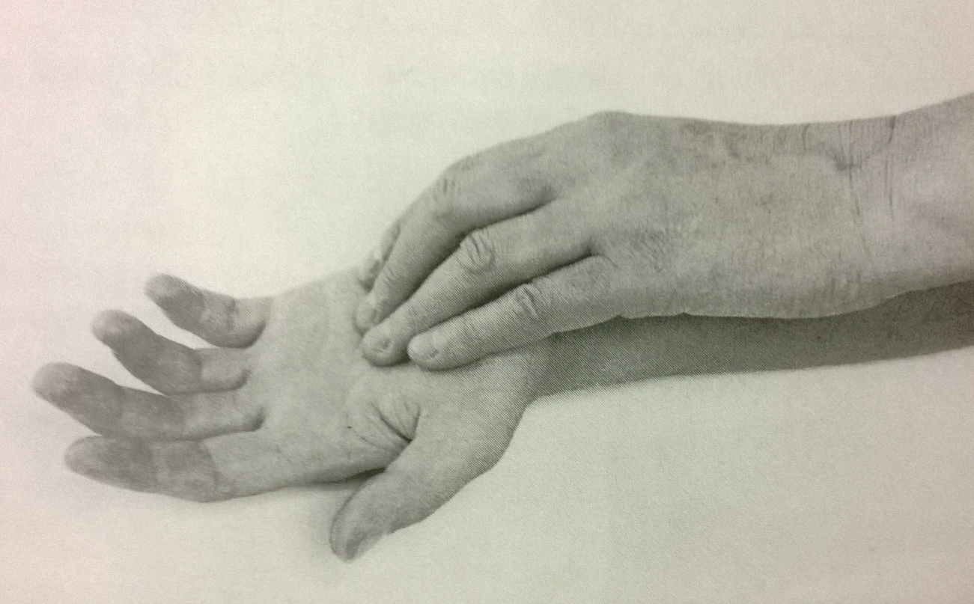
MCP flexion – grade 1,0
Position: patient sits (or lies supine), elbow slightly flexed, forearm lying supine on the table, fingers relaxed
Attempt to move: PT palpates the trace of contraction of lumbricales during patients´ attempt to flex the MCP joints (in the palm)

Slide 75
MCP flexion – notes:
Don´t forget to fix the metacarps
The wrist should stay in central position, fingers should stay extended during testing
Put resistance against proximal phalanges

Slide 76
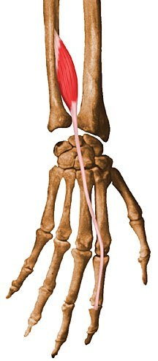
MCP extension
Extensor
digitorum
Extensor
indicis
Extensor
digiti minimi

Slide 77
Extensor digitorum
Origin
Lateral epicondyle of humerus
Insertion
Extensor expansions of medial four digits
Action
Extends medial four digits at metacarpophalangeal joints
Extends hand at wrist joint
Innervation
Posterior interosseous nerve (C7 and C8), the continuation of the deep branch of the radial nerve (C7, C8)

Slide 78
Extensor indicis
Origin
Posterior surface of ulna and interosseous membrane
Insertion
Extensor expansion of 2nd digit
Action
Extends 2nd digit and helps to extend hand
Innervation
Posterior interosseous nerve (C7 and C8), the continuation of the deep branch of the radial nerve (C7, C8)

Slide 79
Extensor digiti minimi
Origin
Lateral epicondyle of humerus
Insertion
Extensor expansion of 5th digit
Action
Extends 5th digit at metacarpophalangeal and interphalangeal joints
Innervation
Posterior interosseous nerve (C7 and C8), the continuation of the deep branch of the radial nerve (C7, C8)

Slide 80
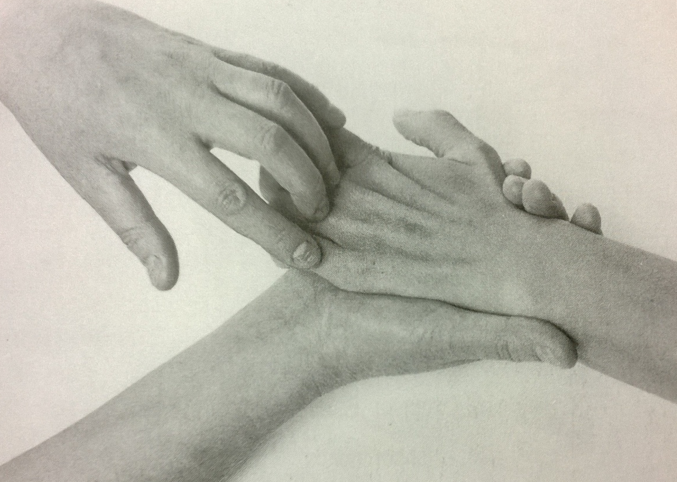
MCP extension – grade 5,4
Position: patient sits or lies supine, elbow slightly flexed, forearm lying prone on the table, wrist in central position, IP joints slightly flexed, MP joints flexed
Fixation: wrist and metacarps from the palmar side
Movement: MCP extension in full range of motion
Resistance: PT puts resistance on the proximal phalangs (II.-V.) against the movement

Slide 81
MCP extension – grade 3
Position: patient sits or lies supine, elbow slightly flexed, forearm lying prone on the table, wrist in central position, IP joints slightly flexed, MP joints flexed
Fixation: wrist and metacarps from the palmar side
Movement: MCP extension in full range of motion

Slide 82
MCP extension – grade 2
Position: patient sits or lies supine, elbow slightly flexed, forearm lying on the ulnar side on the table, wrist in central position, IP joints slightly flexed, MP joints flexed
Fixation: wrist and metacarps from the palmar side
Movement: MCP extension in full range of motion

Slide 83
MCP extension – grade 1,0
Position: patient sits or lies supine, elbow slightly flexed, forearm lying prone on the table, wrist in central position, IP joints slightly flexed, MP joints flexed
Fixation: wrist and metacarps from the palmar side
Attempt to move: PT palpates a trace of contraction during patients´ attempt of MCP extension (on the back of the hand over the metacarps)

Slide 84
MCP extension – notes:
Don´t interchange extension of MCP and IP joints
Fix the hand (wrist) firmly
Fingers has to be relaxed during testing

Slide 85
MCP adduction
Interosseals palmares

Slide 86
MCP adduction – grade 5,4
Position: patient sits or lies supine, forearm lying supine on the table, fingers supported in abduction
Fixation: support fingers and put resistance (at the same time)
Movement: from maximal abduction do an adduction of II., IV., V. finger
Resistance: PT put resistance against MCP adduction on the proximal IP joints

Slide 87
MCP adduction – grade 3
Position: patient sits or lies supine, forearm lying:
ulnar side on the table (for testing IV., V. finger)
b. radial side on the table (for testing II. finger)
Fixation: wrist
Movement: from maximal abduction do an adduction of II., IV., V. finger (acording the position)

Slide 88
MCP adduction – grade 2
Position: patient sits or lies supine, forearm lying prone on the table, fingers abducted
Fixation: wrist (not necessary)
Movement: from maximal abduction do an adduction of II., IV., V. finger

Slide 89
MCP adduction – grade 1,0
Position: patient sits or lies supine, forearm lying prone on the table, fingers abducted
Attempt to move: PT palpates the trace of contraction of interosseal palmares during patients attempt to do an adduction of II., IV., V. finger (at the area of basis of proximal phalangs)

Slide 90
MCP abduction
Interosseals dorsales
Abductor digiti minimi

Slide 91
Abductor digiti minimi
Origin
Pisiform
Insertion
Medial side of base of proximal phalanx of little finger
Action
Abducts little (5th) finger
Innervation
Deep branch of ulnar nerve (C8 and T1) (C8, T1)

Slide 92
MCP abduction – grade 5,4
Position: patient sits or lies supine, the forearm prone, fingers adducted
Fixation: wrist and lower part of the forearm
Movement: MCP abduction in full range of motion
Resistance: PT puts resistance on the basis of first phalanges of fingers (one by one) against the MCP abduction

Slide 93
MCP abduction – grade 3
Position: patient sits or lies supine, the forearm on the table:
Ulnar side
Radial side
Fixation: wrist and lower part of the forearm
Movement: MCP abduction in full range of motion
Ulnar side – for II., III. finger
Radial side – for III., IV., V. finger

Slide 94
MCP abduction – grade 2
Position: patient sits or lies supine, the forearm prone, fingers adducted
Fixation: wrist and lower part of the forearm
Movement: MCP abduction in full range of motion

Slide 95
MCP abduction – grade 1,0
Position: patient sits or lies supine, the forearm prone, fingers adducted
Attempt to move: PT palpates the trace of contraction of interosseals dorsales at intermetacarpal area (or see the vibration of fingers)

Slide 96
Interphalangeal joints of fingers (IP)

Slide 97
Proximal IP flexion
Flexor digitorum superficialis

Slide 98
Flexor digitorum superficialis
Origin
Humeroulnar head: medial epicondyle of humerus, ulnar collateral ligament, and coronoid process of ulna;
Radial head: superior half of anterior border of radius
Insertion
Bodies of middle phalanges of digits 2 – 5
Action
Flexes middle phalanges at proximal IP joints of medial four digits
acting more strongly, it also flexes proximal phalanges at MCP joints and hand
Innervation
Median nerve (C7, C8 and T1) (C7, C8, T1)

Slide 99
Proximal IP flexion – grade 5,4
Position: patient sits or lies supine, elbow slightly flexed, forearm supine, wrist in central position, fingers extended
Fixation: fix proximal phalang to ensure MP joint hyperextension
Movement: proximal IP flexion in full range of motion
Resistance: PT put resistance on the volar side of middle phalang

Slide 100
Proximal IP flexion – grade 3,2
Position: patient sits or lies supine, elbow slightly flexed, forearm supine, wrist in central position, fingers extended
Fixation: fix proximal phalang to ensure MP joint hyperextension
Movement: proximal IP flexion in full range of motion

Slide 101
Proximal IP flexion – grade 1,0
Position: patient sits or lies supine, elbow slightly flexed, forearm supine, wrist in central position, fingers extended
Attempt to move: PT palpates a trace of contraction during patients´ attempt of proximal IP flexion (the tendon on volar side of proximal phalang)

Slide 102
Proximal IP flexion – notes:
Wrist has to be in central position during whole test
Fixation of MCP joints is necessary: it has to be slightly hyperextended
Distal IP joint has to be extended, no flexion during testing
We don´t differentiate grade 3 and 2
Test each finger individually

Slide 103
Distal IP flexion
Flexor digitorum profundus

Slide 104
Flexor digitorum profundus
Origin
Proximal 3/4 of medial and anterior surfaces of ulna and interosseous membrane
Insertion
Base of the distal phalanx of digits 2 – 5
Action
Flexes distal phalanges at distal interphalangeal joints of medial four digits
assists with flexion of hand
Innervation
Medial part: ulnar nerve (C8 and T1)
Lateral part: anterior interosseous branch of median nerve (C8 and T1) (C8, T1)

Slide 105
Distal IP flexion – grade 5,4
Position: patient sits or lies supine, elbow slightly flexed, forearm supine, wrist in central position, fingers extended
Fixation: the middle phalang (from the side)
Movement: distal IP flexion in full range of motion
Resistance: PT puts resistance on the volar side of distal phalang against the movement

Slide 106
Distal IP flexion – grade 3,2
Position: patient sits or lies supine, elbow slightly flexed, forearm supine, wrist in central position, fingers extended
Fixation: the middle phalang (from the side)
Movement: distal IP flexion in full range of motion

Slide 107
Distal IP flexion – grade 1,0
Position: patient sits or lies supine, elbow slightly flexed, forearm supine, wrist in central position, fingers extended
Attempt to move: PT palpates a trace of contraction during patients attempt of distal IP flexion (on the volar side of the middle phalang)

Slide 108
Distal IP flexion – notes:
Wrist should be in central position during whole testing
Fix the middle phalang from the side (no compression of the tendon)
Proximal IP joint and MCP joint should be extended

Slide 109
CMC joint of thumb

Slide 110
CMC thumb joint adduction
Adductor pollicis

Slide 111
Adductor pollicis
Origin
Oblique head: bases of 2nd and 3rd metacarpals, capitate, and adjacent carpals
Transverse head: anterior surface of body of 3rd metacarpal
Insertion
Medial side of base of proximal phalanx of thumb
Action
Draws 1st metacarpal laterally to oppose thumb toward center of palm and rotates it medially
Innervation
Deep branch of ulnar nerve (C8 and T1) (C8, T1)

Slide 112
CMC thumb joint adduction – grade 5,4
Position: patient sits or lies supine, forearm lying prone on the table, wrist in central position, thumb abducted
Fixation: wrist
Movement: CMC thumb joint adduction (in palm plane) in full range of motion
Resistance: PT puts resistance on the ulnar side of thumb against movement

Slide 113
CMC thumb joint adduction – grade 3
Position: patient sits or lies supine, forearm on the radial side on the table, wrist in central position, thumb abducted
Fixation: support forearm and wrist, fingers
Movement: CMC thumb joint adduction (in palm plane) in full range of motion

Slide 114
CMC thumb joint adduction – grade 2
Position: patient sits or lies supine, forearm lying prone on the table, wrist in central position, thumb abducted
Fixation: not necessary
Movement: CMC thumb joint adduction (in palm plane) in full range of motion

Slide 115
CMC thumb joint adduction – grade 1,0
Position: patient sits or lies supine, forearm lying supine on the table, wrist in central position
Attempt to move: PT palpates a trace of contraction during patients´ attempt of CMC thumb joint adduction (in palm plane) – on the volar side between I. and II. metacarp

Slide 116
CMC thumb joint adduction – notes:
The movement of the joint should be in the plane of the palm
MCP and IP joint should be extended

Slide 117
CMC thumb joint abduction
Abductor pollicis longus
Abductor pollicis brevis

Slide 118
Abductor pollicis longus
Origin
Posterior surfaces of ulna, radius and interosseous membrane
Insertion
Base of 1st metacarpal
Action
Abducts thumb and extends it at carpometacarpal joint
Innervation
Posterior interosseous nerve (C7 and C8), the continuation of the deep branch of the radial nerve (C7, C8)

Slide 119
Abductor pollicis brevis
Origin
Flexor retinaculum and tubercles of scaphoid and trapezium
Insertion
Lateral side of base of proximal phalanx of thumb
Action
Abducts thumb and helps oppose it
Innervation
Recurrent branch of median nerve (C8 and T1) (C8, T1)

Slide 120
CMC thumb joint abduction – grade 5,4
Position: patient sits or lies supine, forearm lying prone on the table, wrist in central position, thumb adducted, fingers extended
Fixation: wrist
Movement: CMC thumb joint abduction in full range of motion
Resistance: PT puts resistance on the radial side of thumb against the movement

Slide 121
CMC thumb joint abduction – grade 3
Position: patient sits or lies supine, forearm lying on the ulnar side on the table, wrist in central position, thumb adducted, fingers extended
Fixation: wrist
Movement: CMC thumb joint abduction in full range of motion

Slide 122
CMC thumb joint abduction – grade 2
Position: patient sits or lies supine, forearm lying prone on the table, wrist in central position, thumb adducted, fingers extended
Fixation: wrist
Movement: CMC thumb joint abduction in full range of motion

Slide 123
CMC thumb joint abduction – grade 1,0
Position: patient sits or lies supine, forearm lying prone on the table, wrist in central position, thumb extended, relaxed, fingers extended
Attempt to move: PT palpates a trace of contraction during patients attempt of CMC thumb joint abduction (in the processus styloideus radii area)

Slide 124
CMC thumb joint abduction – notes:
Wrist and the hand should be fixed, in central position
The movement should be done in the plane of the palm

Slide 125
Thumb and little finger opposition
Opponnens pollicis
Opponnens digiti minimi

Slide 126
Opponnens pollicis
Origin
Flexor retinaculum and tubercles of scaphoid and trapezium
Insertion
Lateral side of 1st metacarpal
Action
Draws 1st metacarpal laterally to oppose thumb toward center of palm and rotates it medially
Innervation
Recurrent branch of median nerve (C8 and T1) (C8, T1)

Slide 127
Opponnens digiti minimi
Origin
Hook of hamate and flexor retinaculum
Insertion
Medial border of 5th metacarpal
Action
Draws 5th metacarpal anteriorly and rotates it, bringing little finger (5th digit) into opposition with thumb
Innervation
Deep branch of ulnar nerve (C8 and T1) (C8, T1)

Slide 128
Thumb and little finger opposition – grade 5,4
Position: patient sits or lies supine, forearm lying supine on the table, wrist in central position, fingers extended
Fixation: not necessary
Movement: thumb and little finger opposition
Resistance: PT puts resistance on volar side of I. and V. metatars

Slide 129
Thumb and little finger opposition – grade 3,2
Position: patient sits or lies supine, forearm lying supine on the table, wrist in central position, fingers extended
Fixation: not necessary
Movement: thumb and little finger opposition

Slide 130
Thumb and little finger opposition – grade 1,0
Position: patient sits or lies supine, forearm lying supine on the table, wrist in central position, fingers extended
Attempt to move: PT palpates a trace of contraction during patients´ attempt of thumb and little finger opposition – on the volar and radial side of I. metacarp, and in the area of hypothenar

Slide 131
Thumb and little finger opposition – notes:
The movement should be done properly – it is not enought to do an adduction an flexion of the thumb
Put the resistance in good way – against opposition

Slide 132
Metacarpophalangeal joint of the thumb (MCP)

Slide 133
Thumb MCP flexion
Flexor pollicis brevis

Slide 134
Flexor pollicis brevis
Origin
Flexor retinaculum and tubercles of scaphoid and trapezium
Insertion
Lateral side of base of proximal phalanx of thumb
Action
Flexes thumb
Innervation
Recurrent branch of median nerve (C8 and T1) (C8, T1)

Slide 135
Thumb MCP flexion – grade 5,4
Position: patient sits or lies supine, forearm lying supine on the table, thumb extended and abducted, fingers relaxed
Fixation: fix first metacarp in starting position (don´t press the thenar)
Movement: thumb MCP flexion in full range of motion
Resistance: PT puts resistance against thumb MCP flexion on volar side of proximal phalang of the thumb

Slide 136
Thumb MCP flexion – grade 3,2
Position: patient sits or lies supine, forearm lying supine on the table, thumb extended and abducted, fingers relaxed
Fixation: fix first metacarp in starting position (don´t press the thenar)
Movement: thumb MCP flexion in full range of motion

Slide 137
Thumb MCP flexion – grade 1,0
Position: patient sits or lies supine, forearm lying supine on the table, thumb extended and abducted, fingers relaxed
Attempt to move: PT palpates a trace of patients´ attempt of thumb MCP flexion on the palmar side of I. metacarp

Slide 138
Thumb MCP extension
Extensor pollicis brevis

Slide 139
Extensor pollicis brevis
Origin
Posterior surfaces of radius and interosseous membrane
Insertion
Base of proximal phalanx of thumb
Action
Extends proximal phalanx of thumb at carpometacarpal joint
Innervation
Posterior interosseous nerve (C7 and C8), the continuation of the deep branch of the radial nerve (C7, C8)

Slide 140
Thumb MCP extension – grade 5,4
Position: patient sits or lies supine, forearm lying prone on the table, wrist in central position, thumb between adduction and abduction, MP joint flexed, fingers relaxed
Fixation: fix slightly the I. metacarp
Movement: thumb MCP extension
Resistance: PT puts resistance against thumb MCP extension on dorsal side of prosimal thumb phalang

Slide 141
Thumb MCP extension – grade 3,2
Position: patient sits or lies supine, forearm lying prone on the table, wrist in central position, thumb between adduction and abduction, MP joint flexed, fingers relaxed
Fixation: fix slightly the I. metacarp
Movement: thumb MCP extension

Slide 142
Thumb MCP extension – grade 1,0
Position: patient sits or lies supine, forearm lying prone on the table, wrist in central position, thumb between adduction and abduction, MP joint flexed, fingers relaxed
Attempt to move: PT palpates a trace of contraction during patients´ attempt of thumb MCP extension in the area of I. metacarp

Slide 143
Interphalangeal joint of the thumb (IP)

Slide 144
Thumb IP flexion
Flexor pollicis longus

Slide 145
Flexor pollicis longus
Origin
Anterior surface of radius and adjacent interosseous membrane
Insertion
Base of distal phalanx of thumb
Action
Flexes phalanges of 1st digit (thumb)
Innervation
Anterior interosseous nerve from median nerve (C8 and T1) (C8, T1)

Slide 146
Thumb IP flexion – grade 5,4
Position: patient sits or lies supine, forearm lying supine on the table, thumb extended and abducted, fingers relaxed
Fixation: proximal phalang of the thumb (from the side)
Movement: thumb IP flexion in full range of motion
Resistance: PT puts resistance against palmar side of distal phalang of the thumb

Slide 147
Thumb IP flexion – grade 3,2
Position: patient sits or lies supine, forearm lying supine on the table, thumb extended and abducted, fingers relaxed
Fixation: proximal phalang of the thumb (from the side)
Movement: thumb IP flexion in full range of motion

Slide 148
Thumb IP flexion – grade 1,0
Position: patient sits or lies supine, forearm lying supine on the table, thumb extended and abducted, fingers relaxed
Fixation: proximal phalang of the thumb (from the side)
Attempt to move: PT palpates a trace of contraction during patients´ attempt of thumb IP flexion on the palmar side of proximal phalang of the thumb

Slide 149
Thumb IP extension
Extensor pollicis longus

Slide 150
Extensor pollicis longus
Origin
Posterior surface of middle 1/3 of ulna and interosseous membrane
Insertion
Base of distal phalanx of thumb
Action
Extends distal phalanx of thumb at carpometacarpal and interphalangeal joints
Innervation
Posterior interosseous nerve (C7 and C8), the continuation of the deep branch of the radial nerve (C7, C8)

Slide 151
Thumb IP extension – grade 5,4
Position: patient sits or lies supine, forearm lying prone on the table, wrist in central position, thumb IP flexion, MP extension, fingers relaxed
Fixation: fix first phalang of the thumb from the side
Movement: thumb IP extension
Resistance: against the distal phalang of the thumb (on the nail)

Slide 152
Thumb IP extension – grade 3,2
Position: patient sits or lies supine, forearm lying prone on the table, wrist in central position, thumb IP flexion, MP extension, fingers relaxed
Fixation: fix first phalang of the thumb from the side
Movement: thumb IP extension

Slide 153
Thumb IP extension – grade 1,0
Position: patient sits or lies supine, forearm lying prone on the table, wrist in central position, thumb IP flexion, MP extension, fingers relaxed
Fixation: fix first phalang of the thumb from the side
Attempt to move: PT palpates a trace of contraction during patients´ attempt of thumb IP extension on dorsal side of first phalang

Slide 154
Literature, e-sources
http://www.medicinenet.com/elbow_pain/article.htm
http://www.houstonmethodist.org/orthopedics/where-does-it-hurt/hand
http://criticalcaremcqs.com/tag/aipgmee-mcqs/page/15/
https://nervesurgery.wustl.edu/ev/upperextremity

Slide 155
Thank you for your attention ☺

