Slide 1
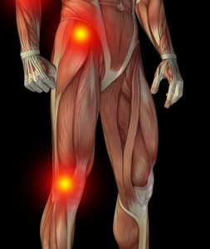
Manual muscle test
Hip and knee
Examination Methods in Rehabilitation (18.10.2021)
Mgr. Veronika Mrkvicová, Ph.D. (physiotherapist)

Slide 2
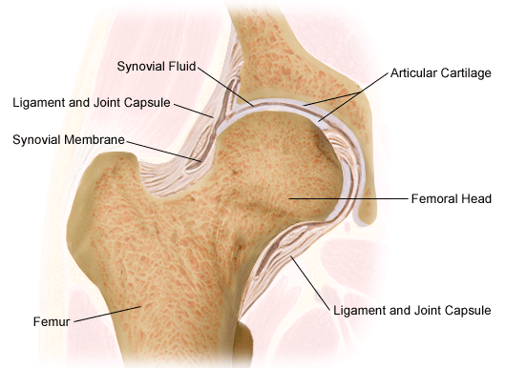
Hip joint

Slide 3
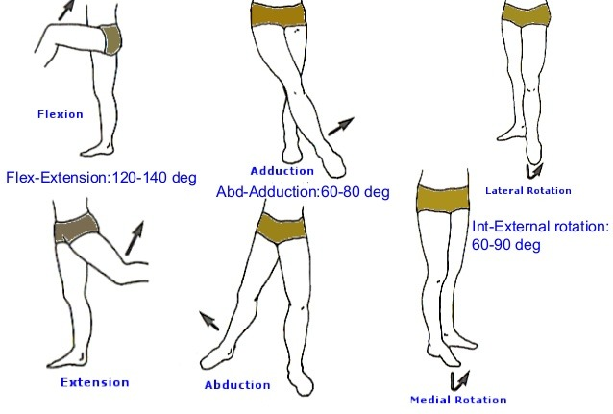
Hip joint movements

Slide 4
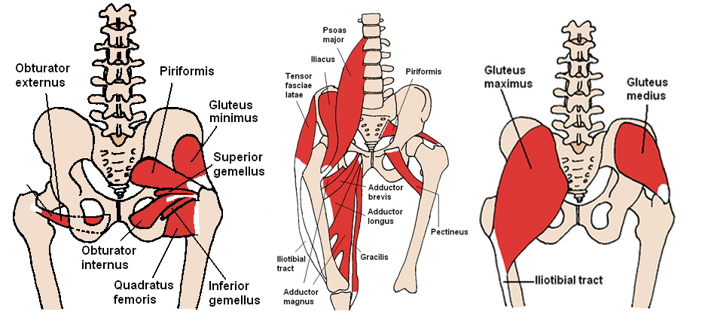
Hip joint muscles

Slide 5
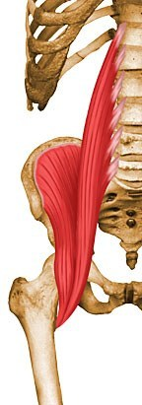
Hip flexion
Iliopsoas

Slide 6
M. iliopsoas
Origin
Upper 2/3 of iliac fossa of ilium, internal lip of iliac crest, lateral aspect of sacrum, ventral sacroiliac ligament, and lower portion of iliolumbar ligament
Insertion
Lesser trochanter
Action
Flex the torso and thigh with respect to each other
Innervation
Muscular branch of femoral nerve (L1, L2, L3)

Slide 7
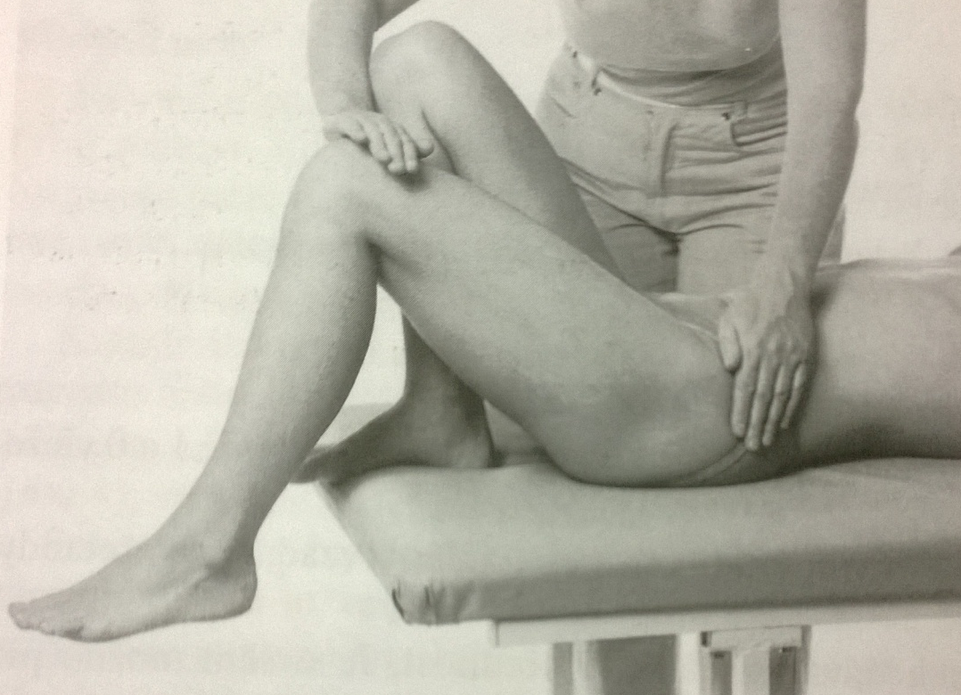
Hip flexion – grade 5,4
Position: lying supine, arms along body side, uninvolved lower limb flexed in hip and knee, foot on the table, tested lower limb in 90° flexion in knee joint, foot free, hanging from the table
Fixation: pelvis on the tested side
Movement: hip flexion in full range of motion
Resistance: at the lower part of thigh (arched)

Slide 8
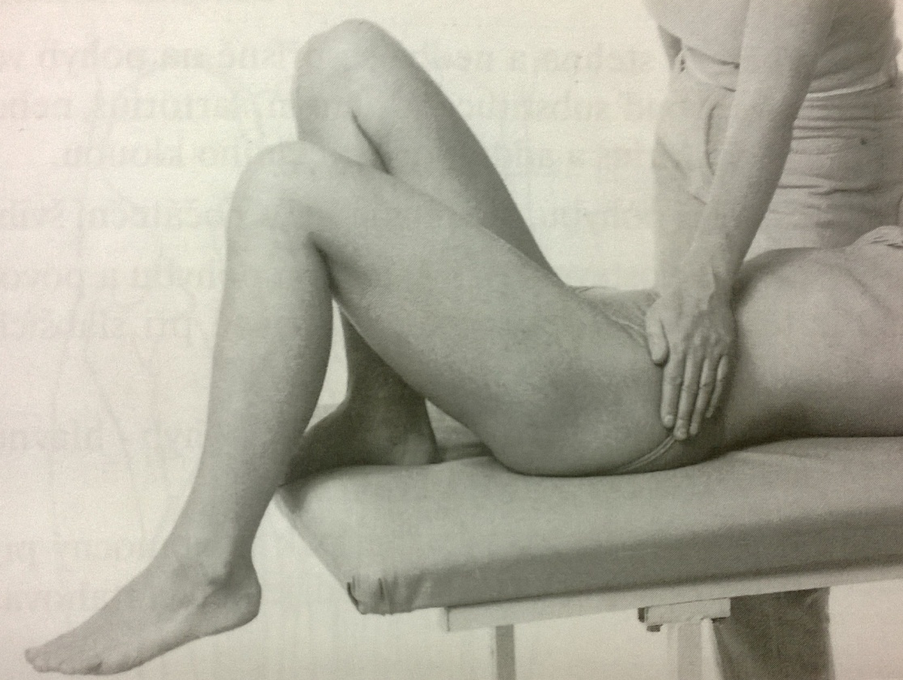
Hip flexion – grade 3
Position: lying supine, arms along body side, uninvolved lower limb flexed in hip and knee, foot on the table, tested lower limb in 90° flexion in knee joint, foot free, hanging from the table
Fixation: pelvis on the tested side
Movement: hip flexion in full range of motion

Slide 9
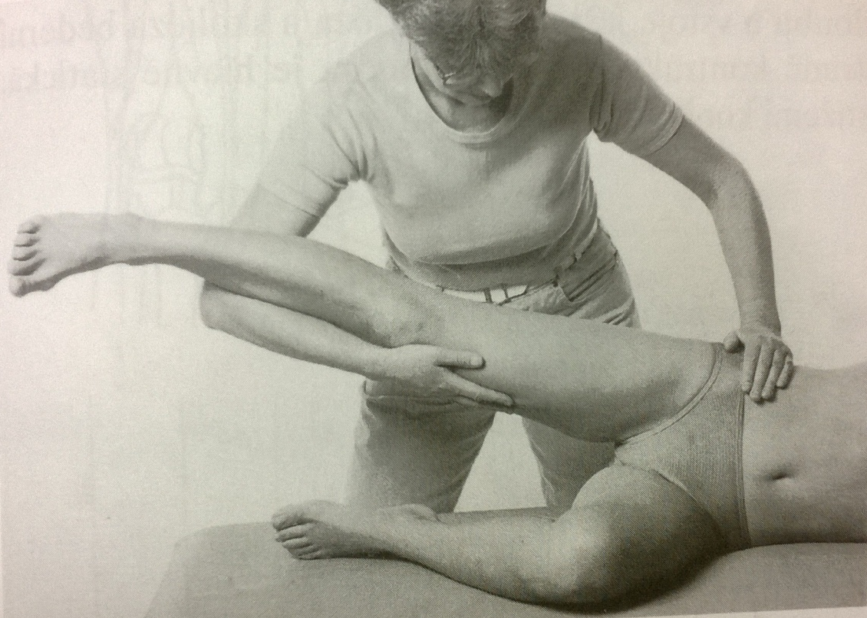
Hip flexion – grade 2
Position: lying on the tested side, tested lower limb in central position of the hip, 90° flexion in the knee joint
Fixation: PT supports with one hand the uninvolved lower limb, which is extended in the knee and central position in the hip joint, PTs´ other hand fix the pelvis on the untesded side
Movement: flexion of the tested lower limb by pushing on the table in full range of motion

Slide 10
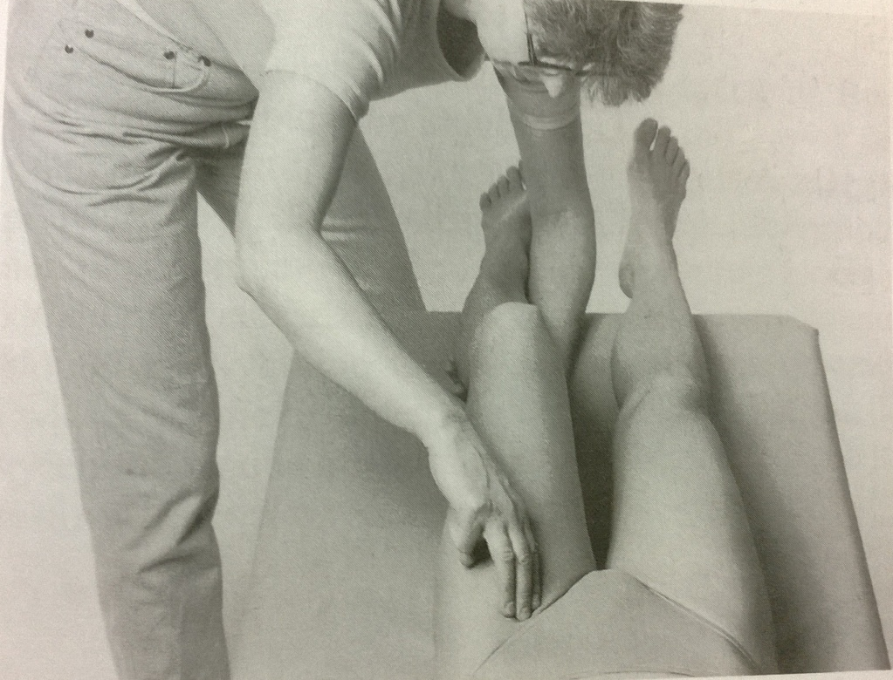
Hip flexion – grade 1,0
Position: patient lying supine
Fixation: PT supports patients tested lower limb in semiflexion in the knee and semiflexion and a slight external rotation in hip joint
Attempt to move: PT palpates a trace of contraction during the patients´ attempt to flex the hip – in the inguinal area (groin)

Slide 11
Hip flexion – notes:
The movement should be done in exact sagital plane (no rotation of the hip joint)
No swing during the movement
No extension of the knee joint or lumbar hyperlordosis (substitution of rectus femoris muscle)
No elevation of the pelvis (substitution of quadratus lumborum)

Slide 12
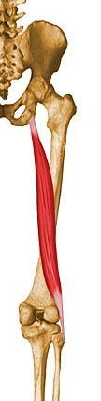
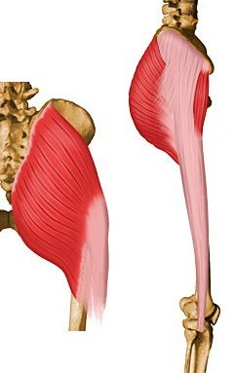
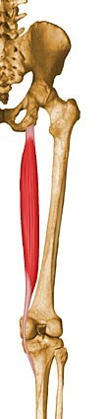
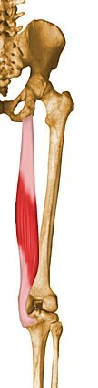
Hip extension
Gluteus
maximus
Biceps femoris
(long head)
Semitendinosus
Semimembranosus

Slide 13
Gluteus maximus
Origin
Posterior aspect of dorsal ilium posterior to posterior gluteal line, posterior superior iliac crest, posterior inferior aspect of sacrum and coccyx, and sacrotuberous ligament
Insertion
Primarily in fascia lata at the iliotibial band
also into the gluteal tuberosity on posterior femoral surface
Action
Major extensor of hip joint, assists in laterally rotating the thigh
upper and middle third section of the muscle are abductors
Innervation
Inferior gluteal nerve (L5, S1, S2) (L5, S1, S2)

Slide 14
Biceps femoris (long head)
Origin
Common tendon with semitendinosus from superior medial quadrant of the posterior portion of the ischial tuberosity
Insertion
Primarily on fibular head
also on lateral collateral ligament and lateral tibial condyle
Action
Flexes the knee, and also rotates the tibia laterally
long head also extends the hip joint
Innervation
Tibial nerve (L5, S1, S2)

Slide 15
Semitendinosus
Origin
From common tendon with long head of biceps femoris from superior medial quadrant of the posterior portion of the ischial tuberosity
Insertion
Superior aspect of medial portion of tibial shaft
Action
Extends the thigh and flexes the knee
rotates the tibia medially, especially when the knee is flexed
Innervation
Tibial nerve (L5, S1, S2)

Slide 16
Semimembranosus
Origin
Superior lateral quadrant of the ischial tuberosity
Insertion
Posterior surface of the medial tibial condyle
Action
Extends the thigh, flexes the knee
rotates the tibia medially, especially when the knee is flexed
Innervation
Tibial nerve (L5, S1, S2)

Slide 17
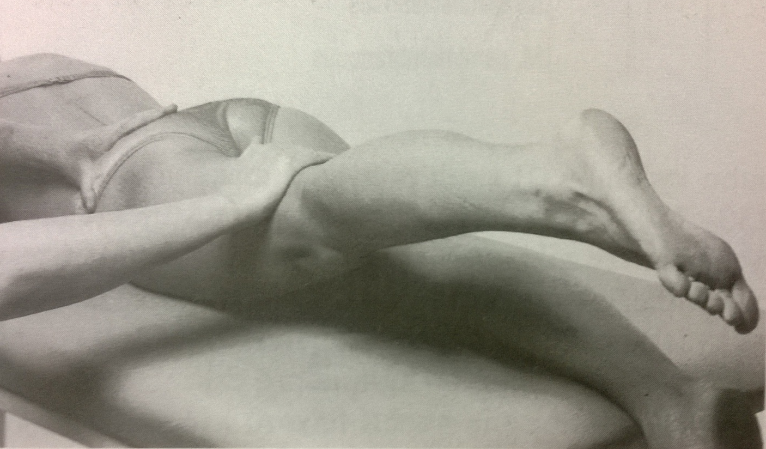
Hip extension – grade 5,4
Position: patient lying prone, arms along body side, head lying on the forehead, lower limbs extended, foot away from the table (the abdomen underlaid with the pillow to ensure lumbar aplanation)
Fixation: the pelvis on the tested side
Movement: hip extension (in 10° range of motion)
Resistance: on the lower part of the thigh (arched)

Slide 18
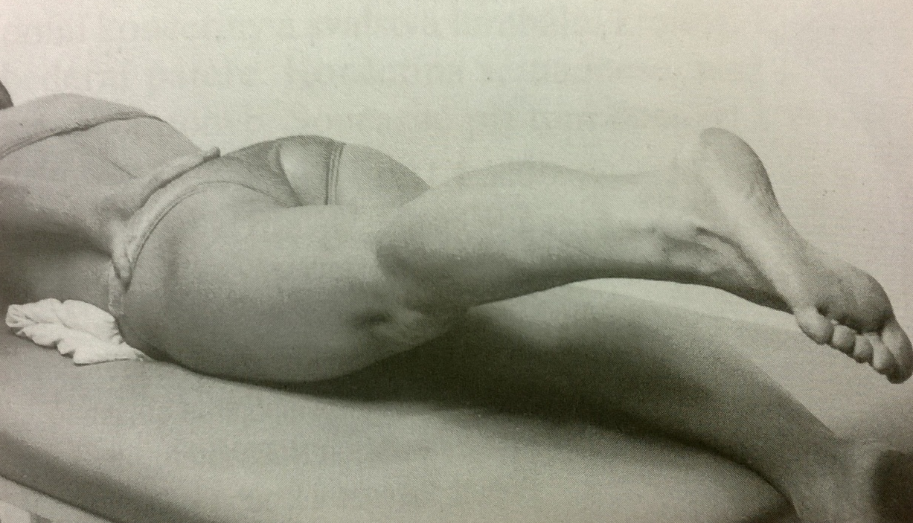
Hip extension – grade 3
Position: patient lying prone, arms along body side, head lying on the forehead, lower limbs extended, foot away from the table (the abdomen underlaid with the pillow to ensure lumbar aplanation)
Fixation: the pelvis on the tested side
Movement: hip extension (in 10° range of motion)

Slide 19
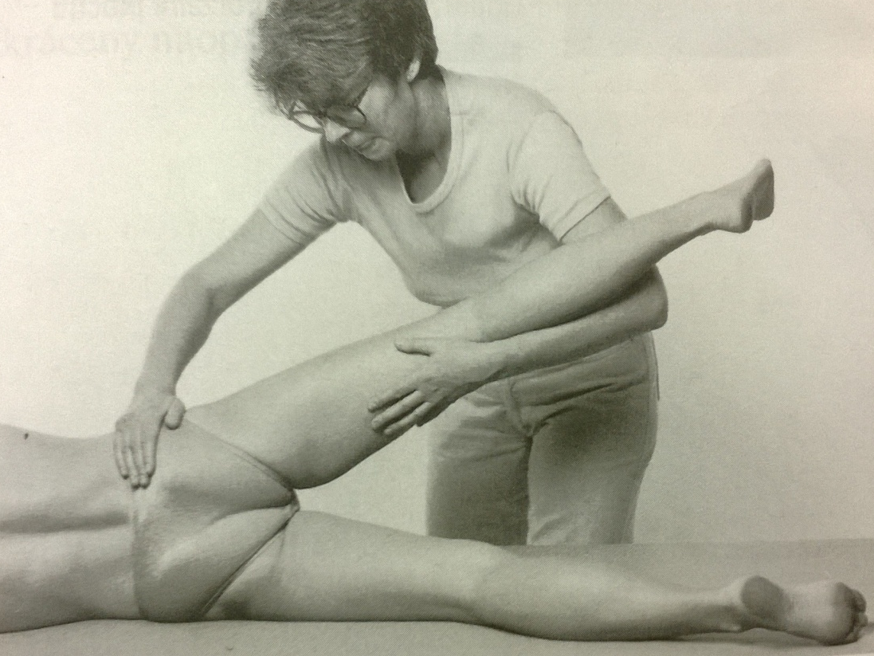
Hip extension – grade 2
Position: lying on the tested side, the uninvolved lower limb is supported by PT in slightly flexion and abduction in the hip and slighly flexed in the knee joint, the tested lower limb extended in the knee joint, central position of the hip
Fixation: the pelvis on the untested side
Movement: hip extension (in 10° range of motion)

Slide 20
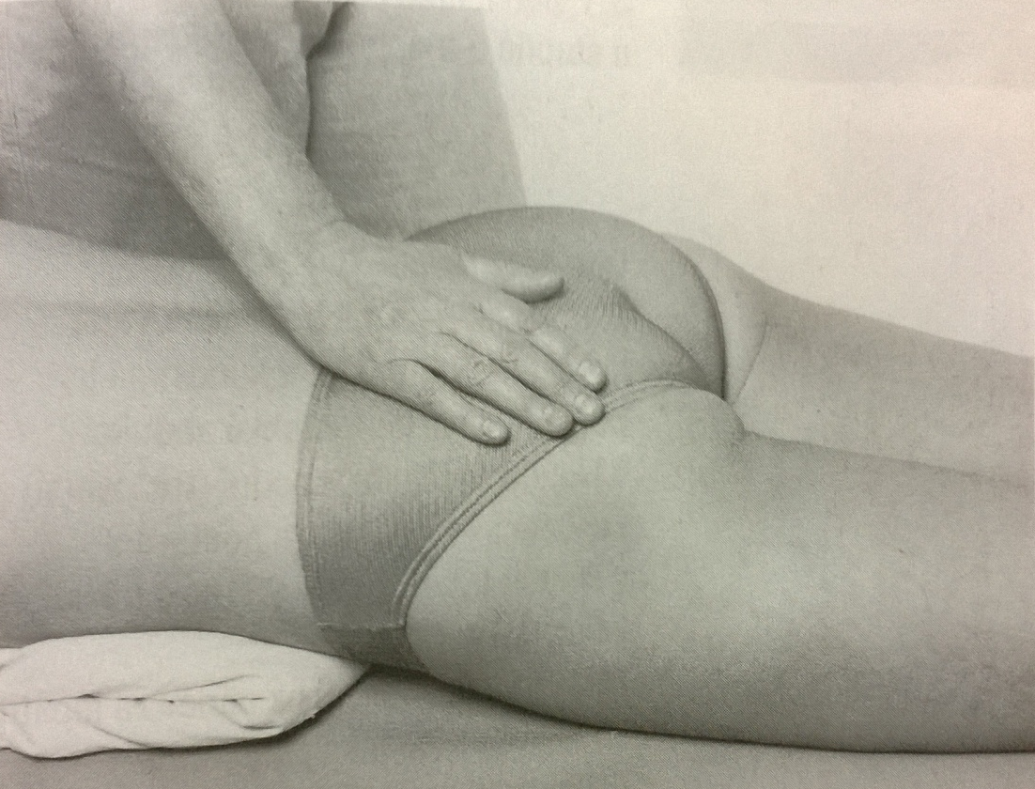
Hip extension – grade 1,0
Position: patient lying prone, arms along body side, head lying on the forehead, lower limbs extended, foot away from the table (the abdomen underlaid with the pillow to ensure lumbar aplanation)
Attempt to move: PT palpates a trace of contraction during patients attempt to extend the hip joint

Slide 21
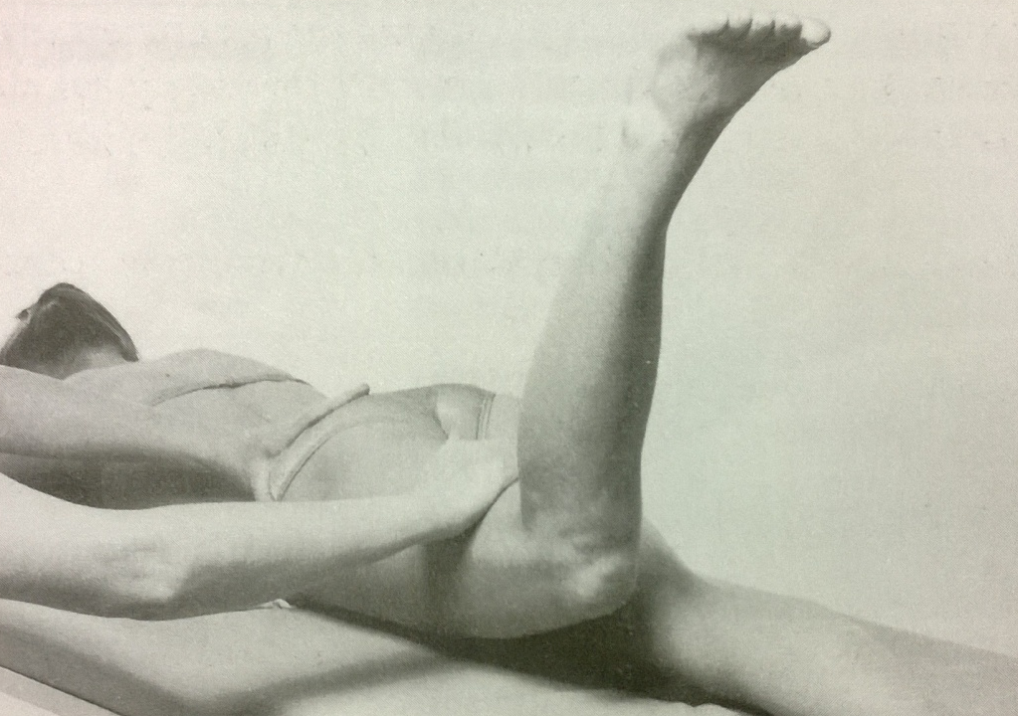
Hip extension (gluteus max.) – grade 5,4
Position: patient lying prone, arms along body side, head lying on the forehead, lower limbs extended (except 90° flexion in the knee of the tested side), foot away from the table (the abdomen underlaid with the pillow to ensure lumbar aplanation)
Fixation: the pelvis on the tested side
Movement: hip extension (in 10° range of motion)
Resistance: on the lower part of the thigh (arched)

Slide 22
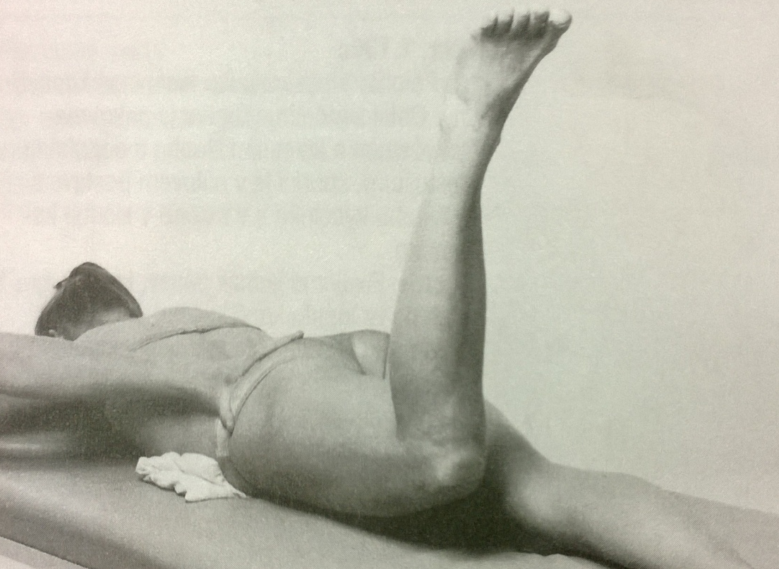
Hip extension (gluteus max.) – grade 3
Position: the same as grade 5,4
Fixation: the pelvis on the tested side
Movement: hip extension (in 10° range of motion)

Slide 23
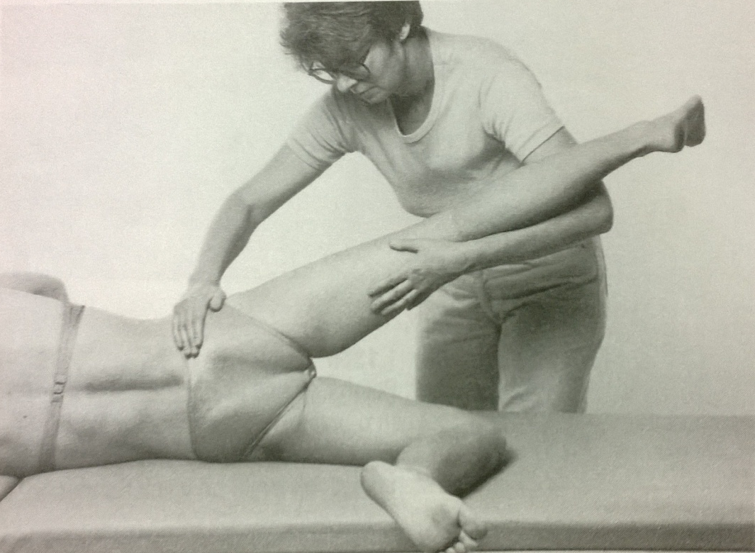
Hip extension (gluteus max.) – grade 2
Position: lying on the tested side, the uninvolved lower limb is supported by PT in slightly flexion and abduction in the hip and slighly flexed in the knee joint, the tested lower limb flexed in the knee joint, central position of the hip
Fixation: the pelvis on the untested side
Movement: hip extension (in 10° range of motion)

Slide 24
Hip extension – notes:
The pelvis has to be fixed by PT (no extension of the lumbal spine as a substitution of hip extension)
No external rotation or adduction or abduction of the hip joint
Foot should be away from to table

Slide 25
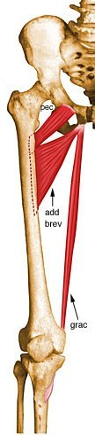
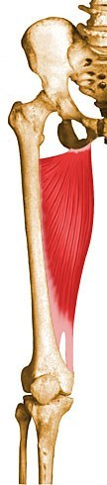
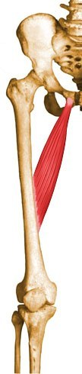
Hip adduction
Adductor
magnus
Adductor
longus
Adductor
brevis
Gracilis
Pectineus

Slide 26
Adductor magnus
Origin
Inferior pubic ramus, ischial ramus, and inferolateral area of ischial tuberosity
Insertion
Gluteal tuberosity of femur, medial lip of linea aspera, medial supracondylar ridge, and adductor tubercle
Action
Powerful thigh adductor
superior horizontal fibers also help flex the thigh
vertical fibers help extend the thigh
Innervation
Posterior division of obturator nerve innervates most of the adductor magnus; vertical or hamstring portion innervated by tibial nerve (L2, L3, L4)

Slide 27
Adductor longus
Origin
Anterior surface of body of pubis, just lateral to pubic symphysis
Insertion
Middle third of linea aspera, between the more medial adductor magnus and brevis insertions and the more lateral origin of the vastus medialis
Action
Adducts and flexes the thigh
helps to laterally rotate the hip joint
Innervation
Anterior division of obturator nerve (L2, L3, L4)

Slide 28
Adductor brevis
Origin
Anterior surface of inferior pubic ramus, inferior to origin of adductor longus
Insertion
Pectineal line and superior part of medial lip of linea aspera
Action
Adducts and flexes the thigh
helps to laterally rotate the thigh
Innervation
Anterior or posterior division of obturator nerve (L4, L2, L3)

Slide 29
Gracilis
Origin
Inferior margin of pubic symphysis, inferior ramus of pubis, and adjacent ramus of ischium
Insertion
Medial surface of tibial shaft, just posterior to sartorius
Action
Flexes the knee, adducts the thigh
helps to medially rotate the tibia on the femur
Innervation
Anterior division of obturator nerve (L2, L3)

Slide 30
Pectineus
Origin
Pecten pubis and pectineal surface of the pubis
Insertion
Pectineal line of femur
Action
Adducts the thigh and flexes the hip joint
Innervation
Femoral nerve usually, although it may sometimes receive additional innervation from the obturator nerve as well (L2, L3, L4)

Slide 31
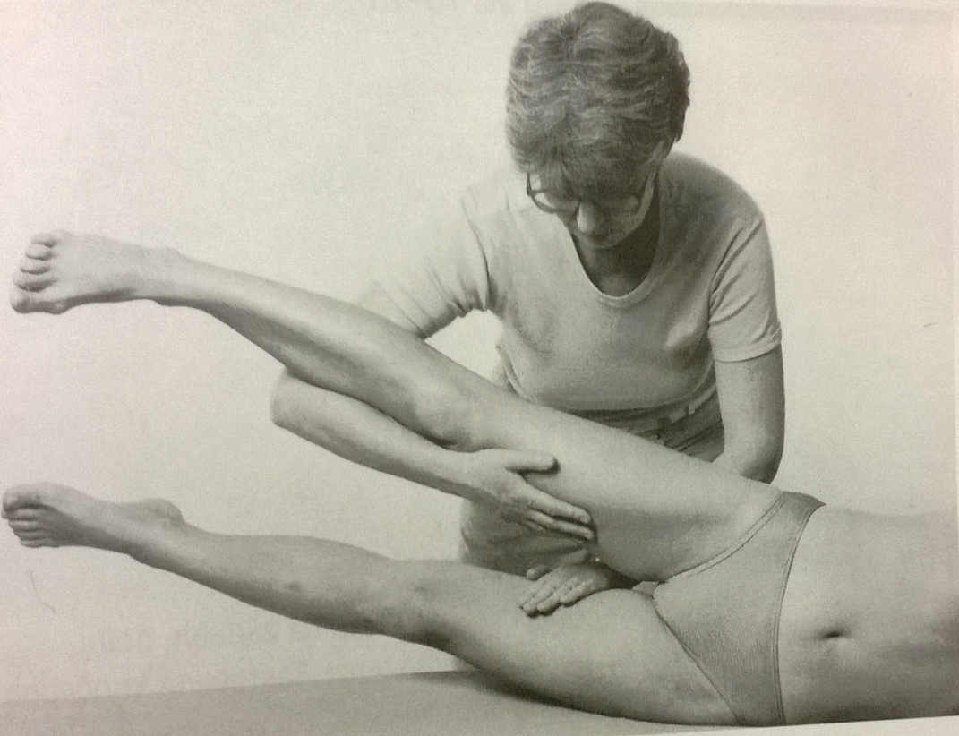
Hip adduction – grade 5,4
Position: patient lying on the tested side, lower limbs extended, the uninvolved one supported by PT in 30° abduction
Fixation: the uninvolved lower limb in abduction
Movement: adduction of the tested hip joint (by moving the tested lower limb closer to the untested)
Resistance: on the lower part of the thigh

Slide 32
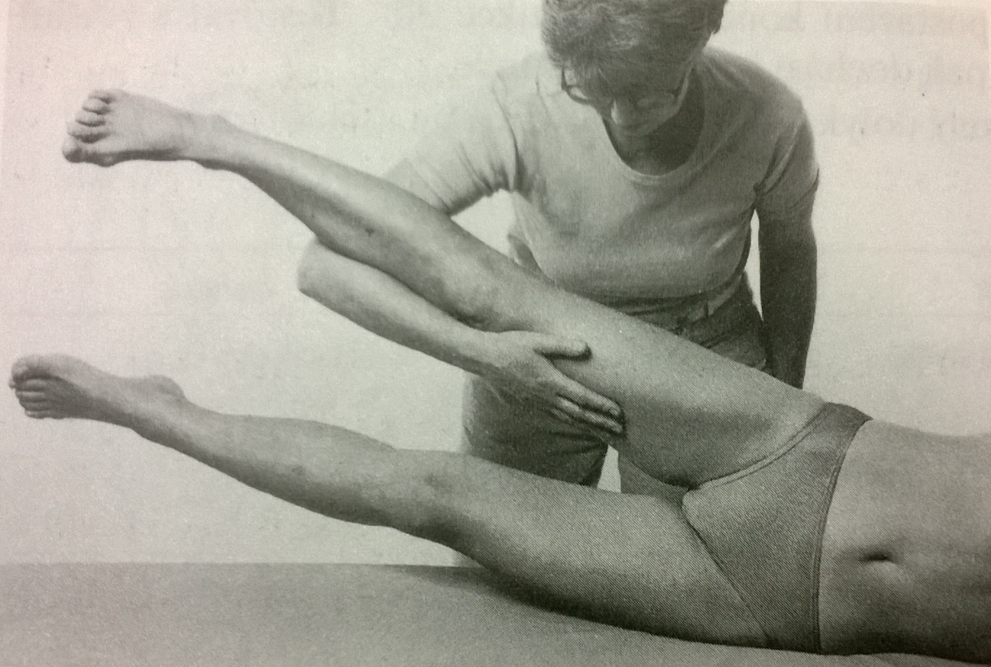
Hip adduction – grade 3
Position: patient lying on the tested side, lower limbs extended, the uninvolved one supported by PT in 30° abduction
Fixation: the uninvolved lower limb in abduction
Movement: adduction of the tested hip joint (by moving the tested lower limb closer to the untested)

Slide 33
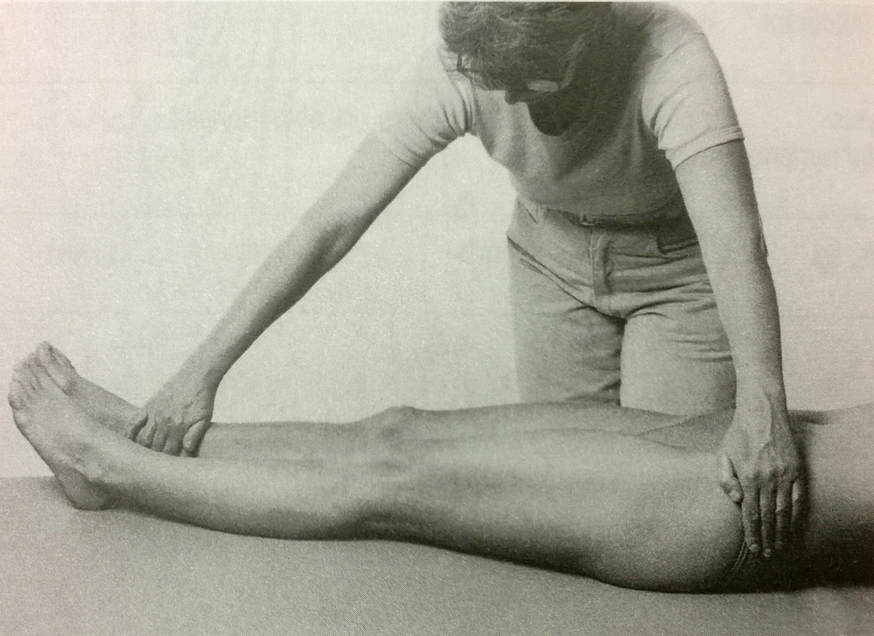
Hip adduction – grade 2
Position: patient lying supine, lower limbs extended and in 30° abduction in hip joint
Fixation: the pelvis on the tested side
Movement: adduction of the tested hip joint – 10-15° (by moving the tested lower limb closer to the untested)

Slide 34
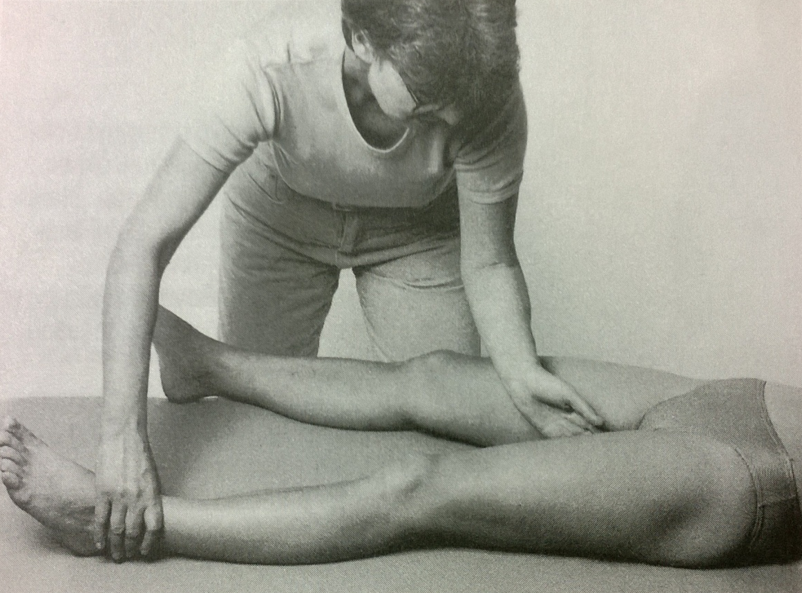
Hip adduction – grade 1,0
Position: patient lying supine, lower limbs extended and in 30° abduction in hip joint
Attempt to move: PT palpates the trace of contraction during patients attempt to adduct the hip (at the inner side of thigh)

Slide 35
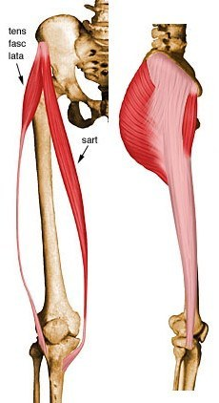
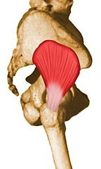
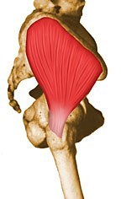
Hip abduction
Gluteus
medius
Tensor
fasciae latae
Gluteus
minimus

Slide 36
Gluteus medius
Origin
Dorsal ilium inferior to iliac crest
Insertion
Lateral and superior surfaces of greater trochanter
Action
Major abductor of thigh
anterior fibers help to rotate hip medially
posterior fibers help to rotate hip laterally
Innervation
Superior gluteal nerve (L4, L5, S1) (L4, L5, S1)

Slide 37
Tensor fasciae latae
Origin
Anterior superior iliac spine, outer lip of anterior iliac crest and fascia lata
Insertion
Iliotibial band
Action
Helps stabilize and steady the hip and knee joints by putting tension on the iliotibial band of fascia
Innervation
Superior gluteal nerve (L4, L5, S1) (L4, L5, S1)

Slide 38
Gluteus minimus
Origin
Dorsal ilium between inferior and anterior gluteal lines; also from edge of greater sciatic notch
Insertion
Anterior surface of greater trochanter
Action
Abducts and medially rotates the hip joint
Innervation
Superior gluteal nerve (L4, L5, S1) (L4, L5, S1)

Slide 39
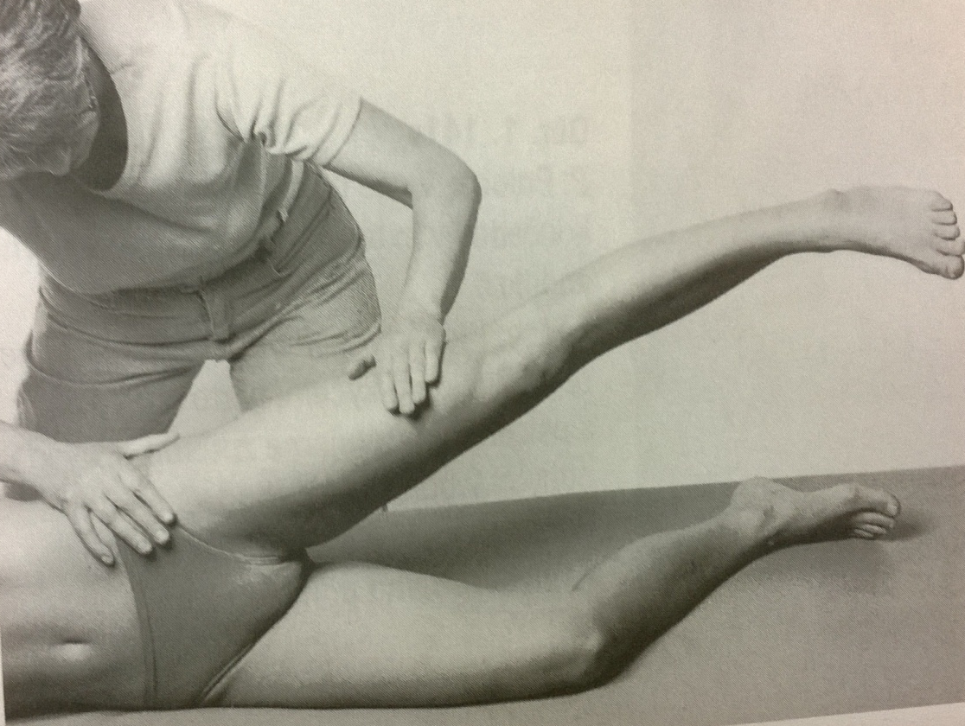
Hip abduction – grade 5,4
Position: patient lying on the untested side, the untested lower limb slightly flexed in knee and hip joint, the tested lower limb extended
Fixation: pelvis on the tested side
Movement: hip abduction in full range of motion
Resistance: on the lower part of the thigh

Slide 40
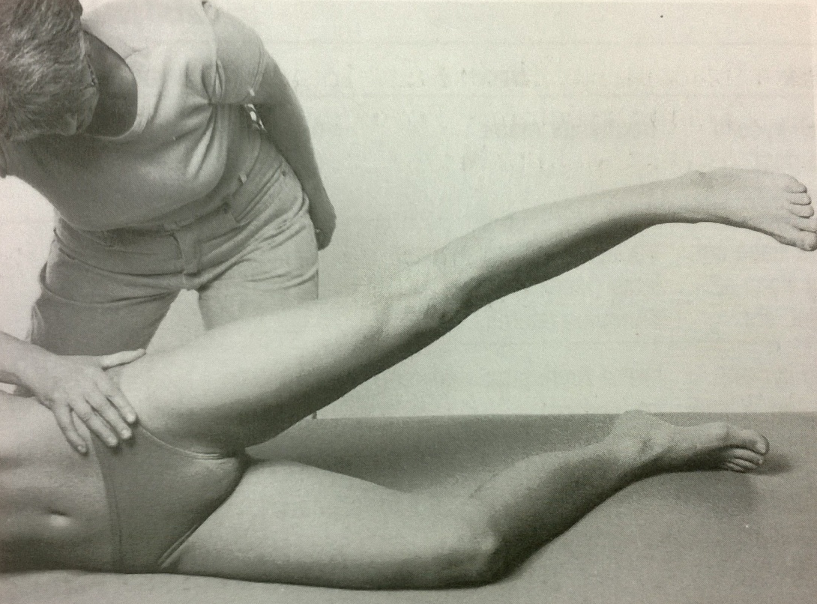
Hip abduction – grade 3
Position: patient lying on the untested side, the untested lower limb slightly flexed in knee and hip joint, the tested lower limb extended
Fixation: pelvis on the tested side
Movement: hip abduction in full range of motion

Slide 41
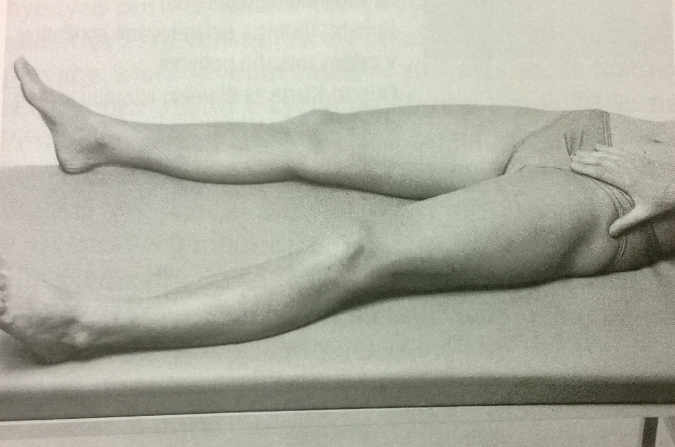
Hip abduction – grade 2
Position: patient lying supine, lower limb extended (the untested one slightly abducted)
Fixation: pelvis on the tested side
Movement: hip abduction in full range of motion

Slide 42
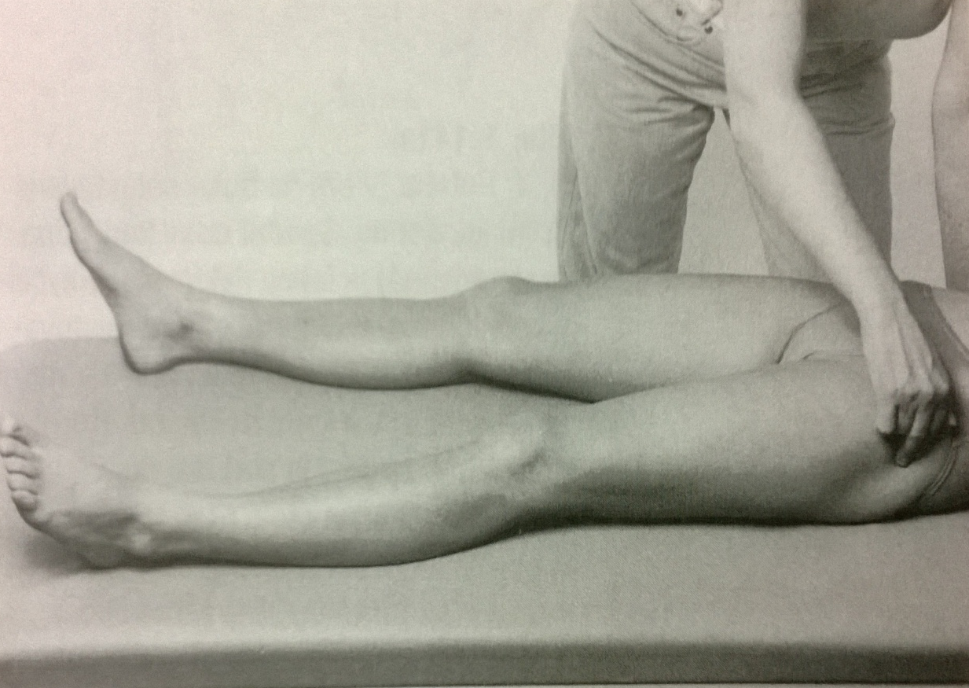
Hip abduction – grade 1,0
Position: patient lying supine, lower limb extended
Attempt to move: PT palpates a trace of contraction during patients attempt to abduct a hip (over the trochanter major)

Slide 43
Hip abduction – notes:
The fixation of the pelvis is necessary (no elevation of the pelvis should be allowed)
No external rotation or flexion in the hip joint (substitution of iliopsoas and tensor fasciae latae)
Proper range of motion and proper direction of movement should be kept
No anteversion of the pelvis or hyperlordosis of the lumbar spine

Slide 44
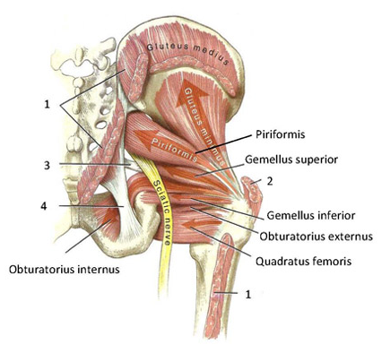
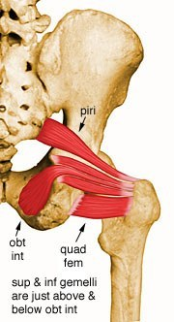
Hip external rotation

Slide 45
Quadratus femoris
Origin
Lateral margin of obturator ring above ischial tuberosity
Insertion
Quadrate tubercle and adjacent bone of intertrochanteric crest of proximal posterior femur
Action
Rotates the hip laterally; also helps adduct the hip
Innervation
Quadratus femoris branch of nerve to the quadratus femoris and inferior gemellus (L5, S1) (L5, S1)

Slide 46
Piriformis
Origin
Anterior surface of lateral process of sacrum and gluteal surface of ilium at the margin of the greater sciatic notch
Insertion
Superior border of greater trochanter
Action
Lateral rotator of the hip joint
helps abduct the hip if it is flexed
Innervation
Piriformis nerve (L5, S1, S2) (L5, S1, S2)

Slide 47
Gemellus superior
Origin
Ischial spine
Insertion
Medial surface of greater trochanter of femur, in common with obturator internus
Action
Rotates the thigh laterally
helps abduct the flexed thigh
Innervation
Nerve to the obturator internus and superior gemellus -- a branch of the sacral plexus (L5, S1) (L5, S1)

Slide 48
Gemellus inferior
Origin
Posterior portions of ischial tuberosity and lateral obturator ring
Insertion
Medial surface of greater trochanter of femur, in common with obturator internus
Action
Rotates the thigh laterally
helps abduct the flexed thigh
Innervation
Nerve to the obturator internus and inferior gemellus -- a branch of the sacral plexus (L5, S1) (L5, S1)

Slide 49
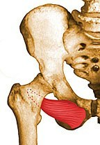
Obturatorius externus
Origin
External surface of obturator membrane and anterior bony margins of obturator foramen
Insertion
Posteromedial surface of greater trochanter of femur
Action
Rotates the thigh laterally; also helps adduct thigh
Innervation
Posterior division of obturator nerve innervates most of the adductor magnus; vertical or hamstring portion innervated by tibial nerve (L3, L4)

Slide 50
Obturatorius internus
Origin
Internal surface of obturator membrane
posterior bony margins of obturator foramen
Insertion
Medial surface of greater trochanter of femur, in common with superior and inferior gemelli
Action
Rotates the thigh laterally
helps abduct the thigh when it is flexed
Innervation
Nerve to the obturator internus and superior gemellus -- a branch of the sacral plexus (L5, S1) (L5, S1)

Slide 51
Gluteus maximus
Origin
Posterior aspect of dorsal ilium posterior to posterior gluteal line, posterior superior iliac crest, posterior inferior aspect of sacrum and coccyx, and sacrotuberous ligament
Insertion
Primarily in fascia lata at the iliotibial band
also into the gluteal tuberosity on posterior femoral surface
Action
Major extensor of hip joint, assists in laterally rotating the thigh
upper and middle third section of the muscle are abductors
Innervation
Inferior gluteal nerve (L5, S1, S2) (L5, S1, S2)

Slide 52
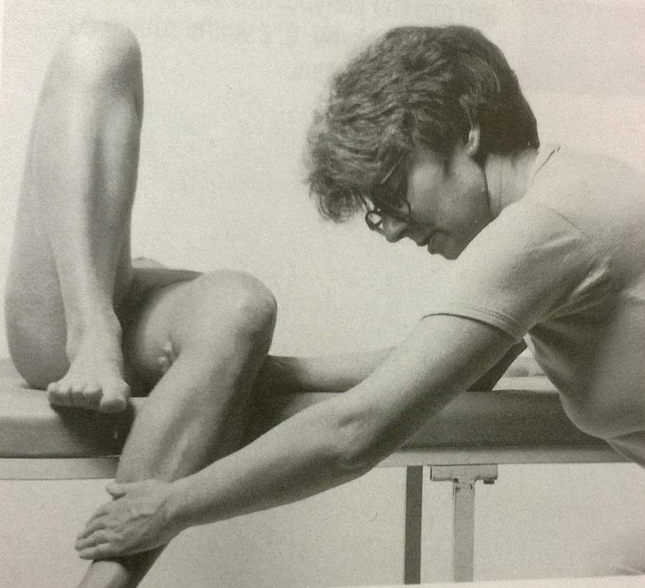
Hip external rotation – grade 5,4
Position: patient lying supine, the shank of the tested lower limb hanging from the table, the untested lower limb flexed in hip and knee joint, foot on the table
Fixation: dorsal side of the lower part of the thigh
Movement: hip external rotation in full range of motion (40-50°)
Resistance: at the inner side of the lower shank

Slide 53
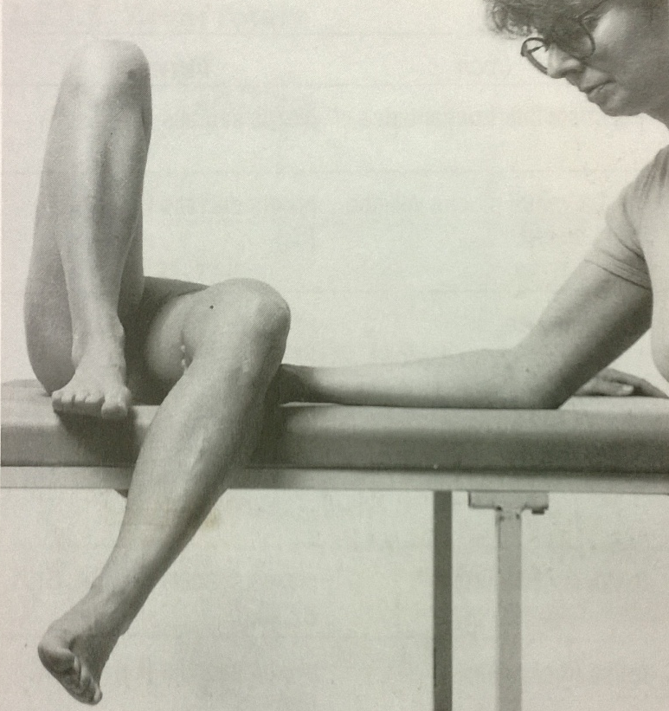
Hip external rotation – grade 3
Position: patient lying supine, the shank of the tested lower limb hanging from the table, the untested lower limb flexed in hip and knee joint, foot on the table
Fixation: dorsal side of the lower part of the thigh
Movement: hip external rotation in full range of motion (40-50°)

Slide 54
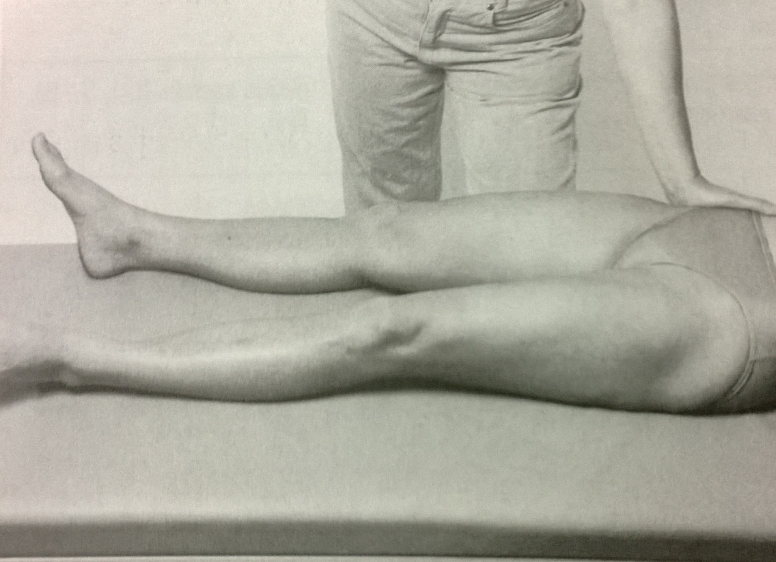
Hip external rotation – grade 2
Position: patient lying supine, lower limbs extended and slightly abducted, the tested one inner rotated
Fixation: pelvis on the untested side
Movement: hip external rotation in full range of motion (40-50°)

Slide 55
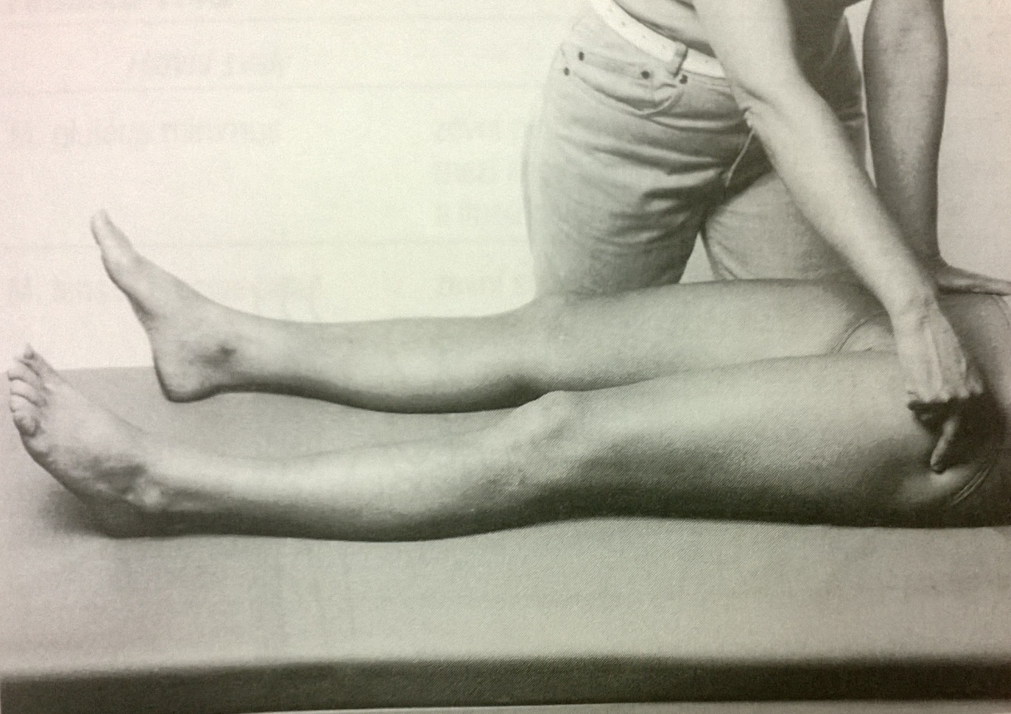
Hip external rotation – grade 1,0
Position: patient lying supine, lower limbs extended
Attempt to move: PT palpates a trace of contraction during patients attempt of hip external rotation (at the area of trochanter major) and observes the attempt to move the leg outward

Slide 56
Hip external rotation – notes:
No adduction and flexion of the hip joint
No supination of the foot

Slide 57
Hip internal rotation
Tensor fasciae latae
Gluteus minimus

Slide 58
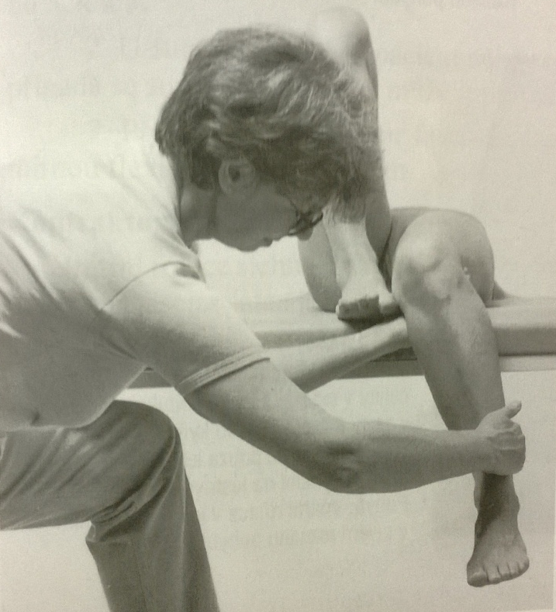
Hip internal rotation – grade 5,4
Position: patient lying supine, the shank of the tested lower limb hanging from the table, the untested lower limb flexed in hip and knee joint, foot on the table
Fixation: dorsal side of the lower part of the thigh
Movement: hip internal rotation in full range of motion (aproximatelly 30°)
Resistance: at the outer side of the lower shank

Slide 59
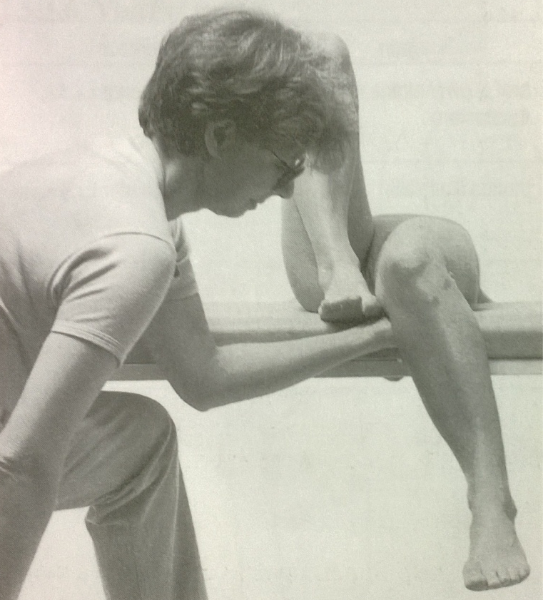
Hip internal rotation – grade 3
Position: patient lying supine, the shank of the tested lower limb hanging from the table, the untested lower limb flexed in hip and knee joint, foot on the table
Fixation: dorsal side of the lower part of the thigh
Movement: hip internal rotation in full range of motion (30°)

Slide 60
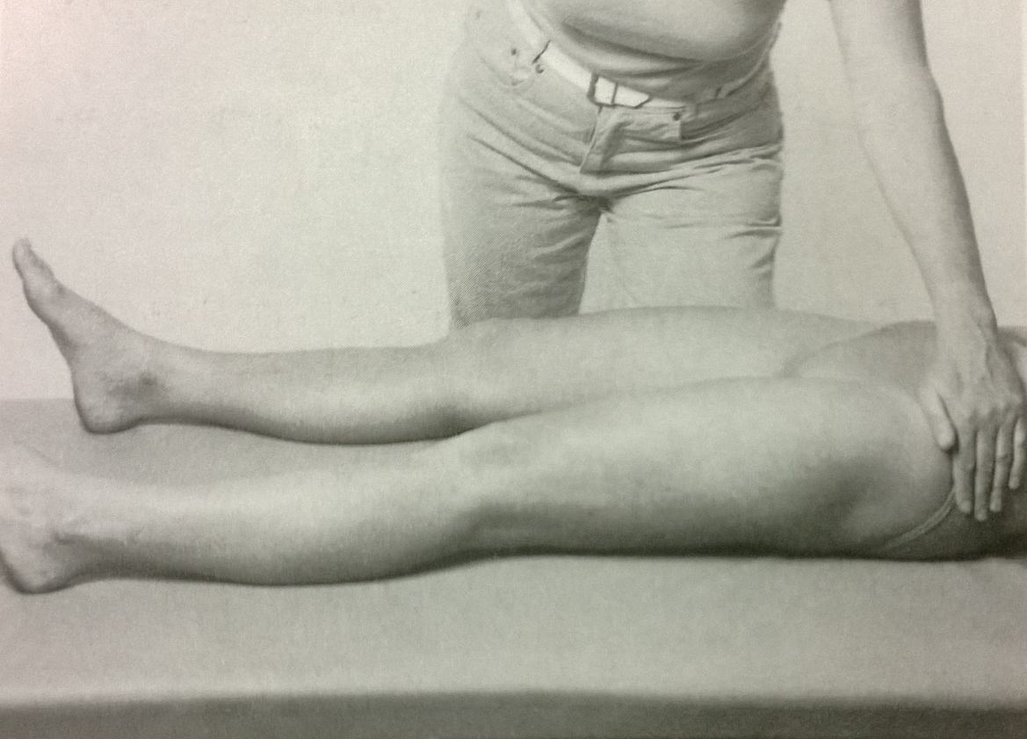
Hip internal rotation – grade 2
Position: patient lying supine, lower limbs extended and slightly abducted, the tested one outer rotated
Fixation: pelvis on the tested side
Movement: hip internal rotation in full range of motion

Slide 61
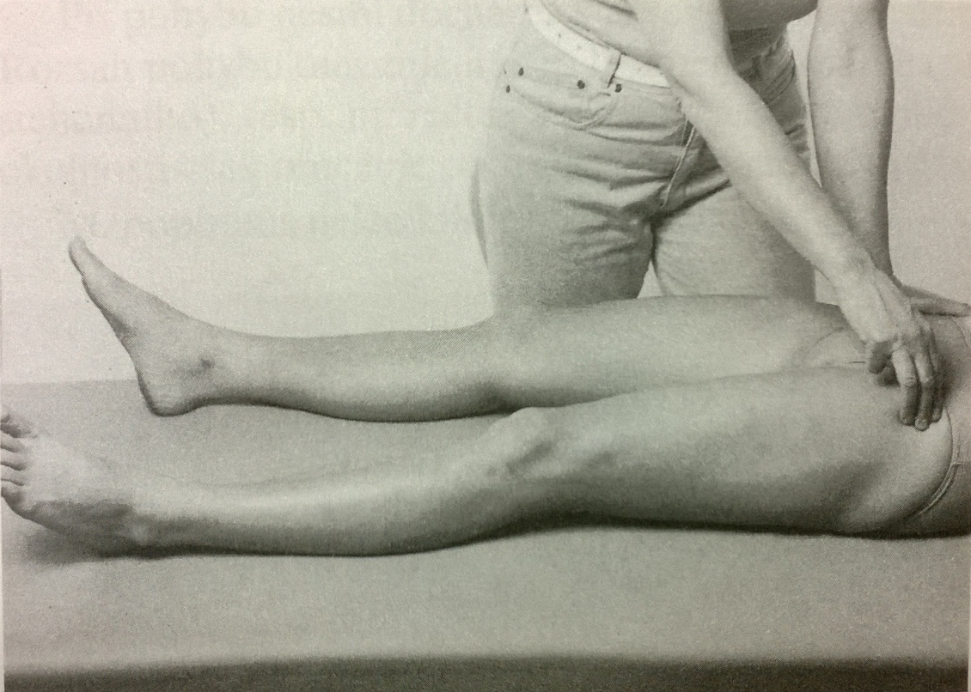
Hip internal rotation – grade 1,0
Position: patient lying supine, lower limbs extended
Attempt to move: PT palpates a trace of contraction during patients attempt of hip internal rotation (at the area of trochanter major) and observes the attempt to move the leg inward

Slide 62
Hip internal rotation
Fixation of the pelvis is necessary, proper position of the lower extremity
No adduction or supination of the foot

Slide 63
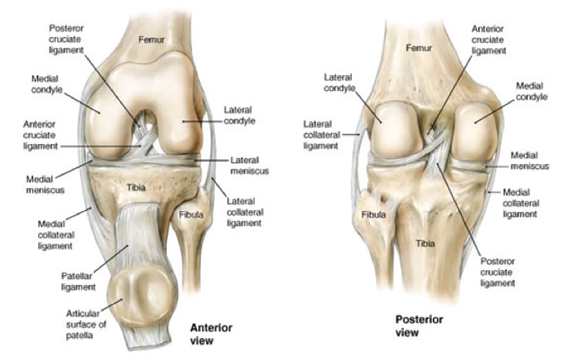
Knee joint

Slide 64
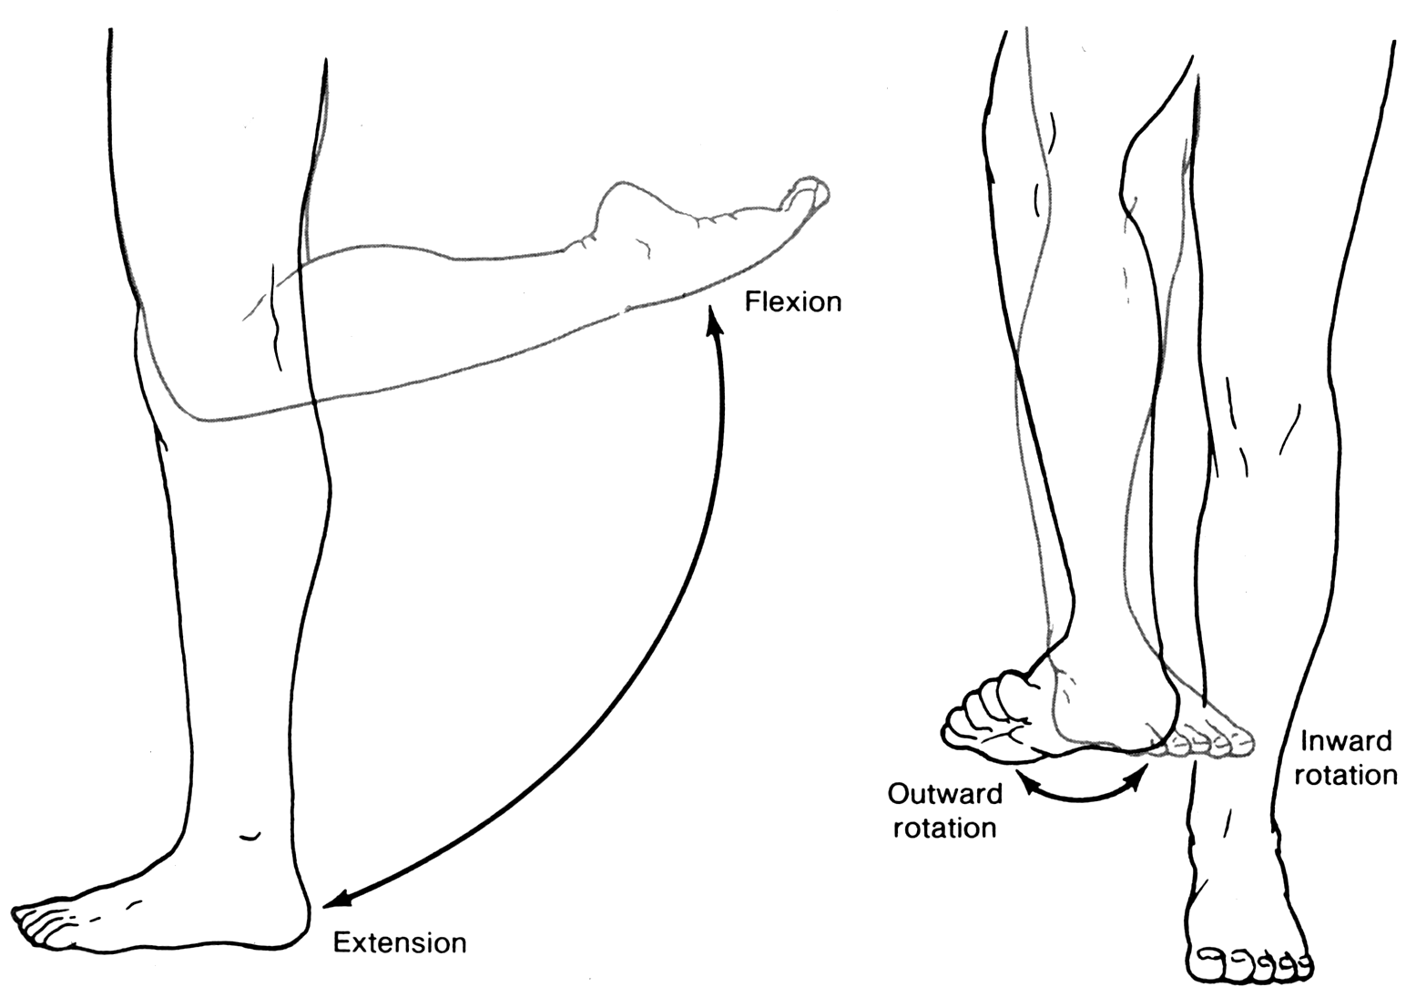
Knee joint movements

Slide 65
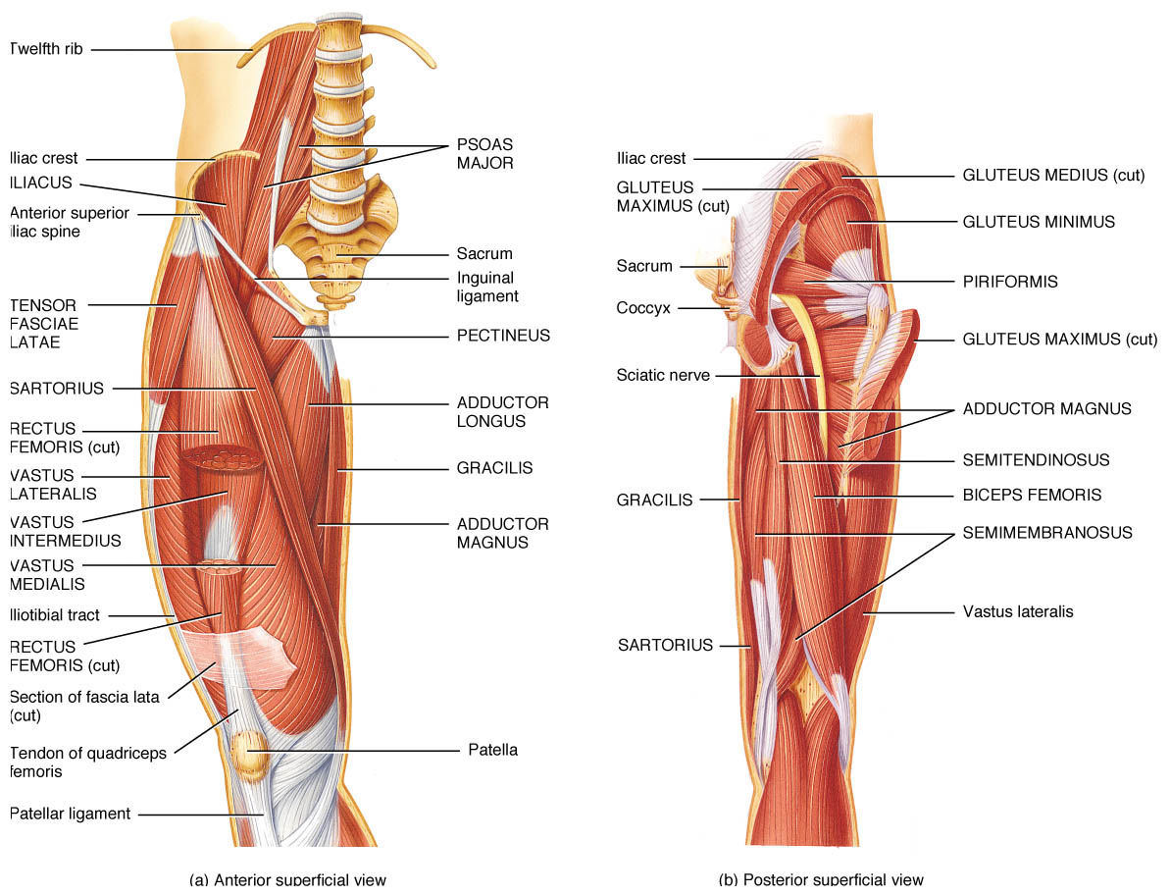
Knee joint muscles

Slide 66
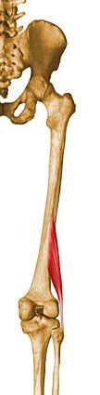
Knee flexion
Biceps femoris (short head)
Biceps femoris
(long head)
Semitendinosus
Semimembranosus

Slide 67
Biceps femoris - long head
Origin
Common tendon with semitendinosus from superior medial quadrant of the posterior portion of the ischial tuberosity
Insertion
Primarily on fibular head
also on lateral collateral ligament and lateral tibial condyle
Action
Flexes the knee, and also rotates the tibia laterally
long head also extends the hip joint
Innervation
Tibial nerve (L5, S1, S2)

Slide 68
Biceps femoris – short head
Origin
Lateral lip of linea aspera, lateral supracondylar ridge of femur, and lateral intermuscular septum of thigh
Insertion
Primarily on fibular head; also on lateral collateral ligament and lateral tibial condyle
Action
Flexes the knee, and also rotates the tibia laterally
long head also extends the hip joint
Innervation
Common peroneal nerve (L5, S1, S2)

Slide 69
Semitendinosus
Origin
From common tendon with long head of biceps femoris from superior medial quadrant of the posterior portion of the ischial tuberosity
Insertion
Superior aspect of medial portion of tibial shaft
Action
Extends the thigh and flexes the knee
rotates the tibia medially, especially when the knee is flexed
Innervation
Tibial nerve (L5, S1, S2)

Slide 70
Semimembranosus
Origin
Superior lateral quadrant of the ischial tuberosity
Insertion
Posterior surface of the medial tibial condyle
Action
Extends the thigh, flexes the knee
rotates the tibia medially, especially when the knee is flexed
Innervation
Tibial nerve (L5, S1, S2)

Slide 71
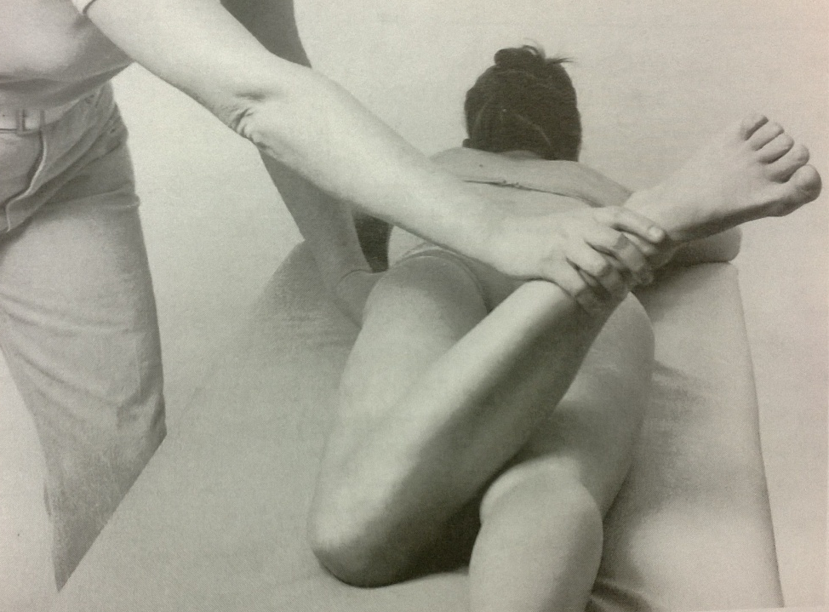

Knee flexion
Knee flexion with external rotation
(biceps femoris)
Knee flexion with internal rotation
(semitendinosus, semimembranosus)

Slide 72

Knee flexion – grade 5,4
Position: patient lying supine, abdomen underlaid with pillow, lower limb extended, feet away from the table
Fixation: the pelvis
Movement: knee flexion in full range of motion
Resistance: at the lower part of the shank (arched)

Slide 73

Knee flexion – grade 3
Position: patient lying supine, abdomen underlaid with pillow, lower limb extended, feet away from the table
Fixation: the pelvis
Movement: knee flexion in full range of motion

Slide 74

Knee flexion – grade 2
Position: patient lying on the tested side, untested lower limb extended and slightly abducted in the hip, extended in the knee
Fixation: PT supports the untested lower limb, fix the the pelvis on the untested side
Movement: knee flexion in full range of motion

Slide 75

Knee flexion – grade 1,0
Position: patient lying supine, abdomen underlaid with pillow, untested lower limb extended with foot away from the table, tested lower limb supported in slighly knee flexion
Attempt to move: PT palpates a trace o contraction during patients attempt to flex the knee joint (at the dorsal part of the thigh)

Slide 76
Knee flexion – notes:
Distinguish knee flexion with external and internal rotation if necessary
No movement of the pelvis (anteversion)
No movement of the hip joint (no rotation)

Slide 77


Knee extension – quadriceps femoris
Rectus
femoris
Vastus
medialis
Vastus
lateralis
Vastus intermedius

Slide 78
Rectus femoris
Origin
Straight head from anterior inferior iliac spine; reflected head from groove just above acetabulum
Insertion
Base of patella to form the more central portion of the quadriceps femoris tendon
Action
Extends the knee
Innervation
Muscular branches of femoral nerve (L2, L3, L4)

Slide 79
Vastus medialis
Origin
Inferior portion of intertrochanteric line, spiral line, medial lip of linea aspera, superior part of medial supracondylar ridge of femur, and medial intermuscular septum
Insertion
Medial base and border of patella; also forms the medial patellar retinaculum and medial side of quadriceps femoris tendon
Action
Extends the knee
Innervation
Muscular branches of femoral nerve (L2, L3, L4)

Slide 80
Vastus lateralis
Origin
Superior portion of intertrochanteric line, anterior and inferior borders of greater trochanter, superior portion of lateral lip of linea aspera, and lateral portion of gluteal tuberosity of femur
Insertion
Lateral base and border of patella; also forms the lateral patellar retinaculum and lateral side of quadriceps femoris tendon
Action
Extends the knee
Innervation
Muscular branches of femoral nerve (L2, L3, L4)

Slide 81
Vastus intermedius
Origin
Superior 2/3 of anterior and lateral surfaces of femur; also from lateral intermuscular septum of thigh
Insertion
Lateral border of patella; also forms the deep portion of the quadriceps tendon
Action
Extends the knee
Innervation
Muscular branches of femoral nerve (L2, L3, L4)

Slide 82

Knee extension – grade 5,4
Position: patient lying supine, shank of the tested lower limb hanging from the table, untested lower limb flexed in knee and hip joint, foot on the table
Fixation: the lower part of the dorsal side of thigh
Movement: knee extension from 90° flexion to full extension
Resistance: at the frontal part of the distal shank

Slide 83

Knee extension – grade 3
Position: patient lying supine, shank of the tested lower limb hanging from the table, untested lower limb flexed in knee and hip joint, foot on the table
Fixation: the lower part of the dorsal side of thigh
Movement: knee extension from 90° flexion to full extension

Slide 84

Knee extension – grade 2
Position: patient lying on the tested side, untested lower limb in knee extension, hip slightly abducted – PT supports the position, tested lower limb in 90° knee flexion, hip extension
Fixation: pelvis on the untested side
Movement: from 90° flexion to full extension of the knee joint

Slide 85


Knee extension – grade 1,0
Position: patient lying supine, untested lower limb in extension, tested lower limb slightly flexed in knee and hip joint (supported by PT)
Attempt to move: PT palpates a trace of contraction during patients attempt of knee extension (at the ligament patellae or quadriceps muscle area)

Slide 86
Knee extension – notes:
No swing at the start of the movement
No rotation of the hip joint
No retroversion of the pelvis
Do the movement to full extension
Don´t fix the thigh from above (don´t touch quadriceps muscle)

Slide 87

Thank you for your attention ☺

