Slide 1
ORGAN DONATION
Miloš Chobola

Slide 2
Educational outcome :
identify potential organ donor
understand what si the definition of neurological death
understand what are the prerequisites before testing
know what tests are used to confirm neurological death

Slide 3
Introduction :
Organ transplantation is a recognised treatment for end organ damage
It is an altruistic act of beneficence resulting in the gift of life
transplantation is life-enhancing for pancreatic and renal diseases
transplantation is life- saving for end stage heart, lung and liver diseases

Slide 4
Donor identification :
Defined clinical trigger factors in patients who have had a catastrophic brain injury.
The absence of one or more cranial nerve reflexes and a Glasgow Coma Score of 5 or less, which is not explained by confounders.
GIVE score
AE, ICU, neurology/stroke units

Slide 5
Donor identification :
A consistent clinical indicator used for the early identification of potential organ and tissue donors
Curran Emer, 2020, Irish Organ Donation Handbook app, version 5.10, MEG Software
Intensive Care Medicine – (VLAM9X1a)

Slide 6
Criteria for organ donation :
the process of organ donation places a huge importance on the balance of risk and benefit to the recipient
potential organ donor (family) /potential organ recipient
primary team /ICU / neurology/ surgeons/ organ donation coordinator.......
suboptimal transplant outcomes :graft dysfunction , disease transmission, recipientś death

Slide 7
Criteria for organ donation :
absolute contraindications :
no consent from next of kin
no consent from coroner (IRL/UK) – cause of death
family dissent/conflict about donation
advanced-stage disease (colon stage > T3 or breast > T1c)

Slide 8
Criteria for organ donation :
relative contraindications to donation :
sepsis, HIV positive, systemic viral infection , herpetic meningoencephalitis, neoplasms ( lymphoma, malignant melanoma,...), lung cancer, glioblastoma, ....
early stage disease cancers (bowel and breast) can be acceptable for organ donation depending on staging and the disease- free interval

Slide 9
Neurological death DBD (donation after brain death) :
definition :
the irreversible loss of consciousness due to a known cause
loss of brain reflexes
apnoea in the presence of respiratory acidemia

Slide 10
Neurological death :
aetiology :
cerebral haemorrhage, cerebrovascular embolism, hypoxic brain injury, , traumatic brain injury, meningitis, brain tumour, epilepsy, brain abscess, hydrocephalus,..
tests :brain stem test
apnoea test
ancillary tests – radiology, audiometry,EEG, transcranial Doppler

Slide 11
Neurological death – prerequisites :
known cause of death
drug free state – no sedatives, no muscle relaxants, no anesthetic agents, alcohol, opiods,....
normothermia > 36 °C
avoid electrolyte imbalance , Na 130-155mmol/L, normal blood glucose levels, ....
no endocrine imbalance

Slide 12
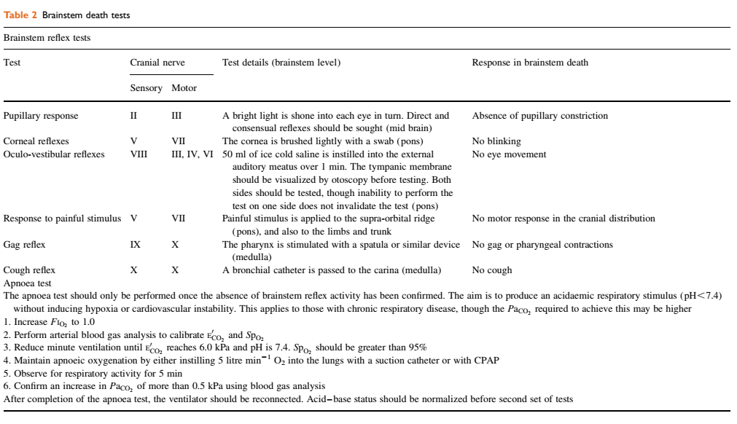
Brainstem tests, apnoea test :
Curran Emer, 2020, Irish Organ Donation Handbook app, vrsion 5.10, MEG Software

Slide 13
ICU managment of potential organ donor :
ICU principles :
maintain euvoleamia
optimise cardiac output
lung protective ventilation
diabetes insipidus- Na/UO/
prevent hypothermia
glyceamia control, (thyroid hormones, glucocortikoids, ...)

Slide 14
Donation after circulatory death (DCD) :
DCD – refers to the retrieval of organs for the purpose of transplantation from patients whose death is diagnosed and confirmed using cardio-respiratory criteria
controlled /uncontrolled expected /unexpected
ICU, stroke unit /emergency department, out of hospital
UK, Australia /France, Spain . both Netherlands

Slide 15
Perioperative management :
maintain clinical targets as in „normal“ patient
no need for opiods
muscle relaxants usually needed
low dose of sevoflurane (inhalational anesthetics) improves outcome

Slide 16
Family approach :
principles
Care of the dying patient is of paramount importance!!!
Measures to maintain the comfort and dignity of the patient must not be compromised for organ donation

Slide 17
Family approach :
use clear language
obtain the patient’s clinical history
identify key family members
identify key family issues, including the need for family support
identify relevant cultural and religious issues
all religions support the ethos of organ donation

Slide 18
Donor identification summary :
Curran Emer, 2020, Irish Organ Donation Handbook app, vrsion 5.10, MEG Software

Slide 19
Take home message :
existence of organ donation program
organ donation program is a multidisciplinary task
dealing with a family is very delicate matter

Slide 20
thank you

