Slide 1
CELLULAR BASIS OF NERVOUS SYSTEM
Dr. Amir Samadian m.d.
Department of physiology
Autumn 2021

Slide 2
Learning objectives
Preparation (self-studying – study following topics prior to the tutorial)
Neuron: structure, functional organisation (receptive zone, initial segment, axon, nerve ending). Basic classification of neurons. Glial cells: types and basic function. Blood-brain barrier. Structure of electrical and chemical synapse. Neurotransmitters: basic types, excitatory vs. inhibitory. Resting membrane potential. Local response of membrane potential vs. action potential (ion currents, conduction with/without decrement). Basis of action potential conduction through axon. Types of nerve fibres.
Content
1. Synapse
Electrical synapse: structure, function.
Structure of chemical synapse. Exocytosis of neurotransmitter. Mechanism of synaptic transmission. Excitatory, inhibitory and modulatory synapses.
2. Neurotransmitters and their receptors
Basic classification of neurotransmitters, excitatory vs. inhibitory. Glutamate, metabotropic and inotropic glutamate receptors – their distribution, function, physiological significance. GABA, GABAA receptor – function and physiological significance. Dopamine, dopaminergic receptors – classification, examples of distribution, physiological significance.

Slide 3
Synapse – types of synpase
Site of transmission of information from one cell to another (neuro-neuro or neuro-muscular)
Types of synapse :
ELECTRICAL SYNAPSE (GAP JUNCTIONS)
Low resistence pathway that allows direct current flow (through Gap Junctions)
Very fast and Bidirectional
Example : rapid cell-cell conduction is important for simultaneous activation and contraction in tissues like ventricular muscle, uterus and bladder.
CHEMICAL SYNAPSE
Depends on release of tranmitter
Operates only in one direction ( Presynaptic cell – SYNAPTIC CLEFT – Postsynaptic cell )
Synaptic delay
Example : Neuro-muscular Junction (NMJ)

Slide 5
Synaptic transmission (eg ; NMJ)

Slide 6
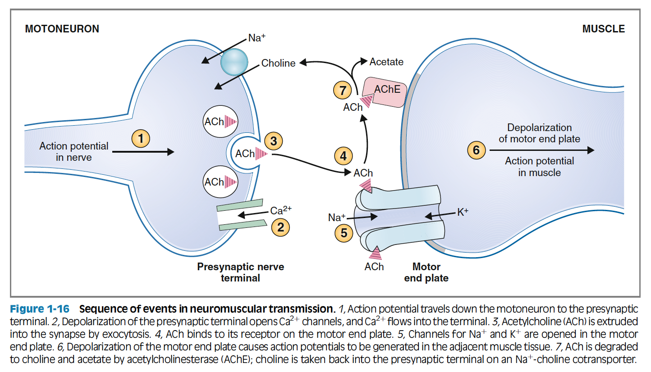

Slide 8
Types of synaptic arrangement
One-to-one synapse
A single action potential in presynaptic cell causes a single action potential in post-synaptic cell ( e.g ; NMJ)
One-to-many synapse
A single action potential in presynaptic cell causes a burst of action potentials in many postsynaptic cells – Rare! ( e.g; synapse of motorneuron with renshaw cells of spinal cord)
Many-to-one synapse
The commonest arrangement . Many presynaptic cells converge on postsynaptic cells, inputs summate, and the sum of the inputs determines whether postsynaptic cell will fire an action potential or not
Inputs can be excitatory or inhibitory

Slide 9
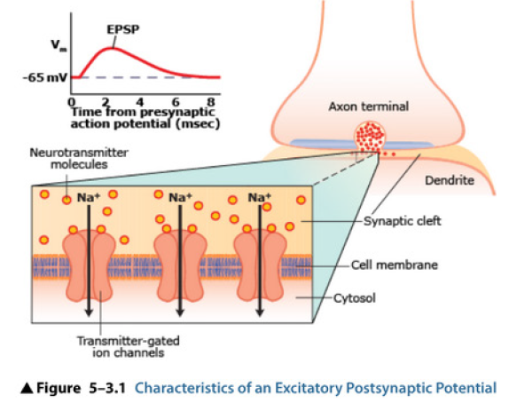
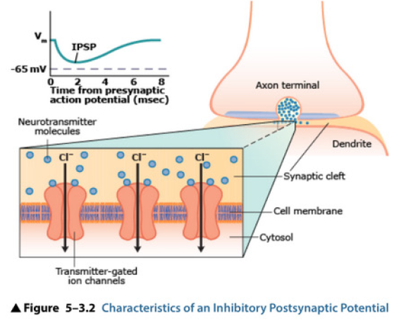
EPSP & IPSP
Excitatory postsynaptic potential (EPSP)
Transmitters depolarize.
Increased conductance of the postsynaptic membrane to both Na+ and K+-
Main current flow is an influx of Na+.
Transmitters include acetylcholine, glutamate, and aspartate.
Inhibitory postsynaptic potential (IPSP)
Transmitters in most cases hyperpolarize.
Increased conductance of the postsynaptic membrane to Cl- ( influx) or possibly K+ (efflux).
Transmitters include GABA, glycine.

Slide 11
Neurotransmitter
Synthesized in the presynaptic cell and stored in a vesicle
Released from presynaptic cell upon stimulation
It bind to its receptor (ionotropic or metabotropic) on postsynaptic cell and produces a physiological response
It‘s Rapidly removed from synaptic cleft by re-uptake or removal by enzyme
Based on their effect on Post-Synaptic cells we can classify them into :
EXCITATORY NEUROTRANSMITTER
INHIBITORY NEUROTRANSMITTER
MODULATORY NEUROTRANSMITTER (Neuromodulators)

Slide 12
Excitatory and Inhibitory Neurotranmiter
Excitatory NT :
Depolarizes the postsynaptic potential (closer to threshold) and causes the initiation and propagation of Action Potential
Example : Glutamtate, Aspartate, Acetylcholine ,
Inhibitory NT :
Hyperpolarizes the postsynaptic potential (away from threshold) , Action potential generation and propagation is inhibited
Example : GABA , Glycine

Slide 13
Modulatory synapse and neuromodulators
Modulatory Synapse- Neuromodulators :
Are NOT directly involved in synaptic transmission
modulate the process
Rather regulates or modifies the effect of other excitatory or inhibitory synapses by acting on their presynaptic or postsynaptic membrane
Example : Serotonin, Histamine, Norepinephrin

Slide 14
Classification based on chemical structure

Slide 15
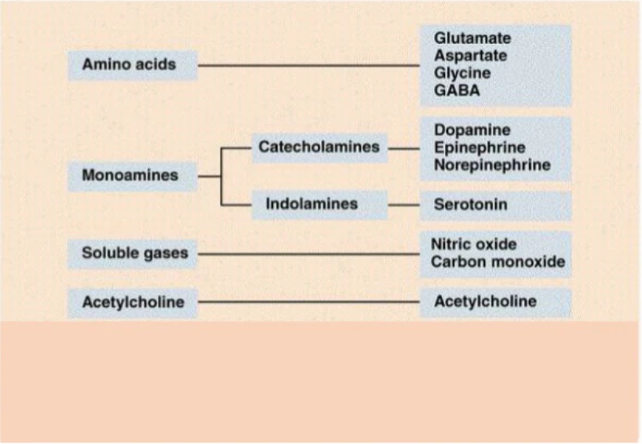
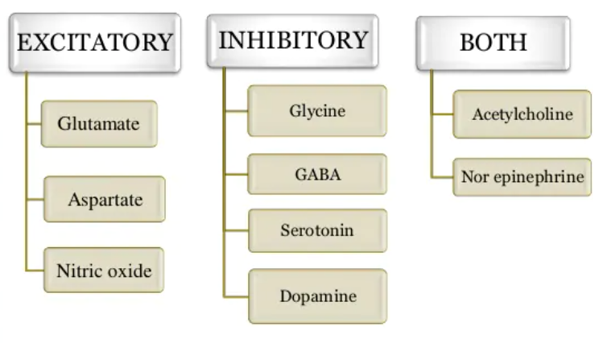

Slide 16
Receptors for neurotranmitters (Ionotropic and metabotropic receptors)

Slide 17
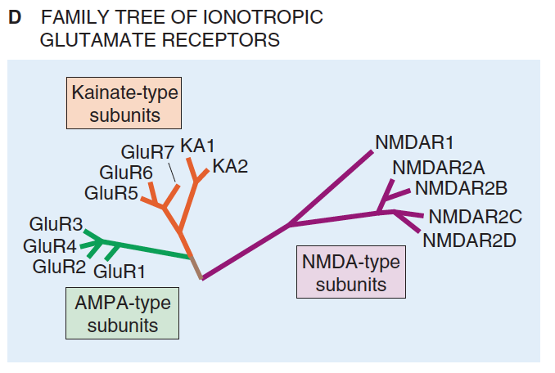
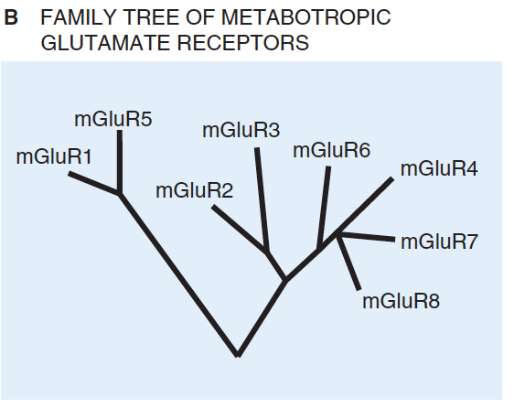
Glutamate
The main excitatory transmitter in CNS – causes EPSP (specially in spinal cord and Cerebellum)
Precursor to GABA
Action terminated by presynaptic membrane reuptake of GABA
Involved in most aspects of normal brain function including congnetion, memory and learning
There 4 subtypes of Glutamate receptors ;
3 ionotropic receptors (Ligand-gated Ion channels)
Quicker transmission of information
AMPA
Kainate
NMDA
1 metabotropic receptors (GPCR)
More prolonged stimulus
3 classes mGlutRs

Slide 18
Ionotropic glutamate receptors

Slide 20
Glutamate
Binding of glutamate to the AMPA and kainate receptors produces EPSPs.
Binding of glutamate to the NMDA receptor has special properties that allow it not only to regulate the entry of ions, but also to allow those ions to act as second messengers to change the biochemical and structural properties of the cell.
These changes are important for the production of new memories, as they initiate a cascade of events that leads to changes in the shape and number of spines at synaptic sites.

Slide 21
Glutamate
Overactivity of glutamate in the brain is thought to play a role in the development of epilepsy.
Too much glutamate can produce excitotoxicity, which is excessive activity of receptors that can literally excite neurons to death.
Excitotoxicity appears to be an unfortunate consequence of a particular form of brain damage, known as ischemia.
Disease associated with Glutamate receptor mutation or Autoantigen/antibody interaction with glutamate receptors :
Autism, Hungtington disease , Diabetes , ADHD , Parkinson disease , Epilepsy ,
Mood disorders (depression, schizophrenia)

Slide 23
NMDA receptors is also voltage-dependent

Slide 24
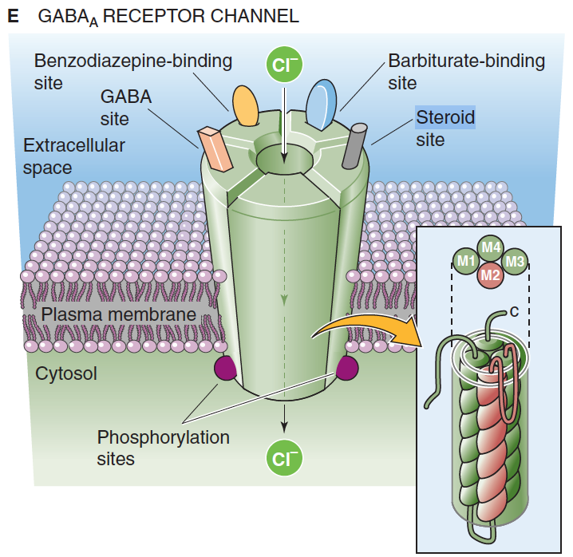
GABA
The major inhibitory transmitters of the central nervoussystem.
• GABA predominates in the brain. (40% receptors)
• Utilize Cl- channels to initiate IPSP.
• Action terminated by reuptake by the presynaptic membrane.
There are two main types of GABA receptors:
GABA_{a} is an ionotropic receptor (linked to Cl- channel → hyperpolarizes (inhibits) )
Note : GABAa is site of action of barbiturates (duration of opening) and benzodiazepines (frequency of opening)
GABA_{b} is metabotropic receptor (coupled with G-protein to K+ channel → hyperpolarizes (inhibits) )
Both appear to be important in dampening oscillatory, reverberatory excitation between the thalamus and cortex

Slide 25
Hungtington disease
Huntington’s disease is associated with GABA deficiency.
The disease is characterized by hyperkinetic choreiform movements related to a deficiency of GABA in the projections from the striatum to the globus pallidus.
The characteristic uncontrolled movements are, in part, attributed to lack of GABA-dependent inhibition of neural pathways

Slide 26
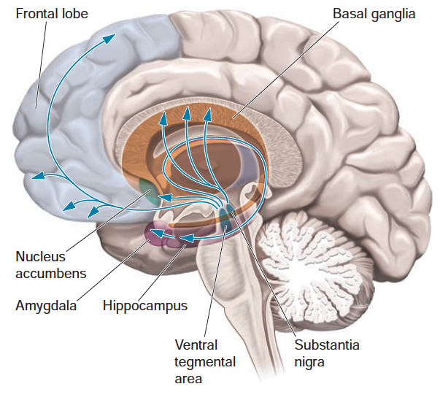
Dopamine
Dopaminergic System
Dopamine is the main neurotransmitter used in the dopaminergic system.
There are actually three dopaminergic subsystems:
the nigrostriatal
the mesolimbic
the mesocortical
These subsystems are differentiated by
the location of their cell bodies
the regions of the brain to which they project
the effect they have on behavior

Slide 27
Dopamine receptors

Slide 28
Nigrostiatal system
The nigrostriatal system
The cell bodies of this system are located in the substantia nigra and project to the neostriatum (i.e., the caudate nucleus and putamen, also known as the basal ganglia).
This subsystem regulates the selection, initiation, and cessation of motor behaviors.
It is the subsystem that is affected by Parkinson’s disease.
In that disorder, the dopaminergic neurons in the substantia nigra die, leading to difficulties with motor control.

Slide 29
Mesolimbic system
The mesolimbic system
It has its cell bodies in the ventral tegmental area.
It projects to several parts of the limbic system, including
nucleus accumbens
ventral portions of the striatum
amygdala
hippocampus
prefrontal cortex

Slide 30
Mesolimbic system
The cell bodies are located in the ventral tegmental area.
The axons of these cells project to much of the cortex, especially motor and premotor cortex, as well as prefrontal cortex, where they influence a variety of mental functions.
One of these functions is working memory, which allows us to keep information “online” for performance of tasks, planning, and strategy preparation for problem solving.

