Slide 1
Hemostais
Amir Samadian m.d
Department of physiology
Autumn 2021

Slide 2
Learning objectives
Primary hemostasis & thrombocytes
Secondary hemostasis – Hemocoagulation (protein vs cell model)
Regulation of hemostasis
Basic Coagulation tests
Circulation and hemostasis

Slide 3
Hemostasis
Integrity of the blood vessel is necessary to carry blood to tissue.
Damage to wall is repaired by hemostasis (by formation of thrombus (clot) at injury site)
Prevention of blood loss require the interaction of blood vessels, platelets , coagulation factors , fibrinolytic agents

Slide 4
4 steps of Hemostasis
Hemostasis occurs in 4 steps :
Vascular phase (transiant vasoconstriction)
Platelet phase (Primary hemostasis)
Coagulation phase (Secondary hemostasis)
Fibrinolytic phase

Slide 5
Hemostasis following injury to the vessel

Slide 6
Platelets

Slide 7
Platelet structure
Contractile element called thrombosthenin helps in clot retraction.
Dense bodies contain:
ADP, an aggregating agent
Calcium, a binding agent for vitamin K–dependent factors
α-Granules contain:
vWF
Fibrinogen
Platelet-derived growth factor (PDGF),
Platelet factor 4 (PF4), (a heparin-neutralizing factor)

Slide 8
Primary hemostasis – 4 steps (results in formation of weak platelet plug)
Transient vasoconstriction of damaged vessel
Mediated by reflex neural stimulation and endothelin release from endothelial cells
Platelet adhesion to the surface of disrupted vessel
Von willbrand factor (vWF) binds exposed subendothelial collagen (SEC)
Platelets bind vWF using GP1b
Note : vWF is drived from Weibel-Palade bodies of endothelial cells and a-granules of plateles
Platelet degranulation
Adhesion induces shape change in platelets and degranulation with release of multiple mediators ;
ADP is released from platelet dense granules ; promotes exposure of GPIIb/IIIa receptors on platelets
TXA2 is synthesized by platelet cyclooxygenase (COX) and released ; promotes platelet aggregation
Platelet aggregation
Platelets aggregate at the site of injury via GPIIb/IIIa using fibrinogen (from plasma) as a linking molecule, results in formation of platelet plug
Platelet plug is weak ; coagulation cascade (secondary hemostasis) stabilizes it

Slide 9
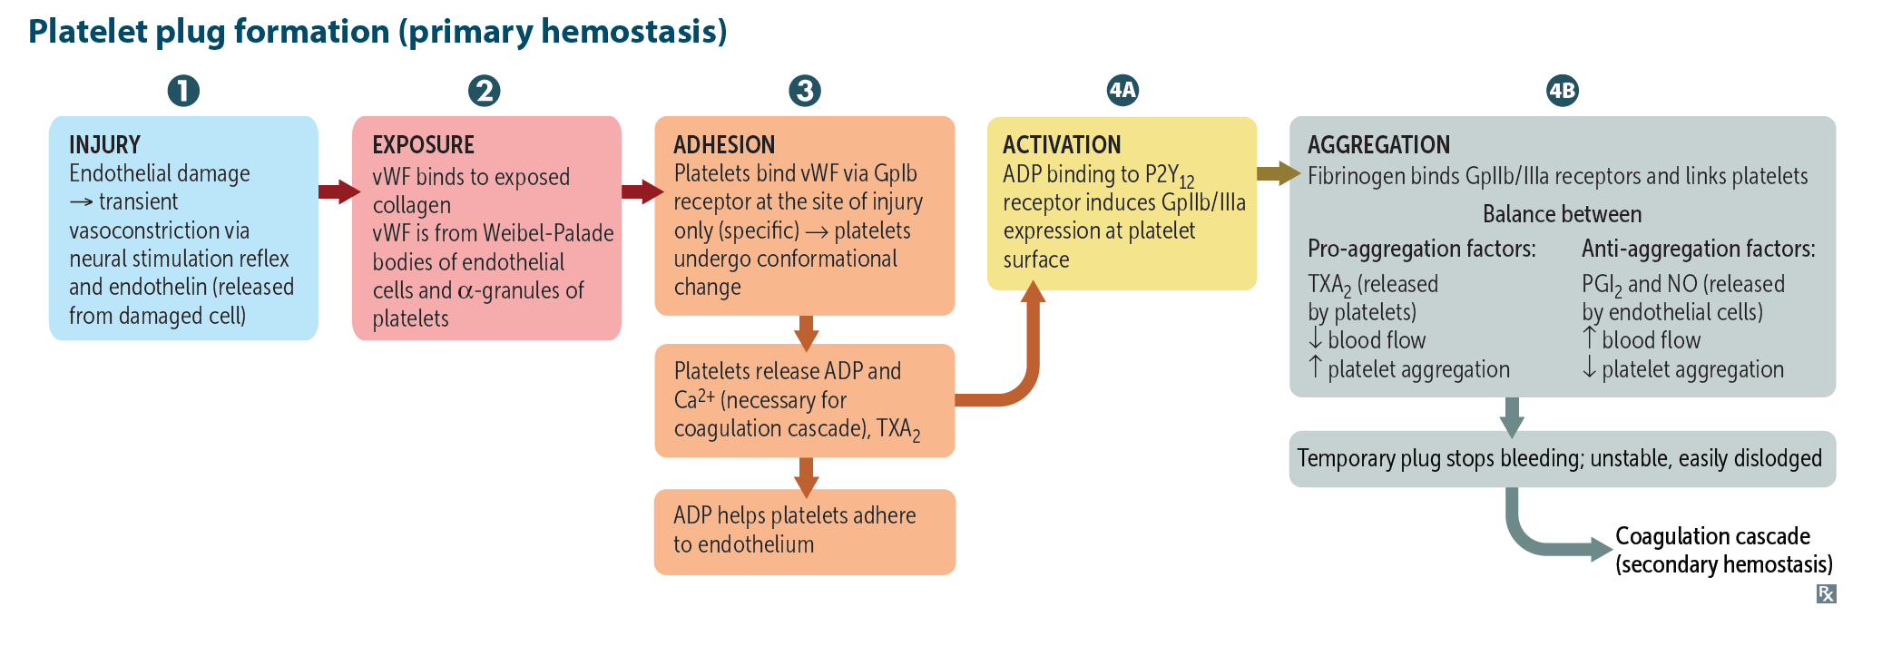

Slide 10
Platelet Adhesion, Activation & Agreggation (3A)

Slide 11
Secondary hemostasis
Secondary hemostasis : stabilizes the platelet plug and is mediated by the coagulation cascade
coagulation cascade generates thrombin (FIIa) which converts Fibrinogen in the platelet plug to fibrin
Fibrin is then cross-linked, yielding a stable platelet-fibrin thrombus.
Factors of the coagulation cascade are produced in the liver in an inactive state
Activation requires :
1. Exposure to an activating substance
Tissue Factor (TF) → F VII (extrinsic pathway)
Subendothelial collagen (SEC) → F XII (intrinsic Pathway)
2. Phospholipid surface of the platelets
3. Calcium (derived from platelet dense granules)

Slide 13
Coagulation cascade made easy (protein based model)

Slide 14
Cell-model theory of coagulation
https://www.youtube.com/watch?v=T4MG7bzQ2NI&t=58s&ab_channel=ThePhysiologyChannel

Slide 15
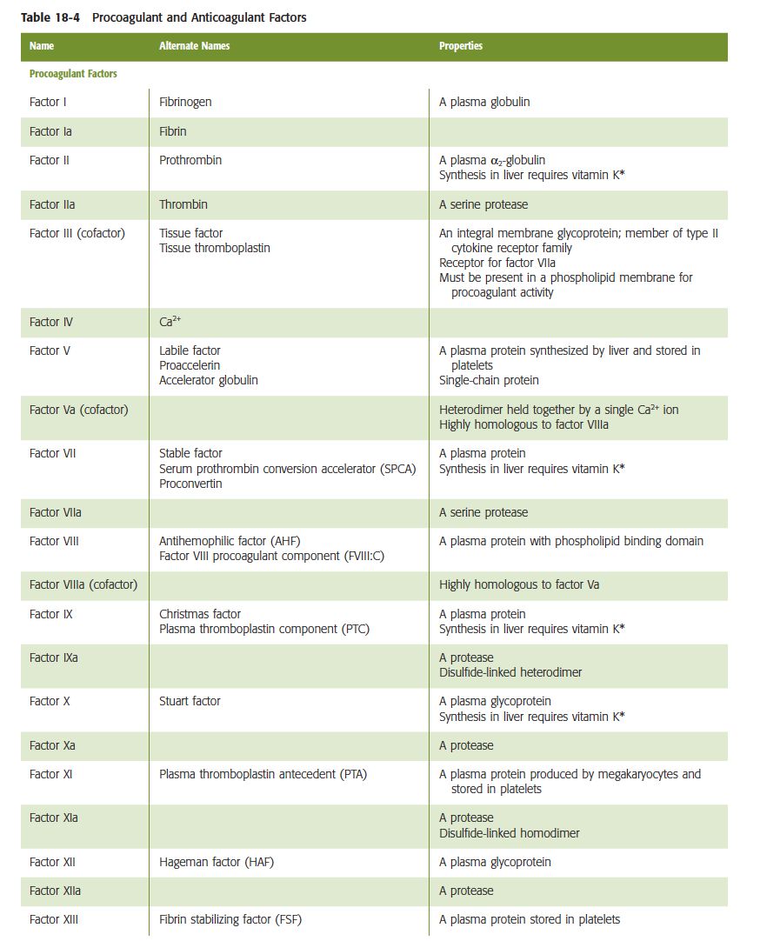
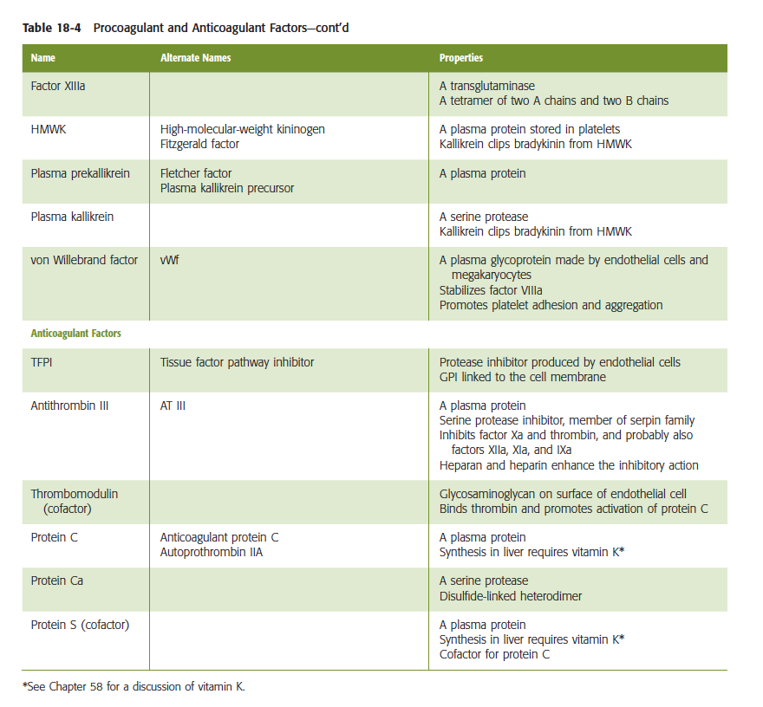

Slide 16
Vitamin K dependent
Coagulation factors

Slide 17
Fibrinolytic phase
a. Tissue plasminogen activator (tPA) activates plasminogen to release the enzyme plasmin.
Plasmin →
Cleaves insoluble fibrin monomers and fibrinogen into fibrinogen degradation products (FDPs) (note : Fragments of cross-linked insoluble fibrin monomers are called d-dimers.)
Degrades factors V and VIII, and fibrinogen
3. α2-Antiplasmin, which is synthesized in the liver, inactivates plasmin.

Slide 18
Fibrinolytics

Slide 19
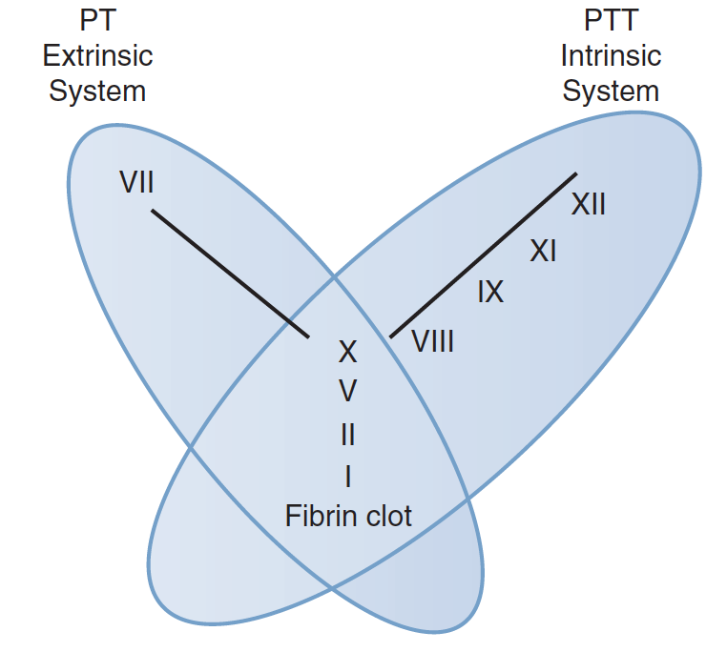
Coagulation tests (PT,INR,PTT)

Slide 20
Platelet test

Slide 22
antithrombotics

Slide 23
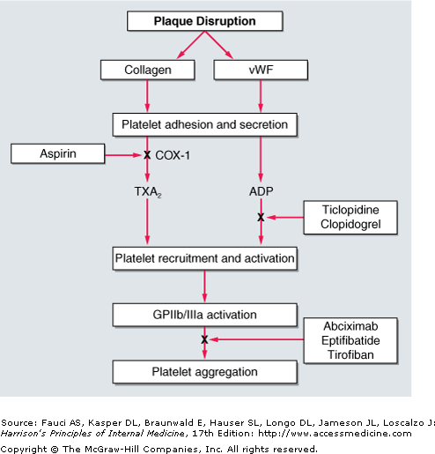
Antiplatelets
We influence function of thrombocytes, not number of throbocytes!
Inhibitors of cyklooxygenase/inhibitors of thromboxane A₂ synthesis or antagonists of the receptors
Inhibitors of ADP receptors (P2Y₁₂)
Antagonists of protease-activated receptors (PAR-1)
Antagonists of surface glycoproteins (GP IIb/IIa)
Blockage of serotonin pathway
Other mechanisms

Slide 24
Anticoagulant

Slide 25
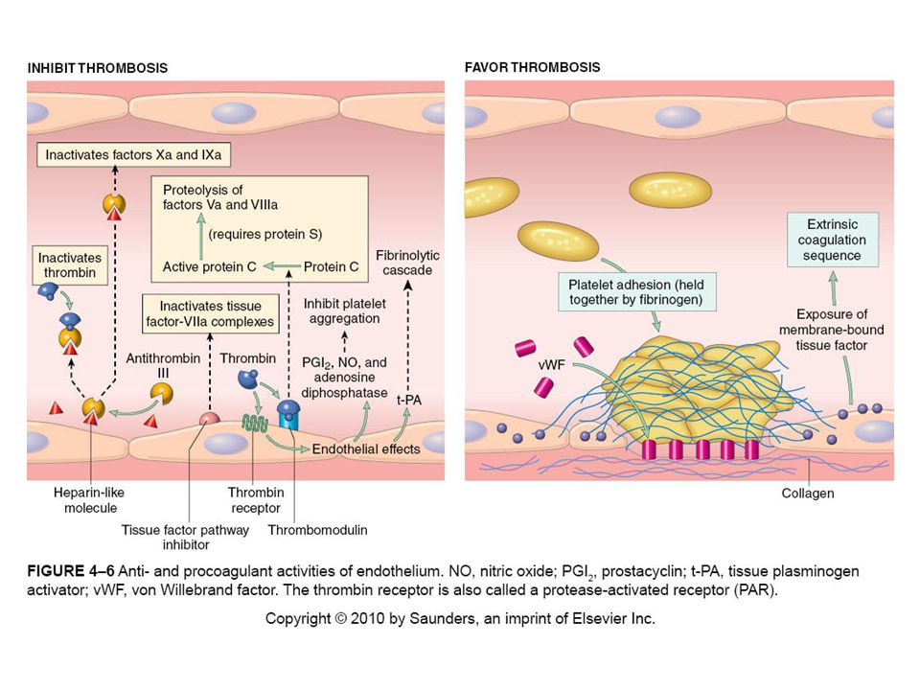

Slide 26
Role of Endothelial cells in hemostasis
Endothelial cells prevent thrombosis by several mechanism ;
Block exposure of to Subendothelial collagen (SEC) and Tissue Factor (TF)
Produce Prostacyclin (PGI2) and NO → Vasodilation and inhibition of platelet aggregation
Expresses heparin-like molecules → augment antithrombin III → ATIII inactivates thrombin (FII) and other factors (XII,XI,IX,VIII,X)
Expresses Tissue Plasminogen aktivator (t-PA) → converts plasminogen to plasmin → cleaves fibrin and fibrinogen/destroys clotting factors & inhibit platelet aggregation
Expresses thrombomodulin → thrombin-thrombomodulin complex → activates Protein C (together with Protein S) → inactivates factor V and VIII
Plasminogen aktivator inhibitor (PAI) → inhibits activation of plasminogen to plasmin

Slide 27
Factors enhancing thrombus formation
Thromboxan A2 → Vasoconstrictor and enhances platelet aggregation
Von willbrand factor (vWF) → Platelet adhesion molecule
Tissue thromboplastin (Factor III) → activates factor VII (exterinsic pathway)

Slide 28
Endothelial function

Slide 29
Thrombosis - Virchows triad

Slide 30
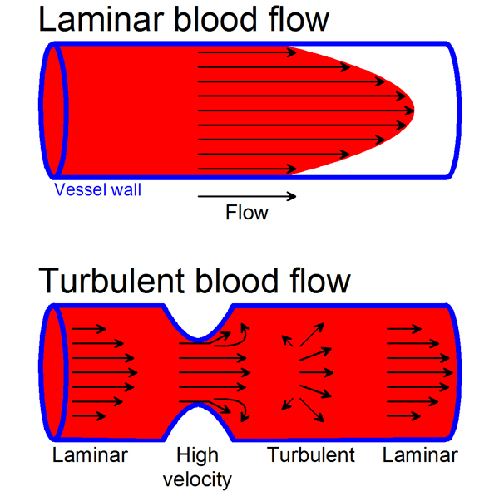
Blood flow in the vessels
Blood flows in the vessels in continues and streameline (straight line) fashion → laminar flow
laminar flow keeps platelets and clotting factors dispersed and inactivated (anti-thrombotic)
Stasis or Turbulance blood flow → increase risk of Clot formation (thrombosis)

Slide 32
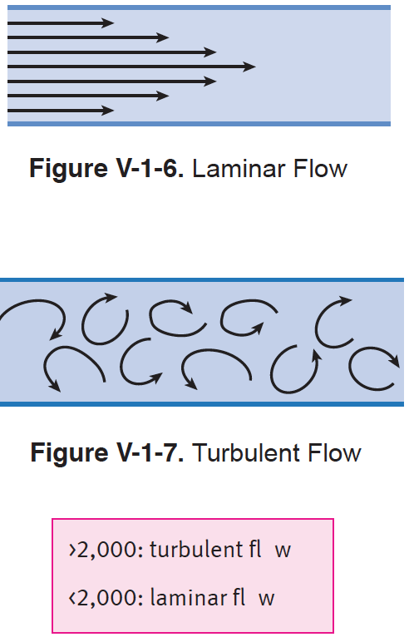
LAMINAR VS. TURBULENT FLOW
Laminar flow is streamlined (in a straight line), turbulent flow is not.
Reynolds’ number predicts whether blood flow will be laminar or turbulent.
When Reynolds’ number is increased, there is a greater tendency for turbulence, which causes audible vibrations called bruits.

Slide 33
Courtesy of Prof.Babula

Slide 34
Courtesy of Prof.Babula

Slide 35
Courtesy of Prof.Babula

Slide 36
Courtesy of Prof.Babula

Slide 37
Courtesy of Prof.Babula

Slide 38
Courtesy of Prof.Babula

Slide 39
Courtesy of Prof.Babula

Slide 40
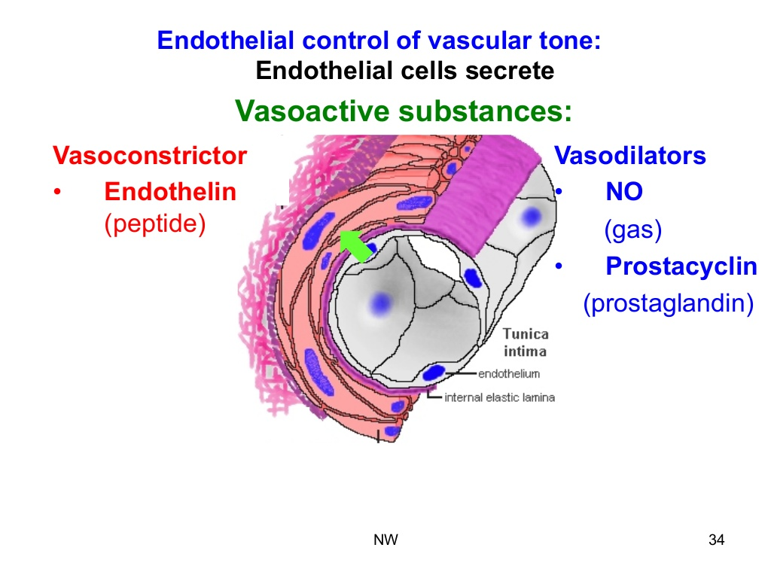
Courtesy of Prof.Babula

Slide 42
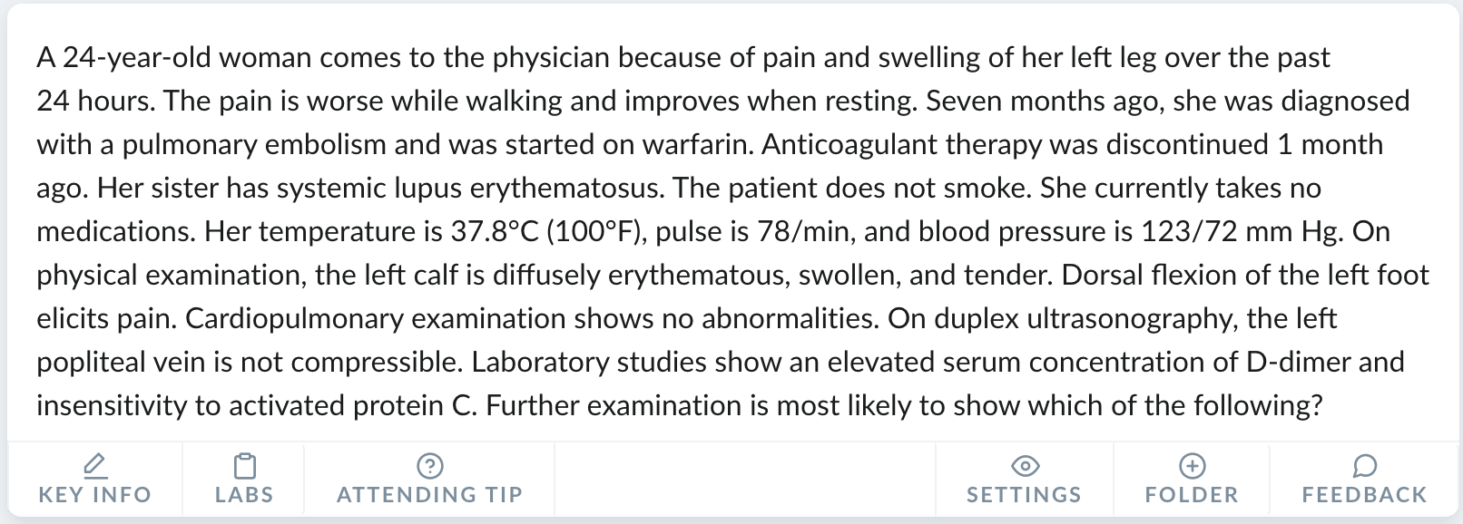
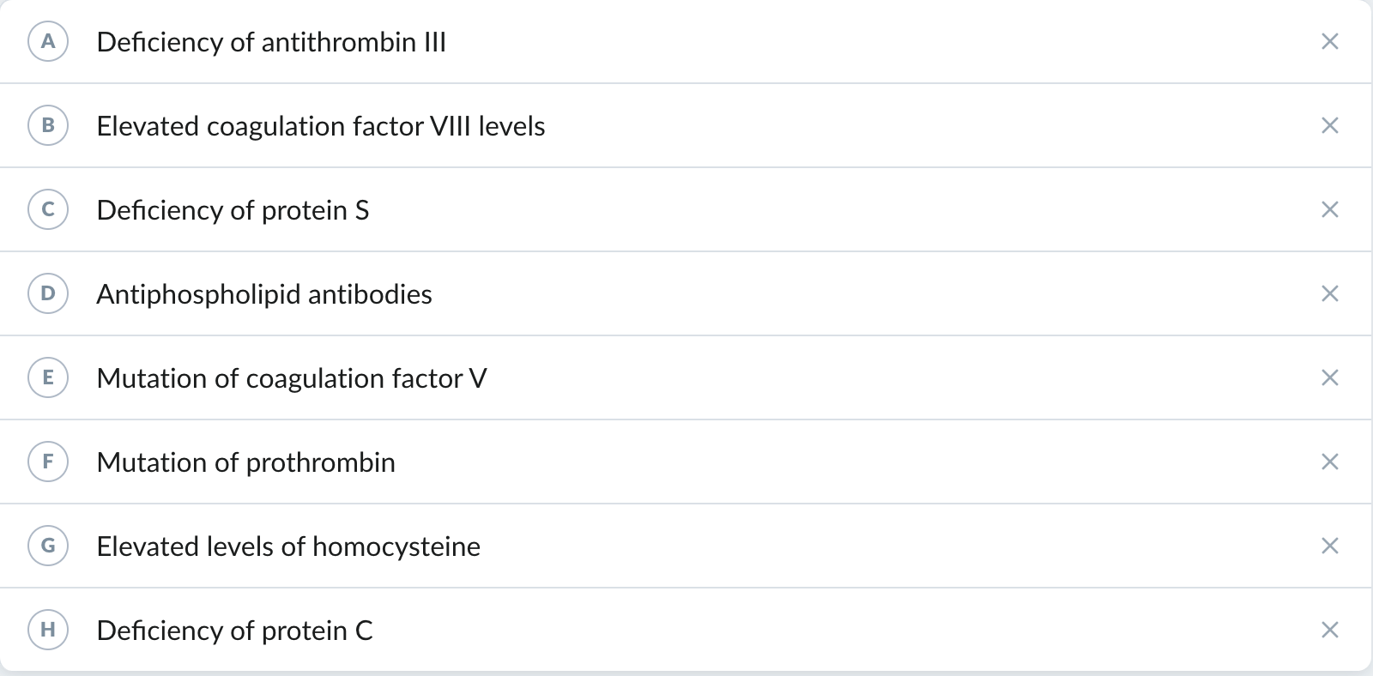

Slide 43
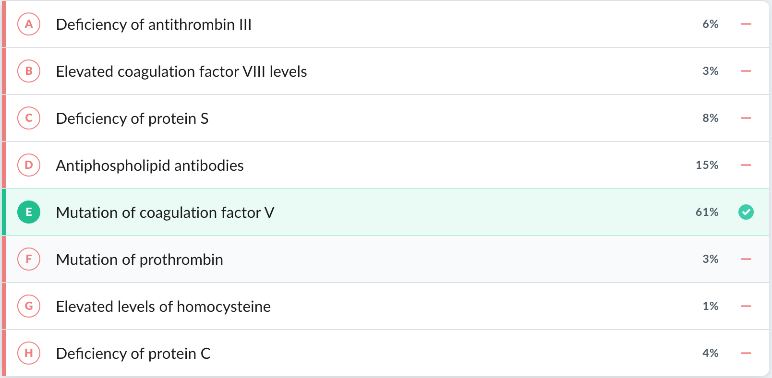

Slide 44
References :
Remember , at the end of the day, patient can present with either bleeding disorder or sign & symptoms of formation of pathological clot.
The fundamental knowladge of hemostasis and pharmacological approach helps you save them !
THANK YOU ☺
1. Le T, Bhushan V, Sochat M, et al., eds. First Aid for the USMLE Step 1 2021. McGraw Hill; 2021.
2. Sattar HA. Fundamentals of Pathology: Medical Course and Step 1 Review. Pathoma.com; 2011. Accessed December 26, 2021.
3. Boron WF, Boulpaep EL, eds. Medical Physiology. Third edition. Elsevier; 2017.
4. Wilson LB. USMLE Step 1 Lecture Notes 2017: Physiology.; 2017.

