Slide 1
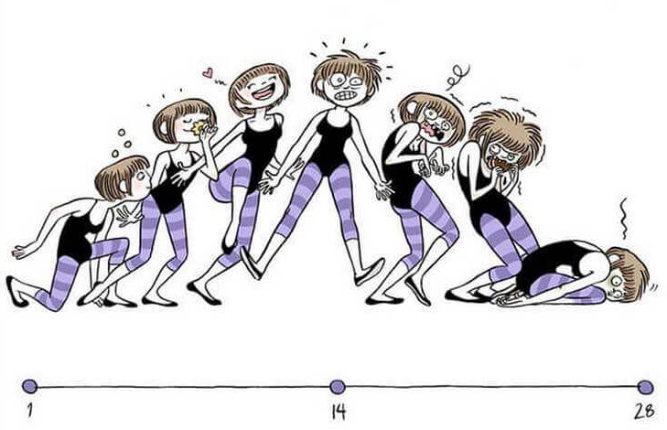
Physiology of reproduction.

Slide 2
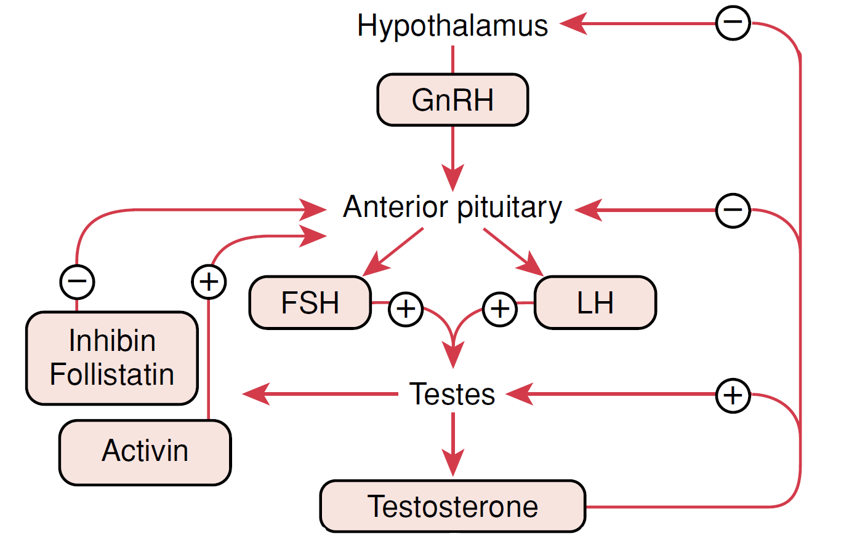
Hypothalamus – hypophysis – gonads

Slide 3
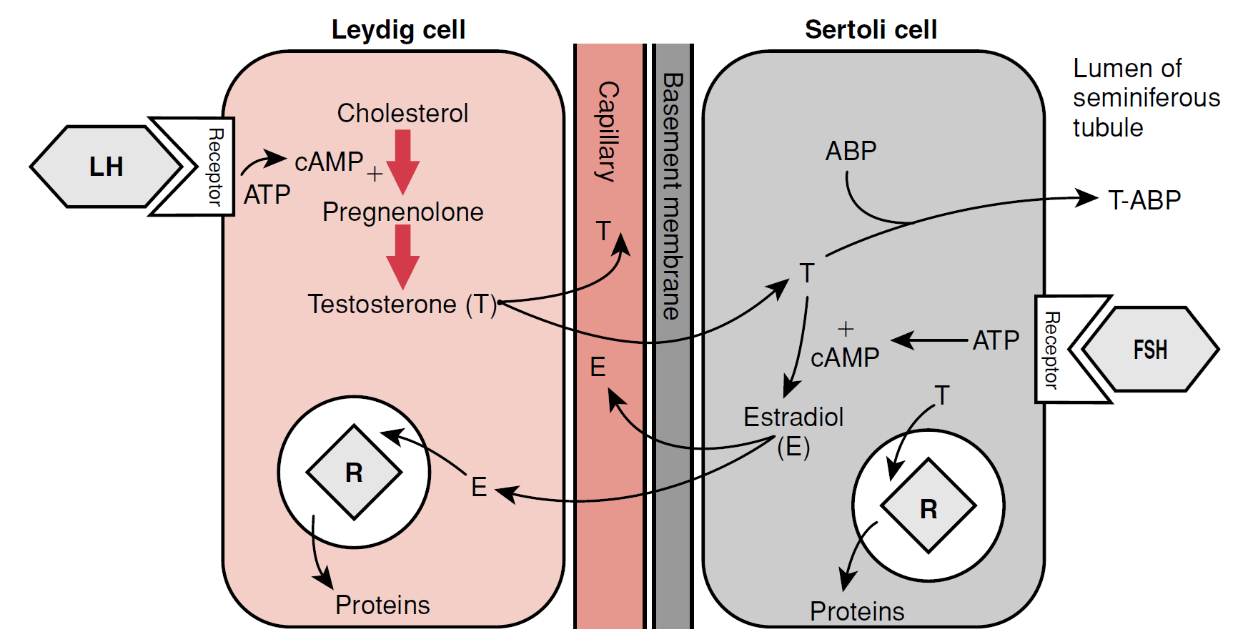
Hypothalamus – hypophysis – gonads

Slide 4
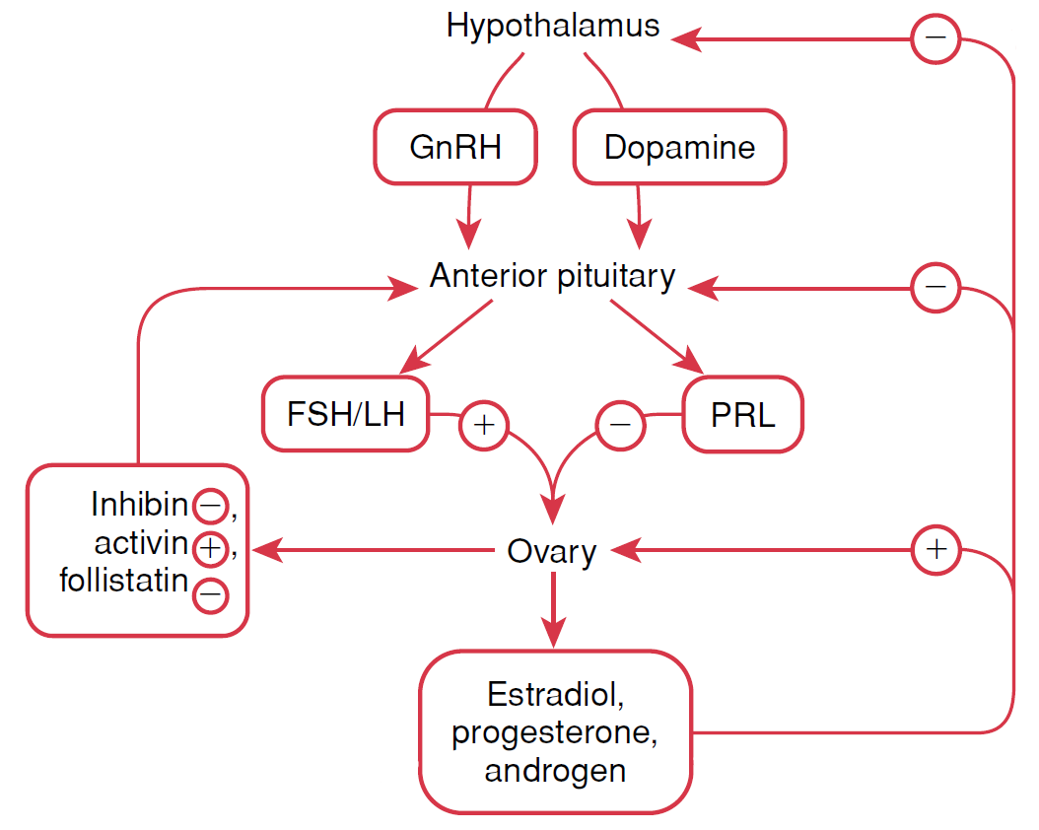
Hypothalamus – hypophysis – gonads

Slide 5
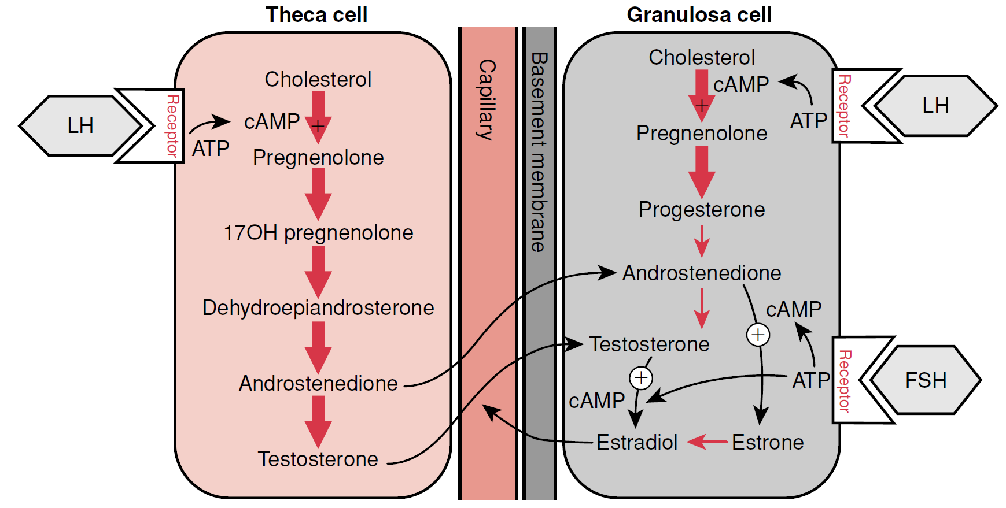
Hypothalamus – hypophysis – gonads

Slide 6
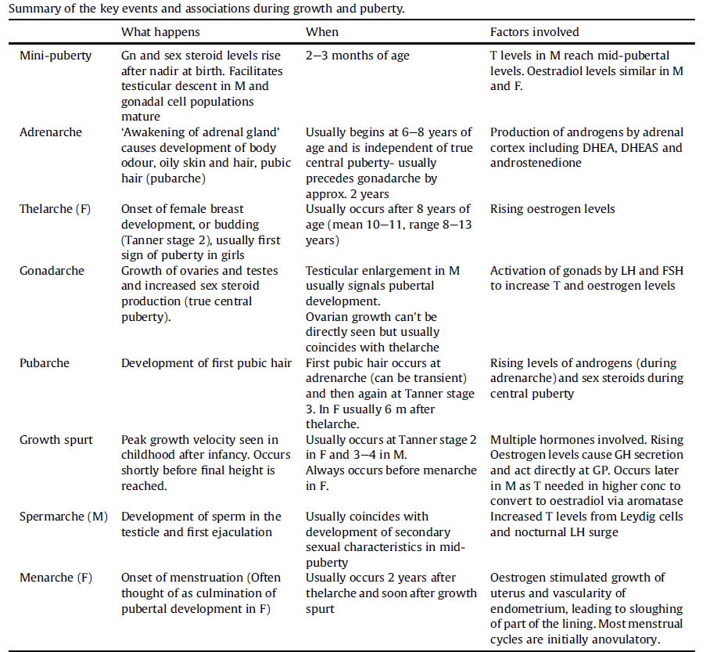
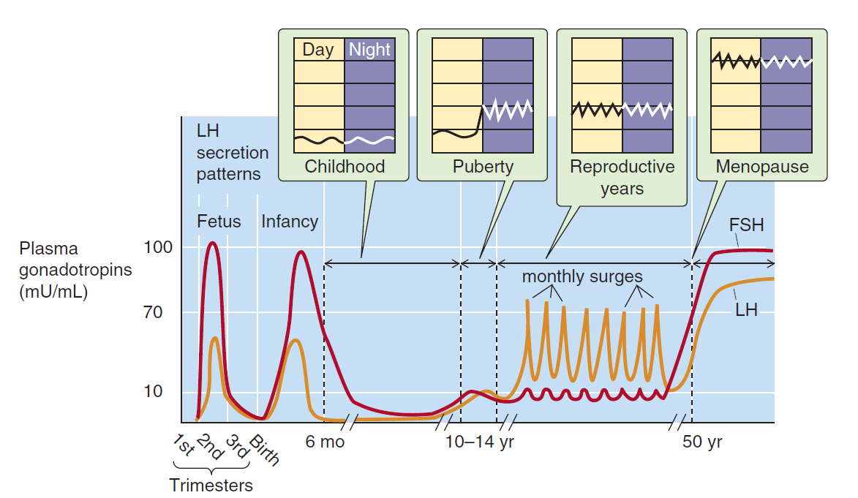

Slide 7
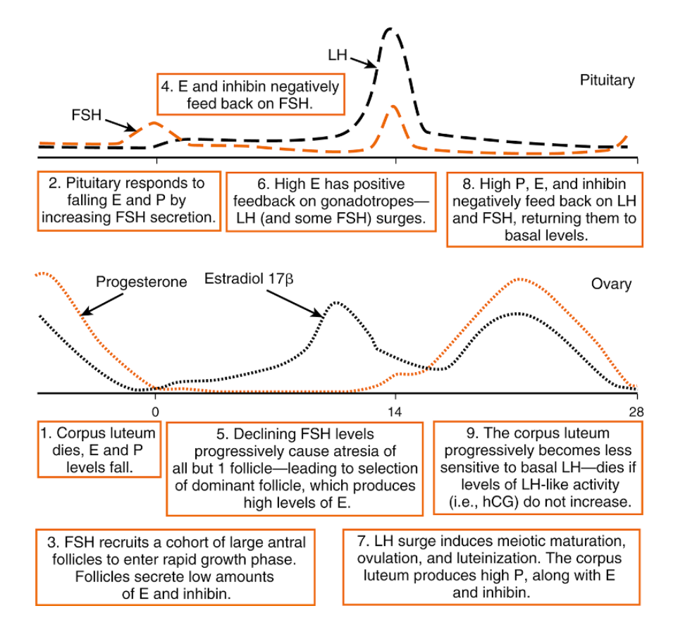
Menstrual cycle

Slide 8
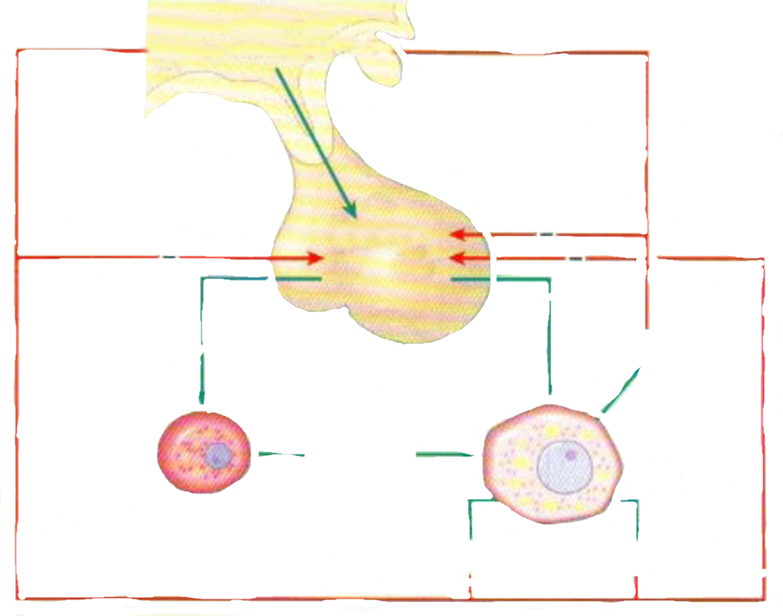
Negative feedback
HYPOTHALAMUS
GnRH
HYPOFYSIS
LH
FSH
LH
FSH
INHIBIN
ANDROGENS
PROGESTINS
ESTROGENS

Slide 9
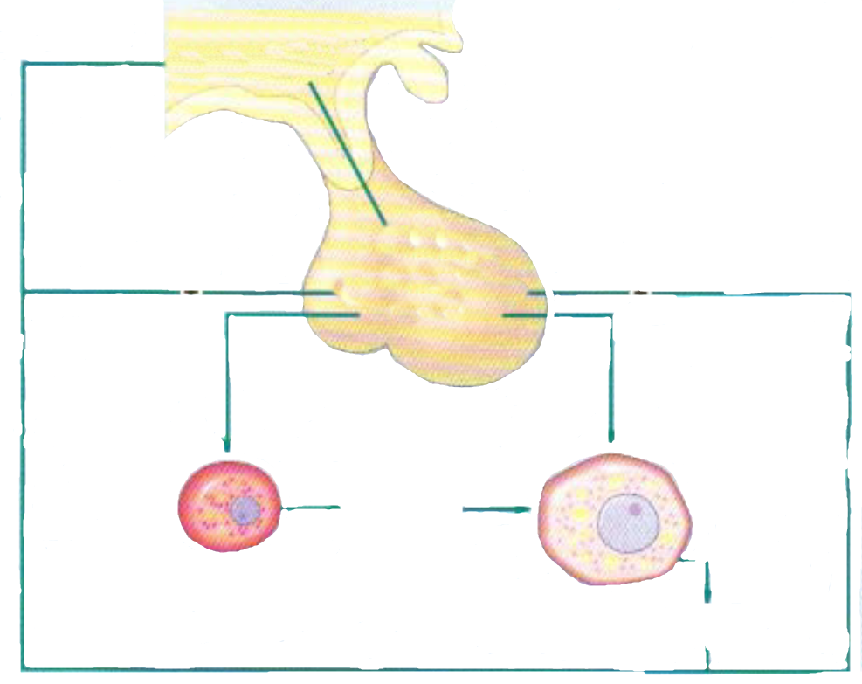
Positive feedback
HYPOTHALAMUS
GnRH
HYPOFYSIS
LH
FSH
LH
FSH
ANDROGENS
ESTROGENS

Slide 10
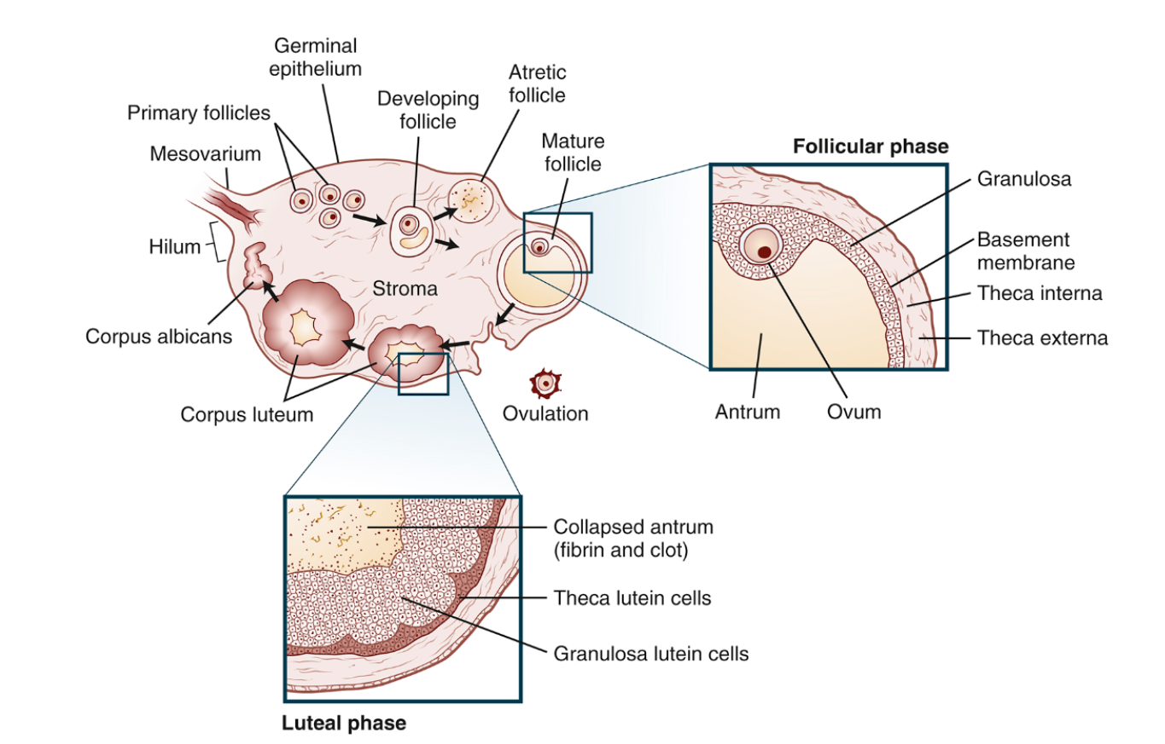
Ovarian cycle

Slide 11
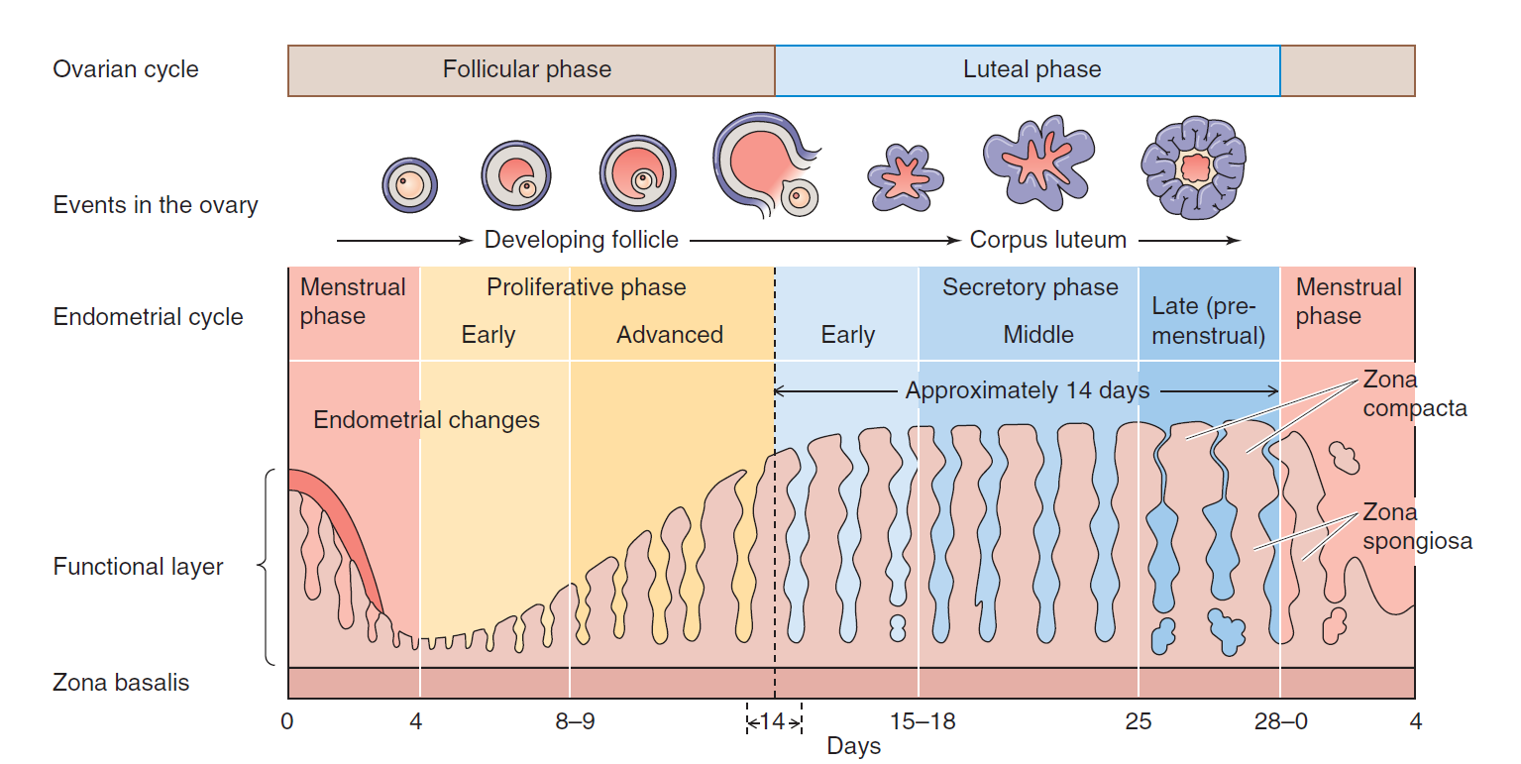
Endometrial cycle

Slide 12
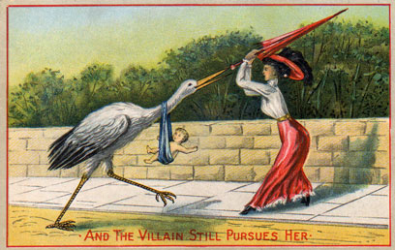
Contraceptives
BARRIER CONTRACEPTIVES:
condoms
contraceptive sponges with spermicide
diaphragms
cervical caps
HORMONAL:
oral pills
implants under the skin
injections
patches
IUDs
vaginal ring
INTRAUTERINE DEVICES:
copper IUDs
IUD with levonorgestrel
BEHAVIORAL:
fertility awareness methods
coitus interruptus
lactation
STERILIZATION:
tubal ligation
vasektomy

Slide 13
Oral pills
P
0,4
E
0,3
0,2
0,1
0
1
7
14
21
28
day

Slide 14
Oral pills
Progestational effects include:
Inhibition of ovulation by suppressing luteinizing hormone (LH);
Thickening of cervical mucus, thus hampering the transport of sperm;
Possible inhibition of sperm capacitation;
Hampered implantation by the production of decidualized endometrium with exhausted and atrophic glands
Estrogenic effects include:
Partial inhibition of ovulation in part by the suppression of follicle-stimulating hormone (FSH) and luteinizing hormone (LH), depending on dose;
Alteration of secretions and cellular structures of the endometrium within the uterus

Slide 15
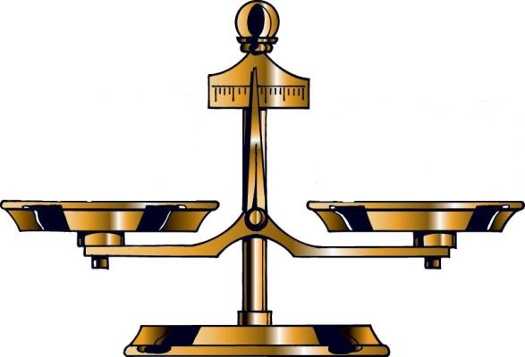
Benefits and riscs of HC
reducing the risk of total cancer by 12%:
ovarian cancer
endometrial cancer
colorectal cancer
ovarian cysts
acne
venous thromboembolism (VTE)
arterial thrombosis (AT)
breast cancer
diseases associated with VTE and AT

Slide 16
Functions of the PLACENTA
TRANSPOR function
Respiratory gases
transport and metabolism of sacharides
transport and metabolism of aminoacods
transport and metabolism of fat
transport of H2O, minerals and vitamines
ENDOCRIN function
Estrogens
Progesteron
HCG
HPL
Growth factors (epidermal and insulin-like growth factors)
PROTECTIV function
Cytochrom P450
Pinocytosis (IgG)
Barier against bacterias, virus etc.

Slide 17
HCG
HCG (Human Chorionic Gonadotropin)
Glycoprotein
secreted by the syncytial trophoblast cells
prevents involution of the corpus luteum
prevent menstruation and cause the endometrium to continue to grow
can ﬁrst be measured in the blood 8 to 9 days after implantation
effect on the fetal testes
↓ - ectopic pregnancy, dead fetus
↑ - multiple pregnancy and diagnosis of trisomy 21 - Down syndrome
4
8
12
16
20
24
28
32
36
40
1
2
3

Slide 18
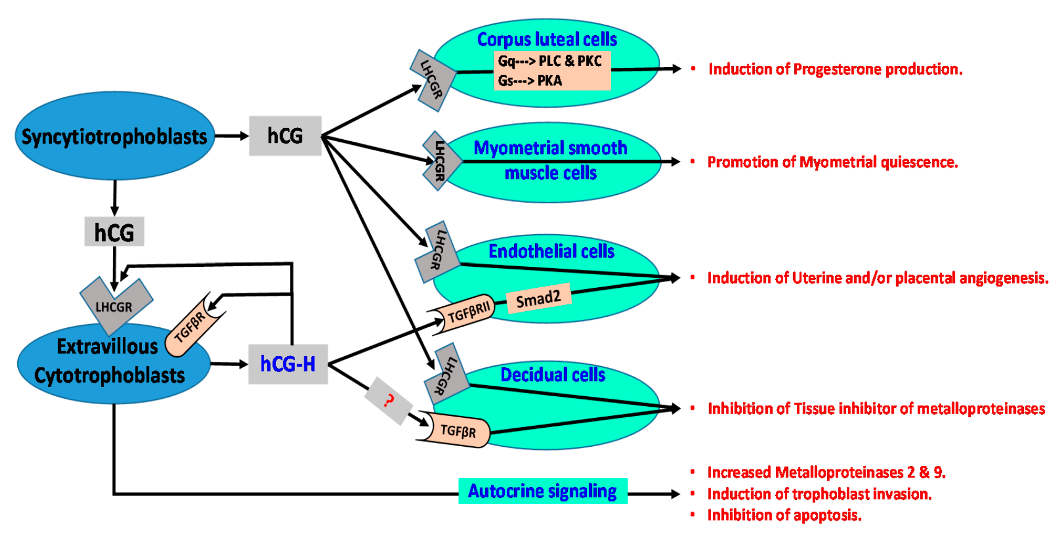
HCG

Slide 19
RX
RX (Relaxin)
relaxes the pubic symphysis and other pelvic joints and softens
dilates the uterine cervix
mediate hemodynamic changes (pregnancy)
RX
4
8
12
16
20
24
28
32
36
40
1
2
3

Slide 20
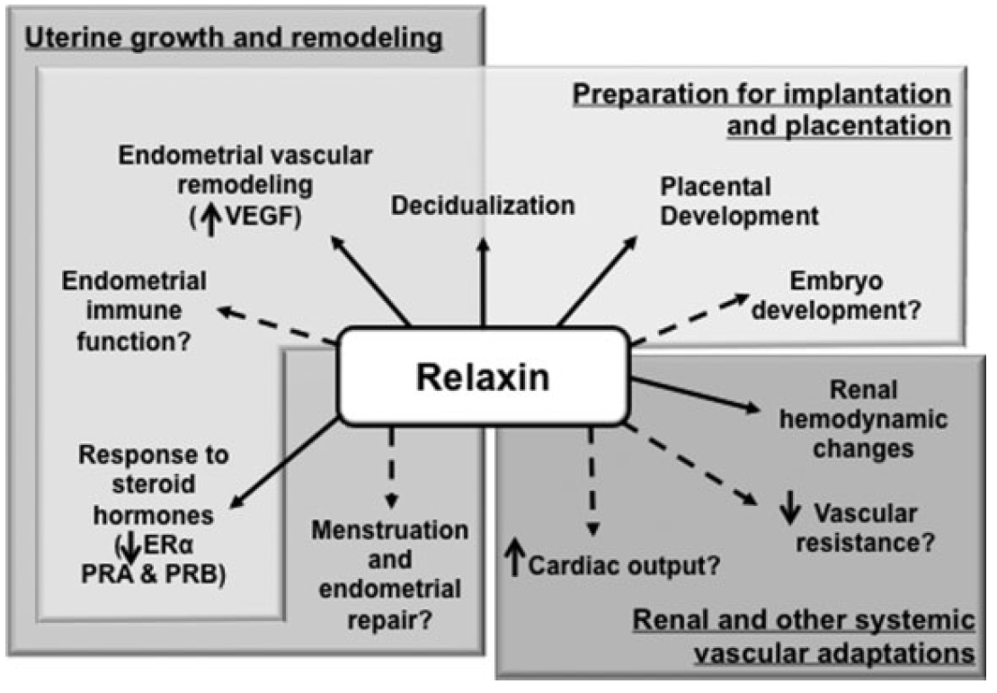
RX

Slide 21
HCS/HPL
HCS (Human Chorionic Somatomammotropin)
placental growth hormone - Human placental lactogen (hPL)
has weak actions similar of growth hormone
causes retention of nitrogen, potassium, calcium
causes decreased insulin sensitivity and decreased utilization of glucose in the mother
secretion of this hormone increases progressively in direct proportion to the weight of the placenta
HCS/HPL
4
8
12
16
20
24
28
32
36
40
1
2
3

Slide 22
PROL
PROL (Prolactin)
luteotropic hormone or luteotropin
stimulates the mammary glands to produce milk (lactation)
provides the body with sexual gratification after sexual acts
plays an important role in maternal behavior
inhibits maturation of ovum
PROL
4
8
12
16
20
24
28
32
36
40
1
2
3

Slide 23
OX
OX (Oxytocin)
secreted by the neurohypophysis (nucleus paraventricularis)
causes uterine contraction
mediates the let-down reflex
OX
4
8
12
16
20
24
28
32
36
40
1
2
3

Slide 24
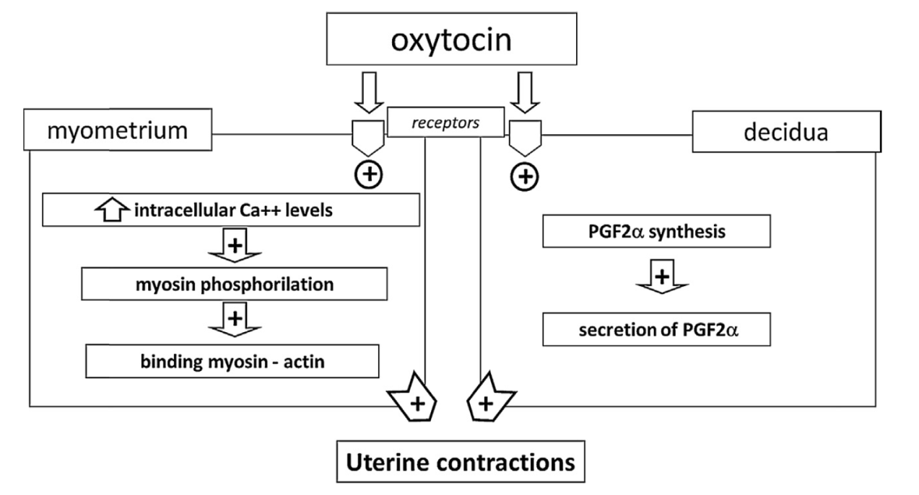
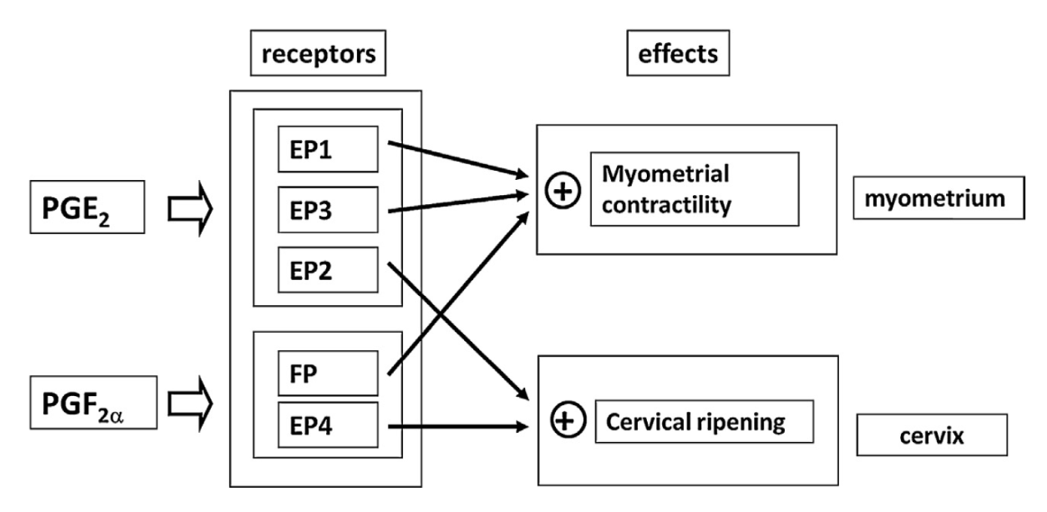
OX

Slide 25
Progesteron
P (Progesteron)
causes decidual cells to develop in the uterine endometrium
decreases the contractility of the pregnant uterus
contributes to the development of the conceptus even before implantation
prepares the mother’s breasts for lactation
P
4
8
12
16
20
24
28
32
36
40
1
2
3

Slide 26
Estroen
E (Estrogen)
enlargement of the mother’s uterus
enlargement of the mother’s breasts and growth of the breast ductal structure
and enlargement of the mother’s female external genitalia
relax the pelvic ligaments of the mother
dampen the formation of the pituitary gonadotropins - not mature further follicles, miss menstrual cycles
E
4
8
12
16
20
24
28
32
36
40
1
2
3

Slide 27
E
HCG
P
PROL
RX
HPL
OX
4
8
12
16
20
24
28
32
36
40
1
2
3

Slide 28
Fetoplacental unit
FETUS
HPA axis
CORTISOL
GROWTH OF FETUS
PLACENTAL
ENDOCRINE AXIS
UTERINE
GROWTH
EXTENSION
OF UTERUS
(+)
P
E
(-)
ACTIVATION
STIMULATION
Gap junctions
oxytocin
PGs
PARTURITION

Slide 29
Fetoplacental unit
FETUS
FETOPLACENTAL
UNIT
MATERNAL
COMPARTMENT
cortisol
cortisol
cortisol
cholesterol
hypotalamus
hypotalamus
CRH
estrogens
adenohypophysis
neurohypophysis
ACTH
ardenal glands
placental OT
PGs
oxytocin
cortisol
(preparation of fetal organs)
placental CRH
uterus
(vazodilation of the placenta)
PARTURITION

Slide 30
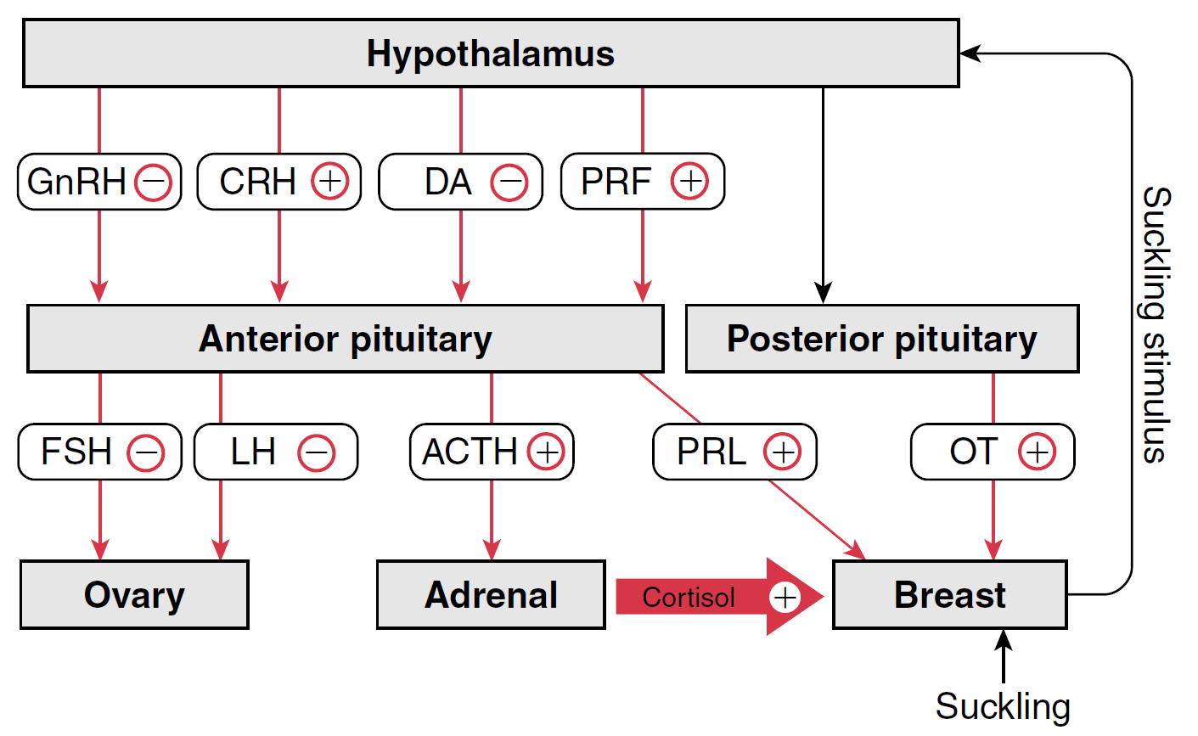
Lactation

Slide 31
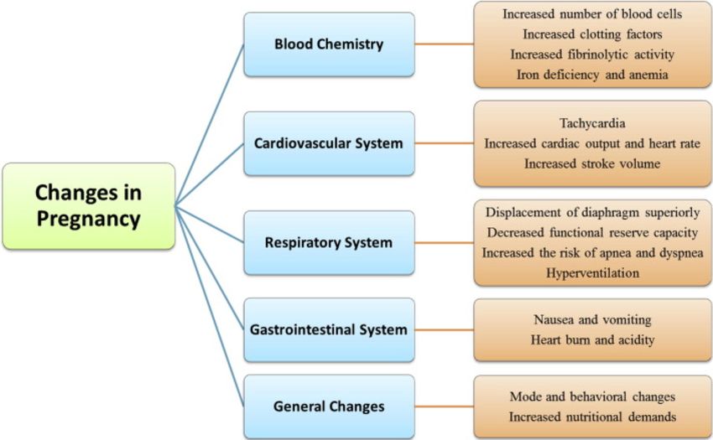
Physiological changes during pregnancy

Slide 32
THANK YOU FOR YOUR ATENTION

