Slide 1
Secondary hypertension
Experimentally induced renal ischemia

Slide 2
Blood pressure and ischemic heart disease mortality

Slide 3
Conceptual definition of hypertension
blood pressure > 140/90 mm Hg
arbitrary definition reflecting CV-related morbidity and mortality
quantitative relationship between blood pressure and mortality
artificial dichotomy between normo- and hypertension
the level at which the benefits of action exceed those of inaction
benefit of action – decreased risk of CV disease
risk of action – side effect of therapy
hypokalemia in diuretics-treated patients
elevation of triglycerides and glucose in β-blockers users
risk of inaction - increased risk of CV disease
benefit of drug treatment have been definitely established in randomized placebo-controlled trials

Slide 4
Hypertension and target organ damage
types
primary and secondary
hypertension
major risk factor for premature cardiovascular disease
leading cause of death worldwide
incidence continues to grow
asymptomatic nature
treatment remains most commonly empiric
often 3 or more pharmacologic agents with complementary mechanisms
hypertension causes
54 % of stroke
47 % of ischemic heart disease
of all modifiable risk factors, hypertension is exceeded only by smoking

Slide 5
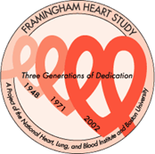
Framingham study
since 29.9.1948, Framingham, Boston, MA
identification of major cardiovascular risk factors
blood pressure, cholesterol, triglycerides, HDL, smoking, obesity, diabetes, physical inactivity, age, gender (male) a psychosocial factors
Initial cohort
5209 people, 30-62 years, detailed examination every 2 years
II. cohort (since 1971)
5,124 adult offspring
III. cohort
3,500 children (grandchildren of original participants)
late clinical manifestations of long-term uncontrolled hypertension
myocardial infarction, stroke
heart failure
kidney failure
retinopathy

Slide 6
Kidney function
regulation of
extracelllular fluid volume and blood pressure
osmolarity
acid-base balance
ion balance
excretion of wastes
production of hormones
kidney perfusion
20 – 25 % of minute heart volume
1200 ml/min, 90 % goes to cortex
markedly more than would correspond to kidney weight
reasons for high perfusion
high energy need of tubular cells
production of primary filtrate in glomeruli
20 % of perfusion
150-180 l/day – 90 % reabsorption
glomerular filtration rate (GFR)
100-120 ml/min

Slide 7
Juxtaglomerular apparatus
juxtaglomerular (JG) cells
specialised muscle cells
advanced endoplasmic reticulum and Golgi apparatus
production of renin
blood pressure receptor
macula densa
close to JG cells
senzitive to NaCl
mesangial cells
specialized pericytes
contraction
juxtaglomerular apparatus
sympathetic innervation

Slide 8
Renin-angiotensin-aldosterone system
plasma/systemic RAS
tissue RAS
kidneys, adrenal gland
intermediate
lungs, heart, vessels, liver
renin – protease released by JG cells
factors controlling renin release
drop in blood pressure
decrease in the amount of NaCl delivered to the kidney
β-adrenergic stimuli
angiotensin II
low potassium
aldosterone
binding to cytosolic mineralocorticoid receptors (MR) in the renal collecting duct cells
sodium channels in the membrane and subsequent reabsorption of Na
volume re-expanding
MR expressed also outside the kidney
impairment of vascular health by multiple extrarenal mechanisms

Slide 9
Effects of angiotensin II
cardiovascular tissues
brain
stimulation of thirst
release of ADH
angiotensin II receptors
AT₁
responsible for the majority of Ang II action
smooth muscle, endothelial cells, adrenal cortex
AT₂
opposes the effect of AT1 (at least in rodent models), the role in humans is not explained
widely distributed in the fetus
in adults expressed in
adrenal medulla, endothelium, brain regions

Slide 10
RAAS overview

Slide 11
RAAS overview

Slide 12
RAAS manipulation

Slide 13
Major forms of secondary hypertension
renal disorders
parenchymal
renovascular
endocrine disorders
Cushing syndrome
primary aldosteronism
vascular disorders
coarctation of the aorta
pregnancy
exogenic cause
medication
contraception
drugs
cocaine, amphetamine
licorice

Slide 14
Screening for secondary hypertension
secondary forms are rare and screening for them expensive and laborious
it is not cost effective to search for secondary causes of hypertension in every patient
testing requires clinical suspicion and knowledge of limitations of different tests
general principles
new onset hypertension if <30 or >50 years of age
hypertension refractory to treatment (>3-4 medications)
specific clinical/lab features typical for secondary HT
hypokalemia, differential BP in arms, episodic hypertension…

Slide 15
Renal parenchymal disease
2 – 5 % cases of hypertension
mechanisms
common pathway
impaired renal autoregulation
high perfusion pressure
damage of the glomerular cells
stiffness of the arteries
↑ SBP, ↓ DBP, ↑ pulse pressure
retention of water and electrolytes due to significant decrease of glomerular fitration

Slide 16
Renovascular hypertension
1-2 % cases of hypertension
atherosclerosis
70 – 90 % of cases
in older adults
fibromuscular dysplasia
more common in women
non-inflammatory vascular disease
affects more commonly young women
often in the 3rd decade
mostly partial obstruction of one main renal artery
decreased RBF, activation of RAAS
suspiction of renal artery stenosis
hypertension in previously normotensive person
< 30 or > 50 years
severe or resistant hypertension
smoking
accelerated hypertension in previously controlled person
worsening renal function after RAS inhibition
reduction in renal perfusion by 50 %
immediate and persistent increase of renin secretion from ischemic kidney
renovascular vs. primary hypertension
hypokalemia
no family history of hypertension
duration < 1 year
administration of ACE inhibitors may cause a decline in renal function
diagnostic tests
assessment of renal function, RAAS
imaging studies
treatment
blood pressure control
renal function stabilization
angioplasty

Slide 17
Renovascular hypertension
atherosclerosis
90 % of RVH
affects mainly proximal third of the main renal artery
seen mostly in older men
bilateral in 30 %
fibromuscular dysplasia
10 % of RVH
noninflammatory vascular disease
involving mainly distal 2/3 and branches of renal arteries
rarely bilateral
predilection in the right renal artery
appears most commonly in younger women

Slide 18
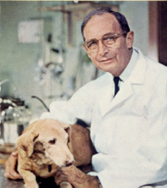
Goldblatt‘s experimental hypertension
2 kidneys/1 clip (2K1C)
hypertension + preserved regulation of extracellular volume
1 kidney/1 clip (1K1C)
hypertension + disorder of extracelllular volume regulation

Slide 19
2K1C hypertension
unilateral stenosis may be present with an intact contralateral renal artery
counterregulatory processes in the contralateral kidney
sodium excretion in response to increased blood pressure

Slide 20
1K1C hypertension
bilateral stenosis and 1K1C lead to more severe hypertension

Slide 21
Phases of experimental hypertension
early phase
renal ischemia, activation of RAAS
elevated renin, hypertension
second phase
blood pressure responds to clip removal
third phase
no reduction of blood pressure after clip removal
microvascular injury of contralateral kidney
oxidative stress?

Slide 22
Mineralocorticoid-induced hypertension

Slide 23
Hyperaldosteronism
group of conditions characterized by chronic excess aldosterone secretion
primary
autonomous overproduction of aldosterone
supression of RAAS, decreased plasma renin
3 types
bilateral idiopathic hyperaldosteronism
the most common cause of primary hyperaldosteronism (60 % of cases)
adrenocortical neoplasm
Conn syndrome – solitary aldosterone-secreting adenoma
glucocorticoid-remediable hyperaldosteronim
uncommon, familial
ectopic aldosterone synthase activity in the cortisol producting zona fasciculata of adrenal cortex
under the regulation of ACTH
glucocorticoid supression
secondary hyperaldosteronism
aldosterone release occurs in response to activation of RAAS
increased plasma renin
conditions
decreased renal perfusion
hypovolemia
pregnancy
estrogen-induced increases in plasma renin substrate

Slide 24
Hyperaldosteronism
clinical consequences
hypertension
one of the most comman causes of secondary hypertension
in 20 % of patients with treatment-resistant hypertension
hypokalemia
profibrotic effect of aldosterone
more CV events in patients with primary aldosteronism than in patients with primary hypertension
diagnosis
hypokalemia, low plasma renin
high plasma aldosterone/renin
decreased excretion of potassium

Slide 25
Hypercortisolism (Cushing syndrome)
conditions that produce elevated glucocorticoids levels
exogenous
administration of steroids is the most common cause of hypercorticolism
endogenous
ACTH dependent and independent
most often secondary to an ACTH-producing pituitary microadenoma (=Cushing disease)
Cushing syndrome
serious disease
hypertension in ∼ 75 %
often difficult to treat
incompletely controlled
4-fold excess of mortality

Slide 26
Causes of endogenous Cushing syndrome

Slide 27
Classification and mechanisms of hypertension
mechanisms of hypertension
Na retaining action of cortisol
↑ cortisol overwhelms 11β-HSD2
cortisol acts on mineralocorticoid receptor (MR)
direct action on smooth muscle cells
↑ production of mineralocorticoids
↓ activity of eNOS
↑ angiotensinogen

Slide 28
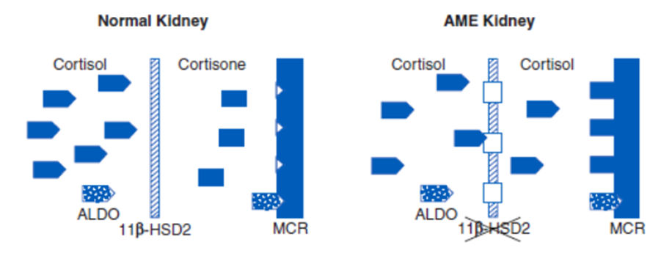
Increased access of cortisol to MR
11β-Hydroxysteroid Dehydrogenase
11β-HSD1
regeneration of active glucocorticoids, amplification of their action
widely expressed in liver, adipose tissue, muscle, pancreas
11β-HSD2
inactivates cortisol and corticosterone to the inert cortisone
protect mineralocorticoid receptor from occupation by cortisol
highly expressed in the distal neuron
deficiencies of 11β-HSD2
enzyme deficiency
autosomal recessive
apparent mineralocorticid excess (AME)
enzyme inhibition
glycerrhizic acid
confectionery licorice
50 g/daily for 2 weeks - ↑BP
treatment
competitive blockade of MR with spironolactone

Slide 29
Coarctation of aorta
distal to the origin of subclavial arteries
signs
hypertension in the arms
weak or absent femoral pulses
BP on lower extremities is normal or low
reduced blood flow to the lower part of the body
kidneys – RAAS activation
increased stroke volume
probably also generalized vasoconstrictor mechanism
diagnosis
pressure diference > 20 mm Hg
treatment
surgical
angioplasty

Slide 30
Pheochromocytoma
tumor of chromaffin tissue
adrenal medulla
sympathetic ganglia
0.1 – 0.5 % of people with hypertension
can cause serious hypertensive crisis
production of epinephrine and norepinephrine
paroxysmal or continuous
episodes of headache, sweating, palpitations
weakness, fatigue, weight loss
marked BP variability
diagnostic test
urinary catecholamines
localization of tumor
treatment
surgery
blockade of catecholamines action or synthesis
50 % have paroxysmal episodes of hypertension
other 50 % have sustaines hypertension
some may be normotensive

Slide 31
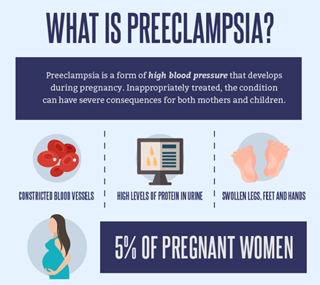
Hypertension in pregnancy
5-10 % of all pregnancies
blood pressure changes during pregnancy
decrease during the first semester
lowest in the second trimester
rise during the third trimester
changes of cardiac output (CO) and peripheral vascular resistence (PR)
large increase of CO in early pregnancy
high throughout pregnancy
decreased PR
pregnancy is normally accompanied by
increased renin, ang I and II, estrogen, progesterone and aldosterone
women with preeclampsia
new-onset hypertension with proteinuria
develops after 20 weeks of pregnancy
sensitive to the RAAS
also responsive to other vasoconstrictors
insulin resistence may predispose to hypertension

Slide 32
Oral contraceptive drugs and hypertension
the most common cause of secondary hypertension in young women
mechanism
volume expansion
estrogens and progesterons cause sodium retention

Slide 33
Malignant hypertension
acute and life-threatening condition associated with a sudden increase in BP
usually in younger people
black men, kidney damage
diastolic > 120 mm Hg
organ dysfunction
hypertensive encephalopathy
cerebral vasoconstriction
homeostatic response
brain edema
damage of kidney vessels
↑ creatinine, urea
metabolic acidosis, hypocalcemie, proteinuria
prolonged exposure to high BP
arterioles injury
intravascular coagulation and RBC fragmentation
renal damage
↑ creatinine
proteinuria

Slide 34
Practical part
weight of
animal
kidneys
heart
suture
microscopic detection of renin

Slide 35
Sleep apnea syndrome
prevalent in middle-aged and older adults
mechanisms
obesity
craniofacial changes
alteration in upper airway muscle function
consequences
intermittent hypoxia and hypercapnia
recurrent arousals and increase in respiratory efforts
secondary sympathetic activation, oxidative stress and systemic inflammation
daytime sleepiness

