Slide 1
Communication skills in Nursing
Andrea Pokorná
Masaryk University,
Faculty of Medicine
Department of Nursing
The way we treat our children in the dawn of their lives, and the way we treat the elderly in the twilight of their lives, is measure of the quality of a nation.
Hubert Humprey

Slide 2
The schedule of the tuition
First part will be little bit theoretical orientated
Second part will be practical work with the model situations

Slide 3
Functions of Communication
Control
Motivation
Emotional Expression
Information

Slide 4
The facts about communication in healthcare
Effective communication is one of the important clinical skills. The caregivers can and have to improve health care delivery today.
Communication skills are more than a „toolbox“ of devices.
Rather, they are means of developing a dialogue and rapport with patients that enhance human connection and health outcomes.
Dr. Toni Laidlawari

Slide 5
The facts about communication in healthcare
Communication in Nursing as with all of the medical field is crucial.
Nurses have to be intermediaries between doctors and patients.
They have to execute what the medical hierarchy expects of them and they must take proper care of the patients.
Communication in Nursing involves both non-verbal and verbal communications.

Slide 6
The Communication Process
Source
Encoding
Channel
Decoding
Receiver
Feedback

Slide 7
Effective communication
This needs to involve the patient and be understood by the patient.
There also needs to be effective communication between all members of the team to ensure that the patient has the right care.
Communication to relatives and to other agencies if the person will need continuing care when they get home.

Slide 8
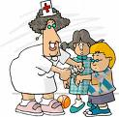
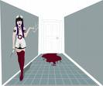
Imagine☺ that you are a nurse….
Which one would you like to be – and why?
1
2
3
4
5
6
7
8

Slide 9
Therapeutic communication in nursing allows
For the patient and family to feel like someone actually cares for him or her in their time of need.
This can be fundamental in the recovery
or death process of a patient.

Slide 10
What do you think is the most important task when you communicate with the patients
to give information
to recognise needs of patients
to educate the patients
to ensure what are the patients worried about
to ensure what are the patients feelings
others…..

Slide 11
What do you think is the most important skill when you communicate with the patients
speaking
listening
watching
touching
moving
others…
UNDERSTANDING

Slide 12
Remember
the patient/client and the nurse can have different perception of reality and the nurse needs to begin the assesment process with the open mind

Slide 13
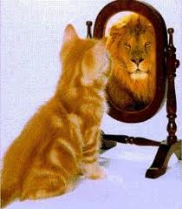
Factors that affect communication
Nurse needs to assess and consider when communicating with patient:
culture
roles and relationships
environment
attitudes and values
level of self esteem
developmental level (age, education…)
physical & psychological barriers
personal space (proxemics)
territoriality

Slide 14
Type of communication
Verbal
conscious
use of spoken or written word
choice of words can reflect:
age,
education,
developmental level,
culture etc.
feelings can be expressed through tone, pace, etc.
Non-verbal
less conscious than verbal
use of gestures,
expressions,
behaviors (body language)
85 % of communication
requires systematic observation and valid interpretation

Slide 15
Congruency…
…are verbal and non-verbal messages consistent?
Nurse states observations and validates with patient.
Nurse to crying patient: „You seem upset today."
Patient: „I'm fine thanks.“
HOW CAN YOU VALIDATE THE FEELINGS OF THE PATIENT?

Slide 16
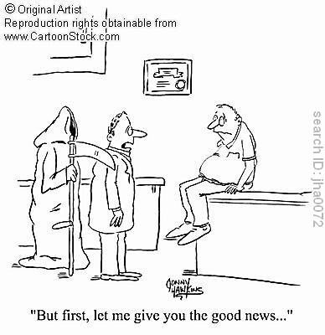
What is the most important message?
Always speak about the issue important
for patient…

Slide 17
Nonverbal communication cues can play 5 roles
Repetition: they can repeat the message the person is making verbally
Contradiction: they can contradict a message the individual is trying to convey
Substitution: they can substitute for a verbal message. For example, a person's eyes can often convey a far more vivid message than words and often do
Complementing: they may add to or complement a verbal message. A boss who pats a person on the back in addition to giving praise can increase the impact of the message
Accenting: they may accent or underline a verbal message. Pounding the table, for example, can underline a message.
Source: The Importance of Effective Communication, Edward G. Wertheim, Ph.D.

Slide 18
It’s not what you say, it’s how you say it
INTENSITY
- a reflection of the amount of energy you project is considered your intensity. Again, this has as much to do with what feels good to the other person as what you personally prefer.
TIMING AND PACE
- your ability to be a good listener and communicate interest and involvement is impacted by timing and pace.
SOUNDS THAT CONVEY UNDERSTANDING
- sounds such as “ahhh, ummm, ohhh,” uttered with congruent eye and facial gestures, communicate understanding and emotional connection. More than words, these sounds are the language of interest, understanding and compassion.

Slide 19
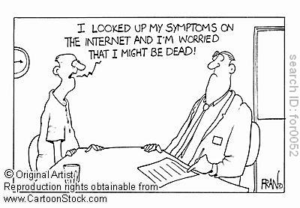
What is the main message of this words???

Slide 20
Types of nonverbal communication and body language
Facial expressions (happiness, sadness, anger, surprise, fear, and disgust are mostly the same across cultures)
Body movements and posture (posture, bearing, stance, and subtle movements)
Gestures (intercultural differencies etc.)
Eye contact (lasting, direction)
Touch (social touching x nursing interventions)
Space (signals of intimacy, aggression, dominance or affection)
Voice

Slide 21
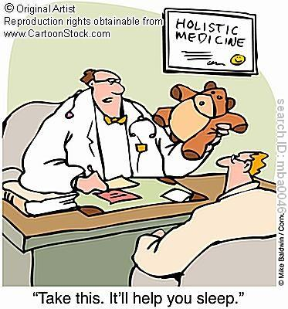
Do you think it
would help the
patient?

Slide 22
Social interaction
subjective feelings
of the other people
my behavior
behavior of others
my subjective
feelings

Slide 23
Communication becomes a major determinant of a succes
in the health promotion, health teaching, and compliance
with health care issues

Slide 24
Do you think it is important to inform the patients about our actual feelings?
YES NO
WHY?

Slide 25
What kind of the relationship do we have to have with the patients
Helping relationship
Helpers take responsibility from
the conduct of the relationship
Relationship determinates when
the identified goals are met.
Relationhip is entered through the use of necessity
Self-disclosure is limited for
the helper; encourage for the helpee
Understanding should always be put into the words
Social relationship
Both parties have an equal responsibility for the conduct of the relationship
Relation may or may not have specific purpose or goals
The needs of both partners should receive equal attention
Understanding does not necessarily need to be put into words

Slide 26
The goal of any therapeutic relationship
empover clients to be all that they can be as they cope with the situations, problems, and people that inevitably present themselves during each person´s live
nurses empover clients every time they foster their client´s self-direction in choosing treatment options, goal setting and problem solving the best way to achieve them as partners in care
Information is always a necessary foundation for empowerment
Empowerment:
enabling people to choose to take
control over and make decisions about
their lives

Slide 27
Barriers to Effective Communication
Filtering
Selective Perception
Emotions
Language

Slide 28
Common barriers of communication with patients
Anxiety
Lack of time
Lack of experience
Stereotyping
Space violation
Dysarthria
Dysphasia
Dementia
Other cognitive problems
The unlikeable patient
Others…..

Slide 29
Blocks of Communication Etiology of poor communication
Offering Cliché Reassurance
Giving Advice
Answering your own questions
Giving Excessive Praise or Reprimands
Defending Against Complaints
Using Parenting Approaches of Behavior
Not Listening
is most harmful behavior!

Slide 30
Useful communication techniques Facilitating communication
Use of Touch
Use of Multiple Modalities
Active listening
Use open-ended rather then closed-ended questions
Dealing with Memories and Reminiscences
Role Modeling
Others……..

Slide 31
Use of Touch
Nurses should be sensitive to their own style of touching:
how it is done, to whom, when, and why
The important thing is to acceptate
the hierarchy of places on the body that are appropriate to touch (e.g. the hands, shoulders, back, arms)

Slide 32
Use of Multiple Modalities
Using more than one sense communication facilitates the proces of communication;
You are able to understand not only trought normal communication channels (ears, eyes) but you can use your heart too.

Slide 33
Role modelling
It is one aspect of care through which we indirectly affects the interpersonal relationships between the patients and caregivers (e.g. medialisation, externalisation).

Slide 34
Active listening
The steps of active listening:
ENCOURAGEMENT
CLARIFICATION – EXPLANATION
PARAPHRASE/ing
REFLECTION – MIRROR
SUMMARISING
APPRECIATION – evaluation

Slide 35
How to Be an Effective Listener
What You Think about Listening?
Understand the complexities of listening
Prepare to listen
Adjust to the situation
Focus on ideas or key points
Capitalize on the speed differential
Organize material for learning

Slide 36
Dealing with memories and Reminiscences
This can be a very meaningful way through which especially older adults review their life, establish its meaning and confront their conflicts/negative acts.
Ask explorative questions
Use the memory as a bridge to other information
Find a cue for questions within frequently heard stories
Practice the ways how to tell the person that you have already heard this story

Slide 37
Levels of nurses actions
1. Accepting - use client´s correct name, respond to cues
- maintain eye contact, adopt open posture
2. Listening - nods head, smiles, encouraging responses,
- use therapeutic silence
3. Clarifying - ask open ended question, restate the problem
- validate perception, acknowledge confusion
Informing - provide honest, complete answers,
- assess client´s knowledge level
4 – 5 Analyzing - identify unknown emotion,
- interpret underlying meanings, confront conflicts

Slide 38
How to be confronted with patients emotions
NURSE–ing and Emotion
N- Name the emotion
U- Understand the emotion
R- Respect or praise the patient
S- Support the patient
E- Explore what underlies the emotion
Robert Smith has created this useful mnemonic to recall four basic techniques to use when confronted by patients emotions

Slide 39
WHAT IS CARE?
Comfort
Acceptance
Responsiveness
Empathy
Empathy is the sense that „I could be you“ and is what patients are ussually feeling when they comment about a physician that really cared for them

Slide 40
Model situation nr. 1
35 years old man was addmitted after the car accident at the ER unit where you work as a nurse.
He is independent (ADL 100 points), but his eyes are covered with the bandages.
He is little bit confused, he does not know where his family is now and what is their condition.

Slide 41
Model situation nr. 2
35 years old man was addmitted on surgical unit where you work as a nurse.
He´s been blind since he was two years old. He is affraid of his future because of the really big headache (his operation is planned for tomorrow).

Slide 42
Model situation nr. 3
30 years old woman was addmitted at the gynaecological unit because of the bleeding.
She is pregnant (36 week) and it is her first pregnancy.

Slide 43
Model situation nr. 4
30 years old woman was addmitted at the gynaecological unit because of the bleeding.
She is pregnant (36 week) she has already two children at home.

Slide 44
Solve the problems of the patients
What should you do as a first step…
What will you be focused on firstly…
What will be the goal of your care in the nearest 30 minutes…
What kind of communication techniques you will use…
Do you think you can use the universal approach to all these patients….

Slide 45
Many attempts to communicate are nullified by saying too much.
Robert Greenleaf
Seek first to understand, then to be understood.
Stephen Covey
Thank you for your attention,
ideas, work and patience

