Slide 1
Antidiabetic drugs
Department of Pharmacology MF MU

Slide 2
Antidiabetic drugs
Insulins
Drugs used in T2DM

Slide 3
Diabetes mellitus
chronic multifactorial endocrine and metabolic disease
DM I. type (IDDM) absolute deficiency in insulin (10 - 15 %)
- infections or toxic effect on pancreas
- autoimmune
DM II. type (INDDM) relative deficiency in insulin (85 - 90 %)

Slide 4
Clinical picture
Polyuria, polydypsy, nighttime urination, weight loss in normal appetite, physical weakness, fatigue, blurred vision, coma (children)
Randomly detected glycemia above 11.1 mmol / L
Fasting glycaemia above 7.0 mmol / L
T1DM - symptoms are more pronounced, develop quickly (weeks)
T2DM - less noticeable symptoms, evolving from months to years
- other - related to organ complications - itchy skin, visual disturbances, pain and tingling, neuralgia, badly healing wounds, skin affections, tooth decay, potency disorders, libido ...

Slide 5
lack of insulin
Muscles
↓glucose oxidation
↓ proteosyntheis
proteins turnover....
AA
Adipose tissue
impaired utilisaton of Glc
↓ glucose uptake by insulin – senzitive cells
↑lipolysis
↑ faty acids production
HYPERGLYCEMIA
↑ AA in liver
↑ketogenesis
OSMOTIC DIURESIS
protein catabolism
acidosis → CNS insult,
coma, exitus
- dehydration
- hypovolemia
- impaired renal functions

Slide 6
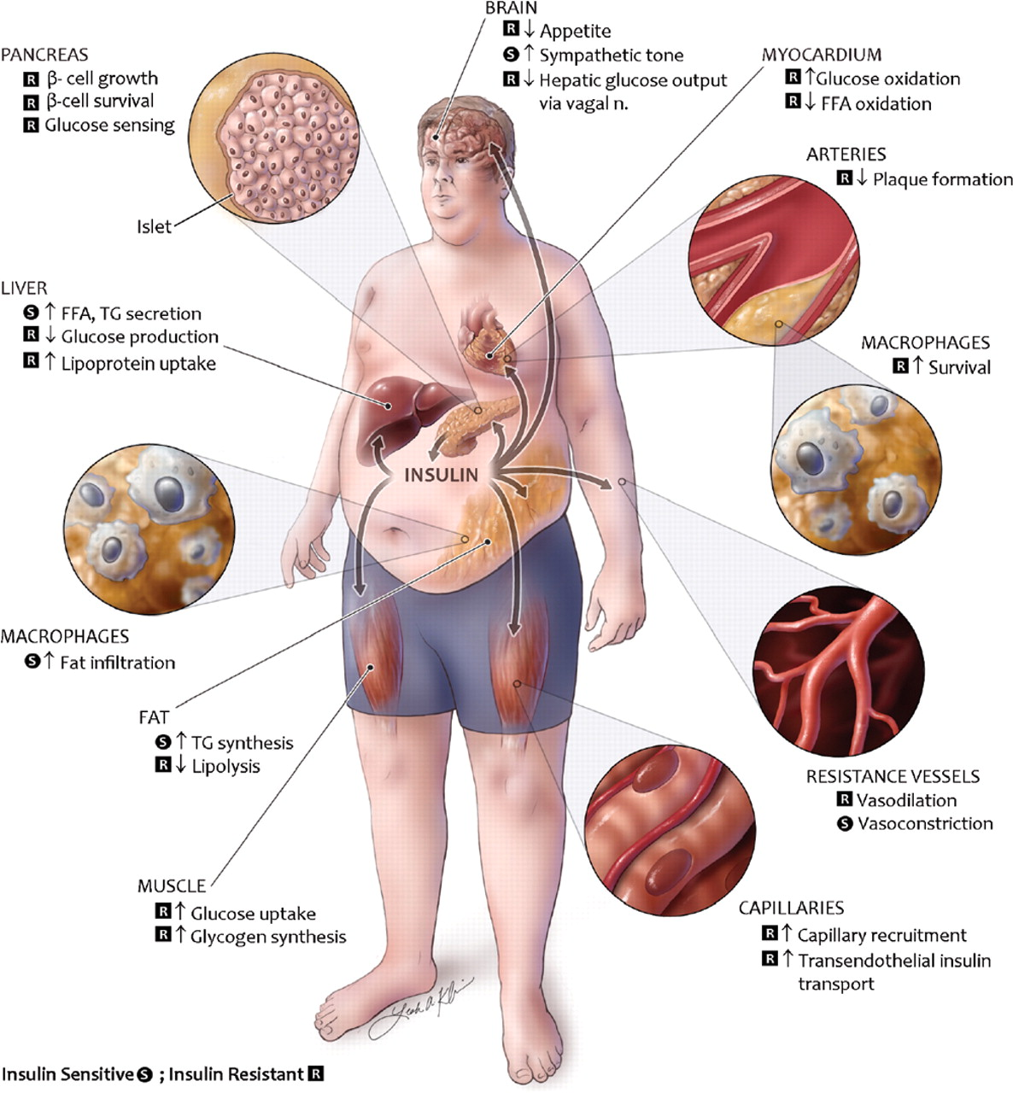
METABOLIC SYNDROME
Insulin resistance
Hypertension (high blood pressure)
Hypertriglyceridaemia (elevated TAG)
Disorders of glucose tolerance or diabetes
Obesity type of apple (male type of obesity)

Slide 7
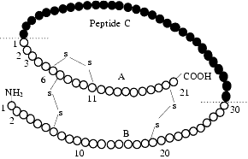
Insulin = lowmolecular protein, 2 chains (A 21 AA, B 30 AA), 2 S-S bonds
Synthesis - preproinsulin (107 AA) → → proinsulin (82 AA, A,B +C-peptide)→insulin
marker of endogenous secretion of insulin
(is not metabolized by the liver so quickly)

Slide 8
somatostatin insulin (negative feedback) α - activation of sympathetic n.s. (adrenalin)
Factors decreasing insulin secretion

Slide 9
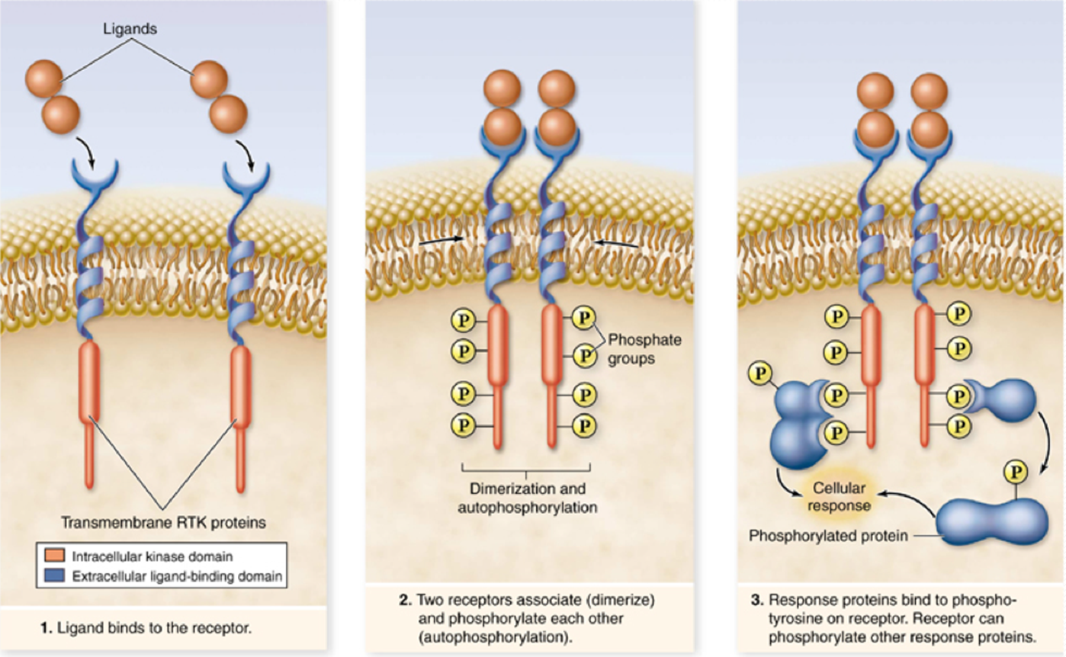
Insulin receptor
Lincová a kol. 2002

Slide 10
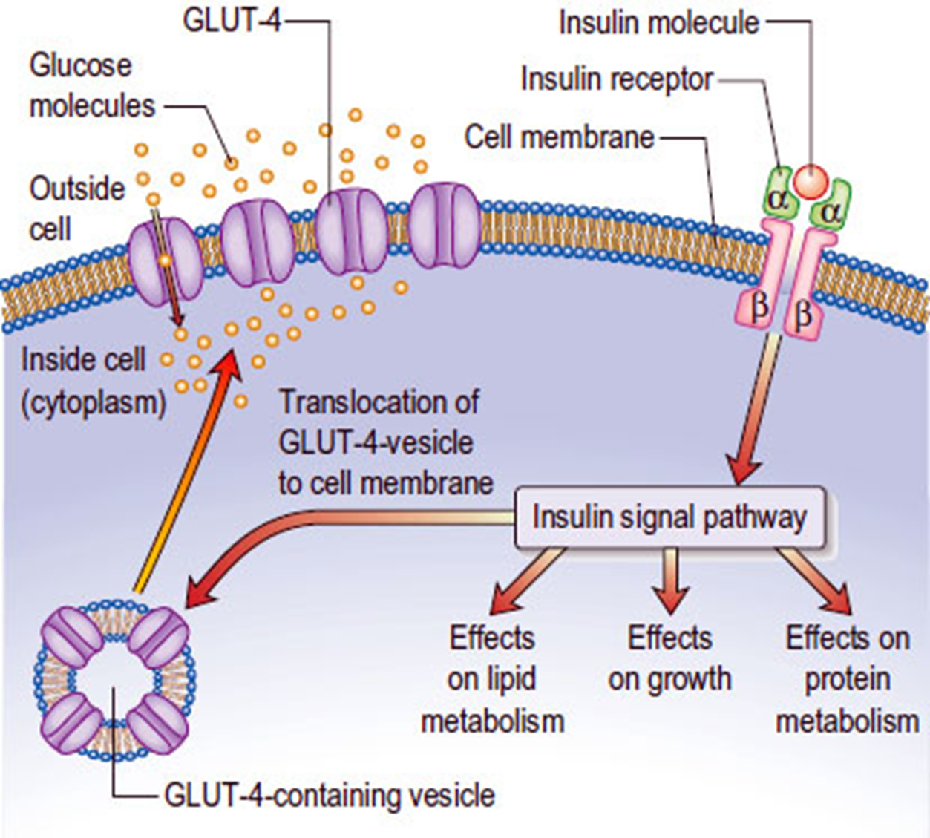
Insulin receptor
Lincová a kol. 2002

Slide 11
Types of insulin
A) animal insulin - from pork or beef pancreas, highly pure, monocomponent, today only AUV
B) human insulin - produced biosynthetically (synthetically since the 1960s, biosynthetically from 70 years, commercially since 1982) is called HM
C) insulin analogues- biosynthetically prepared, spec. Properties - length of action (short, prolonged effect)
- the production of antibodies to insulin depends on the purity

Slide 12
Terapeutical use of insulin
DM I. Type
ketosis, ketonuria or ketoacidosis
- patients with serious infetion/gangrene
DM II where blood Glc. not normalized with POAD, diet
DM II patients, use corticosteroids, liver or kidney impairment

Slide 13
Insulin preparations
solutions/suspensions of insulin
suspesions of „zinc-insulin“
suspensions „protamin-zinc-insulin“
Σ insulin as a mixture of mono-/di-/tetra-/hexamers
+ pH, stability, isotonicity adjusted

Slide 14
Insulin preparations
Short acting
A) insulin analogues: insulin lispro, aspart, glulisine
Can be administered intravenously
Start of operation 0-15 min.
Maximum of efficacy 30-45 min after admin.
Effective for 2 - 5 hours.
B) neutral aqueous solutions of insulins
(Crystalline insulin, soluble insulin)
Can be administered intravenously
Start of action 30 min.
Maximum 1 - 3 hours.
Effective for 4 - 6 hours.

Slide 15
Intermediate acting
NPH (Neutral Protamine Hagedorn)
Protamine insulins or mixtures of amorphous and crystalline forms of insulin in a ratio of 30:70
Start of operation 1 - 2.5 hours
Maximum 4 - 8 hours.
Working time 12 - 24 hours.
Almost no longer used

Slide 16
Long acting
Crystalline suspensions of large crystals with very slow absorption
Analogs and their conjugates (glargin, detemir, degludec)
Onset of effect 2 - 3 hours
Maximum 10-18 h (not apparent in degludec)
Effective for 24 - 36 hours.
Steady state after 3 days (3 doses)
Less hypoglycemia than NPH, less weight gain

Slide 17
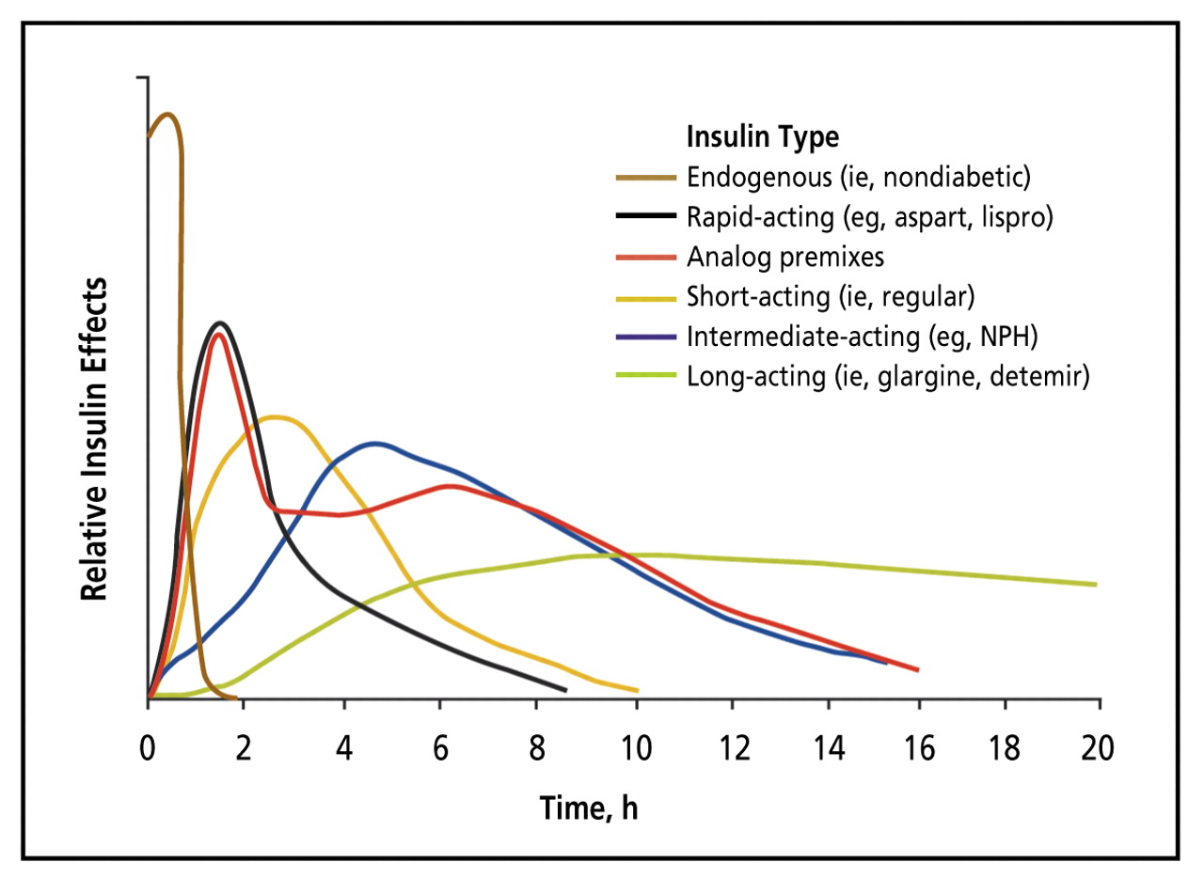

Slide 18
Complications of insulin therapy
- hypoglycaemia
- allergy
- lipodystrophy
insulin resistance - spec. antibodies
weight gain

Slide 19
Delivery systems (self-administration)
1) Insulin pen - cartridge with extendable needle; In the form of a fountain pen
2)Insulin pumps - continuous infusion s.c. (better compensation, less infectious risk)
3)Insulin syringes - with a sealed needle, calibrated per unit
4) Inhalation (USA) / transnasal ?

Slide 20
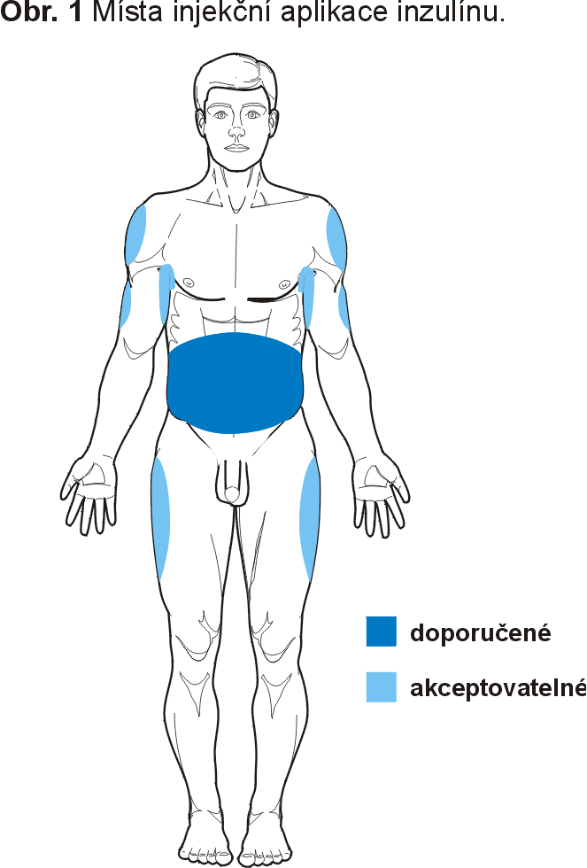
Insulin administration sites
preferred
acceptable

Slide 21
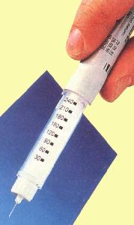
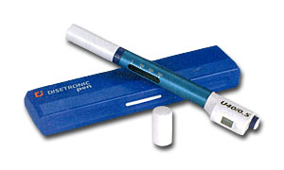

Slide 22
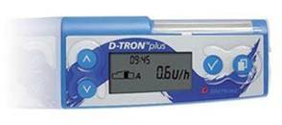

Slide 23
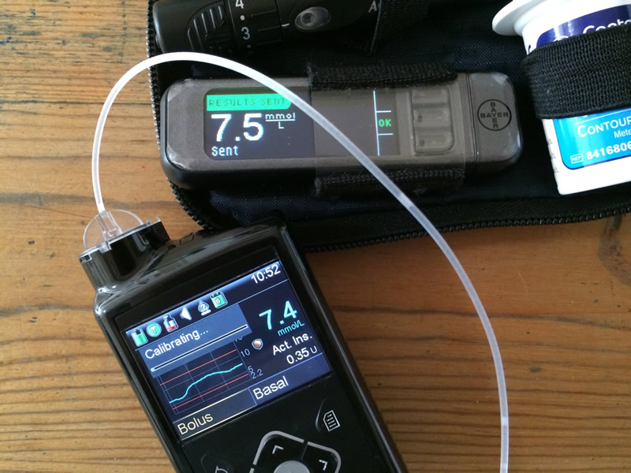
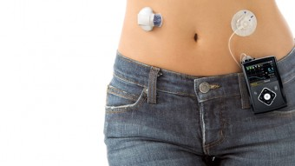

Slide 24
Hypoglycaemia - below 2.8 mmol / l
Causes : - overdose with insulin - delayed food intake, vomiting, diarrhea - excessive physical load (delayed hypoglycaemia)
In the elderly, liver, kidney, cardial insufficiency
Rapid onset of symptoms: nervousness, tremor, palpitations restlessness, hunger, sweating, consciousness disorders, changes in EEG, coma, exitus
Therapy: Saccharide / glucose delivery p.o./i.v. (40% glucose, 30-50 ml or more)
Glucagon, followed by glucose

Slide 25
Antidiabetics

Slide 26
Criteria for initiation of pharmacotherapy of DM II type and suitable selection of drug
OAD do not replace regimen (diet)
age, weight, blood insulin level
glycemia (fasting and postprandial)
comorbidities, metabolic syndrome

Slide 27
(Oral) antidiabetics
The effect is linked to the ability of insulin secretion
Most OAD are contraindicated in pregnancy (metformin may be used)
- indication:
- T2DM - if not properly compensated with diet
- T1DM with a high insulin resistance, when insulin does not lead to a sufficient decrease in blood glucose

Slide 28
Antidiabetics
biguanides
sulfonylurea derivatives (SU)
thiazolidindiones
alpha-glucosidase inhibitors
meglitinides
GLP1 analogues
Inhibitors of DPP IV
SGLT2 (sodium-glucose cotransporter) inhibitors

Slide 29
Biguanides
metformin
fenformin
buformin
Mechanism of action
increase sensitivity of peripheral tissues to insulin
increase insulin binding to its receptor
reduce hepatic gluconeogenesis
decrease glucose absorption from GIT
Do not affect insulin secretion, function of B cells
→ no hypoglycemia
„euglycemic agents“

Slide 30
Further benefits:
Direct stimulation of glycolysis in the periphery
Reduce hepatic gluconeogenesis
Delay Glc absorption from GIT
Decrease plasma glucagon levels
Increase the proportion of HDL Chol. → improve lipid profile
Improve rheological properties of blood
Are not metabolized, low protein binding
Side effects
Lactic acidosis
Nausea, GIT problems about 20% of people (diarrhea)
Reduced absorption vit. B12
Weight loose
disulfiram effect

Slide 31
sulfonylurea derivatives (SU)
Tolbutamide
mechanism of action
1) pancreatic – release of I. from beta - cell
2) extrapankreatic
- potentiation of endogenous I effect on the target tissue
- reduction of hepatal glucose production
- reduction of hepatal Insulin degradation
- reduction of serum glucagon levels

Slide 32
SU derivatives
I. Generation - chlorpropamide
tolbutamide
II. Generation - glibenclamide (gliburide)
glipizide
gliclazide
gliquidone
III. Generation - glimepiride
Therapeutic use: not drugs of choice, 2nd line treatment

Slide 33
Adverse effects
increased appetite
metal taste in mouth
Hypoglycemia
headaches, nausea (5 %)
fluids retention
allergy, fotosensitivity
Contraindications
DM Type 1 monotherapy, hypoglycemia, ketoacidosis, kidney or liver failure
pregnancy, hypersensitivity

Slide 34
Thiazolidinediones
rosiglitazon
pioglitazon
troglitazon
Mechanism of action
increase the sensitivity of periphery to insulin
ligands of PPARγ (part of the steroid and thyroid superfamily of nuclar receptors) modulate the expression of the genes involved in the metabolism of lipids and glucose
rosiglitazone

Slide 35
Thiazolidindiones
Lowering blood glucose by the primary effect on insulin resistance - in diabetic and pre-diabetic patients
Does not cause hypoglycemia, scavengers
Increase glycogen synthesis and glycolysis in muscles
Stimulating glucose oxidation and lipogenesis in adipose tissue and reducing gluconeogenesis in the liver ... optimal metabolic effects

Slide 36
Therapeutic use
Sensitizers of insulin receptors
The onset of effect in 4 weeks
Side effects
Hepatotoxicity
Fluid retention
Increase TAG
Contraindications
Hypersensitivity
Predisposition to heart failure
Liver damage
Pregnancy, lactation

Slide 37
Inhibitors of intestinal glucosidase
acarbose
acarbose
miglitol
voglibose
Mechanism of the action
reduce sacharides absorption from GIT
competitive inhibition of the gut α - glucosidases
(inhibits the cleavage of the polysacharides from the meal)

Slide 38
Inhibitors of intestinal glucosidase
decrease postprandial glycemia
do not affect monosacharides absorption
acarbosis do not rech the systemic blood, miglitol does
„educative drugs“- consequences in bad compliance
In hypoglycemia and the simultaneous treatment with other
POADs can not be administered sucrose (monosacharide necessary - Glu, Fru) or Glucagon

Slide 39
Meglitinides
repaglinid
nateglinid
meglitinid
repaglinide
Mechanism of the action
similar to SU-derivatives:
block ATP- sensitive K⁺ channel in membrane of beta-cells, depolarisation of membrane, activation of voltage-gated Ca²⁺ channel, influx Ca²⁺ , insulin release
through different receptor at K⁺ channel

Slide 40
Clinical use
combined with metformin - esp. if patient not suffciently compensed
alternative of the SU medication in patients with renal impariment (excreted in bile)
Contraindications:
hypersensitivity
DM I. type
diabetic ketoacidosis
pregnancy, lactation
AE:
Hypoglycemia, nausea, diarrhea, joint pain

Slide 41
DM - Complications
1) hypoglycemia
consciousness - sweet (sacharide) drink, meal
unconsciousness - i.v. Glu 20-40%
- u DM I. type i.v. glucagon

Slide 42
DM - Complications
2) allergy (hypersensitivity IgE) - corticosteroids, adrenalin i.v.
3) insulin resistance - IgG against insulin (animal insulins), change insulin preparation, POAD
4) lipodystrophy - change application sites (scheme), esthetic surgery

Slide 43
DM - Complications
Diabetic nefropathy - hypertrophy, hyperfiltration; → nefropathy, ↑blood pressure (ACEi), microalbuminuria, insufficiency
Diabetic neuropathy – gabapentin, pregabaline, carbamazepine, TCA, duloxetine
Hyperlipoproteinemia - diet, statins, fibrates, probucol, nicotinic acid..

Slide 44
DM - Complications
Diabetic retinopathy - protein glycation, small vessels collagenisation; microangiopathy
Diabetic foot - micro- and macrovascular impairments
neuropatic - warm, non-sensitive, dry, complicated with neuropathic ulcer oedema
b) ischemic - cold, without pulsations
c) neuroischemic - ulcerations, gangrene

Slide 45
DM - Complications
relapse of infections, mycosis
hypertension

