Slide 1
Biological treatment - principles, technology, examples
MUDr. Alena Máchalová, Ph.D., Department of Pharmacology
Tato prezentace je autorským dílem vytvořeným zaměstnanci Masarykovy univerzity. Studenti předmětu ZLFA0722p mají právo pořídit si kopii prezentace pro potřeby vlastního studia

Slide 2


Biological drug
„Biodrugs, biologics, targeted treatment “
- recombinant proteins, peptides, antibodies, hormones
substances derived from blood / plasma and recombination variants
„Biologicals, Biopharmacy, Biopharmaceuticals“
- recombinant proteins, peptides, antibodies, hormones
+ Stem cells, xenotransplantation, gene and antisense therapy

Slide 3
Targeted effects of biologicals
A specific effect of biologics is targeted - a specific target structure, antigen, enzyme, signal path (e.g. tumor cells).
Biologics are able to identify the damaged cells for destruction by the immune system.
Can prevent the growth and proliferation of cells that cause disease.
Can deliver drug directly to the target which increases the effectiveness of treatment.

Slide 4
Traditional/Classical vs. Biological drug
Small molecule <1kDa, different from endogenous substances
Produced by chemical synthesis / isolation from plants
Less critical steps in the synthesis, easier handling and formulation
Very well characterized
Molecular mechanism of action
usually better described, linear dose-response relationship, affects the whole body
Mostly non-immunogenic
Usually with pharmacokinetic interactions at P450
  Large, complex molecules, commonly proteins> 50 kDa, similar or identical to endogenous
  Manufactured using living organisms / cells
  - risk contamination
  - own "inherited„ activity
  Complex heterogeneous structure matrix from which was drug isolated
  More difficult to characterize (3D conformation)
  Mechanism of action is complex, sometimes not fully understood, targeted action
  Usually immunogenic
  Mostly without interaction at P450

Slide 5
Research and development of Biological drugs
The development of biologics is 10 - 15 years, costs 1.5 billion USD
Biologics are produced by the genetically modified host cells (bacterial, yeast, mammalian and plant) into which was inserted the genetic information stored in DNA.
The first drug produced by biotechnological procedure was insulin (in 1978, registering 1982).
The discovery of biotechnological production of pharmaceuticals, respectively monoclonal antibodies, was in 1984 awarded the Nobel Prize.
Notes:
• 1972 - obtained recombinant deoxyribonucleic acid (rDNA)
• 1975 - first monoclonal antibody (MAb).
• This was followed by the establishment of the first biotech pharmaceutical companies.
USA - Genentech
Europe - Biotech
• 1982 - The first biotech product was - recombinant insulin (Genentech, marketed by Eli Lilly)
• 1986 monoclonal antibody OKT3 (OrthoCloneR) recombination. IFN

Slide 6
Examples of Biological drugs
1) Imunomodulating biologics
MAb (Infliximab) and fusion proteins (etanercept), IFN
2) Hormones – insulin, GH
3) Vaccines – e.g. HVB, HPV
4) Growth factors – erytropoetin, trombopoetin, CSF
5) Enzymes for the treatment of hereditary diseases (monogenic) (e.g. Imiglucerase for the treatment of Gaucher disease)
6) Biologics influencing homeostasis- f. VII, F VIII, F IX, other inh. Of coaglation or activators of fibrinolysis
7) Gene therapy (e.g.. Alipogen tiparvovek – LPL gene)

Slide 7
Advantages for the patients
better efficiency vs. "Classical" drugs
biologicals are used under the supervision of experts in specialized centers.
targeted, personalized treatment, which is always personalized
the patient undergoes a more detailed examination before medication
better understanding of the basic properties of the drug and its effects
better solution of possible ADRs, their early detection

Slide 8
Risks and disadvantages of biological drugs in general
carcinogenicity
allergenic potential
contaminants from the source cells
stabilizing additives (cryopreservation stabilizers)
sterility
stability, variability of drugs (biotechnology products)

Slide 9
Production of biological drugs
Historically isolation from natural sources:
insulin from the pancreas of cattle, pigs (recombinant today)
h-choriogonadotropin - from the urine of pregnant women (today recombinant)
hirudin - Medical leeches (H. officinalis) (today synthetic / recombinant)

Slide 10
The production of biological drugs - recombinant technology
3 generation of biologicals
1 ) "copies" of human proteins
2 ) modified proteins (AAs substitution, glycosylation, PEGylation)
- better pharmacokinetics, pharmacodynamics - e.g. glargine, PEG-IFN
3 ) de novo designed proteins / MAB

Slide 11
Nomenclature
Derived from biochemical name (Pegasys -PEG IFN)
The name given by the manufacturer - unrelated to the effect of the origin
Hormone with different tradename (Serostim, Saizen, Zorbtive)
MAB- system root words and suffixes

Slide 12
Nomenclature of MAB
Generally: suffix -mab
Letter before suffix:
  o – of mice origin
  a - rat origin
  e - hamster origin
  i - of primates
  u – of human origin (human cell line production)
  zu – humanized
  xi – chimeric
  mumab – fully human

Slide 13
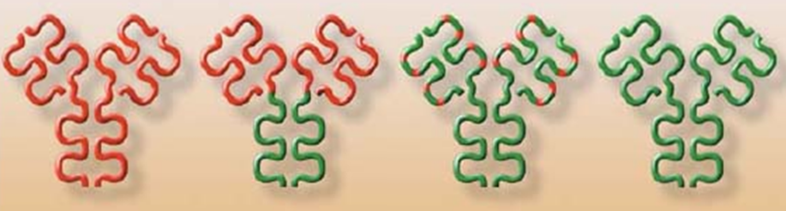
Mouse MAb
100% of the mice orig.
Hypersensitivity High levels of Ab (not used clinically)
Chimeric MAb
34% of mice orig.
Hypersensitivity
Low levels of circulating Ab (rituximab
infliximab)
Humanized
5-10% mice orig. MAb
Hypersensitivity Low levels of Neutralizing Antibodies (Trastuzumab Certolizumab)
Human MAb
100% human
Hypersensitivity Low levels of Neutralizing Antibodies (panitumumab
adalimumab)

Slide 14
Nomenclature of MAB
Sometimes encoding indication
lim - immune
bac - bacterial
cir- cardiovascular
tu - malignity
E.g.
rituximab - chimeric MAB to treat Non-Hodgkin. lymphomas
alemtuzumab - humanized antibody to the CD52 glycoprotein CLL

Slide 15
The production of biological drugs - recombinant technology
DNA extraction
product / synthesis according to library
transformation / DNA transfection into producer cells
production
purification
stabilization
testing (biological activity - CT I-III)
registration ( RCT + IV )

Slide 16
The production of biological drugs - recombinant technology
DNA extraction
product / synthesis according to library
transformation / DNA transfection into producer cells
production
purification
stabilization
testing (biological activity - CT I-III)
registration ( RCT + IV )

Slide 17
Contaminants from manufacture process
Microorganisms - antigenic structures, pyrogenicity , sepsis
Viruses
DNA - ? Consequences?
Custom product in improper 3D structure
Contaminating proteins
  antigenicity
  stability (protease )
  safety (growth factors, hormones, toxins)
Purification - affinity gel / permeation chromatography

Slide 18
Contaminants from manufacture process
Purification - affinity gel / permeation chromatography
Purity ± 98-99 %
Verification of the biological activity of each batch !
- Biochemical methods , cell lines or animal ( e.g. Epoetin )
= Time-consuming , cost , accuracy

Slide 19
The production of biological drugs - recombinant technology
Microorganisms
- bacteria - optimized E. coli strains (mutations of periplasmatic and membrane protease)
- yeast - S. cerevisiae
Tissue cultures of higher organisms
Cell-free expression systems
Genetically modified animals, plants

Slide 20
The production of biological drugs - recombinant technology
E. Coli
- The synthesis of proteins without posttranslational modifications
- Cheap medium, mutated forms of E. coli with advantageous properties - increase the stability of the gene product ...
- Modification of wall, transformation of plasmid (DNA product introduction) - thermal shock, electroporation
Selection - resistance to antibiotics / cell culture media
Renaturation
- E.g. IFN , GSM, insulin, growth hormone ...

Slide 21
The production of biological drugs - recombinant technology
S. Cerevisieae
- synthesis of proteins with posttranslational modifications, possibility of hybridization
easy, economical cultivation, generation time of 2h, mutants with advantageous properties - increased stability of the gene product
- modification of cell wall, transformation of plasmid (various vectors)
- selection - auxotrophic strains (disabled biosynthetic pathway for AA, NA); plasmid introduce this gene – only transformed yeast are viable in selection media (ATB)
- renaturation
- E.g. insulin, growth hormone ...

Slide 22
The production of biological drugs - recombinant technology
Tissue cultures of higher organisms
- About 60% of recombinant proteins
positives: same way of modifications as in humans
a wide variety of products
eliminates ethical / technical problems (isolation, animal cells, the lack of material)
negatives: higher risk of contamination
(rich medium, slower growth, expensive, difficult cultivation)

Slide 23
The production of biological drugs - recombinant technology
Tissue cultures of higher organisms
Primary cultures (subculturing or passaging not possible)/ cell lines (tumor)
mostly adherent cell lines - release trypsin
Medium: ions , glucose, vitamins, nucleotides , lipids, calf serum (source of growth factors, hormones + PDGF, EGF, FGF, ... )
pH control, morphology
Vectors (details are kept secret): plasmids , viral plasmids (retroviruses), polycations
Part of the transfected DNA are regions of DNA increasing production
Selection (principles similar to those of S. cerevisiae . )
Notes:
epidermal growth factor (EGF), platelet-derived growth factor (PDGF) and fibroblast growth factor (FGF)
DEAE diethylaminoethyl

Slide 24
The production of biological drugs - recombinant technology
Tissue cultures of higher organisms
CHO – chinese hamster ovary
NS0, Sp2/0-Ag14 – mouse plasmocytome cells (leukocytes) – auxotrophic for L-glutamine
BHK 21 (baby hamster kidney – syrian hamster)

Slide 25
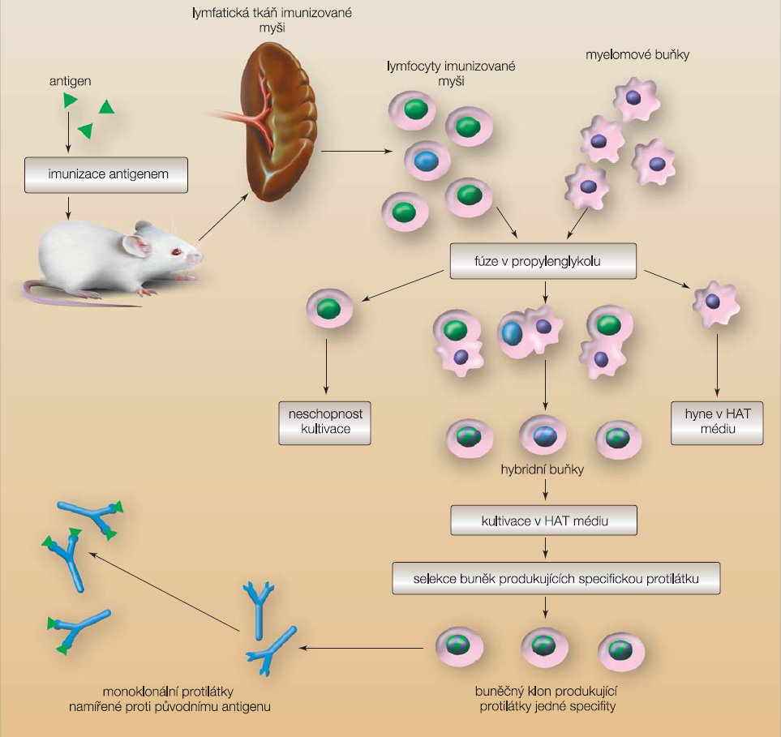
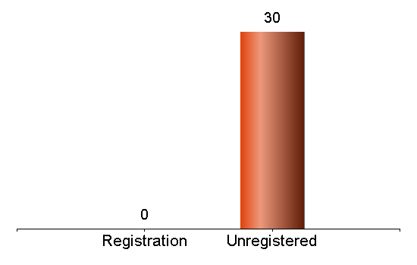
Tissue cultures of higher organisms
production of „hybridomes“
Participant:0
Voted:0
Sobotková M, Bartůňková J. Remedia 2008, 18 (5), 356-364
Notes:
Nejprve je indukována imunitní odpověď na specifický antigen u experimentálního zvířete. Z jeho sleziny (nebo jiné lymfatické tkáně) je získána
směs lymfocytů, z nichž některé tvoří protilátky specifické proti podanému antigenu. Tyto lymfocyty jsou v roztoku propylenglykolu smíchány s myelomovými buňkami. Takové myeolomové buňky postrádají enzym nutný pro metabolismus purinů (hypoxantin-guanin-fosforibosyl transferáza). Vlivem propylenglykolu dojde k fúzi obou typů buněk. Kromě těchto hybridů budou v médiu i nefúzované lymfocyty a myelomové buňky. Nefúzované lymfocyty rostou velmi pomalu nebo nerostou vůbec, a tak se postupně samy eliminují. Jestliže kulturu buněk přeneseme do média obsahujícího hypoxantin, aminopterin a thymidin (HAT médium), zahynou i nefúzované myelomové buňky, protože postrádají enzym nutný pro metabolizaci těchto látek. Proliferovat tak budou jen buňky hybridomové. Ty však kromě požadované monoklonální protilátky produkují i směs jiných protilátek. Dalším selektováním a klonováním pak postupně získáme buněčnou kulturu, která produkuje požadovanou monoklonální protilátku; podle [34] – Goetz, et al., 1995.

Slide 26
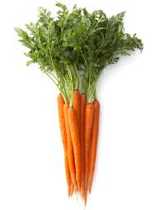
The production of biological drugs - recombinant technology
Transgenic plants
„Edible vaccines " - production of the immunogenic protein (like the polio vaccine )
culturing plant tissue culture in agar
Agrobacterium transfection (+ recombinant plasmid)
selection, planting
tobacco (Nicotiana tabacum ), Arabidopsis thaliana
PRX - 112 - 06/2014 - 1st patient treated with recombinant protein from the plant ( Protalix Biotherapeutics ) Gaucher disease - deficit of glucocerebrosidase
„…active recombinant proteins systemically through oral administration of plant cells expressing biotherapeutic proteins...“
Notes:
PRX-106 is the Company's orally administered, plant cell-expressed recombinant anti-TNF fusion protein that successfully concluded Phase I clinical trial.
In preclinical studies, PRX-106 alleviated immune-mediated hepatitis and reduced interferon gamma levels in a concanavalin A (ConA) inflammatory mouse model. Furthermore, the drug was shown to alleviate liver damage and reducing liver necrosis and reduction of liver enzymes, ALT and AST, thus leading to an improvement in liver biopsies.

Slide 27
The risk of functional damage of biologicals
denaturation
precipitation
deamination
mismatch of SH groups ( = incorrect 3D )
oligomerization, aggregation, covalent binding
hydrolysis
isomerization
racemisation
formation imides
oxidation
Multiple stabilizers cryopreservation
metal chelation
checking the pH, osmolarity , strengthening the hydrophobic bonds

Slide 28
Costs of the treatment
Biological therapy is more expensive than "traditional" drugs
Reasons - significantly higher development costs
- Demanding and complex testing
- The nature of products and higher costs after launch
- Higher costs for production, storage, transportation, shorter expiration
consequences: lower numbers of treated patients (up to 2 orders !!! )
Despite that:
- effective and in many cases can save money in terms of direct and indirect costs
direct costs: shorter hospitalization, reducing the number of surgical procedures, reduce the cost of follow-up treatment , ...
indirect costs : accelerating the patient's self-sufficiency, reducing the costs of absenteeism, cost reductions in social support and care allowances , reducing the cost of informal care and nursing

Slide 29
BIOSIMILARS

Slide 30
BIOSIMILARS
" Copy" of biotechnology drugs
• produced after the expiry of patent protection on the original biotechnology drugs
• In the US, for the same group uses the term „Follow –on Biologics“ , abbreviated „fobs“
The standard procedure for the registration of generic medicines with defined structure (ie . bioequivalence study) is inapplicable

Slide 31
BIOSIMILARS
Biosimilars drugs are similar, but not identical with the original biological drug.
Biosimilars are not automatically therapeutically interchangeable with the original biological drug .
small change process in biosimilars may cause an entirely different drug.
Biosimilars pass before entering the market or shorter simplified clinical trials , but disproportionately more complex than with generics

Slide 32
Biological drugs in a broader context
1. Gene therapy
2. Anti-sense therapy
3. Immunization with vaccines

Slide 33
Biological drugs in a broader context
1. Gene therapy
incorporation of a gene sequence into a target tissue by an appropriate vector
treating or preventing gene-related illnesses by changing the expression human genes
AE, risks:
Adverse immune response
Infections vector - natural activation of virus
Genetic influence on gametes
Risk of malignity- activation of protooncogenes , suppression of regulatory genes

Slide 34
Biological drugs in a broader context
2. Anti-sense therapy
  Incorporation of complementary oligonucleotides to the initiation codon / promoter to DNA
  block the effects of action of proteins that are not transcribed
Olimersen - lowering expression of Bcl -2 (overexpressed in many cancer) - withdrawn from registration

Slide 35
The antisense and gene therapy in practice
Fomivirsen - antisense sequences to the mRNA of human CMV - Ophthalmic applications for pac . HIV + to reduce CMV infection
Pegaptanib - oligonucleotide binding to the VEGF protein - for the treatment of wet AMD
Glybera - 3 x 1012 genome copies of human lipoprotein lipase in a viral vector (adeno- associated virus serotype 1 (AAV1 ) to treat hyperlipoproteinemia I
Notes:
Gencidin spinocelulární karcinom hlavy a krku…

Slide 36
Biological/targeted treatment of selected diseases
Oncology
Rheumatic diseases
Psoriasis
Inflammatory bowel disease
Asthma
Multiple sclerosis
Ophtalmology
Hyperlipidemia

Slide 37
Pharmacokinetics of biodrugs
different than in „classic“ drugs (ADME)
administration parenteral, absorption via lymphatic system, low bioavailability
s.c. administration (not mAb)
i.v. only in specialised centers, higher risk of immune reaction
Tmax - several days!
big molecules – slow and limited distribution, low Vd, binding to carrier proteins, no albumin!

Slide 38
Pharmacokinetics of biodrugs
different than in „classic“ drugs (ADME)
elimination – not liver, mostly katabolism, intensive elimination via neutralising Ab (saturable)
kidneys – small peptides, active tubular transport
Binding to target
influences PK
The higher the dose, the lower Vd
The higher the dose, the lower Cl

Slide 39
Adverse effects in general
mAb:
Reaction to foreign protein - allergic reaction, anaphylaxis (prevention – premedication, slow administration of the 1st dose)
Tumor lysis syndrome – typical for hematological malignities – ion dysbalance (hyperuricaemia, hyperkalaemia, hyperphosphataemia and hypocalcaemia)
Effect on healthy cells - rash, diaorrhea, tiredness, neurological symptoms, heart and lungs may be affected

Slide 40
Adverse effects in general
TKI: decreased haematopoiesis, oedemas, fever, nauzea, vomiting, hematomas, rash, hair loss, bain in joints and muscles, changes in perception of taste and vision, dyslipidaemia…
In case of toxicity it is usually possible to decerase dosing without loss of clinical effect.

Slide 41
1. Biological (targeted) treatment in oncology
„target“ may be localised in
tumor cells - membrane receptor – extracellular part or/ intracellular signalling pathway
immune system (specific T-cells)
- cancer immunotherapy
- Immune check-point inhibitors (anti-CTLA-4 or anti-PD(L)1)
Notes:
checkpoints are designed to protect normal body cells from immune damage during the immune reaction to the pathogens

Slide 42
Target on tumor cells
1. Biological (targeted) treatment in oncology
The most common targets
  EGFR (epidermal growth factor receptor) – trastuzumab, pertuzumab, erlotinib, lapatinib
  VEGF(vascular endothelial growth factor receptor)- bevacizumab, sunitinib
  PDGF (platelet derived growth factor receptor)
  FGF (fibroblast growth factor receptor)
  SCGF = c-KIT (stem cell growth factor) - imatinib
MoA:
antagonization of extracelullar part of receptor or endogenous ligand - monoclonal antibodies (-mabs)
inhibition of intracellular pathway – proteinkinase inhibitors (-nibs)

Slide 43
Targeted therapy – „mAbs and –nibs“
Monoclonal
antibodies
Receptor´s activation
Receptors with TKI activities
Ligand bindingl
Cell membrane
P
Y
Y
P
P
Y
Y
P
Tyrosin-
Kinases domain
(TKI)
Signal transduction
B-Raf
Proliferation
Survival
Migration
Tyrozin-kinases
inhibitors
Tumor growth and matastases

Slide 44
Target on tumor cells
Trastuzumab (HERCEPTIN ®)
HER-2 - 1985 – identification of the human Her-2/neu gene as a negative prognostic marker
I:
treatment of HER-2 positive breast cancer or adjuvant therapy of breast Ca
AE:
allergic reaction, fever, chills, hypotension
cardiotoxicity
diarrhea, nausea, vomiting, rash
muscle and joint pain
pulmonary infiltrates, penumonitis

Slide 45
Trastuzumab (HERCEPTIN ®)
Target on tumor cells
Mechanisms of Action
Trastuzumab
binds to subdomain IV and inhibits downstream signalling
HER2
HER1-4
Cell membrane
Franklin MC, et al. Cancer Cell. 2004;5(4):317-328.
Notes:
45

Slide 46
Pertuzumab (PERJETA)
Mechanisms of Action
Target on tumor cells
Pertuzumab binds to a specific domain II and inhibits ligand-activated dimerization
Trastuzumab
binds to subdomain IV and inhibits downstream signalling
HER2
HER1-4
Cell membrane
The combined regimen of pertuzumab and trastuzumab offers the potential
for a more comprehensive HER blockade
Franklin MC, et al. Cancer Cell. 2004;5(4):317-328.
Notes:
46

Slide 47
Erlotinib
Target on tumor cells
MoA:
HER1 (EGFR – 1) TKI
I:
non-small-cell lung carcinoma (NSCLC)
pancreatic cancer

Slide 48
Bevacizumab (AVASTIN ®)
Target on tumor cells
The growth of malignant tumor needs the continuous supply of oxygen and nutrients.
Simple diffusion and not enough nutrition to the cells under the influence of hypoxia.
Tumor produced a series mediators, particularly VEGF (vascular endothelial factor).
MoA:
mAb against VEGF preventing it from binding to receptors
inhibition of angiogenesis and regression of tumor vasculature

Slide 49
Bevacizumab (AVASTIN ®)
Target on tumor cells
I:
Metastatic colorectal Ca
Metastatic breast Ca, renal Ca, non-small-cell lung Ca
AE:
acceleration of hypertenzion
proteinuria
trombembolic complications
poor wound healing

Slide 50
Sunitinib
Target on tumor cells
MoA:
Multikinase inhibitor (anti VEGF, PDGF, c-KIT)
I:
GIST – gastrointestinal stromal tumor
mRCC – renal cell carcinoma
pNET – pancreatic neuroendocrine tumors

Slide 51
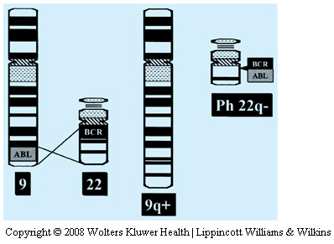
Target on tumor cells
Imatinib mesylate (GLIVEC ®)
Bcr-abl inhibitor – CML
c-KIT inhibitor – 1st line treatment of GIST (mutation c-KIT in 85% pts.) – 70% of the pts. Are responders!!!
AE:
neutropenia, trombocytopenia
diarrhoea, vomiting
joint pain
(BCR-ABL Translocation)

Slide 52
Rituximab
Target on B cells
1997 - fhe first registered mAB approved by FDA for the treatment of lymphomas
MoA: binding to the transmembrane antigen CD20 (on pre-B and mature B lymphocytes), which is expressed on> 95% of all non-Hodgkin lymphomas of B cell origin
I: NHL, CLL, autoimmune disesases
AE: rash, itchiness, hypotension
severe – infection, toxic epidermal necrolysis

Slide 53
Target on T cells
„Checkpoint inhibitors“
Checkpoints
– provide protection from immune destruction even during an immune reaction
- may have stimulatory on inhibitory function
  anti-CTLA-4 (cytotoxic T-lymphocyte antigen 4) – co-inhibitory
  – ipilimumab - melanoma
  anti-PD-1 (programmed death-1 receptor) - nivolumab, pembrolizumab
  - melanoma, RCCa, NSCLC
  anti-PD-L1 – atezolizumab

Slide 54
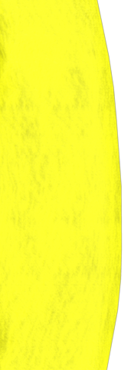

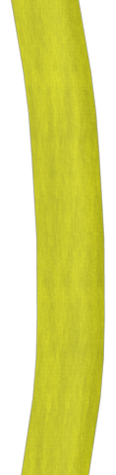
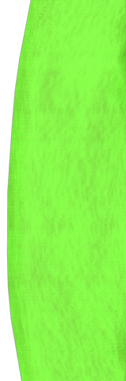
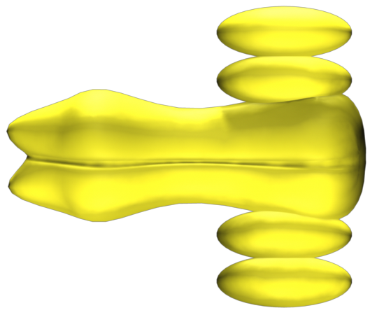
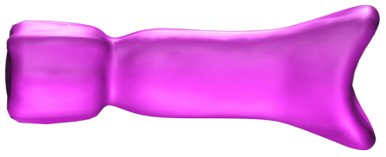

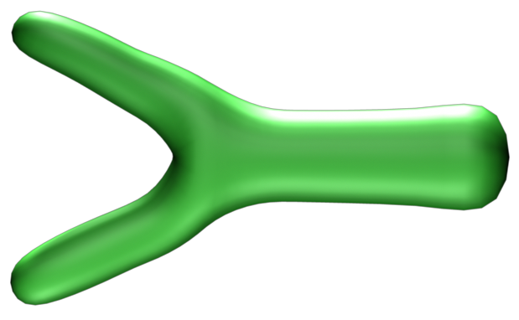
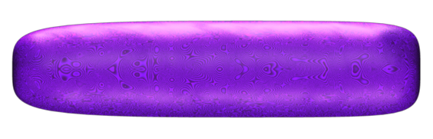

Activation of T lymfocytes through TCR and co-stimulating molecule CD28
MHC
Antigen
TCR
Dendritic cell
T lymfocyte
B7
CD28
CTLA-4

Slide 55
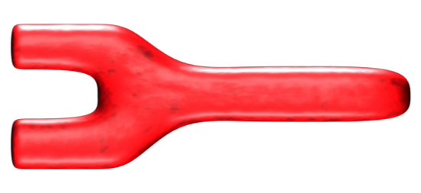
Up-regulation of CTLA-4 receptors after T- cell activation
MHC
Antigen
TCR
Dendritic cell
T lymfocyte
B7
CD28
CTLA-4

Slide 56
CTLA-4 receptor inhibition
MHC
Antigen
TCR
Dendritic cell
T lymfocyte
CD28
B7
CTLA-4

Slide 57
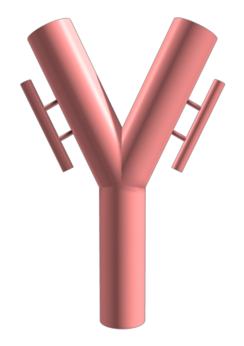
Antagonisation of CTLA-4 receptors Ipilimumab
MHC
Antigen
TCR
Dendritic cell
T lymfocyte
B7
CD28
Ipilimumab
CTLA-4
Leach DR, Science 1996;271:1734-1736.

Slide 58
Checkpoint inhibitors – PD-(L)-1
T cell recruitment
Blocking PD1:PD-L1 binding might activate immunity within the tumor microenvironment
Migration
PD-L1
Tumor
Cytotoxic
T cell
Chemokines
PD1
Anergy
T
T
T reg
MDSC
Gajewski TF, et al. Curr Opin Immunol. 2011;23:286-292. Spranger S, Gajewski T. J Immunother cancer. 2013;1:16.

Slide 59
2. Biological treatment of rheumatic diseases
Anti-TNF drugs – Ab (infliximab, adalimumab)
- receptor etanercept
Anti IL drugs - anakinra, tocilizumab
Immunomodulants – adalimumab, rituximab

Slide 60
2. Biological treatment of rheumatic diseases
Anti-TNF drugs - Ab
Infliximab – chimeric mAbs, IgG, 75 % of human, 25% of the murine antibody
high affinity binding to human TNFα
Adalimumab - human MAB binds specifically to TNF and neutralizes the biological function of TNF by blocking its interaction with the p55 and p75 cell surface TNF receptors
Certolizumab – humanized Fab fragment of TNFα antibody, conjugated with PEG
Golimumab - the same mechanism action as infliximab, not registered in EU

Slide 61
2. Biological treatment of rheumatic diseases
Anti-TNF drugs - receptor
Etanercept – soluble dimeric fusion protein – extracelular domain of receptor for TNFα and Fc chain of human IgG₁
Mechanism of action: competitive inhibition of TNFα, decreased effect of TNFβ
does not bind complement, but leads to the disintegration of granulomas

Slide 62
2. Biological treatment of rheumatic diseases
Anti-TNF drugs – adverse effects
Opportunistic infections – increased risk in combination of immunosuppressive drugs (with 2 - combined to 14x ! ), malnutrition, age > 50 years
- mycobacteria , listeria , fungal , viral infections
Paradoxical autoimmune reactions
Anti-idiotypic antibodies (in addition prevents binding of the antibody to TNF)
TB –activation of latent forms
Late carcinogenicity - lymphoproliferative disease
(2-3 times higher versus the healthy population) , inconsistent data
Others - specific AE for specific substances

Slide 63
2. Biological treatment of rheumatic diseases
Anti IL treatment
Anakinra – IL1 receptor antagonist
weaker effect than anti-TNF drugs
Tocilizumab - humanized mAb against IL6
AE: (infection ) + increase in lipids ( CHOL , LDL, TAG)

Slide 64
2. Biological treatment of rheumatic diseases
Immunomodulants
Abatacept - recombinant fusion protein from composed of Fc region of IgG and extracellular domain of CTLA4 ( receptor expressed in T-cells);
competitively binds to CD80, preventing T cell activation proliferation
Rituximab - binds to the transmembrane antigen CD20 (on pre-B and mature B lymphocytes) expressed on> 95% of all non-Hodgkin lymphomas of B cell origin

Slide 65
3. The biological treatment of psoriasis
Anti-TNF drugs
Etanercept - see above
Only one biological treatment of psoriasis for children 8-18 years
Infliximab - see above
Anti IL drugs
Ustekinumab - fully human MAb IgG1 anti-IL -12/ 23 (important in the pathogenesis of psoriasis), inhibition of cytokine cascade
AE : nasopharyngitis, headache, arthralgia, local irritation at the injection site

Slide 66
4. Biological treatment of inflammatory bowel disease
(Crohn's disease, ulcerative colitis )
Anti-TNF drugs (see above)
infliximab
adalimumab
certolizumab
Selective adhesion molecule inhibitors
Natalizumab – humanized IgG4 mAb against integrin α (prevents migration of leukocytes across the capillary wall)
Vedolizumab - humanized IgG1 mAb against α4β1 integrin (on activated leukocytes, provides adhesion to the endothelium and the penetration into the circulation from the gastrointestinal tract )

Slide 67
5. Biological treatment of bronchial asthma
  Adjunctive/supplementary treatment in patients with more serious desease which do not respond to other treatments
  Mepolizumab - anti IL-5 Ab
  Omalizumab – humanized Ab anti IgE

Slide 68
6. Biological treatment of multiple sclerosis
IF β – 1a – antiinflammatory, immunomodulatory effects, supresses Th1 T lymphocytes activity and HEB permeability
AE: flu-like syndrome, inhibition of hematopoiesis
Natalizumab – see above
Anti-CD20 mAb (B cells) - rituximab (see above), ocrelizumab, alemtuzumab
Anti-IL-2 - daclizumab humanized mAb

Slide 69
7. Biological treatment in ophtalmplogy
Monoclonal antibody against VEGF - A
Bevacizumab (see above) - was developed for the treatment of colorectal cancer, off-label use in wet age-related macular degeneration (AMD)
Ranibizumab
  Indications : AMD, CNV (chorioidal neovascularization)

Slide 70
Thanks for your attention

