Slide 1
Pharmacotherapy in children, elderly, in pregnant women and in lactation
Alena Máchalová

Slide 2
Overview of factors affecting drug effects
A.Factors related to drug:
Physical and chemical properties
Dose
Drug form
Combination of drugs
Food administered together with a drug
Repeated administration
B. Factors related to organism:
Age
Gender
Weight and body constitution
Circadian rhytms
Pathological state of organism
Genotype/fenotype (Race group/ethnic group)

Slide 3
Age
Administration of medicinal product (MP)
to children
to elderly people

Slide 4
Administration of MP to children
A child is not small adult
particularities of PD
particularities of PK

Slide 5
Changes of PK of drugs in young age - A
Higher pH in stomach
Large surface area/volume ration + thinner skin – increased skin absorption

Slide 6
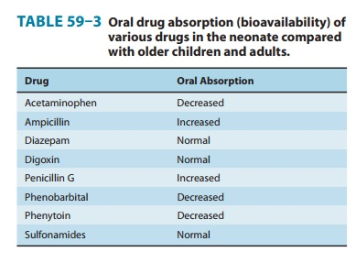

Slide 7
Changes of PK of drugs in young age - D
Higher total body water
Increase of body fat with age
Lower plasma proteins in infants
Unfinished development of HEB
→ increased Vd
→ obese children – higher risk in drugs not distributed into fat
→ higher distribution and lower peak concentrations of protein-bound drugs

Slide 8
Changes of PK of drugs in young age - M
The most complex difference between adults and children
Activity of CYP begins in foetus and increases with age (in 2 y exceeds adult levels)
Glucuronidation takes at least 3 years to mature
Liver blood flow is relatively higher
→ higher first pass effect
→ without adjustment of dose and dosing intervals there is a risk of cummulation and toxicity especially in newborns

Slide 9
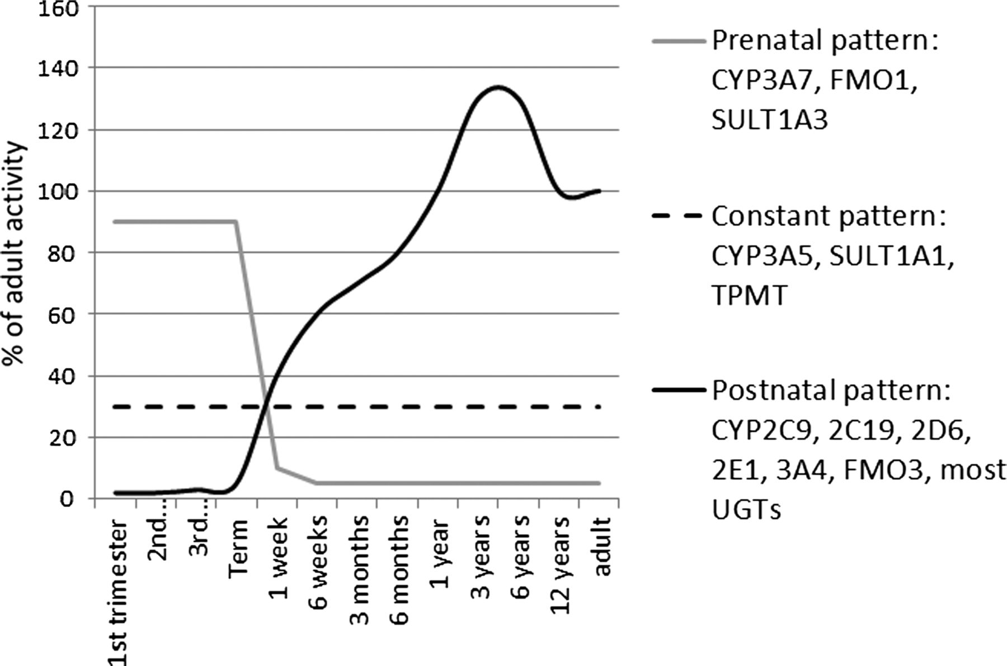

Slide 10
Changes of PK of drugs in young age - E
Decreased GF, but still is more advanced than TS
Decreased TS (aminoglycosides!!)
→ preterm infants develop renal excretion pathways more slowly than term neonates

Slide 12
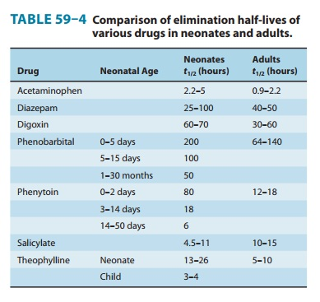

Slide 13
Changes of PD in children
Antihistamins:
In adult patient sedation (sleppines, tiredness)
In children excitation (cramps)
Chloramphenicol – gray baby syndrome
Salicylates – Reye syndrome
Barbiturates – paradoxical reaction (excitation, agressivity)

Slide 14
Administration of MP to children
Doses are given in SPC or have to be calculated
Approximate dose for children = body surface area (m2) x dose for adult
1,7 (m2 )
Body surface area =
7 x age (years) + 45
100

Slide 15
Administration of MP to old people
Seniors represent 14% of population but use 35% of drugs „Young“ senior 60 – 64y ....... 83% use medicines
„Middle“ senior 65 – 74y....... 89% use medicines
„Old“ senior above 75y....... 91-98% use medicines
Avarage amount of used preparations increase with age Ambulant seniors 4-6
Hospitalised 5-8 prep

Slide 16
Administration of MP to old people
physiological changes (organs lose their functional reserve)
worse adaptability to changes in inner or external conditions
polymorbidity (concomitant diseases or cause-effect chain)
polypragmasia (administration of many drugs together, risk of drug interactions is increasing)
higher incidence and severity of adverse effects

Slide 17
Characteristics of morbidity in old age
Microsymptomatology – asymptomatology
(lack of typical symptoms – fever, leucocytosis, silent AMI)
Mono(oligo)symptomatology
(tachyfibrillation in thyreotoxicosis)
Non-specific symptoms
(tiredness, loss of appetite, weightloss)
Syndrom of secondary impairment
(symptoms of another organ than which is the cause of disease e.g. disease of kidney leads to delirant state)
Cascade reaction (chain of diseases)
Atypic reactions to drugs

Slide 18
Changes of PD in old age
Very variable
Tissue hypoxia
Dysfunction of regulatory mechanisms
Change of sensibility of target structures
= hyperergic or paradoxical reactions

Slide 19
Changes of PD in old age - examples
ATB aminoglycosides:
lower doses in case of lower GF (correction according to CL CR)
Antihypertensives:
orthostatic hypotension, psychical alternations (confusion)
Anticoagulants:
bleeding from GIT (decreased absorption of vitamin K and decreased synthesis of prothrombin)
NSAID:
in 25% hematemesis
Anticholinergic drugs:
higher toxicity, depression, confusion

Slide 20
The most often mistakes in prescription in old age
underprescribing
not prescribing drugs with proven benefit (statins, AD, ACE-I)
overprescribing
drugs which are not indicated (hypnotics, BZD, peripheral vazodilatants, nootropics
„imperative drugging“
prescribing drugs for each disease per se
prescription with risk of interactions
prescription of drugs with risky profile
drugs CI due to comorbidities (β-blockers + COPD)

Slide 21
Drugs not suitable in old age
Mark H. Beers, 54, Expert on Drugs Given to Elderly, Dies Feb 28, 2009
Beers' List — Potentially Inappropriate Medications for the Elder
Fick DM, Cooper JW, Wade WE, Waller JL, Maclean JR, Beers MH. Updating the Beers criteria for potentially inappropriate medication use in older adults: results of a US consensus panel of experts. Arch Intern Med. 2003;163:2716-2724
Notes:
Med. 2003;163:2716-2724 Beers' List — Potentially Inappropriate Medications for the Elderly nejde o kontraidikaci při podáváni, je ale nutná zvýšená opatrnost!!!

Slide 22
Gender
Women are in general more sensitive to effects of some drugs, e.g. because of lower weight, but also of lower CL (olanzapine)
Specific periods are:
menstruation
gravidity
lactation
menopause

Slide 23
Pregnancy
slowed stomach and intestinal motility
increased volume of plasma
body water can be raised by up to 8 litres
occupancy rate of plasma proteins by hormones,
relative hypoalbumineamia
increased blood flow through kidneys and increase of GFR
changed liver enzymes activity (some stimulated, some inhibited)

Slide 24
Safety of medication in pregnancy
Consider
Dose
Lenght of therapy
Ability of drug to cross placentar barrier
Ability of the baby to eliminate the drug
Cummulation of the drug in the baby or in the water
Period of gestation when the drug is administered

Slide 25
Safety of medication in pregnancy
Period of implantation – all or nothing (14 days)
Organogenesis – the most sensitive period to teratogenic effects of drugs (till 12th week)
Fetal period – relatively safer when considering teratogenic effects, but risky in toxic eff.
Last month of gravidity – long acting drugs can affect newborn !
Lactation

Slide 28
General recommendations
Prescription for women in fertile age
Prescribe medicines which were tested for teratogenicity
Newly registered drugs should be prescribed only if older (time-proven) drugs cannot be used
If known teratogenic drug cannot be avoided, contraception is necessary

Slide 29
General recommendations
Prescription for pregnant women
Choose proven medication before pregnancy if chronic therapy is necessary
Sudden discontinuation may provoke worsening of the condition with possible severe consequences for both mother and child
Prefer monotherapy with the lowest dose possible

Slide 30
Lactation
Almost all of the drugs given to mother gets into her milk (apart from big molecules), however often in very small amount
depends on characteristics of the molecule (size, lipophility, binding to proteins in mother´s plasma, ionisation)
milk is mildly acidic
drugs which cross the barrier easiest are typically small molecules, lipophylic, weak bases and non-ionised
Notes:
Milk is generally slightly more acidic (pH 7.2) than the mother’s plasma (pH 7.4) so it attracts weak organic bases such as oxycodone and codeine.⁷ Such drugs become ionised and ‘trapped’ in the milk. Conversely, weak organic acids such as penicillin tend to be ionised and held in maternal plasma.
What affects the concentration of a drug in milk?
It is important to be aware of how drugs transfer into breast milk and what factors can influence this.
Maternal plasma concentration
Passive diffusion is the primary pathway by which drugs enter milk. There is a good concordance between the time-course of maternal plasma-drug concentration and milk-drug concentration. Maternal plasma concentration is also affected by the drug’s distribution into different tissues. A high volume of distribution (as for sertraline) will contribute to a lower maternal plasma concentration and a subsequent lower concentration in milk.
Maternal plasma protein binding
Transfer into breast milk is also influenced by the extent to which the drug is bound by maternal plasma proteins. Free unbound drug diffuses readily while highly protein-bound drugs like ibuprofen or warfarin (both 99% protein bound) are unable to diffuse in significant amounts.⁶ Sertraline is highly protein bound (98%) so overall it will be minimally transferred to the breastfed baby.⁶ By comparison, venlafaxine has much lower protein binding and so more of the drug will be present in milk.⁶
Size of the drug molecule
Most drug molecules, including alcohol, nicotine and caffeine, are small enough to enter milk. Exceptions are drugs with high molecular weights such as heparins and insulin.
Degree of ionisation
Drugs cross membranes in an un-ionised form. Milk is generally slightly more acidic (pH 7.2) than the mother’s plasma (pH 7.4) so it attracts weak organic bases such as oxycodone and codeine.⁷ Such drugs become ionised and ‘trapped’ in the milk. Conversely, weak organic acids such as penicillin tend to be ionised and held in maternal plasma.
Lipid solubility
In addition to the passive diffusion into the aqueous phase, lipid-soluble drugs such as citalopram⁸ may have co-secretion by dissolution in the fat droplets of milk.² In practical terms, this may not be of concern. It would not be an indication to change therapy if citalopram has been effective, but infant drowsiness should be monitored. Although the fat content of the milk varies according to infant age and phase of the feed, this is unlikely to impact on the choice of drug therapy.
Maternal pharmacogenomics
A growing understanding of the influence of pharmacogenomics is well exemplified with codeine which is variably metabolised to morphine by the cytochrome P450 (CYP) 2D6 enzyme. The ultra-rapid metaboliser phenotype occurs in up to 10% of Western Europeans and up to 30% of North Africans. Repeated codeine doses in these women produce significant amounts of morphine. Rapid transfer from maternal plasma to the milk may result in central nervous system depression and potentially infant death.⁹ Codeine should be avoided during breastfeeding¹⁰ and alternative analgesia is recommended, such as paracetamol or ibuprofen.
Most drugs are not of concern in breastfeeding.²⁻⁴ In addition, most lactating women take few medicines, and then only occasionally. Further, even though virtually all drugs are transferred into breast milk to some extent, the amount of drug is usually small and unlikely to cause an adverse effect on the baby. Considering the number of drugs available, relatively few known adverse effects occur in babies and it is generally not necessary to suspend breastfeeding because of the mother’s medication. This concept is not new. It was suggested over 100 years ago that ‘… it is possible to show that drugs … when given to a mother, rarely affect the milk injuriously, and almost never the babe to a marked degree’.⁵

Slide 31
Lactation
- drugs given to mother only locally or in small amount (nose or eye drops, inhalant sprays, topical preparations applied on small area) do not reach the baby in significant concentrations
- the relative infant dose is the dose received via breast milk (mg/kg/day) relative to the mother’s dose (mg/kg/day). It is expressed as a percentage.
- A relative dose of 10% or above is the notional level of concern, but this is rare (e.g. Lithium)

Slide 32
Safety of medication during lactation
Possible risk for breast-fed child depends on
Amount of the drug fed in breast-milk to the baby
PK of the drug in the baby (t1/2)
Safety profile of the drug
Health state of the baby

Slide 33
General recommendations
1. Adjust time of administrations and feeding –
Generally the most suitable pattern is to feed baby 1-3h after administration of the drug (exceptions - amoxicilin 4-6 h, metylprednisolon 8 h, caffeine 0,5 h).
2. The safest is to use drugs, which can be administered once a day
3. In this case the drug should be given after evening feeding, before child´s longest sleep

Slide 35
Drugs stimulating milk production = galactogogues
Domperidone and metoclopramide
- D antagonists
- used off-label to stimulate prolactin and enhance milk supply
- do not have high evidence of efficacy for this indication, risk of arrhytmias!
Other drug increasing milk production – side effects
Imipramine, fenothiazin, sulpirid, haloperidol, reserpin, metyldopa, TSH
Drugs decreasing milk production
Estrogens, ergot alkaloids (very strong effect)
androgens, tamoxifen, bromocriptine, levodopa, barbiturates, apomorphin,
diuretics,1st generation of antihistaminics, pyridoxin (in very high doses)

Slide 36
Where to look for information?
Product information - SPC
State-based obstetric drug information services provide detailed advice on the use of drugs during lactation and should be able to advise about past clinical experience with the drug.
LactMed11 is a freely accessible, well-resourced and peer-reviewed online database. It is updated to keep pace with new information, including published studies and drug approvals. It also incorporates information on complementary treatments.
Drugs and Lactation Database (LactMed) - NCBI Bookshelf (nih.gov)

Slide 37
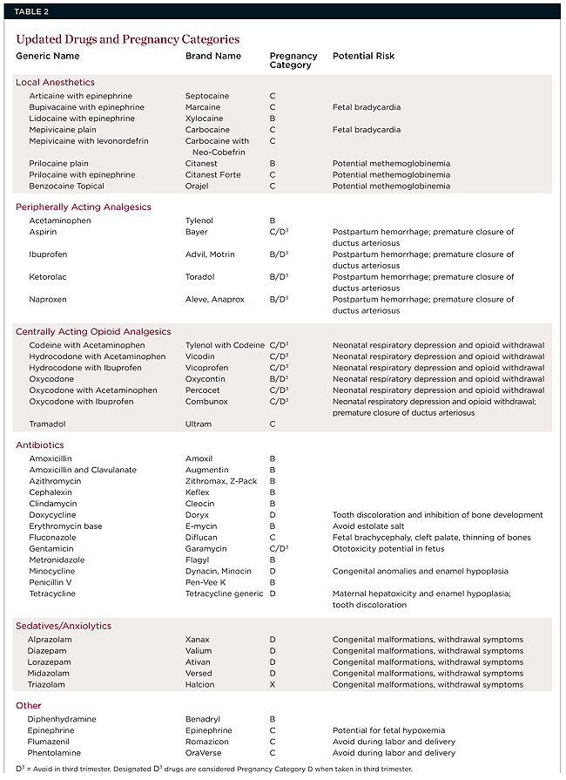
Drugs used in dentistry

Slide 38
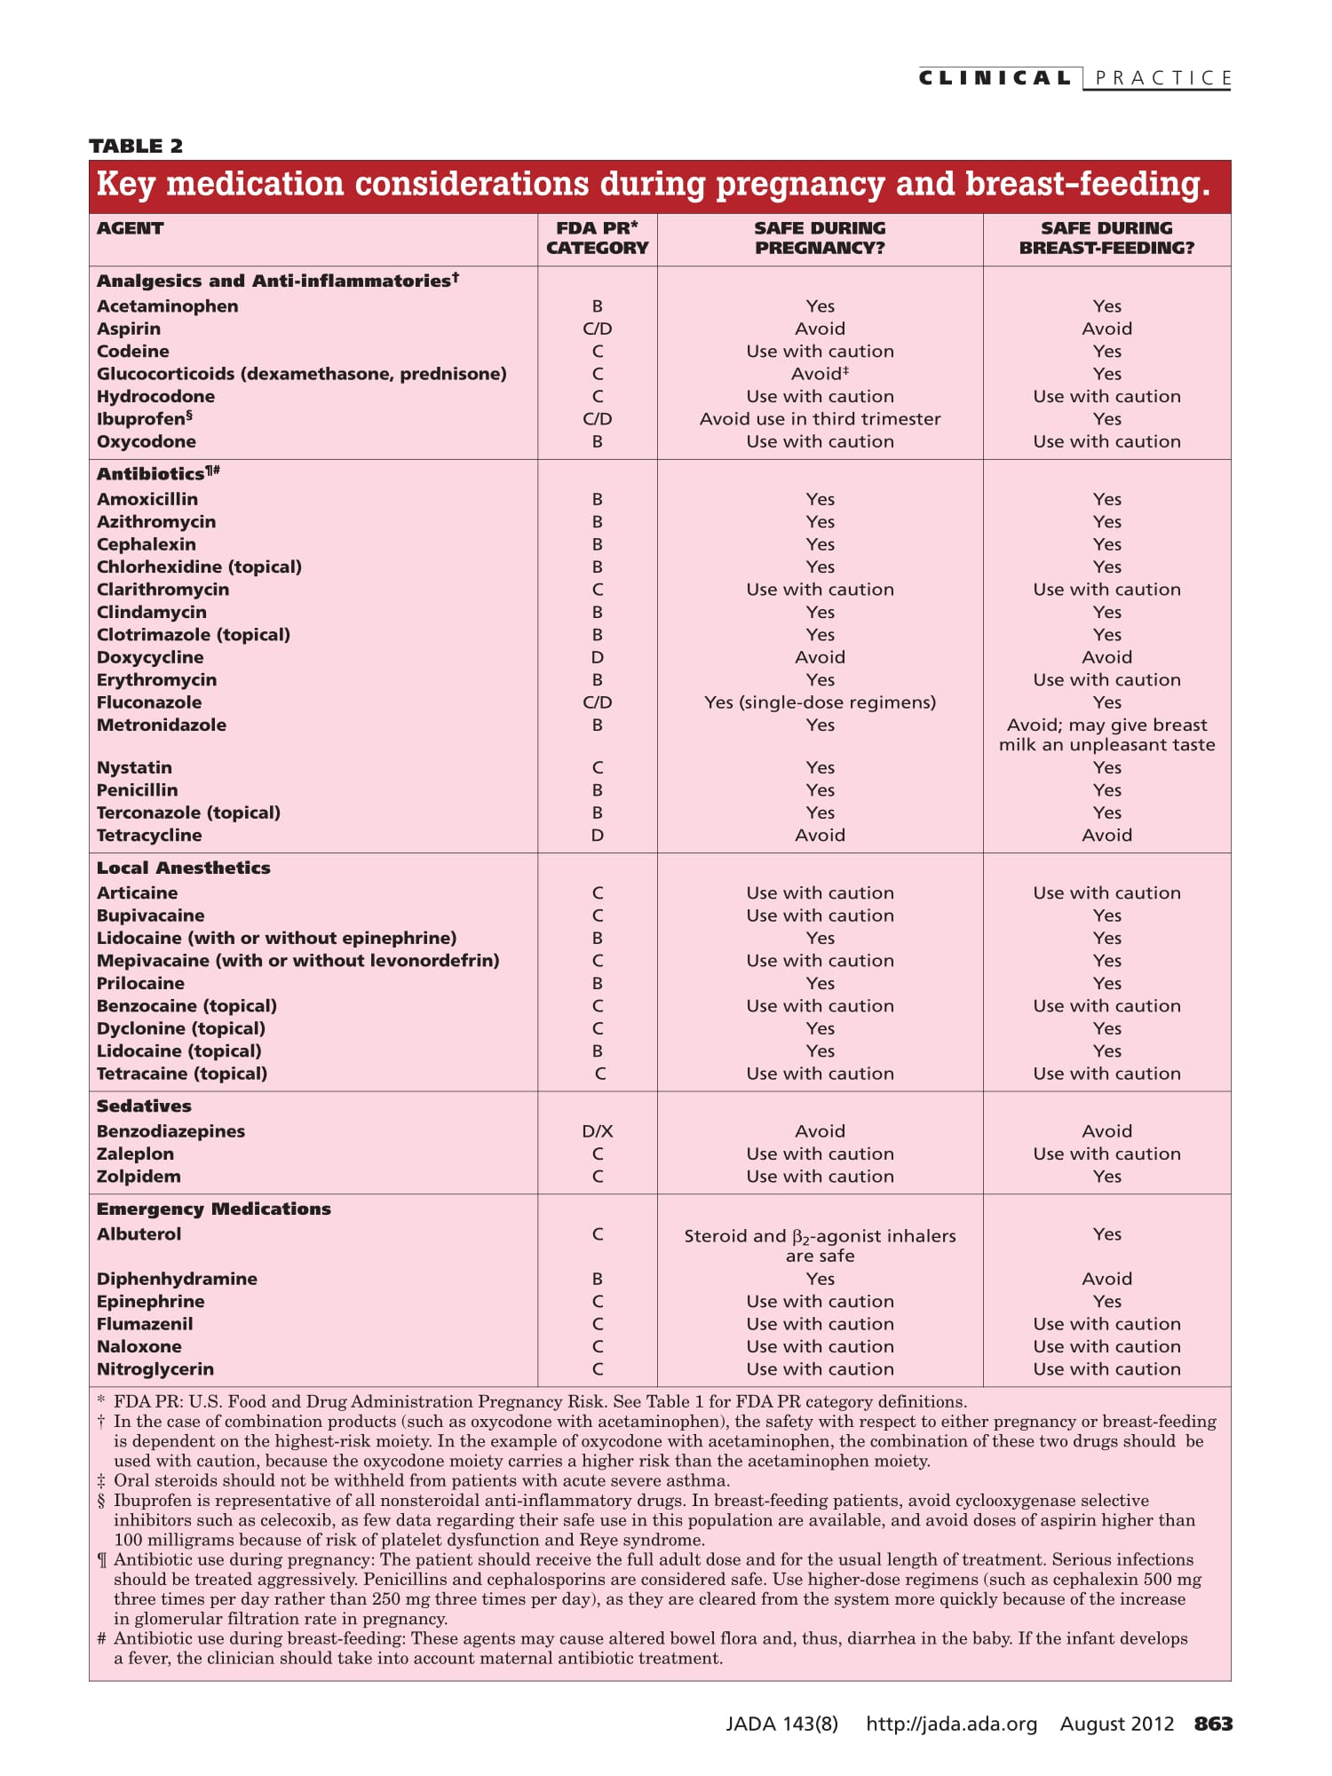

Slide 39
Thank you for your attention
amachal@med.muni.cz

