Slide 1

Drug Interactions
Alena Máchalová

Slide 2
Agenda
Drug interactions (DDI) - terminology
Pharmacokinetic DDI – examples
  Absorption
  Distribution
  Metabolism
  Elimination
Pharmacodynamic DDI - examples
Pharmaceutical DDI - examples
Drug interactions with food, beverages, herbs
Recommendation
Summary

Slide 3
Definitions and Terms
Drug Interactions: “The pharmacologic or clinical response to the administration of a drug combination different from that anticipated from the known effects of the two agents when given alone ”
1Tatro DS (Ed.) Drug Interaction Facts. J.B. Lippincott Co. St. Louis 1992.
Positive?
Negative?
Clinically significant

Slide 4
Definition of drug-drug interaction
Interactions of two or more different drugs that affect the action and effects of at least one of them
  One-sided
    − combination of levodopa and carbidopa
    − combination of 5-fluorouracil and leucovorin
    − combination of glucocorticoids and setrons
  Double-sided
    − combination of sulfamethoxazole and trimethoprim

Slide 5
Definition of drug-drug interaction
Antagonism is the opposite effect of two or more drugs administered (NSAIDs and ACEIs, methotrexate and leucovorin, heparine and protamine)
Receptor antagonism - naloxone with fentanyl
Synergism - The effects are magnified many times over (opioids and benzodiazepines, sulfamethoxazole with trimethoprim, amoxiciline and gentamicine)
Addition - the resulting effect corresponds to the sum of the effects of both substances (summation) (amoxicillin and clavulanic acid)
Potentiation – one drug has an effect, the other one not, but enhances effect of the first one (probenecid + penicillin).

Slide 6
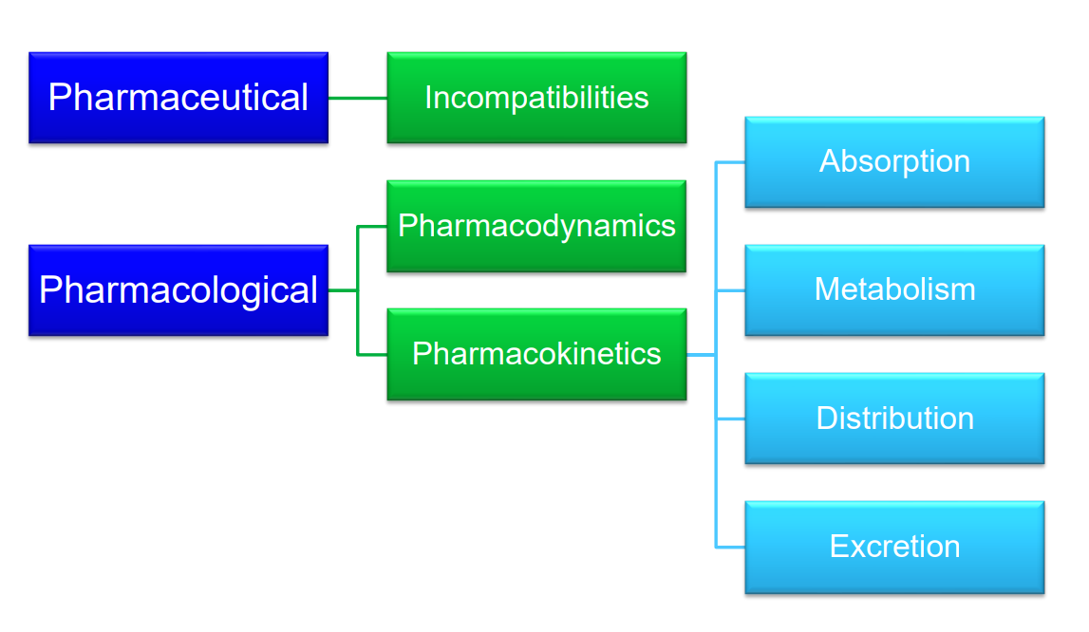
Drug interactions

Slide 7
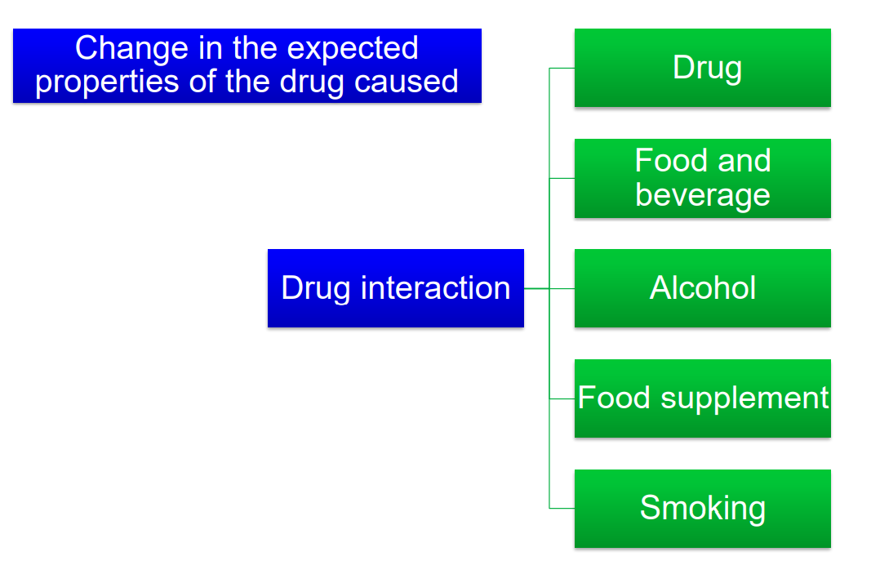
Drug interactions

Slide 8
Why are the drug interactions so important?
The side effects of the drugs are 4.-6. the most common cause of death (analysis of national registers of ARs, Lazaru J., JAMA, 1998)
Two-thirds of side effects are caused by drug interactions (US National Register Analysis, Philips KA, JAMA, 2001)
Behind most serious interactions is the background of polymorphism in the metabolism of several dozen "problematic" drugs (analysis of serious emergencies, McNamara, Circulation, 2001)
The risk of drug interactions increases with the number of drugs
Frequent polypharmacy in gerontological practice

Slide 9
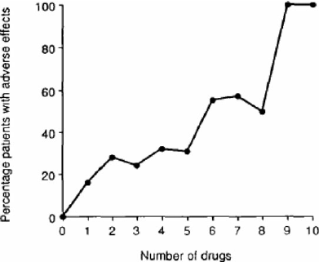
The risk of polypharmacy
Polypharmacy - unjustified and irrational overuse of pharmacotherapy Drugs with a narrow therapeutic index and therapeutic range. Drugs that are metabolised via CYP3A4
Cresswell, Kathrin & Fernando, Bernard & Mckinstry, Brian & Sheikh, Aziz. (2007). Adverse drug event in the elderly. British medical bulletin. 83. 259-74. 10.1093/bmb/ldm016.

Slide 10
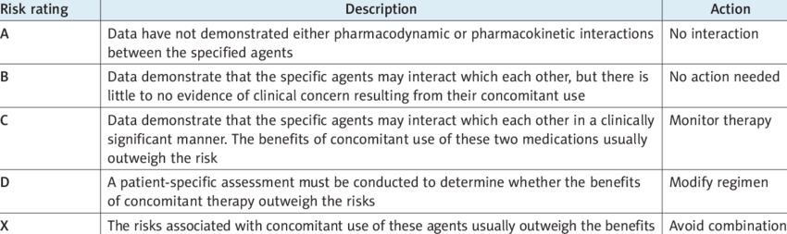
Classifying drug interactions
Non-relevant
Minor
Moderate
(use with caution)
Major
(should be avoided)
Contraindicated
(prohibited)

Slide 11
Significance of drug interactions
Desirable (beneficial for the patient) drug combination
potentiating drug effect and decreasing the toxicity
  combination of:
    cytostatics
    analgesics
    antihypertensives
    ATBs
    drugs for asthma…

Slide 12
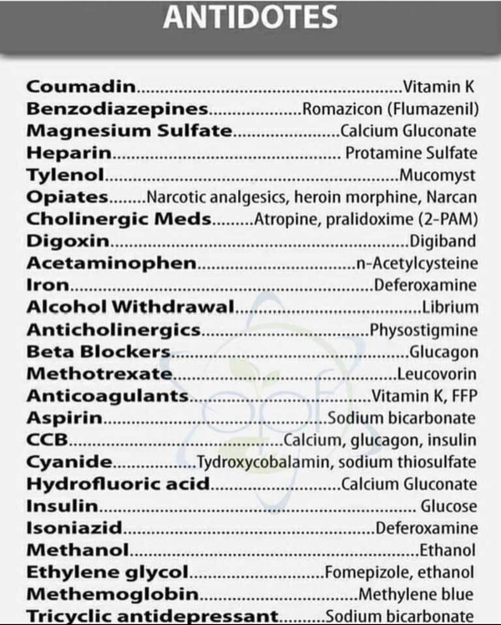
Significance of drug interactions
Desirable (beneficial for the patient) - combination of the active substance suppressing/inhibiting the effect of another drug in the treatment of intoxication/poisoning organism

Slide 13
Significance of drug interactions
Undesirable (for the patient harmful, potentially dangerous)
This may result in:
  increase or decrease (loss) effect
  increasing or reducing the incidence of side effects
  other changes in effect
  injury or even death
  Always evaluate clinical significance

Slide 14
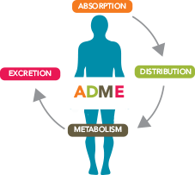
2. Pharmacokinetic DDIs

Slide 15
Pharmacokinetic interactions - Absorption
1. altered pH
2. altered bacterial flora
3. formation of drug chelates or complexes
4. drug induced mucosal damage
5. altered GIT motility

Slide 16
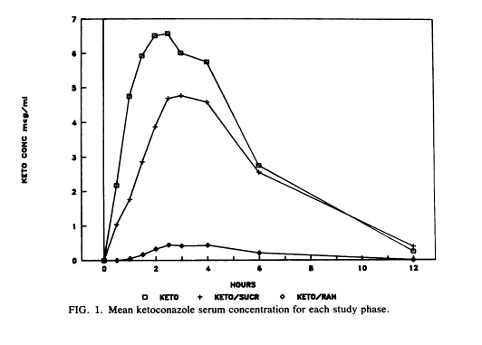
1. Altered pH
The non-ionized form of a drug is more lipid soluble and more readily absorbed from GIT than the ionized form does.
Decrease the tablet dissolution of p.o. azole antimycotics (e.g. Ketoconazole)
Antacids
H2 antagonists (acidic)
PPI
Therefore, these drugs must be separated by at least 2h in the time of administration of both.
Effects of ranitidine and sucralfate on ketoconazole bioavailability. Piscitelli S., Antimicrob Agents Chemother. 1991 Sep; 35(9): 1765–1771.

Slide 17
2. Altered intestinal bacterial flora
40 % or more of the administered digoxin dose is under physiological conditions metabolized by the intestinal flora. Antibiotics kill a large number of the normal flora of the intestine
Increase digoxin concentration and increase its toxicity

Slide 18
3. Formation of drug chelates or complexes
DDIs Can Occur in the GI Tract
Sucralfate, some milk products, antacids, and oral iron preparations
Medical coal (charcoal)
Didanosine (given as a buffered tablet)
Cholestyramine
Block absorption of quinolones, tetracycline, and azithromycin
Reduces absorption of p.o. drugs (e.g. Metoprolole, delavirdine…)
Reduces ketoconazole absorption
Binds raloxifene, thyroid hormone, and digoxin

Slide 19
Complexation or chelation
Tetracyclines, Quinolones interact with iron, calcium, magnesium, aluminium preparations (antacid - aluminum or magnesium hydroxide) or
Unabsorpable complex
milk (Ca²⁺)
Decrease absorption of ciprofloxacin by 85% due to chelation carbo medicinalis (coal), diosmectin – readsorption of other drugs

Slide 20
4. Drug-induced mucosal damage
Antineoplastic agents cyclophosphamide, vincristine, procarbazin
Inhibit absorption of several drugs such as digoxin

Slide 21
5. Altered motility
Increased motility (diarrhea)
• Prokinetic drugs - metoclopramide, domperidone, itopride
Decreased motility (ileus, constipation)
• Opioids, diphenoxylate, loperamide
Reduced absorption
Increase in AUC of drugs, toxicity

Slide 22
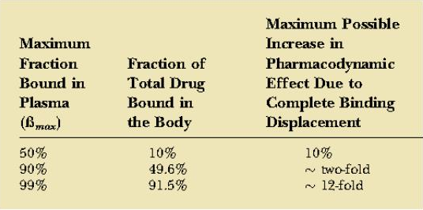
Pharmacokinetic interactions - Distribution
The major plasma proteins to which most drugs bind are
albumin - typically binds acidic, anionic drugs
a1-acid glycoprotein - typically favors basic drugs
Competitive protein binding by another drug will result in increase concentration of free drug, and that will yield more drug response

Slide 23
Displaced protein binding
Depends on the affinity of the drug to plasma protein. The most likely bound drugs are capable to displace others. It is clinically important if displaced drug is highly PP binding , with LONG T ½, small Vd, narrow therapeutic range.
Aspirin, Phenylbutazone, Clofibrate displace:
Oral Anti-coagulants (Dicumarol, Warfarin)
Oral Hypoglycemics (Tolbutamide)
Bilirubin in Neonate.
Bleeding
Hypoglycemia
Jaundice & Kernicterus

Slide 24
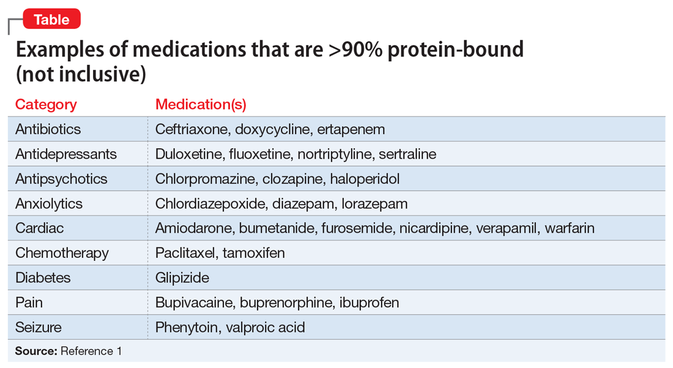
Protein binding of drugs
obr

Slide 25
Distribution
glycoprotein P - most important - works in tandem with CYP3A4 (mutual substrates, inductors and inhibitors)
OATP (organic anion transport protein) significant system ensuring the transfer of org. anions - risk of inhibition or competition or induction
reduced activity of P-gp
(present in a quarter of the population)
Increased absorption of drugs

Slide 26
Distribution
Useful mnemonics:
P glycoprotein
Increase Quantitative Absorption Very Effectively
Itraconazole
Quinidine
Amiodarone
Verapamil – most potent Pg inhibitor
Erythromycin

Slide 27
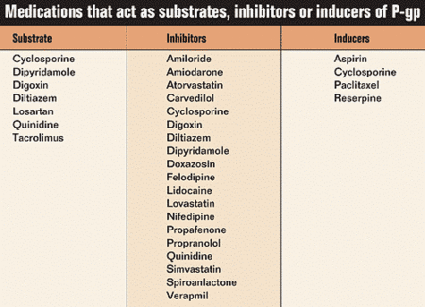
Distribution of drugs in relation to P-glycoprotein

Slide 28
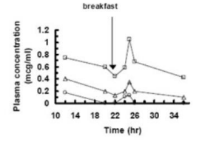
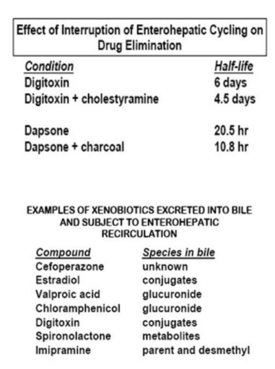
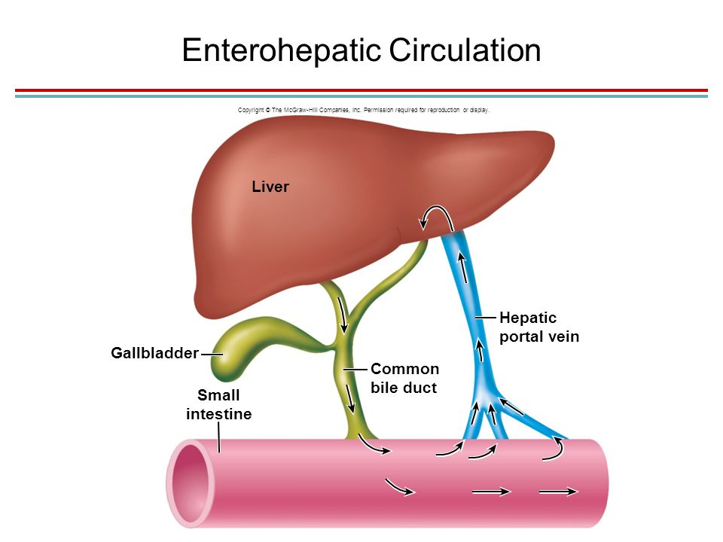
Influence of enterohepatic recirculation

Slide 29
Pharmacokinetic interactions - Metabolism
The effect of one drug on the metabolism of the other is well documented. The liver is the major site of drug metabolism but other organs can also do e.g., WBC, skin, lung, and GIT.
CYP450 family is the major metabolizing enzyme in phase I (oxidation process). Therefore, the effect of drugs on the rate of metabolism of others can involve the following examples

Slide 30
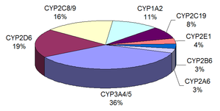
CYP P450
a key enzyme in the metabolism of xenobiotics mainly responsible for Phase I biotransformation processes occurring in the liver, lungs, kidneys, brain, skin, small intestine and other organs
Substrates P450
  drug metabolizing using this enzyme
Inducers of cytochrome P450
  increased degradation of the drug from the organism
  subtherapeutic plasma levels of the drug
  reduce the effect of drugs
Inhibitors of cytochrome P450
  accumulation of the drug in the body
  increased plasma levels
  Increased toxicity

Slide 31
Polymorphism of enzymes
slow metabolizer - all defective alleles
medium metabolizer - an intact allele
rapid metabolizer - all intact allele (wild type)
ultrarapid metabolizer - multiplication of a gene or a higher enzyme activity

Slide 32
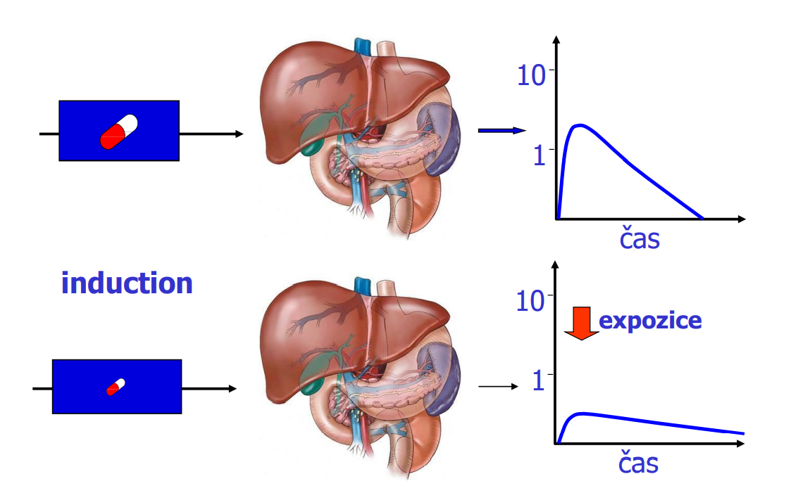
Drug interactions - induction
It may take seconds up to weeks in case of enzyme induction (weeks for protein synthesis), while enzyme inhibition occurs rapidly.

Slide 33
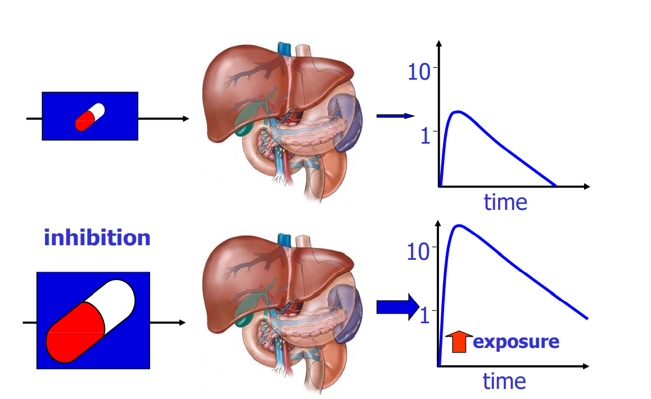
Basic mechanisms - inhibition

Slide 34
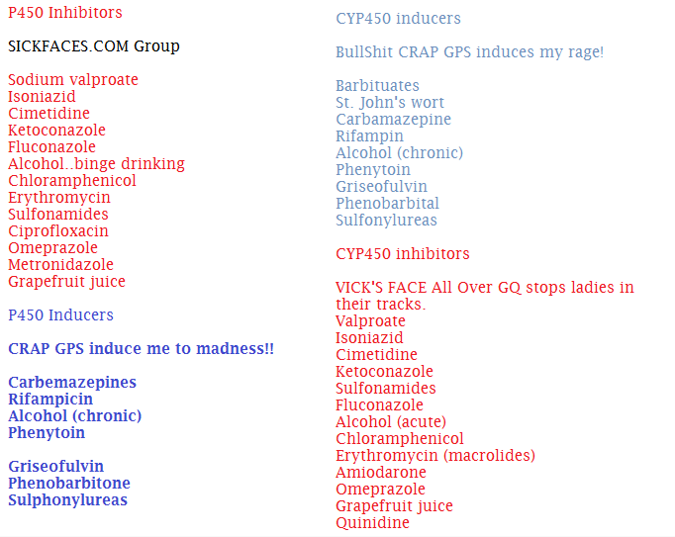
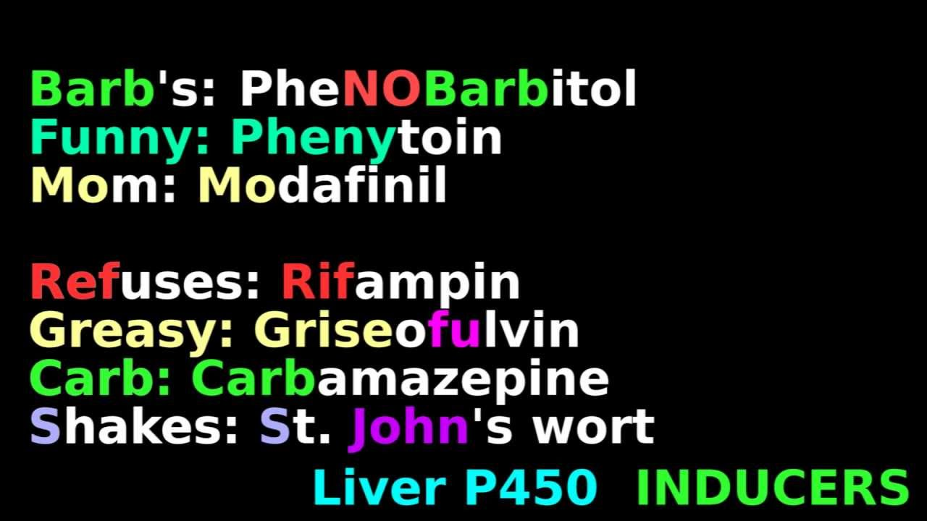
Mnemonics

Slide 35
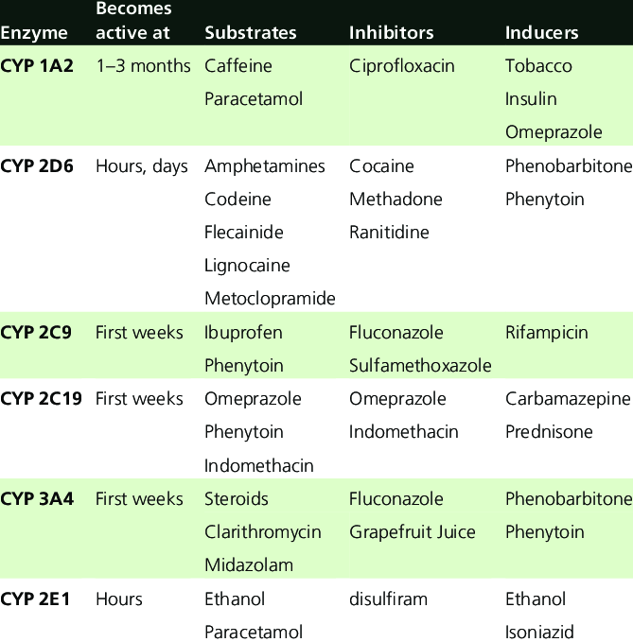
High interindividual variability

Slide 36
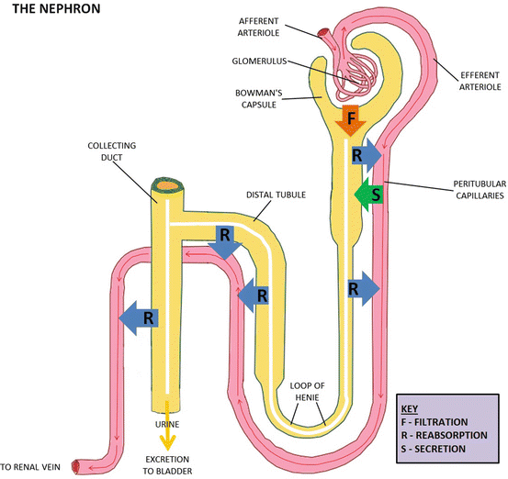
Elimination
glomerular filtration has only a limited effect on protein-bound substances
active tubular secretion - active transport of strong acids and bases in the proximal tubule
passive tubular resorption - is possible only for non-ionized forms
competition - reduction of the capacity for excretion of drugs eliminated exclusively by the kidneys
urine pH - alcalinisation / acidification
Hepatic clearance - Enterohepatic recirculation
Elimination by lungs, breast milk, sweat…

Slide 37
Elimination
Example:
co-administering methotrexate and
nonsteroidal anti-inflammatory drugs (NSAIDs), probenecid (Probalan, generics), penicillins, proton pump inhibitors, vitamin C, sulfa, and some other antibiotics
Toxicity (nausea, vomiting, diarrhea, mucositis, stomatitis, esophagitis, elevated hepatic enzymes, renal failure, rash, myelosuppression (leukopenia, pancytopenia, thrombocytopenia), acute lung injury, tachycardia, hypotension, and neurologic dysfunction (depression, headache, seizures, motor dysfunction, stroke-like symptoms, encephalopathy, coma)
Why?
Renal excretion is the major route of elimination for methotrexate (∼80% ); the drug being actively secreted in the renal tubule by the general organic acid transport system. The renal clearance of methotrexate is decreased by the co- administration of (organic) acids.
Solution?
With high dose methotrexate, routine administration of fluid and/or bicarbonate is recommended to prevent intratubular precipitation of the drug.
The renal clearance of methotrexate is correlated with endogenous creatinine clearance which may provide a guideline to dosage adjustments according to renal function and age.

Slide 38
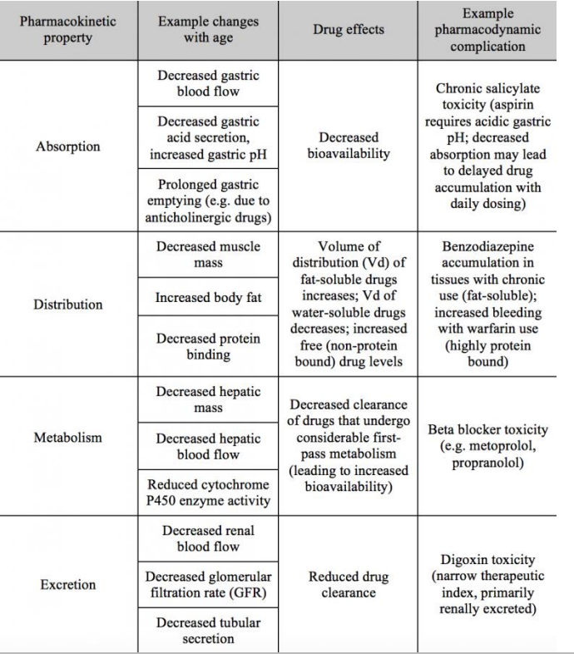
Summary of PK DDIs
emDOCs.net – Emergency Medicine EducationCommon ED Medication Errors: Polypharmacy - emDOCs.net - Emergency Medicine Education

Slide 39
Pharmacodynamics drug interactions
= alteration of the drug action without change in its serum concentration by pharmacokinetic factors.
Additive effect : 1 + 1 = 2
Synergistic effect : 1 + 1 > 2
Potentiation effect : 1 + 0 = 2
Antagonism : 1 – 1 = 0

Slide 40
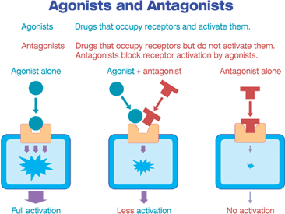
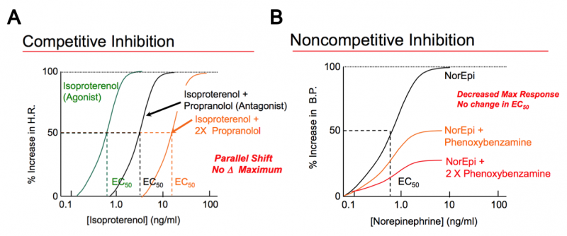
Receptor antagonism
Opioids x naloxone
BDZ x flumazenil
Tubocurarium x neostygmine

Slide 41
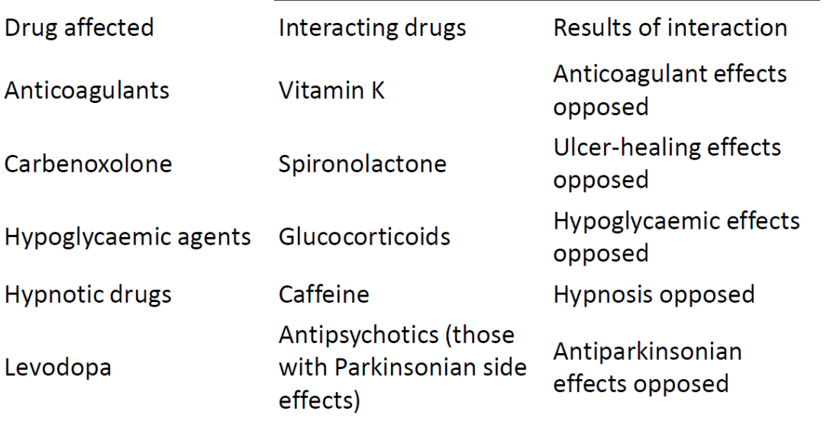
Opposing or antagonistic interactions

Slide 42
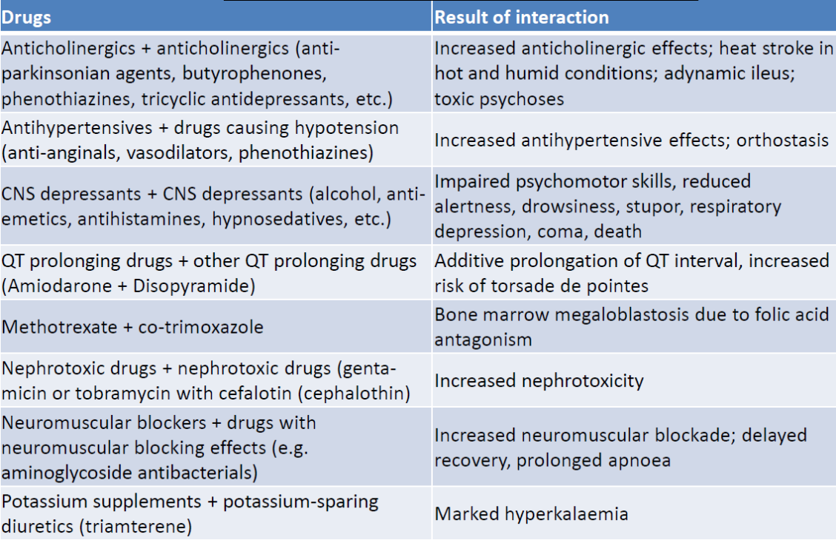
Pharmacodynamics drug interactions

Slide 43
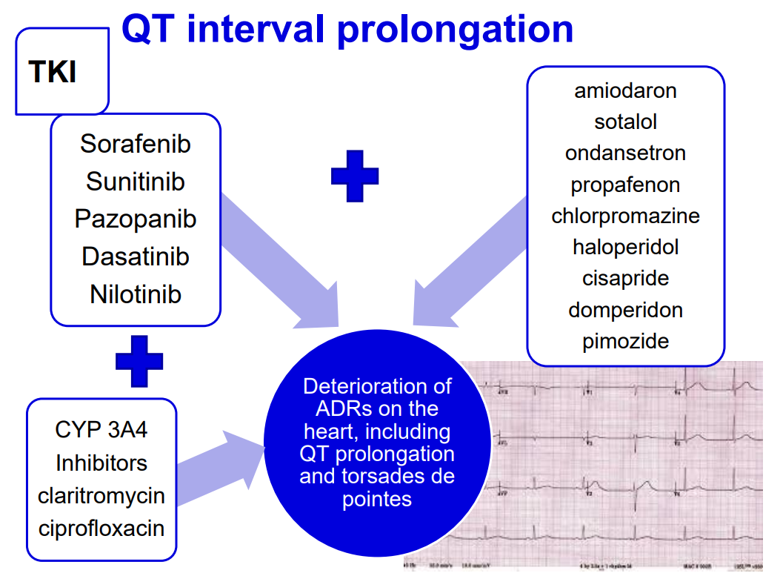

Slide 44
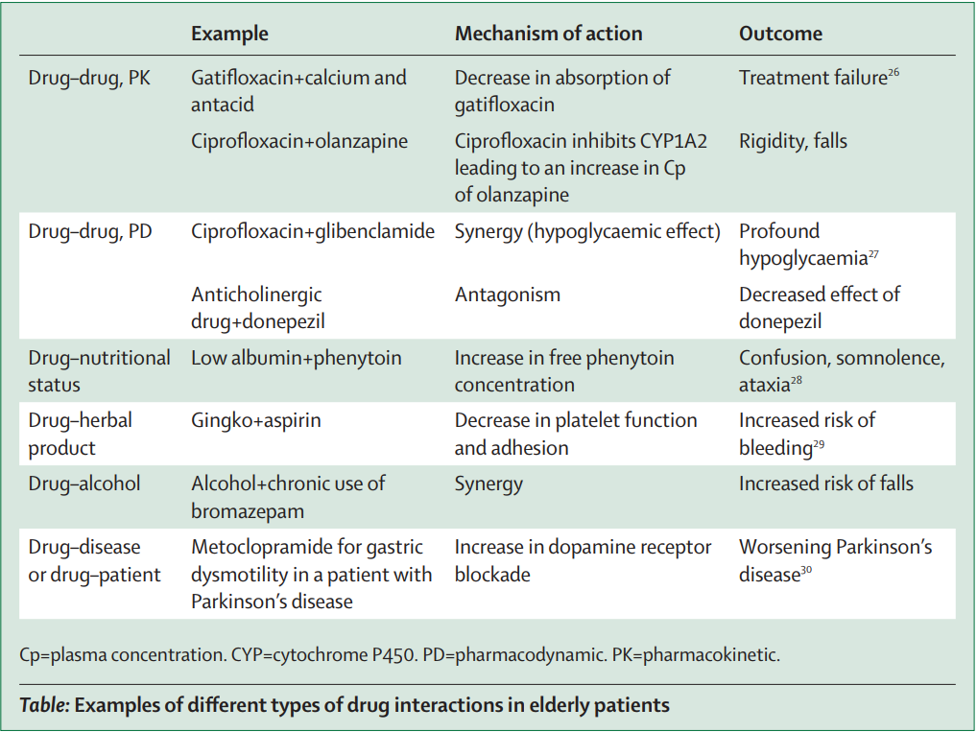
Important Drug Interactions in the Elderly
Louise Mallet, Anne Spinewine, Allen Huang,
The challenge of managing drug interactions in elderly people,
The Lancet, Volume 370, Issue 9582,
2007

Slide 45
Clinically significant drug interactions
Penicillins
Do not administer concomitantly with other penicillins
Digoxin - is metabolized by the intestinal microflora - TDM
Oral contraceptives - inform about the use of other contraceptive methods
Metronidazole
Alcohol - disulfiram reaction
Warfarin - risk of bleeding, INR control, dose adjustment
Lithium - toxicity, do not administer simultaneously

Slide 46
Clinically significant drug interactions
Clarithromycine
Theophylline - risk of TDM toxicity, dose adjustment
Carbamazepine - choice of another ATB
Digoxin - TDM, dose adjustment
Cyclosporine - TDM, dose adjustment
Statins - choice of another ATB or replacement with lovastatin, pravastatin
Oral contraceptives - informing about the use of other contraceptives
Warfarin - risk of bleeding
Midazolam - increased sedation

Slide 47
Clinically significant drug interactions
Clindamycine
Azole antifungals
Neuromuscular blockers prolongation of their effect, toxicity
Fluoroquinolones
Antacids, minerals - ↓ absorption of ATB, do not administer together
Caffeine - ↑ toxicity of caffeine

Slide 48
Clinically significant drug interactions
Acetylsalicylic acid and NSAIDs
Warfarin - increased risk of bleeding
ACE inhibitors, beta-blockers, sartans - reduction of antihypertensive effect
Furosemide - reduction of diuretic effect
Paracetamol
Alcohol
Phenytoin, carbamazepine, isoniazid - increased risk of hepatotoxicity

Slide 49

Clinically significant drug - food interactions
St. John´s wort X immunosuppresants (tacrolimus, sirolimus, cyclosporine)
Tyramine X MAOI
Grapefruit juice X statins

Slide 50
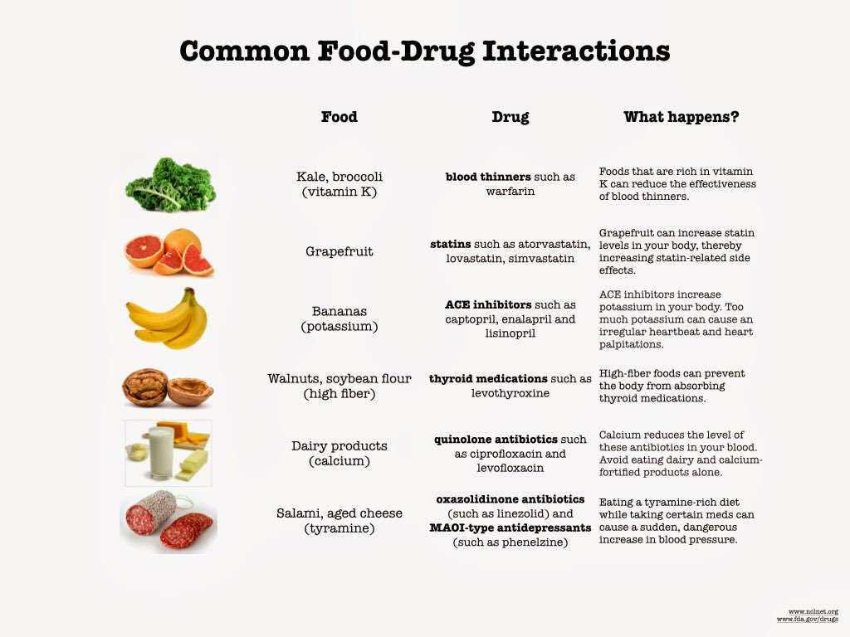
Drugs – food interactions

Slide 51
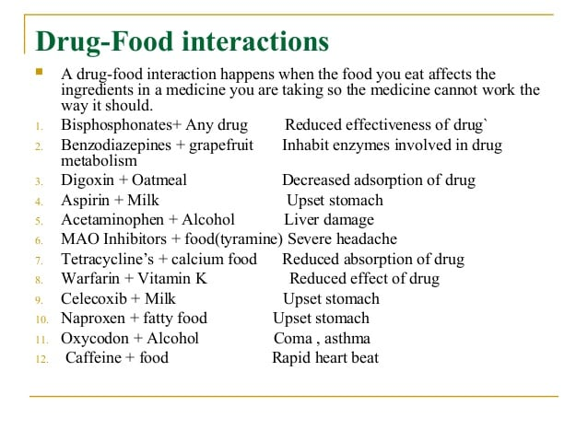
Drugs – food interactions

Slide 52
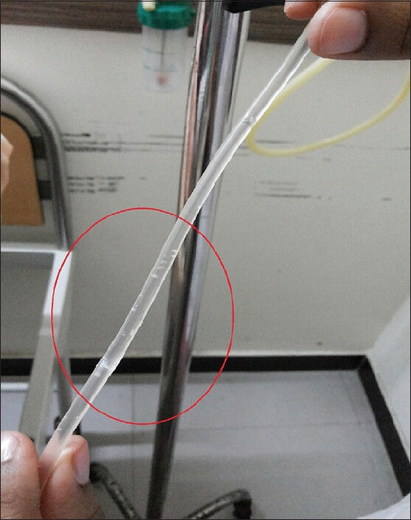
Pharmaceutical drug interactions

Slide 53
Incompatibility
Administration of aminoglycosides and beta-lactams meeting in one of the lumens - inactivation of the free -NH2 in the free aminoglycosides and -COOH in beta-lactams
Amiodarone diluted in 5% glucose solution meets Norepinephrine reconstituted in saline solution - precipitation of amiodarone
Octreotide meets in one lumen with parenteral nutrition, octreotide is inactivated
do not mix in one fluid, split the route of administration, do not give in at the same time
dilute NE in 5% glucose solution
separate pathways for parenteral nutrition and octreotide

Slide 54
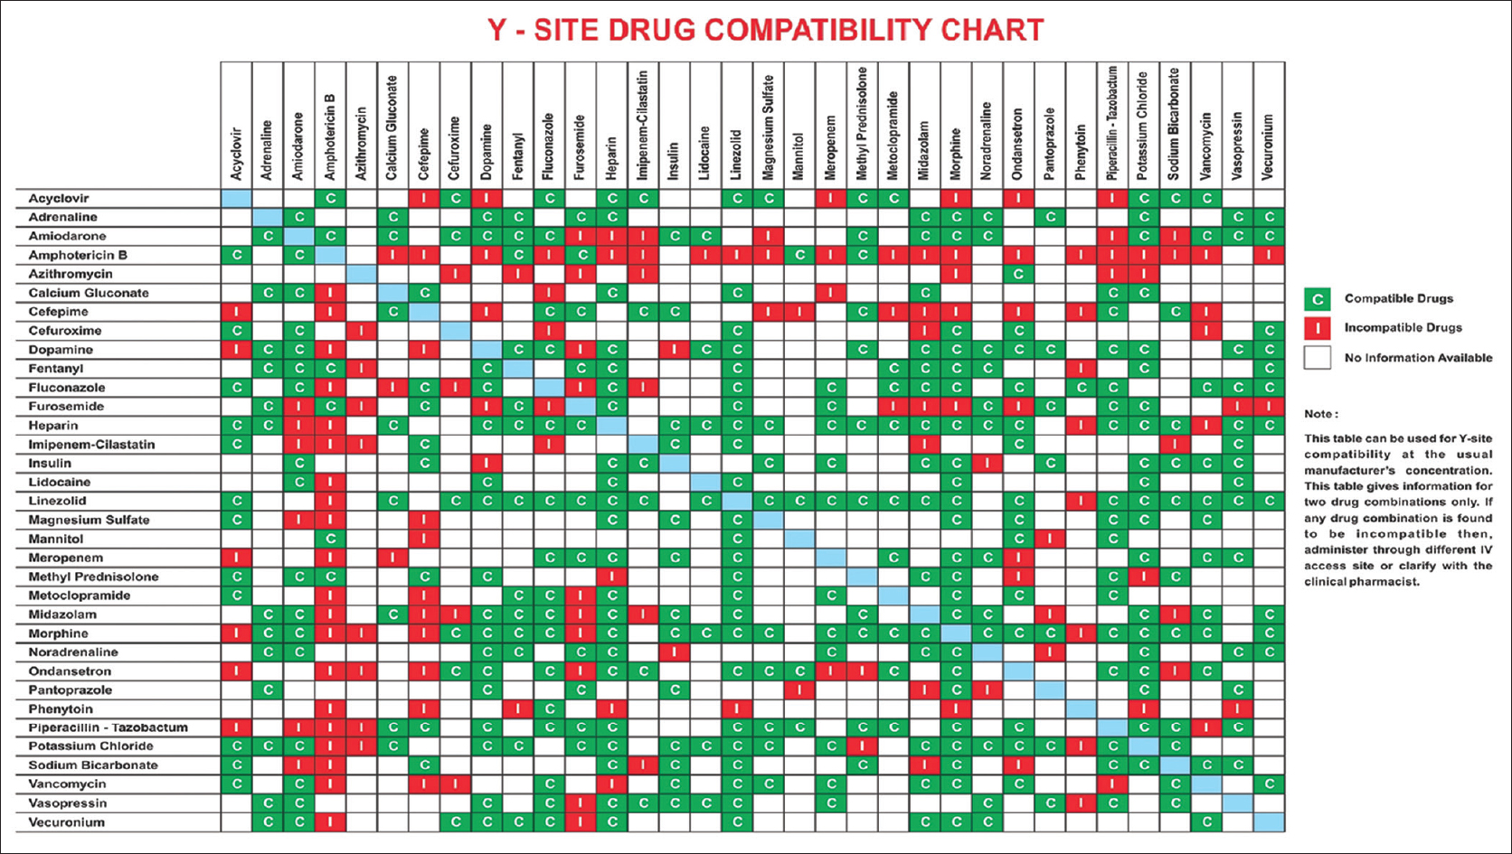
IV Drug Compatibility Chart
www.ijccm.org

Slide 55
Things to remember
Interactions are easily forgotten when prescribing
Interactions are difficult to remember
PD interactions can often be predicted across drug classes
PK often cannot be predicted – experiments needed
Many interactions probably remain undescribed
The chances of interaction are 60 times higher in a patient taking 5 drugs than in a patient taking 2

Slide 56
References:
SmPCs − Stockley’s Drug Interactions −
Micromedex − https://pubmed.ncbi.nlm.nih.gov/ −
https://www.drugs.com/drug_interactions.html −
https://www.webmd.com/interaction-checker/default.htm −
https://reference.medscape.com/drug-interactionchecker −
www.arizonacert.org (drug interactions) −
www.drug-interactions.com (P450-mediated drug interactions) −
http://www.drugwatch.com/drug-interactions/ −
http://www.uspharmacist.com −
www.QTdrugs.org (drug-induced arrhythmia) −
www.C-Path.org (drug development

Slide 57
Thanks for your attention

