Slide 1
Department of Gynecology and Obstetrics
Brno University Hospital and
Masaryk University, Faculty of Medicine
head: doc. MUDr. Vít Weinberger, Ph.D
Menstrual cycle and amenorrhoea
Tvarožek S., Meixnerová I.
Obstetrics and Gynecology - lectures
2020

Slide 2
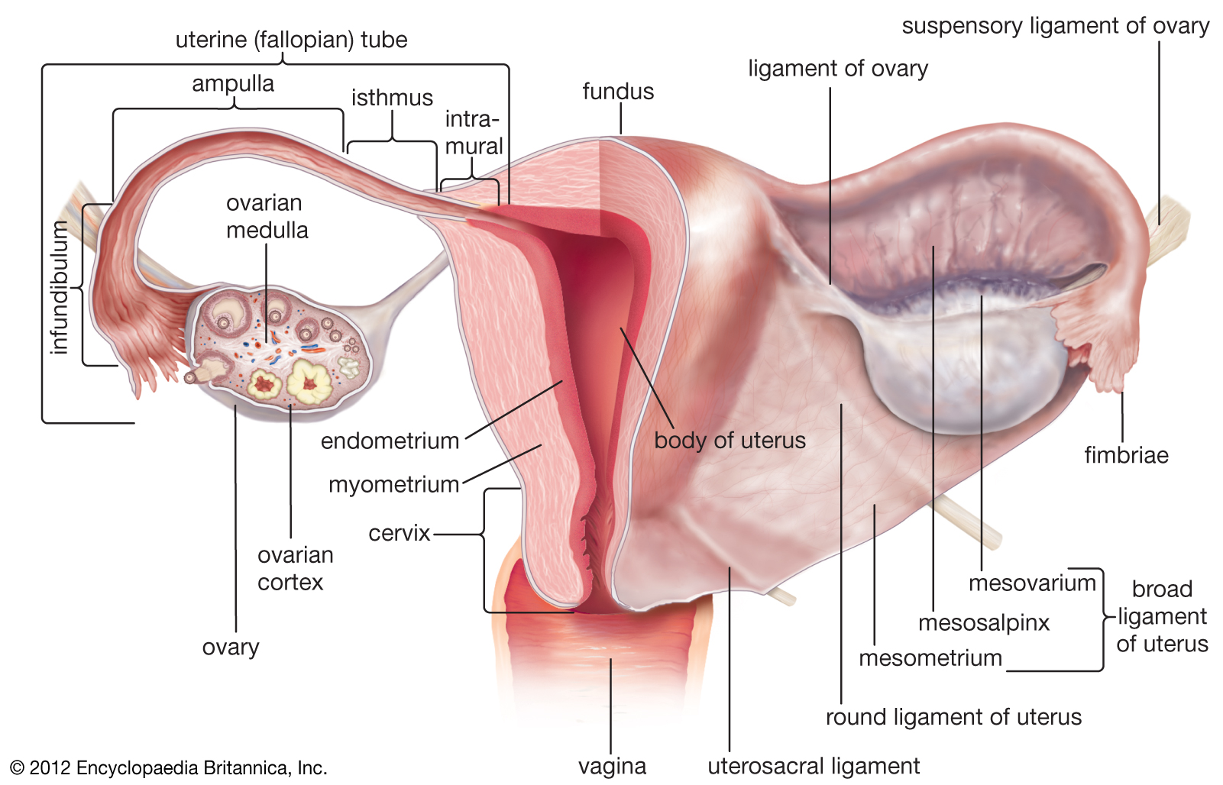
Menstrual cycle and amenorrhoea
Kliknutím vložíte text.
Kliknutím vložíte text.
Kliknutím vložíte text.
Kliknutím vložíte text.

Slide 3
Menstrual cycle and amenorrhoea
Menstrual cycle
Endometrial changes based on hormonal changes during ovarian cycle
Menarche 12-15
Length of MC: 25-35 days
Length of bleeding (menstrual phase): 3-5; 7 max. = eumenorrhoea
Blood loss: 1 ml/kg
Menopause 45-55

Slide 4
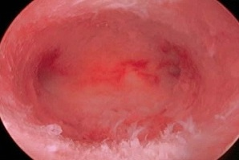
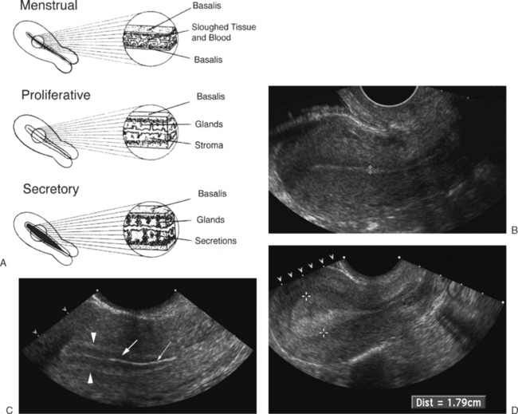
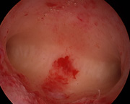
Menstrual cycle and amenorrhoea

Slide 5
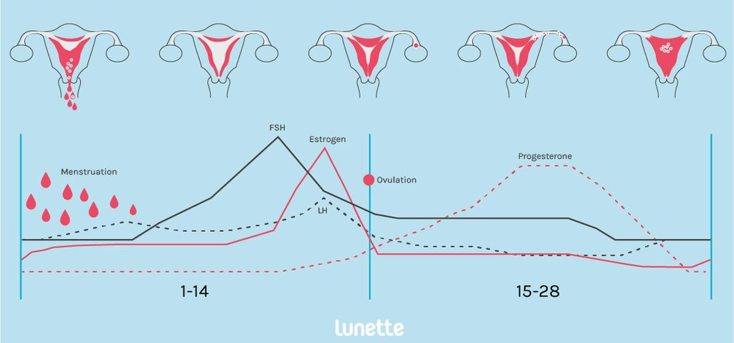
Menstrual cycle and amenorrhoea
Phases of MC:
menstrual
proliferative
secretory

Slide 6
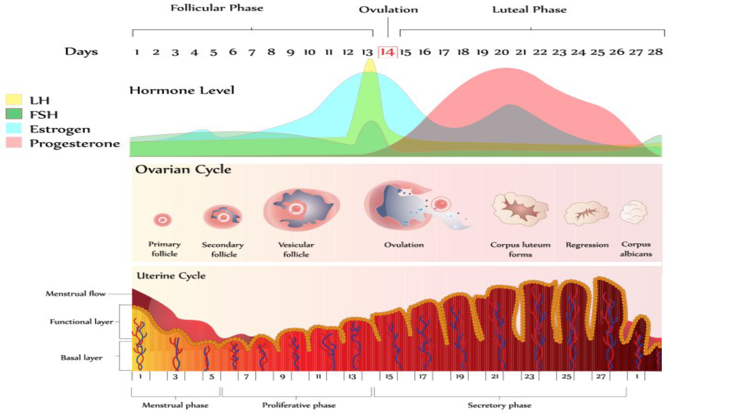
https://theugandaagus.wordpress.com/2019/10/21/how-to-calculate-safe-period-to-avoid-pregnancy/

Slide 7
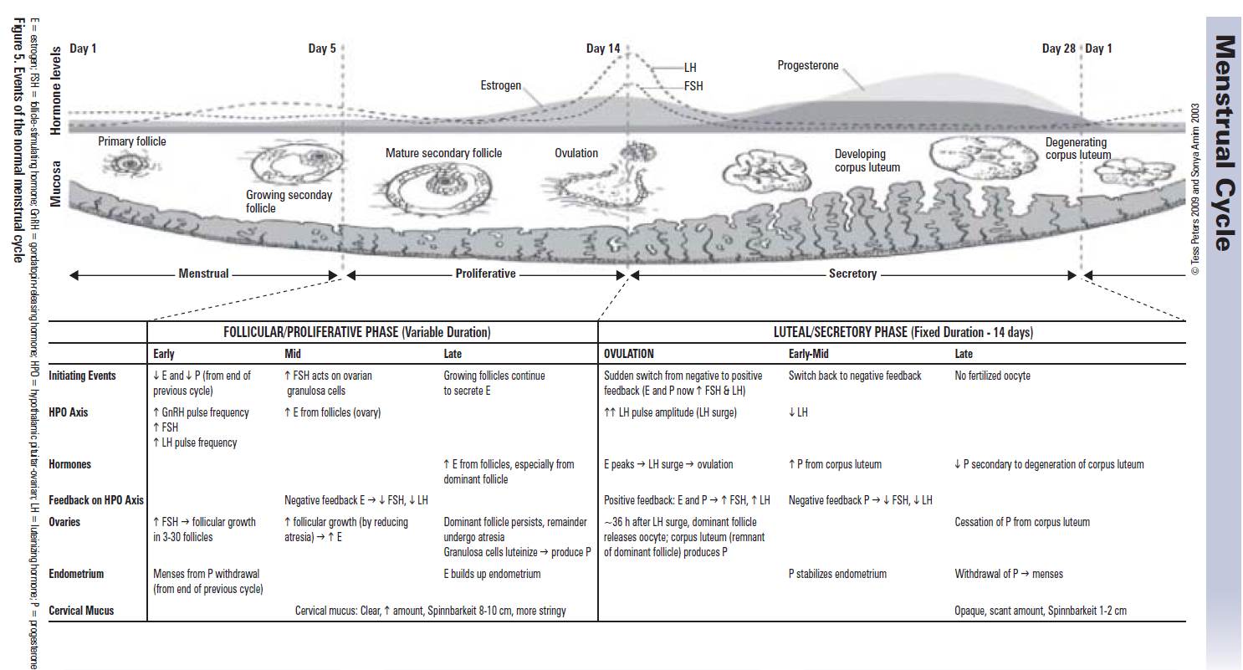
Toronto Notes 33rd Edition (2017)

Slide 8
Menstrual cycle and amenorrhoea
Disorders of menstrual cycle
Frequency disorders
Intensity disorders
Irregular uterine bleeding
Premenstrual disorders (PMS, PMDD)
Dysmenorrhoea

Slide 9
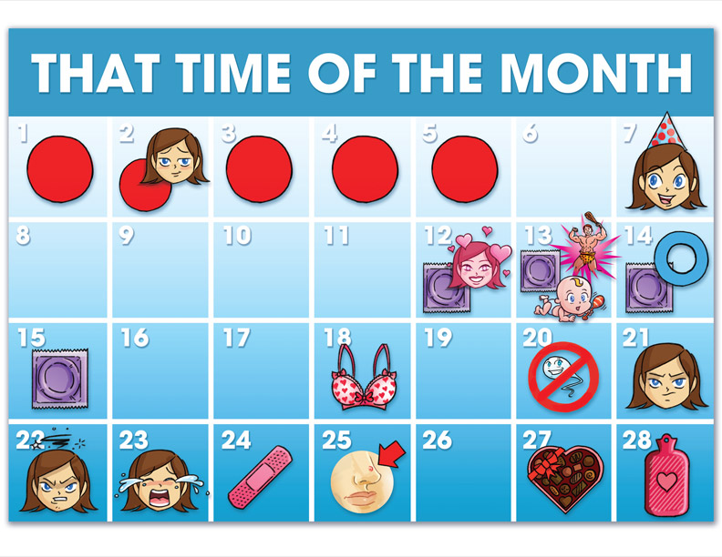
Menstrual cycle and amenorrhoea
Frequency disorders
Polymenorrhoea
– MC shorter than 22 days
Oligomenorrhoea
– MC longer than 35 days
Amenorrhoea
– no bleeding
primary
secondary

Slide 10
Menstrual cycle and amenorrhoea
Primary amenorrhoea
failure of initiation of menses by age 15
Hypothyroidism
Hyperprolactinemia
PCOS
Anatomic abnormalities (cryptomenorrhoea) – vaginal septum, imperforate hymen, Rokitanski syndrom)
Turner syndrome 45X0, Swyer syndrome XY dysgenesis
Other (pituitary tumour, IBD, chronic infections ….)

Slide 11
Menstrual cycle and amenorrhoea
Secondary amenorrhoea
cessation of regular menses for three months
PCOS
Hyperandrogenism – ovarian tumour, adrenal androgen secreting tumour
Premature ovarian failure
Autoimmune – thyroid disease, DM 1
Addison‘s disease
Hyperprolactinaemia

Slide 12
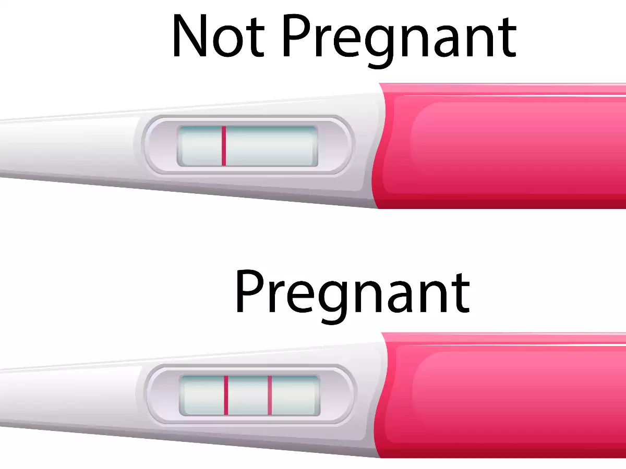
Menstrual cycle and amenorrhoea
Secondary amenorrhoea
cessation of regular menses for three months
Hyper/hypothyroidism
Pituitary adenoma, Sheehan‘s syndrome
Asherman syndrome
Oclusion of cervical canal (iatrogenic)
– cryptomenorrhea
Anorexia
Always exclude pregnancy at first!

Slide 13
Menstrual cycle and amenorrhoea
Intensity disorders
Hypermenorrhoea (Menorrhagia)
heavy menstrual bleeding
soaking a pad/tampon at least every 2 hours, or bleeding lasting for >7 days
Hypomenorrhoea
short and extremely light menstrual blood flow

Slide 14
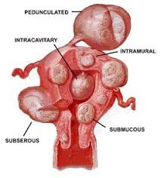
Menstrual cycle and amenorrhoea
Hypermenorrhoea causes
Uterine fibroids (myomas)
Endometrial polyp
Ovarian dysfunction
Adenomyosis
IUD
Endometrial cancer
Medication (Warfarin, LMWH, Xa inhibitors)

Slide 15
Menstrual cycle and amenorrhoea
Oligomenorrhoea causes
COC
Eating disorders (anorexia, bulimia)
Perimenopausal women
Adolescent girls
Antipsychotics, Antiepileptics

Slide 16
Menstrual cycle and amenorrhoea
Irregular uterine bleeding
Metrorrhagia (NOT Menorrhagia)
dysfunctional intermenstrual uterine bleeding
Causes: Cervical/Uterine cancer, Endomeriosis, polyps, uterine fibroids, juvenile metrorrhagia, PCOS...

Slide 17
Menstrual cycle and amenorrhoea
Diagnosis
Menstrual calendar
Gynaecologic examination (polyps, fibroids)
Ultrasound (endometrium thickness, fibroids...)
Hormonal examination
FSH, LH, Prolactine,E2, Progesterone
Testosterone, SHBG, TSH, T₄
Functional cytology

Slide 18
Menstrual cycle and amenorrhoea
Diagnosis
Functional tests (Estrogen, Progesterone,...)
Hysteroscopy (polyps, adenomyosis, fibroids)
Endometrial biopsy
Laparoscopy
CT, MRI
Genetics, Endocrinology, Hematology

Slide 19
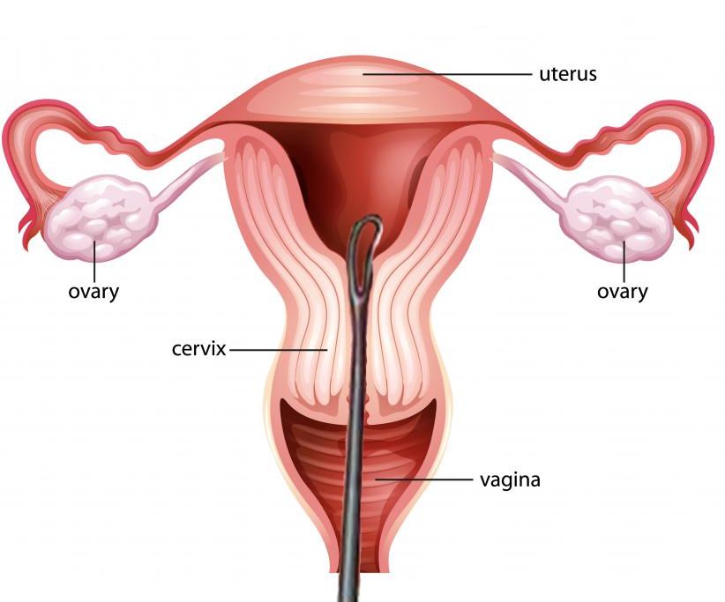
Menstrual cycle and amenorrhoea
Therapy
Based on cause
Hormonal:
Estrogens, Gestagens
Surgical:
uterine abrasion (curettage),
RFA, thermal ablasion, hysterectomy

Slide 20
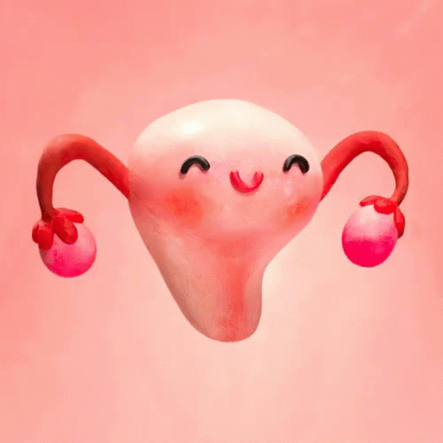
Menstrual cycle and amenorrhoea
Thank you
for your attention

